Slide 1




Video Segmentation
CVPR 2014 Tutorial
http://www.supervoxel.com/CVPR14_videoseg/
Jason J. Corso
Chenliang Xu
University of Michigan
jjcorso@eecs.umich.edu
Matthias Grundmann
Google Research
grundman@cc.gatech.edu
Irfan Essa
Georgia Tech
irfan@cc.gatech.edu

Slide 2
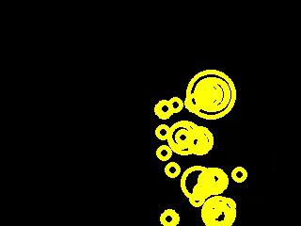
Representing Video Content
Method: Laptev. “On Space-Time Interest Points.” IJCV 64(2/3):107-123. 2005.

Slide 3
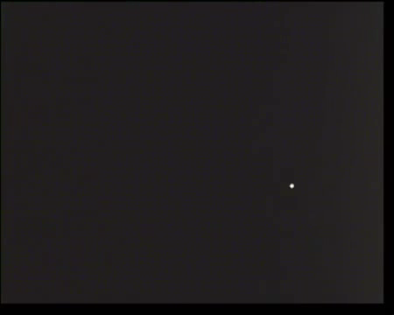
Representing Video Content
A good representation is paramount to good high-level video understanding.
Sources: Maas 1971 with Johansson; downloaded from Youtube.
Notes:
From the ICLR 2013 Call: It is well understood that the performance of machine learning methods is heavily dependent on the choice of data representation (or features) on which they are applied. The rapidly developing field of representation learning is concerned with questions surrounding how we can best learn meaningful and useful representations of data. We take a broad view of the field, and include in it topics such as deep learning and feature learning, metric learning, kernel learning, compositional models, non-linear structured prediction, and issues regarding non-convex optimization.

Slide 4
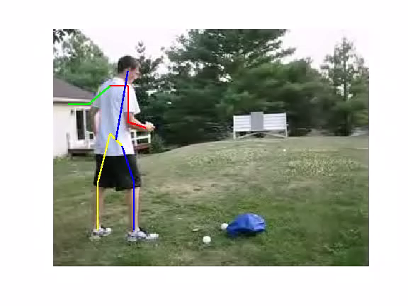
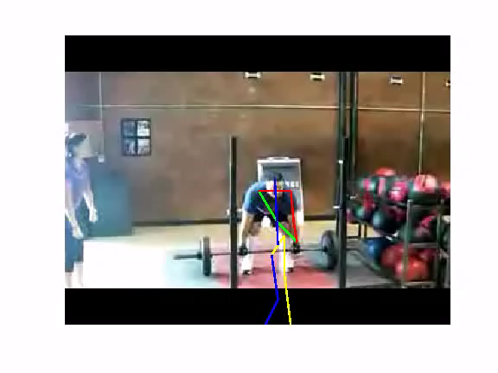
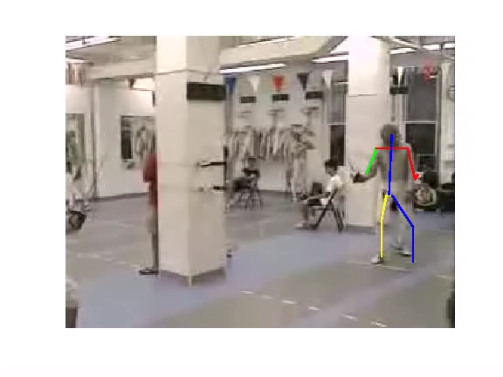
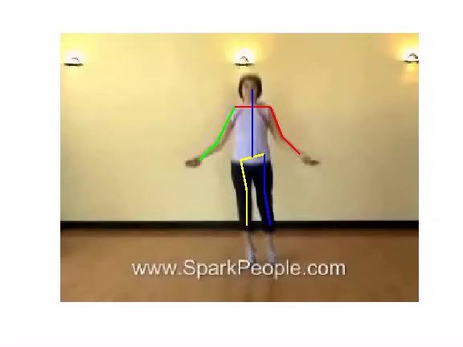
Not There Yet…
Method: Yang and Ramanan. “Articulated Pose Estimation with Flexible Mixtures-of-Parts.” CVPR 2011.
Notes:
Pose computed using state of the art Yang and Ramanan method independently on each frame.
Notice the jittery character of the pose due to local variation.
--- even with stable backgrounds.

Slide 5
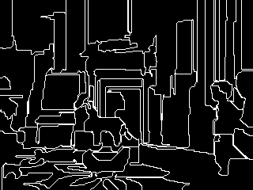
Alas, what makes such a good representation?
Method: Supervoxel segment boundaries. Xu and Corso CVPR 2012.

Slide 6
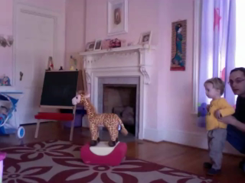

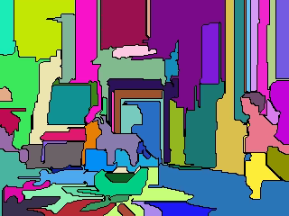
Segmentation: Toward a Rich Representation?
Applications of Video Understanding
  Real-time / Interactive
    Mobile robotic guidance, navigation and manipulation.
    Human computer/machine/robot interaction and entertainment.
    Healthcare monitoring and surveillance.
  Off-line
    Video indexing and search.
    Video to text.
    Sports analysis.
    Advertising analytics.
  Vision meets Big Data.
    The vast majority of all visual data is video data (YouTube: 72h/min).
    Need methods for video analysis before we can handle the deluge.

Slide 7
Goals of the Tutorial
Spread the word on the advances of recent supervoxel methods—this tutorial is about an alternative representation of video content suitable for various subsequent inquiries.
Expose the vision audience to the how these methods can be used as an early step in various video analysis problems.
Introduce the software tools we have produced and released that are available to the community.

Slide 8
Distinct Types of Video Segmentation
Shot Segmentation
Motion Segmentation
Supervoxel Over-Segmentation
Video Segmentation
Semantic Segmentation

Slide 9
Tutorial Plan
1:00 – 1:30 | Introduction | Jason
1:30 – 2:00 | Graph-Based Hierarchical Segmentation | Matthias
2:00 – 2:30 | Segmentation by Weighted Aggregation | Jason
2:30 – 3:00 | Other Methods/Topics | Jason
3:00 – 3:30 | Coffee Break
3:30 – 4:15 | Applications of Video Segmentation | Irfan & Matthias
4:15 – 4:45 | LIBSVX and Evaluation | Chenliang
4:45 – 5:00 | Wrap-Up | All

Slide 10
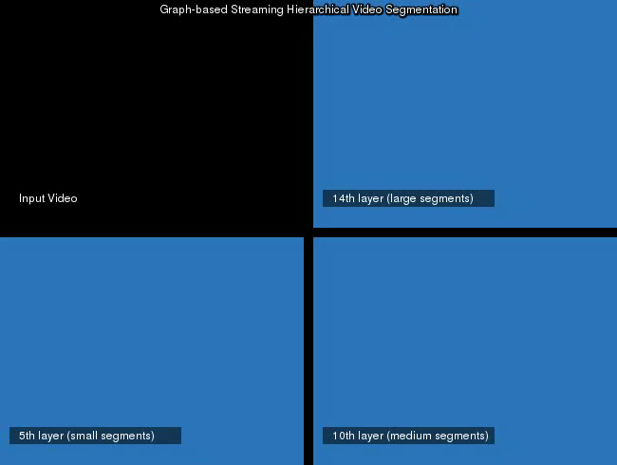
Supervoxels: A Complementary “Feature”?
Want to establish a representation that is suitable for rich understanding in images and video.
  Points, trajectories and other features may be limited.
  Cannot provide spatial or spatiotemporal boundaries.
  Superpixels, supervoxels.
Discuss an evaluation of methods in space-time segmentation to justify why we talk about the methods we do.
Present end-game experimental results showing that supervoxel segmentations retain sufficient semantic information for classification tasks.
Notes:
Where we’d clearly want to note that there has not been any work we are aware of that does segmentation initially followed by activity recognition.

Slide 11
What makes a good spatial segmentation method?
Rationale for oversegmentation
  Pixels are not natural elements in images.
  The number of pixels is very high.
Spatial uniformity – prefers compact and uniformly shaped superpixels.
  Embeds basic Gestalt principles of continuity, closure, etc.
Spatial boundary preservation – as superpixel boundaries should align with perceptual boundaries when present and should be stable when they are not.
Computation – the overall computational cost for a particular application should be reduced via superpixels.
Performance – the overall performance of a method should be increased.
Parsimony – The above properties should be maintained with as few superpixels as possible.
Notes:
The main rationale behind superpixel
oversegmentation is twofold: (1) pixels are not natural
elements but merely a consequence of the discrete sampling
of the digital images and (2) the number of pixels
is very high making optimization over sophisticated models
intractable.

Slide 12
What makes a good space-time segmentation method?
Rationale for oversegmentation
  Voxels are not natural elements in video.
  The number of voxels is very high.
Spatiotemporal uniformity – prefers compact and uniformly shaped supervoxels.
  Embeds basic Gestalt principles of continuity, closure, etc.
Spatiotemporal boundary preservation – as supervoxel boundaries should align with perceptual boundaries when present and should be stable when they are not.
Computation – the overall computational cost for a particular application should be reduced via supervoxels.
Performance – the overall performance of a method should be increased.
Parsimony – The above properties should be maintained with as few supervoxels as possible.
Notes:
The main rationale behind superpixel
oversegmentation is twofold: (1) pixels are not natural
elements but merely a consequence of the discrete sampling
of the digital images and (2) the number of pixels
is very high making optimization over sophisticated models
intractable.

Slide 13
Evaluating Standard Methods.
Meanshift
  Fukunaga and Hostetler, Comaniciu and Meer, Wang et al.
Graph-based / Minimum Spanning Forest
  Felzenswalb and Huttenlocher.
  Arguably the most popular superpixel method.
Hierarchical graph-based
  Grundmann et al.
Nyström normalized cuts.
  Shi and Malik, Fowlkes et al.
Segmentation by weighted aggregation
  Sharon et al., Corso et al.
[Xu and Corso CVPR 2012]

Slide 14
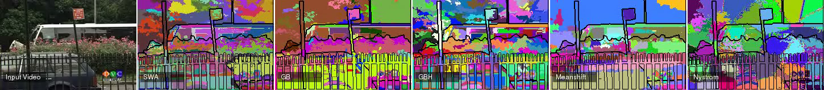
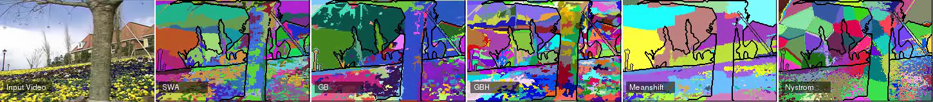
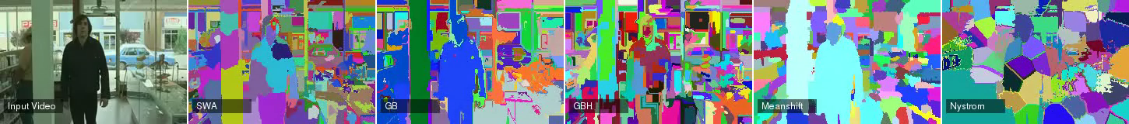
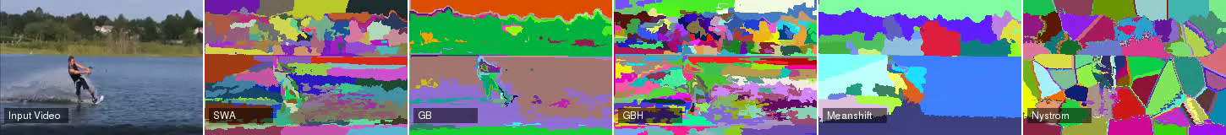
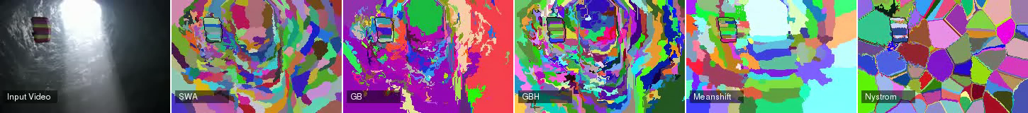
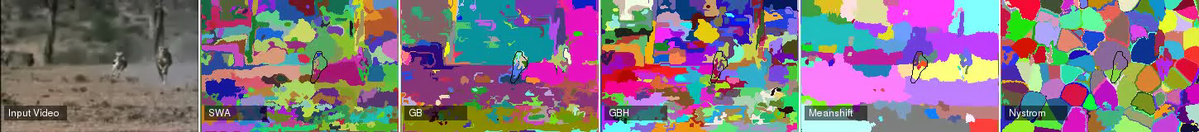
SWA GB GBH MeanShift Nyström
[Xu and Corso CVPR 2012]

Slide 15
LIBSVX: Library and Benchmark
We implemented a set of quantitative evaluation benchmarks to assess these five methods against the properties discussed earlier.
  3D undersegmentation error.
  3D boundary recall.
  3D segmentation accuracy.
  Explained variation (human independent).
Three data sets
 | Human Annotation | No. Videos | Mean FPV
SegTrack | Single Object | 6 | 41
GaTech | None | 15 | 86
Chen Xiph.org | Full Scene Segments | 8 | 85
[Xu and Corso CVPR 2012]
Notes:
3DUE: This metric measures what fraction of voxels exceed the
volume boundary of the ground-truth segment when mapping
the supervoxels onto it.

Slide 16
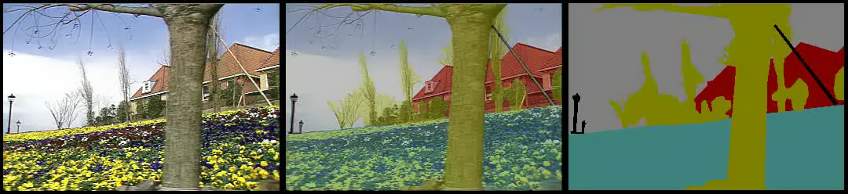
Chen Xiph.org Video Example
[Xu and Corso CVPR 2012]

Slide 17
Quantitative Evaluation Results
3D Segmentation Accuracy
SegTrack
Chen Xiph.org
[Xu and Corso CVPR 2012]

Slide 18
3D Boundary Recall (Top) and 3D Undersegmentation Error (Bottom)
SegTrack
Chen Xiph.org

Slide 19
Quantitative Evaluation Results
3D Undersegmentation Error
SegTrack
Chen Xiph.org
[Xu and Corso CVPR 2012]

Slide 20
Quantitative Evaluation Results
Explained Variation
SegTrack
Chen Xiph.org
GaTech
[Xu and Corso CVPR 2012]

Slide 21
Key Finding
SWA and GBH systematically outperform the other three methods, despite sharing some similarities. E.g.,
  SWA and Nyström both minimize the normalized cut function.
  GB and GBH are both based on the MST grouping method.
  SWA, GBH, MeanShift are all hierarchical.
Why?
The characteristic that separates them is that they recompute similarity/affinity at multiple scales as the hierarchy increases incorporating coarse and fine information.
[Xu and Corso CVPR 2012]
Notes:
Clearly, they exhaust memory resources on all typical and
even some quite large machines (e.g., consider these loading a 320 240 video: 3
seconds of video requires 21MB of memory; 2 minutes: 840 MB; 30 minutes: 12.6
GB; 2h: 50GB, and so on).

Slide 22
Detailed Methods to the Discussed
Hence, we will focus on two methods in detail in the tutorial
  Graph-based hierarchical segmentation
  Segmentation by Weighted Aggregation
We will discuss other variants and applications of these.
Disclaimer: this is not to say there are no other methods we should also be discussing. But, given time and goals, this is what we choose. Examples you may consider reading:
  Galasso et al. ACCV 12
  TSP Chang et al. CVPR 13
  Video Seeds, Van der Bergh et al. ICCV 13
  Trajectory Binary Partition Tree, Palou and Salembier CVPR13
However, first, some results on why you should care of supervoxels as a feature.

Slide 23
A Study on
Human Supervoxel Perception
Are Actor and Action Semantics Retained
in Video Supervoxel Segmentation?

Slide 24
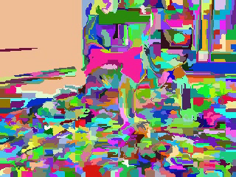
Can Humans Perceive Action from Supervoxels?

Slide 25
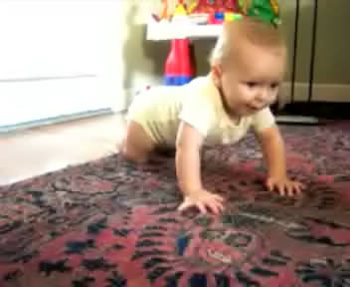
Can Humans Perceive Action from Supervoxels?

Slide 26
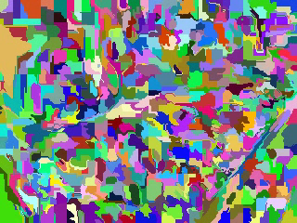
Can Humans Perceive Action from Supervoxels?

Slide 27
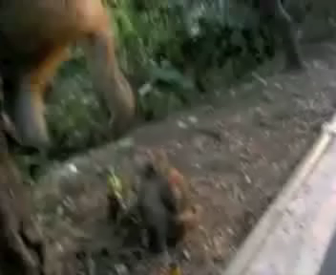
Can Humans Perceive Action from Supervoxels?

Slide 28
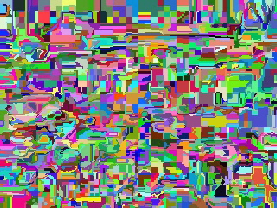
Can Humans Perceive Action from Supervoxels?

Slide 29
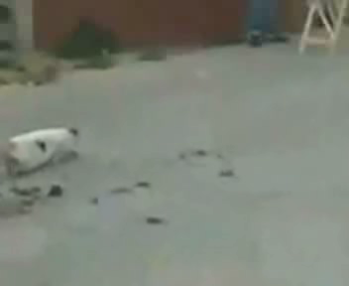
Can Humans Perceive Action from Supervoxels?

Slide 30
Study Questions
Primary Question:
  Do the segmentation hierarchies retain enough information for the human perceiver to recognize
    Actor? (human or animal)
    Act? (forced-choice one of eight)
Secondary Questions:
  How does the human performance vary with density of the supervoxels?
  How does the human performance vary with actor?
  How does human performance vary with static versus moving background?
  How does speed vary with act? with correctness?

Slide 31
Study Setup: Participant Cohort and Data Set
Study cohort of 20 college-age participants.
  No student is studying segmentation.
Data Set
  Stratified according to Actors, Acts, and Background
    Actors: human or animal
    Background: static or moving
    Acts: climbing, crawling, eating, flying, jumping, running, spinning, walking.
  Sample 3 levels of the segmentation hierarchy (coarse, medium, and fine).
  In total, we have 96 videos
    2 actors * 2 backgrounds * 8 acts * 3 levels

Slide 32
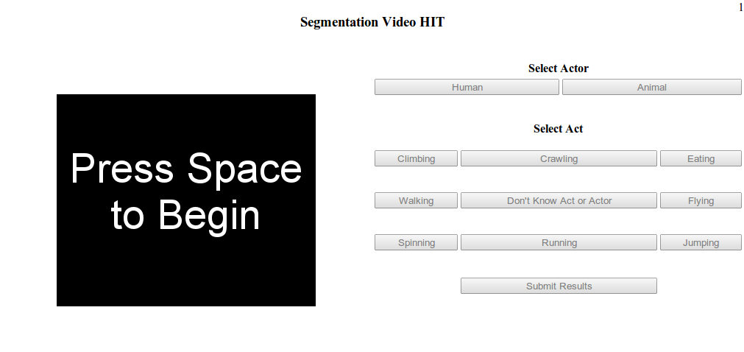
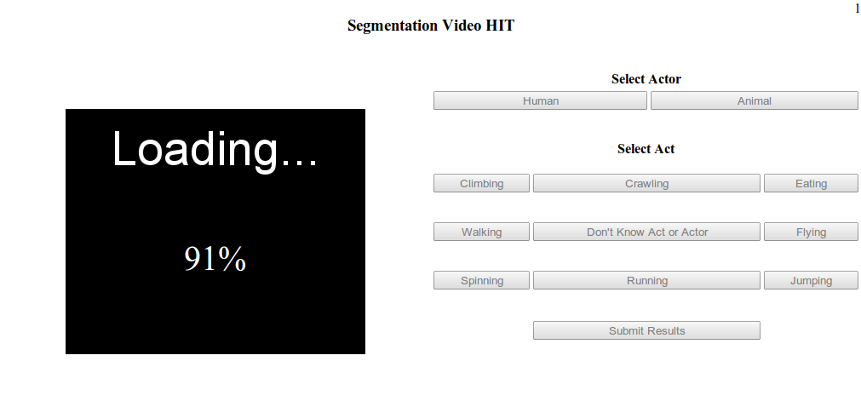
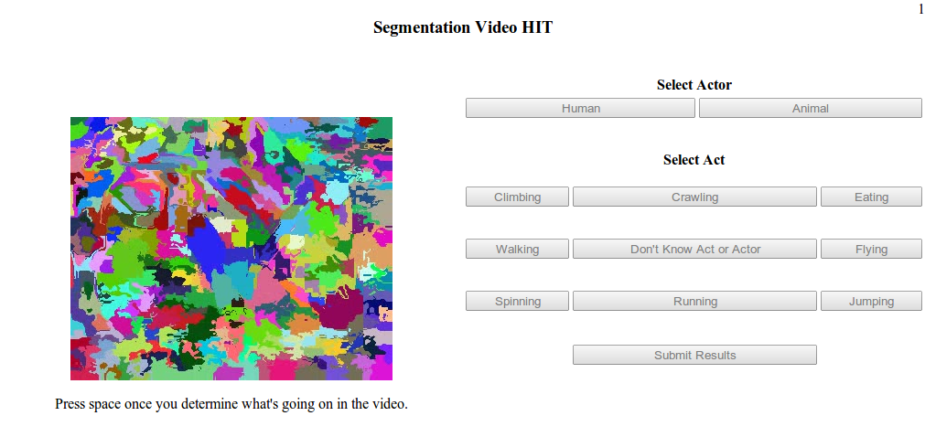
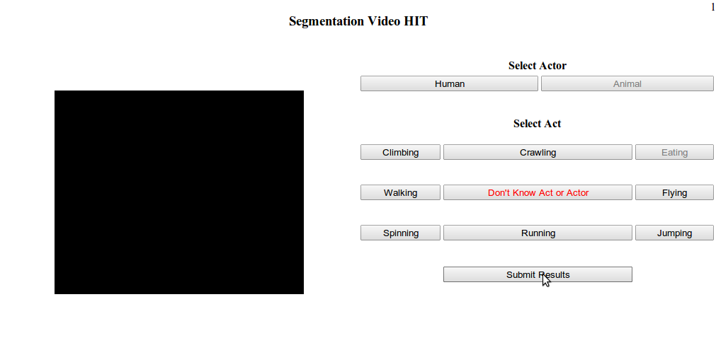
Study Setup: The Interface and Instructions
Web-based interface
Each participant is shown 32 videos and sees a given (input) video only once (in a single segmentation level).
Participants never see the input RGB videos.
[Xu, Doell,… Corso ICSC 2013 and IJSC In Press]

Slide 33
Study Results: Actor Discrimination
High actor discrimination rate: 82.4% overall accuracy.
[Xu, Doell,… Corso ICSC 2013 and IJSC In Press]

Slide 34
Study Results: Act Discrimination
Overall act discrimination rate: 70.5%.

Slide 35
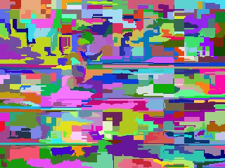
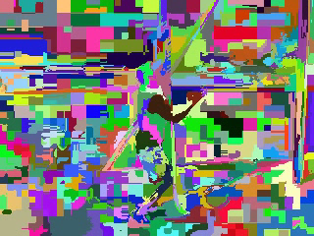
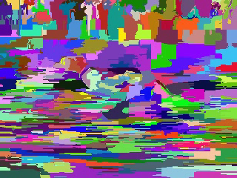
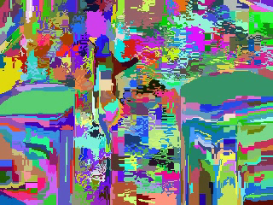
Study Results: Action Discrimination
Dominant unidirectional motion.
Human_Running
Human_Climbing
Animal_Running
Animal_Climbing
[Xu, Doell,… Corso ICSC 2013 and IJSC In Press]

Slide 36
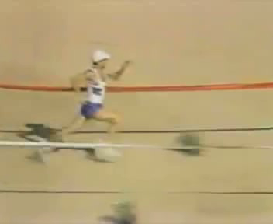

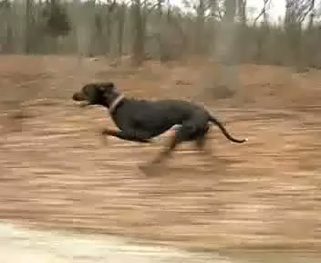
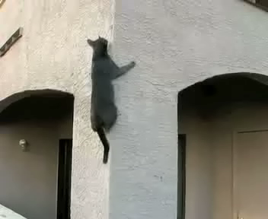
Study Results: Action Discrimination
Dominant unidirectional motion.
Human_Running
Human_Climbing
Animal_Running
Animal_Climbing
[Xu, Doell,… Corso ICSC 2013 and IJSC In Press]

Slide 37
Study Results: Performance by Level
Fine
Medium
Coarse
62.8%
72.8%
76.7%
Bar figures are the response time.
  X-axis: Time at the half-frame-rate.
  Y-axis: density of responses.
  Blue bars: simple histogram.
  Red curve: Gaussian kernel density estimate.
Correct
Incorrect
[Xu, Doell,… Corso ICSC 2013 and IJSC In Press]

Slide 38
Study Results: Performance by Level
Fine
Medium
Coarse
62.8%
72.8%
76.7%
Correct action matches:
  Response distributions are early equivalent.
  Heavily weighted toward the shorter end of X-axis.
If the participant knows the answer then typically knows it quickly.
Correct
Incorrect
[Xu, Doell,… Corso ICSC 2013 and IJSC In Press]

Slide 39
Study Results: Performance by Level
Fine
Medium
Coarse
62.8%
72.8%
76.7%
Incorrect action matches:
  Different patterns.
  Fine videos peaked at about eight seconds.
Participant watched the whole video and still got the wrong action perception.
Correct
Incorrect
[Xu, Doell,… Corso ICSC 2013 and IJSC In Press]

Slide 40
Summary of Study
Segmentation hierarchies generate rich decompositions of the video content.
They compress the signal significantly, but does enough semantic information remain to discriminative actor and act?
Yes! 82% accuracy on actor and 70% on act.
Act discrimination increases with coarseness of the signal.
Act discrimination for human actors is better than animals.
Act discrimination for a static background is better than a moving background.
Limitation: 20 participants on 32 input videos. Moving to 64 input videos and Mechanical Turk.
Notes:
Framework for other methods…
Full Hierarchy…
Fewer Parameters…
Demonstrate results outperforming raw GBH and state of the art segmentation merging method, SAS.

