Slide 1
Fairness and Ethics in AI
David Fouhey, EECS 442 Winter 2023
https://web.eecs.umich.edu/~fouhey/teaching/EECS442_W23/
(but most of the slides taken from Justin Johnson’s Fairness lecture from our last joint offering in W2021)

Slide 2
Disclaimers
This lecture goes beyond Computer Vision
I’m not an expert at this but I think it’s really important
I’m not part of any marginalized group
We can only begin to scratch the surface in one lecture
There are generally more problems than solutions

Slide 3
Additional Resources
Timnit Gebru and Emily Denton,
CVPR 2020 Tutorial on FATE/CV
https://sites.google.com/view/fatecv-tutorial/home?authuser=0
Kate Crawford, “The Trouble with Bias”, NeurIPS 2017 Keynote
https://www.youtube.com/watch?v=fMym_BKWQzk
Solon Barocas, Moritz Hardt, Arvind Narayanan, “Fairness and machine learning”, https://fairmlbook.org/
ACM Conference on Fairness, Accountability, and Transparency https://facctconference.org/

Slide 4
Why do we build ML systems?
Automate decision making, so machines can make decision instead of people.
Ideal: Automated decisions can be cheaper, more accurate, more impartial, improve our lives
Reality: If we aren’t careful, automated decisions can encode bias, harm people, make lives worse

Slide 5
Case Study: COMPAS
Person commits a crime, is arrested
COMPAS software predicts the chance that the person will commit another crime in the future (recidivism)
Recidivism scores impact criminal sentences: if a person is likely to commit another crime, shouldn’t they get a longer sentence?
Real system that has been used in New York, Wisconsin, California, Florida, etc

Slide 6
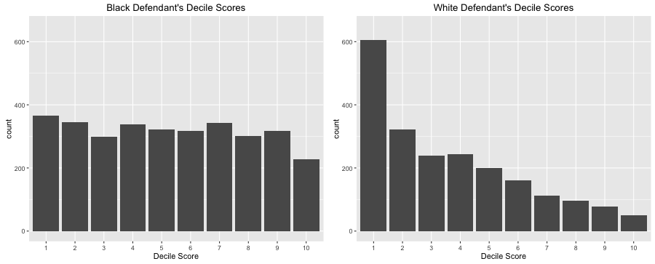
Case Study: COMPAS
2016 ProPublica article analyzed COMPAS scores for >7000 people arrested in Broward county, Florida
Question: How many of these people ended up committing new crimes within 2 years?
Source: https://www.propublica.org/article/how-we-analyzed-the-compas-recidivism-algorithm

Slide 7
Error Metrics
 | Prediction: Low Risk | Prediction: High Risk
Outcome: No Recidivism | True Negative (TN) | False Positive (FP)
Outcome: Recidivated | False Negative (FN) | True Positive (TP)

Slide 8
Error Metrics: Error Rate
 | Prediction: Low Risk | Prediction: High Risk
Outcome: No Recidivism | True Negative (TN) | False Positive (FP)
Outcome: Recidivated | False Negative (FN) | True Positive (TP)
Error Rate = $\frac{FP+FN}{TN+FP+FN+TP}$
How often is the prediction wrong?

Slide 9
Error Metrics: False Positive Rate
 | Prediction: Low Risk | Prediction: High Risk
Outcome: No Recidivism | True Negative (TN) | False Positive (FP)
Outcome: Recidivated | False Negative (FN) | True Positive (TP)
Error Rate = $\frac{FP+FN}{TN+FP+FN+TP}$
How often is the prediction wrong?
False Positive Rate = $\frac{FP}{FP+TN}$
How often were non-offenders predicted to reoffend?

Slide 10
Error Metrics: False Negative Rate
 | Prediction: Low Risk | Prediction: High Risk
Outcome: No Recidivism | True Negative (TN) | False Positive (FP)
Outcome: Recidivated | False Negative (FN) | True Positive (TP)
Error Rate = $\frac{FP+FN}{TN+FP+FN+TP}$
How often is the prediction wrong?
False Positive Rate = $\frac{FP}{FP+TN}$
How often were non-offenders predicted to reoffend?
False Negative Rate = $\frac{FN}{FN+TP}$
How often were offenders predicted not to reoffend?

Slide 11
Error Metrics: Different Stakeholders
 | Prediction: Low Risk | Prediction: High Risk
Outcome: No Recidivism | True Negative (TN) | False Positive (FP)
Outcome: Recidivated | False Negative (FN) | True Positive (TP)
Error Rate = $\frac{FP+FN}{TN+FP+FN+TP}$
How often is the prediction wrong?
Defendants care about this
False Positive Rate = $\frac{FP}{FP+TN}$
How often were non-offenders predicted to reoffend?
False Negative Rate = $\frac{FN}{FN+TP}$
How often were offenders predicted not to reoffend?

Slide 12
Error Metrics: Different Stakeholders
 | Prediction: Low Risk | Prediction: High Risk
Outcome: No Recidivism | True Negative (TN) | False Positive (FP)
Outcome: Recidivated | False Negative (FN) | True Positive (TP)
Error Rate = $\frac{FP+FN}{TN+FP+FN+TP}$
How often is the prediction wrong?
Defendants care about this
False Positive Rate = $\frac{FP}{FP+TN}$
How often were non-offenders predicted to reoffend?
Judges care about this
False Negative Rate = $\frac{FN}{FN+TP}$
How often were offenders predicted not to reoffend?

Slide 13
Case Study: COMPAS
 | Prediction: Low Risk | Prediction: High Risk
Outcome: No Recidivism | 2681 (TN) | 1282 (FP)
Outcome: Recidivated | 1216 (FN) | 2035 (TP)
Error Rate = $\frac{FP+FN}{TN+FP+FN+TP}≈34.6\%$
False Positive Rate = $\frac{FP}{FP+TN}≈32.4\%$
False Negative Rate = $\frac{FN}{FN+TP}≈37.4\%$
Source: https://www.propublica.org/article/how-we-analyzed-the-compas-recidivism-algorithm

Slide 14
Case Study: COMPAS
Black Defendants | Prediction: Low Risk | Prediction: High Risk
Outcome: No Recidivism | 990 (TN) | 805 (FP)
Outcome: Recidivated | 532 (FN) | 1369 (TP)
White Defendants | Prediction: Low Risk | Prediction: High Risk
Outcome: No Recidivism | 1139 (TN) | 349 (FP)
Outcome: Recidivated | 461 (FN) | 505 (TP)
Source: https://www.propublica.org/article/how-we-analyzed-the-compas-recidivism-algorithm

Slide 15
Case Study: COMPAS
Black Defendants | Prediction: Low Risk | Prediction: High Risk
Outcome: No Recidivism | 990 (TN) | 805 (FP)
Outcome: Recidivated | 532 (FN) | 1369 (TP)
White Defendants | Prediction: Low Risk | Prediction: High Risk
Outcome: No Recidivism | 1139 (TN) | 349 (FP)
Outcome: Recidivated | 461 (FN) | 505 (TP)
Error Rate $≈36.2\%$
Error Rate $≈33.0\%$
Roughly similar error rates between white and black defendants
Source: https://www.propublica.org/article/how-we-analyzed-the-compas-recidivism-algorithm

Slide 16
Case Study: COMPAS
Black Defendants | Prediction: Low Risk | Prediction: High Risk
Outcome: No Recidivism | 990 (TN) | 805 (FP)
Outcome: Recidivated | 532 (FN) | 1369 (TP)
White Defendants | Prediction: Low Risk | Prediction: High Risk
Outcome: No Recidivism | 1139 (TN) | 349 (FP)
Outcome: Recidivated | 461 (FN) | 505 (TP)
Error Rate $≈36.2\%$
Error Rate $≈33.0\%$
False Positive Rate $≈44.9\%$
False Positive Rate $≈23.5\%$
Black defendants have 1.9x higher False Positive Rate!
Source: https://www.propublica.org/article/how-we-analyzed-the-compas-recidivism-algorithm

Slide 17
Case Study: COMPAS
Black Defendants | Prediction: Low Risk | Prediction: High Risk
Outcome: No Recidivism | 990 (TN) | 805 (FP)
Outcome: Recidivated | 532 (FN) | 1369 (TP)
White Defendants | Prediction: Low Risk | Prediction: High Risk
Outcome: No Recidivism | 1139 (TN) | 349 (FP)
Outcome: Recidivated | 461 (FN) | 505 (TP)
Error Rate $≈36.2\%$
Error Rate $≈33.0\%$
False Positive Rate $≈44.9\%$
False Positive Rate $≈23.5\%$
False Negative Rate $≈28.0\%$
False Negative Rate $≈47.7\%$
White defendants have 1.7x higher False Negative Rate

Slide 18
Case Study: COMPAS
Black Defendants | Prediction: Low Risk | Prediction: High Risk
Outcome: No Recidivism | 990 (TN) | 805 (FP)
Outcome: Recidivated | 532 (FN) | 1369 (TP)
White Defendants | Prediction: Low Risk | Prediction: High Risk
Outcome: No Recidivism | 1139 (TN) | 349 (FP)
Outcome: Recidivated | 461 (FN) | 505 (TP)
Surprising fact: COMPAS gives very different outcomes for white vs black defendants, but it does not use race as an input to the algorithm!

Slide 19
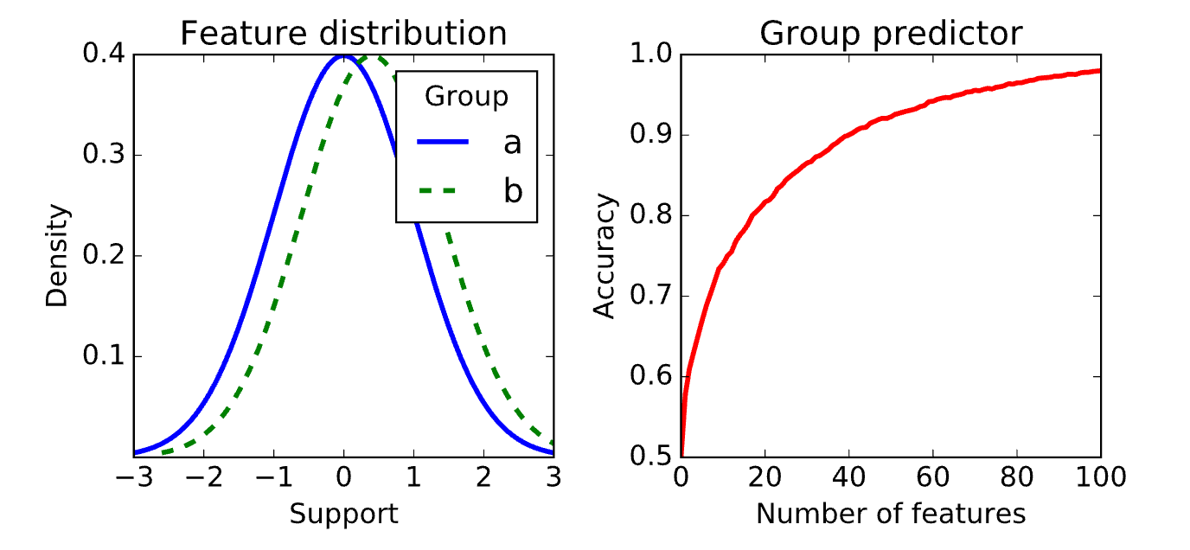
No Fairness Through Unawareness
Even if a sensitive feature (e.g. race) is not an input to the algorithm, other features (e.g. zip code) may correlate with the sensitive feature
Source: https://fairmlbook.org/classification.html

Slide 20
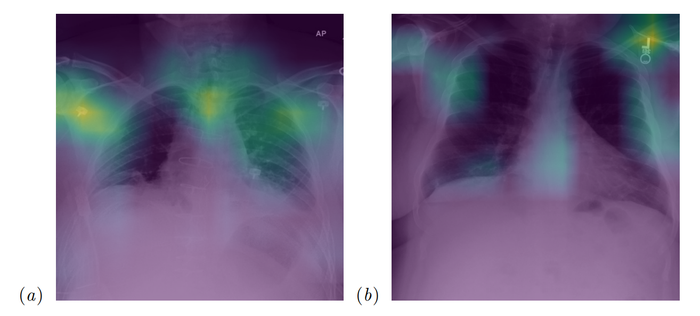
In Practice
Deep Learning Applied to Chest X-Rays: Exploiting and Preventing Shortcuts. S. Jabbour et al. MLHC 2020.

Slide 21
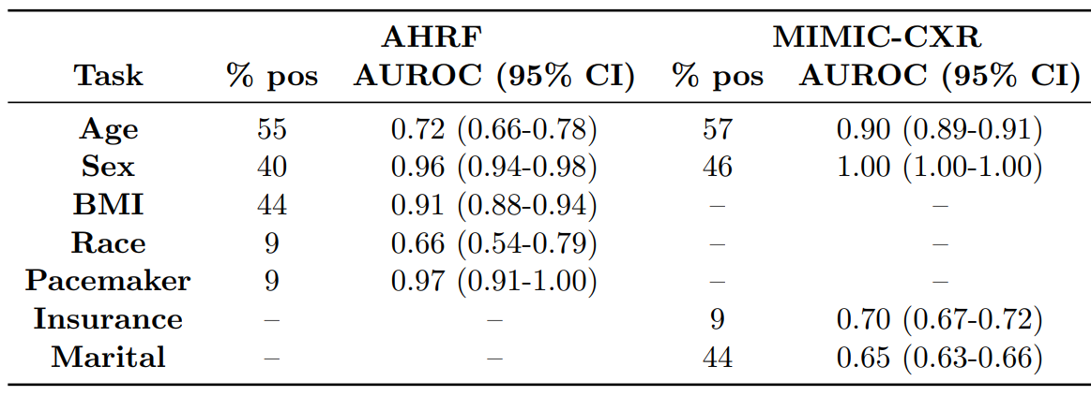
In Practice
Neural networks love taking shortcuts!
Are there shortcuts in our data?
Do I want to get diagnosed by an AI? Stay tuned.
Deep Learning Applied to Chest X-Rays: Exploiting and Preventing Shortcuts. S. Jabbour et al. MLHC 2020.

Slide 22
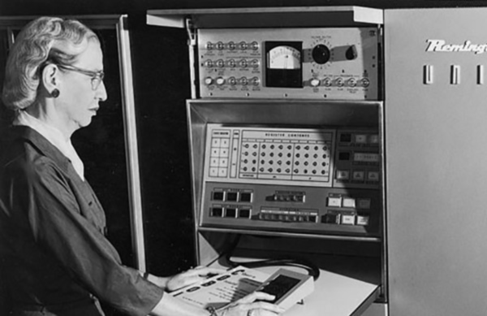
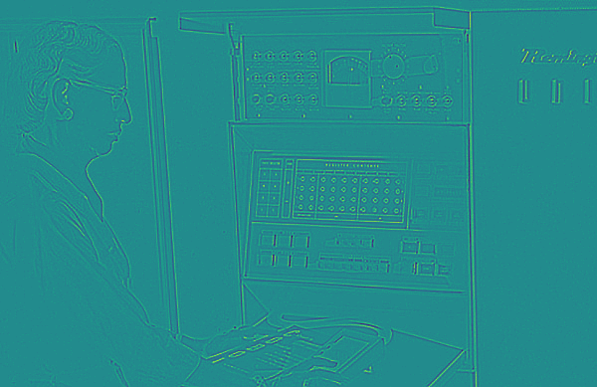
In Practice
σ = 0.5px
σ = 0.4px
Why might this be an issue for medical diagnosis?

Slide 23
Formalizing Fairness
$Y$: Target variable (e.g. recidivism)
$R$: Classifier response (e.g. predicted recidivism)
$A$: Sensitive attribute (e.g. race)
Barocas, Hardt, and Narayanan. “Fairness and Machine Learning”, https://fairmlbook.org/index.html

Slide 24
Formalizing Fairness
$Y$: Target variable (e.g. recidivism)
$R$: Classifier response (e.g. predicted recidivism)
$A$: Sensitive attribute (e.g. race)
Fairness Definition 1: Independence
The classifier response is independent (as a random variable) from the sensitive attribute
$$P\left(R, A\right)=P\left(R\right)P(A)$$
Barocas, Hardt, and Narayanan. “Fairness and Machine Learning”, https://fairmlbook.org/index.html

Slide 25
Formalizing Fairness
$Y$: Target variable (e.g. recidivism)
$R$: Classifier response (e.g. predicted recidivism)
$A$: Sensitive attribute (e.g. race)
Fairness Definition 1: Independence
The classifier response is independent (as a random variable) from the sensitive attribute
$$P\left(R, A\right)=P\left(R\right)P(A)$$
$=P\left(R \right| A)P(A)$ (Chain Rule)
$⟹P\left(R \right| A)=P(R)$
Barocas, Hardt, and Narayanan. “Fairness and Machine Learning”, https://fairmlbook.org/index.html

Slide 26
Formalizing Fairness
$Y$: Target variable (e.g. recidivism)
$R$: Classifier response (e.g. predicted recidivism)
$A$: Sensitive attribute (e.g. race)
Fairness Definition 1: Independence
The classifier response is independent (as a random variable) from the sensitive attribute
$$P\left(R, A\right)=P\left(R\right)P\left(A\right) ⟹ P\left(R \right| A)=P(R)$$
COMPAS predictions are not independent – different distributions for black vs white
Barocas, Hardt, and Narayanan. “Fairness and Machine Learning”, https://fairmlbook.org/index.html

Slide 27
Formalizing Fairness
$Y$: Target variable (e.g. recidivism)
$R$: Classifier response (e.g. predicted recidivism)
$A$: Sensitive attribute (e.g. race)
Fairness Definition #2: Separation
The classifier response is conditionally independent from the sensitive attribute given the target
$$P\left(R,A | Y\right)=P\left(R \right|Y)P\left(A \right| Y)$$
Barocas, Hardt, and Narayanan. “Fairness and Machine Learning”, https://fairmlbook.org/index.html

Slide 28
Formalizing Fairness
COMPAS scores do not satisfy separation
Fairness Definition #2: Separation
The classifier response is conditionally independent from the sensitive attribute given the target
$$P\left(R,A | Y\right)=P\left(R \right|Y)P\left(A \right| Y)$$
By chain rule: $=P\left(R \right| A, Y)P\left(A \right| Y)$
Which implies that: $P\left(R \right| A, Y)=P\left(R \right| Y)$
Same False Positive Rates between groups:
$$P\left(R=1 \right| Y=0, A=a)=P\left(R=1 \right| Y=0, A=b)$$
Same False Negative Rates between groups:
$$P\left(R=0 \right| Y=1, A=a)=P\left(R=0 \right| Y=1, A=b)$$
Barocas, Hardt, and Narayanan. “Fairness and Machine Learning”, https://fairmlbook.org/index.html

Slide 29
Formalizing Fairness
There are multiple ways to formalize notions of fairness mathematically
We’ve seen two (independence, separation) but there are many more!
Arvind Narayanan, “21 fairness definitions and their politics” https://www.youtube.com/watch?v=jIXIuYdnyyk
It may be impossible to achieve all notions of fairness at the same time
Conclusion: Fairness in ML is not (purely) a technical problem! We need to think about context, stakeholders

Slide 30
Allocative Harms
A system decides how to allocate resources
If the system is biased, it may allocate resources unfairly or perpetuate inequality
Examples:
Sentencing criminals
Loan applications
Mortgage applications
Insurance rates
College admissions
Job applications
Barocas et al, “The Problem With Bias: Allocative Versus Representational Harms in Machine Learning”, SIGCIS 2017
Kate Crawford, “The Trouble with Bias”, NeurIPS 2017 Keynote

Slide 31
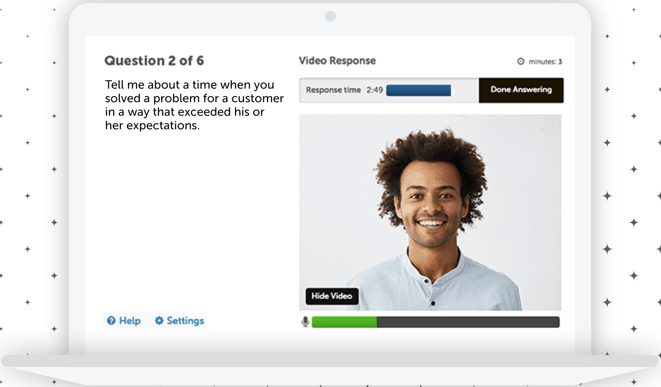
Example: Video Interviewing
Source: https://www.washingtonpost.com/technology/2019/10/22/ai-hiring-face-scanning-algorithm-increasingly-decides-whether-you-deserve-job/
https://www.hirevue.com/platform/online-video-interviewing-software
Example Credit: Timnit Gebru

Slide 32
Hungarian -> English Translation
English translation makes assumptions
Hungarian does not use gendered pronouns
Source: https://www.reddit.com/r/europe/comments/m9uphb/hungarian_has_no_gendered_pronouns_so_google

Slide 33
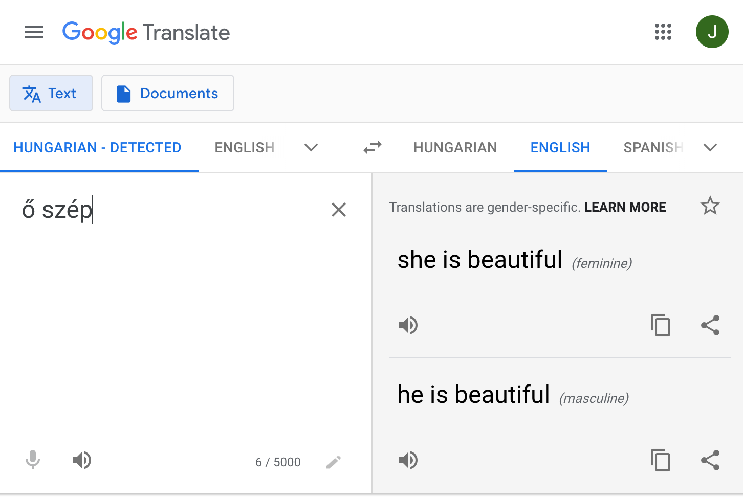
Hungarian -> English Translation
Possible solution: Change the task; offer multiple suggestions

Slide 34
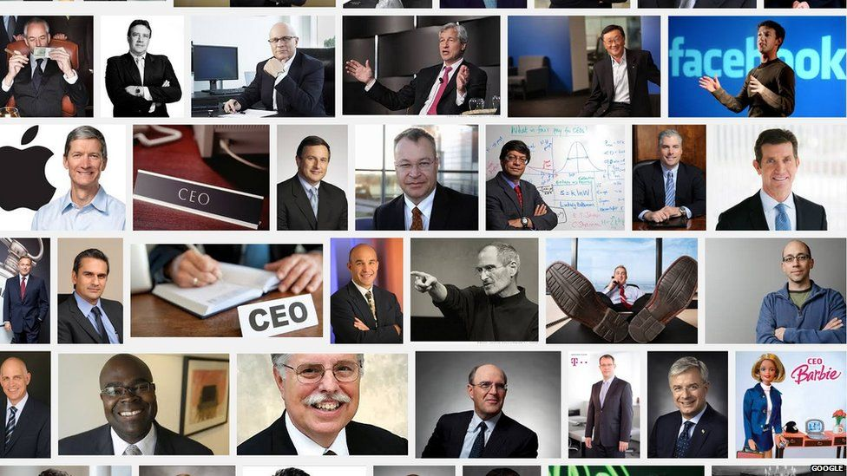
First woman: CEO Barbie =(
Source: https://www.bbc.com/news/newsbeat-32332603

Slide 35
2021 results more diverse

Slide 36
Image Super-Resolution
Input: Low-Resolution Face
Output: High-Resolution Face
Menon et al, “PULSE: Self-Supervised Photo Upsampling via Latent Space Exploration of Generative Models”, CVPR 2020
Example source: https://twitter.com/Chicken3gg/status/1274314622447820801

Slide 37
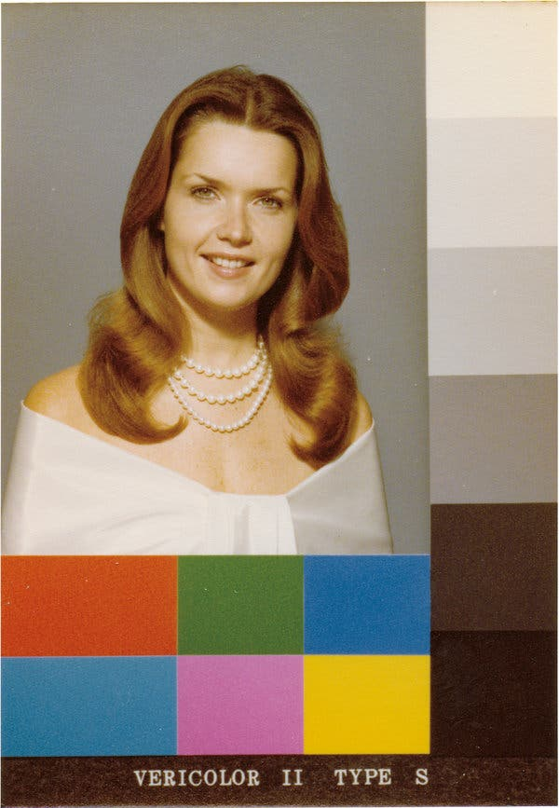
Pre-AI Photos
What does this photo do?
Back in the day you got your photos printed. Kodak had print shops calibrate their settings via “Shirley Cards”
Calibration settings totally off for people with darker skin!
Photo credit: NYTimes.com

Slide 38
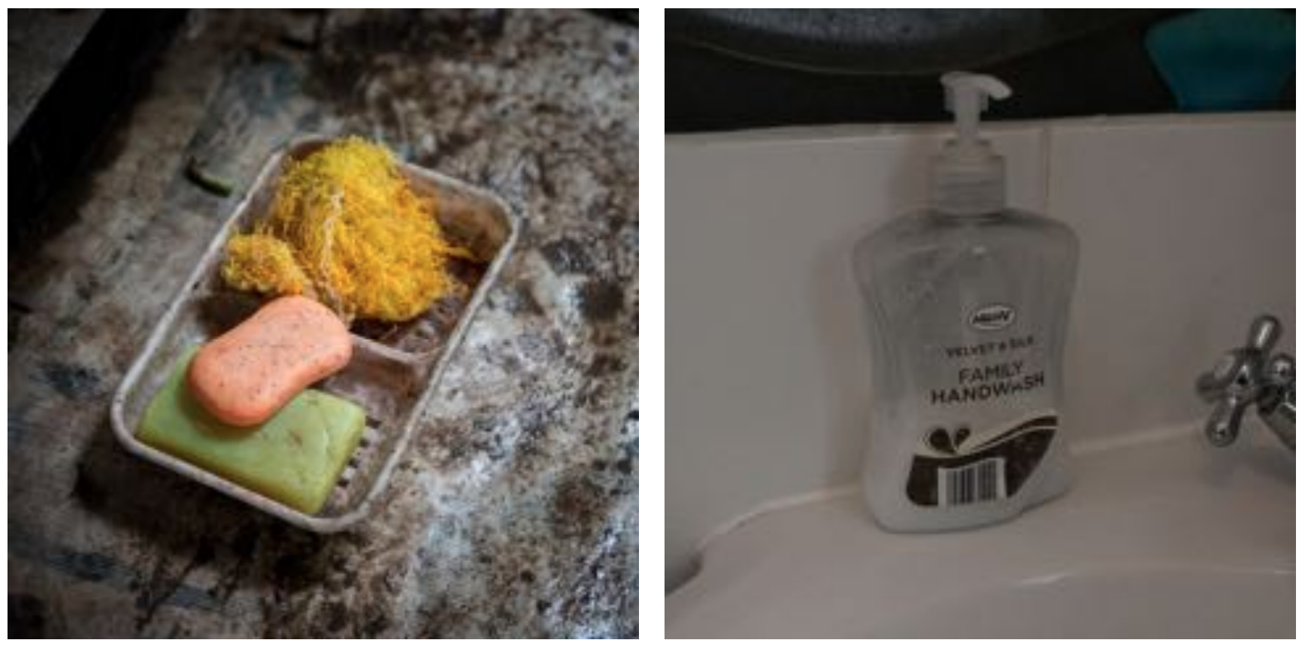
Economic Bias in Visual Classifiers
Ground-Truth: Soap
Source: UK, $1890/month
Azure: toilet, design, art, sink
Clarifai: people, faucet, healthcare, lavatory, wash closet
Google: product, liquid, water, fluid, bathroom accessory
Amazon: sink, indoors, bottle, sink faucet
Watson: gas tank, storage tank, toiletry, dispenser, soap dispenser
Tencent: lotion, toiletry, soap dispenser, dispenser, after shave
Ground-Truth: Soap
Source: Nepal, $288/month
Azure: food, cheese, bread, cake, sandwich
Clarifai: food, wood, cooking, delicious, healthy
Google: food, dish, cuisine, comfort food, spam
Amazon: food, confectionary, sweets, burger
Watson: food, food product, turmeric, seasoning
Tencent: food, dish, matter, fast food, nutriment
DeVries et al, “Does Object Recognition Work for Everyone?”, CVPR Workshops, 2019

Slide 39
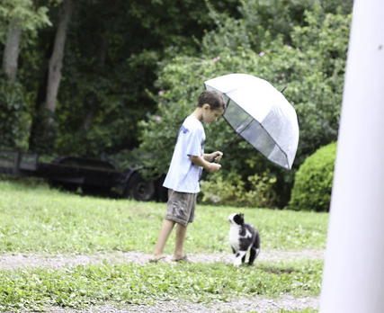
Problem: Datasets are Biased
*This analysis conflates gender with sex, and assumes that it is binary.
Example: COCO Dataset
Multilabel
Classification
Person
Umbrella
Cat
Define “gender bias” of object category C as:
$$\frac{\#(C, Man)}{\#(C, Man)+\#(C,Woman)}$$
Example: “Snowboards” are 90% biased towards men
Zhao et al, “Men Also Like Shopping: Reducing Gender Bias Amplification using Corpus-level Constraints”, EMNLP 2017

Slide 40
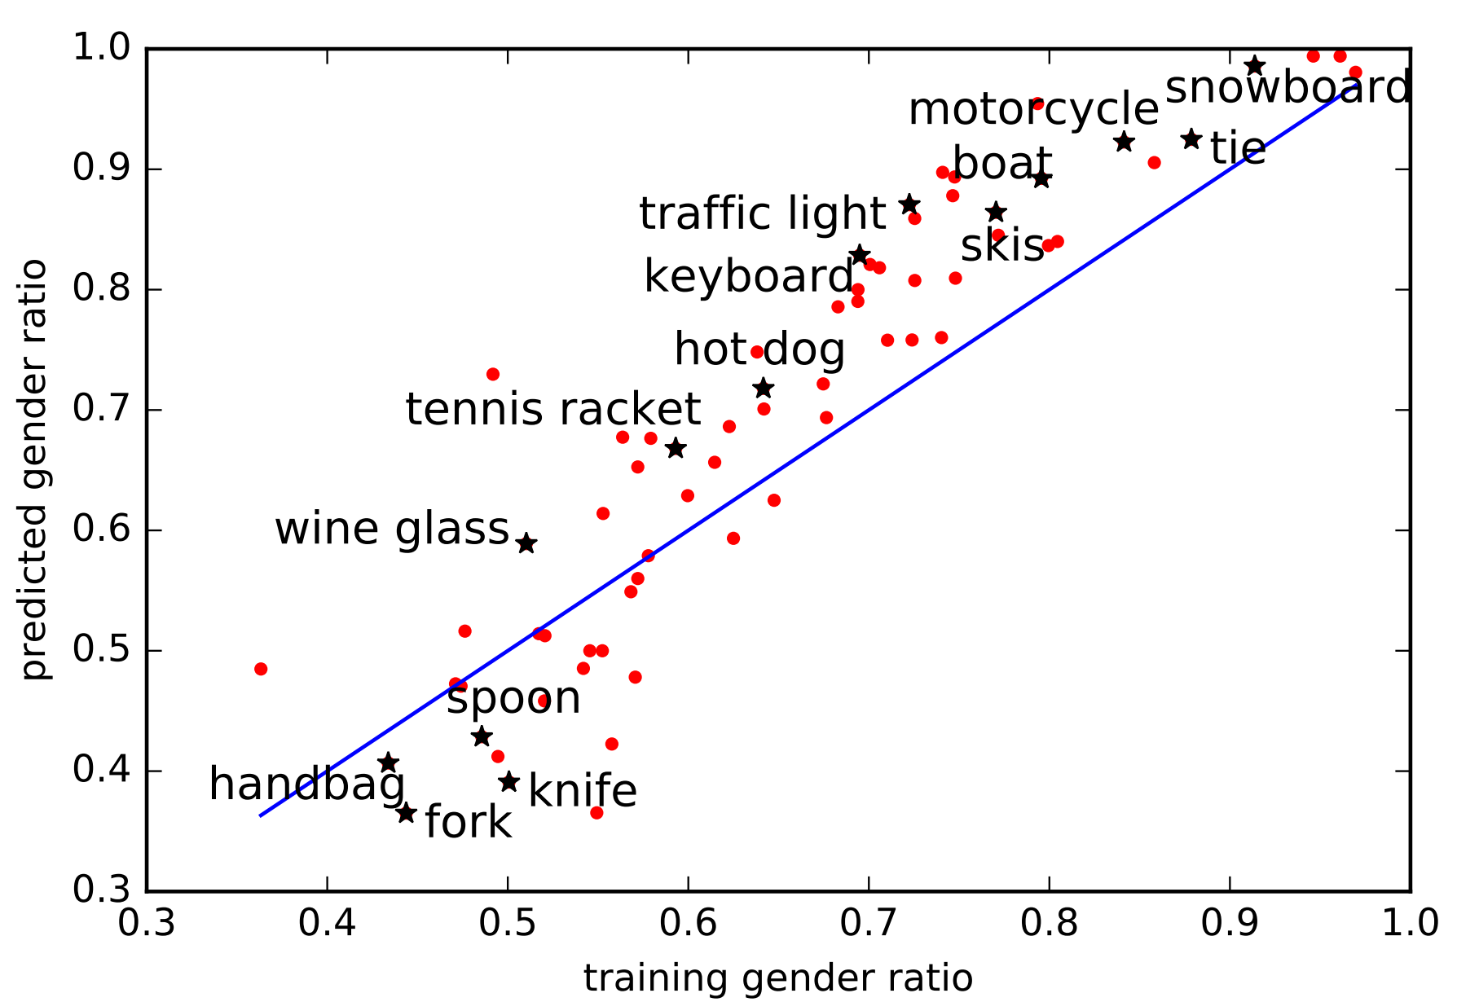
Problem: Bias Amplification
CNN predictions are more biased than their training data!
Reducing bias in datasets is not enough
Zhao et al, “Men Also Like Shopping: Reducing Gender Bias Amplification using Corpus-level Constraints”, EMNLP 2017

Slide 41
Gender Shades: Intersectionality
Task: Gender Classification
Input: RGB Image
Output: {Man, Woman} Prediction
Buolamwini and Gebru, “Gender Shades: Intersectional Accuracy Disparities in Commercial Gender Classification”, FAT* 2018

Slide 42
Gender Shades: Intersectionality
Buolamwini and Gebru, “Gender Shades: Intersectional Accuracy Disparities in Commercial Gender Classification”, FAT* 2018

Slide 43
Gender Shades: Intersectionality
Buolamwini and Gebru, “Gender Shades: Intersectional Accuracy Disparities in Commercial Gender Classification”, FAT* 2018

Slide 44
Gender Shades: Intersectionality
Buolamwini and Gebru, “Gender Shades: Intersectional Accuracy Disparities in Commercial Gender Classification”, FAT* 2018

Slide 45
Gender Shades: Intersectionality
Problem: Much higher error rate for dark-skinned women
Bigger Problem: Why are we classifying gender at all? Why does an automated system care? If it does, ask!
Buolamwini and Gebru, “Gender Shades: Intersectional Accuracy Disparities in Commercial Gender Classification”, FAT* 2018

Slide 46
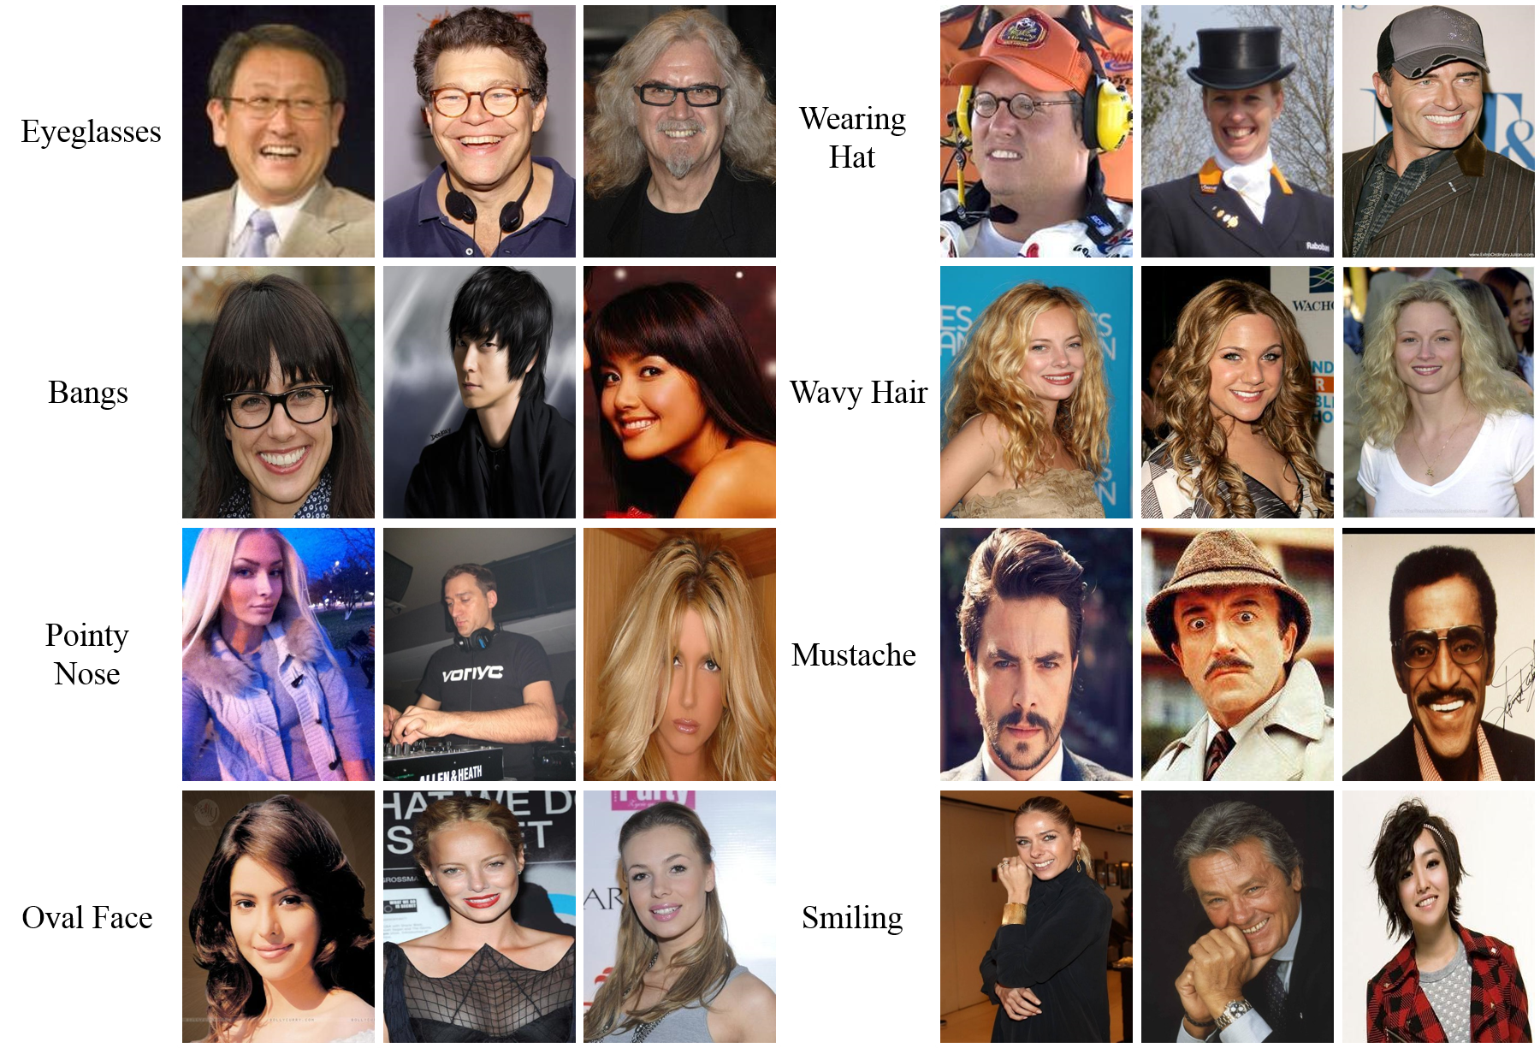
Think Critically about Datasets
CelebA Dataset: 202k images labeled with 40 binary attributes
Liu et al, “Deep Learning Face Attributes in the Wild”, ICCV 2015

Slide 47
Think Critically about Datasets
CelebA Dataset: 202k images labeled with 40 binary attributes
5_o_Clock_Shadow
Arched_Eyebrows
Attractive
Bags_Under_Eyes
Bald
Bangs
Big_Lips
Big_Nose
Black_Hair
Blond_Hair
Blurry
Brown_Hair
Bushy_Eyebrows
Chubby
Double_Chin
Eyeglasses
Goatee
Gray_Hair
Heavy_Makeup
High_Cheekbones
Male
Mouth_Slightly_Open
Mustache
Narrow_Eyes
No_Beard
Oval_Face
Pale_Skin
Pointy_Nose
Receding_Hairline
Rosy_Cheeks
Sideburns
Smiling
Straight_Hair
Wavy_Hair
Wearing_Earrings
Wearing_Hat
Wearing_Lipstick
Wearing_Necklace
Wearing_Necktie
Young
Liu et al, “Deep Learning Face Attributes in the Wild”, ICCV 2015

Slide 48
Think Critically about Datasets
CelebA Dataset: 202k images labeled with 40 binary attributes
5_o_Clock_Shadow
Arched_Eyebrows
Attractive
Bags_Under_Eyes
Bald
Bangs
Big_Lips
Big_Nose
Black_Hair
Blond_Hair
Blurry
Brown_Hair
Bushy_Eyebrows
Chubby
Double_Chin
Eyeglasses
Goatee
Gray_Hair
Heavy_Makeup
High_Cheekbones
Male
Mouth_Slightly_Open
Mustache
Narrow_Eyes
No_Beard
Oval_Face
Pale_Skin
Pointy_Nose
Receding_Hairline
Rosy_Cheeks
Sideburns
Smiling
Straight_Hair
Wavy_Hair
Wearing_Earrings
Wearing_Hat
Wearing_Lipstick
Wearing_Necklace
Wearing_Necktie
Young
Many attributes seem subjective. Who chose the attributes? Why? How are they defined? Who labeled the images?
Liu et al, “Deep Learning Face Attributes in the Wild”, ICCV 2015

Slide 49
Think Critically about Datasets
CelebA Dataset: 202k images labeled with 40 binary attributes
5_o_Clock_Shadow
Arched_Eyebrows
Attractive
Bags_Under_Eyes
Bald
Bangs
Big_Lips
Big_Nose
Black_Hair
Blond_Hair
Blurry
Brown_Hair
Bushy_Eyebrows
Chubby
Double_Chin
Eyeglasses
Goatee
Gray_Hair
Heavy_Makeup
High_Cheekbones
Male
Mouth_Slightly_Open
Mustache
Narrow_Eyes
No_Beard
Oval_Face
Pale_Skin
Pointy_Nose
Receding_Hairline
Rosy_Cheeks
Sideburns
Smiling
Straight_Hair
Wavy_Hair
Wearing_Earrings
Wearing_Hat
Wearing_Lipstick
Wearing_Necklace
Wearing_Necktie
Young
Almost no detail in the paper
Many attributes seem subjective. Who chose the attributes? Why? How are they defined? Who labeled the images?
Liu et al, “Deep Learning Face Attributes in the Wild”, ICCV 2015

Slide 50
Datasheets for Datasets
Idea: A standard list of questions to answer when releasing a dataset. Who created it? Why? What is in it? How was it labeled?
Gebru et al, “Datasheets for Datasets”, FAccT 2018

Slide 51
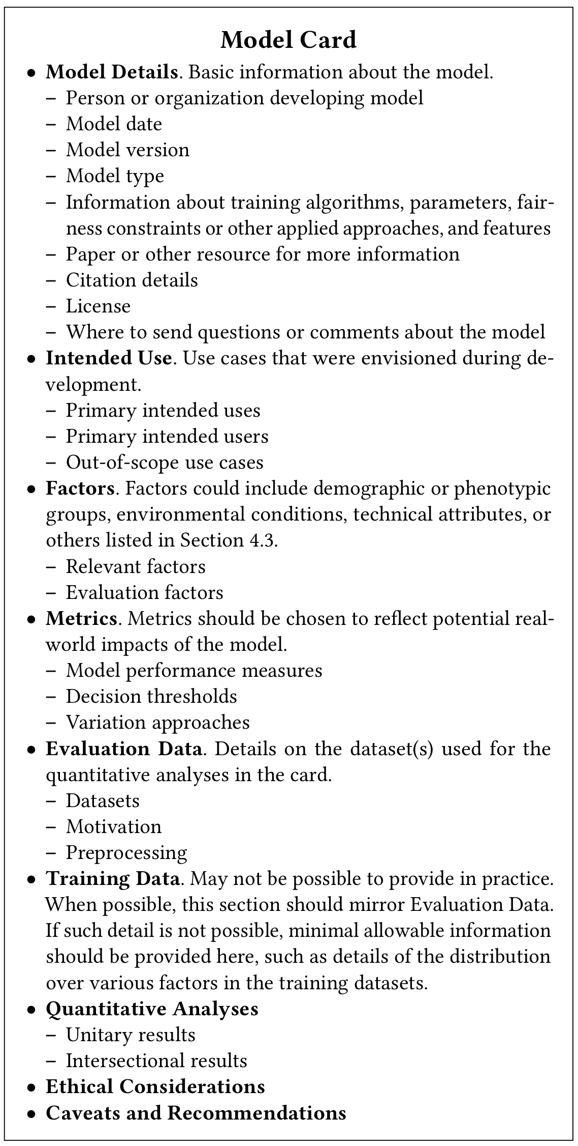
Model Cards
Idea: A standard list of questions to answer when releasing a trained model. Who created it? What data was it trained on? What should it be used for? What should it not be used for?
Mitchell et al, “Model Cards for Model Reporting”, FAccT 2019

Slide 52
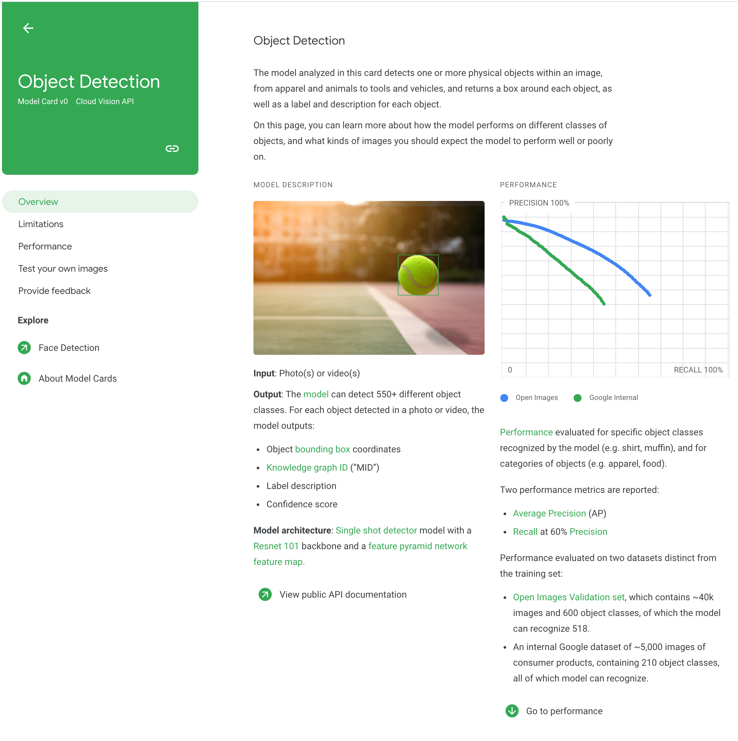
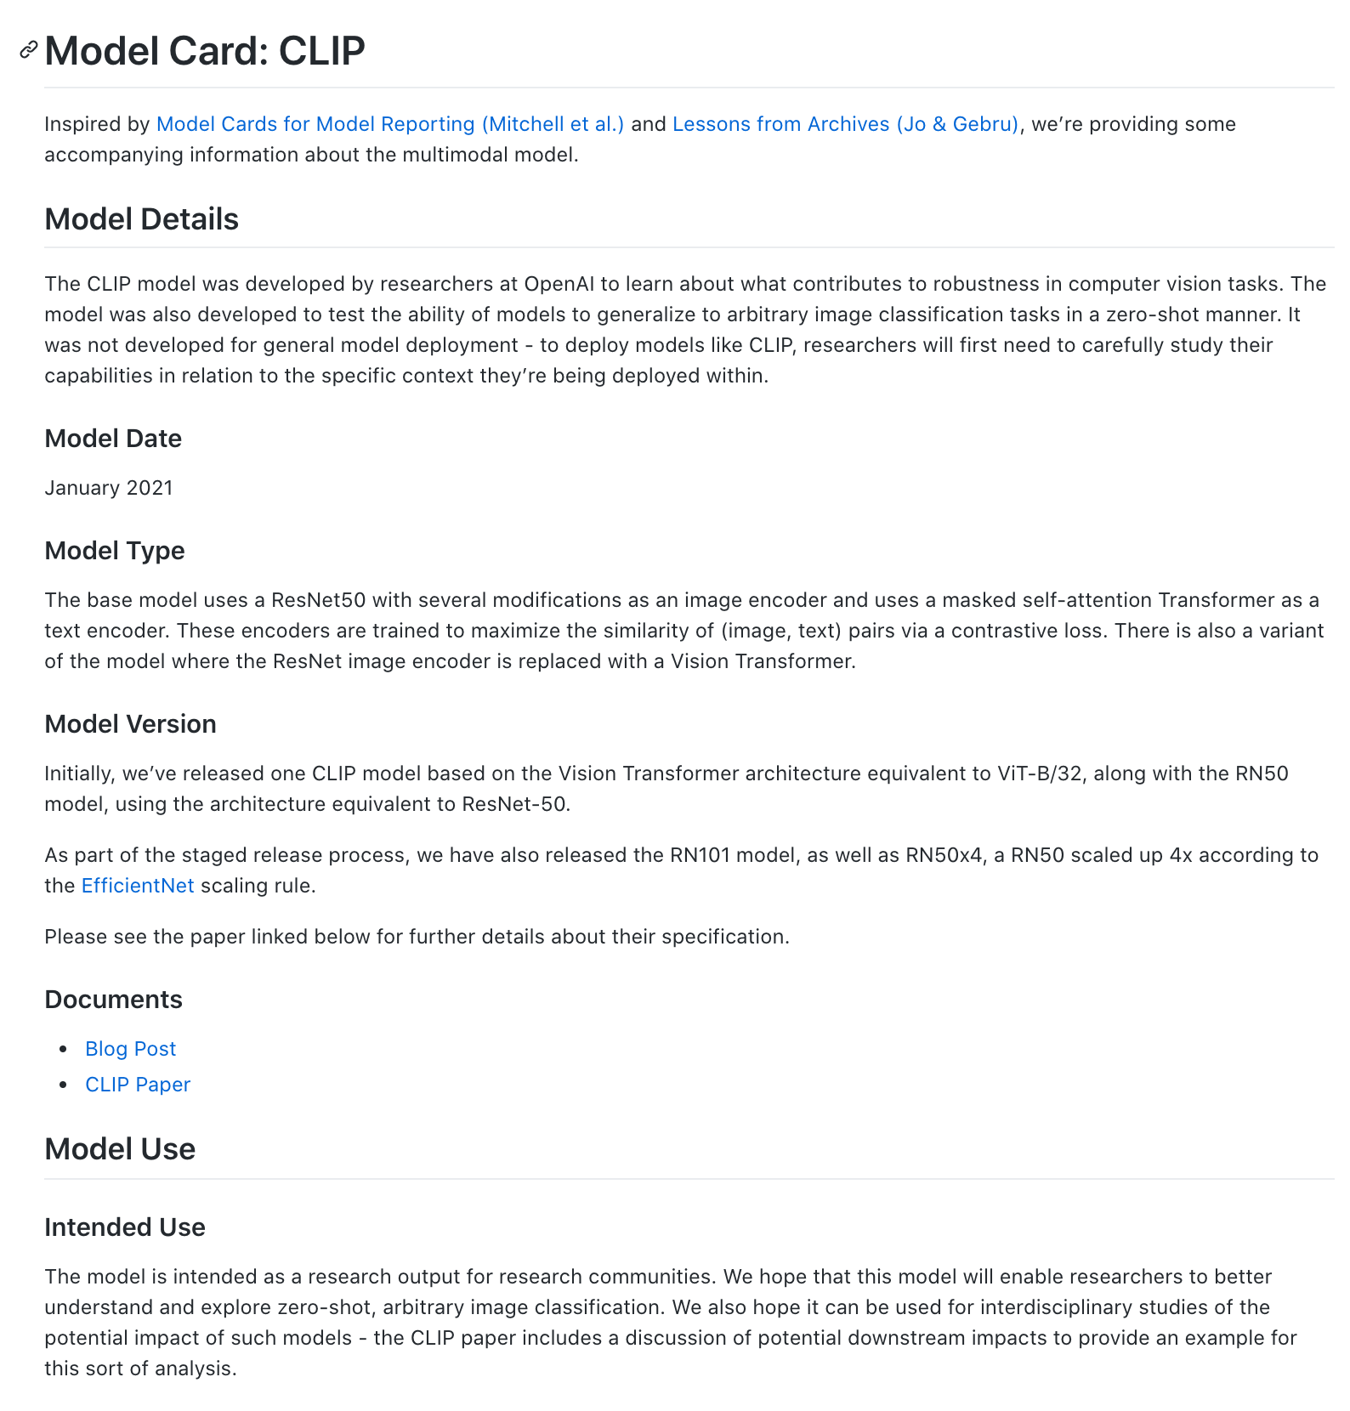
Model Cards
Adopted by Google, OpenAI
https://modelcards.withgoogle.com/object-detection
https://github.com/openai/CLIP/blob/main/model-card.md

Slide 53
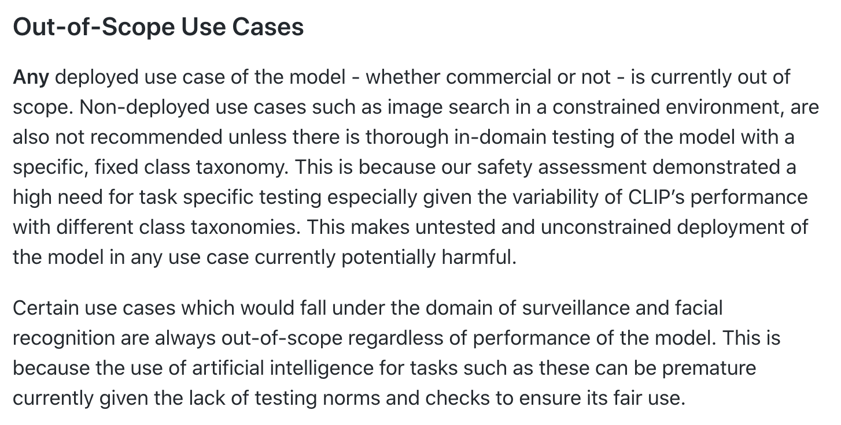
Model Cards
Some models are just for research and not to be deployed. Make it clear!
https://github.com/openai/CLIP/blob/main/model-card.md

Slide 54
Re-Examining Vision Datasets
Tiny Images Dataset: 80M images collected semi-automatically from a dictionary plus image search
Turns out it contains offensive category labels
Birhane and Prabhu, “Large Image Datasets: A Pyrrhic Win for Computer Vision?”, WACV 2021
Torralba et al, “80 million tiny images: A large data set for nonparametric object and scene recognition”, TPAMI 2008

Slide 55
Re-Examining Vision Datasets
Tiny Images dataset contains offensive category labels
Result: Tiny Images Dataset taken offline by authors
Torralba et al, “80 million tiny images: A large data set for nonparametric object and scene recognition”, TPAMI 2008

Slide 56
Consent vs Copyright
Image copyright != Consent to use in a dataset
Birhane and Prabhu, “Large Image Datasets: A Pyrrhic Win for Computer Vision?”, WACV 2021

Slide 57
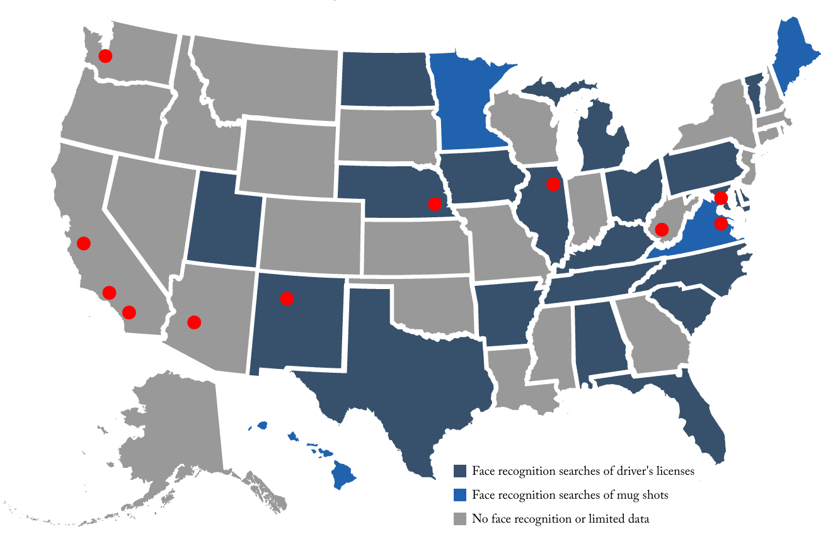
Consent vs Copyright
Image copyright != Consent to use in a dataset
“One in two American adults is in a law enforcement face recognition network.”
Garvie, Bedoya, and Frankle: “The Perpetual Line-Up”, 2016, https://www.perpetuallineup.org/
Birhane and Prabhu, “Large Image Datasets: A Pyrrhic Win for Computer Vision?”, WACV 2021

Slide 58
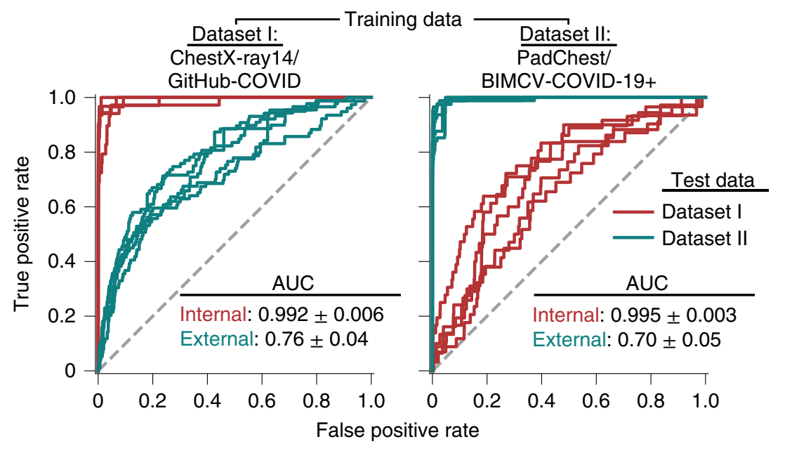
Bigger Picture
DeGrave et al. Nature Machine Intelligence, 2021.

Slide 59
Takeaways
Thinking about bias and fairness in automated systems goes far beyond computer vision
People in many fields are thinking about these issues, not just CS
It’s important that the next generation of engineers and scientists (you all!) spend some time thinking about the implications of their work on people and society

Slide 60
Next Time: AI For Science

Slide 62
Formalizing Fairness
Independence: $P\left(R, A\right)=P\left(R\right)P\left(A\right)$
Separation: $P\left(R,A \right| Y)=P\left(R \right| Y)P\left(A \right| Y)$
What happens if a binary classifier satisfies both?
Barocas, Hardt, and Narayanan. “Fairness and Machine Learning”, https://fairmlbook.org/index.html

Slide 63
Formalizing Fairness
Independence: $P\left(R, A\right)=P\left(R\right)P(A)$
Separation: $P\left(R,A \right| Y)=P\left(R \right| Y)P\left(A \right| Y)$
What happens if a binary classifier satisfies both?
$P\left(R=r \right| A=a)=P\left(R=r\right)$ (Independence)
Barocas, Hardt, and Narayanan. “Fairness and Machine Learning”, https://fairmlbook.org/index.html

Slide 64
Formalizing Fairness
Independence: $P\left(R, A\right)=P\left(R\right)P(A)$
Separation: $P\left(R,A \right| Y)=P\left(R \right| Y)P\left(A \right| Y)$
What happens if a binary classifier satisfies both?
$P\left(R=r \right| A=a)=P\left(R=r\right)$ (Independence)
$=\sum_{y}{P\left(R=r \right| Y=y)P(Y=y)}$
(Total probability)
Barocas, Hardt, and Narayanan. “Fairness and Machine Learning”, https://fairmlbook.org/index.html

Slide 65
Formalizing Fairness
Independence: $P\left(R, A\right)=P\left(R\right)P(A)$
Separation: $P\left(R,A \right| Y)=P\left(R \right| Y)P\left(A \right| Y)$
What happens if a binary classifier satisfies both?
$P\left(R=r \right| A=a)=P\left(R=r\right)$ (Independence)
$=\sum_{y}{P\left(R=r \right| Y=y)P(Y=y)}$
$P\left(R=r \right| A=a)=\sum_{y}{P\left(R=r \right| A=a,Y=y)P\left(Y=y \right| A=a)}$
(Total probability)
(Total probability)
Barocas, Hardt, and Narayanan. “Fairness and Machine Learning”, https://fairmlbook.org/index.html

Slide 66
Formalizing Fairness
Independence: $P\left(R, A\right)=P\left(R\right)P(A)$
Separation: $P\left(R,A \right| Y)=P\left(R \right| Y)P\left(A \right| Y)$
What happens if a binary classifier satisfies both?
$P\left(R=r \right| A=a)=P\left(R=r\right)$ (Independence)
$=\sum_{y}{P\left(R=r \right| Y=y)P(Y=y)}$
$P\left(R=r \right| A=a)=\sum_{y}{P\left(R=r \right| A=a,Y=y)P\left(Y=y \right| A=a)}$
(Separation) $=\sum_{y}{P\left(R=r \right| Y=y)P\left(Y=y | A=a\right)}$
(Total probability)
(Total probability)
Barocas, Hardt, and Narayanan. “Fairness and Machine Learning”, https://fairmlbook.org/index.html

Slide 67
Formalizing Fairness
Independence: $P\left(R, A\right)=P\left(R\right)P(A)$
Separation: $P\left(R,A \right| Y)=P\left(R \right| Y)P\left(A \right| Y)$
What happens if a binary classifier satisfies both?
$P\left(R=r \right| A=a)=P\left(R=r\right)$ (Independence)
$=\sum_{y}{P\left(R=r \right| Y=y)P(Y=y)}$
$P\left(R=r \right| A=a)=\sum_{y}{P\left(R=r \right| A=a,Y=y)P\left(Y=y \right| A=a)}$
(Separation) $=\sum_{y}{P\left(R=r \right| Y=y)P\left(Y=y | A=a\right)}$
(Total probability)
(Total probability)
Barocas, Hardt, and Narayanan. “Fairness and Machine Learning”, https://fairmlbook.org/index.html

Slide 68
Formalizing Fairness
Independence: $P\left(R, A\right)=P\left(R\right)P(A)$
Separation: $P\left(R,A \right| Y)=P\left(R \right| Y)P\left(A \right| Y)$
What happens if a binary classifier satisfies both?
For all values a of A, and all values r of R, we must have:
$$\sum_{y}{P\left(R=r \right| Y=y)P\left(Y=y\right)=\sum_{y}{P\left(R=r \right| Y=y)P\left(Y=y | A=a\right)}}$$
Barocas, Hardt, and Narayanan. “Fairness and Machine Learning”, https://fairmlbook.org/index.html

Slide 69
Formalizing Fairness
Independence: $P\left(R, A\right)=P\left(R\right)P(A)$
Separation: $P\left(R,A \right| Y)=P\left(R \right| Y)P\left(A \right| Y)$
What happens if a binary classifier satisfies both?
For all values a of A, and all values r of R, we must have:
$$\sum_{y}{P\left(R=r \right| Y=y)P\left(Y=y\right)=\sum_{y}{P\left(R=r \right| Y=y)P\left(Y=y | A=a\right)}}$$
$${P\left(Y=0 | A=a\right)=p}_{a}$$
$${P\left(Y=1 | A=a\right)=1−p}_{a}$$
Barocas, Hardt, and Narayanan. “Fairness and Machine Learning”, https://fairmlbook.org/index.html

Slide 70
Formalizing Fairness
Independence: $P\left(R, A\right)=P\left(R\right)P(A)$
Separation: $P\left(R,A \right| Y)=P\left(R \right| Y)P\left(A \right| Y)$
What happens if a binary classifier satisfies both?
For all values a of A, and all values r of R, we must have:
$$\sum_{y}{P\left(R=r \right| Y=y)P\left(Y=y\right)=\sum_{y}{P\left(R=r \right| Y=y)P\left(Y=y | A=a\right)}}$$
$$P\left(Y=0\right)=p$$
$$P\left(Y=1\right)=1−p$$
$${P\left(Y=0 | A=a\right)=p}_{a}$$
$${P\left(Y=1 | A=a\right)=1−p}_{a}$$
Barocas, Hardt, and Narayanan. “Fairness and Machine Learning”, https://fairmlbook.org/index.html

Slide 71
Formalizing Fairness
Independence: $P\left(R, A\right)=P\left(R\right)P(A)$
Separation: $P\left(R,A \right| Y)=P\left(R \right| Y)P\left(A \right| Y)$
What happens if a binary classifier satisfies both?
For all values a of A, and all values r of R, we must have:
$$\sum_{y}{P\left(R=r \right| Y=y)P\left(Y=y\right)=\sum_{y}{P\left(R=r \right| Y=y)P\left(Y=y | A=a\right)}}$$
$${P\left(R=r | Y=0\right)=r}_{0}$$
$${P\left(R=r | Y=1\right)=r}_{1}$$
$$P\left(Y=0\right)=p$$
$$P\left(Y=1\right)=1−p$$
$${P\left(Y=0 | A=a\right)=p}_{a}$$
$${P\left(Y=1 | A=a\right)=1−p}_{a}$$
Barocas, Hardt, and Narayanan. “Fairness and Machine Learning”, https://fairmlbook.org/index.html

Slide 72
Formalizing Fairness
Independence: $P\left(R, A\right)=P\left(R\right)P(A)$
Separation: $P\left(R,A \right| Y)=P\left(R \right| Y)P\left(A \right| Y)$
What happens if a binary classifier satisfies both?
For all values a of A, and all values r of R, we must have:
$$\sum_{y}{P\left(R=r \right| Y=y)P\left(Y=y\right)=\sum_{y}{P\left(R=r \right| Y=y)P\left(Y=y | A=a\right)}}$$
$${P\left(R=r | Y=0\right)=r}_{0}$$
$${P\left(R=r | Y=1\right)=r}_{1}$$
$$P\left(Y=0\right)=p$$
$$P\left(Y=1\right)=1−p$$
$${P\left(Y=0 | A=a\right)=p}_{a}$$
$${P\left(Y=1 | A=a\right)=1−p}_{a}$$
$$r_{0}p+r_{1}\left(1−p\right)=r_{0}p_{a}+r_{1}\left(1−p_{a}\right)$$
Option 2: $p=p_{a}$
Target, attribute are independent
$$p\left(r_{0}−r_{1}\right)=p_{a}\left(r_{0}−r_{1}\right)$$
Option 1: $r_{0}=r_{1}$
Useless classifier!
Barocas, Hardt, and Narayanan. “Fairness and Machine Learning”, https://fairmlbook.org/index.html

