Slide 1
Single-View Geometry
EECS 442 – David Fouhey
Winter 2022, University of Michigan
https://web.eecs.umich.edu/~fouhey/teaching/EECS442_W22/

Slide 2
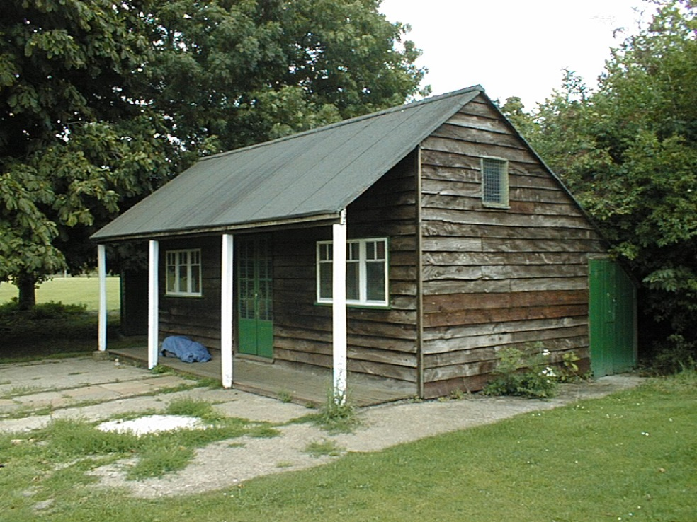
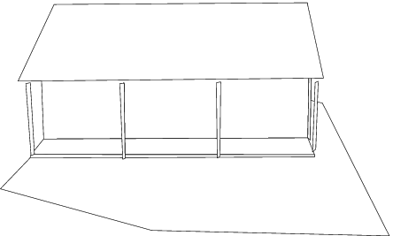
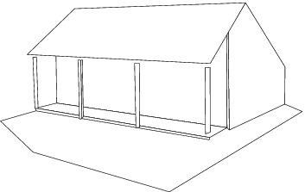
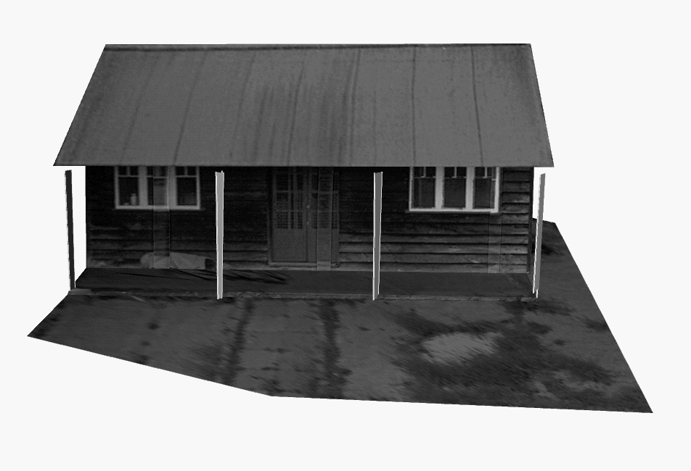
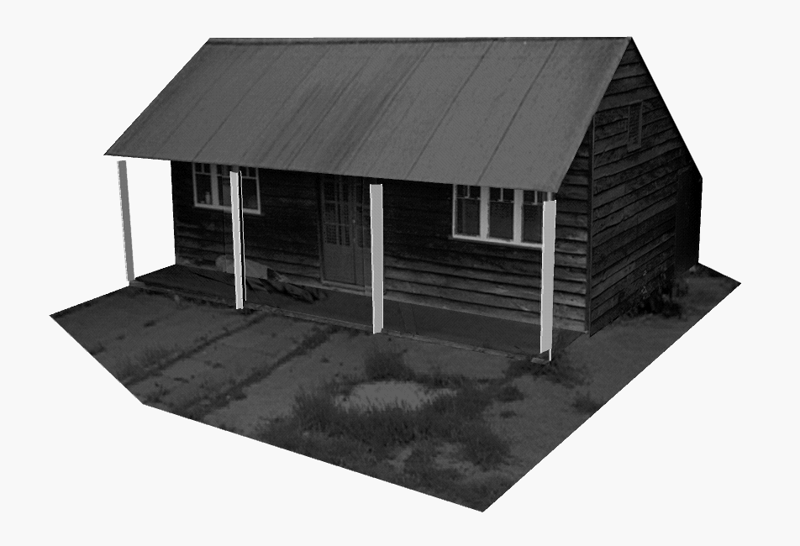
Application: Single-view modeling
A. Criminisi, I. Reid, and A. Zisserman, Single View Metrology, IJCV 2000

Slide 3
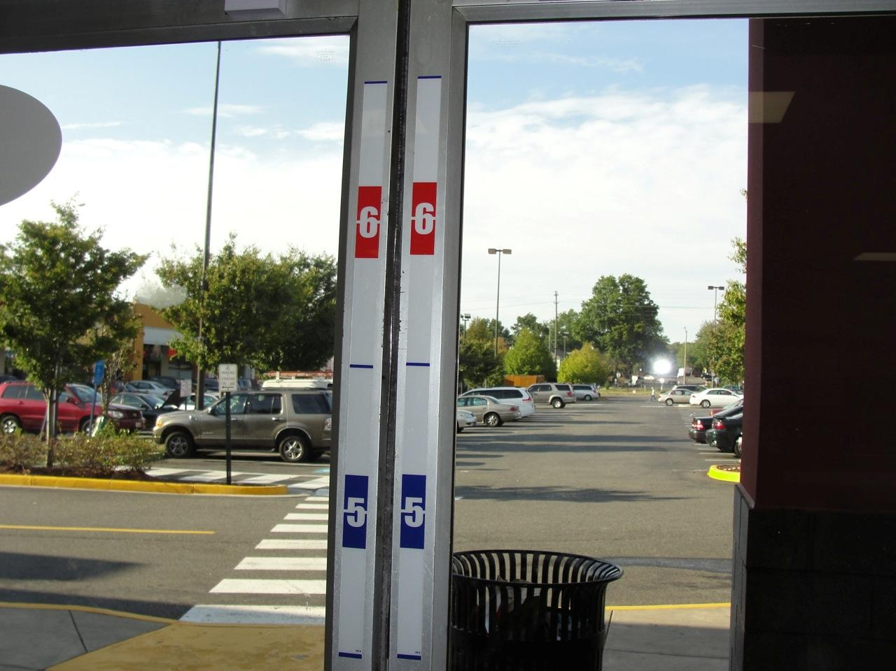
Application: Measuring Height

Slide 4

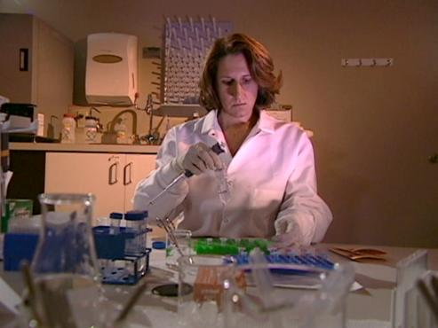
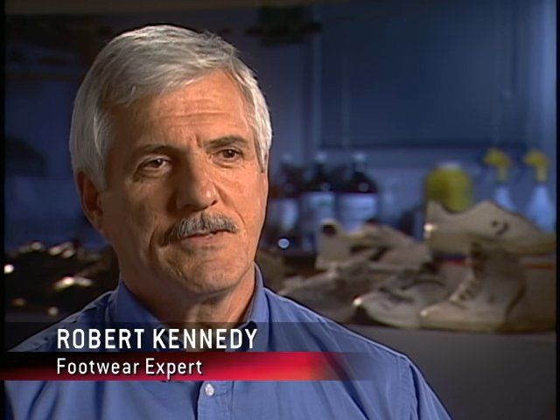
Application: Measuring Height
CSI before CSI
Covered criminal cases talking to random scientists (e.g., footwear experts)
How do you tell how tall someone is if they’re not kind enough to stand next to a ruler?

Slide 5
Application: Camera Calibration
Calibration a HUGE pain
…

Slide 6
Application: Camera Calibration
What if 3D coordinates are unknown?
Use scene features such as vanishing points
Slide from Efros, Photo from Criminisi

Slide 7
Camera calibration revisited
What if 3D coordinates are unknown?
Use scene features such as vanishing points
Vertical vanishing
point
(at infinity)
Vanishing
line
Vanishing
point
Vanishing
point
Slide from Efros, Photo from Criminisi

Slide 8
Recall: Vanishing points
image plane
vanishing point v
camera
center
line in the scene
All lines having the same direction share the same vanishing point
Slide credit: S. Lazebnik

Slide 9
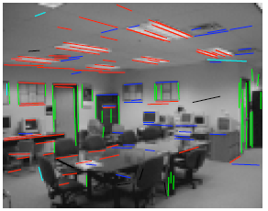
Calibration from vanishing points
Consider a scene with 3 orthogonal directions
v₁, v₂ are finite vps, v₃ infinite vp
Want to align world coordinates with directions
.
.
v₁
v₂
v₃
Slide credit: S. Lazebnik

Slide 10


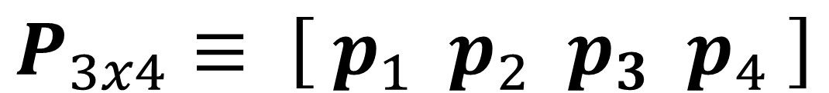



Calibration from vanishing points
$$P_{3x4}≡ \left[ p_{1} p_{2} p_{3} p_{4} \right]$$
It turns out that
$$p_{1}≡P {\left[1,0,0,0\right]}^{T}$$
VP in X direction
$$p_{2}≡P {\left[0,1,0,0\right]}^{T}$$
VP in Y direction
$$p_{3}≡P {\left[0,0,1,0\right]}^{T}$$
VP in Z direction
$$p_{4}≡P {\left[0,0,0,1\right]}^{T}$$
Projection of origin
Note the usual $≡$ (i.e., all of this is up to scale) as well as where the 0 is

Slide 11




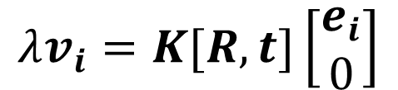

Calibration from vanishing points
Let’s align the world coordinate system with the three orthogonal vanishing directions:
$$e_{1}= \left[\begin{matrix}1 \\ 0 \\ 0\end{matrix}\right]$$
$$e_{2}= \left[\begin{matrix}0 \\ 1 \\ 0\end{matrix}\right]$$
$$e_{3}= \left[\begin{matrix}0 \\ 0 \\ 1\end{matrix}\right]$$
$$λv_{i}=K[R,t]\left[\begin{matrix}e_{i} \\ 0\end{matrix}\right]$$
$$λv_{i}=KRe_{i}$$
Drop the t
$$R^{−1}K^{−1}{λv}_{i}=e_{i}$$
Inverses

Slide 12

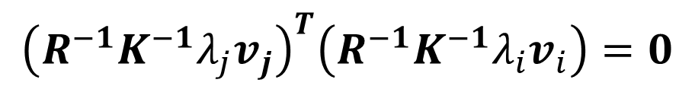

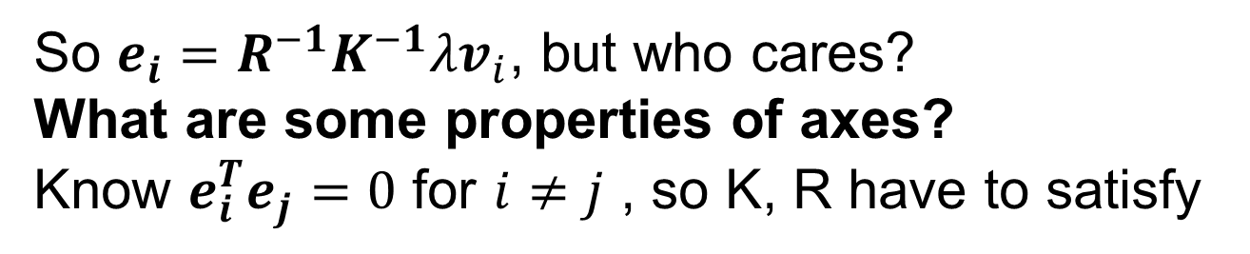
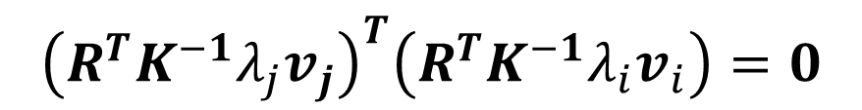

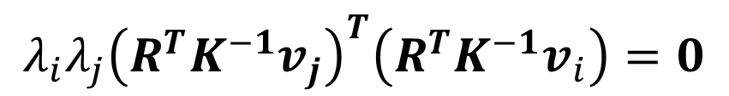

Calibration from vanishing points
So $e_{i}=R^{−1}K^{−1}{λv}_{i}$, but who cares?
What are some properties of axes?
Know $e_{i}^{T}e_{j}=0$ for $i≠j$ , so K, R have to satisfy
$${\left(R^{−1}K^{−1}λ_{j}v_{j}\right)}^{T}\left(R^{−1}K^{−1}{λ_{i}v}_{i}\right)=0$$
$${\left(R^{T}K^{−1}{λ_{j}v}_{j}\right)}^{T}\left(R^{T}K^{−1}{λ_{i}v}_{i}\right)=0$$
$$R^{−1}=R^{T}$$
$${λ_{i}λ_{j}\left(R^{T}K^{−1}v_{j}\right)}^{T}\left(R^{T}K^{−1}v_{i}\right)=0$$
Move scalars
$$v_{j}K^{−T}RR^{T}K^{−1}v_{i}=0$$
Clean up
$$v_{j}K^{−T}K^{−1}v_{i}=0$$
$$RR^{T}=I$$

Slide 13

Calibration from vanishing points
Intrinsics (focal length f, principal point u₀,v₀) have to ensure that the rays corresponding to vanishing points for 3 mutually orthogonal directions are orthogonal
$$v_{j}K^{−T}K^{−1}v_{i}=0$$

Slide 14
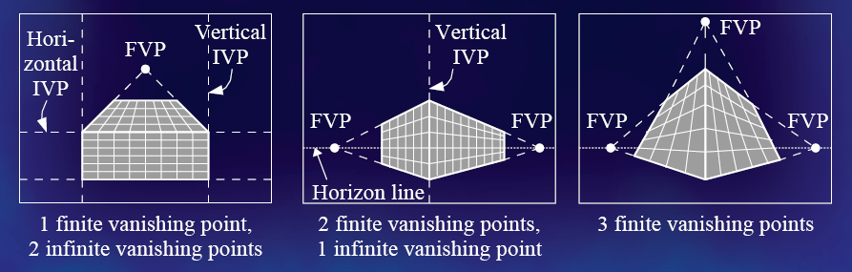
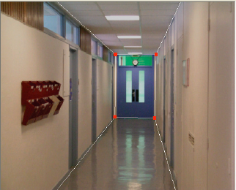
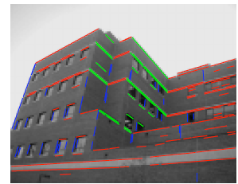
Calibration from vanishing points
Cannot recover focal length, principal point is the third vanishing point
Can solve for focal length, principal point
Slide credit: S. Lazebnik

Slide 15
Directions and vanishing points

Slide 16
Directions and vanishing points
v₁
v₂
v₃

Slide 17
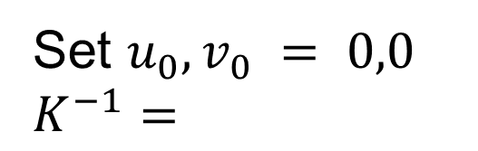
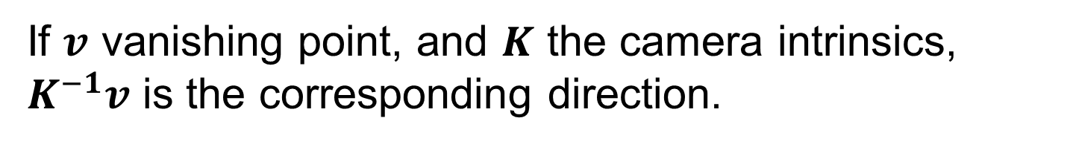
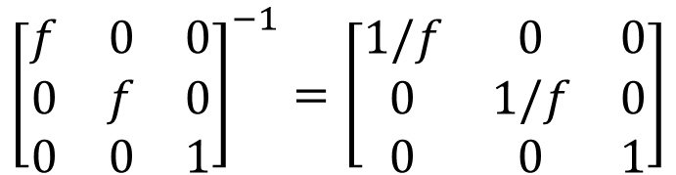
Directions and vanishing points
If $v$ vanishing point, and $K$ the camera intrinsics, $K^{−1}v$ is the corresponding direction.
v₁
[-f,0,1]
[f,0,1]
v₂
Set $u_{0},v_{0} = 0,0$
$$K^{−1}=$$
$${\left[\begin{matrix}f & 0 & 0 \\ 0 & f & 0 \\ 0 & 0 & 1\end{matrix}\right]}^{−1}=\left[\begin{matrix}1/f & 0 & 0 \\ 0 & 1/f & 0 \\ 0 & 0 & 1\end{matrix}\right]$$
[0,f*10⁹⁹,1]
v₃

Slide 18
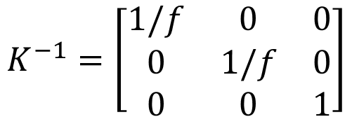

Directions and vanishing points
If I normalize each $K^{−1}v_{i}$, I get:
$\left[−\frac{1}{\sqrt{2}},0\frac{1}{\sqrt{2}} \right]$, $\left[\frac{1}{\sqrt{2}},0\frac{1}{\sqrt{2}} \right],\left[0,1,0\right]$
v₁
[-f,0,1]
[f,0,1]
v₂
K⁻¹v₁ = [-1,0,1]
K⁻¹v₂ = [1,0,1]
K⁻¹v₃ = [0, 10⁹⁹,1]
$$K^{−1}=\left[\begin{matrix}1/f & 0 & 0 \\ 0 & 1/f & 0 \\ 0 & 0 & 1\end{matrix}\right]$$
[0,f*10⁹⁹,1]
v₃

Slide 19
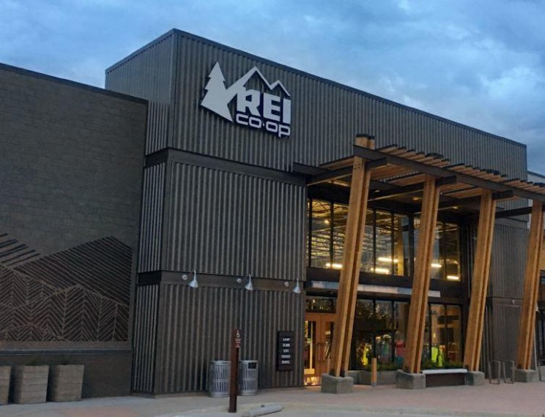

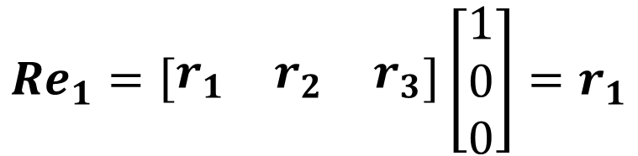
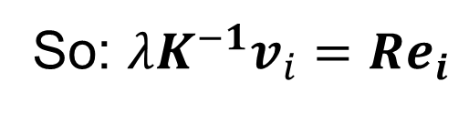

Rotation from vanishing points
Know that $λ_{i}v_{i}=KRe_{i}$ and have K, but want R
So: $λK^{−1}v_{i}=Re_{i}$
What does $Re_{i}$ look like?
$$Re_{1}=\left[\begin{matrix}r_{1} & r_{2} & r_{3}\end{matrix}\right]\left[\begin{matrix}1 \\ 0 \\ 0\end{matrix}\right]=r_{1}$$
The ith column of R is a scaled version of
$$r_{i}=λK^{−1}v_{i}$$

Slide 20
Calibration from vanishing points
Solve for K (focal length, principal point) using 3 orthogonal vanishing points
Get rotation directly from vanishing points once calibration matrix known
Pros:
  Could be totally automatic!
Cons:
  Need 3 vanishing points, estimated accurately, AND orthogonal with at least two finite!
Slide credit: S. Lazebnik

Slide 21
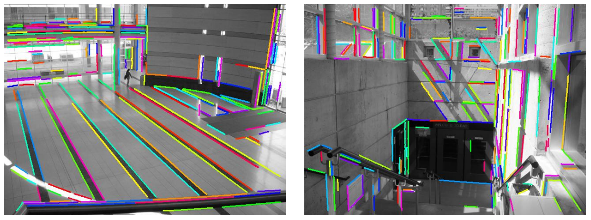
Finding Vanishing Points
What might go wrong with the circled points?
Image credit: J.P. Tardif

Slide 22
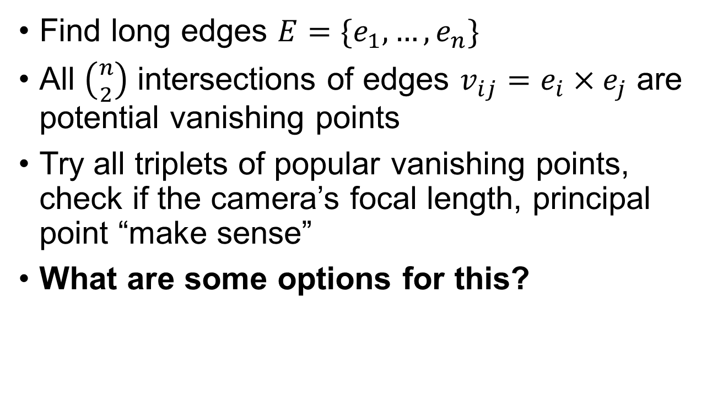
Finding Vanishing Points
Find long edges $E=\{e_{1},…, e_{n}\}$
All $\left({n \atop 2}\right)$ intersections of edges $v_{ij}=e_{i}×e_{j}$ are potential vanishing points
Try all triplets of popular vanishing points, check if the camera’s focal length, principal point “make sense”
What are some options for this?

Slide 23
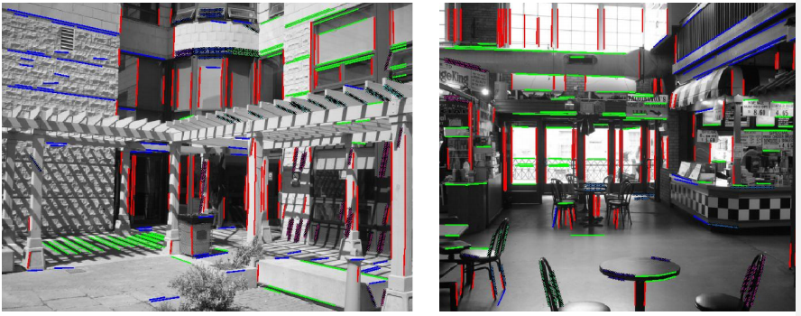
Finding Vanishing Points
Image credit: J.P. Tardif

Slide 24




Measuring height
Slide by Steve Seitz

Slide 25
Measuring height
Slide by Steve Seitz

Slide 26
Measuring height
5.3
5
Camera height
4
3.3
3
2.8
2
1

Slide 27
Measuring height without a ruler
O
Z
ground plane
Compute Z from image measurements: We’ll need more than vanishing points to do this
Slide credit: S. Lazebnik

Slide 28
Projective invariant
We need to use a projective invariant: a quantity that does not change under projective transformations (including perspective projection)
Slide credit: S. Lazebnik

Slide 29
Projective invariant
We need to use a projective invariant: a quantity that does not change under projective transformations (including perspective projection)
The cross-ratio of four points:
P₄
P₃
This is one of the cross-ratios (can reorder arbitrarily)
P₂
Slide credit:
S. Lazebnik
P₁

Slide 30
Measuring height
∞
scene cross ratio
T (top of object)
t
r
R (reference point)
C
H
b
R
image cross ratio
v_{Z}
B (bottom of object)
ground plane
Slide credit: S. Lazebnik

Slide 31

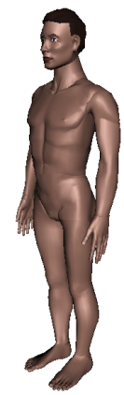
Measuring height without a ruler

Slide 32
v_{z}
r
vanishing line (horizon)
t₀
t
v_{x}
v
v_{y}
H
R
H
b₀
b
image cross ratio

Slide 33
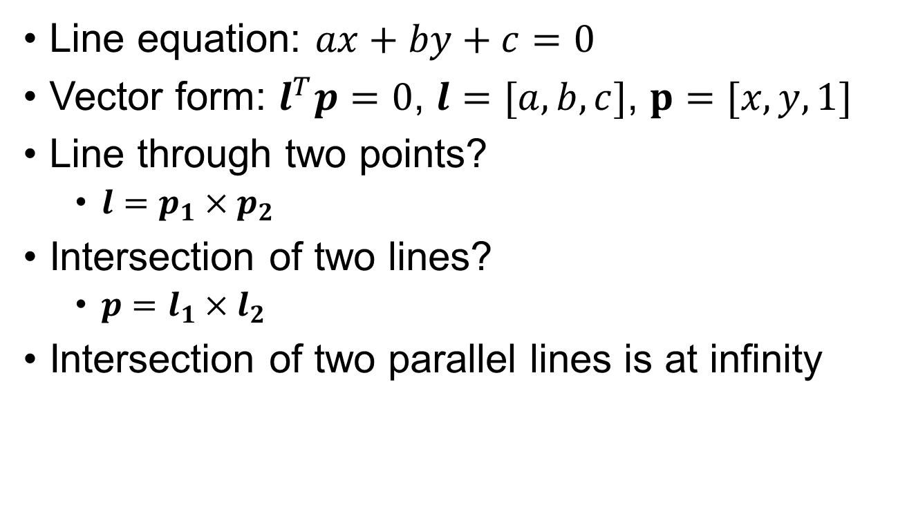
Remember This?
Line equation: $ax+by+c=0$
Vector form: $l^{T}p=0$, $l=[a,b,c]$, $p=[x,y,1]$
Line through two points?
  $l=p_{1}×p_{2}$
Intersection of two lines?
  $p=l_{1}×l_{2}$
Intersection of two parallel lines is at infinity

Slide 34

v_{z}
r
vanishing line (horizon)
t₀
t
v_{x}
v
v_{y}
H
R
H
b₀
b
image cross ratio

Slide 35
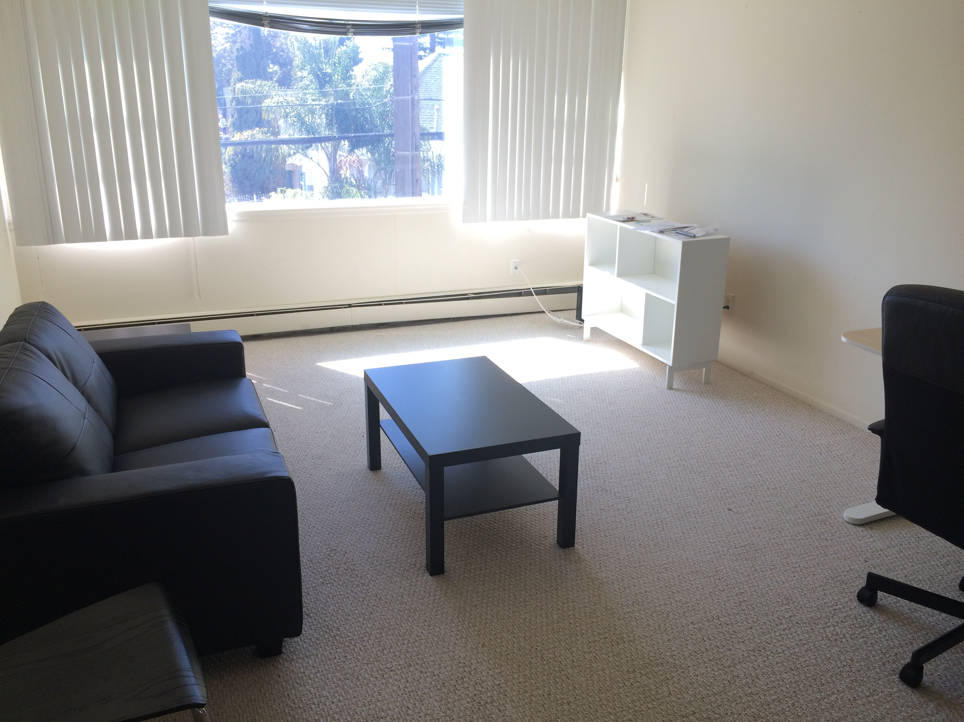
Example Gone Wrong
v
Know length of red → can figure out height of blue because they intersect at vanishing point v
Wrong! Any two lines always intersect!
Need to point to same 3D direction / VP.

Slide 36
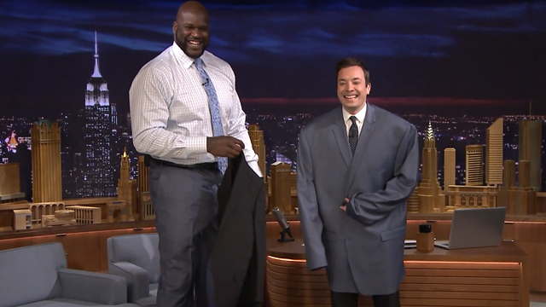
Example Gone Wrong
Horizon
Shaquille O’Neal and Jimmy Fallon are the same height!!!!
Wrong! Need to connect feet to the horizon (at infinity – thank homogenous coordinates), and then to Jimmy’s head.

Slide 37
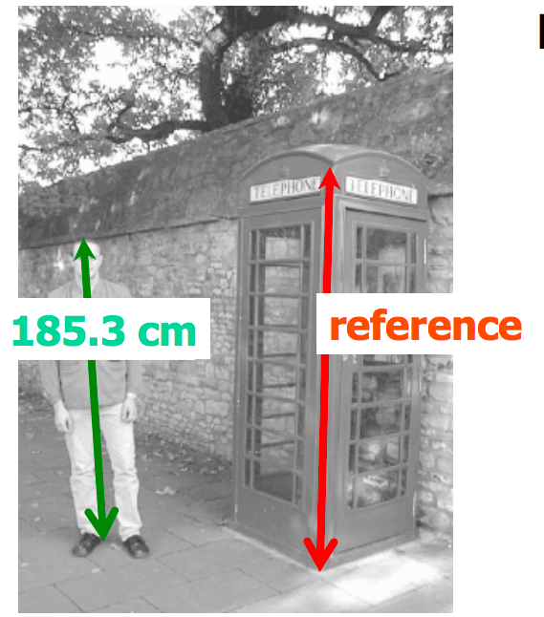
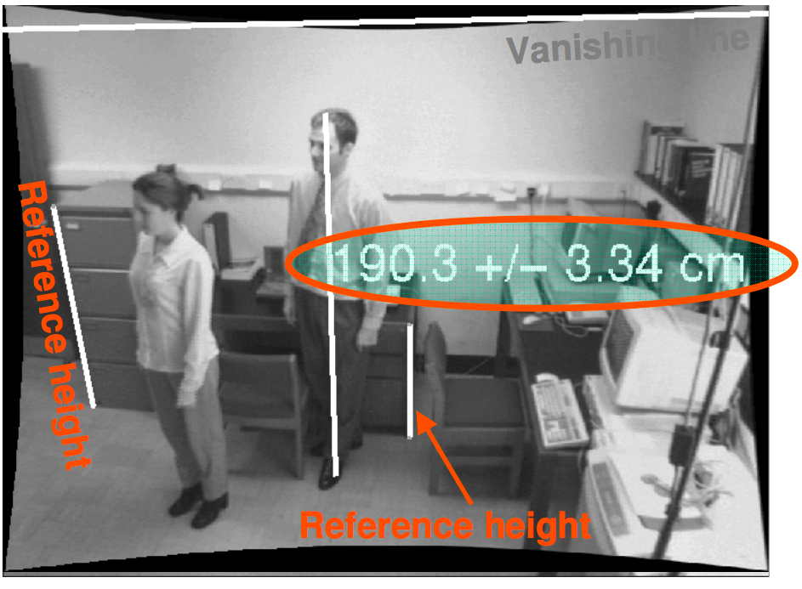
Examples
A. Criminisi, I. Reid, and A. Zisserman, Single View Metrology, IJCV 2000
Figure from UPenn CIS580 slides
Slide credit: S. Lazebnik

Slide 38
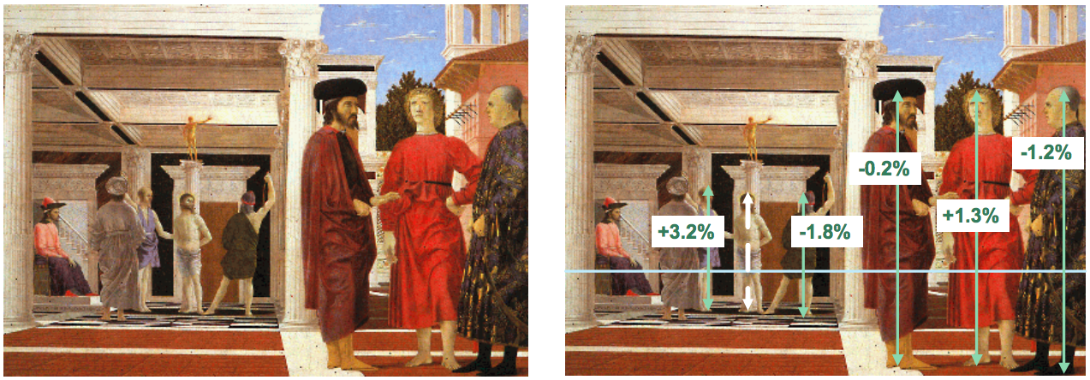
Another example
Are the heights of the two groups of people consistent with one another?
Piero della Francesca, Flagellation, ca. 1455
A. Criminisi, M. Kemp, and A. Zisserman,Bringing Pictorial Space to Life: computer techniques for the analysis of paintings,
Proc. Computers and the History of Art, 2002
Slide credit: S. Lazebnik

Slide 39
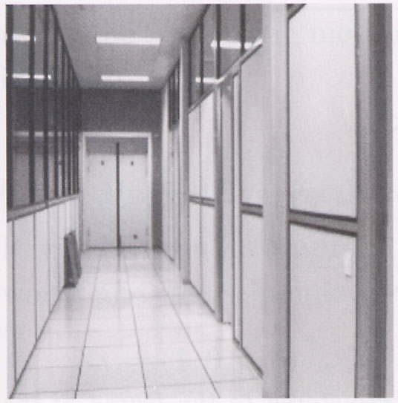
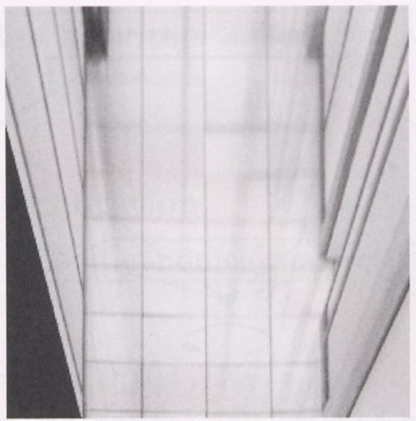
Measurements on planes
4
3
2
1
1
2
3
4
Slide credit: S. Lazebnik

Slide 40
Measurements on planes
4
3
2
p′
1
p
1
2
3
4
Slide credit: S. Lazebnik

Slide 41
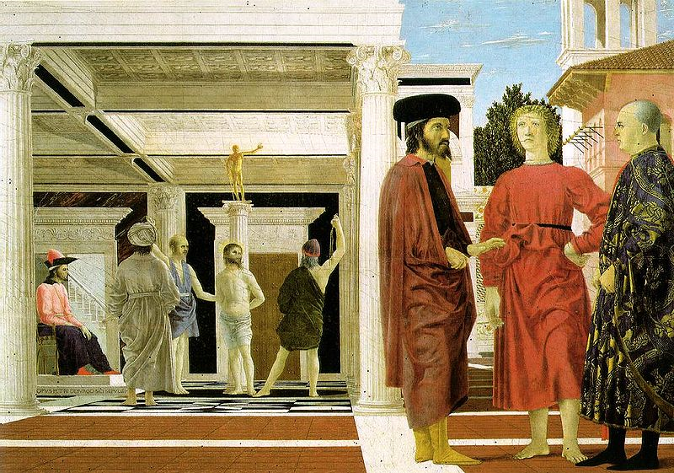

Image rectification: example
Piero della Francesca, Flagellation, ca. 1455
Slide credit: S. Lazebnik

Slide 42
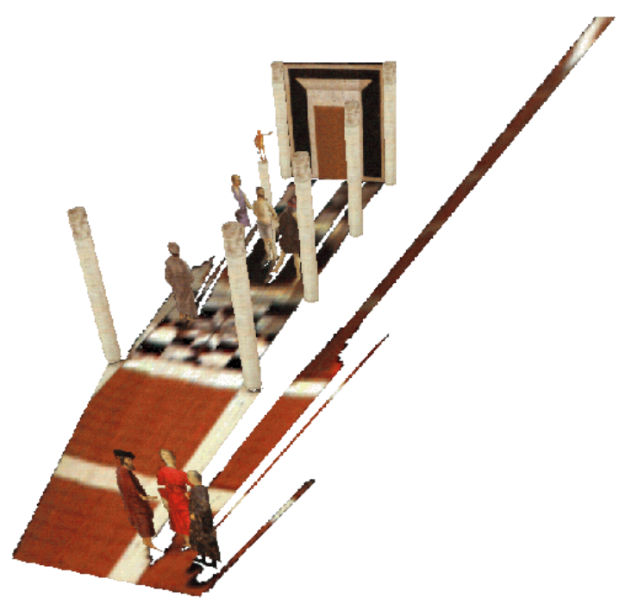
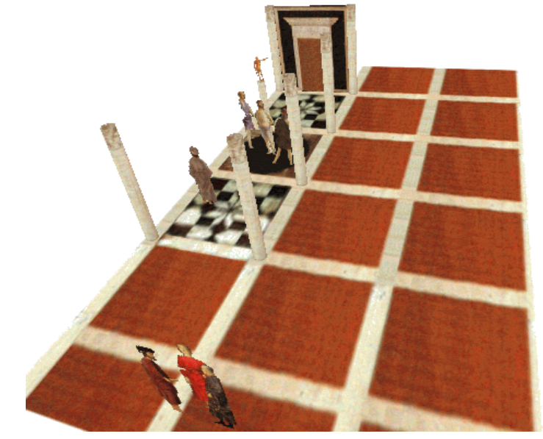
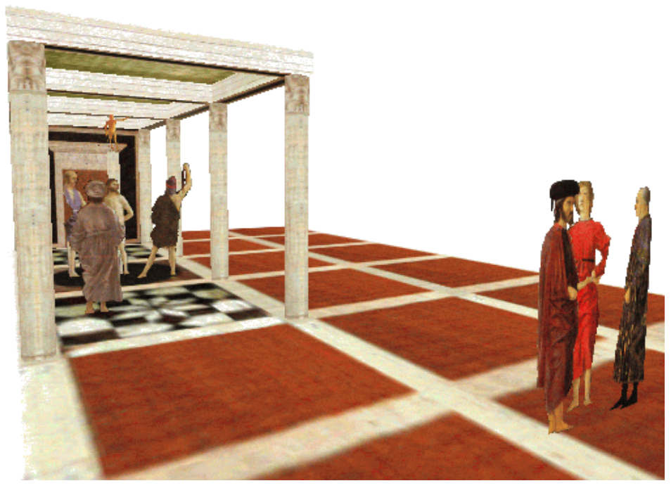
Application: 3D modeling from a single image
A. Criminisi, M. Kemp, and A. Zisserman,Bringing Pictorial Space to Life: computer techniques for the analysis of paintings,
Proc. Computers and the History of Art, 2002
Slide credit: S. Lazebnik

Slide 43
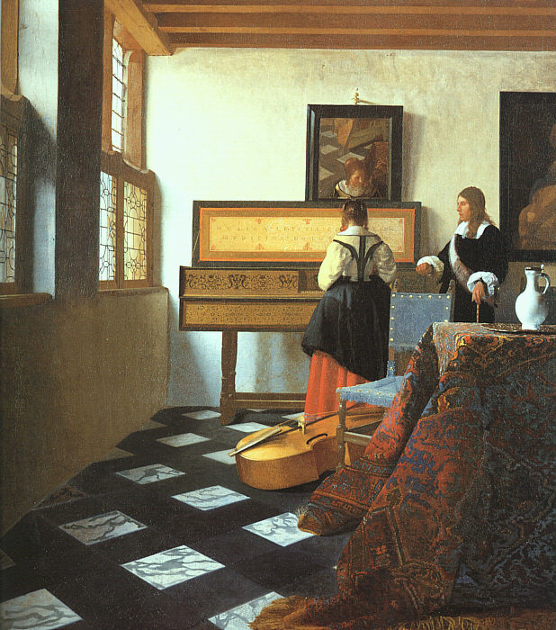
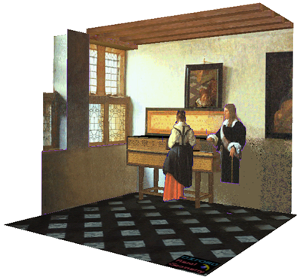
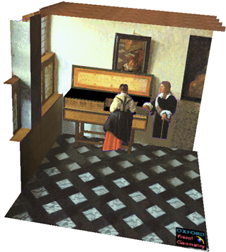
Application: 3D modeling from a single image
J. Vermeer, Music Lesson, 1662
A. Criminisi, M. Kemp, and A. Zisserman,Bringing Pictorial Space to Life: computer techniques for the analysis of paintings,
Proc. Computers and the History of Art, 2002
Slide credit: S. Lazebnik

Slide 44
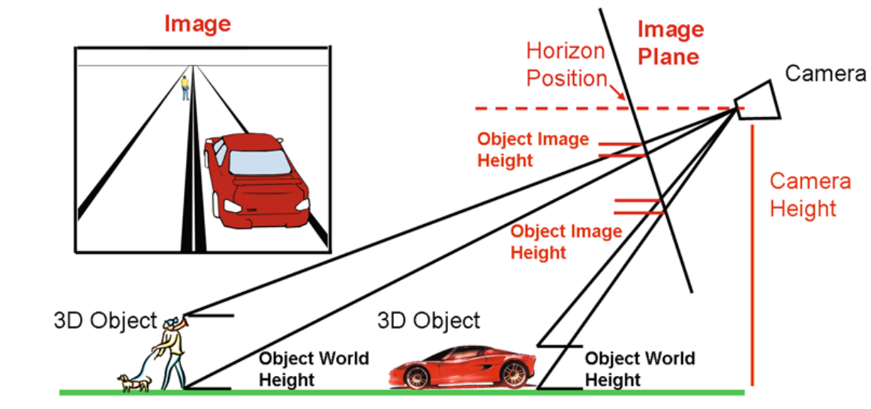
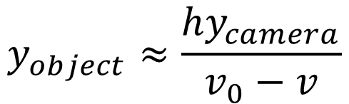
Application: Object Detection
(1,1)
v₀
h
v
(0,0)
$$y_{object}≈\frac{hy_{camera}}{v_{0}−v}$$
“Reasonable” approximation:
Diagram Credit: D. Hoiem

Slide 45
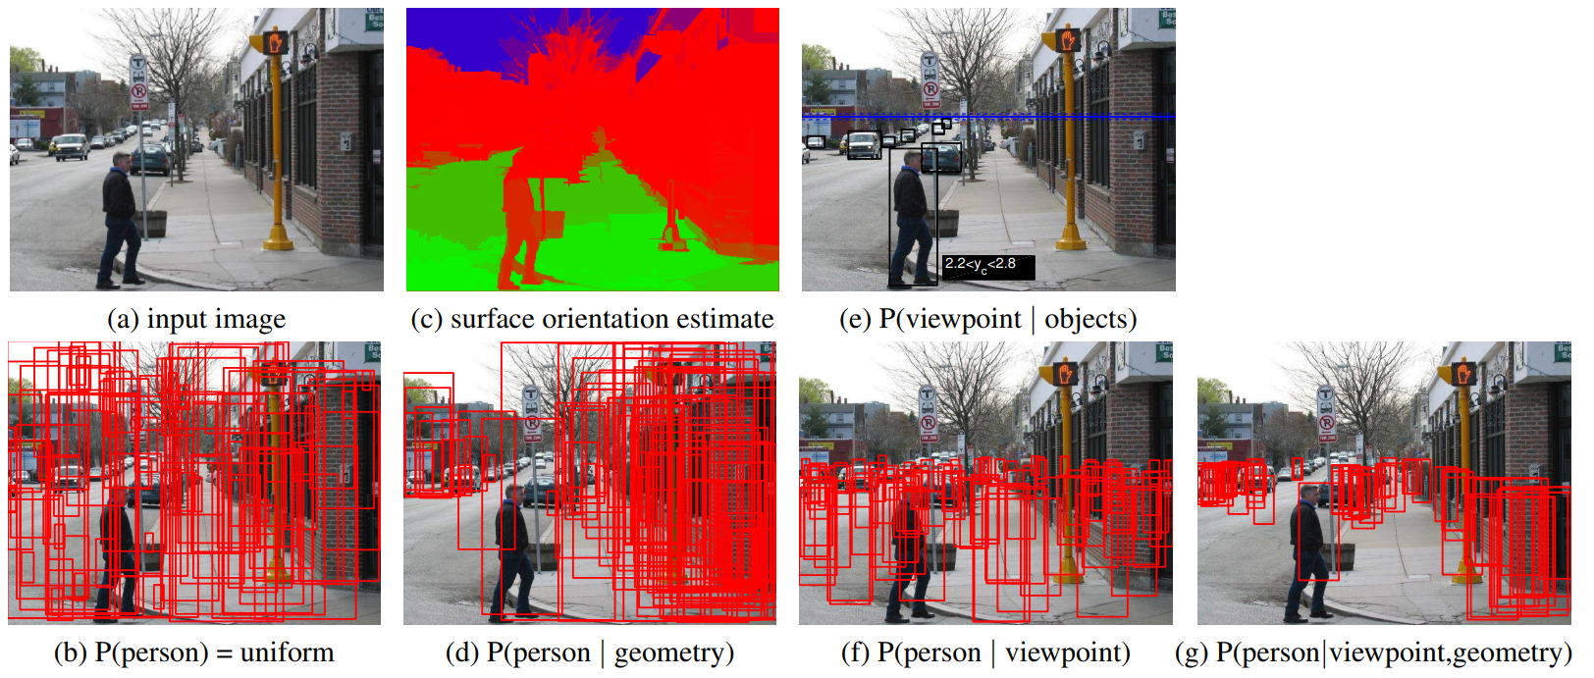
Application: Object detection
Diagram Credit: D. Hoiem

Slide 46
Application: Object detection
Diagram Credit: D. Hoiem

Slide 47

Application: Image Editing
K. Karsch and V. Hedau and D. Forsyth and D. Hoiem, Rendering Synthetic Objects into Legacy Photographs, SIGGRAPH Asia 2011

Slide 48

Application: Estimating Layout
V. Hedau, D. Hoiem, D. Forsyth
Recovering the spatial layout of cluttered rooms ICCV 2009

