Slide 1
Optimization and (Under/over)fitting
EECS 442 – David Fouhey
Winter 2022, University of Michigan
http://web.eecs.umich.edu/~fouhey/teaching/EECS442_W22/

Slide 2


Regularized Least Squares
Add regularization to objective that prefers some solutions:
Before:
$$\arg{\min_{w}{{\left\|y−Xw\right\|}_{2}^{2}}}$$
Loss
After:
$$\arg{\min_{w}{{\left\|y−Xw\right\|}_{2}^{2}+λ{\left\|w\right\|}_{2}^{2}}}$$
Loss
Trade-off
Regularization
Want model “smaller”: pay a penalty for w with big norm
Intuitive Objective: accurate model (low loss) but not too complex (low regularization). λ controls how much of each.

Slide 3
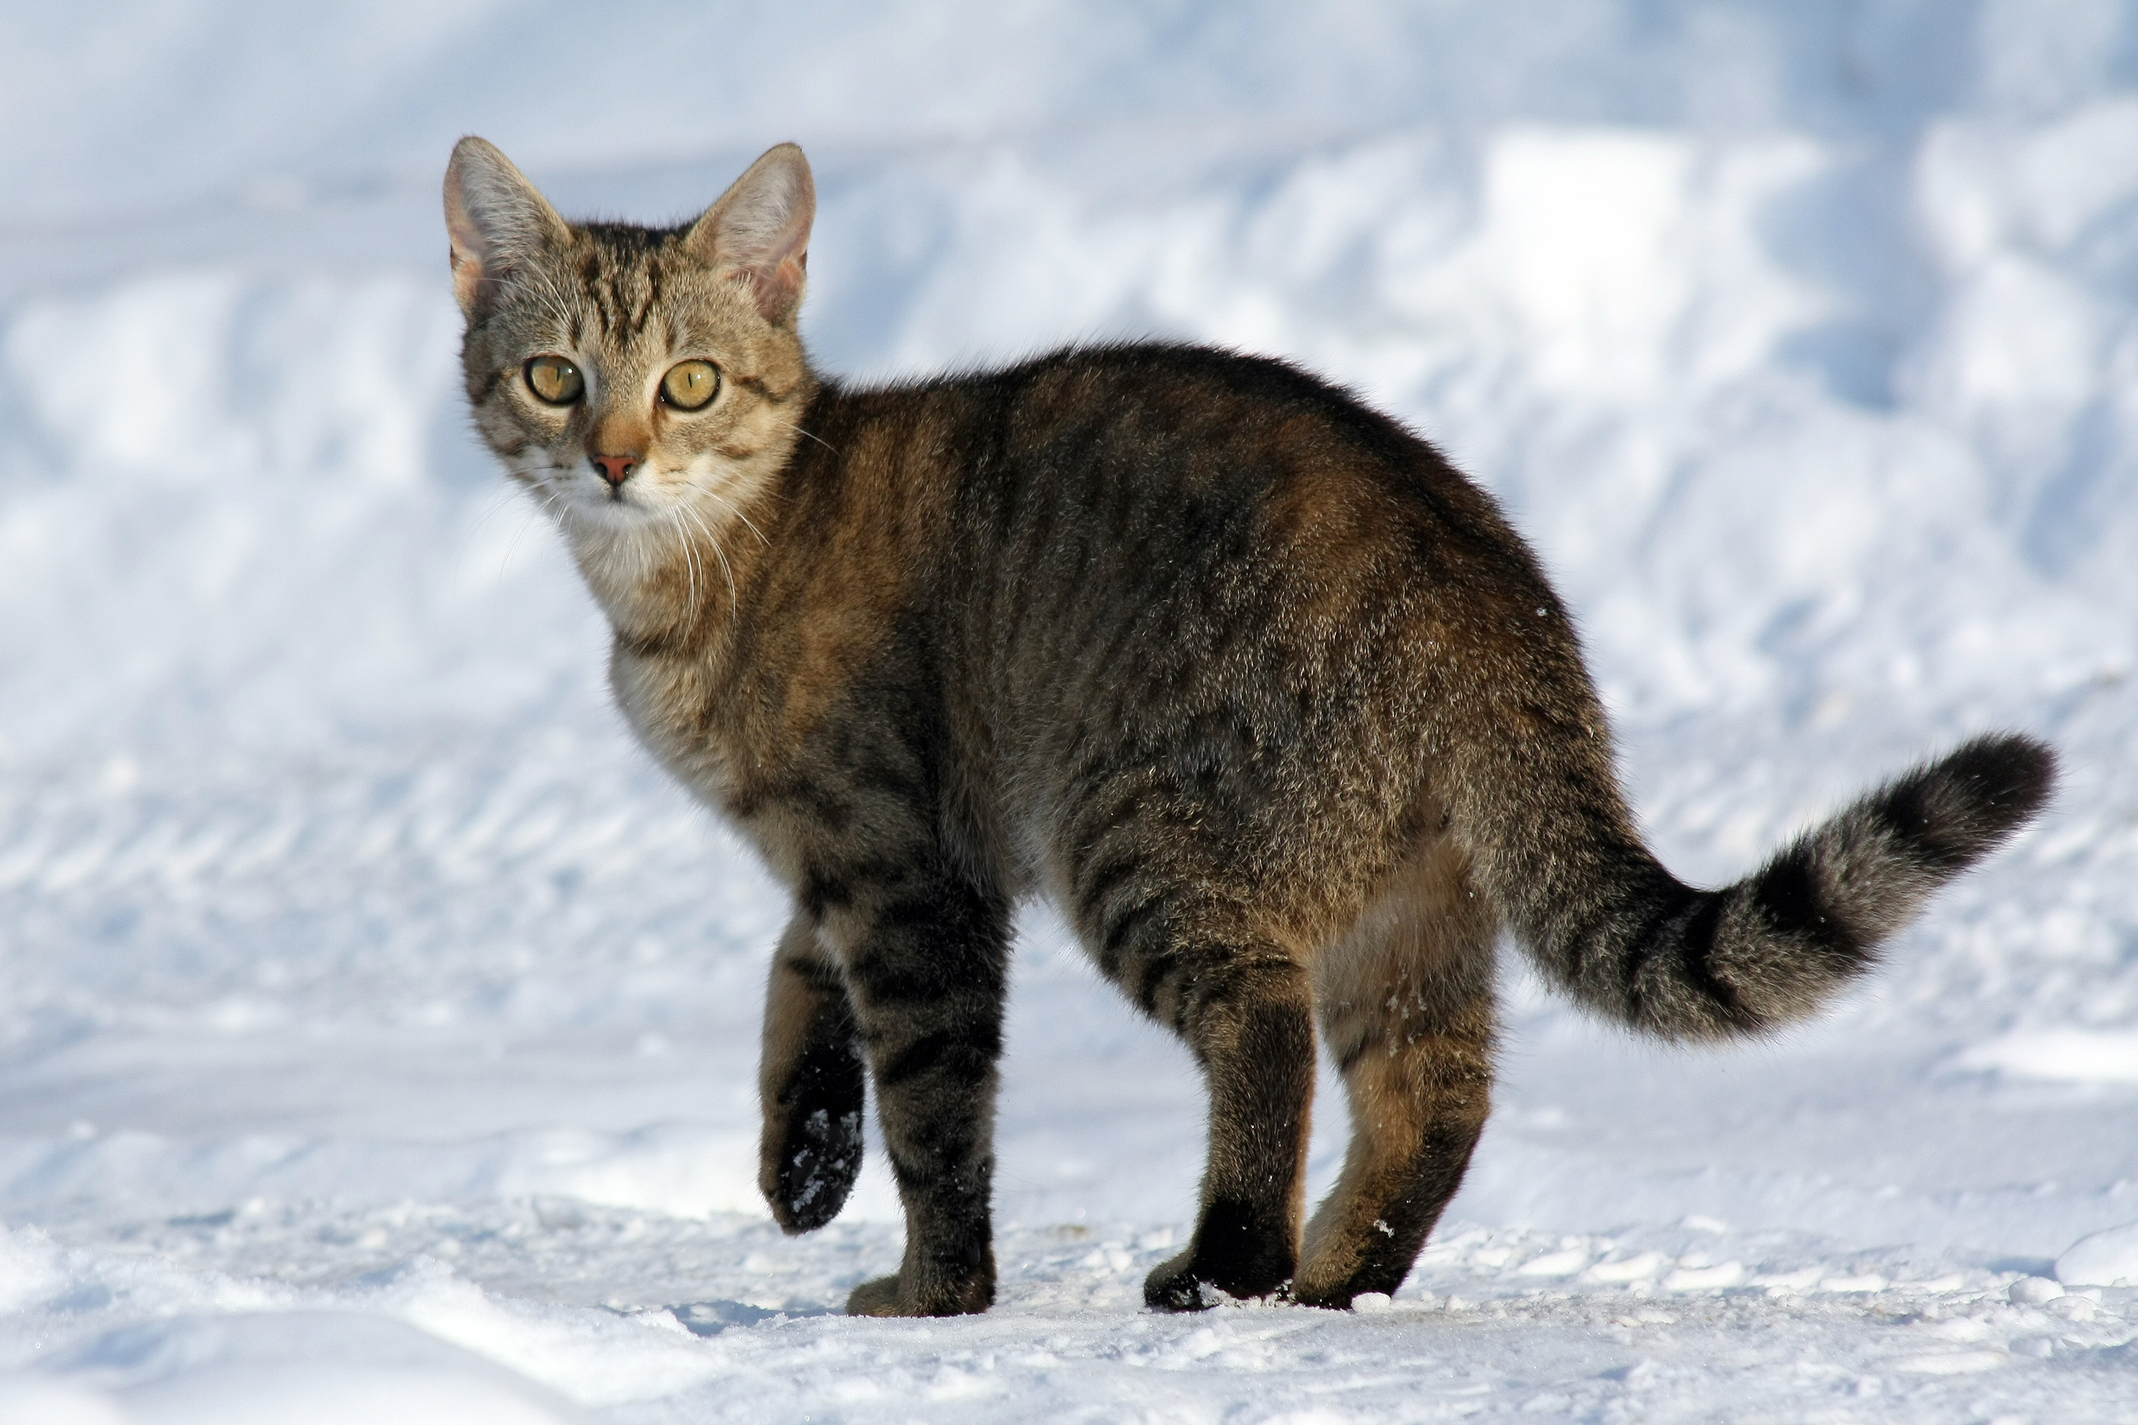

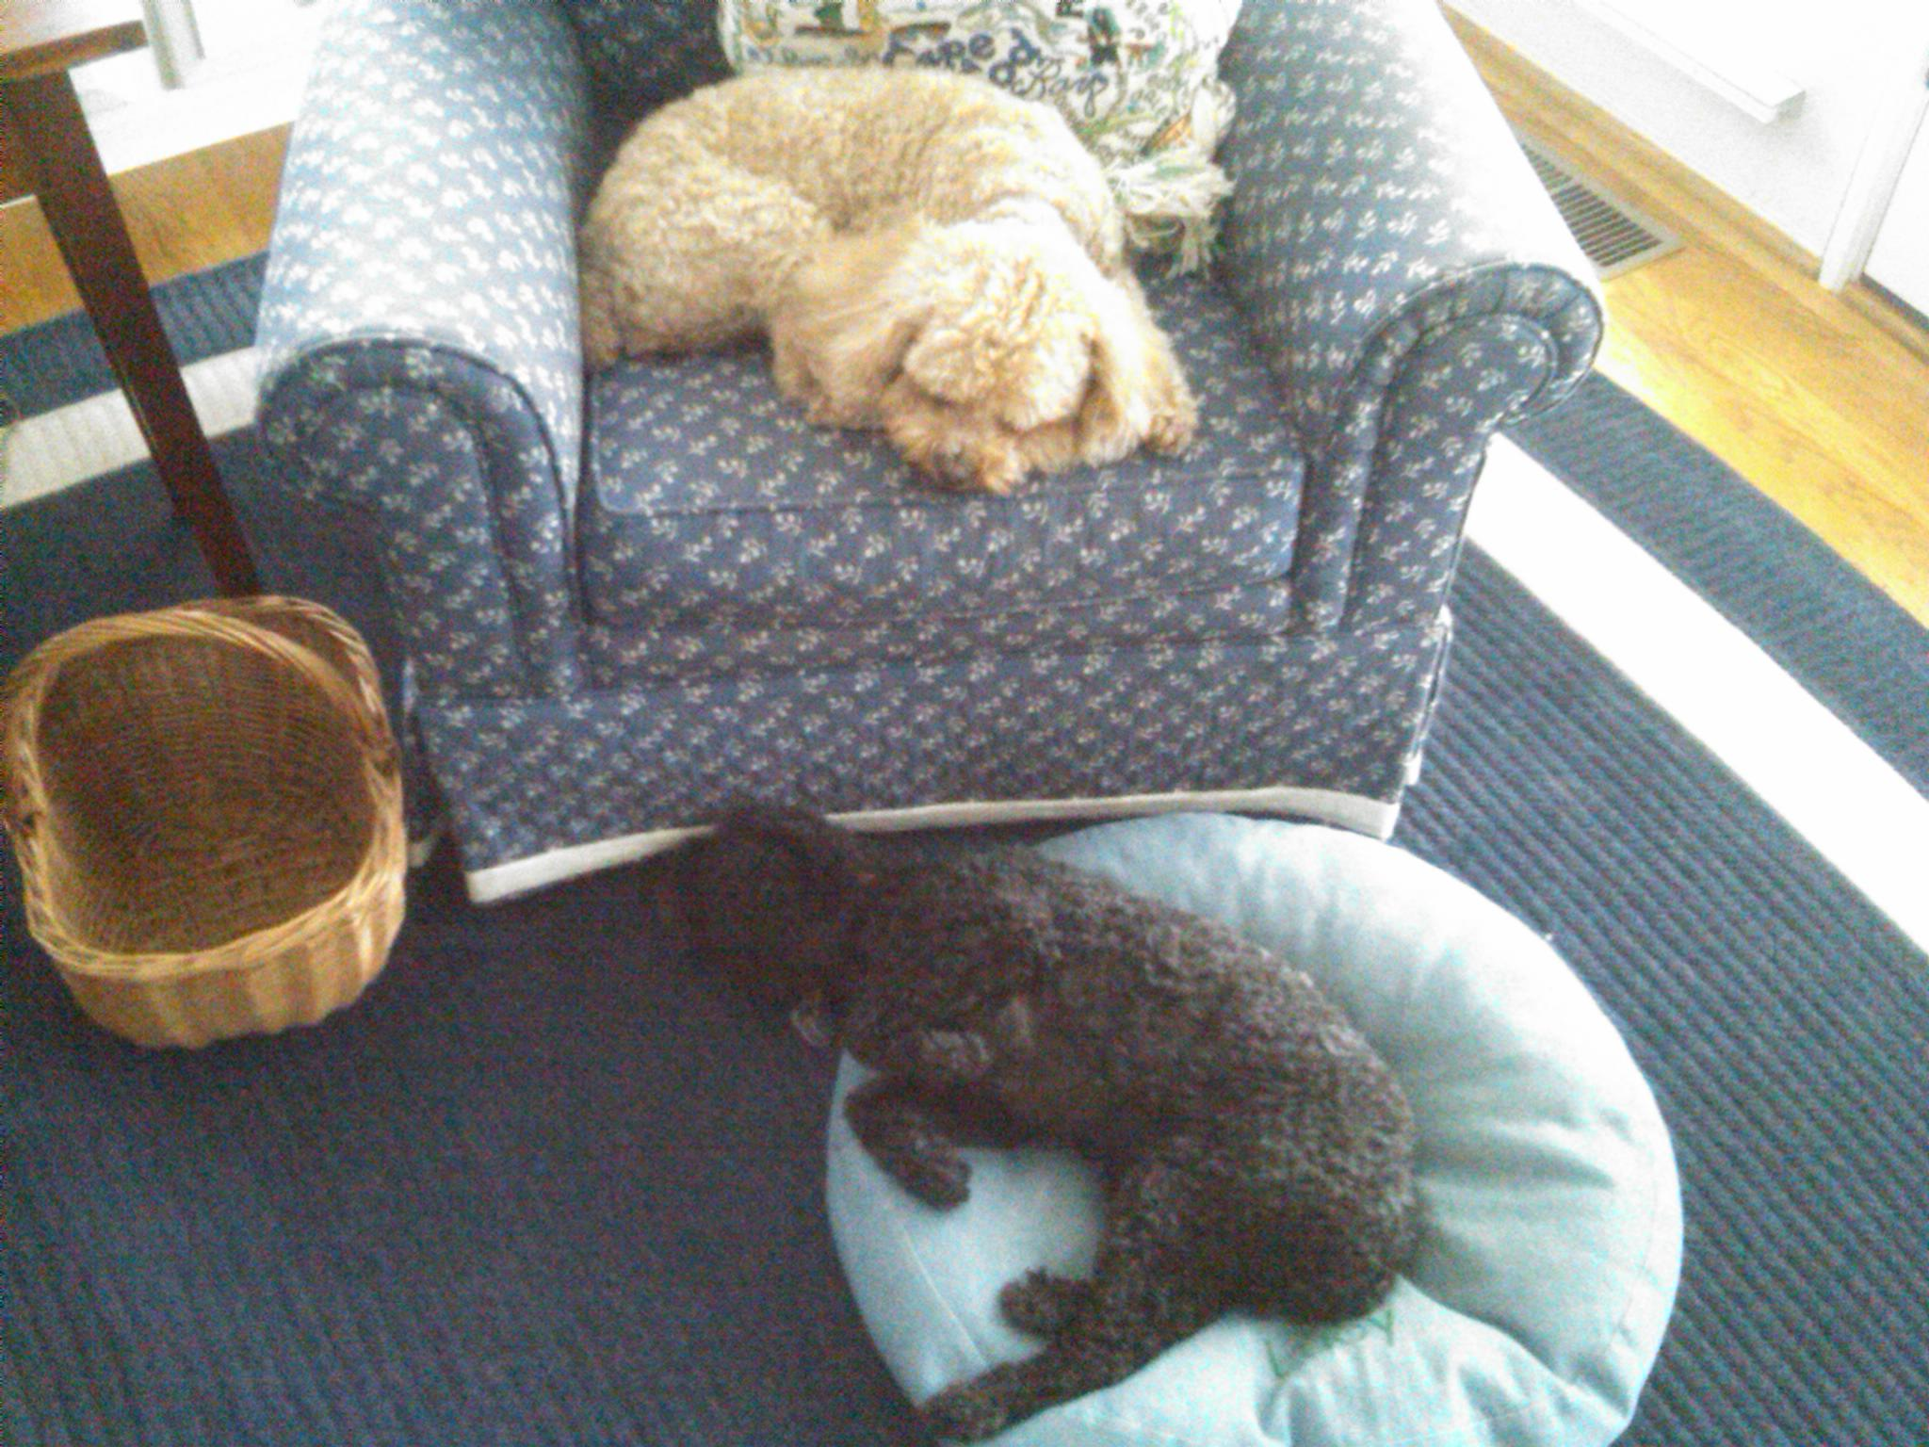





Nearest Neighbors
Known Images
Labels
Test
Image
$$x_{1}$$
$$D(x_{1},x_{T})$$
$$x_{T}$$
Cat
Cat!
…
$$D(x_{N},x_{T})$$
(1) Compute distance between feature vectors (2) find nearest (3) use label.
$$x_{N}$$
Dog

Slide 4
Picking Parameters
What distance? What value for k / λ?
Training
Validation
Test
Use these data
points for lookup
Evaluate on these points for different k, λ, distances

Slide 5
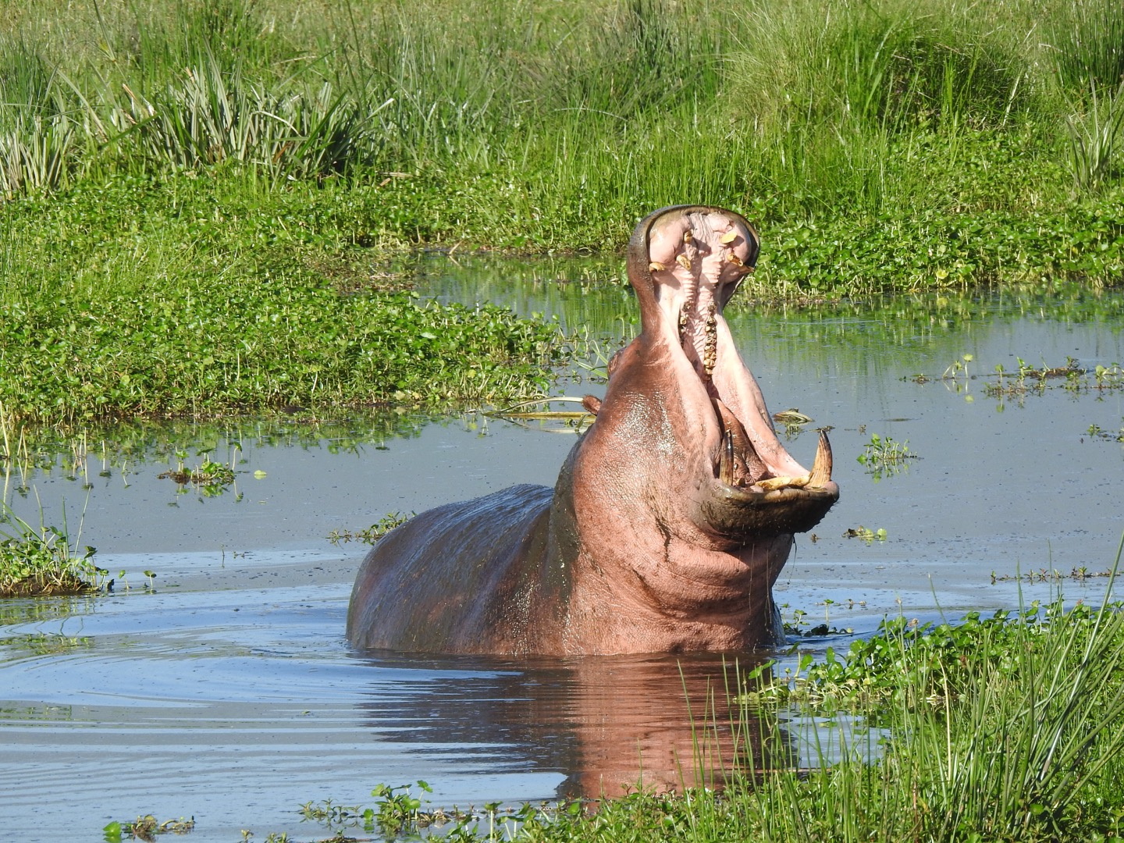





Linear Models
Example Setup: 3 classes
Model – one weight per class:
$$w_{0},w_{1}, w_{2}$$
$$w_{0}^{T}x$$
big if cat
Want:
$$w_{1}^{T}x$$
big if dog
$$w_{2}^{T}x$$
big if hippo
Stack together:
$$W_{3xF}$$
where x is in R^{F}

Slide 6



Linear Models
Cat weight vector
0.2
-0.5
0.1
2.0
1.1
56
-96.8
Cat score
Dog weight vector
1.5
1.3
2.1
0.0
3.2
231
437.9
Dog score
Hippo weight vector
0.0
0.3
0.2
-0.3
-1.2
24
61.95
Hippo score
2
$$W$$
$$Wx$$
1
Weight matrix a collection of scoring functions, one per class
Prediction is vector where jth component is “score” for jth class.
$$x$$
Diagram by: Karpathy, Fei-Fei

Slide 7




How Badly Are We Doing?
Loss: dog score – cat score
How much higher-scored is “dog” vs “cat”?
$${\left(Wx\right)}_{1}$$
-96.8
Cat score
$${\left(Wx\right)}_{2}$$
437.9
Dog score
$${\left(Wx\right)}_{3}$$
61.95
Hippo score
$${\left(Wx\right)}_{2}−{\left(Wx\right)}_{1}$$
Don’t give negative penalties
$$Wx$$
$${max(0,\left(Wx\right)}_{2}−{\left(Wx\right)}_{1})$$
Prediction is vector where jth component is “score” for jth class.
Diagram by: Karpathy, Fei-Fei

Slide 8

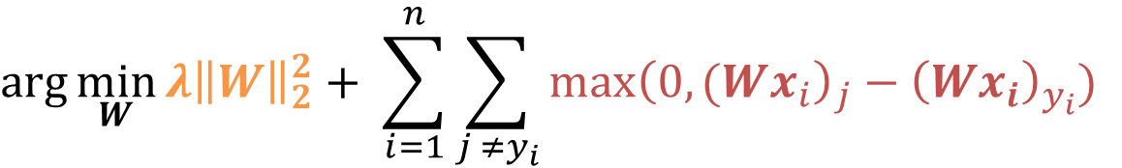
Objective 1: Multiclass SVM*
(Take the class whose weight vector gives the highest score)
Inference (x):
$$\arg{\max_{k}{ }{\left(Wx\right)}_{k}}$$
Training (x_{i},y_{i}):
$$\arg{\min_{W}{λ{\left\|W\right\|}_{2}^{2}+ \sum_{i=1}^{n}{\sum_{j ≠y_{i}}{\max{{\left(0,(Wx_{i}\right)}_{j}−{\left(Wx_{i}\right)}_{y_{i}})}}}}}$$
Regularization
Pay no penalty if prediction for class y_{i} is bigger than j. Otherwise, pay proportional to the score of the wrong class.
Over all data points
For every class j that’s NOT the correct one (y_{i})

Slide 9
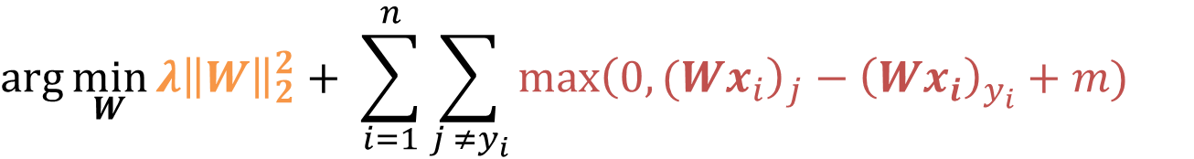
Objective 1: Multiclass SVM
(Take the class whose weight vector gives the highest score)
Inference (x):
$$\arg{\max_{k}{ }{\left(Wx\right)}_{k}}$$
Training (x_{i},y_{i}):
$$\arg{\min_{W}{λ{\left\|W\right\|}_{2}^{2}+ \sum_{i=1}^{n}{\sum_{j ≠y_{i}}{\max{{\left(0,(Wx_{i}\right)}_{j}−{\left(Wx_{i}\right)}_{y_{i}}+m)}}}}}$$
Regularization
Pay no penalty if prediction for class y_{i} is bigger than j by m (“margin”). Otherwise, pay proportional to the score of the wrong class.
Over all data points
For every class j that’s NOT the correct one (y_{i})

Slide 10
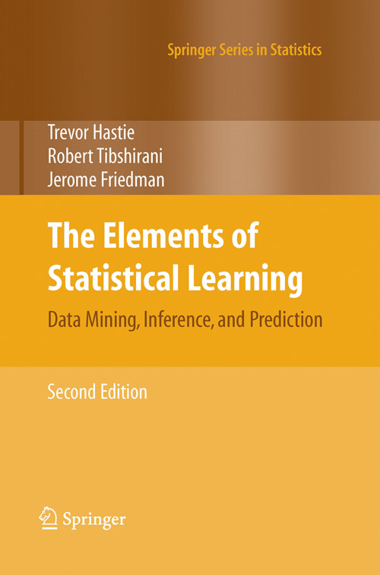
Objective 1:
Called: Support Vector Machine
Lots of great theory as to why this is a sensible thing to do (but kernel SVMs are just secret nearest neighbor machines). See:
Useful book (Free too!):
The Elements of Statistical Learning
Hastie, Tibshirani, Friedman https://web.stanford.edu/~hastie/ElemStatLearn/

Slide 11
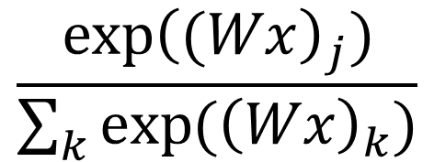
Objective 2: Making Probabilities
Converting Scores to “Probability Distribution”
Cat score
-0.9
e^{-0.9}
0.41
0.11
P(cat)
Dog score
0.4
exp(x)
e^{0.4}
1.49
Norm
0.40
P(dog)
Hippo score
0.6
e^{0.6}
1.82
0.49
P(hippo)
∑=3.72
$$\frac{\exp{{\left((Wx\right)}_{j})}}{\sum_{k}{\exp{({\left(Wx\right)}_{k})}}}$$
Generally P(class j):
Called softmax function
Inspired by: Karpathy, Fei-Fei

Slide 12
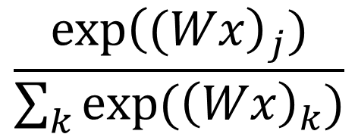
Objective 2: Softmax
(Take the class whose weight vector gives the highest score)
Inference (x):
$$\arg{\max_{k}{ }{\left(Wx\right)}_{k}}$$
$$\frac{\exp{{\left((Wx\right)}_{j})}}{\sum_{k}{\exp{({\left(Wx\right)}_{k})}}}$$
P(class j):
Why can we skip the exp/sum exp
thing to make a decision?

Slide 13
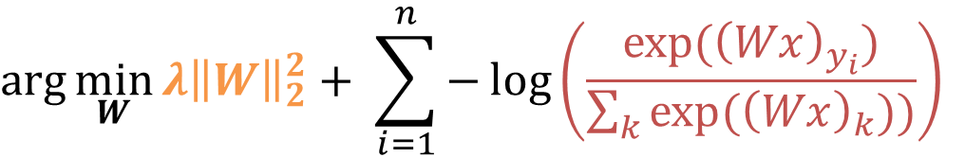
Objective 2: Softmax
(Take the class whose weight vector gives the highest score)
Inference (x):
$$\arg{\max_{k}{ }{\left(Wx\right)}_{k}}$$
Training (x_{i},y_{i}):
P(correct class)
$$\arg{\min_{W}{λ{\left\|W\right\|}_{2}^{2}+ \sum_{i=1}^{n}{−\log\left(\frac{\exp{({\left(Wx\right)}_{y_{i}})}}{\sum_{k}{exp⁡({\left(Wx\right)}_{k}))}}\right)}}}$$
Regularization
Over all data points
Pay penalty for not making correct class likely.
“Negative log-likelihood”

Slide 14
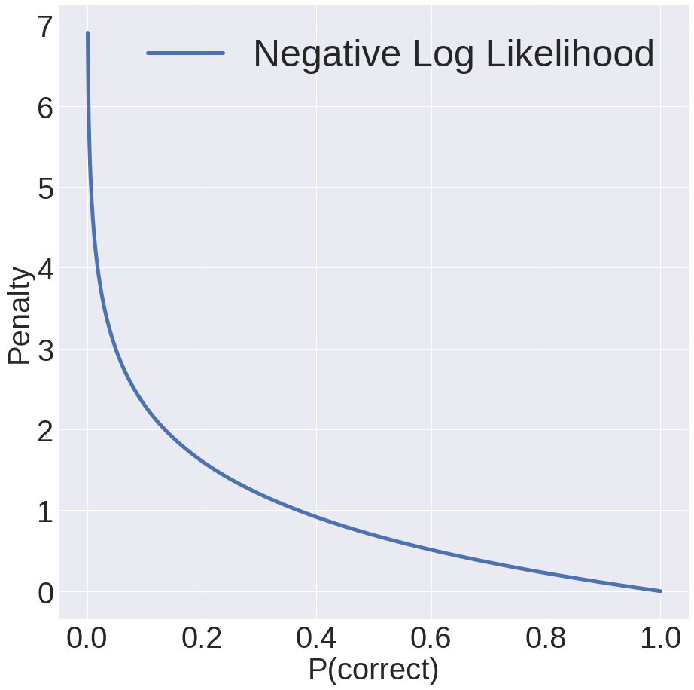
Objective 2: Softmax
P(correct) = 0.05:
3.0 penalty
P(correct) = 0.5:
0.11 penalty
P(correct) = 0.9:
0.11 penalty
P(correct) = 1:
No penalty!

Slide 15
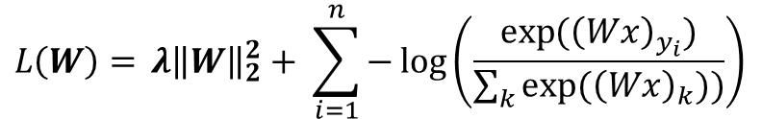
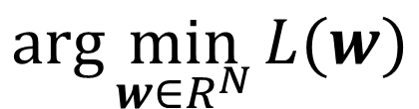
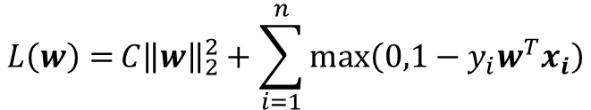
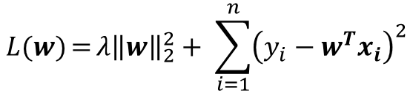
How Do We Optimize Things?
Goal: find the w minimizing some loss function L.
$$\arg{\min_{w∈R^{N}}{L(w)}}$$
$${L\left(W\right)={λ{\left\|W\right\|}_{2}^{2}+ \sum_{i=1}^{n}{−\log\left(\frac{\exp{({\left(Wx\right)}_{y_{i}})}}{\sum_{k}{exp⁡({\left(Wx\right)}_{k}))}}\right)}}}$$
Works for lots of different Ls:
$$L(w){={λ{\left\|w\right\|}_{2}^{2}+ \sum_{i=1}^{n}{{\left(y_{i}−w^{T}x_{i}\right)}^{2}}}}$$
$$L\left(w\right)={C{\left\|w\right\|}_{2}^{2}+\sum_{i=1}^{n}{max⁡\left(0,1−y_{i}w^{T}x_{i}\right)}}$$

Slide 16
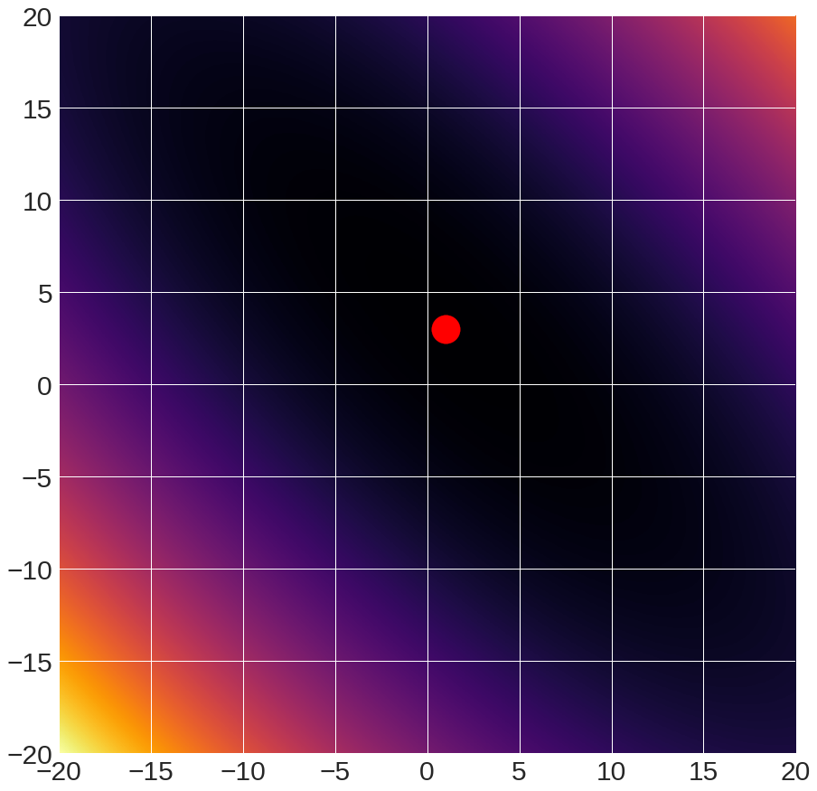
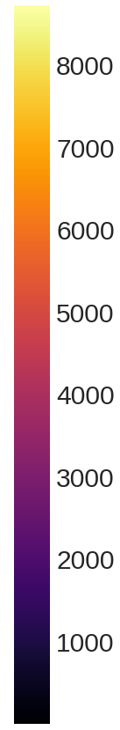
Sample Function to Optimize
f(x,y) = (x+2y-7)² + (2x+y-5)²
Global minimum

Slide 17
Sample Function to Optimize
I’ll switch back and forth between this 2D function (called the Booth Function) and other more-learning-focused functions
Beauty of optimization is that it’s all the same in principle
But don’t draw too many conclusions: 2D space has qualitative differences from 1000D space
See intro of: Dauphin et al. Identifying and attacking the saddle point problem in high-dimensional non-convex optimization NIPS 2014
https://ganguli-gang.stanford.edu/pdf/14.SaddlePoint.NIPS.pdf

Slide 18
A Caveat
Each point in the picture is a function evaluation
Here it takes microseconds – so we can easily see the answer
Functions we want to optimize may take hours to evaluate

Slide 19


A Caveat
Model in your head: moving around a landscape with a teleportation device
20
-20
-20
20
Landscape diagram: Karpathy and Fei-Fei

Slide 20
Option #1A – Grid Search
#systematically try things
best, bestScore = None, Inf
for dim1Value in dim1Values:
….
for dimNValue in dimNValues:
w = [dim1Value, …, dimNValue]
if L(w) < bestScore:
best, bestScore = w, L(w)
return best

Slide 21
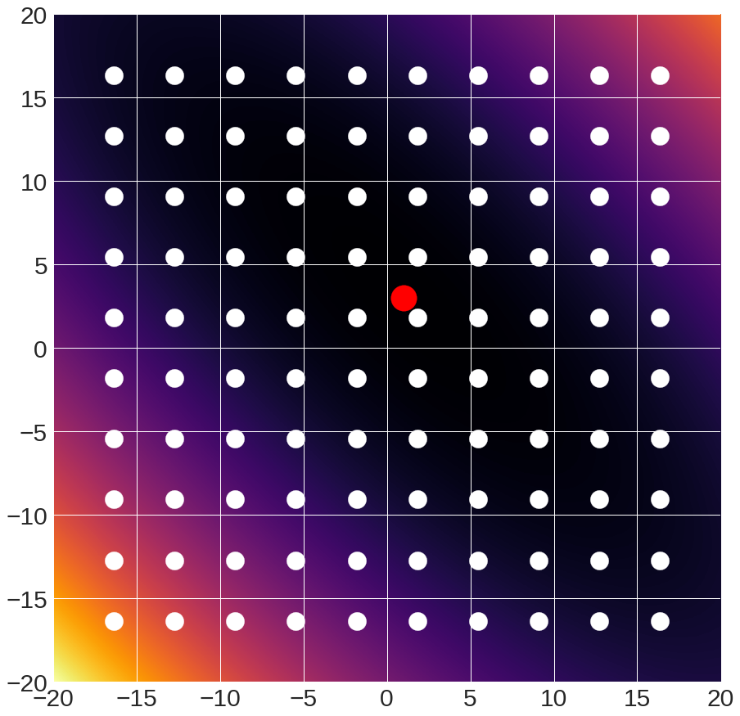
Option #1A – Grid Search

Slide 22
Option #1A – Grid Search
Pros:
Super simple
Only requires being able to evaluate model
Cons:
Scales horribly to high dimensional spaces
Complexity: samplesPerDim^{numberOfDims}

Slide 23
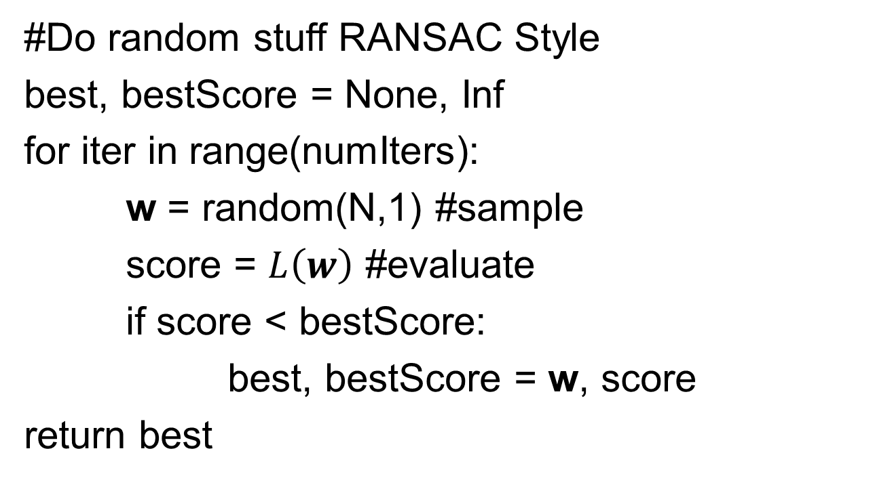
Option #1B – Random Search
#Do random stuff RANSAC Style
best, bestScore = None, Inf
for iter in range(numIters):
w = random(N,1) #sample
score = $L\left(w\right)$ #evaluate
if score < bestScore:
best, bestScore = w, score
return best

Slide 24
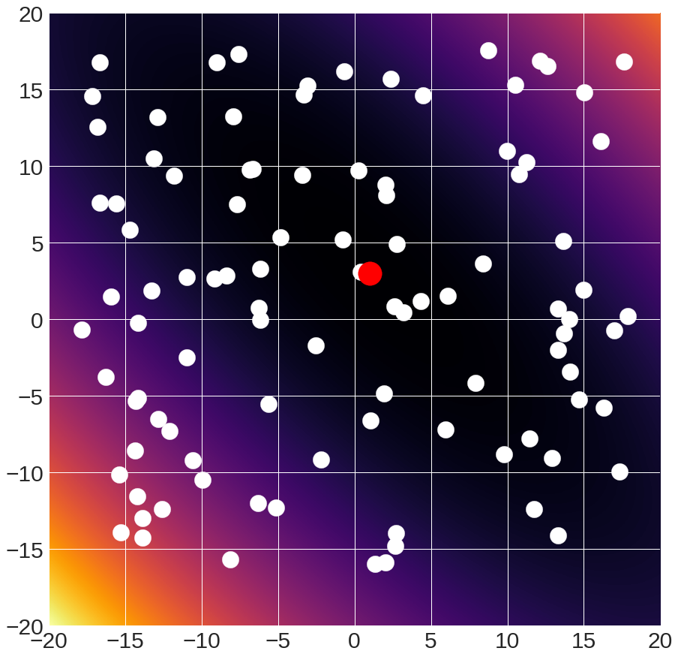
Option #1B – Random Search

Slide 25
Option #1B – Random Search
Pros:
Super simple
Only requires being able to sample model and evaluate it
Cons:
Slow –throwing darts at high dimensional dart board
Might miss something
P(all correct) =
ε^{N}
ε
Good parameters
All parameters
0
1

Slide 26
When Do You Use Options 1A/1B?
Use these when
Number of dimensions small, space bounded
Objective is impossible to analyze (e.g., validation accuracy if one uses a distance function)
Random search is more effective; grid search makes it easy to systematically test something (people love certainty)

Slide 27
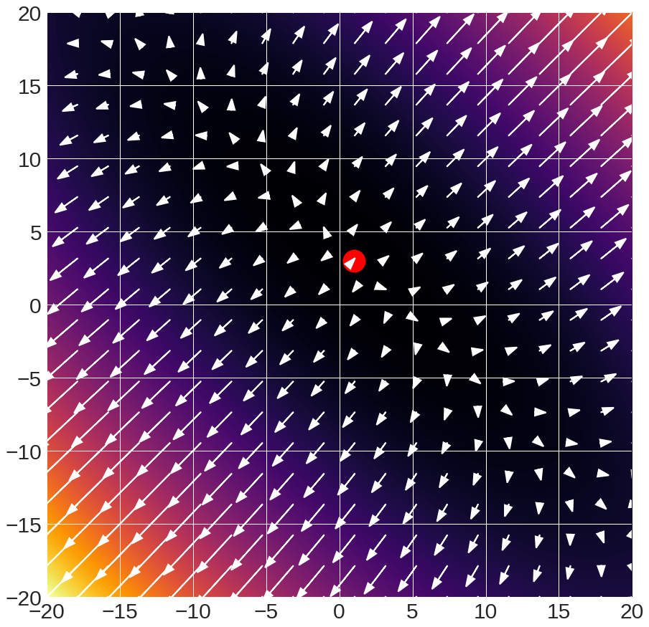
Option 2 – Use The Gradient
Arrows:
gradient

Slide 28
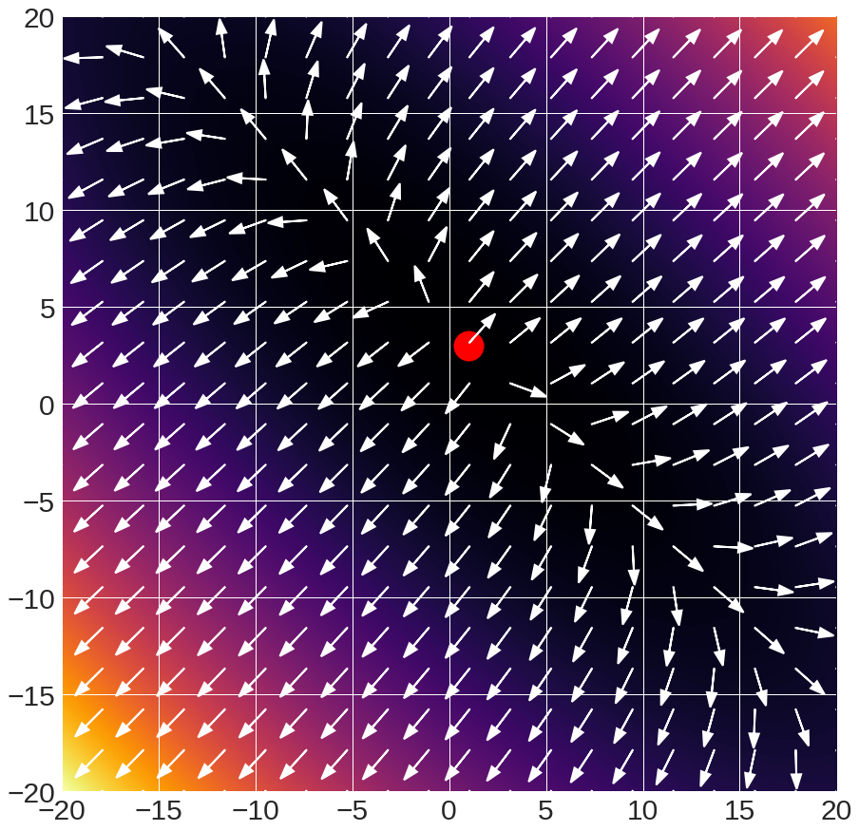
Option 2 – Use The Gradient
Arrows:
gradient direction
(scaled to unit length)

Slide 29
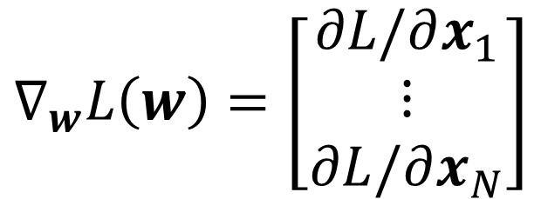

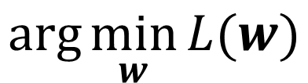



Option 2 – Use The Gradient
Want:
$$\arg{\min_{w}{L(w)}}$$
$$∇_{w}L\left(w\right)=\left[\begin{matrix}∂L/∂x_{1} \\ ⋮ \\ ∂L/∂x_{N}\end{matrix}\right]$$
What’s the geometric interpretation of:
Which is bigger (for small α)?
$$≤?$$
$$L\left(w\right)$$
$$L\left(w+{α∇}_{w}L(w)\right)$$
$$>?$$

Slide 30
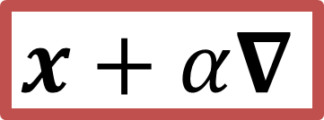

Option 2 – Use The Gradient
Arrows:
gradient direction
(scaled to unit length)
$$x$$
$$x+α∇_{ }$$

Slide 31
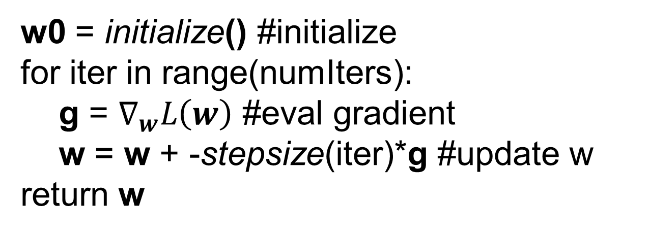
Option 2 – Use The Gradient
Method: at each step, move in direction of negative gradient
w0 = initialize() #initialize
for iter in range(numIters):
g = $∇_{w}L\left(w\right)$ #eval gradient
w = w + -stepsize(iter)*g #update w
return w

Slide 32
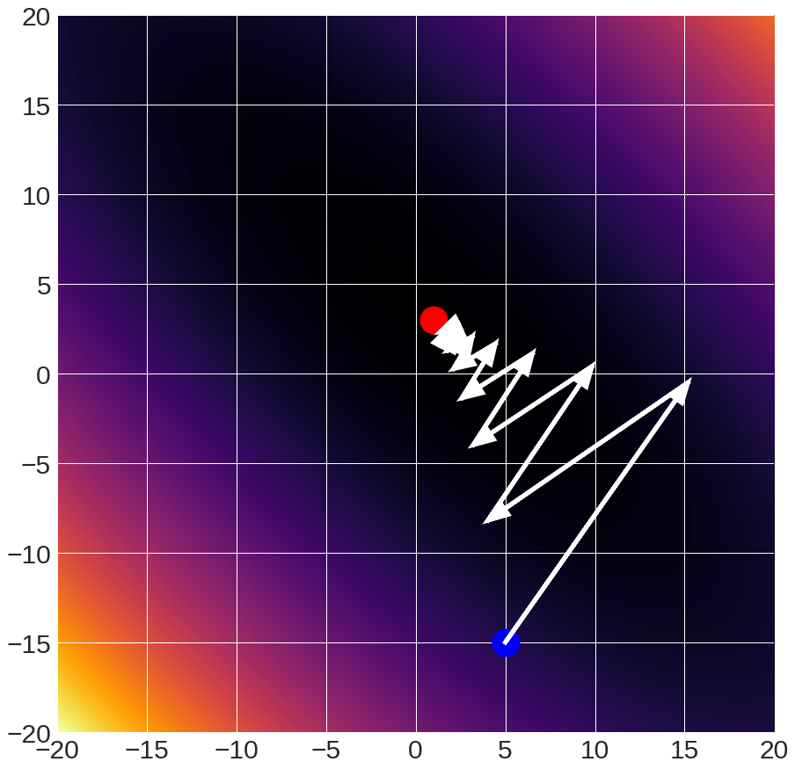
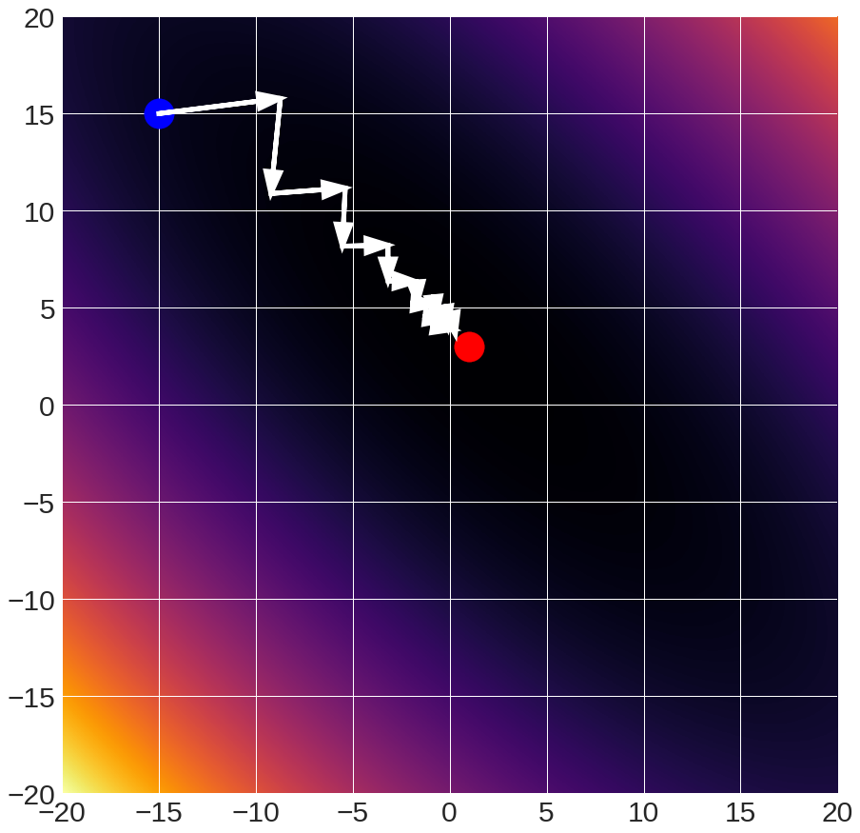
Gradient Descent
Given starting point (blue)
w_{i+1} = w_{i} + -9.8x10⁻² x gradient

Slide 33
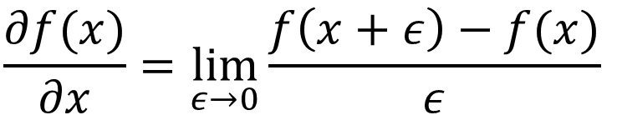
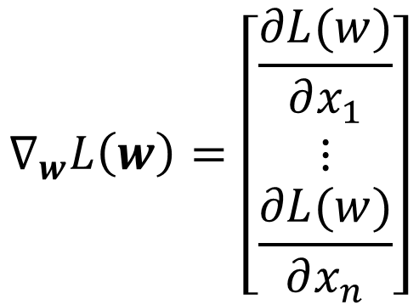
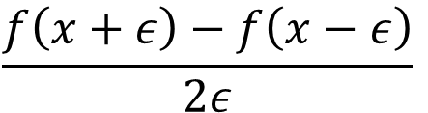
Computing the Gradient
How Do You Compute The Gradient?
Numerical Method:
How do you compute this?
$$∇_{w}L\left(w\right)=\left[\begin{matrix}\frac{∂L(w)}{∂x_{1}} \\ ⋮ \\ \frac{∂L(w)}{∂x_{n}}\end{matrix}\right]$$
$$\frac{∂f(x)}{∂x}=\lim_{ε→0}{\frac{f\left(x+ε\right)−f(x)}{ε}}$$
In practice, use:
$$\frac{f\left(x+ε\right)−f\left(x−ε\right)}{2ε}$$

Slide 34
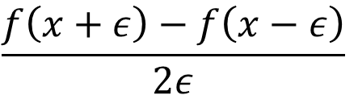
Computing the Gradient
How Do You Compute The Gradient?
Numerical Method:
Use:
$$\frac{f\left(x+ε\right)−f\left(x−ε\right)}{2ε}$$
$$∇_{w}L\left(w\right)=\left[\begin{matrix}\frac{∂L(w)}{∂x_{1}} \\ ⋮ \\ \frac{∂L(w)}{∂x_{n}}\end{matrix}\right]$$
How many function
evaluations per dimension?

Slide 35
Computing the Gradient
How Do You Compute The Gradient?
Analytical Method:
$$∇_{w}L\left(w\right)=\left[\begin{matrix}\frac{∂L(w)}{∂x_{1}} \\ ⋮ \\ \frac{∂L(w)}{∂x_{n}}\end{matrix}\right]$$
Use calculus!

Slide 36
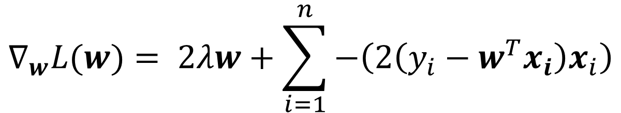
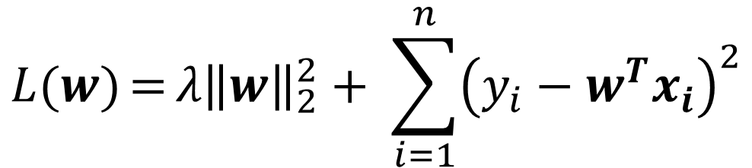
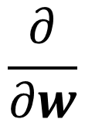
Computing the Gradient
$$L(w){={λ{\left\|w\right\|}_{2}^{2}+ \sum_{i=1}^{n}{{\left(y_{i}−w^{T}x_{i}\right)}^{2}}}}$$
$$\frac{∂}{∂w}$$
$$∇_{w}L(w)= 2λw+\sum_{i=1}^{n}{−\left(2\left(y_{i}−w^{T}x_{i}\right)x_{i}\right)}$$
Note: if you look at other derivations, things are written either (y-w^{T}x) or (w^{T}x – y); the gradients will differ by a minus.

Slide 37

Interpreting Gradients (1 Sample)
Recall:
w = w + -$∇_{w}L\left(w\right)$ #update w
$$∇_{w}L(w)= 2λw+−\left(2\left(y−w^{T}x\right)x\right)$$
Push w towards 0
α
$${−∇}_{w}L\left(w\right)=−2λw+\left(2\left(y−w^{T}x\right)x\right)$$
If y > w^{T}x (too low): then w = w + αx for some α
Before: w^{T}x
After: (w+ αx)^{T}x = w^{T}x + αx^{T}x

Slide 38

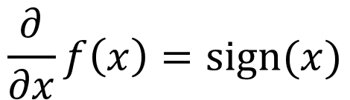

Quick annoying detail: subgradients
What is the derivative of |x|?
|x|
Derivatives/Gradients
Defined everywhere but 0
$$\frac{∂}{∂x}f\left(x\right)=sign(x)$$
$$x ≠0$$
undefined
$$x=0$$
Oh no! A discontinuity!

Slide 39

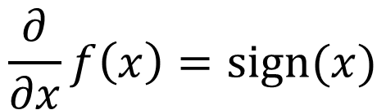
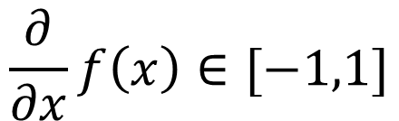

Quick annoying detail: subgradients
Subgradient: any underestimate of function
|x|
Subderivatives/subgradients
Defined everywhere
$$\frac{∂}{∂x}f\left(x\right)=sign(x)$$
$$x ≠0$$
$$\frac{∂}{∂x}f\left(x\right)∈[−1,1]$$
$$x=0$$
In practice: at discontinuity, pick value on either side.

Slide 40
Computing The Gradient
Numerical: foolproof but slow
Analytical: can mess things up ☺
In practice: do analytical, but check with numerical (called a gradient check)
Slide: Karpathy and Fei-Fei

Slide 41
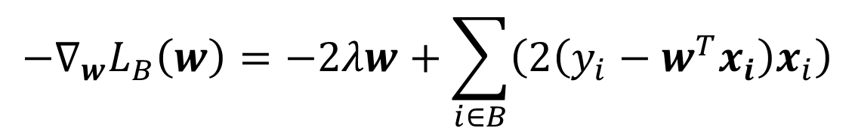
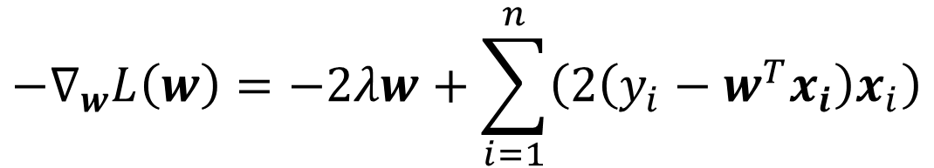
Implementing Gradient Descent
Loss is a function that we can
evaluate over data
$${−∇}_{w}L\left(w\right)=−2λw+\sum_{i=1}^{n}{\left(2\left(y_{i}−w^{T}x_{i}\right)x_{i}\right)}$$
All
Data
Subset
B
$${−∇}_{w}L_{B}\left(w\right)=−2λw+\sum_{i∈B}^{ }{\left(2\left(y_{i}−w^{T}x_{i}\right)x_{i}\right)}$$

Slide 42
Implementing Gradient Descent
Option 1: Vanilla Gradient Descent
Compute gradient of L over all data points
for iter in range(numIters):
g = gradient(data,L)
w = w + -stepsize(iter)*g #update w

Slide 43
Implementing Gradient Descent
Option 2: Stochastic Gradient Descent
Compute gradient of L over 1 random sample
for iter in range(numIters):
index = randint(0,#data)
g = gradient(data[index],L)
w = w + -stepsize(iter)*g #update w

Slide 44
Implementing Gradient Descent
Option 3: Minibatch Gradient Descent
Compute gradient of L over subset of B samples
for iter in range(numIters):
subset = choose_samples(#data,B)
g = gradient(data[subset],L)
w = w + -stepsize(iter)*g #update w
Typical batch sizes: ~100 (although there’s lots of great research on huge batch sizes)

Slide 45
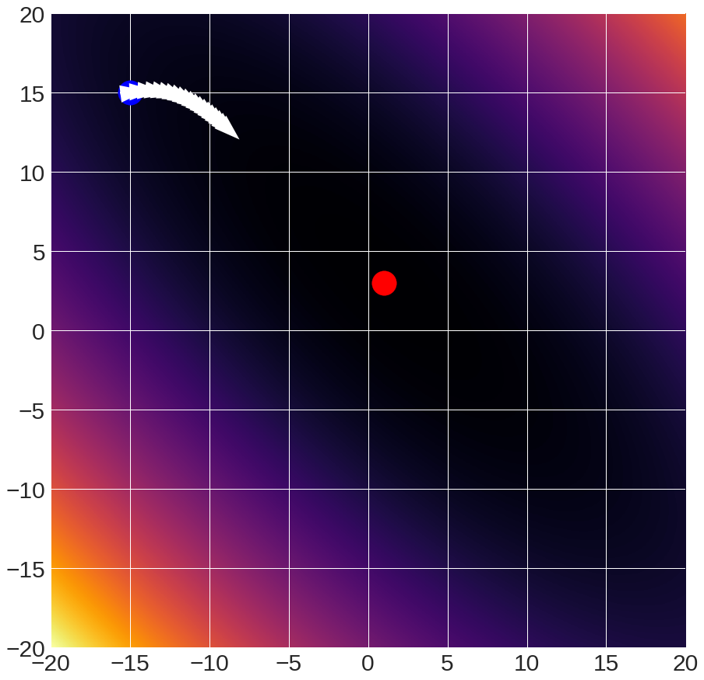
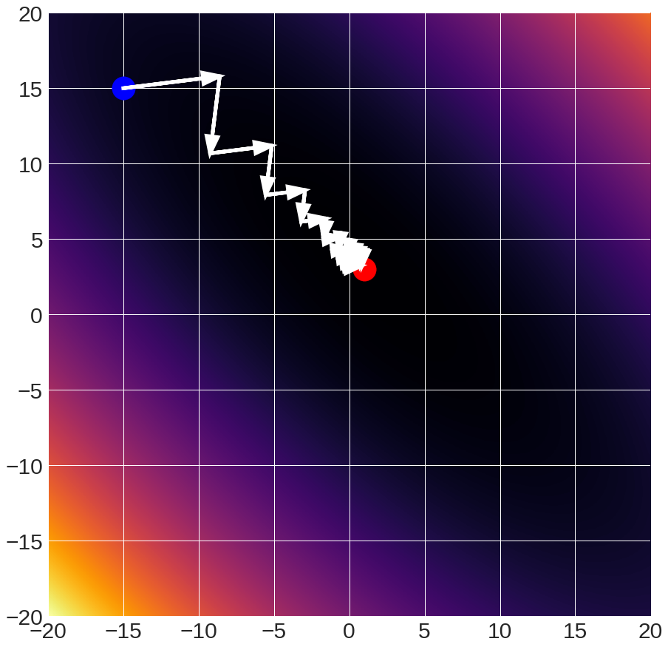
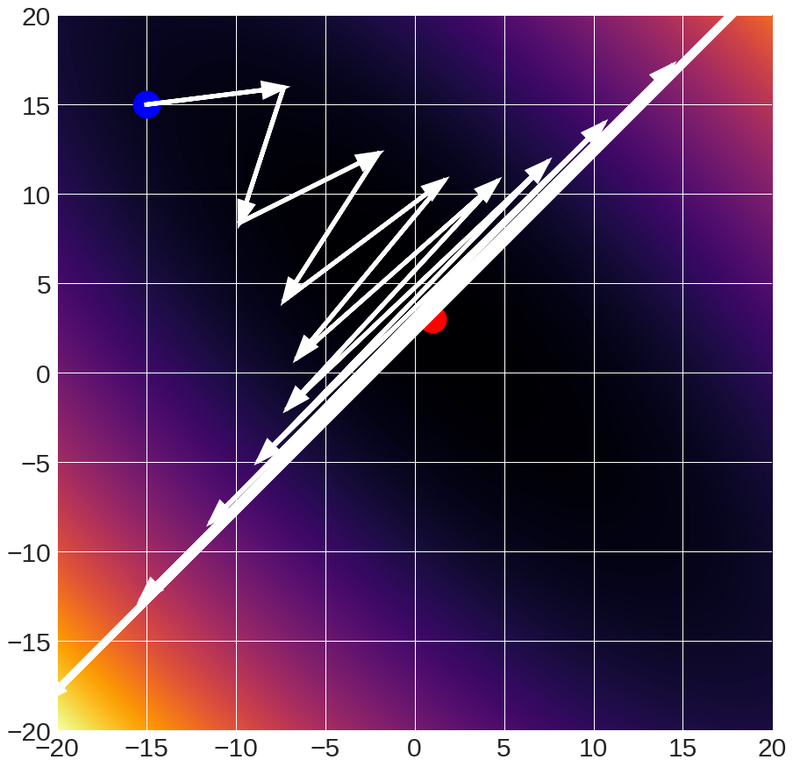
Gradient Descent Details
Step size (also called learning rate / lr)
critical parameter
1x10⁻²
10x10⁻²
12x10⁻²
falls short
converges
diverges

Slide 46
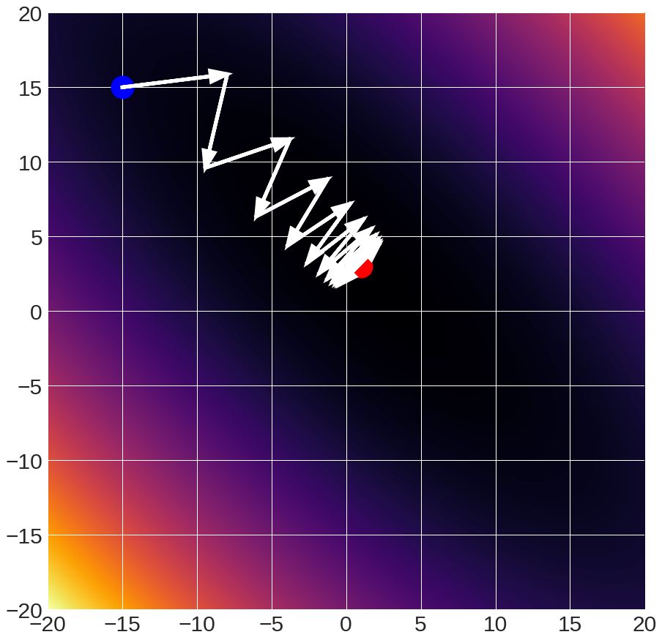
Gradient Descent Details
11x10⁻² :oscillates
(Raw gradients)

Slide 47
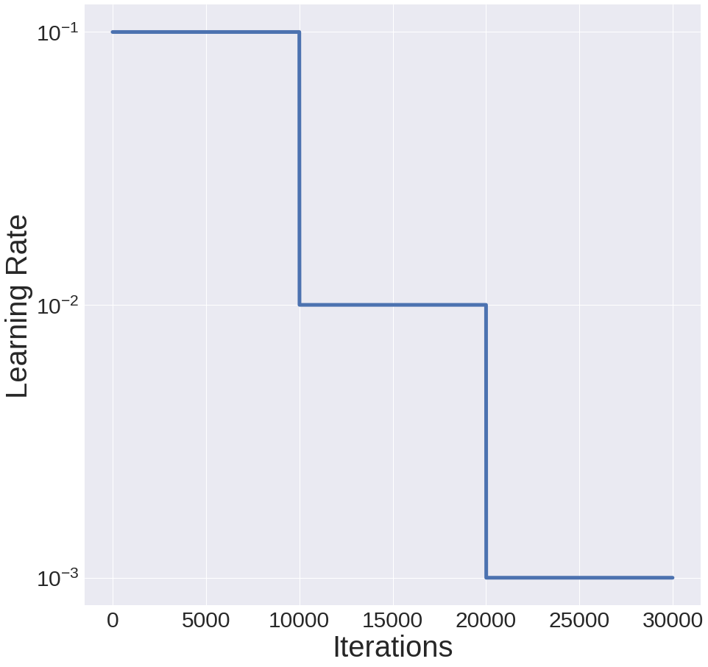
Gradient Descent Details
One solution: start with initial rate lr, multiply by f every N interations
init_lr = 10⁻¹
f = 0.1
N = 10K

Slide 48
Gradient Descent Details
11x10⁻² :oscillates
(Raw gradients)
Solution:
Average gradients
With exponentially decaying weights, called “momentum”

Slide 49
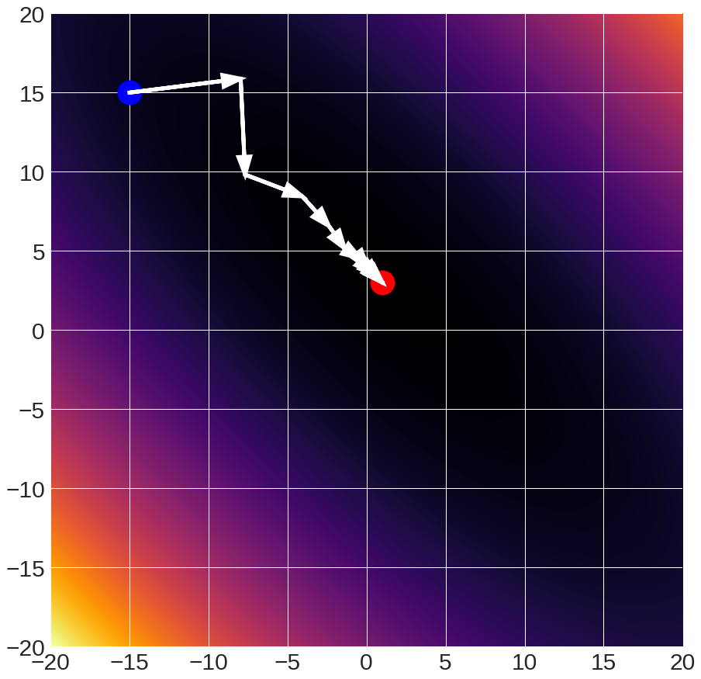
Gradient Descent Details
11x10⁻² :oscillates
(Raw gradients)
11x10⁻²
(0.25 momentum)

Slide 50
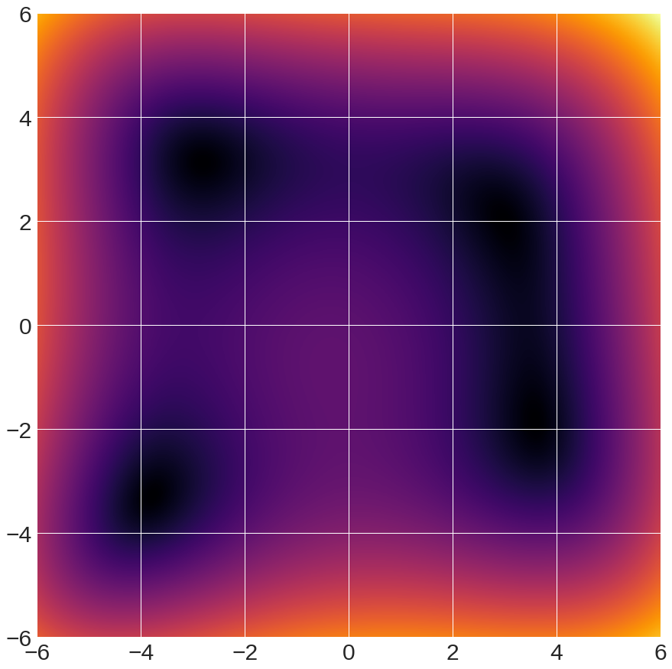
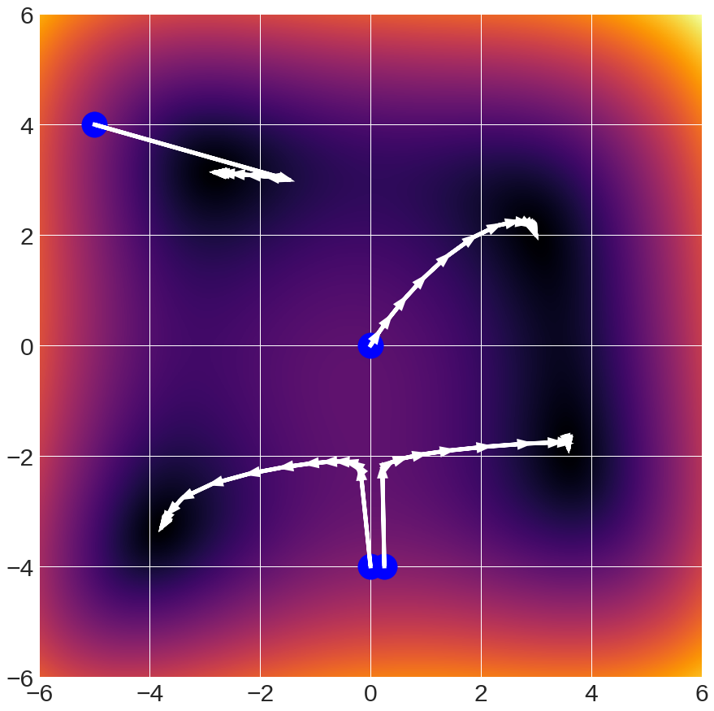
Gradient Descent Details
Multiple Minima
→
Gradient Descent
Finds local
minimum

Slide 51
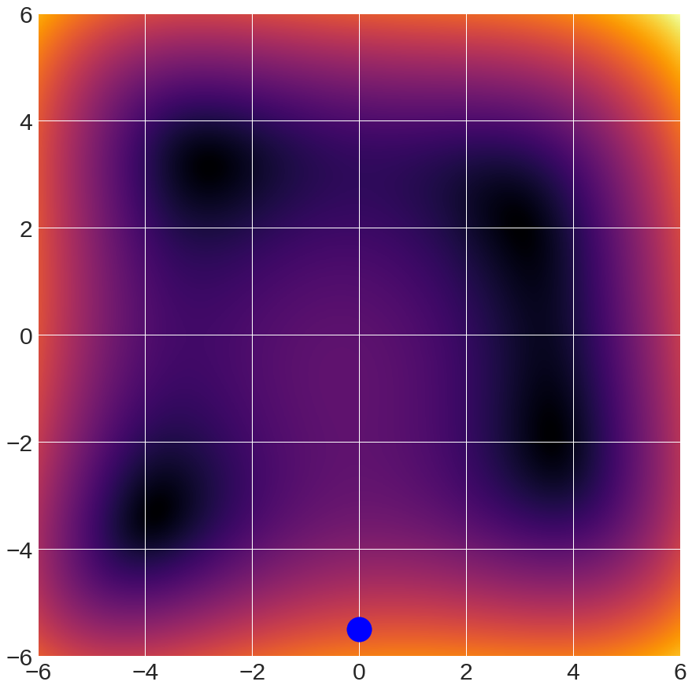
Gradient Descent Details
Guess the minimum!
2
3
1
4
start

Slide 52
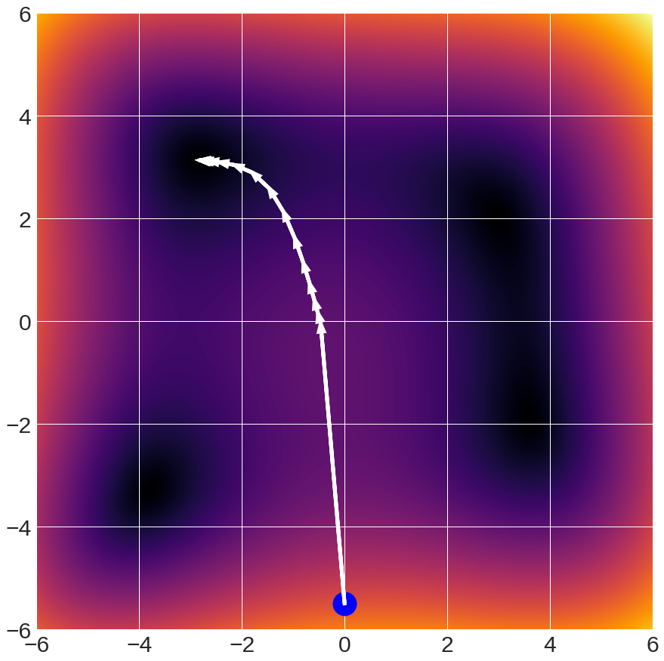
Gradient Descent Details

Slide 53

Gradient Descent Details
Guess the minimum!
2
3
1
4
start

Slide 54
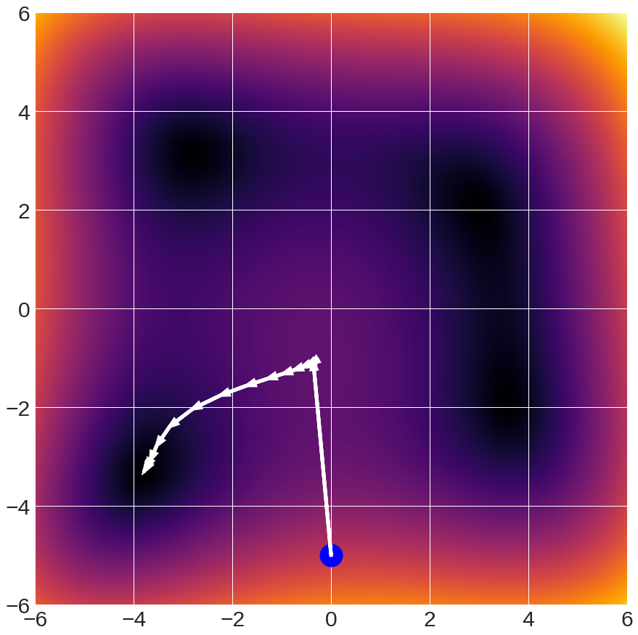
Gradient Descent Details
Dynamics are fairly complex
Many important functions are convex: any local minimum is a global minimum
Many important functions are not.

Slide 55
In practice
Conventional wisdom: minibatch stochastic gradient descent (SGD) + momentum (package implements it for you) + some sensibly changing learning rate
The above is typically what is meant by “SGD”
Other update rules exist (e.g., AdamW). Can often work better on some problems.

Slide 56


Optimizing Everything
$${L\left(W\right)={λ{\left\|W\right\|}_{2}^{2}+ \sum_{i=1}^{n}{−\log\left(\frac{\exp{({\left(Wx\right)}_{y_{i}})}}{\sum_{k}{exp⁡({\left(Wx\right)}_{k}))}}\right)}}}$$
$$L(w){={λ{\left\|w\right\|}_{2}^{2}+ \sum_{i=1}^{n}{{\left(y_{i}−w^{T}x_{i}\right)}^{2}}}}$$
Optimize w on training set with SGD to maximize training accuracy
Optimize λ with random/grid search to maximize validation accuracy
Note: Optimizing λ on training sets it to 0

Slide 57

(Over/Under)fitting and Complexity
Let’s fit a polynomial: given x, predict y
Note: can do non-linear regression with copies of x
$$\left[\begin{matrix}y_{1} \\ ⋮ \\ y_{N}\end{matrix}\right]=\left[\begin{matrix}\begin{matrix}\begin{matrix}x_{1}^{F} \\ ⋮ \\ x_{N}^{F}\end{matrix} & \begin{matrix}⋯ \\ ⋱ \\ ⋯\end{matrix}\end{matrix}\begin{matrix} \\ \\ \end{matrix} \begin{matrix}x_{1}^{2} \\ ⋮ \\ x_{N}^{2}\end{matrix} & \begin{matrix}\begin{matrix}x_{1} \\ ⋮ \\ x_{N}\end{matrix} & \begin{matrix}1 \\ ⋮ \\ 1\end{matrix}\end{matrix}\end{matrix}\right]\left[\begin{matrix}w_{F} \\ \begin{aligned}⋮ \\ w_{2} \\ w_{1}\end{aligned} \\ w_{0}\end{matrix}\right]$$
Matrix of all polynomial degrees
Weights: one per polynomial degree

Slide 58

(Over/Under)fitting and Complexity
Model: 1.5x² + 2.3x+2 + N(0,0.5)

Slide 59


Underfitting
Model: 1.5x² + 2.3x+2 + N(0,0.5)

Slide 60
Underfitting
Model doesn’t have the parameters to fit the data.
Bias (statistics): Error intrinsic to the model.

Slide 61


Overfitting
Model: 1.5x² + 2.3x+2 + N(0,0.5)

Slide 62

Overfitting
Model has high variance: remove one point, and model changes dramatically

Slide 63

(Continuous) Model Complexity
$$\arg{\min_{W}{λ{\left\|W\right\|}_{2}^{2}+ \sum_{i=1}^{n}{−\log\left(\frac{\exp{({\left(Wx\right)}_{y_{i}})}}{\sum_{k}{exp⁡({\left(Wx\right)}_{k}))}}\right)}}}$$
Regularization: penalty for complex model
Pay penalty for negative log-likelihood of correct class
Intuitively: big weights = more complex model
Model 1: 0.01*x₁ + 1.3*x₂ + -0.02*x₃ + -2.1x₄ + 10
Model 2: 37.2*x₁ + 13.4*x₂ + 5.6*x₃ + -6.1x₄ + 30

Slide 64



Fitting Model
Again, fitting polynomial, but with regularization
$$\arg{\min_{w}\left\|y−Xw\right\|+λ\left\|w\right\| }$$
$$\left[\begin{matrix}\begin{matrix}\begin{matrix}x_{1}^{F} \\ ⋮ \\ x_{N}^{F}\end{matrix} & \begin{matrix}⋯ \\ ⋱ \\ ⋯\end{matrix}\end{matrix}\begin{matrix} \\ \\ \end{matrix} \begin{matrix}x_{1}^{2} \\ ⋮ \\ x_{N}^{2}\end{matrix} & \begin{matrix}\begin{matrix}x_{1} \\ ⋮ \\ x_{N}\end{matrix} & \begin{matrix}1 \\ ⋮ \\ 1\end{matrix}\end{matrix}\end{matrix}\right]$$
$$\left[\begin{matrix}w_{F} \\ ⋮ \\ w_{0}\end{matrix}\right]$$

Slide 65

Adding Regularization
No regularization:
fits all data points
Regularization:
can’t fit all data points

Slide 66
In General
Error on new data comes from combination of:
Bias: model is oversimplified and can’t fit the underlying data
Variance: you don’t have the ability to estimate your model from limited data
Inherent: the data is intrinsically difficult
Bias and variance trade-off. Fixing one hurts the other.

Slide 67
Underfitting and Overfitting
Underfitting!
Overfitting!
Test
Error
Getting Better
Error
Training
Error
High Bias
Low Variance
Complexity
Low Bias
High Variance
Diagram adapted from: D. Hoiem

Slide 68
Underfitting and Overfitting
Small data
Overfits w/small model
Big data
Overfits w/bigger model
Test
Error
High Bias
Low Variance
Complexity
Low Bias
High Variance
Diagram adapted from: D. Hoiem

Slide 69

Underfitting and Overfitting
Small data
Overfits w/small model
Lots of this behavior doesn’t seem to replicate in models with high learning capacity.
See below for details.
Big data
Overfits w/bigger model
Test
Error
High Bias
Low Variance
Complexity
Low Bias
High Variance
Diagram adapted from: D. Hoiem; comic: https://webcomicname.com/
Reconciling modern machine learning practice and the bias-variance trade-off, Belkin et al. https://arxiv.org/pdf/1812.11118.pdf

Slide 70
Underfitting
Do poorly on both training and validation data due to bias.
Solution:
More features
More powerful model
Reduce regularization

Slide 71
Overfitting
Do well on training data, but poorly on validation data due to variance
Solution:
More data
Less powerful model
Regularize your model more
Cris Dima rule: first make sure you can overfit, then stop overfitting.

Slide 72
Next Class
Non-linear models (neural nets)

Slide 74
Let’s Compute Another Gradient
Below is another derivation that’s worth looking at on your own time if you’re curious

Slide 75


Computing The Gradient
Multiclass Support Vector Machine
$$\arg{\min_{W}{λ{\left\|W\right\|}_{2}^{2}+ \sum_{i=1}^{n}{\sum_{j ≠y_{i}}{\max{{\left(0,(Wx_{i}\right)}_{j}−{\left(Wx_{i}\right)}_{y_{i}}+m)}}}}}$$
Notation:
W → rows w_{i} (i.e., per-class scorer)
(Wx_{i})_{j} → w_{j}^{T}x_{i}
$$\arg{\min_{W}{λ\sum_{j=1}^{K}{{\left\|w_{j}\right\|}_{2}^{2}}+ \sum_{i=1}^{n}{\sum_{j ≠y_{i}}{max⁡(0,w_{j}^{T}x_{i}−w_{y_{i}}^{T}x_{i}+m)}}}}$$
Derivation setup: Karpathy and Fei-Fei

Slide 76







Computing The Gradient
$$\arg{\min_{W}{λ\sum_{j=1}^{K}{{\left\|w_{j}\right\|}_{2}^{2}}+ \sum_{i=1}^{n}{\sum_{j ≠y_{i}}{max⁡(0,w_{j}^{T}x_{i}−w_{y_{i}}^{T}x_{i}+m)}}}}$$
$$w_{j}^{T}x_{i}−w_{y_{i}}^{T}x_{i}+m≤0:$$
$$0$$
$$\frac{∂}{∂w_{j}}:$$
$$w_{j}^{T}x_{i}−w_{y_{i}}^{T}x_{i}+m>0:$$
$$x_{i}$$
$${→1(w}_{j}^{T}x_{i}−w_{y_{i}}^{T}x_{i}+m>0)x_{i}$$
Derivation setup: Karpathy and Fei-Fei

Slide 77


Computing The Gradient
$$\arg{\min_{W}{λ\sum_{j=1}^{K}{{\left\|w_{j}\right\|}_{2}^{2}}+ \sum_{i=1}^{n}{\sum_{j ≠y_{i}}{max⁡(0,w_{j}^{T}x_{i}−w_{y_{i}}^{T}x_{i}+m)}}}}$$
$$\frac{∂}{∂w_{y_{i}}}:$$
$$\sum_{j≠y_{i}}{1\left(w_{j}^{T}x_{i}−w_{y_{i}}^{T}x_{i}+m>0\right)\left(−x_{i}\right)}$$
Derivation setup: Karpathy and Fei-Fei

Slide 78


Interpreting The Gradient
$$−\frac{∂}{∂w_{j}}:$$
$${1(w}_{j}^{T}x_{i}−w_{y_{i}}^{T}x_{i}+m>0){−x}_{i}$$
If we do not predict the correct class by at least a score difference of m …
Want incorrect class’s scoring vector to score that point lower.
Recall:
Before: w^{T}x;
After: (w-αx)^{T}x = w^{T}x - ax^{T}x
Derivation setup: Karpathy and Fei-Fei

