Slide 1
Detectors and Descriptors
EECS 442 – David Fouhey
Winter 2022, University of Michigan
https://web.eecs.umich.edu/~fouhey/teaching/EECS442_W22/

Slide 2
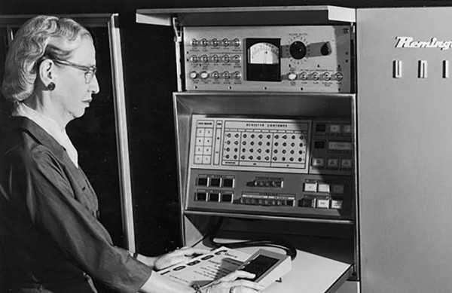
Goal
How big is this image as a vector?
389x600 = 233,400 dimensions (big)

Slide 3
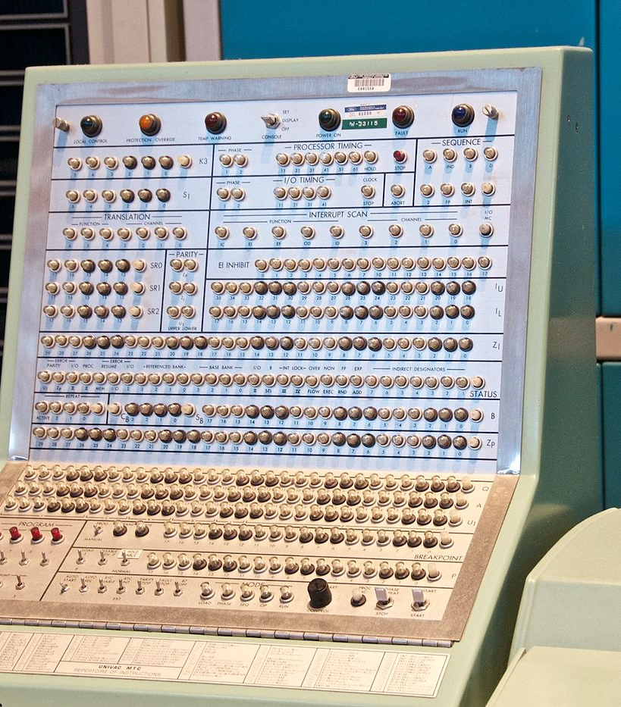
Applications To Have In Mind
Part of the same photo?
Same computer from another angle?

Slide 4
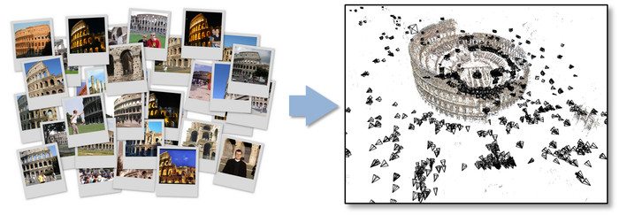
Applications To Have In Mind
Building a 3D Reconstruction Out Of Images
Slide Credit: N. Seitz

Slide 5
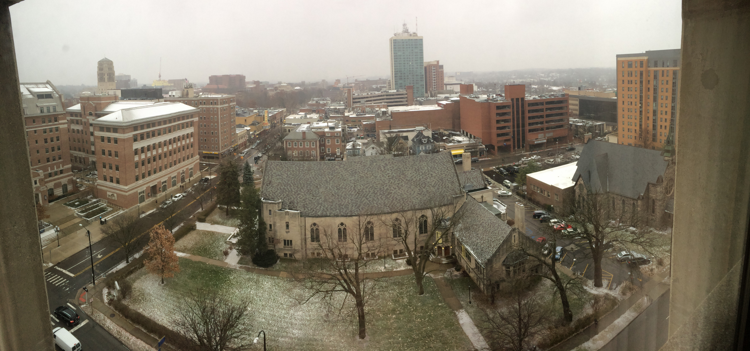
Applications To Have In Mind
Stitching photos taken at different angles

Slide 6
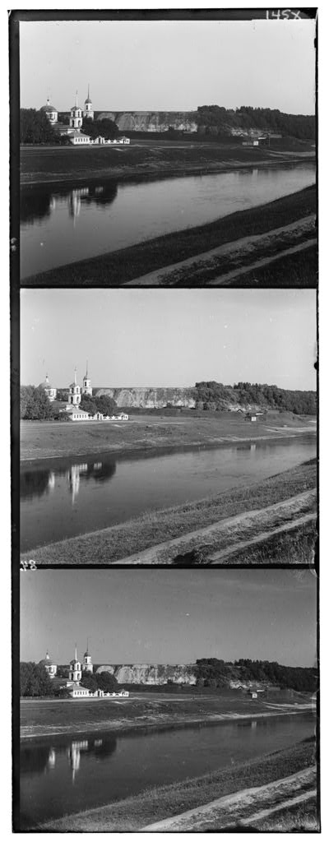
One Possibly Familiar Example
Given two images: how do you align them?

Slide 7
One (Soon To Be Familiar) Solution
for y in range(-ySearch,ySearch+1):
for x in range(-xSearch,xSearch+1):
#Touches all HxW pixels!
check_alignment_with_images()

Slide 8


One Motivating Example
Given these images: how do you align them?
These aren’t off by a small 2D translation but instead by a 3D rotation + translation of the camera.
Photo credit: M. Brown, D. Lowe

Slide 9
One (Soon To Be Familiar) Solution
for y in yRange:
for x in xRange:
for z in zRange:
for xRot in xRotVals:
for yRot in yRotVals:
for zRot in zRotVals:
#touches all HxW pixels!
check_alignment_with_images()
This code should make you really unhappy
Note: this actually isn’t even the full number of parameters; it’s actually 8 for loops.

Slide 10
An Alternate Approach
Given these images: how would you align them?
A mountain peak!
A mountain peak!
This dark spot
This dark spot

Slide 11


An Alternate Approach
Finding and Matching
1: find corners+features
2: match based on local image data
Slide Credit: S. Lazebnik, original figure: M. Brown, D. Lowe

Slide 12
What Now?
Given pairs
p1,p2 of correspondence, how do I align?
Consider translation-only case from HW1.

Slide 13
An Alternate Approach
Solving for a Transformation
T
3: Solve for transformation T (e.g. such that p1 ≡ T p2) that fits the matches well
Note the homogeneous coordinates, you’ll see them again.
Slide Credit: S. Lazebnik, original figure: M. Brown, D. Lowe

Slide 14

An Alternate Approach
Blend Them Together
Key insight: we don’t work with full image. We work with only parts of the image.
Photo Credit: M. Brown, D. Lowe

Slide 15
Today
Finding edges (part 1) and corners (part 2) in images.
Corner of
the glasses
Edge next to panel

Slide 16
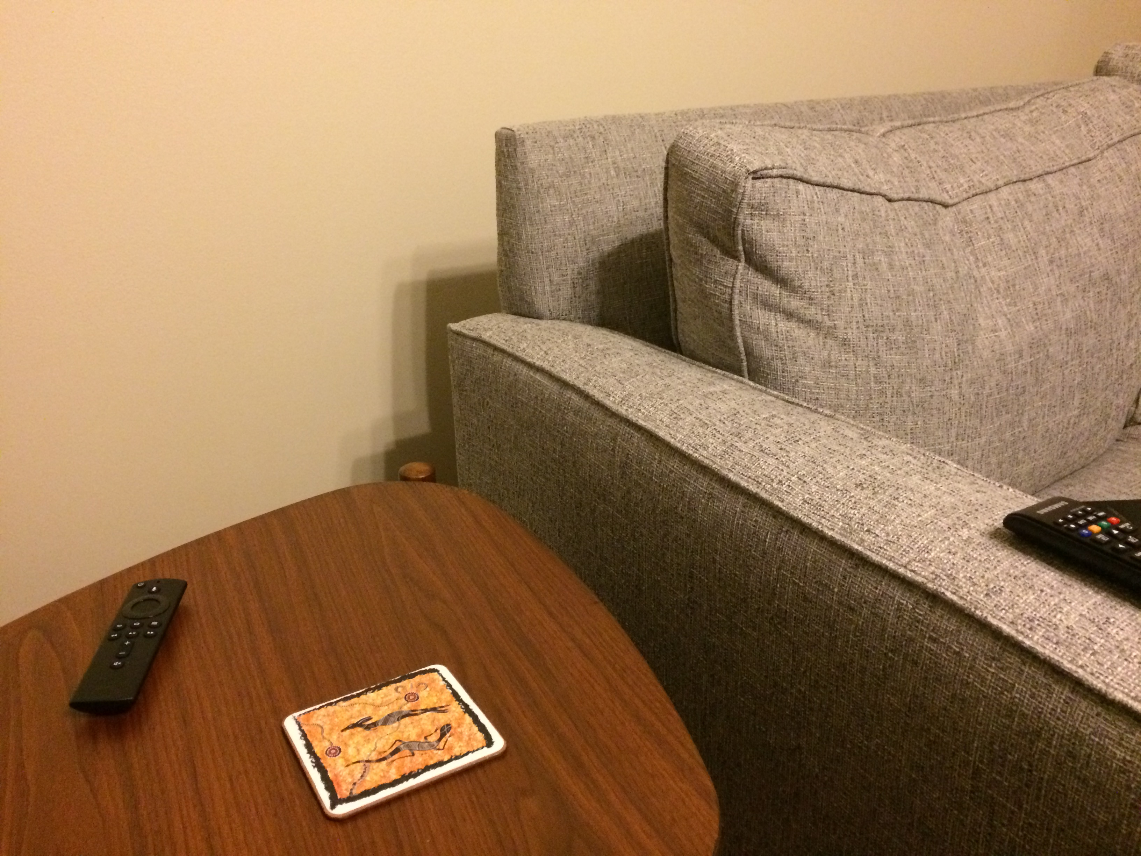
Where do Edges Come From?

Slide 17
Where do Edges Come From?
Depth / Distance
Discontinuity
Why?

Slide 18
Where do Edges Come From?
Surface Normal / Orientation Discontinuity
Why?

Slide 19
Where do Edges Come From?
Surface Color / Reflectance Properties Discontinuity

Slide 20
Where do Edges Come From?
Illumination
Discontinuity

Slide 21
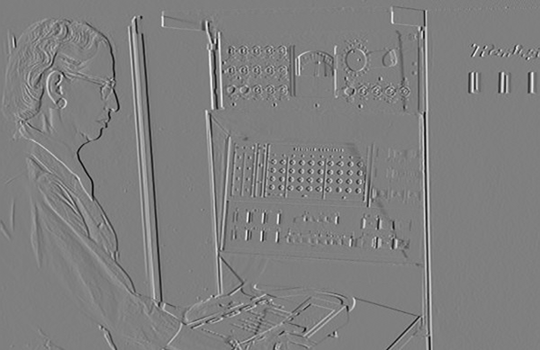
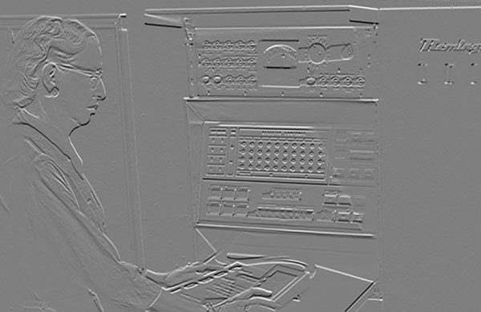
Last Time
T
-1
0
1
-1
0
1
Ix
Iy

Slide 22
Derivatives
Remember derivatives?
Derivative: rate at which a function f(x) changes at a point as well as the direction that increases the function
Gradient: all of the partial derivatives (derivatives in only one direction) stacked together.

Slide 23
What Should I Know?
Gradients are simply partial derivatives per-dimension: if $x$ in $f(x)$ has n dimensions, $∇_{f}(x)$ has n dimensions
Gradients point in direction of ascent and tell the rate of ascent
If a is minimum of $f(x)$ → $∇_{f}\left(a\right)=0$
Reverse is not true, especially in high-dimensional spaces

Slide 24
Last Time
T
-1
0
1
-1
0
1
Ix
Iy

Slide 25
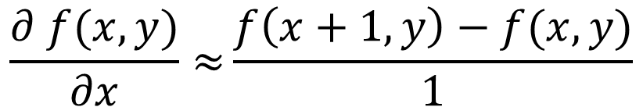
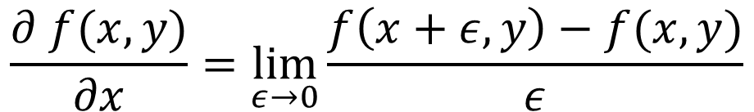
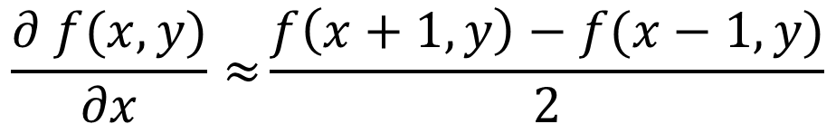
Why Does This Work?
Image is function f(x,y)
$$\frac{∂ f(x,y)}{∂x}=\lim_{ε→0}{\frac{f\left(x+ε,y\right)−f(x,y)}{ε}}$$
Remember:
$$\frac{∂ f(x,y)}{∂x}≈{\frac{f\left(x+1,y\right)−f(x,y)}{1}}$$
Approximate:
-1
1
$$\frac{∂ f(x,y)}{∂x}≈{\frac{f\left(x+1,y\right)−f(x−1,y)}{2}}$$
Another one:
-1
0
1

Slide 26
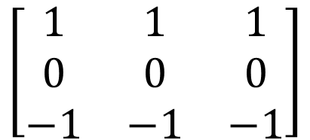
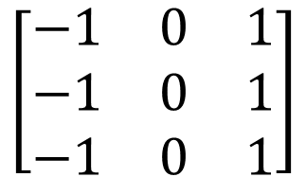
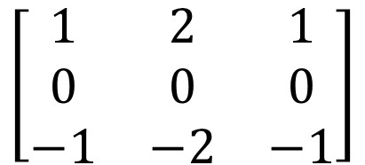
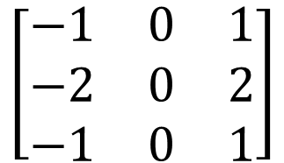
Other Differentiation Operations
Horizontal
Vertical
$$\left[\begin{matrix}−1 & 0 & 1 \\ −1 & 0 & 1 \\ −1 & 0 & 1\end{matrix}\right]$$
$$\left[\begin{matrix}1 & 1 & 1 \\ 0 & 0 & 0 \\ −1 & −1 & −1\end{matrix}\right]$$
Prewitt
$$\left[\begin{matrix}−1 & 0 & 1 \\ −2 & 0 & 2 \\ −1 & 0 & 1\end{matrix}\right]$$
$$\left[\begin{matrix}1 & 2 & 1 \\ 0 & 0 & 0 \\ −1 & −2 & −1\end{matrix}\right]$$
Sobel
Why might people use these compared to [-1,0,1]?

Slide 27
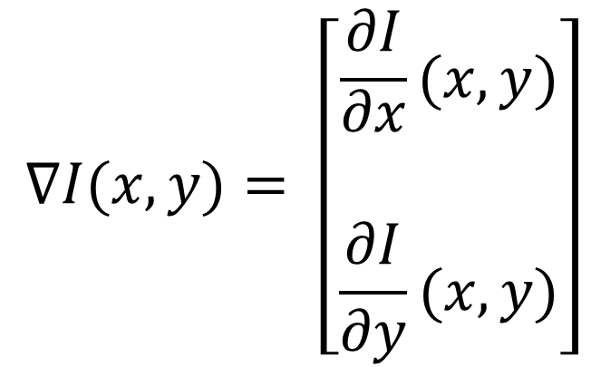
Images as Functions or Points
Key idea: can treat image as a point in R^{(HxW)} or as a function of x,y.
$$∇I(x,y)= \left[\begin{matrix}\frac{∂I}{\begin{aligned}∂x \\ \end{aligned}}(x,y) \\ \frac{∂I}{∂y}(x,y)\end{matrix}\right]$$
How much the intensity of the image changes as you go horizontally at (x,y)
(Often called Ix)

Slide 28
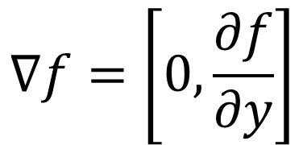
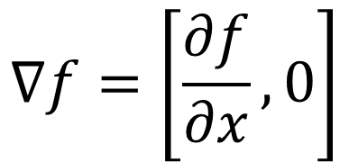
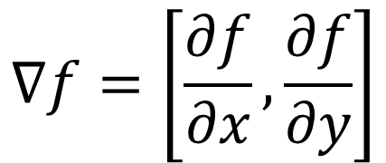
Image Gradient Direction
Some gradients
$$∇f=\left[\frac{∂f}{∂x}, 0\right]$$
$$∇f=\left[0,\frac{∂f}{∂y}\right]$$
$$∇f=\left[\frac{∂f}{∂x}, \frac{∂f}{∂y}\right]$$
Figure Credit: S. Seitz

Slide 29
Image Gradient
Gradient: direction of maximum change.
What’s the relationship to edge direction?
Ix
Iy

Slide 30
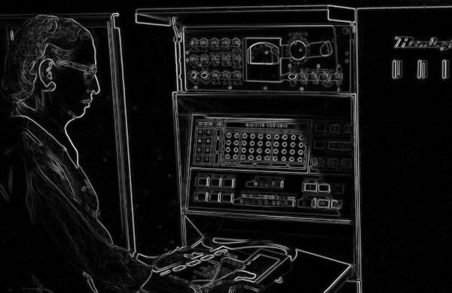
Image Gradient
(Ix² + Iy² )^{1/2} : magnitude

Slide 31
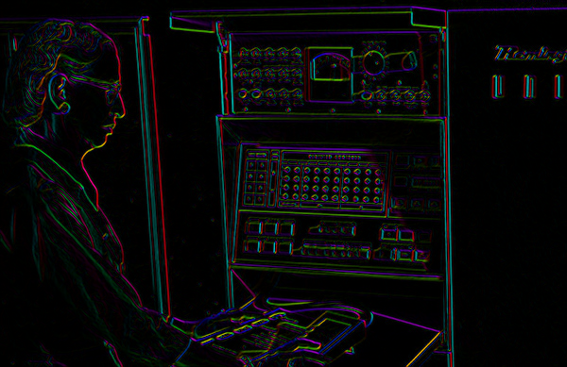

Image Gradient
atan2(Iy,Ix): orientation
I’m making the lightness equal to gradient magnitude

Slide 32
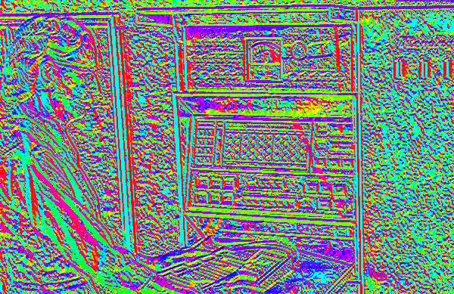
Image Gradient
atan2(Iy,Ix): orientation
Now I’m showing all the gradients

Slide 33
Image Gradient
atan2(Iy,Ix): orientation
Why is there structure at 1 and not at 2?
1
2

Slide 34



Noise
Consider a row of f(x,y) (i.e., fix y)
Slide Credit: S. Seitz

Slide 35



Noise
Conv. image + per-pixel noise with
-1
0
1
$$I_{i,j}=$$
True image
$$ε_{i,j}∼N(0,σ^{2})$$
$$D_{i,j}={(I}_{i,j+1}+ε_{i,j+1})−{(I}_{i,j−1}+ε_{i,j−1 })$$
$$D_{i,j}={(I}_{i,j+1}−{I_{i,j−1})+ ε}_{i,j+1}−ε_{i,j−1 }$$
True difference
Sum of 2 Gaussians
$$ε_{i,j}−ε_{k,l}∼N\left(0,{2σ}^{2}\right)→$$
Variance doubles!

Slide 36
Noise
Consider a row of f(x,y) (i.e., make y constant)
How can we use the last class to fix this?
Slide Credit: S. Seitz

Slide 37
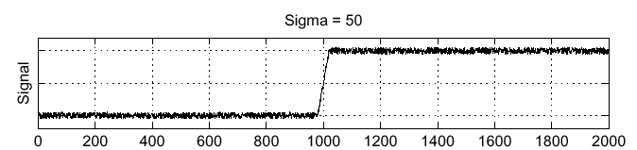
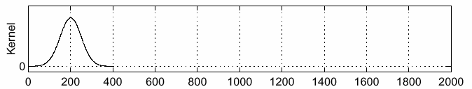
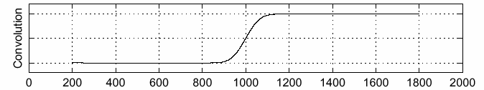
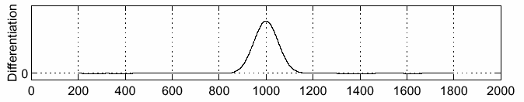
Handling Noise
f
g
f * g
Slide Credit: S. Seitz

Slide 38

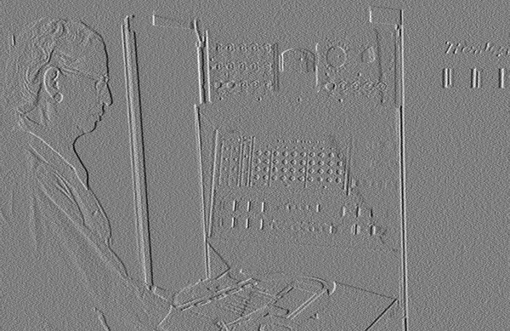
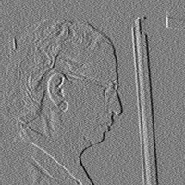

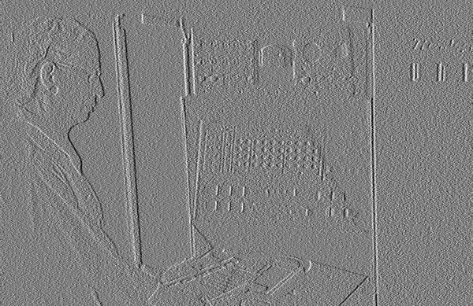
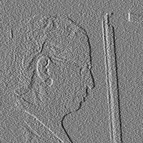
Noise in 2D
Noisy Input
Ix via [-1,01]
Zoom

Slide 39

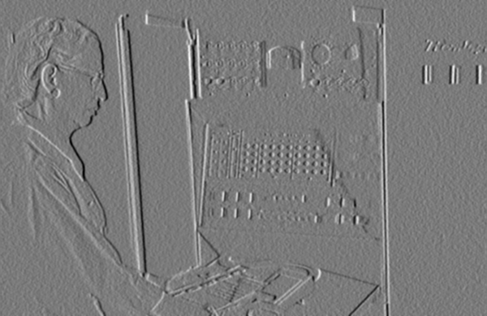
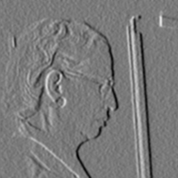



Noise + Smoothing
Smoothed Input
Ix via [-1,01]
Zoom

Slide 40

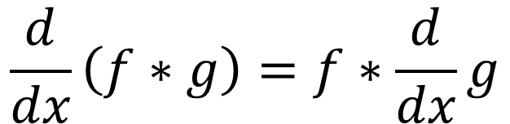
Let’s Make It One Pass (1D)
$$\frac{d}{dx}\left(f∗g\right)=f∗\frac{d}{dx}g$$
f
Slide Credit: S. Seitz

Slide 41


Let’s Make It One Pass (2D)
Gaussian Derivative Filter
Which one finds the X direction?
Slide Credit: L. Lazebnik

Slide 42
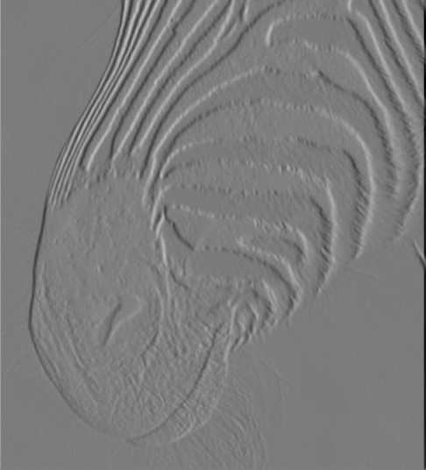
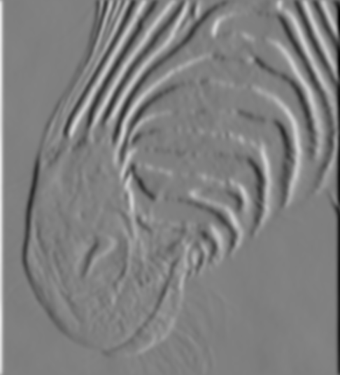
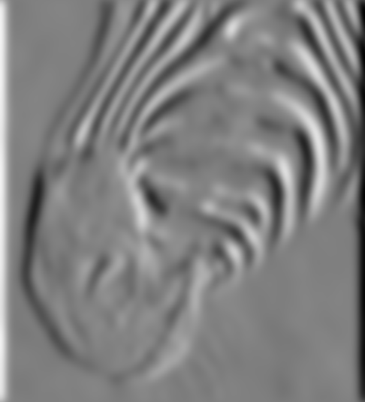
Applying the Gaussian Derivative
1 pixel
3 pixels
7 pixels
Removes noise, but blurs edge
Slide Credit: D. Forsyth

Slide 43
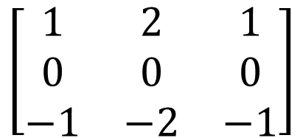
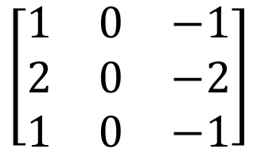
Compared with the Past
Gaussian
Derivative
Sobel
Filter
$$\left[\begin{matrix}1 & 0 & −1 \\ 2 & 0 & −2 \\ 1 & 0 & −1\end{matrix}\right]$$
$$\left[\begin{matrix}1 & 2 & 1 \\ 0 & 0 & 0 \\ −1 & −2 & −1\end{matrix}\right]$$
Why would anybody use the bottom filter?

Slide 44
Filters We’ve Seen
Smoothing
Derivative
Example
Gaussian
Deriv. of gauss
Goal
Remove noise
Find edges
Only +?
Yes
No
Sums to
1
0
Why sum to 1 or 0, intuitively?
Slide Credit: J. Deng

Slide 45






Problems
Image
human segmentation
gradient magnitude
Still an unsolved problem

Slide 46
Localizing Reliably
Suppose you need to meet someone but you can’t use your cell phone to coordinate
Where do you agree to meet?
A: Along the Huron river
B: Along State Street
C: At Liberty and State Street
D: On North Campus

Slide 47
Desirables
Repeatable: should find same things even with distortion
Saliency: each feature should be distinctive
Compactness: shouldn’t just be all the pixels
Locality: should only depend on local image data
Property list: S. Lazebnik

Slide 48


Example
Can you find the correspondences?
Slide credit: N. Snavely

Slide 49


Example Matches
Look for the colored squares
Slide credit: N. Snavely

Slide 50

Basic Idea
Should see where we are based on small window, or any shift → big intensity change.
“flat” region:
no change in all directions
“edge”:
no change along the edge direction
“corner”:
significant change in all directions
Slide Credit: S. Lazebnik

Slide 51
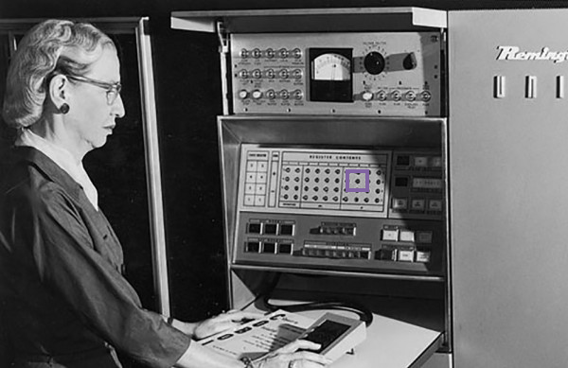
Formalizing Corner Detection

Slide 52

Formalizing Corner Detection
Zoom-In at x,y
Original Image

Slide 53
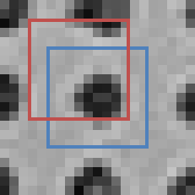


Formalizing Corner Detection
Zoom-In at x,y
Window without and with Offset
“Window”
At x+u, y+v
Here: u=-2,v=-3
“Window”
At x, y
How might we measure similarity?

Slide 54
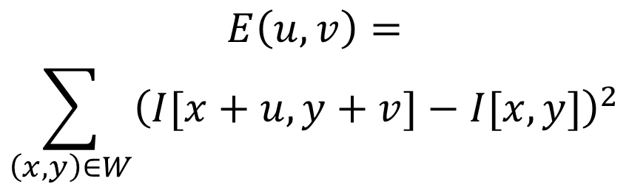
Formalizing Corner Detection
Zoom-In at x,y
Error (Sum Sqs) for u,v offset
$$E\left(u,v\right)=$$
$$\sum_{\left(x,y\right)∈W}{{\left(I[x+u,y+v]−I[x,y]\right)}^{2}}$$
(
)²
-

Slide 55

Formalizing Corner Detection
Zoom-In at x,y
Error (Sum Sqs) for u,v offset
v=-10
(
)²
-
v=0
Sum of Squares between @u=-2,v=-3
and unshifted
v=10
u
=
-10
u
=
0
u
=
10

Slide 56
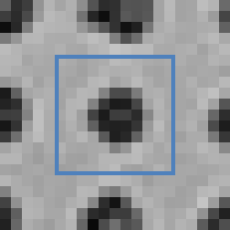
Formalizing Corner Detection
Zoom-In at x,y
Error (Sum Sqs) for u,v offset
v=-10
Error at u=0,v=0 is always 0. Why?
v=0
v=10
u
=
-10
u
=
0
u
=
10

Slide 57

Match The Location and Plot
Original Image and Zoom-In
Error Options
A
B

Slide 58
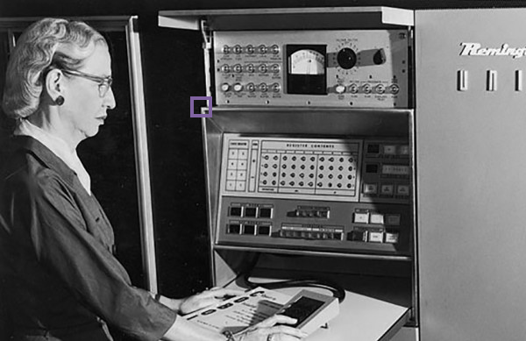

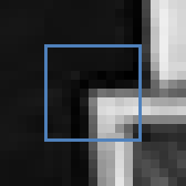
Match The Location and Plot
Original Image and Zoom-In
Error Options
A
B

Slide 59
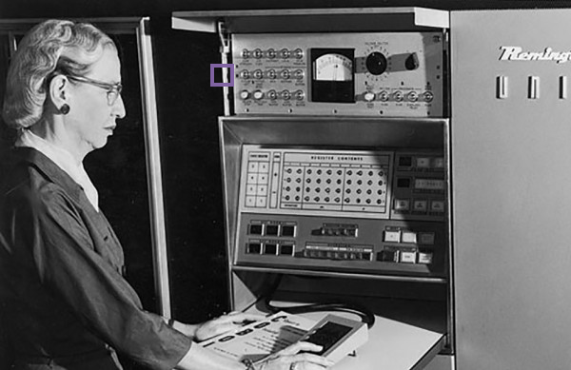


Match The Location and Plot
Original Image and Zoom-In
Error Options
A
B

Slide 60

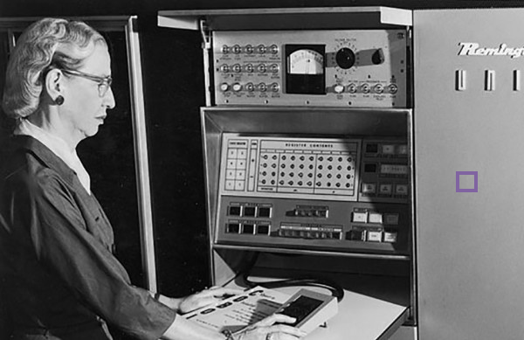

Match The Location and Plot
Original Image and Zoom-In
Error Options
A
B

Slide 61
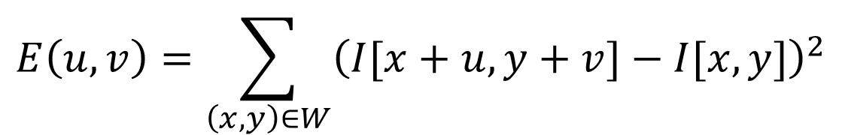
Ok But Back To Math
$$E\left(u,v\right)=\sum_{\left(x,y\right)∈W}{{\left(I[x+u,y+v]−I[x,y]\right)}^{2}}$$
(
)²
-
Shifting windows around is expensive!
We’ll find a trick to approximate this.
Note: only need to get the gist

Slide 62
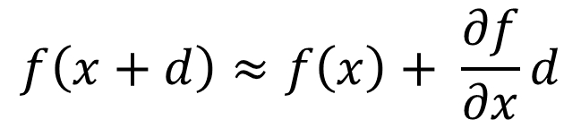
Aside: Taylor Series for Images
Recall Taylor Series – way of linearizing a function:
$$f\left(x+d\right)≈f\left(x\right)+ \frac{∂f}{∂x}d$$
Do the same with images, treating them as function of x, y
$$I\left(x+u,y+v\right)≈I\left(x,y\right)+I_{x}u+I_{y}v$$
For brevity: Ix = Ix at point (x,y), Iy = Iy at point (x,y)

Slide 63
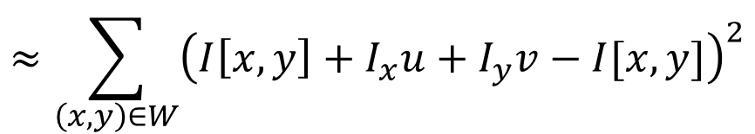
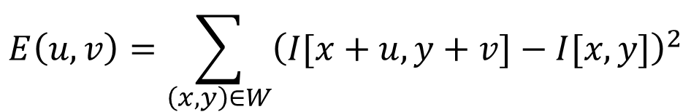


Formalizing Corner Detection
$$E\left(u,v\right)=\sum_{\left(x,y\right)∈W}{{\left(I[x+u,y+v]−I[x,y]\right)}^{2}}$$
Taylor series expansion for I at every single point in window
$$≈\sum_{\left(x,y\right)∈W}{{\left(I\left[x,y\right]+I_{x}u+I_{y}v−I[x,y]\right)}^{2}}$$
$$=\sum_{\left(x,y\right)∈W}{{\left(I_{x}u+I_{y}v\right)}^{2}}$$
Cancel
$$=\sum_{\left(x,y\right)∈W}{I_{x}^{2}u^{2}+2I_{x}I_{y}uv+I_{y}^{2}v^{2}}$$
Expand
For brevity: Ix = Ix at point (x,y), Iy = Iy at point (x,y)

Slide 64


Formalizing Corner Detection
By linearizing image, we can approximate E(u,v) with quadratic function of u and v
$$E\left(u,v\right)≈\sum_{\left(x,y\right)∈W}{\left(I_{x}^{2}u^{2}+2I_{x}I_{y}uv+I_{y}^{2}v^{2}\right)}$$
$$=\left[u,v\right]M{\left[u,v\right]}^{T}$$
$$M= \left[\begin{matrix}\sum_{x,y∈W}{I_{x}^{2}} & \sum_{x,y∈W}{I_{x}I_{y}} \\ \sum_{x,y∈W}{I_{x}I_{y}} & \sum_{x,y∈W}{I_{y}^{2}}\end{matrix}\right]$$
M is called the second moment matrix

Slide 65





Intuitively what is M?
Pretend gradients are either vertical or horizontal at a pixel (so Ix Iy = 0)
Obviously Wrong!
$$M= \left[\begin{matrix}\sum_{x,y∈W}{I_{x}^{2}} & \sum_{x,y∈W}{I_{x}I_{y}} \\ \sum_{x,y∈W}{I_{x}I_{y}} & \sum_{x,y∈W}{I_{y}^{2}}\end{matrix}\right]≈ \left[\begin{matrix}a & 0 \\ 0 & b\end{matrix}\right]$$
$$\left[\begin{matrix}0.1 & 0 \\ 0 & 0.1\end{matrix}\right]$$
a,b both small:
flat
One big,
other small:
$$\left[\begin{matrix}50 & 0 \\ 0 & 0.1\end{matrix}\right]$$
$$\left[\begin{matrix}0.1 & 0 \\ 0 & 50\end{matrix}\right]$$
edge
or
$$\left[\begin{matrix}50 & 0 \\ 0 & 50\end{matrix}\right]$$
corner
a,b both big:

Slide 66

Intuitively what is M?
Pretend gradients are either vertical or horizontal at a pixel (so Ix Iy = 0)
$$M= \left[\begin{matrix}\sum_{x,y∈W}{I_{x}^{2}} & \sum_{x,y∈W}{I_{x}I_{y}} \\ \sum_{x,y∈W}{I_{x}I_{y}} & \sum_{x,y∈W}{I_{y}^{2}}\end{matrix}\right]≈? \left[\begin{matrix}a & 0 \\ 0 & b\end{matrix}\right]$$
Image might be rotated by rotation θ!
a,b both small:
flat
One big,
other small:
edge
corner
a,b both big:

Slide 67


Intuitively what is M?
Pretend gradients are either vertical or horizontal at a pixel (so Ix Iy = 0)
$$M= \left[\begin{matrix}\sum_{x,y∈W}{I_{x}^{2}} & \sum_{x,y∈W}{I_{x}I_{y}} \\ \sum_{x,y∈W}{I_{x}I_{y}} & \sum_{x,y∈W}{I_{y}^{2}}\end{matrix}\right]=V^{−1}\left[\begin{matrix}a & 0 \\ 0 & b\end{matrix}\right]V$$
a,b both small:
If image rotated by rotation θ / matrix V
M will look like
$$V^{−1}\left[\begin{matrix}a & 0 \\ 0 & b\end{matrix}\right]V$$
flat
One big,
other small:
edge
corner
a,b both big:

Slide 68


So What Now?
Can calculate M at pixel, by summing nearby gradients, but need access to a and b.
$$M= \left[\begin{matrix}\sum_{x,y∈W}{I_{x}^{2}} & \sum_{x,y∈W}{I_{x}I_{y}} \\ \sum_{x,y∈W}{I_{x}I_{y}} & \sum_{x,y∈W}{I_{y}^{2}}\end{matrix}\right]=V^{−1}\left[\begin{matrix}a & 0 \\ 0 & b\end{matrix}\right]V$$
Given M, can decompose it into eigenvectors V and eigenvalues $λ_{1},λ_{2}$ with $M=V^{−1}\left[\begin{matrix}λ_{1} & 0 \\ 0 & λ_{2}\end{matrix}\right]V$.
Really slow. Why?

Slide 69
So What Now?
Can calculate M at pixel, by summing nearby gradients, but need access to a and b.
$$M= \left[\begin{matrix}\sum_{x,y∈W}{I_{x}^{2}} & \sum_{x,y∈W}{I_{x}I_{y}} \\ \sum_{x,y∈W}{I_{x}I_{y}} & \sum_{x,y∈W}{I_{y}^{2}}\end{matrix}\right]=V^{−1}\left[\begin{matrix}a & 0 \\ 0 & b\end{matrix}\right]V$$
Instead: compute quantity R from M
$$R= det\left(M\right)−α trace{\left(M\right)}^{2}=λ_{1}λ_{2}−α {\left(λ_{1}+λ_{2}\right)}^{2}$$
Easy fast formula
for 2x2
Fast – sum the diagonal
Empirical value,
usually 0.04-0.06

Slide 70





So What Now?
R tells us whether we’re at a corner, edge, or flat
$$R= det\left(M\right)−α trace{\left(M\right)}^{2}=λ_{1}λ_{2}−α {\left(λ_{1}+λ_{2}\right)}^{2}$$
R << 0
flat
$$λ_{1},λ_{2}≈0$$
R >> 0
$$λ_{1}≫λ_{2}≫0$$
$$λ_{2}≫λ_{1}≫0$$
edge
$$λ_{1}$$
corner
$$λ_{1}≈λ_{2}≫0$$
|R|≈0
R << 0
$$λ_{2}$$
Remake of standard diagram from S. Lazebnik from original Harris paper.

Slide 71

What Do I Need To Know?
Need to be able to take derivatives of image
Need to be able to compute the entries of M at every pixel.
Should know that some properties of M indicate whether a pixel is a corner or not.
$$M= \left[\begin{matrix}\sum_{x,y∈W}{I_{x}^{2}} & \sum_{x,y∈W}{I_{x}I_{y}} \\ \sum_{x,y∈W}{I_{x}I_{y}} & \sum_{x,y∈W}{I_{y}^{2}}\end{matrix}\right]$$

Slide 72

In Practice
Compute partial derivatives Ix, Iy per pixel
Compute M at each pixel, using Gaussian weighting w
$$M= \left[\begin{matrix}\sum_{x,y∈W}{{w(x,y)I}_{x}^{2}} & \sum_{x,y∈W}{{w(x,y)I}_{x}I_{y}} \\ \sum_{x,y∈W}{{w(x,y)I}_{x}I_{y}} & \sum_{x,y∈W}{{w(x,y)I}_{y}^{2}}\end{matrix}\right]$$
C.Harris and M.Stephens. “A Combined Corner and Edge Detector.” Proceedings of the 4th Alvey Vision Conference: pages 147—151, 1988.
Slide credit: S. Lazebnik

Slide 73

In Practice
Compute partial derivatives Ix, Iy per pixel
Compute M at each pixel, using Gaussian weighting w
Compute response function R
$$R=\det\left(M\right)−α trace{\left(M\right)}^{2}$$
$$=λ_{1}λ_{2}−α{\left(λ_{1}+λ_{2}\right)}^{2}$$
C.Harris and M.Stephens. “A Combined Corner and Edge Detector.” Proceedings of the 4th Alvey Vision Conference: pages 147—151, 1988.
Slide credit: S. Lazebnik

Slide 74

Computing R
Slide credit: S. Lazebnik

Slide 75

Computing R
Slide credit: S. Lazebnik

Slide 76
In Practice
Compute partial derivatives Ix, Iy per pixel
Compute M at each pixel, using Gaussian weighting w
Compute response function R
Threshold R
C.Harris and M.Stephens. “A Combined Corner and Edge Detector.” Proceedings of the 4th Alvey Vision Conference: pages 147—151, 1988.
Slide credit: S. Lazebnik

Slide 77

Thresholded R
Slide credit: S. Lazebnik

Slide 78
In Practice
Compute partial derivatives Ix, Iy per pixel
Compute M at each pixel, using Gaussian weighting w
Compute response function R
Threshold R
Take only local maxima (called non-maxima suppression)
C.Harris and M.Stephens. “A Combined Corner and Edge Detector.” Proceedings of the 4th Alvey Vision Conference: pages 147—151, 1988.
Slide credit: S. Lazebnik

Slide 79
Thresholded, NMS R
Slide credit: S. Lazebnik

Slide 80

Final Results
Slide credit: S. Lazebnik

Slide 81
Desirable Properties
If our detectors are repeatable, they should be:
Invariant to some things: image is transformed and corners remain the same
Covariant/equivariant with some things: image is transformed and corners transform with it.
Slide credit: S. Lazebnik

Slide 82


Recall Motivating Problem
Images may be different in lighting and geometry

Slide 83

Affine Intensity Change
$$I_{new}=aI_{old}+b$$
M only depends on derivatives, so b is irrelevant
But a scales derivatives and there’s a threshold
R
R
threshold
x (image coordinate)
x (image coordinate)
Partially invariant to affine intensity changes
Slide credit: S. Lazebnik

Slide 84
Image Translation
All done with convolution. Convolution is translation invariant.
Equivariant with translation
Slide credit: S. Lazebnik

Slide 85
Image Rotation
Rotations just cause the corner rotation to change. Eigenvalues remain the same.
Equivariant with rotation

Slide 86
Image Scaling
Corner
One pixel can become many pixels and vice-versa.
Not equivariant with scaling

Slide 88
For the Curious

Slide 90



Review: Quadratic Forms
Suppose have symmetric matrix M, scalar a, vector [u,v]:
$$E\left([u,v]\right)=\left[u,v\right]M{\left[u,v\right]}^{T}$$
Then the isocontour / slice-through of F, i.e.
$$E\left([u,v]\right)=a$$
is an ellipse.
Diagram credit: S. Lazebnik

Slide 91

Review: Quadratic Forms
We can look at the shape of this ellipse by decomposing M into a rotation + scaling
$$M=R^{−1}\left[\begin{matrix}λ_{1{ }} & 0 \\ 0 & λ_{2{ }}\end{matrix}\right]R$$
direction of the fastest change
λ₁ and λ₂ are eigenvalues
direction of the slowest change
(λ₁)^{-1/2}
(λ₂)^{-1/2}
Slide credit: S. Lazebnik

Slide 92

Interpreting The Matrix M
The second moment matrix tells us how quickly the image changes and in which directions.
Can compute at each pixel
Directions
$$M= \left[\begin{matrix}\sum_{x,y∈W}{I_{x}^{2}} & \sum_{x,y∈W}{I_{x}I_{y}} \\ \sum_{x,y∈W}{I_{x}I_{y}} & \sum_{x,y∈W}{I_{y}^{2}}\end{matrix}\right]=R^{−1}\left[\begin{matrix}λ_{1} & 0 \\ 0 & λ_{2{ }}\end{matrix}\right]R$$
Amounts

Slide 93

Visualizing M
Slide credit: S. Lazebnik

Slide 94

Visualizing M
Technical note: M is often best visualized by first taking inverse, so long edge of ellipse goes along edge
Slide credit: S. Lazebnik

Slide 95
Interpreting Eigenvalues of M
λ₂
“Edge”
λ₂ >> λ₁
“Corner”
λ₁ and λ₂ are large,
λ₁ ~ λ₂;
E increases in all directions
λ₁ and λ₂ are small;
E is almost constant in all directions
“Flat” region
“Edge”
λ₁ >> λ₂
λ₁
Slide credit: S. Lazebnik; Note: this refers to previous ellipses, not original M ellipse. Other slides on the internet may vary

Slide 96

Putting Together The Eigenvalues
“Edge”
R < 0
$$R=\det\left(M\right)−α trace{\left(M\right)}^{2}$$
$$=λ_{1}λ_{2}−α{\left(λ_{1}+λ_{2}\right)}^{2}$$
“Corner”
R > 0
α: constant (0.04 to 0.06)
|R| small
“Flat” region
“Edge”
R < 0
Slide credit: S. Lazebnik; Note: this refers to previous ellipses, not original M ellipse. Other slides on the internet may vary

Slide 97

Corners
9300 Harris Corners Pkwy, Charlotte, NC
Slide Credit: S. Lazebnik

Slide 98
Derivatives Review

Slide 99



Given quadratic function f(x)
$$f\left(x\right)={\left(x−2\right)}^{2}+5$$
$f\left(x\right)$ is function
$g\left(x\right)=f^{′}\left(x\right)$
aka
$$g\left(x\right)=\frac{d}{dx}f(x)$$

Slide 100

Given quadratic function f(x)
$$f\left(x\right)={\left(x−2\right)}^{2}+5$$
What’s special about x=2?
$f\left(x\right)$ minim. at 2
$g\left(x\right)=0$ at 2
a = minimum of f →
$$g\left(a\right)=0$$
Reverse is not true

Slide 101

Rates of change
$$f\left(x\right)={\left(x−2\right)}^{2}+5$$
Suppose I want to increase f(x) by changing x:
Blue area: move left
Red area: move right
Derivative tells you direction of ascent and rate

Slide 102
What Calculus Should I Know
Really need intuition
Need chain rule
Rest you should look up / use a computer algebra system / use a cookbook
Partial derivatives (and that’s it from multivariable calculus)

Slide 103
Partial Derivatives
Pretend other variables are constant, take a derivative. That’s it.
Make our function a function of two variables
$$f\left(x\right)={\left(x−2\right)}^{2}+5$$
$$\frac{∂}{∂x}f\left(x\right)=2\left(x−2\right)∗1=2(x−2)$$
Pretend it’s constant → derivative = 0
$$f_{2}\left(x,y\right)={\left(x−2\right)}^{2}+5+{\left(y+1\right)}^{2}$$
$$\frac{∂}{∂x}f_{2}\left(x\right)=2(x−2)$$

Slide 104

Zooming Out
$$f_{2}\left(x,y\right)={\left(x−2\right)}^{2}+5+{\left(y+1\right)}^{2}$$
Dark = f(x,y) low
Bright = f(x,y) high

Slide 105

Taking a slice of
$$f_{2}\left(x,y\right)={\left(x−2\right)}^{2}+5+{\left(y+1\right)}^{2}$$
Slice of y=0 is the function from before:
$$f\left(x\right)={\left(x−2\right)}^{2}+5$$
$$f^{′}\left(x\right)=2(x−2)$$

Slide 106

Taking a slice of
$$f_{2}\left(x,y\right)={\left(x−2\right)}^{2}+5+{\left(y+1\right)}^{2}$$
$\frac{∂}{∂x}f_{2}\left(x,y\right)$ is rate of change & direction in x dimension

Slide 107

Zooming Out
$$f_{2}\left(x,y\right)={\left(x−2\right)}^{2}+5+{\left(y+1\right)}^{2}$$
$\frac{∂}{∂y}f_{2}\left(x,y\right)$ is
$$2(y+1)$$
and is the rate of change & direction in y dimension

Slide 108

Zooming Out
$$f_{2}\left(x,y\right)={\left(x−2\right)}^{2}+5+{\left(y+1\right)}^{2}$$
Gradient/Jacobian:
Making a vector of
$$∇_{f}=\left[\frac{∂f}{∂x },\frac{∂f}{∂y}\right]$$
gives rate and direction of change.
Arrows point OUT of minimum / basin.

