Slide 1
Video: Tracking and Action Recognition
EECS 442 – Prof. David Fouhey
Winter 2019, University of Michigan
http://web.eecs.umich.edu/~fouhey/teaching/EECS442_W19/

Slide 2
Today: Tracking Objects
Goal: Locating a moving object/part across video frames
This class:
Examples
Probabilistic Tracking
Kalman filter
Particle filter
Slide credit: D. Hoiem

Slide 3
Tracking Examples
Video credit: B. Babenko

Slide 4
Tracking Examples

Slide 5
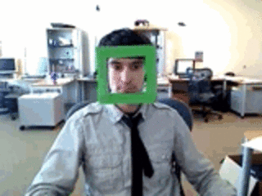
Best Tracking
Slide credit: B. Babenko

Slide 6
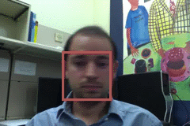
Difficulties
Erratic movements, rapid motion
Occlusion
Surrounding similar objects
Slide credit: D. Hoiem

Slide 7
Tracking by Detection
Tracking by detection:
Works if object is detectable
Need some way to link up detections
Slide credit: D. Hoiem

Slide 8
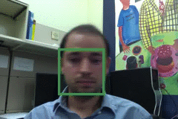
Tracking With Dynamics
Based on motion, predict object location
Restrict search for object
Measurement noise is reduced by smoothness
Robustness to missing or weak observations
Slide credit: D. Hoiem

Slide 9
Strategies For Tracking
Tracking with motion prediction:
Predict object’s state in next frame.
Fuse with observation.
Slide credit: D. Hoiem

Slide 10
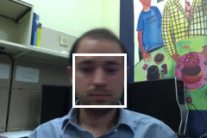
General Tracking Model
State X: actual state of object that we want to estimate.
Could be: Pose, viewpoint, velocity, acceleration.
Observation Y: our “measurement” of state X. Can be noisy. At each time step t, state changes to X_{t}, get Y_{t}.
Slide credit: D. Hoiem

Slide 11
Steps of Tracking
Prediction: What’s the next state of the object given past measurements
$$P(X_{t}|Y_{0}=y_{0},…, Y_{t−1}=y_{t−1})$$
Correction: Compute updated estimate of the state from prediction and measurements
$$P(X_{t}|Y_{0}=y_{0},…, Y_{t−1}=y_{t−1},Y_{t}=y_{t})$$
Slide credit: D. Hoiem

Slide 12
Simplifying Assumptions
Only immediate past matters (Markovian)
$$P\left(X_{t} | X_{0},…, X_{t−1}\right)=P(X_{t}|X_{t−1})$$
Measurement depends only on current state
(Independence)
$$P\left(Y_{t} | X_{0},Y_{0},…, X_{t−1},Y_{t−1},X_{t}\right)=P(Y_{t}|X_{t})$$
…
X₀
X₁
X_{t-1}
X_{t}
Y₀
Y₁
Y_{t-1}
Y_{t}
Slide credit: D. Hoiem

Slide 13
Problem Statement
Have models for:
(1) P(next state) given current state / Transition
$$P(X_{t}|X_{t−1})$$
(2) P(observation) given state / Observation
$$P(Y_{t}|X_{t})$$
Want to recover, for each timestep t
$$P(X_{t}|y_{0},…, y_{t})$$
Slide credit: D. Hoiem

Slide 14
Probabilistic tracking
Base case:
Start with initial prediction/prior: P(X₀)
For the first frame, correct this given the first measurement: Y₀=y₀
Slide credit: D. Hoiem

Slide 15
Probabilistic tracking
Base case:
Start with initial prediction/prior: P(X₀)
For the first frame, correct this given the first measurement: Y₀=y₀
Each subsequent step:
Predict X_{t} given past evidence
Observe y_{t}: correct X_{t} given current evidence
Slide credit: D. Hoiem

Slide 16
Prediction
Given P(X_{t-1}|y₀,…,y_{t-1}) want P(X_{t}|y₀,…,y_{t-1})
$$P(X_{t}|y_{0},…,y_{t−1})$$
$$=\int{P\left(X_{t},X_{t−1} | y_{0},…,y_{t−1}\right) dX_{t−1}}$$
Total
probability
$$=\int{P\left(X_{t}, | X_{t−1},y_{0},…,y_{t−1}\right)P(X_{t−1}|y_{0},…,y_{t−1}) dX_{t−1}}$$
Condition on X_{t-1}
$$=\int{P\left(X_{t}, | X_{t−1} \right)P(X_{t−1}|y_{0},…,y_{t−1}) dX_{t−1}}$$
Markovian
dynamics model
corrected estimate from previous step
Slide credit: D. Hoiem

Slide 17
Correction
Given P(X_{t}|y₀,…,y_{t-1}) want P(X_{t}|y₀,…,y_{t-1},y_{t})
$$P\left(X_{t} | y_{0},…, y_{t}\right)$$
$$=\frac{P\left(y_{t} | X_{t},y_{0},…,y_{t−1}\right)P(X_{t}|y_{0},…, y_{t−1})}{P\left(y_{t} | y_{0},…, y_{t−1}\right)}$$
Bayes
Rule
$$=\frac{P\left(y_{t} | X_{t}\right)P(X_{t}|y_{0},…, y_{t−1})}{P\left(y_{t} | y_{0},…, y_{t−1}\right)}$$
Independence
Assumption
$$=\frac{P\left(y_{t} | X_{t}\right)P(X_{t}|y_{0},…, y_{t−1})}{\int{P\left(y_{t} | X_{t}\right)P\left(X_{t} | y_{0},…, y_{t−1}\right) dX_{t}}}$$
Condition
on X_{t}
Slide credit: D. Hoiem

Slide 18
Correction
Given P(X_{t}|y₀,…,y_{t-1}) want P(X_{t}|y₀,…,y_{t-1},y_{t})
$$P\left(X_{t} | y_{0},…, y_{t}\right)$$
observation model
Predicted
estimate
$$=\frac{P\left(y_{t} | X_{t},y_{0},…,y_{t−1}\right)P(X_{t}|y_{0},…, y_{t−1})}{P\left(y_{t} | y_{0},…, y_{t−1}\right)}$$
Bayes
Rule
$$=\frac{P\left(y_{t} | X_{t}\right)P(X_{t}|y_{0},…, y_{t−1})}{P\left(y_{t} | y_{0},…, y_{t−1}\right)}$$
Independence
Assumption
$$=\frac{P\left(y_{t} | X_{t}\right)P(X_{t}|y_{0},…, y_{t−1})}{\int{P\left(y_{t} | X_{t}\right)P\left(X_{t} | y_{0},…, y_{t−1}\right) dX_{t}}}$$
Condition
on X_{t}
Normalization
Factor
Slide credit: D. Hoiem

Slide 19
Summarize
Transition
P(state given past)
Observation
P(state given past+present)
Prediction:
$$P(X_{t}|y_{0},…,y_{t−1})=\int{P\left(X_{t}, | X_{t−1} \right)P(X_{t−1}|y_{0},…,y_{t−1}) dX_{t−1}}$$
Correction:
$$P\left(X_{t} | y_{0},…, y_{t}\right)=\frac{P\left(y_{t} | X_{t}\right)P(X_{t}|y_{0},…, y_{t−1})}{\int{P\left(y_{t} | X_{t}\right)P\left(X_{t} | y_{0},…, y_{t−1}\right) dX_{t}}}$$
Nasty integrals! Also these are probability distributions

Slide 20
Solution 1 – Kalman Filter
What’s the product of two Gaussians?
Gaussian
What do you need to keep track of for a multivariate Gaussian?
Mean, Covariance
Kalman filter: assume everything’s Gaussian

Slide 21
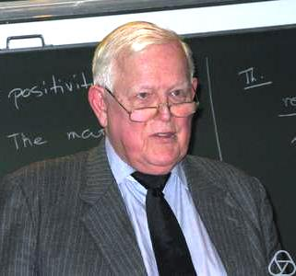
Solution 1 – Kalman Filter
“The Apollo computer used 2k of magnetic core RAM and 36k wire rope [...]. The CPU was built from ICs [...]. Clock speed was under 100 kHz”
Rudolf
Kalman
Photo, Quote credit: Wikipedia

Slide 22
Comparison
Ground Truth
Observation
Correction
Slide credit: D. Hoiem

Slide 23
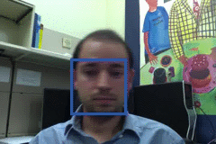
Example: Kalman Filter
Ground
Truth
Observation
Correction
Prediction
Slide credit: D. Hoiem

Slide 24
Propagation of Gaussian densities
Expected
change
Current state
(a)
(b)
(d)
(c)
Decent model if there is just one object, but localization is imprecise
Uncertainty
Observation and Correction
Slide credit: D. Hoiem

Slide 25
Particle filtering
Represent the state distribution non-parametrically
Prediction: Sample possible values X_{t-1} for the previous state
Correction: Compute likelihood of X_{t} based on weighted samples and P(y_{t}|X_{t})
M. Isard and A. Blake, CONDENSATION -- conditional density propagation for visual tracking, IJCV 29(1):5-28, 1998

Slide 26
Non-parametric densities
Current state
Expected change
(a)
(b)
Good if there are multiple, confusable objects (or clutter) in the scene
(d)
(c)
Uncertainty
Observation and Correction
Slide credit: D. Hoiem

Slide 27
Particle Filtering

Slide 28
Particle Filtering More Generally
Object tracking:
State: object location
Observation: detect bounding box
Transition: assume constant velocity, etc.
Vehicle tracking:
State: car location [x,y,theta] + velocity
Observation: register location in map
Transition: assume constant velocity, etc.

Slide 29
Particle Filtering More Generally

Slide 30
In General
If you have something intractable:
Option 1: Pretend you’re dealing with Gaussians, everything is nice
Option 2: Monte-carlo method, don’t have to do intractable math

Slide 31
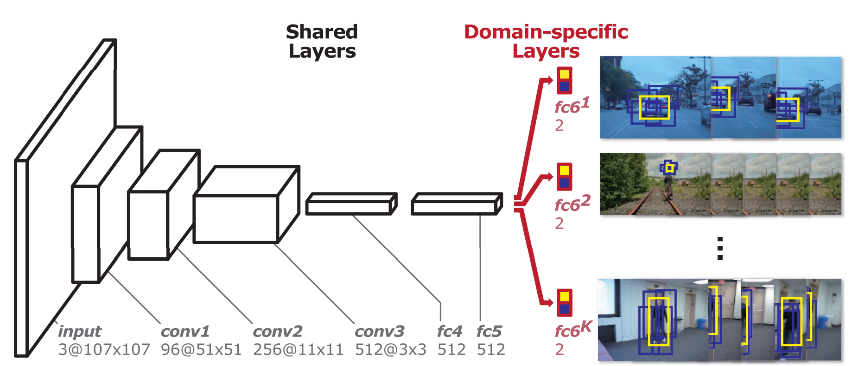
MD-Net
Offline: train to differentiate between target and bg for K different targets
Online: fine-tune network in new sequence
Nam and Han, CVPR 2016, Learning Multi-Domain Convolutional Neural Networks For Visual Tracking

Slide 32
Nam and Han, CVPR 2016, Learning Multi-Domain Convolutional Neural Networks For Visual Tracking

Slide 33
Tracking Issues
Initialization
Manual (click on stuff)
Detection
Background subtraction
Slide credit: D. Hoiem

Slide 34
Detour: Background Subtraction

Slide 35
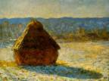
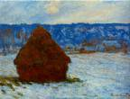
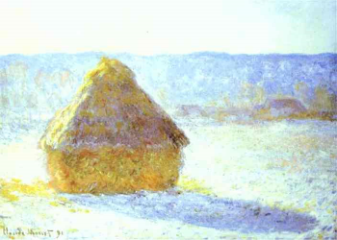
Moving in Time
Moving only in time, while not moving in space, has many advantages
No need to find correspondences
Can look at how each ray changes over time
In science, always good to change just one variable at a time
This approach has always interested artists (e.g. Monet)
Slide credit: A. Efros

Slide 36
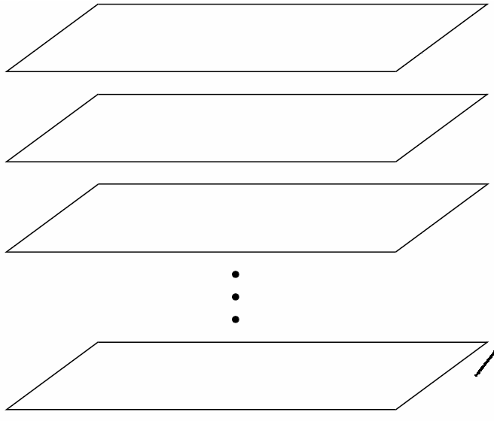
Image Stack
time
255
0
t
As can look at video data as a spatio-temporal volume
If camera is stationary, each line through time corresponds to a single ray in space
We can look at how each ray behaves
What are interesting things to ask?
Slide credit: A. Efros

Slide 37
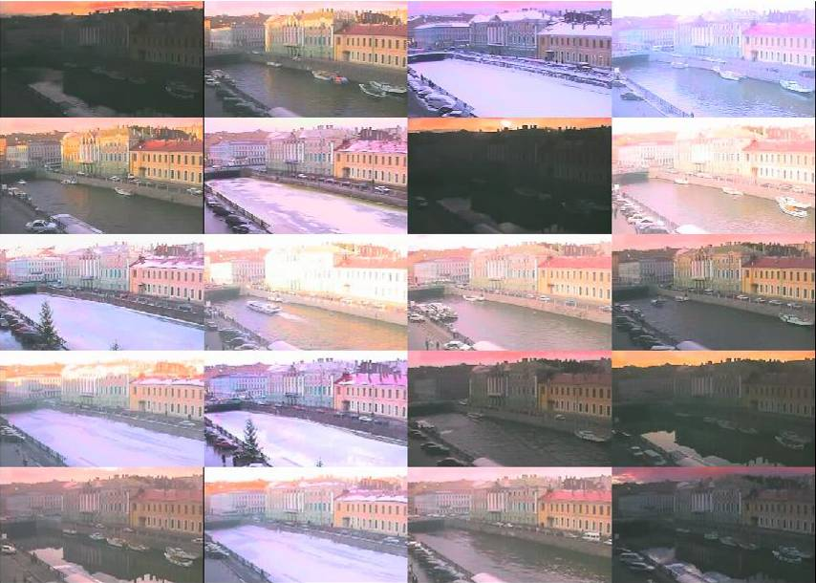
Example
Slide credit: A. Efros

Slide 38
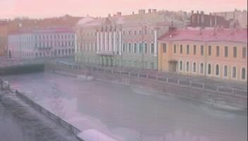
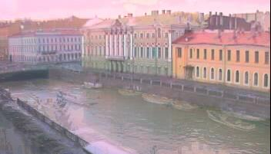
Examples
Average image
Median Image
Slide credit: A. Efros

Slide 39
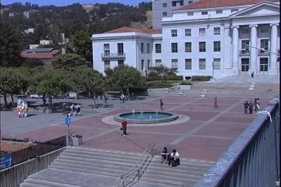
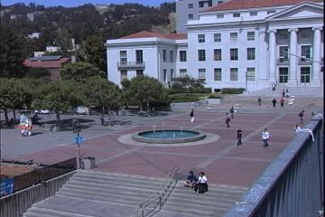
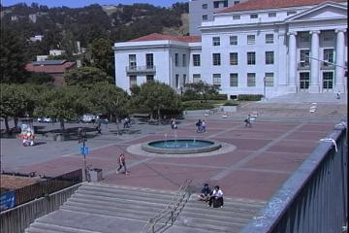
Average/Median Image
Slide credit: A. Efros

Slide 40
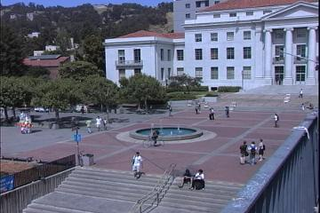
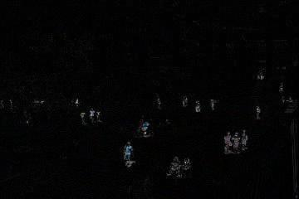
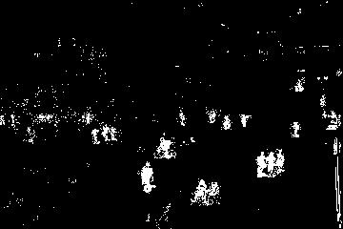
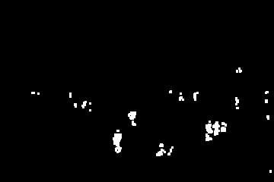
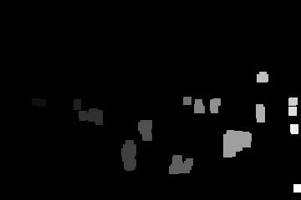
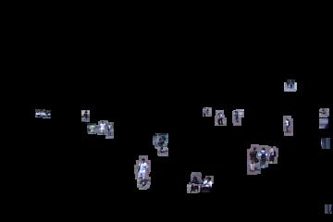
Background Subtraction
-
=
Slide credit: A. Efros

Slide 41
Tracking Issues
Initialization
Getting observation and dynamics models
Observation model: match template or use trained detector
Dynamics Model: specify with domain knowledge
Slide credit: D. Hoiem

Slide 42
Tracking Issues
Initialization
Getting observation and dynamics models
Combining prediction vs correction:
Dynamics too strong: ignores data
Observation too strong: tracking = detection
Too strong dynamics model
Too strong observation model
Slide credit: D. Hoiem

Slide 43
Tracking Issues
Initialization
Getting observation and dynamics models
Combining prediction vs correction
Data association:
Need to keep track of which object is which. Particle filters good for this
Slide credit: D. Hoiem

Slide 44
Tracking Issues – Data Association

Slide 45
Tracking Issues
Initialization
Getting observation and dynamics models
Combining prediction vs correction
Data association
Drift
Errors can accumulate over time
Slide credit: D. Hoiem

Slide 46
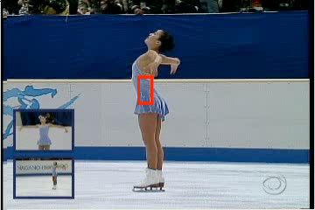
Drift
D. Ramanan, D. Forsyth, and A. Zisserman. Tracking People by Learning their Appearance. PAMI 2007.

Slide 47
Things to remember
Tracking objects = detection + prediction
Probabilistic framework
Predict next state
Update current state based on observation
Two simple but effective methods
Kalman filters: Gaussian distribution
Particle filters: multimodal distribution
Slide credit: D. Hoiem

Slide 48
Action Recognition
Image recognition:
Input: HxWx3 image
Output: F-dimensional output
Action recognition
Input: ?x?x? video
Output: F-dimensional output

Slide 49
Datasets – KTH
#Classes: 6, Videos: 2391, Source: Lab, Year: 2004
Recognizing Human Actions: A Local SVM Approach
C. Schuldt, I. Laptev, B. Caputo

Slide 50
Datasets – UCF 101
#Classes: 101, #Videos: 9,511, Source: YouTube, Year: 2012
UCF101: A Dataset of 101 Human Action Classes From Videos in The Wild.
K. Soomro, A. Zamir, M. Shah

Slide 51
Datasets – Kinetics
#Classes: 400, #Videos: 240K, Source: YouTube, Year: 2017
The Kinetics Human Action Video Dataset
W. Kay, J. Carreira, K. Simonyan, B. Zhang, C. Hillier, S. Vijayanarasimhan, F. Viola, T. Green, T. Back, P. Natsev, M. Suleyman, A. Zisserman,

Slide 52
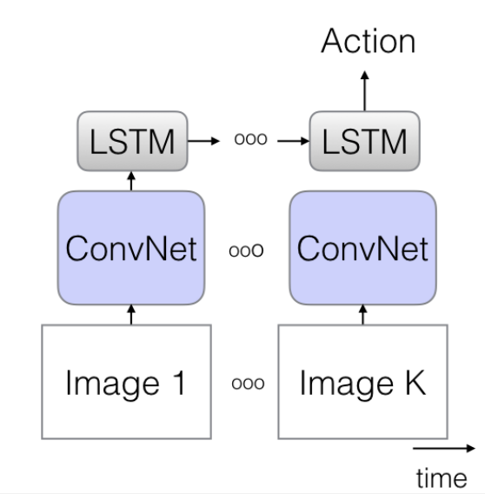
Models for Action Recognition
Take learned sequence modeler (also used in language tasks, e.g., sentence -> sentiment)
Feed in convnet activations as opposed to words
Diagram credit: J. Carreira, A. Zisserman

Slide 53
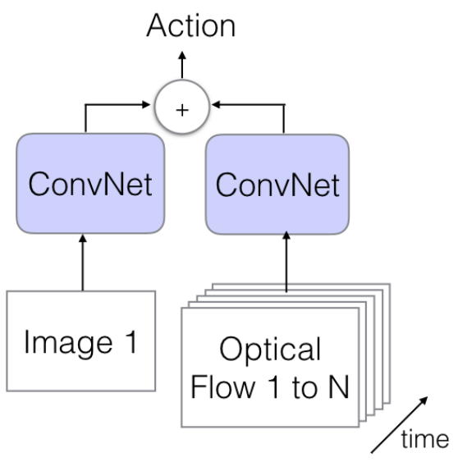
Models for Action Recognition
One network (Image) takes HxWx3 image
Other network (Flow) takes HxWx2*N image
Add them together
Diagram credit: J. Carreira, A. Zisserman

Slide 54
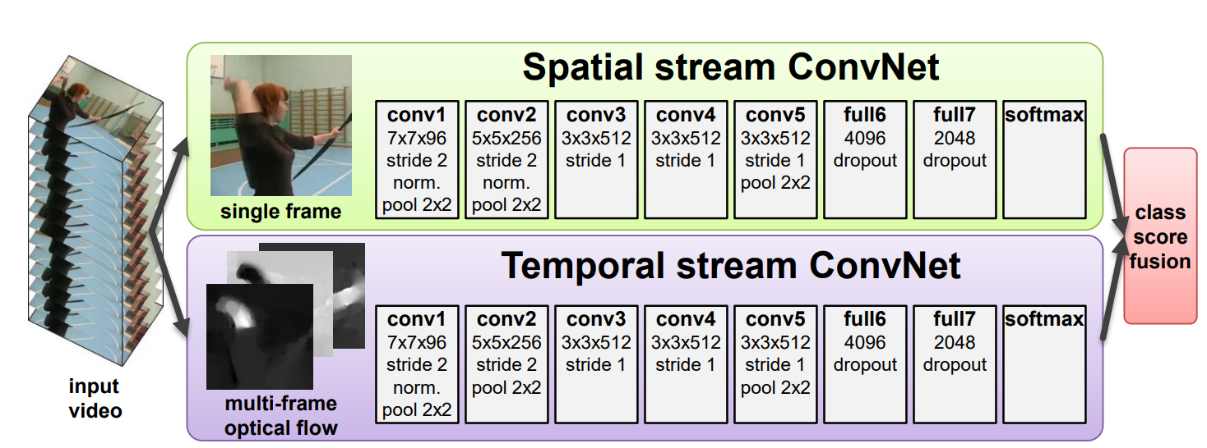
Models for Action Recognition
Diagram credit: J. Carreira, A. Zisserman

Slide 55
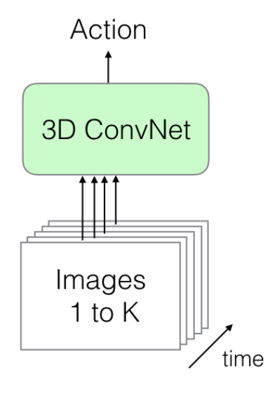
Models for Action Recognition
Dump all the frames in as a HxWx3xN tensor
Convolutions are 3D
Diagram credit: J. Carreira, A. Zisserman

Slide 56
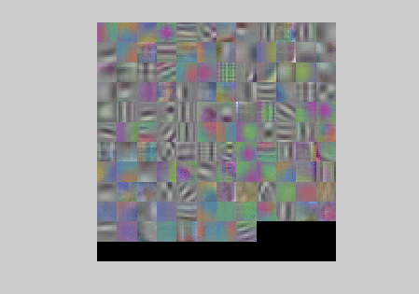
Models for Action Recognition
Filters pick up on spatial patterns and motion patterns

Slide 57
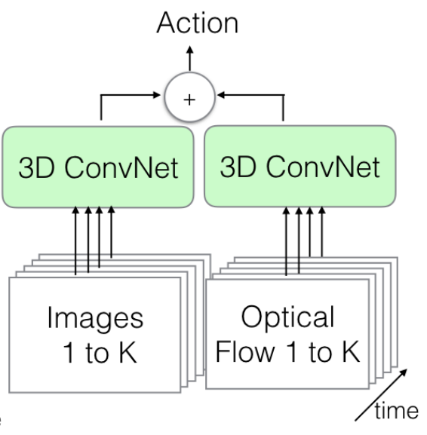
Models for Action Recognition
RGB frames go in as HxWx3xN tensor
Flow frames in as HxWx2xN tensor
Convolutions are 3D
Diagram credit: J. Carreira, A. Zisserman

Slide 58
Comparisons
Take-homes:
Flow + RGB does best
3D Convolutions does best

Slide 59
Hmm… #1
Just looking at independent frames does shockingly well.

Slide 60
Hmm… #2
Using optical flow as input improves things. If flow is so important, can’t it just learn this on its own?

