Slide 1
EECS 442
Computer Vision
Prof. David Fouhey
Winter 2019, University of Michigan
http://web.eecs.umich.edu/~fouhey/teaching/EECS442_W19/

Slide 2
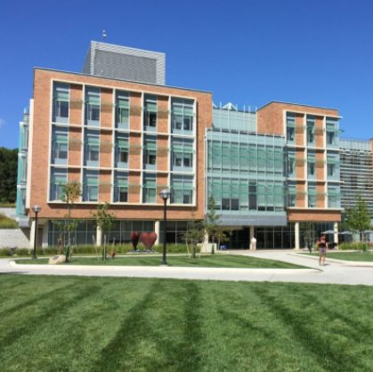
Goals of Computer Vision
Get a computer to understand

Slide 3
Goal: Naming
Building
Person
Grass

Slide 4
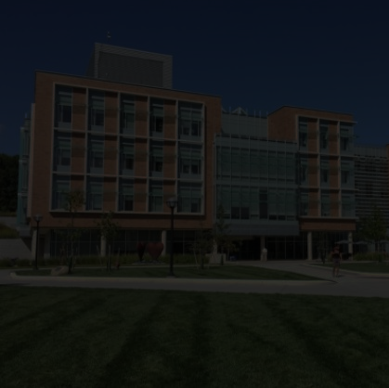
Goal: Naming
The picture shows a building with many windows and grass in front of it. There is a person walking on the right…

Slide 5
Goal: 3D
∞

Slide 6
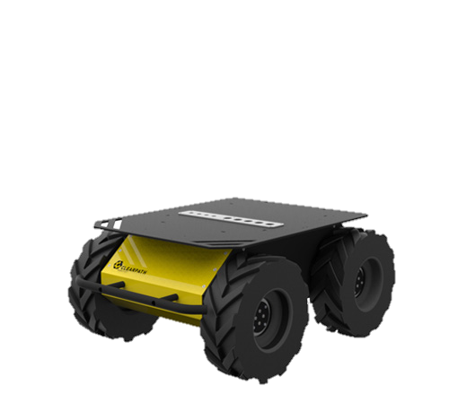
Goal: Actions
What can I
do here?

Slide 7
Seems Obvious, Right?
Key concept to keep in mind throughout the course: you see with both your eyes and your brain.

Slide 8

Why is it Hard?

Slide 10

Why is it Hard?

Slide 11

Goal of computer vision

Slide 12
Despite This, We’ve Made Progress
Few of these problems are solved (and there are lots of dangers to pretending things are solved when they aren’t)
But we do have systems with performance ranging from non-embarrassing to super-human (with the right caveats)

Slide 13
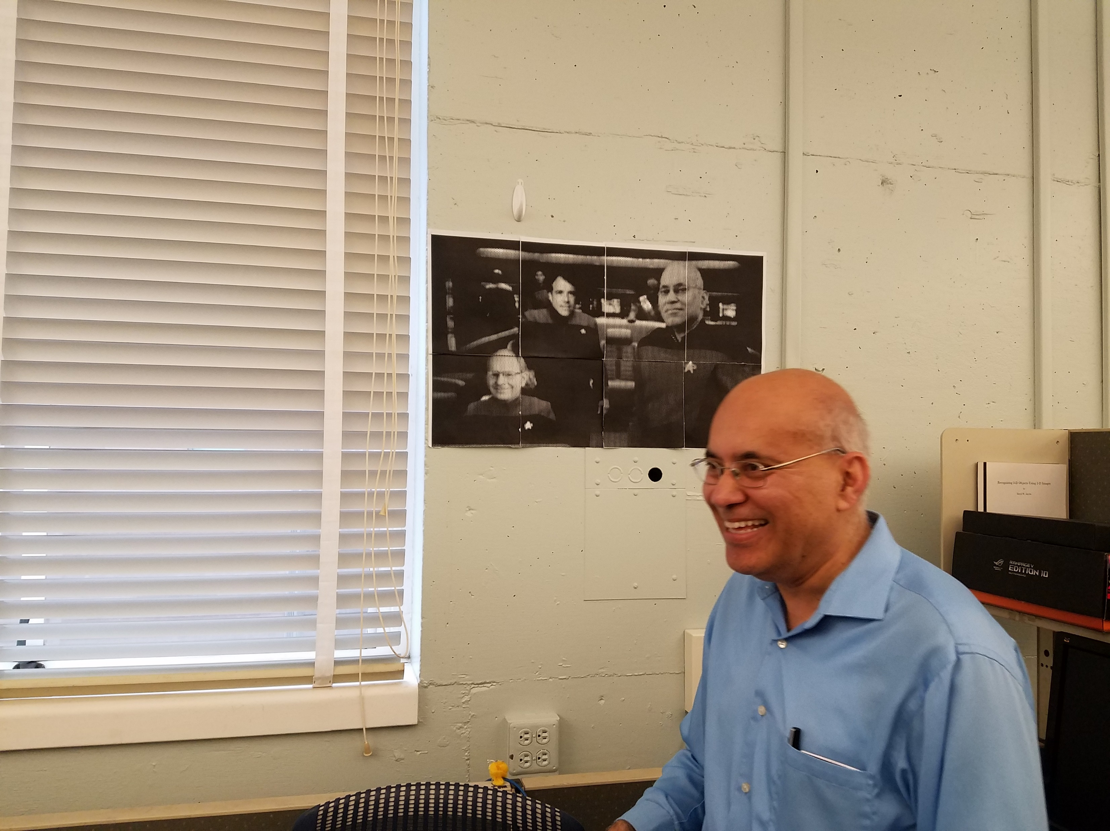
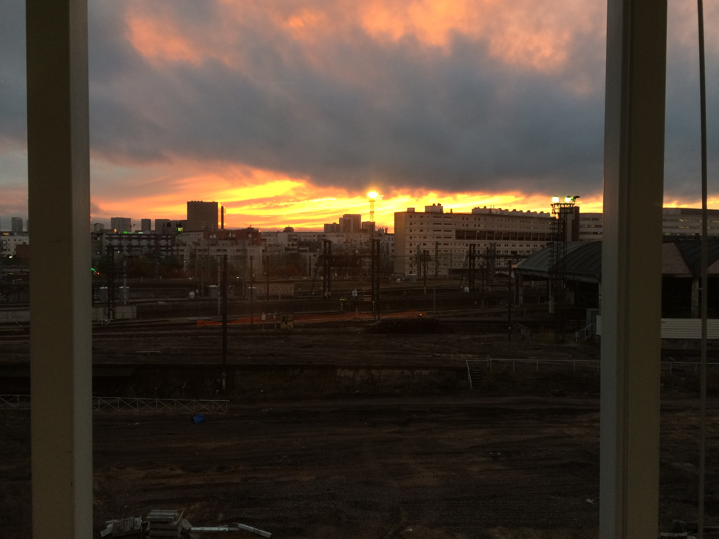
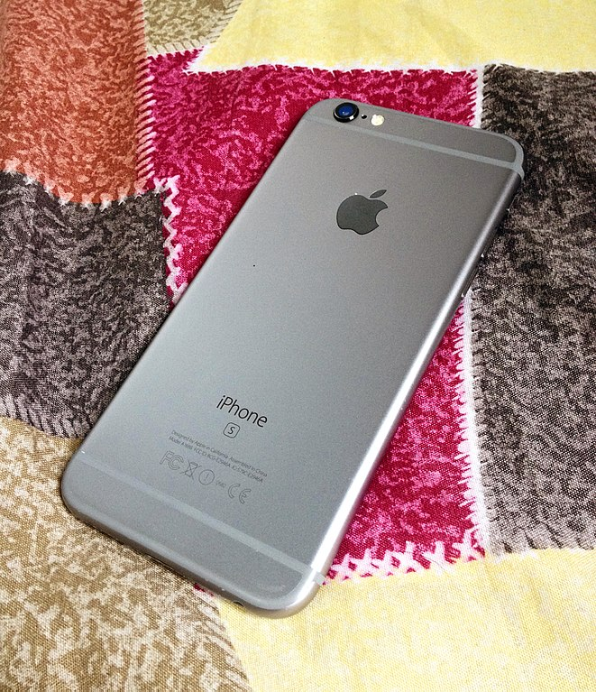
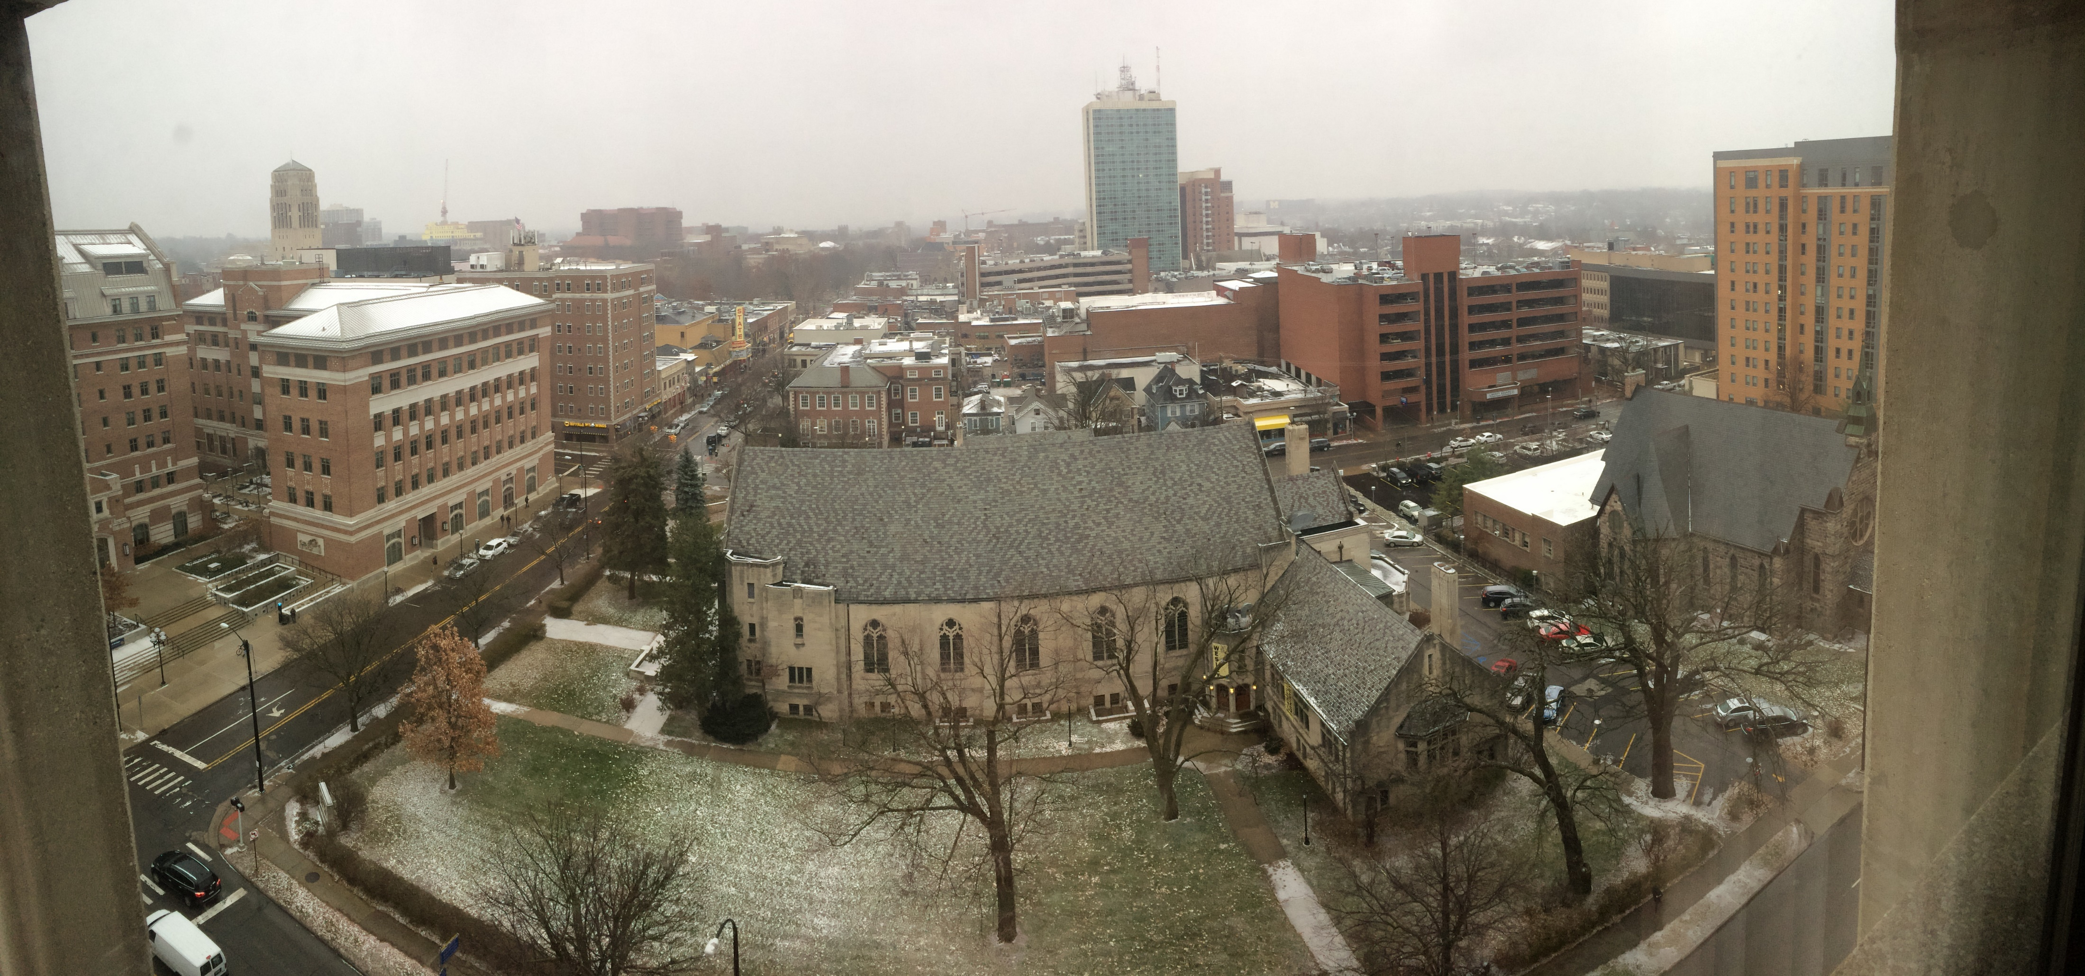
Look at Your Phone
Iphone Image Credit: Wikipedia

Slide 14
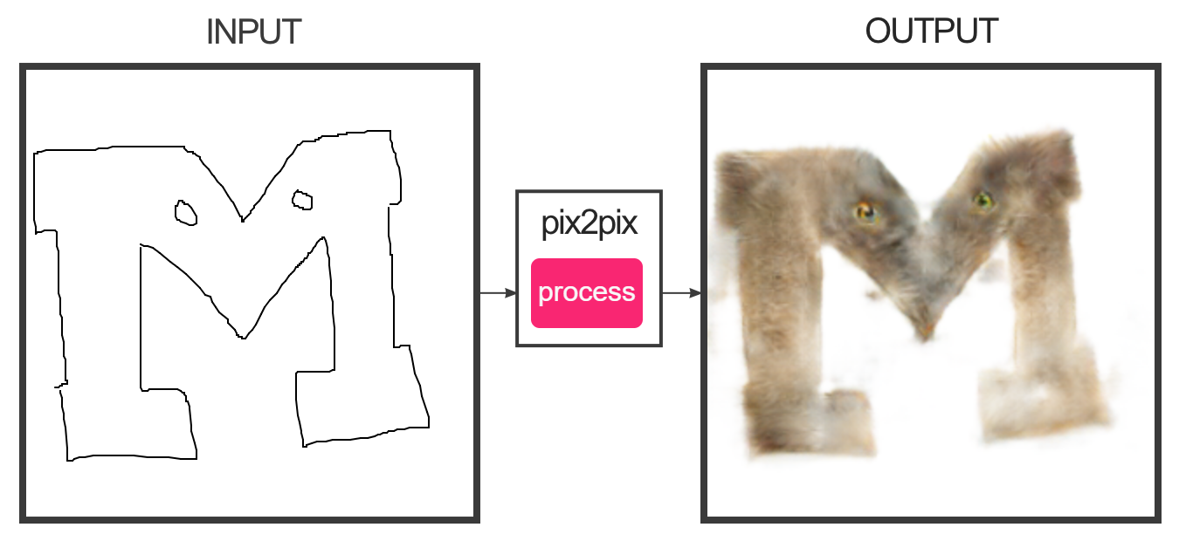
Graphics
https://affinelayer.com/pixsrv/
Isola et al. Image-to-Image Translation with Conditional Adversarial Networks. CVPR 2017

Slide 15
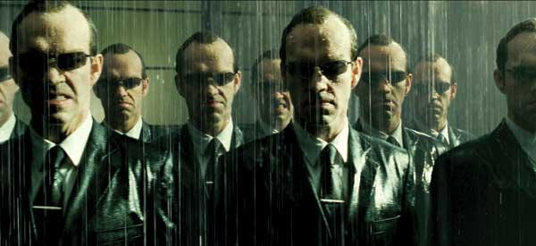
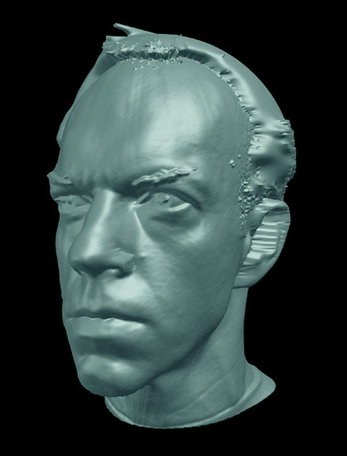
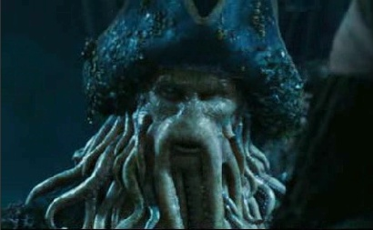
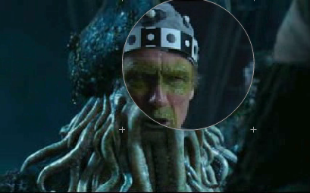
Graphics
Slide Credit: S. Seitz

Slide 16
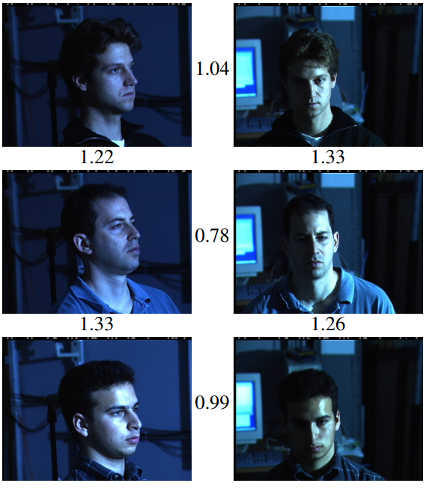
Faces
R¹²⁸
Schroff et al. FaceNet: A Unified Embedding for Face Recognition and Clustering. CVPR 2015

Slide 17
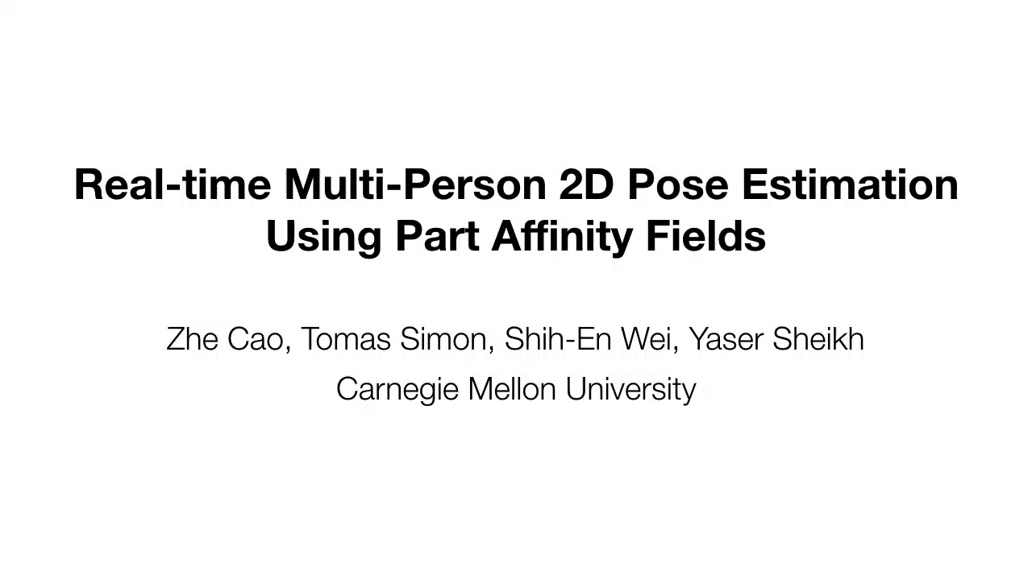
Humans
Cao et al. Realtime Multi-person 2D Pose Estimation using Part Affinity Fields. CVPR 2017

Slide 18
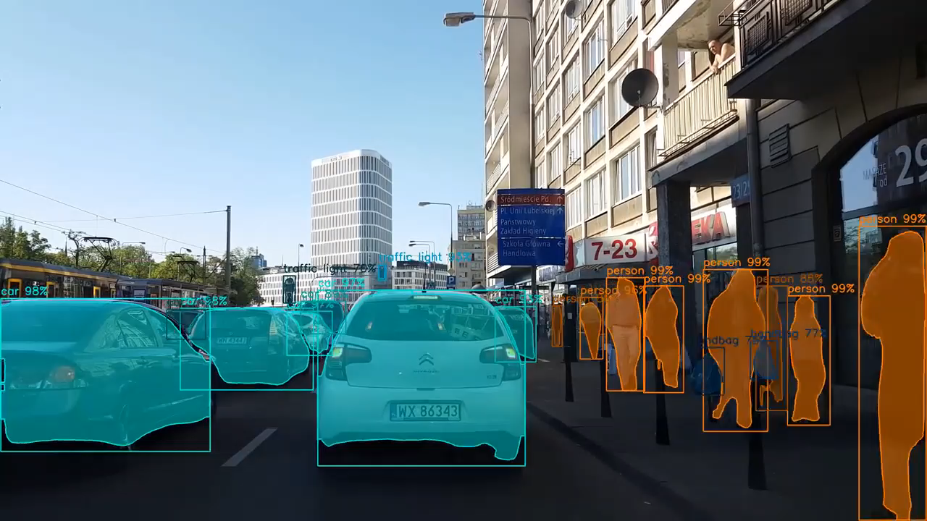
Recognition
He et al. Mask RCNN. ICCV 2017.
Video Credit: Karol Majek (https://www.youtube.com/watch?v=OOT3UIXZztE)

Slide 19

3D
Agarwal et al. Building Rome In A Day. ICCV 2009.

Slide 20
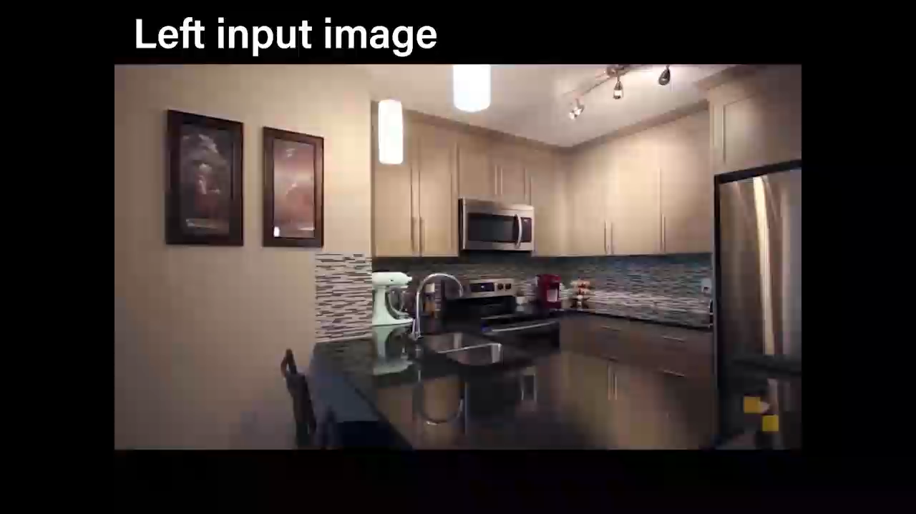
3D
Zhou et al. Stereo Magnification: Learning View Synthesis using Multiplane Images. SIGGRAPH 2018.

Slide 21
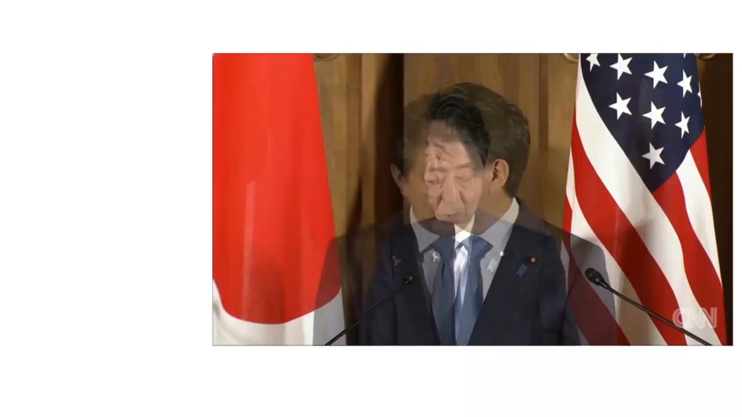
Vision Assisting Things
Owens et al. Audio-Visual Scene Analysis with Self-Supervised Multisensory Features . ECCV 2018

Slide 22
Why is Computer Vision Difficult?

Slide 23
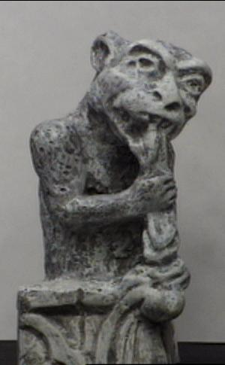
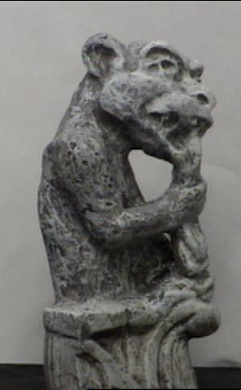
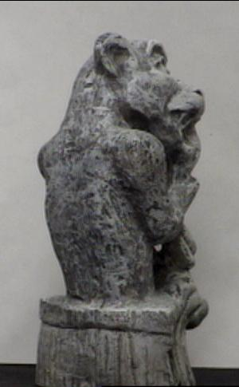
Viewpoint Variation
Slide Credit: L. Lazebnik

Slide 24
Illumination Variation
Image Credit: J. Koenderink

Slide 25
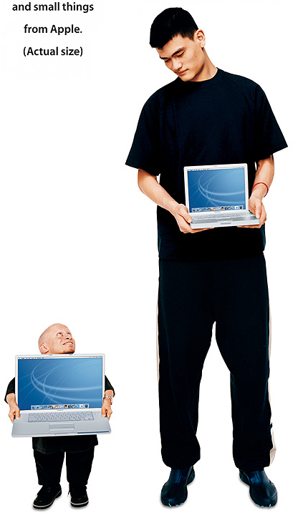
Scale Variation
Slide Credit: L. Fei-Fei, Fergus & Torralba

Slide 26
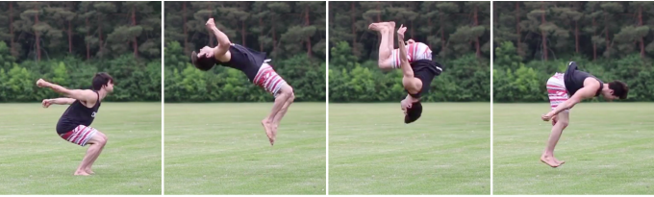
Deformation
Image Credit: Peng et al., SIGGRAPH ASIA 2018

Slide 27

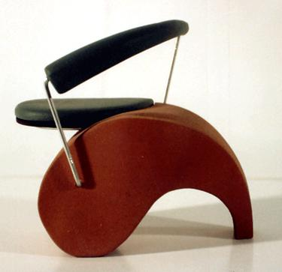


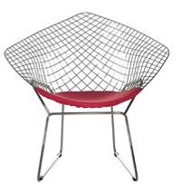

Intra-Object Class Variation
Slide Credit: Fei-Fei, Fergus & Torralba

Slide 28
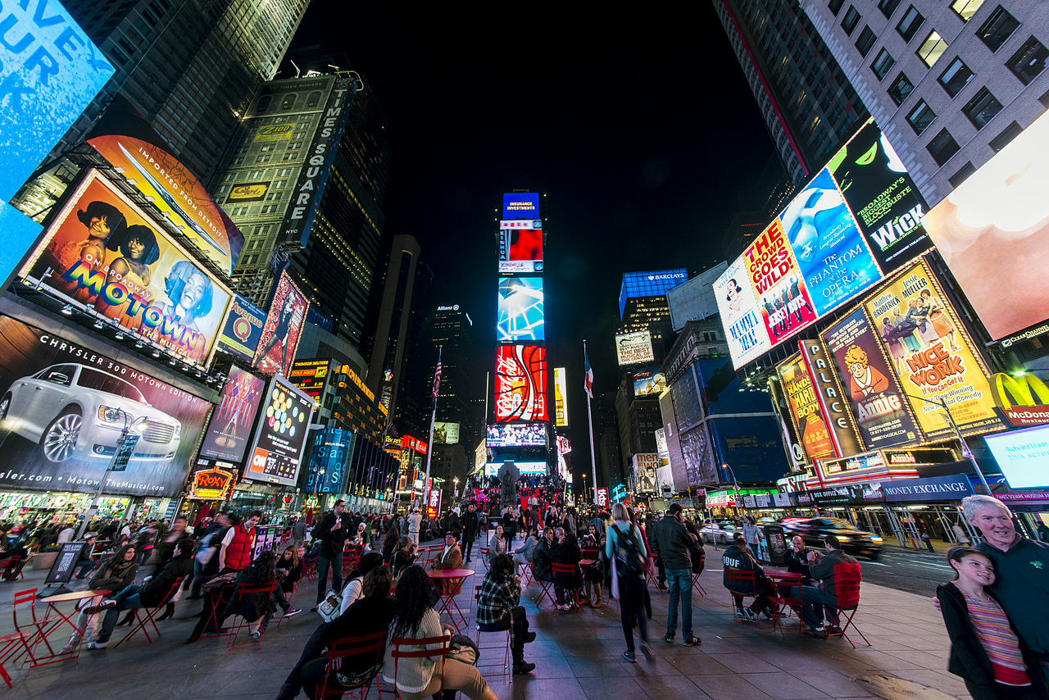
Occlusion, Clutter
Image Credit: Wikipedia

Slide 29

Ambiguity
Slide Credit: Fliegende Blätter

Slide 30
Ambiguity
Slide Credit: L. Fei-Fei, Fergus & Torralba

Slide 31
Ambiguity
Slide Credit: Sinha and Adelson 1993

Slide 32
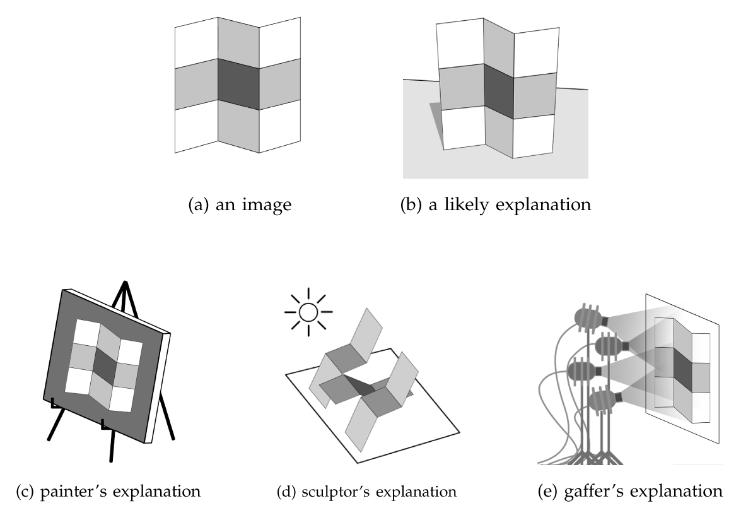
Ambiguity
Credit: E. Adelson and A. Pentland.The perception of shading and reflectance. Perception as Bayesian inference, 1996

Slide 33
Why is it Possible?
How many images are there?
#Colors^{#Pixels}
#Colors: 256³ > 10⁷
#Pixels: 1024² > 10⁶
10⁷⁰⁰⁰⁰⁰⁰
Atoms in universe: 10⁸²

Slide 34
Why is it Possible?
But most of those images aren’t “real” images or are slightly variations of real images.
Has
regularity
Has rules
Has rules and regularity
The
World
Imaging

Slide 35
Why is it Possible?
Has
regularity
Has rules
Has rules and regularity
The
World
Imaging

Slide 36
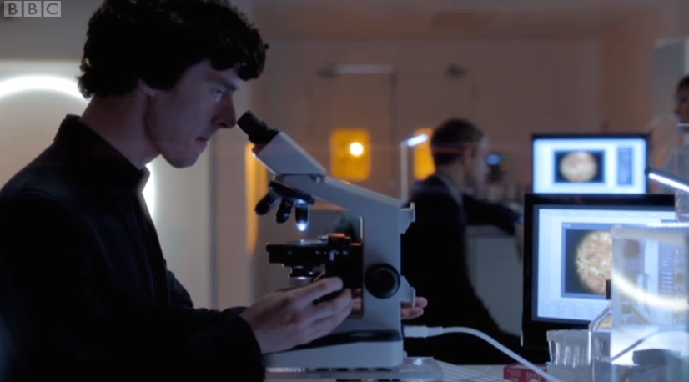
Our Job
Sift through: evidence (the image) and past experience (knowledge) to interpret the image correctly.
Slide Credit: J. Deng

Slide 37
Cues: Perspective

Slide 38
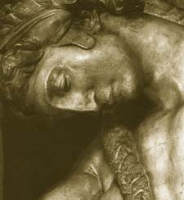
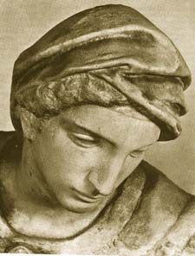
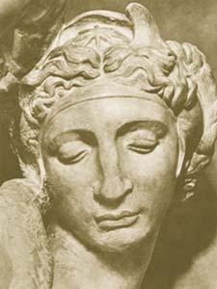
Cues: Shading
Slide Credit: L. Lazebnik, L. Fei-Fei, Fergus & Torralba

Slide 39
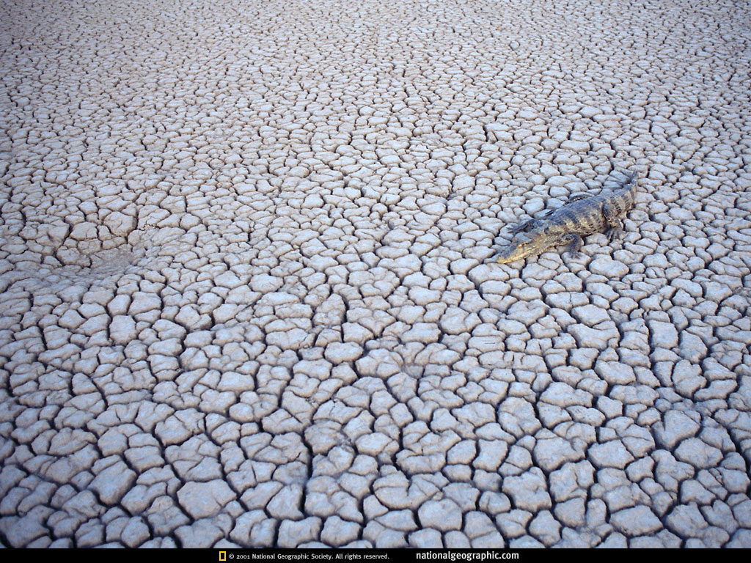
Cues: Texture Gradient
Slide Credit: J. Deng

Slide 40
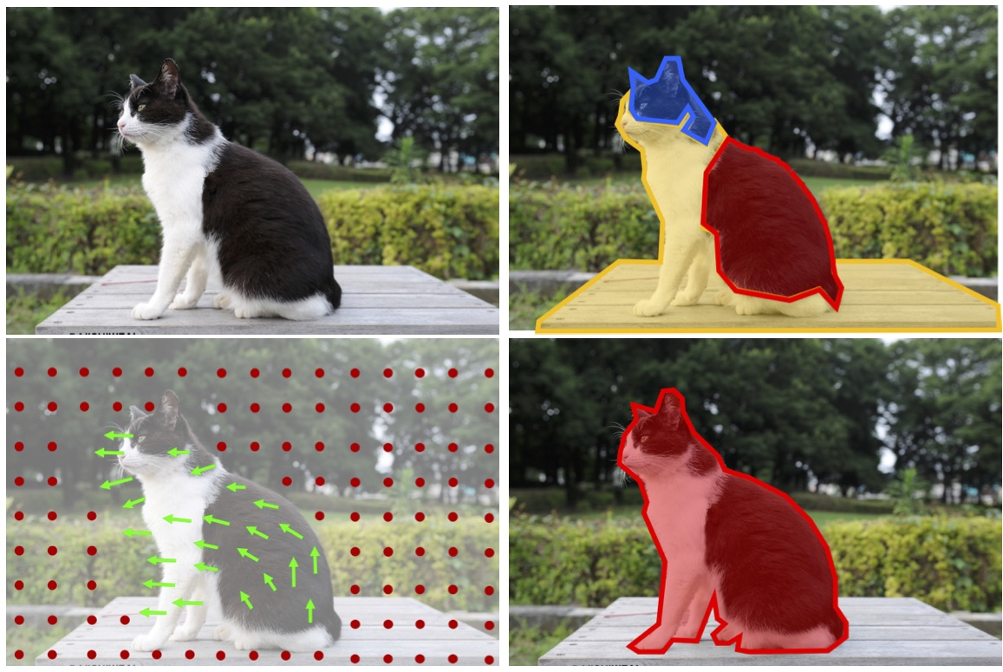
Cues: Common Fate
Image Credit: Pathak et al. Learning Features by Watching Objects Move. CVPR 2017.

Slide 41
Course overview
Image formation and processing
Learning and deep learning
Transformations and motion
3D reconstruction
Advanced topics

Slide 42
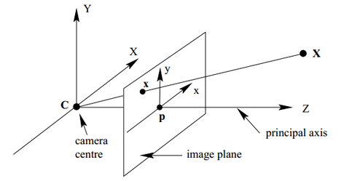
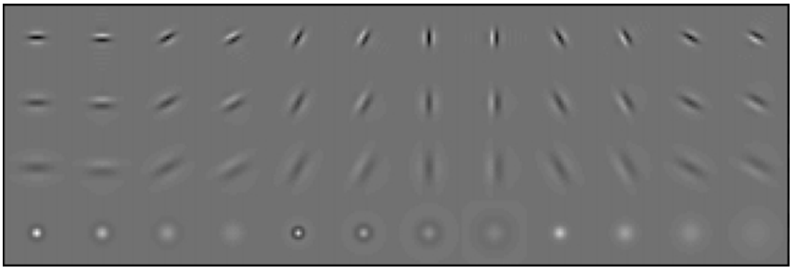
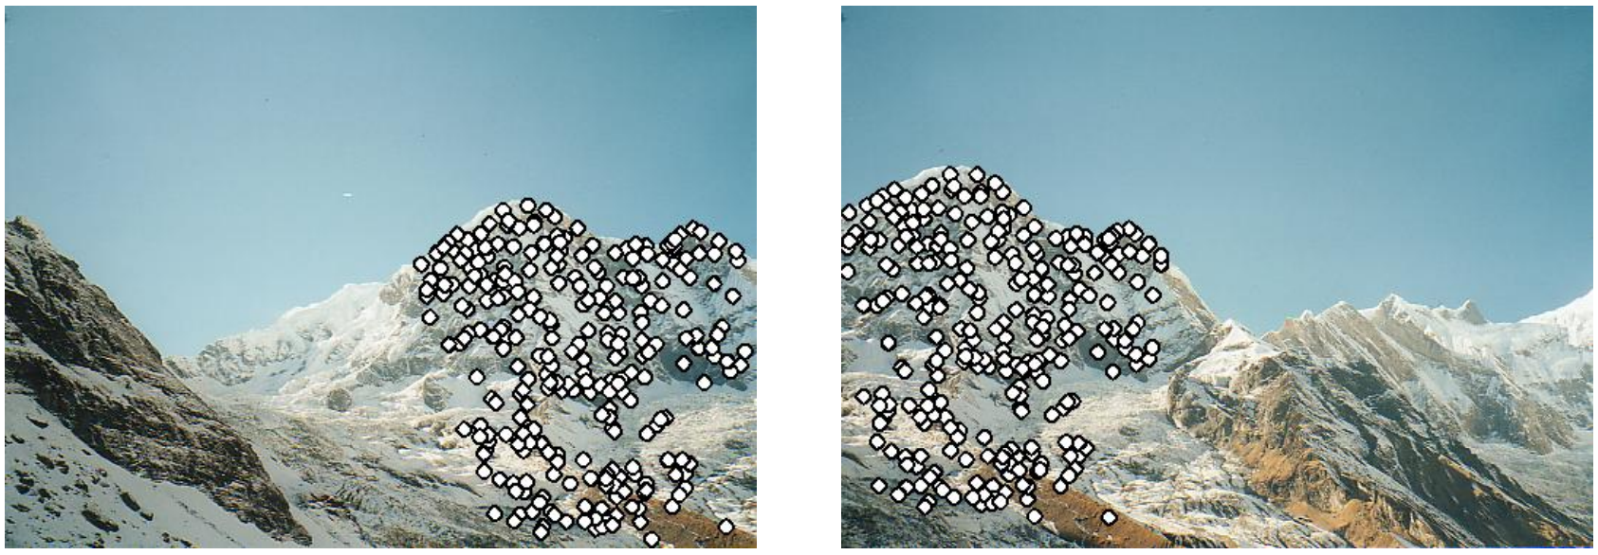
Part 1: Formation and Processing
Camera Models
Linear Filtering
Feature Detection
Image Credit: Hartley and Zisserman 04, Leung and Malik IJCV 01, Brown and Lowe ICCV 03,

Slide 43
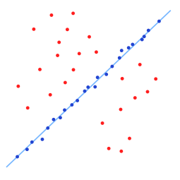
Part 2: Transformations and Fitting
Transformations
Robust Fitting
Image Credit: Wikipedia

Slide 44
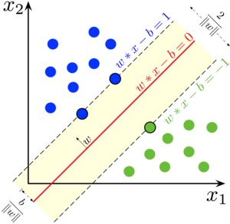
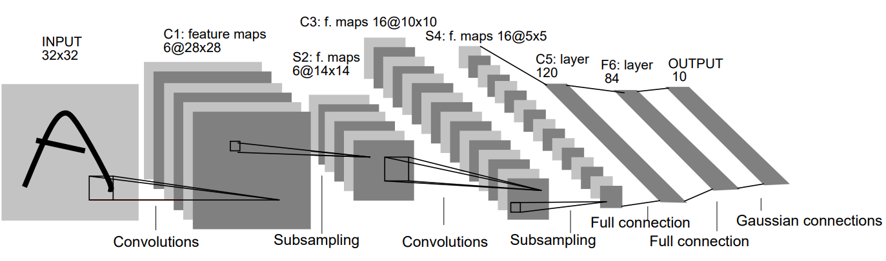
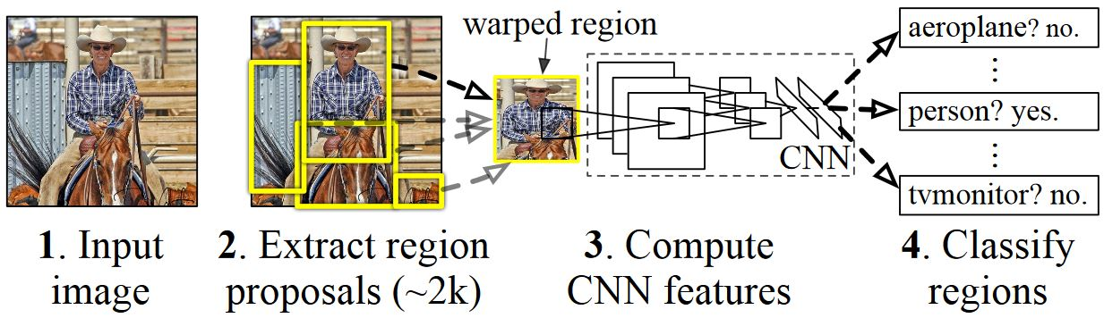
Part 3: Learning and Deep Learning
Image Credit: Wikipedia, LeCun et al. Proc IEEE 01, Girshick et al. CVPR14

Slide 45
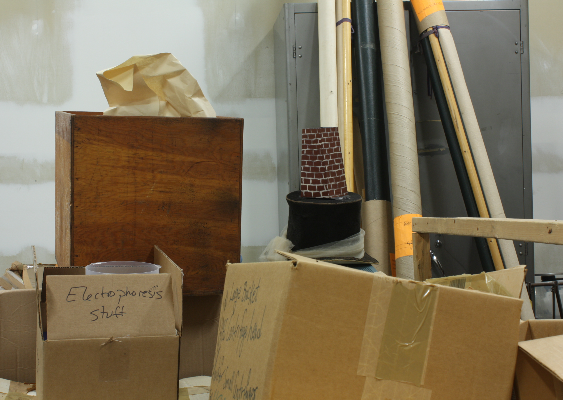
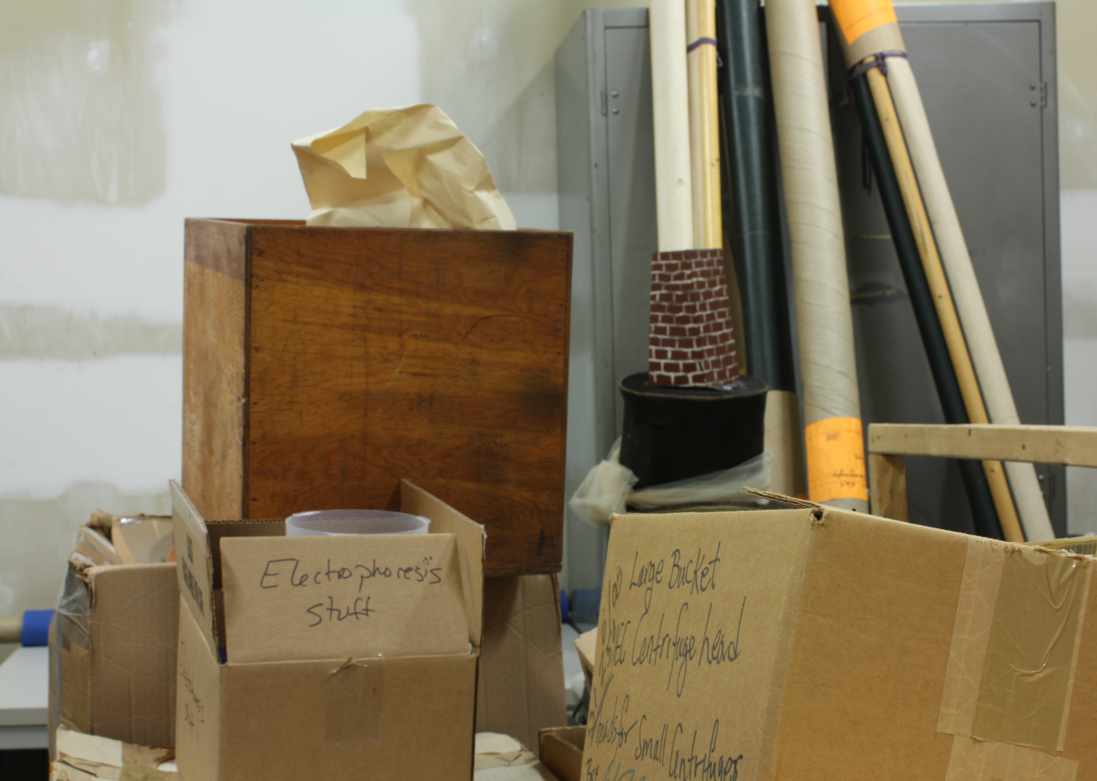
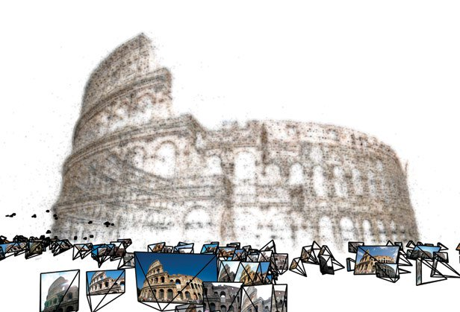
Part 4: 3D Reconstruction
Stereo
Vision
Multiview Stereo and
Structure From Motion

Slide 46
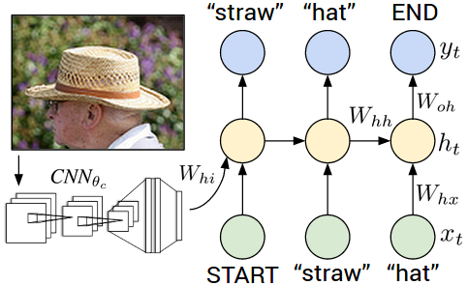
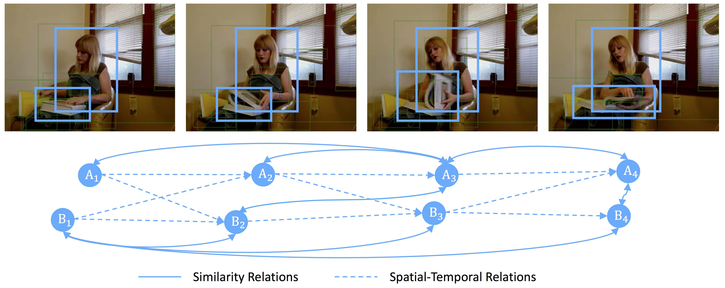
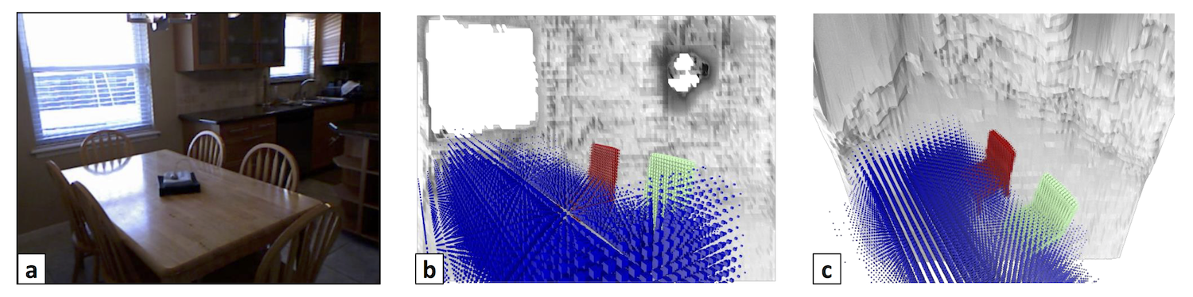
Part 5: Advanced Topics
Vision & Language
Video
Learning and Geometry
Image Credit: Karpathy et al. CVPR 2015, Wang et al. ECCV 2018, Tulsiani et al. CVPR 2018

Slide 47

Textbooks
No textbook, but Szeliski, Computer Vision: Algorithms and Applications, is a good reference and available online.
http://szeliski.org/Book/

Slide 48
Administrivia
Websites / Staff
Prerequisites
Waitlist etc.
Evaluation
Classes/Discussions/Piazza/Office Hours

Slide 49
Websites
Course website: http://web.eecs.umich.edu/~fouhey/teaching/EECS442_W19/
Piazza: You should have access via canvas
We’ll use Piazza to make announcements/discussions, and things like homework will appear on the website.

Slide 50
Piazza
Please ask questions on Piazza so we can answer the question once, officially, and quickly
We will monitor Piazza in a systematic way, but we cannot guarantee instant response times
Same goes for email

Slide 51
Staff
Professor: (me) David Fouhey
GSIs / IAs:
  Linyi Jin,
  Richard Higgins
  Shengyi Qian
  Yi Wen

Slide 52
Prerequisites
You absolutely need: EECS 281 and corresponding programming ability.
You will struggle continuously without: Basic knowledge of linear algebra, calculus.
You’ll have to learn: Numpy+PyTorch, a little tiny bit of continuous optimization

Slide 53
Prerequisites
Suppose K in R^{3x3}, x in R³ .Should know:
How do I calculate Kx?
When is K invertible?
What is x if Kx = λx for some λ?
What’s the set {y: x^{T}y = 0} geometrically?
You should also be able to remember some notion of a derivative

Slide 54
Waitlist Policies
Waitlist right now is huge
I will move as many people off as possible
I will not reorder the waitlist
If you are dropping, please drop quickly so others can be added quickly

Slide 55
Evaluation
Mid-term Exam: 15%
Homeworks: 5 x 10%
Project: 35%

Slide 56
Evaluation: Mid-term
15% of grade
Thursday before Spring Break (2/28) in class
  Please do not schedule things.
Will cover:
  Images and image processing
  Fitting and matching
  Basics of Learning

Slide 57
Evaluation: Homework
5 Homeworks, 10% Each
Submit a tiny project (code) + write-up (pdf)
You should discuss, but your implementations should be your own.
No: copying off the Internet or your classmates, asking reddit / stackoverflow, over-the-shoulder debugging
Overall: should not know the code for how others solved it.

Slide 58
Evaluation: Homework Late Days
3 late days in The Ann Arbor Bank of Late HW
Spend these as you choose. No loans!
No need to announce you’re taking a late day – we’ll just deduct it automatically.

Slide 59
Evaluation: Homework Late Policy
Penalty: 1% per hour, round to nearest hour
Example:
  Due: Midnight Mon. (1s after 11:59:59pm Mon)
  Submitted at 12:15am Tue: No penalty!
  Submitted at 6:50am Tue: 7% penalty
Exceptions only for exceptional circumstances (talk to us)
Questions?

Slide 60
Evaluation: Homework Advice
Start early: vision often takes a while to run. Think of both computer time and your time. They’re different.
Vision code often “works” a little, but poorly, with bugs. Build in time for two full screwups
Make things modular: visualize and test on smaller data.
All three interact – bugs are expensive since they may require lengthy reruns

Slide 61
Evaluation: Term Project
Work in a team of 2+ to do something cool
There will be a piazza thread for pairing up
Could be:
  Independent re-implementation of a paper
  Applying vision to a problem you care about
  Trying to build and extend an approach
Should be 3 homeworks worth of work per person

Slide 62
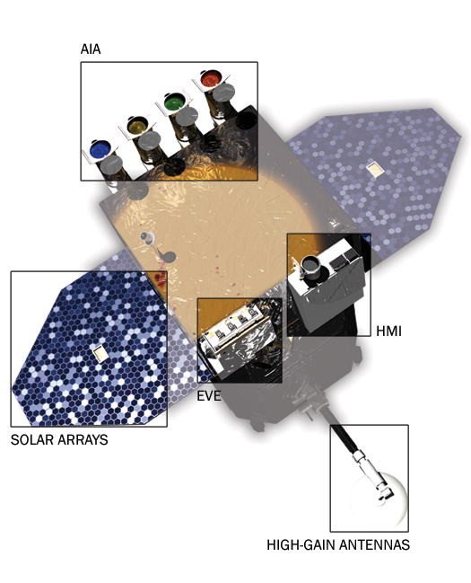
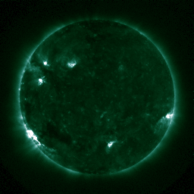


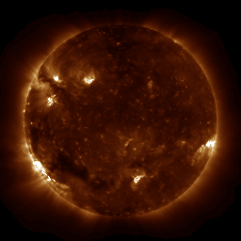
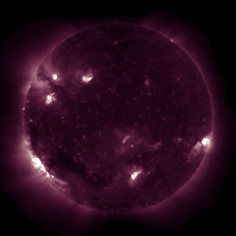

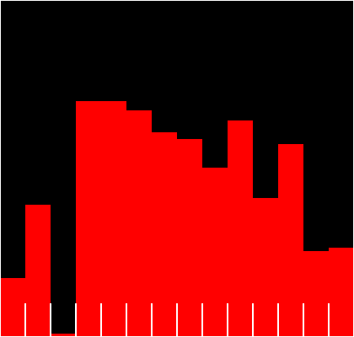



Evaluation: Term Project
Think outside the box!
FeXVIII
FeXX
FeIX
FeXI
FeXIII
HeII
FeXVI
Image Credit: Wikipedia

Slide 63
Evaluation: Term Project
Proposal due between Feb 14 – March 19. We will provide some inspiration. You can turn it in at any point and we will give you feedback quickly.
Progress Report due April 4: what have you done, what is left?
Final Project (code + report) due April 23 at the earliest (may give an extension).
Poster Session during Exams.
Questions?

Slide 64
Meetings
Class:
  Tue/Thu 10:30am – Noon, 1571 GGBL
Discussion Section
  Wed 5PM-6PM, 1571 GGBL
  Mon 12:30PM – 1:30PM, 1200 EECS
Office Hours
  Professor: 10:30am-Noon Fridays (BBB 3777)
  GSI/IAs: 3:00-4:30pm Tuesday, 2:30-4:00pm Thursday (BBB Learning Center)

Slide 65
Meetings
Mon
Discussion
12:30pm-
1:30pm
Tue
Class
10:30am-
12:00pm
Office Hours
3:00pm-
4:30pm
Wed
Discussion
5:00pm-
6:00pm
Thu
Class
10:30am-
12:00pm
Office Hours
2:30pm-
4pm
Fri
Office Hours
10:30am-
12:00pm

Slide 66
Questions?

Slide 67
Slide Credit: L. Lazebnik

