Slide 1
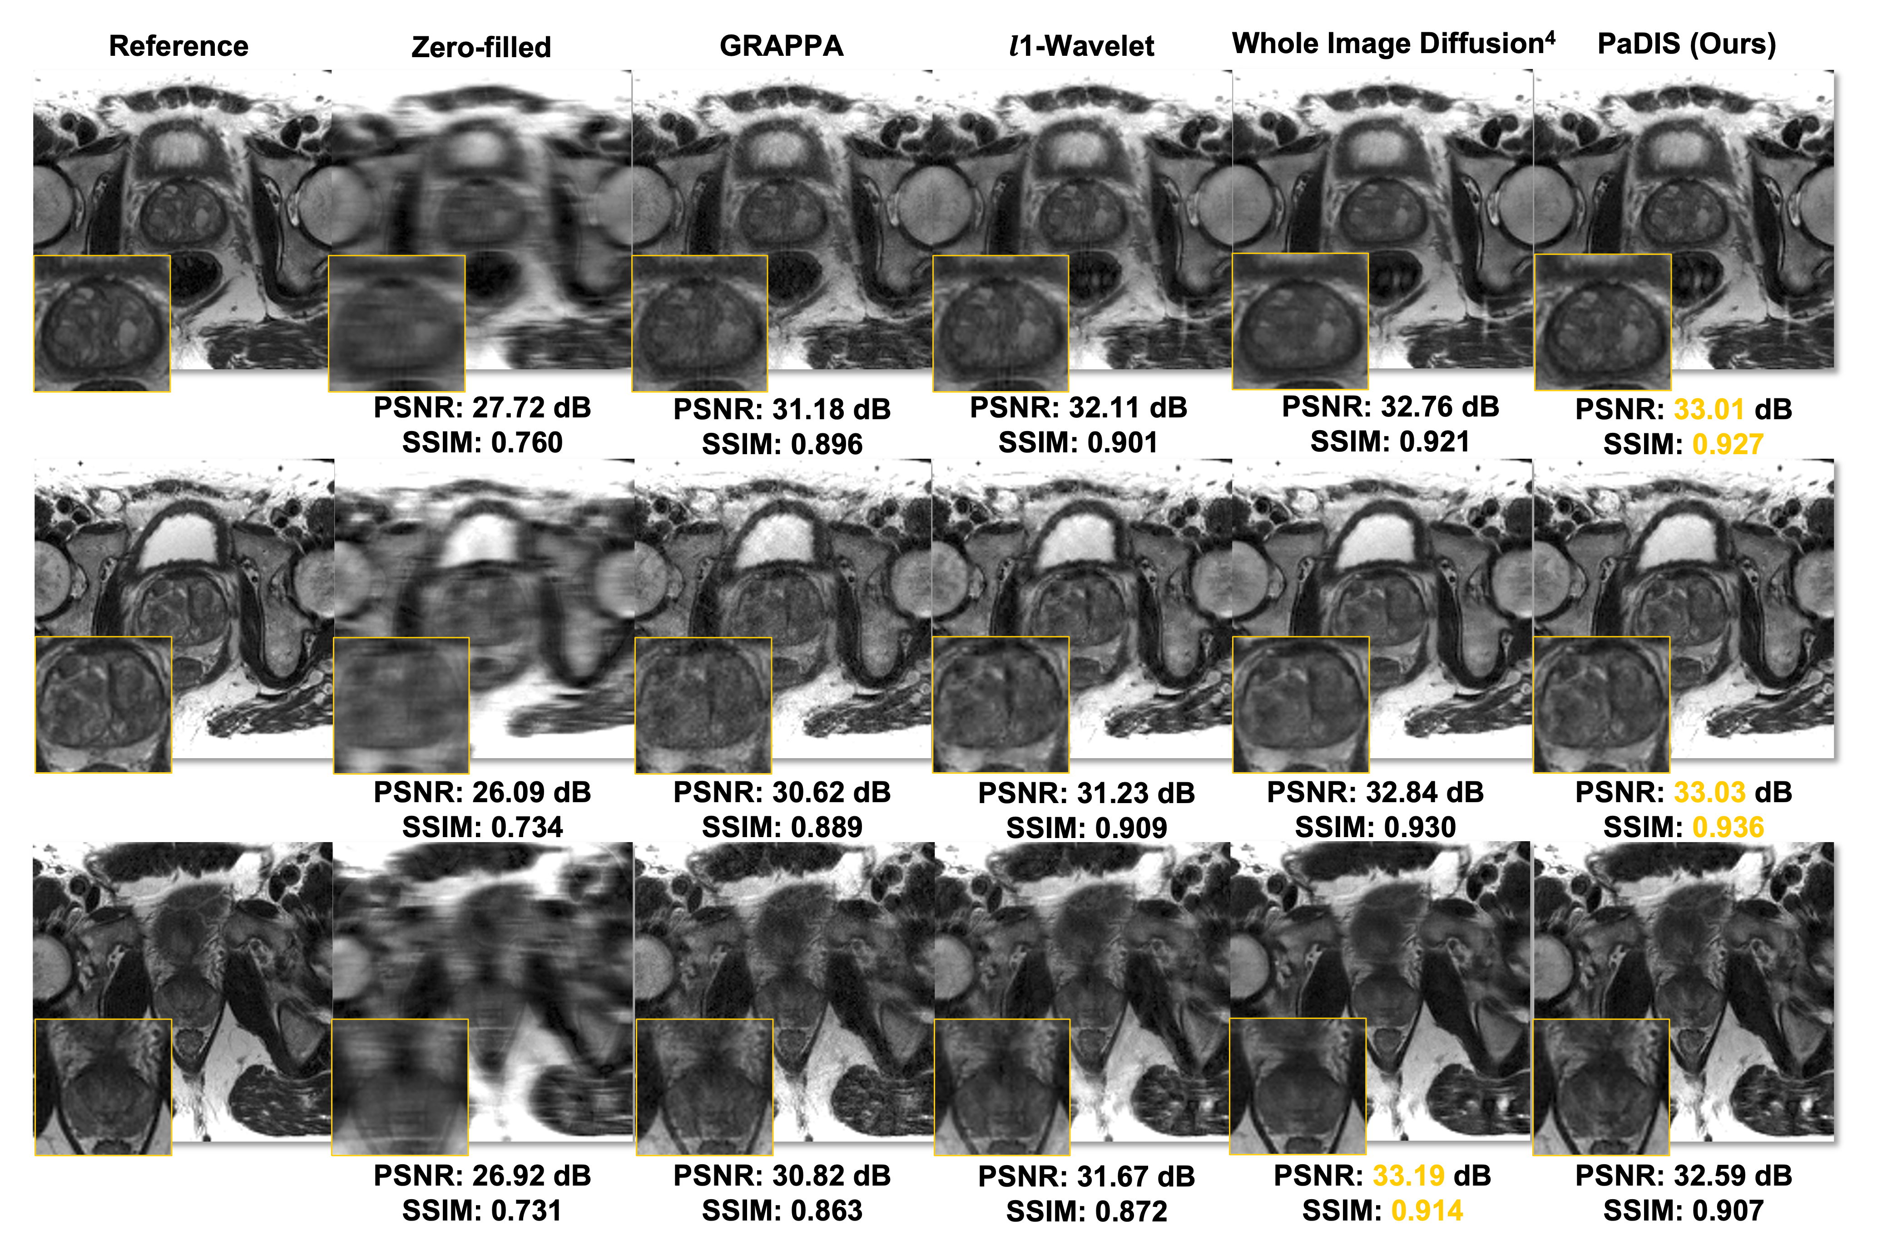
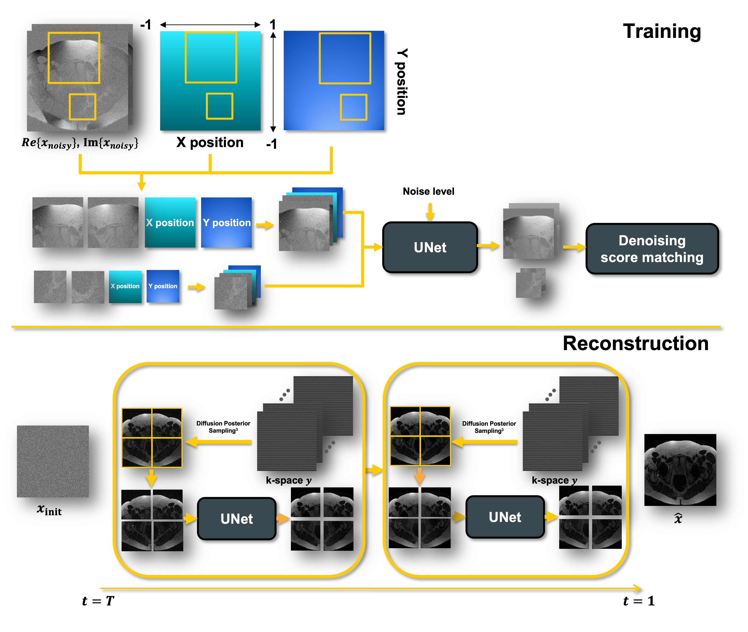
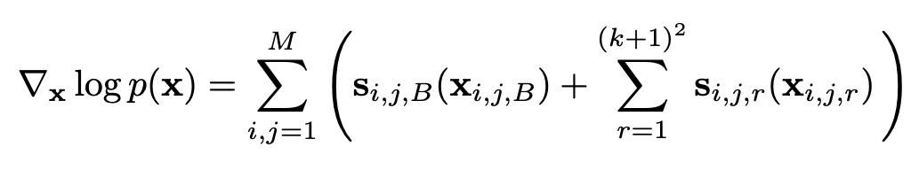
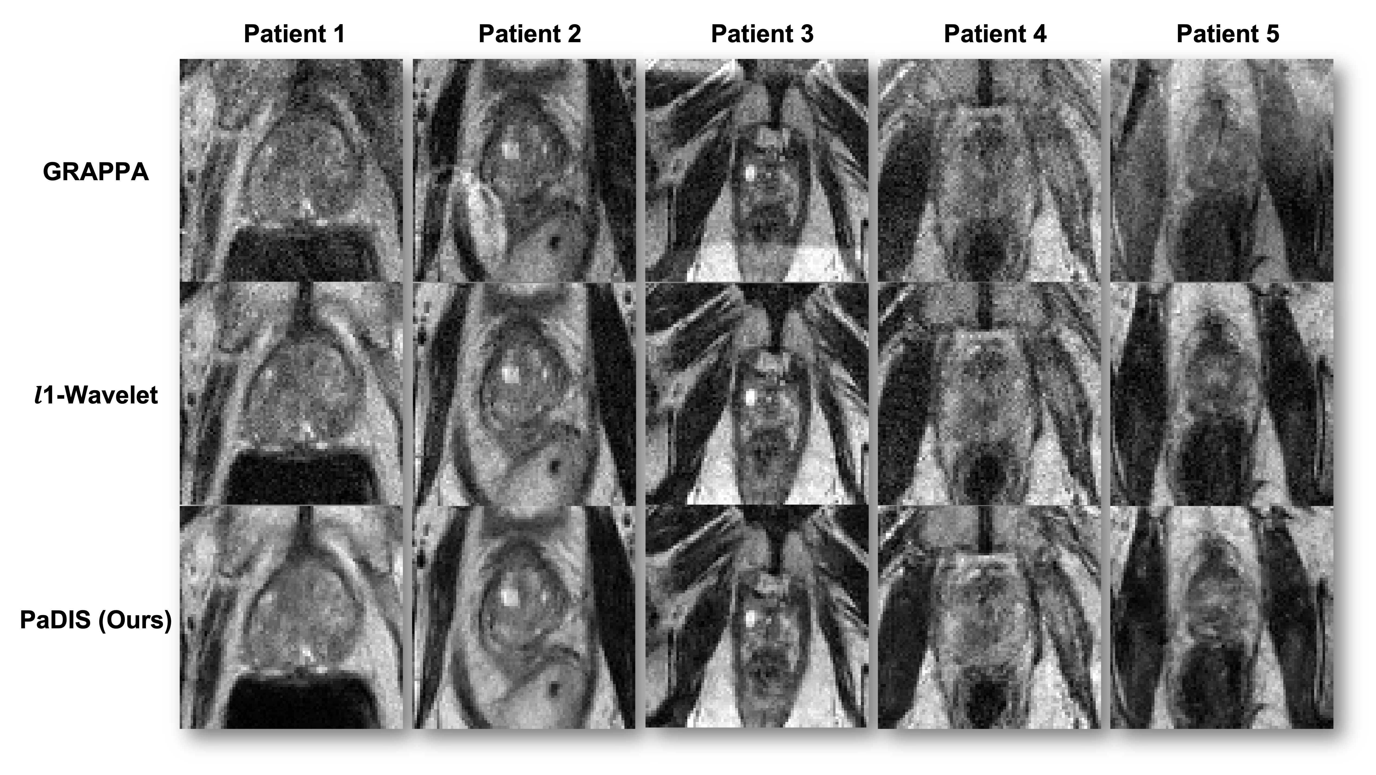
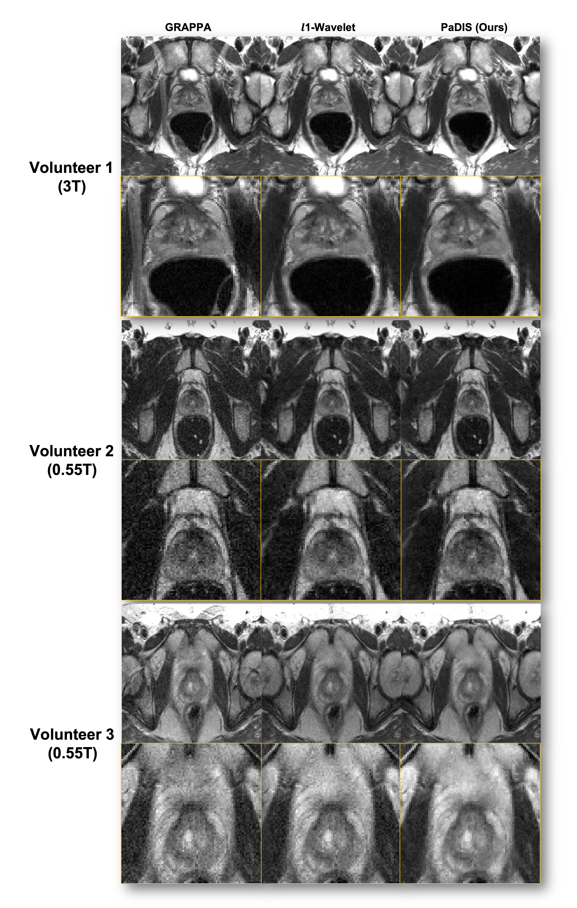
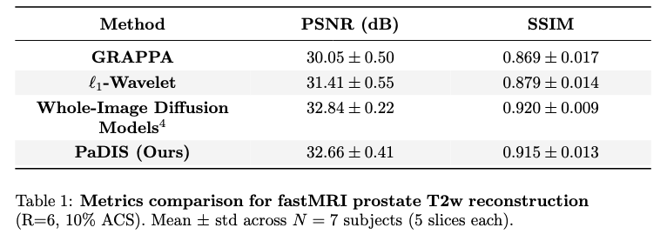
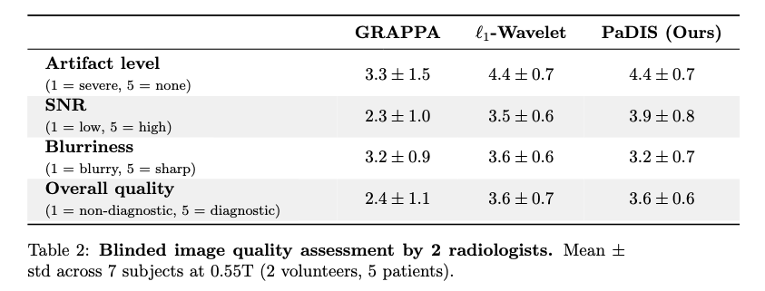



Patch-based Diffusion Inverse Solver for T2-Weighted Prostate Imaging Reconstruction
FastMRI Prostate Reconstruction :
Methods :
Hongze Yu¹, Jason Hu¹, Michael J. Jaroszewicz², Hero K. Hussain², Vikas Gulani², Jeffrey A. Fessler^{1,2,3}, Yun Jiang^{2,3}
Department of Electrical Engineering and Computer Science, University of Michigan, Ann Arbor, MI, US.
Department of Radiology, University of Michigan, Ann Arbor, MI, US
Department of Biomedical Engineering, University of Michigan, Ann Arbor, MI, US.
Model:
Overview: (1) learn a patch diffusion prior, (2) data-consistent reconstruction
Stage 1 (Prior): train a position-encoded patch U-Net denoiser $D_{θ}$ (real/imag + (x,y) position) through denoising score matching to obtain patch scores. The whole-image score is formed by summing tiled patch scores. B denotes the zero-padded boarder. Random patch shifts are included.
Stage 2 (Recon): starting from noise, iterate data consistency with forward model A and prior-gradient updates from aggregated tiled patch scores. Random tiling shifts are also implemented to avoid seams.
Goals :
Achieve high-quality, accelerated prostate T2-weighted MRI at 3T and 0.55T using a diffusion prior without whole-image training.
Introduction .
Prostate MRI benefits from fast, high-quality T2-weighted imaging, but acceleration is constrained by SNR loss and undersampling artifacts, especially at 0.55T, where longer scans increase motion risk and reduce diagnostic confidence.
Diffusion models [1–4] provide strong priors for accelerated MRI [5,6], but whole-image diffusion typically requires large curated datasets, long training, and high GPU memory. Patch-based Diffusion Inverse Solver (PaDIS) [7] mitigates these constraints by training on spatially encoded patches and aggregating patch scores into a global prior at inference, enabling data-efficient, memory-light diffusion priors.
We extend PaDIS to prostate T2-weighted imaging in this work and evaluate accelerated reconstruction at 3T and 0.55T. We benchmark against GRAPPA [8], ℓ1-wavelet [9], and whole-image diffusion [4], and include blinded 0.55T reader scoring for artifacts, SNR, sharpness, and overall quality.
(6x, 10% ACS)
0.55T Patient Reconstruction :
Volunteer Reconstruction :
Conclusions :
PaDIS provides a diffusion prior for accelerated prostate MRI using only patch-based training, reducing data and GPU memory needs versus whole-image diffusion. Across 3T and 0.55T, PaDIS improved SNR and reduced aliasing relative to GRAPPA and ℓ1-wavelet and achieved comparable or higher radiologist preference. These results support faster, higher-quality prostate MRI, particularly at low field, and the approach is readily extensible to other anatomies.
(4x, no ACS)
Experiments :
PaDIS and a whole-image diffusion baseline [4] were trained on 6,000 fastMRI 3T prostate slices [10] and evaluated at 3T and 0.55T.
In vivo data comprised fastMRI 3T and in-house scans: 1 healthy at 3T (Vida) and 2 healthy + 5 patients at 0.55T (FreeMax), axial T2w TSE, 3 mm slices, with (FOV/resolution/acceleration) 180×180 mm²/0.56×0.56 mm²/6× (retrospective), 200×200/0.52×0.52/3× (prospective), and 220×220/0.85×0.85/4× (prospective). PaDIS trains ~3× faster and uses ~2× less GPU memory than whole-image diffusion.
Full Abstract
Reference: [1] Song, Y, et al. NeurIPS 2019. [2] Ho, J, et al. NeurIPS 2020. [3] Chung, H, et al. ICLR 2023. [4] Karras, T, et al. NeurIPS 2022. [5] Cao, C, et al. IEEE TMI 2024. [6] Sanda, R, et al. arXiv 2025 (arXiv:2509.21531). [7] Hu, J, et al. NeurIPS 2024. [8] Griswold, MA, et al. MRM 2002. [9] Lustig, M, et al. MRM 2007. [10] Tibrewala, R, et al. Sci Data 2024.
Notes:
Todo list:
Reference in the main contents
Proofread

