Slide 1
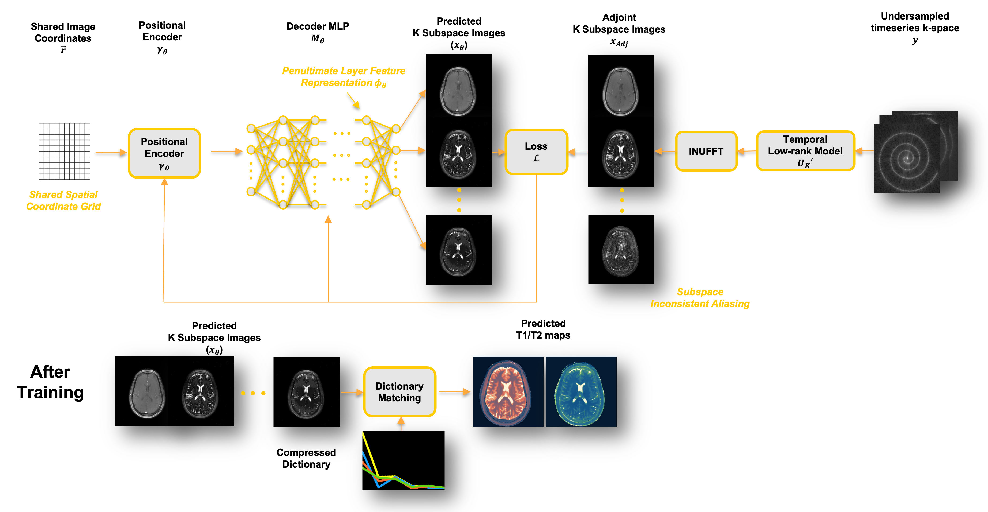
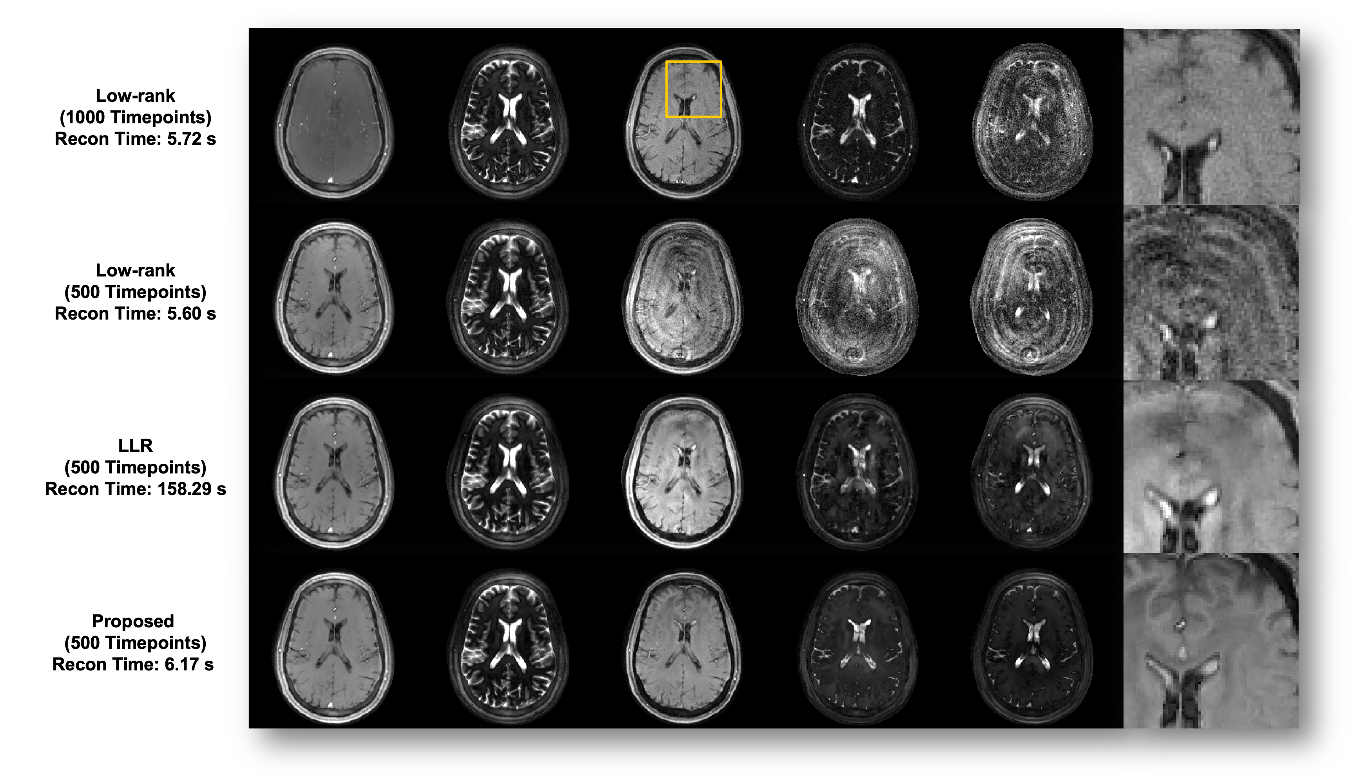
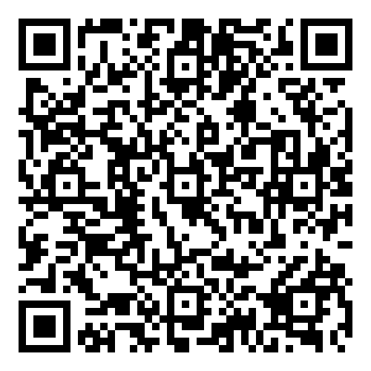
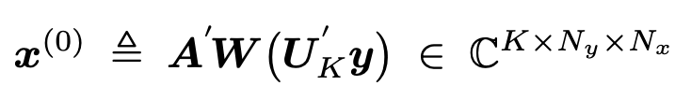
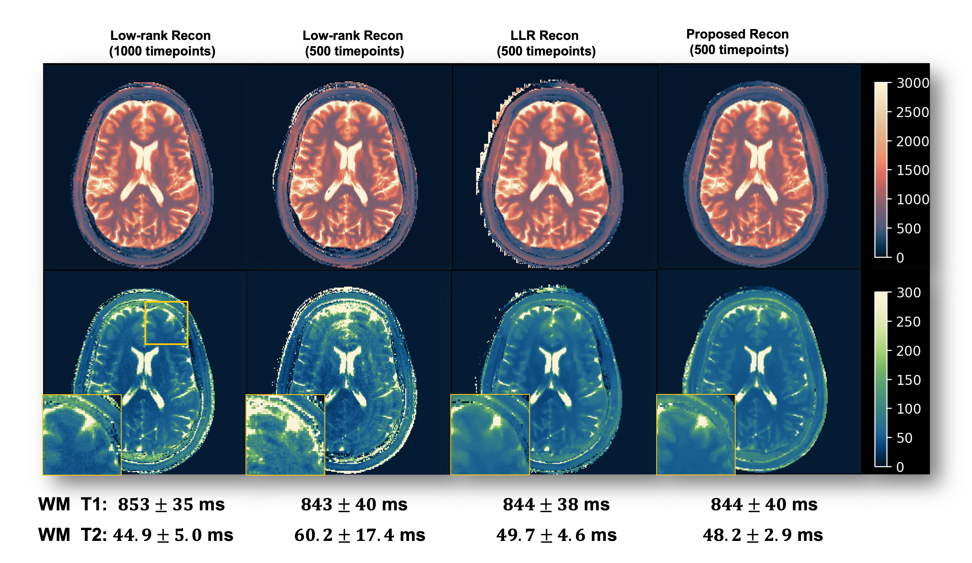
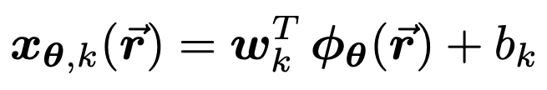
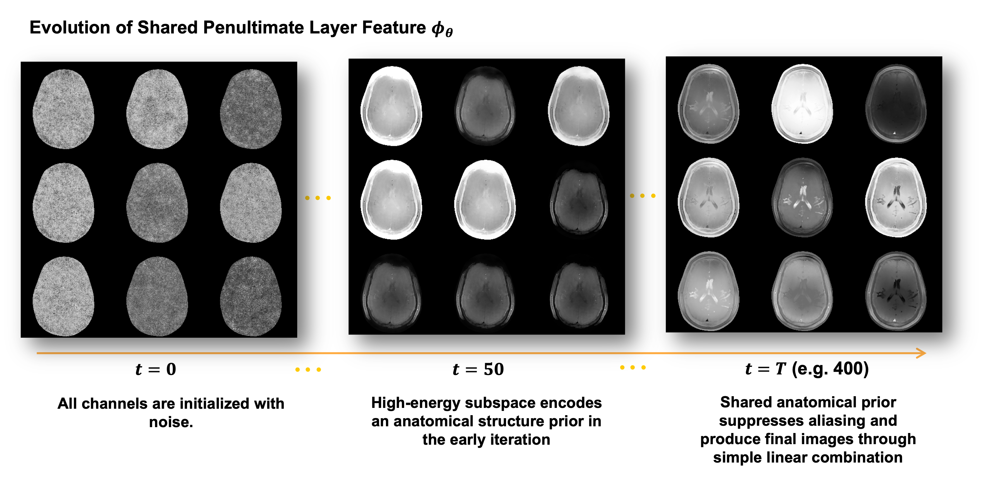
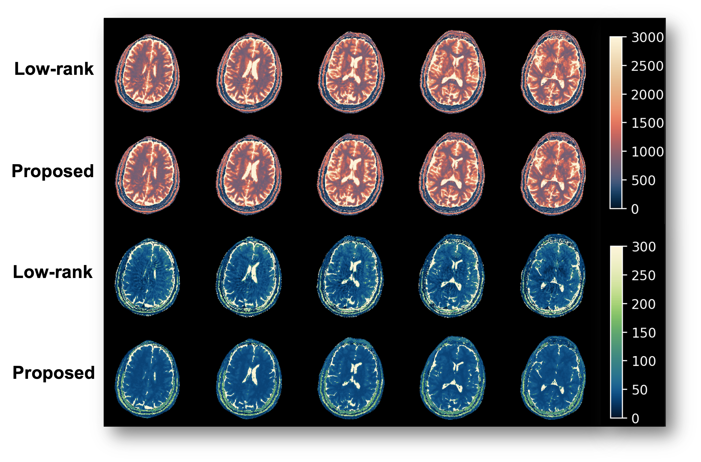
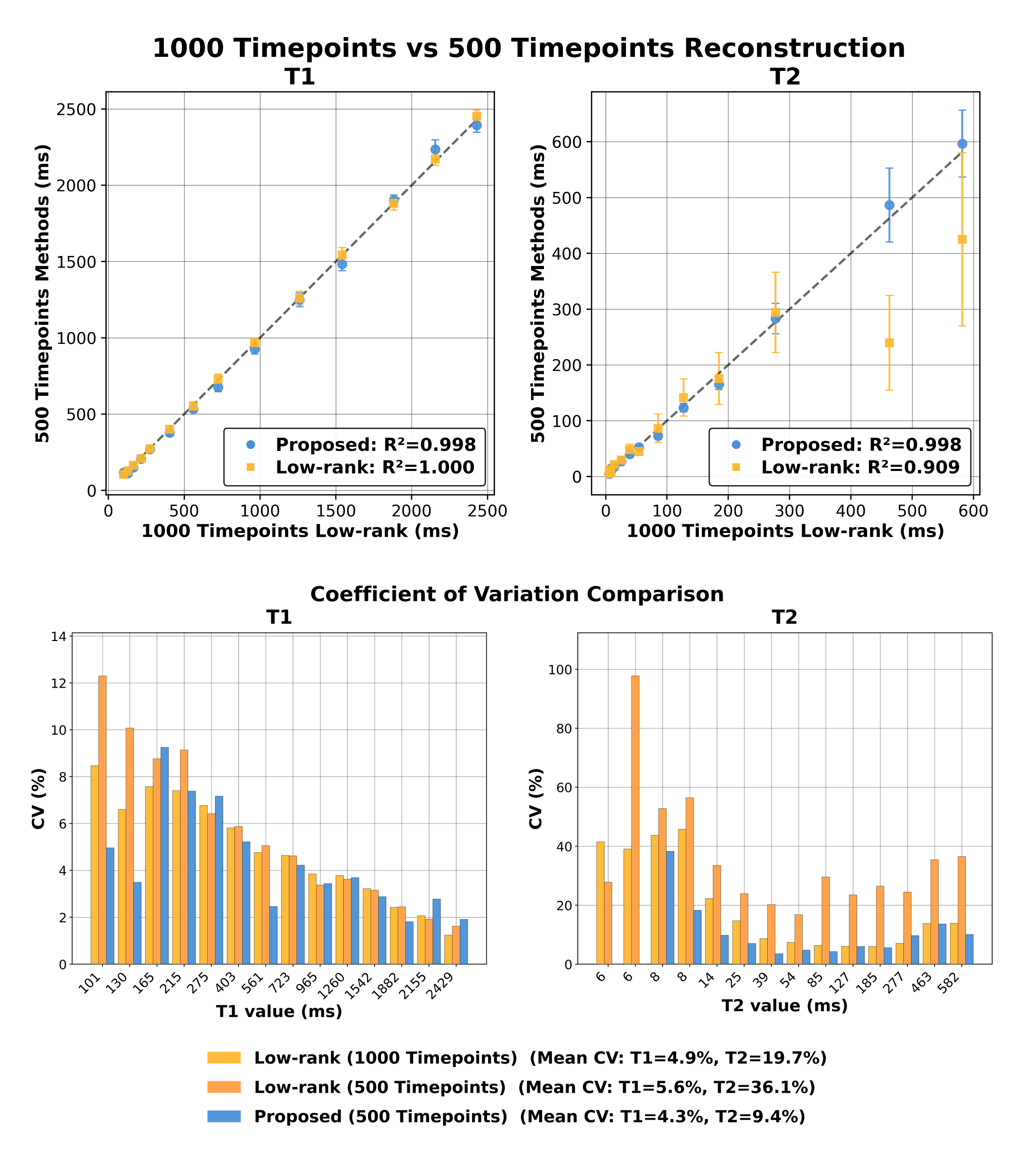



Joint Implicit Neural Representation for Fast Scan-Specific Magnetic Resonance Fingerprinting
Joint Implicit Neural Representation for Fast MRF :
Shared Spatial Representation :
Hongze Yu¹, Christopher Keen², Kaixuan Jin¹,
Jeffrey A. Fessler^{1,2,3}, Yun Jiang^{2,3}
Department of Electrical Engineering and Computer Science, University of Michigan, Ann Arbor, MI, US.
Department of Biomedical Engineering, University of Michigan, Ann Arbor, MI, US.
Department of Radiology, University of Michigan, Ann Arbor, MI, US
Video Visualization
Shared Spatial Representation – Suppress Subspace Inconsistent Aliasing and Recover Anatomical Structure
Methods :
Model:
Input (Target): Low-rank subspace reconstruction (W – Density Compensation, U_{k} – Rank-k temporal basis matrix (99.99% energy),
y – highly undersampled time-series MRF k-space data)
Joint INR: fit a single network $f_{θ}\left(\vec{r}\right)∈ℂ^{K}$ with shared coordinates to all K subspace images
Shared anatomy feature: INR trunk outputs $φ_{θ}\left(\vec{r}\right)$ (penultimate-layer feature) representing scan-specific anatomy
Subspace-specific contrast: each fit subspace coefficient uses the lightweight final linear layer of MLP to model contrast while sharing anatomy (w_{k} , b_{k}: weight and bias corresponding to k-th subspace)
Why it works (gradient dominance): the high-SNR, least-aliased component dominates early gradients, driving $φ_{θ}\left(\vec{r}\right)$toward a clean anatomy; more aliased components reuse $φ_{θ}\left(\vec{r}\right)$, suppressing subspace-inconsistent aliasing. (Evolution of $φ_{θ}$ shown below)
Optimization: fit $f_{θ}\left(\vec{r}\right)$in the image domain with L2 loss + encoder/MLP weight decay (no iterative k-space consistency)
Goals :
Achieve fast, scan-specific MRF reconstruction with accurate, precise T1/T2 mapping from shorter acquisitions.
Shared Spatial Representation + Pure Image-Domain Fitting
2D MRF (6 seconds) & 3D MRF (45 seconds) :
Introduction .
MR Fingerprinting (MRF) enables rapid multiparametric mapping [1,2], but its highly undersampled, long time-series makes reconstruction ill-posed and slow. Model-based iterative methods [3] and network priors [4] suppress aliasing but often remain too slow for routine use. We propose a scan-specific MRF reconstruction using a gradient-guided joint implicit neural representation (INR) [5]. A single INR parameterizes all subspace images from the MRF series, acting as an implicit spatial prior that suppresses subspace-inconsistent aliasing while preserving fine detail. The INR is fit purely in the image domain—no training data or iterative k-space consistency required as in prior INR approaches [6–9]—reducing runtime. We evaluate T1/T2 mapping on the ISMRM/NIST phantom and in vivo brain, compared with low-rank [10] and iterative LLR [3] reconstructions.
2D Single-Slice MRF Recon
(500 Timepoints)
48-96x Undersampled Variable-Density Spiral
2.21 ms Readout
Acquisition time (1000 timepoints) – 4.5 s
Reconstruction time
Low-rank: 5.60 s
Iterative LLR: 158.29 s
Proposed: 6.17 s
3D Volumetric MRF Recon
(384 Timepoints)
48-96x undersampled variable-density spiral
2.21 ms readout
20 partitions (showing 5 representative slices)
Input 3D spatial grid
Acquisition time (1000 timepoints) – 180 s
Reconstruction time
Low-rank: 15.13 s
Proposed: 45.33 s
Conclusions :
The proposed method learns a shared, scan-specific spatial representation that serves as an implicit prior to suppress aliasing in highly undersampled MRF. It produces sharp, low-variance T1/T2 maps with as few as 500 timepoints. The approach is image-domain, requires no external training data, and avoids iterative k-space data consistency, enabling faster reconstruction with improved map quality. Overall, the results indicate that shorter acquisitions and near-real-time MRF reconstruction are feasible without compromising quantitative accuracy or precision.
ISMRM/NIST Phantom Validation :
NIST Phantom Recon
(500 Timepoints)
48-96x undersampled variable-density spiral
2.21 ms readout
Lower coefficient of variation than 1000 timepoints low-rank reconstruction
Pure Image-Domain Fitting – Fast Reconstruction
*Reconstruction time includes all processing from raw data to T1/T2 maps for all methods
Experiments :
ISMRM/NIST phantom and 4 healthy volunteers were scanned on a 3T Siemens Vida using FISP-MRF [2] (TE/TR = 2/9 ms, 1000 timepoints) with single-interleaf variable-density spiral undersampling (2.21 ms readout; 96 interleaves fully sampled).
Full Abstract
Reference: [1] Ma, D, et al. Nature 2013. [2] Jiang, Y, et al. MRM 2015. [3] Lima da Cruz, G, et al. MRM 2019. [4] Hamilton, JI. Front Cardiovasc Med 2022. [5] Sitzmann, V, et al. NeurIPS 2020. [6] Feng, R, et al. IEEE TMI 2024. [7] Feng, J, et al. IEEE TMI 2025. [8] Li, C, et al. MRM 2025. [9] Yu, H, et al. arXiv 2025 (arXiv:2502.21292). [10] McGivney, DF, et al. IEEE TMI 2014.
Notes:
Todo list:
3 Minutes Pitch, write a draft of the pitch
What is the center message and key message, show it
Change the order of the second panel
Different Way to use INR then others
5 seconds reconstruction

