Slide 1


Detecting Covert Timing Channels with Time-deterministic Replay
Ang Chen* W. Brad Moore⁺ Hanjun Xiao*
Andreas Haeberlen* Linh Thi Xuan Phan* Micah Sherr ⁺ Wenchao Zhou ⁺
University of Pennsylvania* Georgetown University ⁺

Slide 2







Motivation: Detecting covert timing channels
Launch code:
1011
Ah! 1011
President
1
0
1
1
Launch code
Code is 1011
H
E
L
L
O
Attacker
Secretary
Covert timing channel: Leaks secrets by changing
the timing of network outputs

Slide 3
State of the art: Statistics-based detection
Normal traffic:
H
E
L
L
O
Large gaps
1
0
1
1
Small gaps
With channel:
H
E
L
L
O
Distribution of inter-packet delays
Current approaches look for specific statistical deviations

Slide 4







Problem: Making a new channel is easy!
1
0
0
1
1
Admin
?
Needle in a haystack
Existing detectors are channel-specific:
Using detector A for channel B doesn’t work
Attacker can always invent a new modulation
Low-rate channels ("Needle in a haystack") are hard to detect

Slide 5








Is there a different way?
Observed
Expected
Existing approaches detect specific anomalies
Our approach: Compare the observed timing to
the expected timing
Works for covert timing channels in general
→ Can detect both known and unknown/novel channels!
But how do we know what timing we should expect?

Slide 6
How can we find the expected timing?
It would be difficult to predict the timing up front
See, e.g., WCET analysis in real-time systems
And WCET would only give us an upper bound -
but we would need the exact timing!
Key insight: We only need to reproduce the timing!
We can record the inputs of the machine and then
replay them on a different machine!
Can we use deterministic replay to do this?

Slide 7
Why Deterministic Replay is not enough
p3
p2
p1
p3
p2
p1
log
log
log
e1
e1
e1
e2
e2
e2
e3
e3
e3
Deterministic replay records and replays non-deterministic events
This reproduces the outputs - but not the timing!

Slide 8




Time-deterministic replay (TDR)
H
E
L
L
O
T
H
E
L
L
O
R
D
Goal: Reproduce both the outputs and the timing
With this, we can detect covert timing channels as follows:
Reproduce the timing of every network output
Compare the observed timing to the reproduced timing
Raise the alarm if there is any discrepancy
7

Slide 9

Outline
Motivation
Challenge
Time-deterministic replay (TDR)
  Deterministic replay vs. Time-deterministic replay
  Time noise, and how to reduce it
  Aligning play and replay
Sanity: A TDR prototype
  Design & Implementation
Evaluation
  Reducing time noise
  Aligning play and replay
  Detecting timing channels
Conclusion

Slide 10
Deterministic Replay is not enough
Time during
replay (s)
240
200
160
120
80
40
0
Replay is faster
Actual
Ideal
Replay is slower
Time during
play (s)
0 20 40 60 80 100 120 140 160
Experiment: Record and replay an HTTP server in an existing VMM with deterministic replay (XenTT)
Result: Play and replay take widely different amounts of time

Slide 11
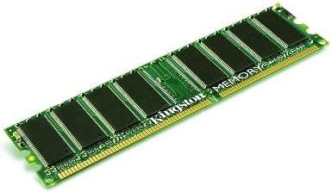

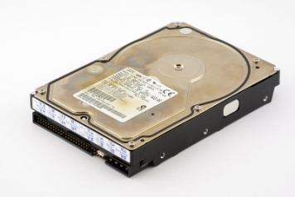



What is causing this discrepancy?
There are many different sources of timing variation ("time noise"), such as:
Different memory allocations and cache behavior
IRQs and system calls take different amounts of time
Disk accesses take different amounts of time
Kernel may interfere with execution or cache content
CPU features, such as frequency scaling and speculation
Non-deterministic scheduling decisions
See paper for details

Slide 12
Example: Controlling time noise from memory
Cache
Memory
var
var
Problem: Different cache behaviors and memory locations during play and replay.
Solution: (1) Manage all memory allocations
(2) Flush cache before execution

Slide 13
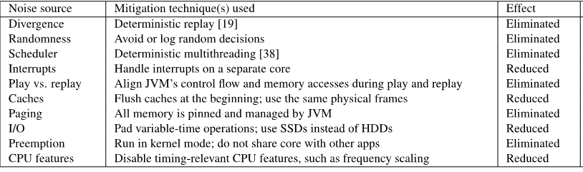
Techniques for mitigating time noise
Not all sources of time noise can be eliminated on commodity
hardware (e.g., speculation)
But we can still achieve a very low noise level

Slide 14
Problem: Play and replay have different logic
void accessInt(int *value, int *buf) {
if (isPlay)
*buf = *value;
else
*value = *buf;
}
void accessInt(int *value, int *buf) {
int temp = (*value) & playMask;
temp = temp | (*buf & ∼playMask);
*value = *buf = temp;
}
Play
Replay
Play
Replay
Different memory access patterns
Different branches taken
Same memory access pattern
No branches taken
Would deterministic hardware, e.g., a PRET machine (Edwards and Lee, 2007), solve all our problems?
Problem: Play and replay involve different operations
Solution: Carefully design the code to align play and replay

Slide 15

Outline
Motivation
Challenge
Time-deterministic replay (TDR)
  Deterministic replay vs. Time-deterministic replay
  Time noise, and how to reduce it
  Aligning play and replay
Sanity: A TDR prototype
  Design & Implementation
Evaluation
  Reducing time noise
  Aligning play and replay
  Detecting timing channels
Conclusion

Slide 16
Prototype implementation: Sanity
Ideal: Implement TDR in an existing VMM, such as Xen
But time-determinism is difficult to add to existing codebases
  Reason: Complex interactions between unrelated functions,
  e.g., through the cache
Our approach: Build a VMM from scratch
  Chose Java VM because of its simplicity
  No advanced features yet (e.g., no JIT)
  → Can't expect to compete with Oracle JVM
We rely on the Linux kernel for device I/O (e.g., network)
Sanity is implemented as a kernel module

Slide 17
How Sanity shields itself from the kernel
Commands
Timed core
Results
Support core
To avoid interference from the kernel, we run the
TDR engine on a separate core
Limitation: Need two cores to do the work of one

Slide 18
Outline
Motivation
Challenge
Time-deterministic replay (TDR)
  Deterministic replay vs. Time-deterministic replay
  Time noise, and how to reduce it
  Aligning play and replay
Sanity: A TDR prototype
  Design & Implementation
Evaluation
  Reducing time noise
  Aligning play and replay
  Detecting timing channels
Conclusion

Slide 19

Evaluation: Overview
Q1: How well can Sanity reduce time noise?
Q2: How well can Sanity align play and replay?
Q3: How fast is Sanity?
Q4: How large is Sanity’s log?
Q5: How well can Sanity detect covert timing channels?

Slide 20
Experimental setup
Experiments were run on a Dell Optiplex 9020 workstation
(3.4GHz Intel i7-4770 CPU, 16 GB RAM, 128GB Vector ZDO SSD, Linux 3.12)
We use two applications:
  SciMark2 (computation-intensive benchmark)
  nfsj: Open-source NFS server
Baseline: Oracle’s SE 7u51 JVM

Slide 21
How well can Sanity reduce time noise?
Timing
Variance
(%)
79
80
60
40
20
0
Dirty (with GUI and other programs)
Clean (single-user mode)
Sanity
51
44
32
32
15
16
17
15
1.2
14
.3
1.2
.09
.08
1.2
SOR SMM MC LU FFT
Benchmark
Experiment: Run SciMark2 for 100 times in Oracle’s JVM and Sanity
Sanity’s time-determinism is orders of magnitude better than that of a standard JVM!

Slide 22
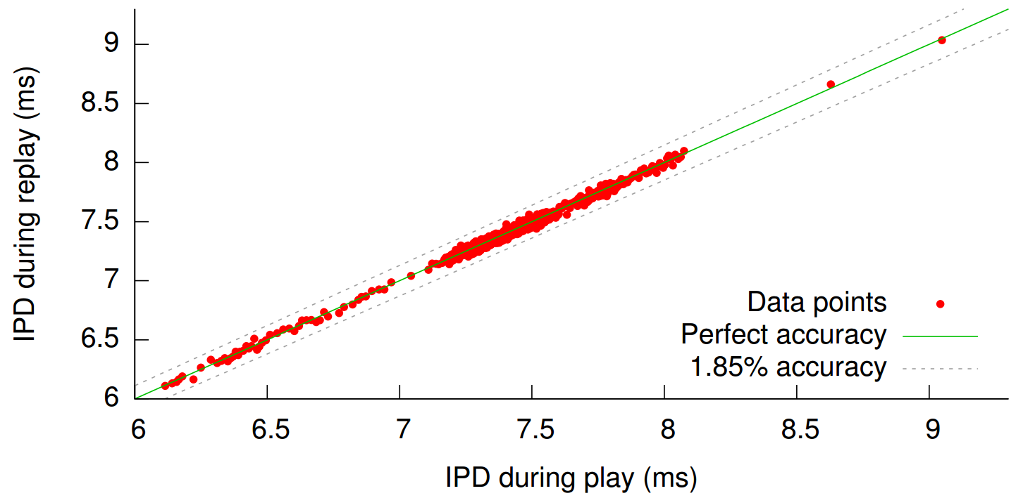
How well can Sanity reproduce timing?
Data points
Perfect accuracy
1.85% difference
Experiment: Run nfsj and serve 30 files, then replay.
Sanity can almost perfectly reproduce the timing of network outputs during replay

Slide 23
How well can Sanity detect timing channels?
We implemented three known channels:
IP covert timing channel (IPCTC) [CBS-CCS’04]
Traffic replay covert timing channel (TRCTC) [Cabuk-thesis’06]
Model-based covert timing channel (MBCTC) [GWWJ-RAID’08]
Plus one new channel:
"Needle in a haystack" (worst case for detector)
We used four known detectors:
Shape test [CBS-CCS’04]
KS test [PNR-S&P’06]
Regularity test [CBS-CCS’04]
Corrected conditional entropy test [GW-CCS’02]
Plus our new Sanity-based detector

Slide 24
How to measure the quality of a detector
True positive rate
Perfect accuracy
1
0
Area under
the curve
False positive rate
0 1

Slide 25
How well can Sanity detect timing channels?
1
0
1
0
1
0
1
0
Shape test
KS test
RT test
CCE test
Sanity
0 1
TRCTC
0 1
0 1
IPCTC
0 1
MBCTC
Needle
Experiment: Run each channel against each detector
Observations:
  All detectors can detect IPCTC with perfect accuracy
  Existing detectors do worse for more sophisticated channels
  Existing detectors cannot detect "Needle in a haystack" well
  Sanity detects all channels with perfect accuracy!
  (no false positives, no false negatives)

Slide 26
Summary
Goal: Detect covert timing channels
Existing detectors look for signs of specific, known channels
  Result: "Cat-and-mouse game" with the attacker
Our approach: Compare the observed timing to what it
'should be' if the machine is not compromised
  Works for all timing channels, including novel ones
  Key challenge: How do we know what the timing should be?
We introduce time-deterministic replay (TDR)
We have built a TDR prototype called Sanity
  Reproduces timing to within 2% (on commodity hardware)
  Can be used to detect a variety of existing and novel covert
  timing channels with perfect accuracy

