Slide 1

Dispersing Asymmetric DDoS Attacks with SplitStack
Ang Chen, Akshay Sriraman, Tavish Vaidya⁺, Yuankai Zhang⁺
Andreas Haeberlen, Boon Thau Loo, Linh Thi Xuan Phan, Micah Sherr⁺ Clay Shields⁺, and Wenchao Zhou⁺
University of Pennsylvania Georgetown University⁺

Slide 2
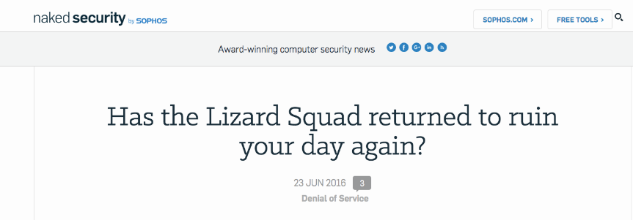
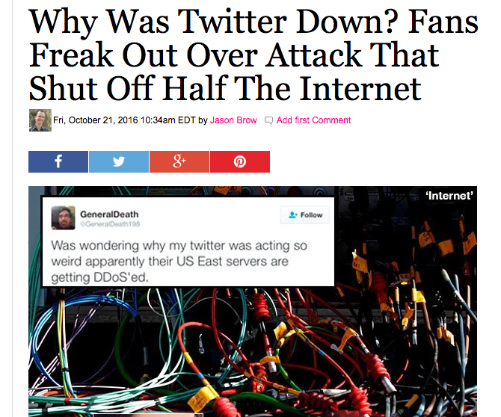
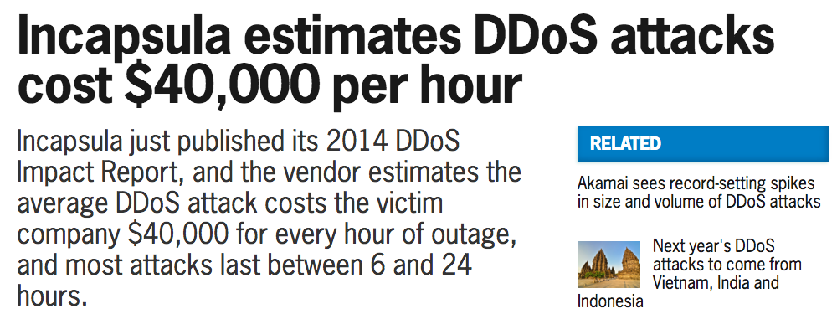
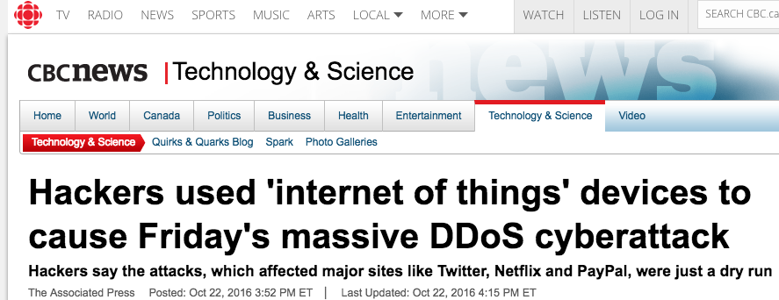
Motivation: Defending against DDoS attacks
Distributed Denial-of-Service (DDoS) attacks happen almost on a daily basis
They cause serious damage
We need effective defenses!

Slide 3


Challenge: Asymmetric attacks
Brute-force attacks
Asymmetric attacks
Brute-force attacks:
  Overwhelm the network link with UDP packets
  Defense → Match the resource on the attacker’s side
Asymmetric attacks:
  Small attack resource, larger attack scale
  David vs. Goliath → Trickier to defend against!

Slide 4



Example: SSL regenotiation
client--hello
server--hello
renegotiate
Server does 10x more computation than the client!
renegotiate
...
SSL renegotiation attack
  Overwhelms the server’s CPU resources by continuously asking for new cryptographic keys

Slide 5











Attack-specific defenses are not enough!
    SYN flood
    SYN cookie
    SSL renegotiation
    SSL accelerator
    Attacks
    Defenses
    Approach: Develop a different defense for each attack
        Limitation 1: Cannot defend against attacks with unknown vectors
        Limitation 2: Need a new defense for each attack
      Can we build a better software architecture to defend against DDoS attacks in general?

Slide 6




Limitation of today’s software architecture
Memory
Disk
+
>
CPU
    Today’s software stacks are monolithic
      Not flexible: either replicate the entire server, or nothing
      Cannot use available resources effectively!

Slide 7

What can we do?
+
=
SSL
    Key observation: If we can replicate smaller components (e.g., SSL) instead of the entire service, we can use available resources more effectively
      But the current software architecture doesn’t permit this!

Slide 8
Approach: SplitStack
SSL
SSL
SSL
    Replication with SplitStack
    Approach: Re-design the architecture of software stacks
    SplitStack: Partition the software stack into small components that can be replicated separately
      Benefit: Fine-grained replication can use available resources better
      Analogous to microservices, but with much finer granularity

Slide 9
The vision of SplitStack
Naïve replication
runs out of resources
SplitStack runs out
of resources
Performance
SplitStack
Naïve
replication
No
defense
Strength of the DoS attack
    Vision: Use fine-grained replication, so that the amount of available resources is the only limit (not the software architecture)!

Slide 10

Outline
Motivation: Mitigating asymmetric DDoS attacks
Existing defenses
Approach: SplitStack
SplitStack architecture
  How should the partitions look like?
  How should the MSUs interact?
  Dataflow transformation
  Routing tables
  The SplitStack controller
  MSU scheduling
Case study: Mitigating SSL renegotiation attacks
Ongoing work
Conclusion

Slide 11
What should the partitions look like?
Buffering
HTTP layer
I/O
SSL
Cache
Buffer management
Parsing
TCP layer
Checksum
Assembly
Handshaking
    Minimal Splittable Units (MSUs)
      Small, self-contained, with narrow interfaces to other MSUs
      Can be replicated independently from other MSUs
      Example: SSL handling, TCP handshaking, …

Slide 12
How would the MSUs interact?
END
Buffering
I/O
SSL
Cache
BEGIN
MSUs form dataflow graphs
  Nodes → MSUs, edges → communication
    Requests are routed through the stack (network-in-a-SW-stack!)

Slide 13
Dataflow transformation
END
Buffering
I/O
SSL
SSL
SSL
Cache
BEGIN
MSUs are monitored to detect attacks
MSUs can be replicated to disperse attacks (add, clone)
Dataflow graph can be reconfigured (reassign)
MSUs can be torn down (remove)

Slide 14


Routing tables
Buffering
HTTP layer
Routing keys
I/O
SSL
Routing dest.
Cache
Incoming queue
Incoming queue
Buffer management
…
TCP layer
Parsing
Five-tuple
Checksum
Assembly
Handshaking
    Each MSU has a set of reconfigurable routing tables
      SDN-in-a-SW-stack!
    Routing entries:
      Routing keys → five-tuple, key-value hash, …
      Routing dest. → routes requests to through the stack
      Incoming queue → stores incoming requests

Slide 15
The SplitStack controller
Controller
SSL
SSL
SSL
Analogous to SDN controllers
    Has a global view of available resources
    Monitors the MSUs
    Invokes the graph transformation primitives
    Updates the routing tables

Slide 16
MSU scheduling
END
Buffering
Controller
I/O
SSL
Cache
BEGIN
The controller schedules dataflow graphs
    Makes optimized, global decisions
    Meets real-time guarantees
    Schedules should be resilient to attacks

Slide 17
Outline
Motivation: Mitigating asymmetric DDoS attacks
Existing defenses
Approach: SplitStack
SplitStack architecture
  How should the partitions look like?
  How should the MSUs interact?
  Dataflow transformation
  Routing tables
  The SplitStack controller
  MSU scheduling
Case study: Dispersing SSL renegotiation attacks
Ongoing work
Conclusion

Slide 18
Experimental setup
SSL
SSL
SSL
    Naïve replication
    SplitStack
Platform: DETERLab
Server-side: Apache web server, MySQL, PHP
  SSL MSU approximated by stunnel
Attacker-side: thc-ssl-dos tool (SSL renegotiation)
Baseline: No defense at all

Slide 19
Results
Normalized throughput
3.77
4
3
2
1
1.98
1
No-defense Naïve-repl. SplitStack
SplitStack can use available resources better when mitigating DDoS attacks

Slide 20
Ongoing work
How should we partition the software stack?
  Currently→ manual partitions (SSL, TCP handshaking, …)
  Long term→ program slicing [ICSE’81], control-flow graph analysis [PLDI’88], …
How should we keep the overheads low?
  Normal modes → Shim layers to keep overheads at a minimum
  Under attack → Should deliver much bigger benefits!
  Needs to identify good partitions!
Are there consistency requirements to be considered?
  Stateless MSUs → Easier
  Stateful MSUs, coordinating MSUs → Need to provide consistency guarantees

Slide 21
Conclusion
Motivation: Mitigating asymmetric DDoS attacks
Existing approaches
  Attack-specific defenses
  All-or-nothing replication
Problem: Existing software stacks are monolithic; they cannot use all the available resources!
New software architecture: SplitStack
    Key approach: Split a monolithic software stack into MSUs to enable fine-grained replication
Preliminary result:
  SplitStack can mitigate higher volume attacks
  (Project website: http://dedos-project.net)
  Questions?

