Slide 1
PRISM: Private Retrieval of the Internet’s Sensitive Metadata
Ang Chen Andreas Haeberlen
University of Pennsylvania

Slide 2

Motivation: Internet-wide threats
Who is attacking me?
AS2
Spoofed traffic
AS4
AS1
AS3
Bob
AS5
bot traffic
Internet-wide threats:
  Example: Botnet detection, DDoS backtrace, …
  Bots scattered in many domains
  But victims only see local ‘views’.

Slide 3

Having multiple data sources helps
AS2
Query
AS4
Bob
AS1
AS3
AS5
    Detect attacks using multiple domains’ data
      Multiple data sources are better than one!
      Example: DDoS detection with 98% accuracy on four domains’ data [Chen-TPDS-2007]

Slide 4

Simple to write, hard to implement
Top ASes with
illegal traffic?
AS2
AS4
Bob
AS1
AS3
AS5
Toy example: top ASes that generate darknet traffic:
      SELECT TOP 10 flow.SourceAS
      FROM JOIN Internet BY FlowID
      WHERE flow.destIP IN Darknet
      Privacy concern: all data is not available in a single place!

Slide 5

An Internet “knowledge plane”
AS2
AS4
AS1
AS3
AS5
A long-standing vision [Clark-SIGCOMM-2003]
  Internet produces data about itself
  Allow real-time queries on metadata
  You can know what is happening where, when
Benefits:
  DDoS backtrace, botnet analysis, distributed troubleshooting, distributed forcasting…

Slide 6


What does it take to make this work?
AS2
Sampled NetFlow
SFlow
AS4
NetFlow
IPFIX
AS1
AS3
AS5
NetFlow
    Domains produce data about their operations.
    Domains use similar data formats.
    Domains allow each other to query their data.

Slide 7
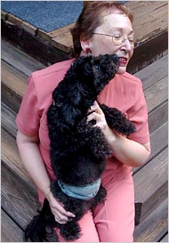

Why are domains reluctant to share data?
Netflix de-anonymization
AOL searcher exposed
Privacy is difficult even if you have the best intentions
  Even after anonymization (Netflix de-anonymization case)
  Or aggregation (auxiliary information attack)
To make a ‘knowledge plane’ work, we need strong privacy guarantees!
  Idea: differential privacy.

Slide 8

Differential privacy
Differential privacy:
  What: provide very strict privacy guarantee for individuals.
  ‘Worst-case’ adversary
  Tunable amount of privacy
  Composable query costs
But, there are caveats too:
  Limited query budget.
  Gives noised answer.
  Distributed DP is hard.
  …
Differential privacy: a good candidate?
Our hypothesis: Yes!

Slide 9

Outline
Motivation
- Challenges
PRISM: Private Retrieval of the Internet’s Sensitive Metadata
  The vision
  Do we have enough budget?
  What about data quality?
  Can we deal with attackers?
  Can we answer all types of queries?
  What about privacy for ISPs?
Conclusion

Slide 10
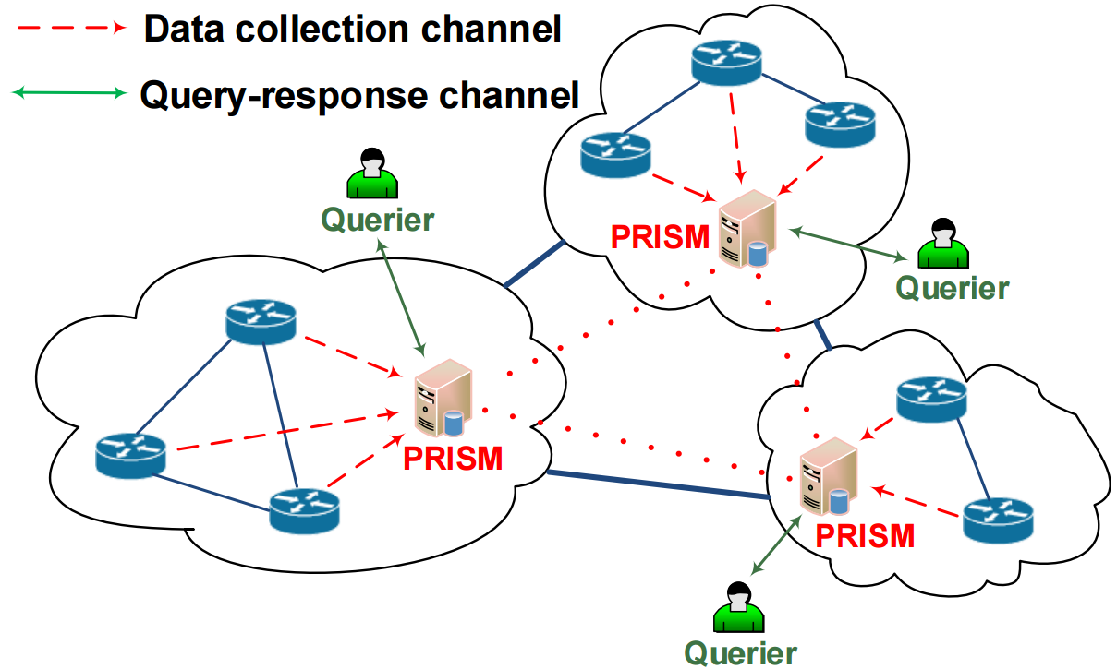
PRISM: differential privacy on Internet data
PRISM: a system sketch
  Domains keep their data local.
  PRISM nodes manage local data and answer queries.
  Query answers released with differential privacy.
Result: private Internet knowledge plane

Slide 11
Background: Differential privacy
How: noise query answer before release
  E.g., noise drawn from a Laplace distribution parameterized by ε.
  ε: privacy parameter; larger values = more privacy release.
Guarantee:
  Query answer on ‘neighboring databases’ are very similar.
We can view ε as a privacy budget:
  The total amount of privacy we are willing to release.
  Each query uses up some budget.
  Refuse further queries once budget is depleted.

Slide 12

Challenges
Do we have enough budget?
Can we detect attacks with noised data?
What about compromised PRISM nodes?
Does PRISM provide privacy for ISPs, too?
Would PRISM work with a partial deployment?
Can we make all queries differentially private?
Would PRISM’s query processor scale?
…
See paper

Slide 13
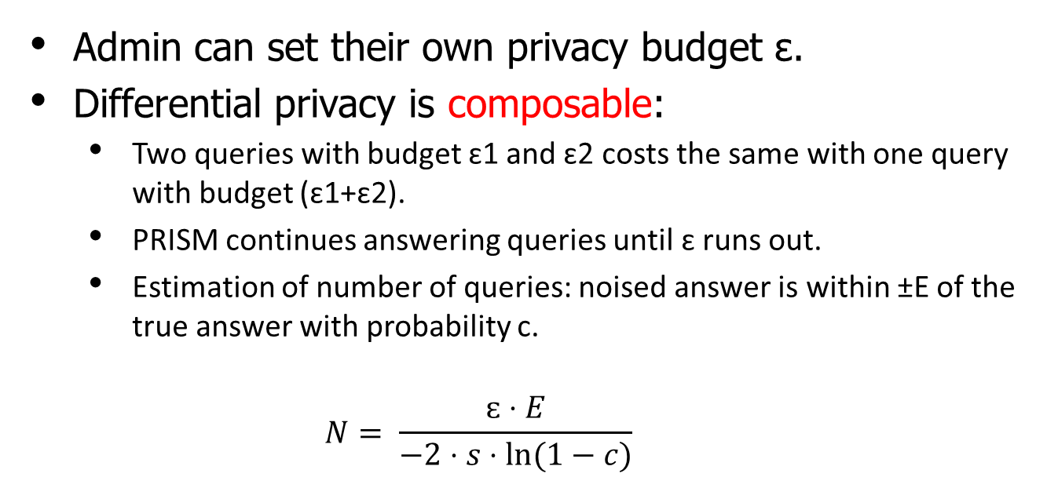
The privacy budget
Admin can set their own privacy budget ɛ.
Differential privacy is composable:
  Two queries with budget ɛ1 and ɛ2 costs the same with one query with budget (ɛ1+ɛ2).
  PRISM continues answering queries until ɛ runs out.
  Estimation of number of queries: noised answer is within ±E of the true answer with probability c.
    $$N= \frac{ɛ⋅E}{−2⋅s⋅ln⁡(1−c)}$$
The budget problem: ɛ sets a hard limit on how many queries PRISM can answer.
  Many ways to set ɛ [e.g., Hsu-CSF-2013]
  No matter how large, budget eventually runs out.

Slide 14
Challenge #1: enough budget?
The Internet data presents unique opportunities!
Large size: queries cost less.
  E.g., counting queries about IP addresses.
  Assume that the answer is 40 million, we want released answer to be 10% within true answer with 95% confidence
  N = 667,616.
  Per ISP: ~10 queries.

Slide 15
Challenge #1: enough budget?
Sampling: reduces query cost
  Internet data is typically sampled, e.g., NetFlow is typically sampled at 1/4K.
  Theoretical result: sampling at rate α reduces cost to α*ε.
  We further sample NetFlow records by ~50%.
  Per ISP: ~100,000 queries.

Slide 16
Challenge #1: enough budget?
We probably don’t have a worst-case adversary!
  ISPs are competitors, so won’t collude on a large scale.
  Conservatively, if no two ISPs collude, we can give each ISP its own budget.
  This scales up budget significantly.
  Even there are small-scale collusions, per ISP: 400 million queries are within reach (1K queries per ISP per day for 1,000 years.)

Slide 17
Challenge #1: enough budget?
Can we replenish the budget?
  Internet data is fast changing
    E.g., many flows expire in seconds
    E.g., IP-to-user mappings also change
    E.g., 40% of /24 address blocks are dynamic
  Eventually, the DB may become entirely different, e.g., in 100 years, most users should be different.
  There should be opportunity for replenishing the budget when users are completely different.

Slide 18
Challenge #2: data quality?
The data quality problem: if DP adds noise, can we still detect attacks accurately?
DP’s noise is easy to interpret!
  Well-known distribution: Laplace.
  Dealing with imprecision: well understood topic.
  Works on true data: instead of inferred data.
  We are looking for large trends, e.g., DDoS, bots.

Slide 19
Challenge #3: compromised nodes?
What if PRISM nodes are compromised?
There are things we can do, too!
  Hackers are unlikely to take over the majority of nodes.
  Quality-checking can be integrated with queries. [Reed-2010-ICFP]
  Queries answers can be released verifiably [Narayan-2015-Eurosys]

Slide 20
Other challenges
Challenge #4: Difficult queries
Challenge #5: Privacy for ISPs
Challenge #6: Partial deployment
Challenge #7: Scaling the query processor
…
Please read paper for details.

Slide 21
Conclusion
Motivation: Internet-wide threats
Primary challenge: privacy concern
Proposal: PRISM
  Differential privacy for Internet data
Feasibility
  Privacy budget
  Noised data for detection?
  Compromised nodes?
  …
  Questions?

