Slide 1
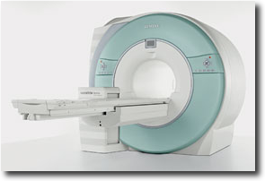
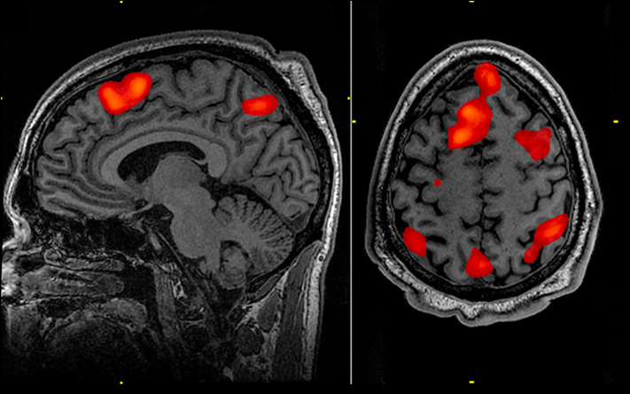
Call for Participants: fMRI Study Regarding Software Engineering Tasks
Study Investigators: Jamie Floyd, Tyler Santander, Wes Weimer (CS)
What will you do?
help develop the first model relating brain activation to Software Engineering tasks
undergo a scan of your brain
perform various tasks related to
Software Engineering
What will we learn?
neural activation patterns for three tasks:
Code Review
Code Comprehension
Prose Review
how to better train or manage these Software Engineering activities
What will you get?
$100 for about 90 minutes of your time
a model of your brain as a series of hundreds of pictures
the warm fuzzy feeling of pushing forth the boundaries of human knowledge
You should participate if:
you are 18+ years old
you can pass an MRI safety screening
most importantly, no metal allowed in the scanner, including glasses (contacts are OK)
you are proficient in the English language
you are right-handed
you have basic knowledge of Software Engineering
you can read and understand code written in C
This study is approved by the HSR-IRB via protocol #18171
Email Jamie Floyd (bef2cj@virginia.edu) by March 1 to participate.
fMRI Study for SE
bef2cj@virginia.edu
fMRI Study for SE
bef2cj@virginia.edu
fMRI Study for SE
bef2cj@virginia.edu
fMRI Study for SE
bef2cj@virginia.edu
fMRI Study for SE
bef2cj@virginia.edu
fMRI Study for SE
bef2cj@virginia.edu
fMRI Study for SE
bef2cj@virginia.edu
fMRI Study for SE
bef2cj@virginia.edu
fMRI Study for SE
bef2cj@virginia.edu
fMRI Study for SE
bef2cj@virginia.edu
fMRI Study for SE
bef2cj@virginia.edu
fMRI Study for SE
bef2cj@virginia.edu
fMRI Study for SE
bef2cj@virginia.edu

