Slide 1
Maestro: Orchestrating Lifetime Reliability
in Chip Multiprocessors
Authors: Shuguang Feng
Shantanu Gupta
Amin Ansari
Scott Mahlke
HiPEAC 2010
January 25-27, 2010

Slide 2
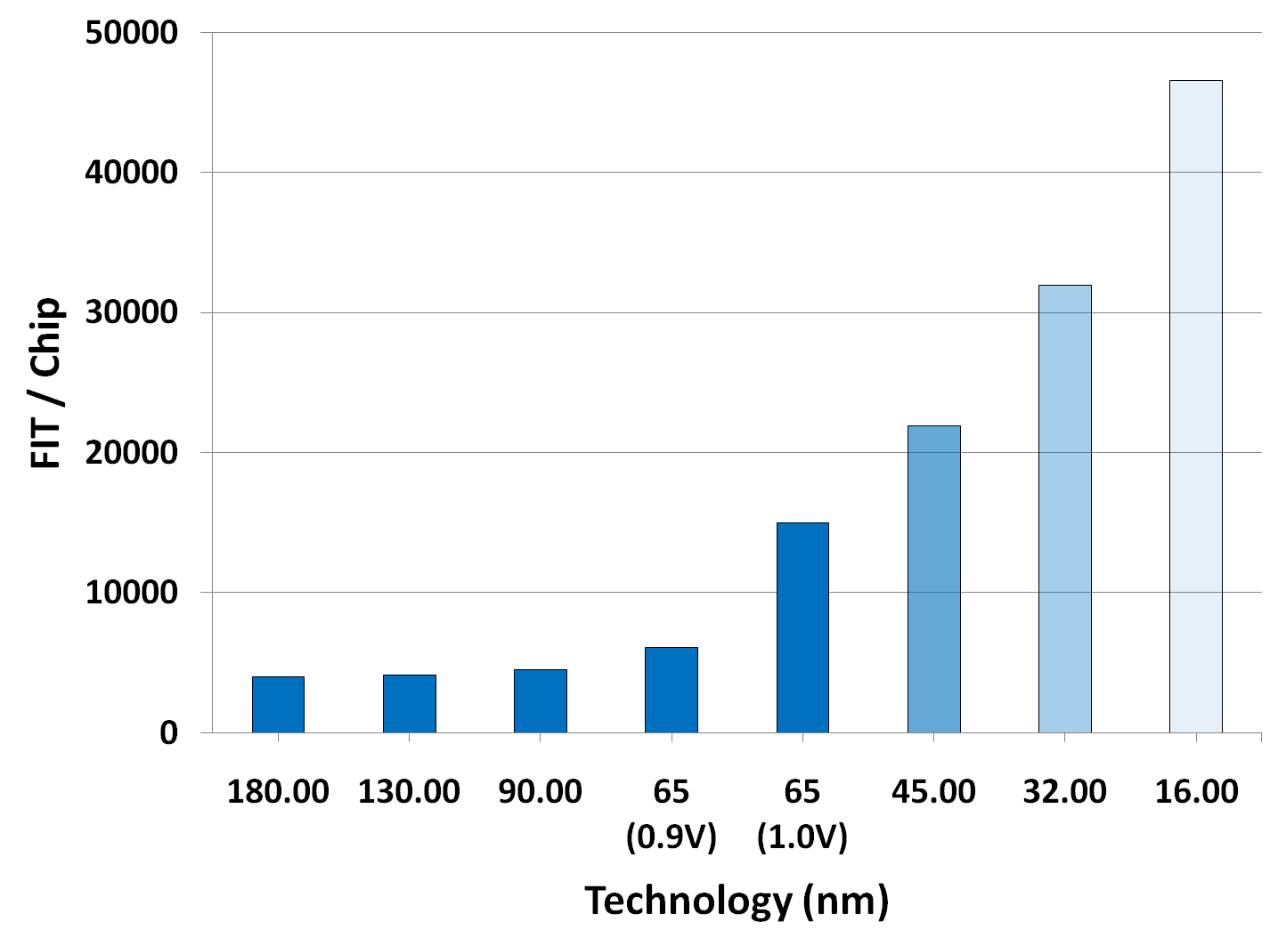
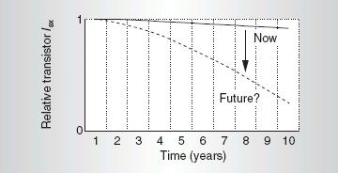
Motivation
“Designing Reliable Systems from Unreliable Components…”
- Shekhar Borkar (Intel)
Failures will be wearout
induced
More failures to come
[Srinivasan, DSN‘04]
[Borkar, MICRO‘05]

Slide 3
Approaches to Reliability
Approaches to Reliability
Tolerate Faults (reactive)
or…
Prevent Faults (proactive)
Circuit-level
Margining
Robust cell topologies
High-K dielectrics
Passivation
Architecture-level
Detect
Diagnose
Repair/reconfigure/recover
Reliability Banking
Dynamic thermal mgmt (DTM)
Maestro
Diva
StageNet
Heat-and-Run
Facelift
Argus
Avoid/postpone failures using intelligent job scheduling
3

Slide 4
Not All Cores are Created Equal
Process variation (PV) will cause “heterogeneity” in future many-core chip multiprocessors (CMPs)
Results in variations in performance and reliability characteristics
Dynamic thermal/power budgeting can be suboptimal
Temperature is only part of the picture
Must account for the condition of underlying hardware
Many reliability solutions can benefit from wearout sensor feedback
System reconfiguration
Dynamic voltage and frequency scaling (DVFS)
Job scheduling

Slide 5
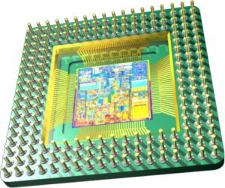
Maestro
Insight
Variations exist in both hardware (PV + wearout) and software (thermal)…embrace it
Solution
+
Monitor wearout with
low-level sensors
Dynamically profile application
thermal characteristics
Formulate wearout-centric schedules to accomplish wear-leveling

Slide 6
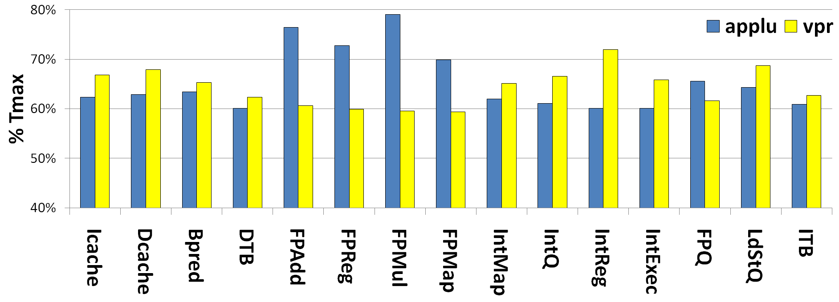
Hot or Cold?
Is the traditional view of “hot”/“cold” applications too simplistic?
35% of core failures are caused by failing structures that never experience peak on-chip temperatures
22% of core failures are caused by modules that do not rank among the top 3 most thermally active

Slide 7
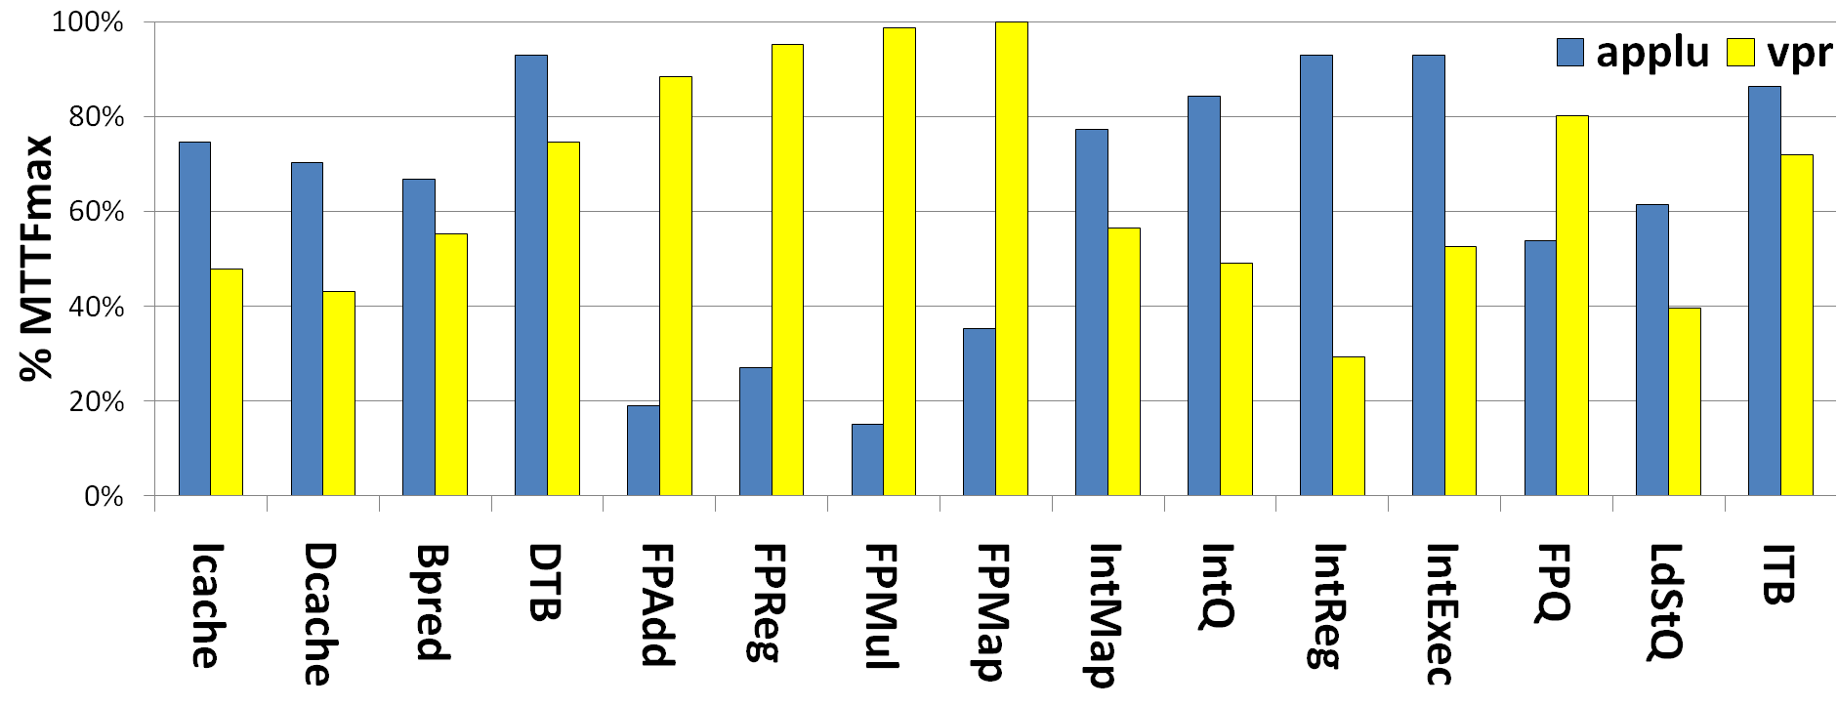
Implications for Lifetime Reliability
Up to ~6x improvement in mean time to failure (MTTF) achievable with wearout-centric job scheduling
Disparity present even in FP v. FP and INT v. INT application comparisons
Must account for both workload variation and process variation

Slide 8
Maestro System Architecture
Low-level Sensors
delay
leakage
temperature
ElastIC [IDT`06]
Reconfigurable Hardware
StageNet [MICRO`08]
CCA [PACT`08]
WDU [MICRO`07]

Slide 9
Scheduling Policies: Greedy
Local wear-leveling (within a core) is achieved by assigning jobs with favorable thermal footprints
Global wear-leveling (across a chip) is achieved by forcing “stronger” cores to execute the less desirable applications
Minimizes premature core failures by favoring “weaker” cores
Re-sort based on C6
Re-sort based on C1
Weak
C7
C6
C1
C3
C10
Light
C6
C1
C3
C10
C4
C1
C3
C10
C4
C0
C8
J12
J3
J9
J5
J4
J4
J3
J9
J5
J7
J13
J8
J9
J3
J5
C0
C1
C2
C3
C4
Cn
J15
J0
J1
J2
J3
J4
Jn
+
J11
J13
J0
J7
J5
J2
J4
J12
J15
J6
J8
J3
J1
J10
J14
J9
Strong
Heavy
Cores
Jobs
Schedule

Slide 10
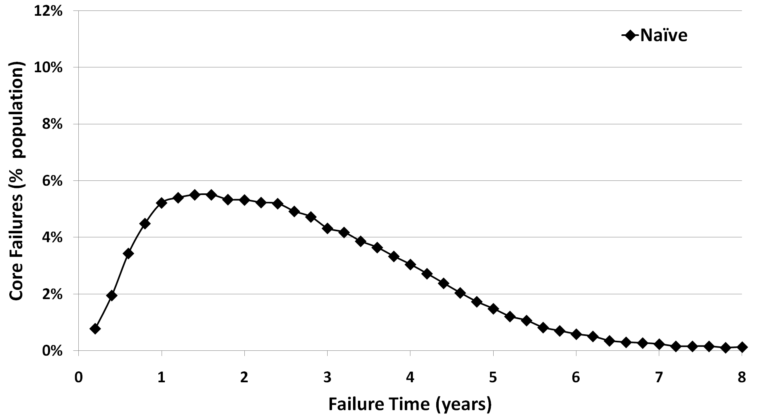
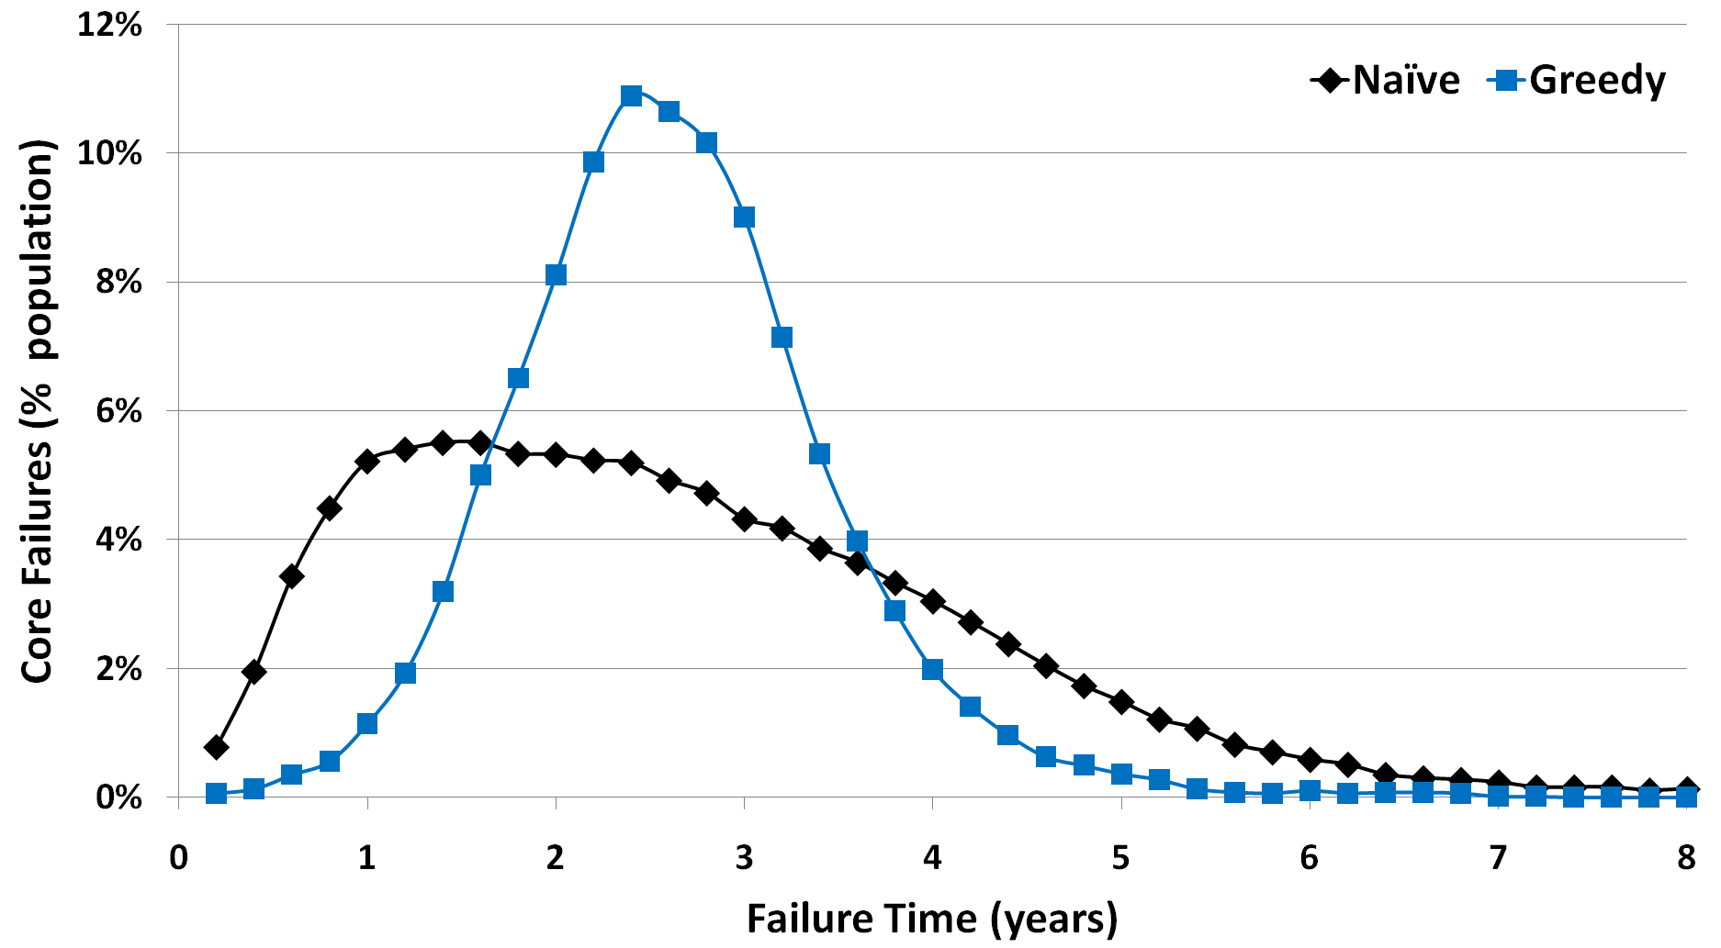
Core Failure Distribution: Greedy
How can we improve upon this?
Systems are unlikely to be kept in service until every last core on a CMP fails
Leverage knowledge of this “failure threshold”
Allow some cores to fail in hopes of prolonging the life of “just enough”
Notes:
-

Slide 11
Scheduling Policies: Adaptive
“Survival-of-the-fittest” approach that maximizes the lifetime of a subset of cores
Select from among
remaining jobs
Weak
C15
C2
C7
C6
C1
C3
C0
C1
C2
C3
C4
Cn
J0
J1
J2
J3
J4
Jn
J11
J13
J0
J1
Secondary
(n-m)
+
J9
J2
J4
J12
J3
J6
J8
J15
Primary
(m)
J7
J10
J14
J5
Strong
Cores
Jobs

Slide 12
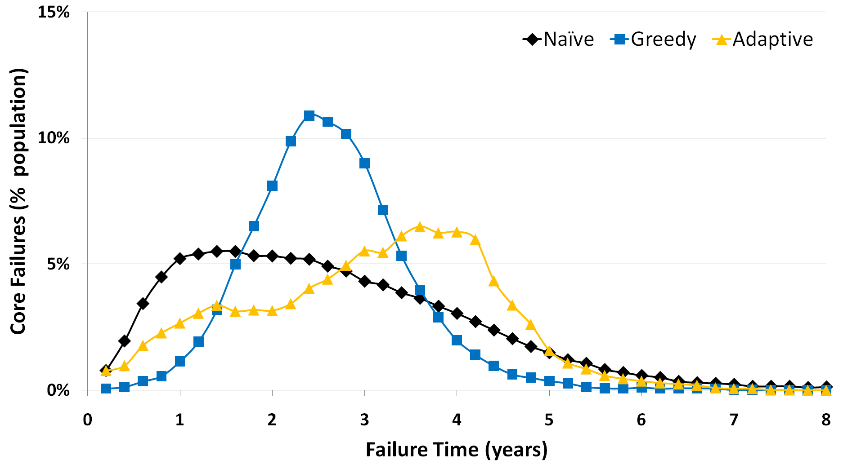
Core Failure Distribution: Adaptive

Slide 13
Scheduling Details
Greedy
Adaptive
Cores
, where m’ is the weakest
module in the core
Jobs
, where the minimal Cost(S) is
identified with a GA*
Cores
Jobs

Slide 14
Experimental Methodology
Application Characterization
Lifetime Simulation
Evaluate naïve (baseline), greedy, and
adaptive scheduling policies
Figures of merit:
Lifetime throughput (LT)
Failure distribution
Simulates wearout degradation
Integrates existing models from literature
Models 2-16 core CMP with
Alpha 21364–like architecture
Simulates hardware sensor feedback
Populates device lifetimes
w/ Varius
Tracks system-wide performance and reliability
statistics
Emulates OS scheduler
Models different system utilization
patterns

Slide 15
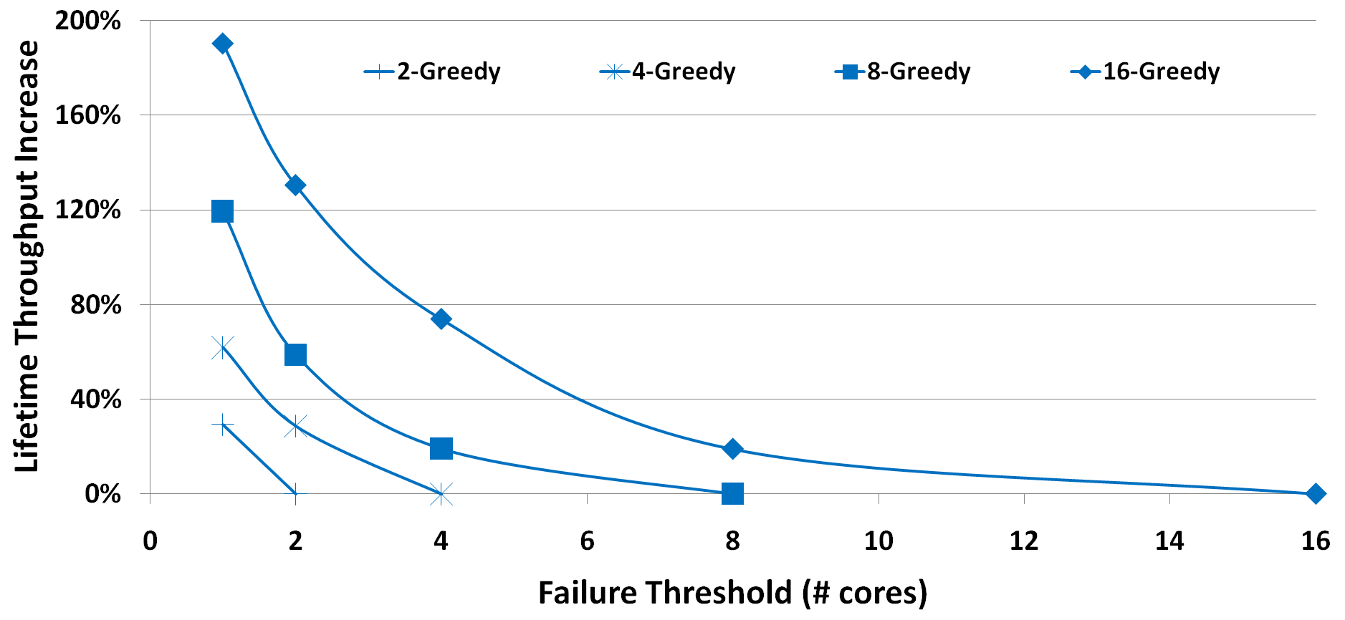
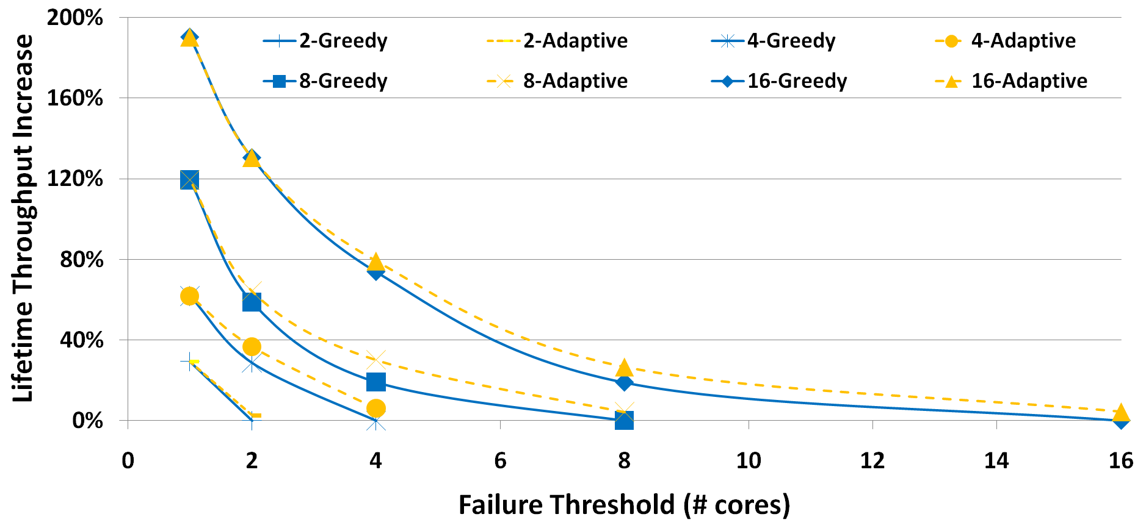
Lifetime Throughput
Failure threshold – the number of cores that can fail before a CMP is considered unusable
↑ CMP size → ↑ LT
↑ Failure threshold → ↓ LT
Failure thresholds ~ N/2 maximizes delta between Greedy and Adaptive

Slide 16
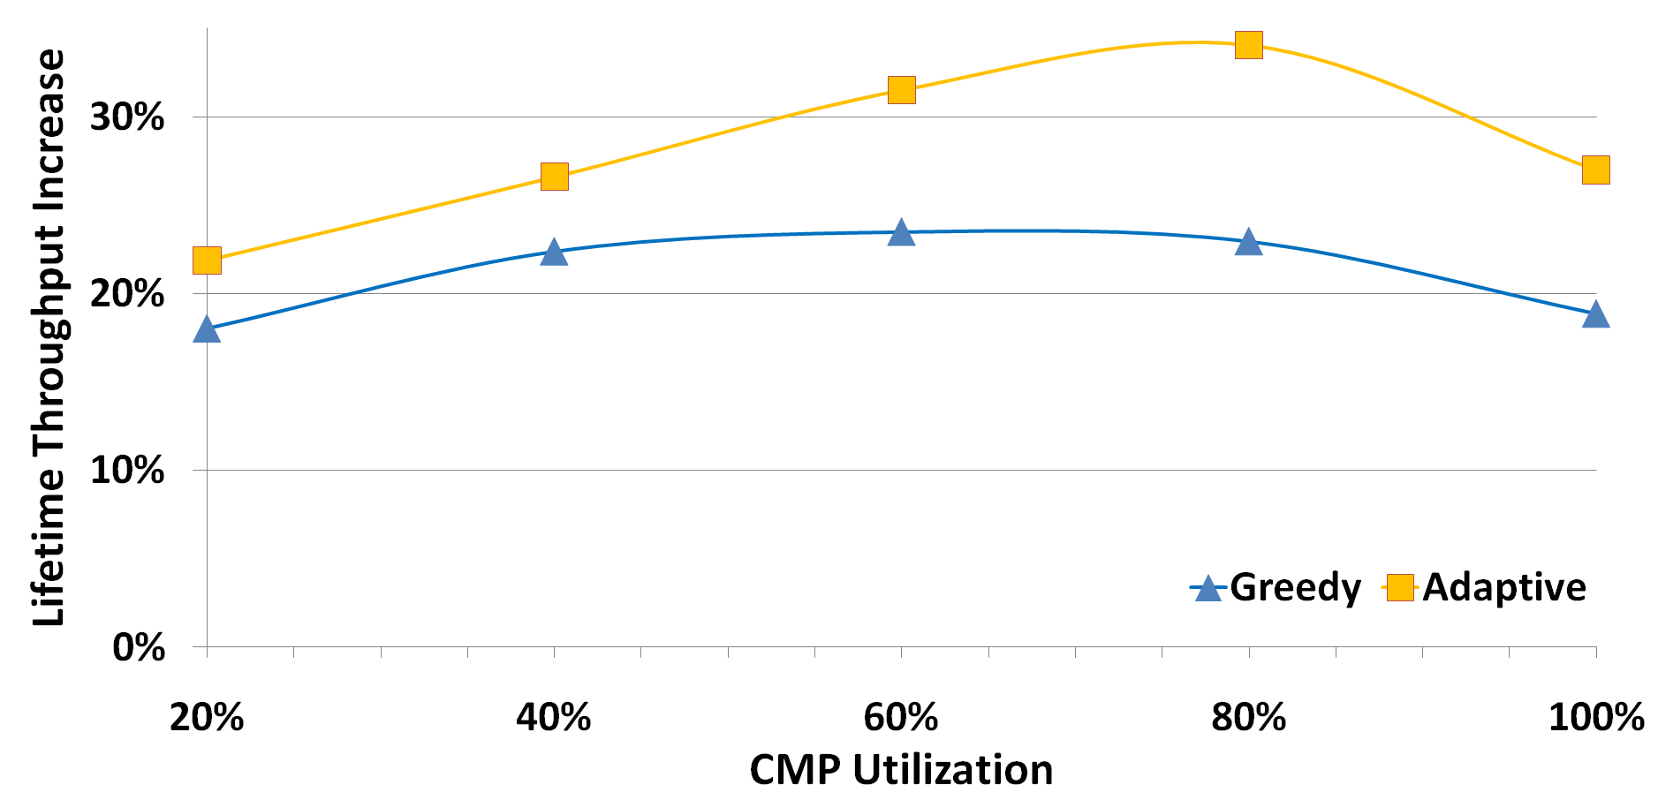
Sensitivity to System Utilization
Lifetime throughput is maximized in moderately over-provisioned systems
16-cores w/ failure threshold of 8

Slide 17
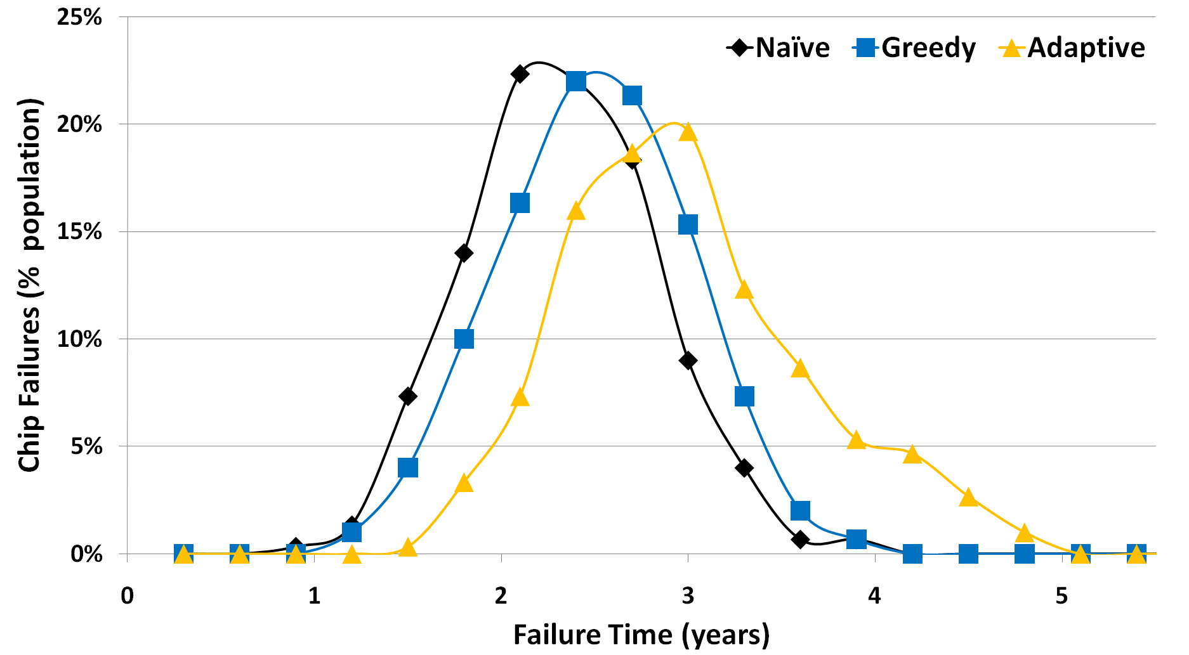
CMP Failure Distribution
16-cores w/ failure threshold of 8

Slide 18
Conclusion
Maestro enables wear-leveling without extensive hardware support*
Capitalizes on the natural heterogeneity in both CMPs (process var.) and their workloads (thermal var.)
Evaluated two approaches (policies) to wearout-centric scheduling
Shown that policies can be tailored based on user requirements to increase their effectiveness
Maestro can…
extend the effective service life of a 16-core CMP by 38%
or be reconfigured to perform 180% more useful work before experiencing the first core failure.

Slide 19
Questions?
http://cccp.eecs.umich.edu

