Slide 1
Shoestring: Probabilistic Reliability on the Cheap
Authors: Shuguang Feng
Shantanu Gupta
Amin Ansari
Scott Mahlke
University of Michigan

Slide 2
The Problem . . .
Soft Errors / Transient Faults / Single Event Upsets (SEU)
Caused by a variety of phenomena
Cosmic radiation (high energy neutrons)
Alpha particles (packaging impurities)
Voltage fluctuations (dI/dt)
Timing speculation
Can alter the value stored in state elements as well as the output of combinational logic
Attenuated by masking at several levels (circuit, logic, μarch, etc.)
Soft error rates (SER) are on the rise

Slide 3
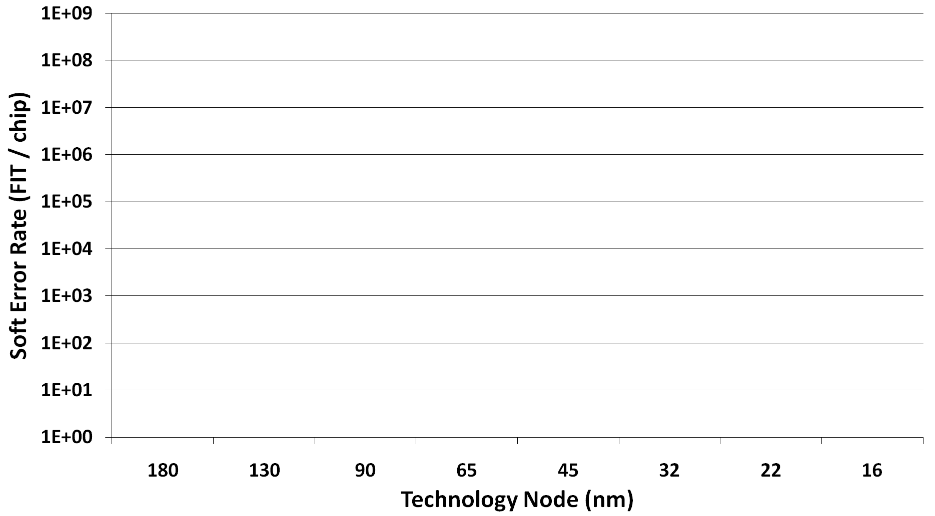
Soft error rate (SER)
One failure per DAY per chip
Past
Present
Future
At high error rates, reliability cannot be reserved only for mission-critical systems
There is a need for low-cost mainstream solutions
One failure per DAY per 100 chips
Aggressive voltage scaling
(near-threshold computing)
One failure per MONTH per 100 chips
[Shivakumar’02]

Slide 4
Traditional Architecture Solutions
n-Modular Redundancy
Invariant Checking
Redundant Multi-threading
Instruction Duplication
Shoestring
Symptom-based
Traditional dual/triple – modular redundancy
Run on separate hardware and compare results
Mission-critical reliability w/ high hardware costs
[IBM Z-series, HP NonStop]
Redundant execution in a single-threaded context
compiler interleaves original and redundant instructions
“tunable” coverage
[SWIFT, EDDI]
Bridge the gap between symptom-based schemes and instruction duplication
“reliability for the masses”
sacrifice a little on coverage to maintain very low costs
Utilize multiple threads (temporal) instead of separate hardware (spatial)
Retain high coverage but sacrifice performance costs to save area
[AR-SMT, Reunion]
Relies on anomalous behavior to identify faults
extremely cheap
moderate coverage
[RESTORE, SWAT]
Increasing Fault Coverage
Perform selective checking
software invariants
critical μarch structures
[ARGUS, DIVA, Reddy:DSN`08]
Increasing Overheads (area, power, performance, etc.)

Slide 5
Shoestring
Shoestring
One failure per MONTH
One failure per WEEK
Cache misses
Branch mispredicts
Hardware exceptions
One failure per DAY
Increasing Fault Coverage
Fault coverage from different sources of masking (92%)
Shoestring
Symptom-based detection
Instruction duplication-based detection
Increasing Overheads (performance)

Slide 6
Shoestring
Shoestring
One failure per MONTH
One failure per WEEK
Provide affordable reliability for commodity systems on
a “shoestring” budget
Exploit cheap symptom-based fault detection
Judiciously apply sw-level instruction duplication to improve coverage
Cache misses
Branch mispredicts
Not all applications/domains require enterprise-level fault tolerance
The cost of “five-nines” reliability is very high
Spent in pursuit of the last few “nines”
Hardware exceptions
One failure per DAY
Increasing Fault Coverage
Fault coverage from different sources of masking (92%)
Shoestring
Symptom-based detection
Instruction duplication-based detection
Increasing Overheads (performance)

Slide 7
Shoestring: System Components
Compilation
Analyzes program structure
Generate enhanced binary w/ selective
duplication for vulnerable code
Selective Duplication
Runtime Environment
OS / Virtual Machine
Trap runtime exceptions
Selected symptoms
Faults in duplicated code
Recovers w/ pipeline flush / lightweight
rollback
Physical Hardware

Slide 8
Shoestring: Compilation
Application Source Code
Shoestring Passes
Preliminary
Classification
Shoestring Passes
Vulnerability
Analysis
Preliminary
Classification
Traditional Optimizations
Front-end
Code Generation Passes
Register Allocation
Instruction Selection
Code Emission
Instruction Selection
Machine-independent Passes
Vulnerability
Analysis
Code Duplication
Code Duplication
Application Binary

Slide 9
Preliminary Classification
Identify instructions that are …
Symptom-generating
Instructions that can aid in detecting the presence of a soft-error
Used during vulnerability analysis
High-value
Instructions that affect “correct” program execution (user-visible output)
Used during selective code duplication
Shoestring Passes
Preliminary
Classification
Preliminary
Classification
Vulnerability
Analysis
Code Duplication

Slide 10
Preliminary Classification: Symptom-generating
If an input operand is corrupted the instruction is likely to cause anomalous behavior
segment fault
divide by zero
cache miss
branch mispredict
. . .
Limit consideration to symptoms that rarely, if ever, occur during normal operation
r0 = mem[old_base]
r1 = mem[new_base]
r2 = 128
r4 = 1
r5 = r2 / r4
r6 = mem[r0+r5]
r4 = r4 + 1
mem[r1+r5] = r6
r7 = mem[new_base]
printf(r7,…)
stack[n_copied] = r4

Slide 11
Preliminary Classification: High-value
Instructions that can corrupt program output after consuming an erroneous operand
stores to global memory
arguments to function/library calls
r0 = mem[old_base]
r1 = mem[new_base]
r2 = 128
r4 = 1
r5 = r2 / r4
r6 = mem[r0+r5]
r4 = r4 + 1
mem[r1+r5] = r6
r7 = mem[new_base]
printf(r7,…)
stack[n_copied] = r4
Ignore local bookeeping variable

Slide 12
Vulnerability Analysis
Identify safe instructions
Instructions with outputs inherently “covered” by symptom-generating instructions
Data/Control flow analysis
Duplication can safely ignore these instructions without losing fault coverage
Shoestring Passes
Preliminary
Classification
Vulnerability
Analysis
Vulnerability
Analysis
Code Duplication

Slide 13
Vulnerability Analysis
Symptom-generating
Machine-dependent Representation
Dataflow Graph (DFG)

Slide 14
Vulnerability Analysis
For each instruction …
Count the # of symptom-generating consumers (N_{tot})
Consider an instruction with “enough” (S_{t}) symptom-generating consumers as safe
Limit to instructions within a fixed distance (S_{lat}) in the statically scheduled code
Scale indirect consumers by S_{iscale}
1
Symptom-generating
3
4
M
Instruction 7
2
3
Instruction 3
Instruction 6
Instruction 9
N_{tot} = 1 + 1(0.8) + 1(0.8)²
= 2.44 , SAFE!
N_{tot} = 1 + 1(0.8) + 1(0.8)²
N_{tot} = 1
N_{tot} = 1 + 1(0.8)
4
15
40
5
6
S_{t} = 2
S_{lat} = 100
S_{iscale} = 0.8
12
60
7
52
8
9
Dataflow Graph (DFG)

Slide 15
Vulnerability Analysis
1
For each instruction …
Count the # of symptom-generating consumers (N_{tot})
Consider an instruction with “enough” (S_{t}) symptom-generating consumers as safe
Limit to instructions within a fixed distance (S_{lat}) in the statically scheduled code
Scale indirect consumers by S_{iscale}
S
Symptom-generating
3
S
Safe
N_{tot} = 2.44
4
V
Vulnerable
N_{tot} = 1.8
N_{tot} = 0
2
V
3
V
What about control flow . . .
Symptom-generating consumers may not be on the common execution path
Scale N_{tot} based on execution probabilities (profiled)
4
S
15
N_{tot} = 2.44
40
2
5
V
6
V
S_{t} = 2
S_{lat} = 100
S_{iscale} = 0.8
N_{tot} = 1.8
N_{tot} = 0
12
60
N_{tot} = 1
7
V
52
N_{tot} = 0
8
V
N_{tot} = 0
9
V
Dataflow Graph (DFG)

Slide 16
Selective Code Duplication
Protect high-value instructions
Ensure high-value instructions operate on correct data (dataflow)
(Partially) duplicate input operands
Ensure they execute when they are supposed to (control flow)
Shoestring Passes
Preliminary
Classification
Vulnerability
Analysis
Code Duplication
Code Duplication

Slide 17
Selective Code Duplication
Duplicate backward slice of input operands, terminating at
Load instructions (“L”)
safe instructions (“S”)
Insert checks prior to use (compare and branch)
Each use has its own check
Starting at high-value instructions …
S
S
What about control flow . . .
Ideally, protect all branches potentially impacting high-value instructions (transitive closure)
Inspired by work on Y-branches [Wang`03] we relax constraints and only protect the subset of branches with control dependence edges
1
1’
L
2
2’
4
5
3
3’
4’
=
S
Safe
=
=
Vulnerable
6
7
8
High-value
Dataflow Graph (DFG)

Slide 18
Evaluation Methodology
Program analysis and selective duplication
Implemented as additional backend passes in the LLVM compiler
Statistical fault injection (SFI) campaign
Instrumented the PTLSim (x86) simulator (AMD-K8 model)
Random (single) bit flip in physical register file
Simulated 10M instructions in detail after fault injection
Simulated remainder of the program on the host machine in native mode
Performance overhead measured on real hardware (Intel Core2)

Slide 19
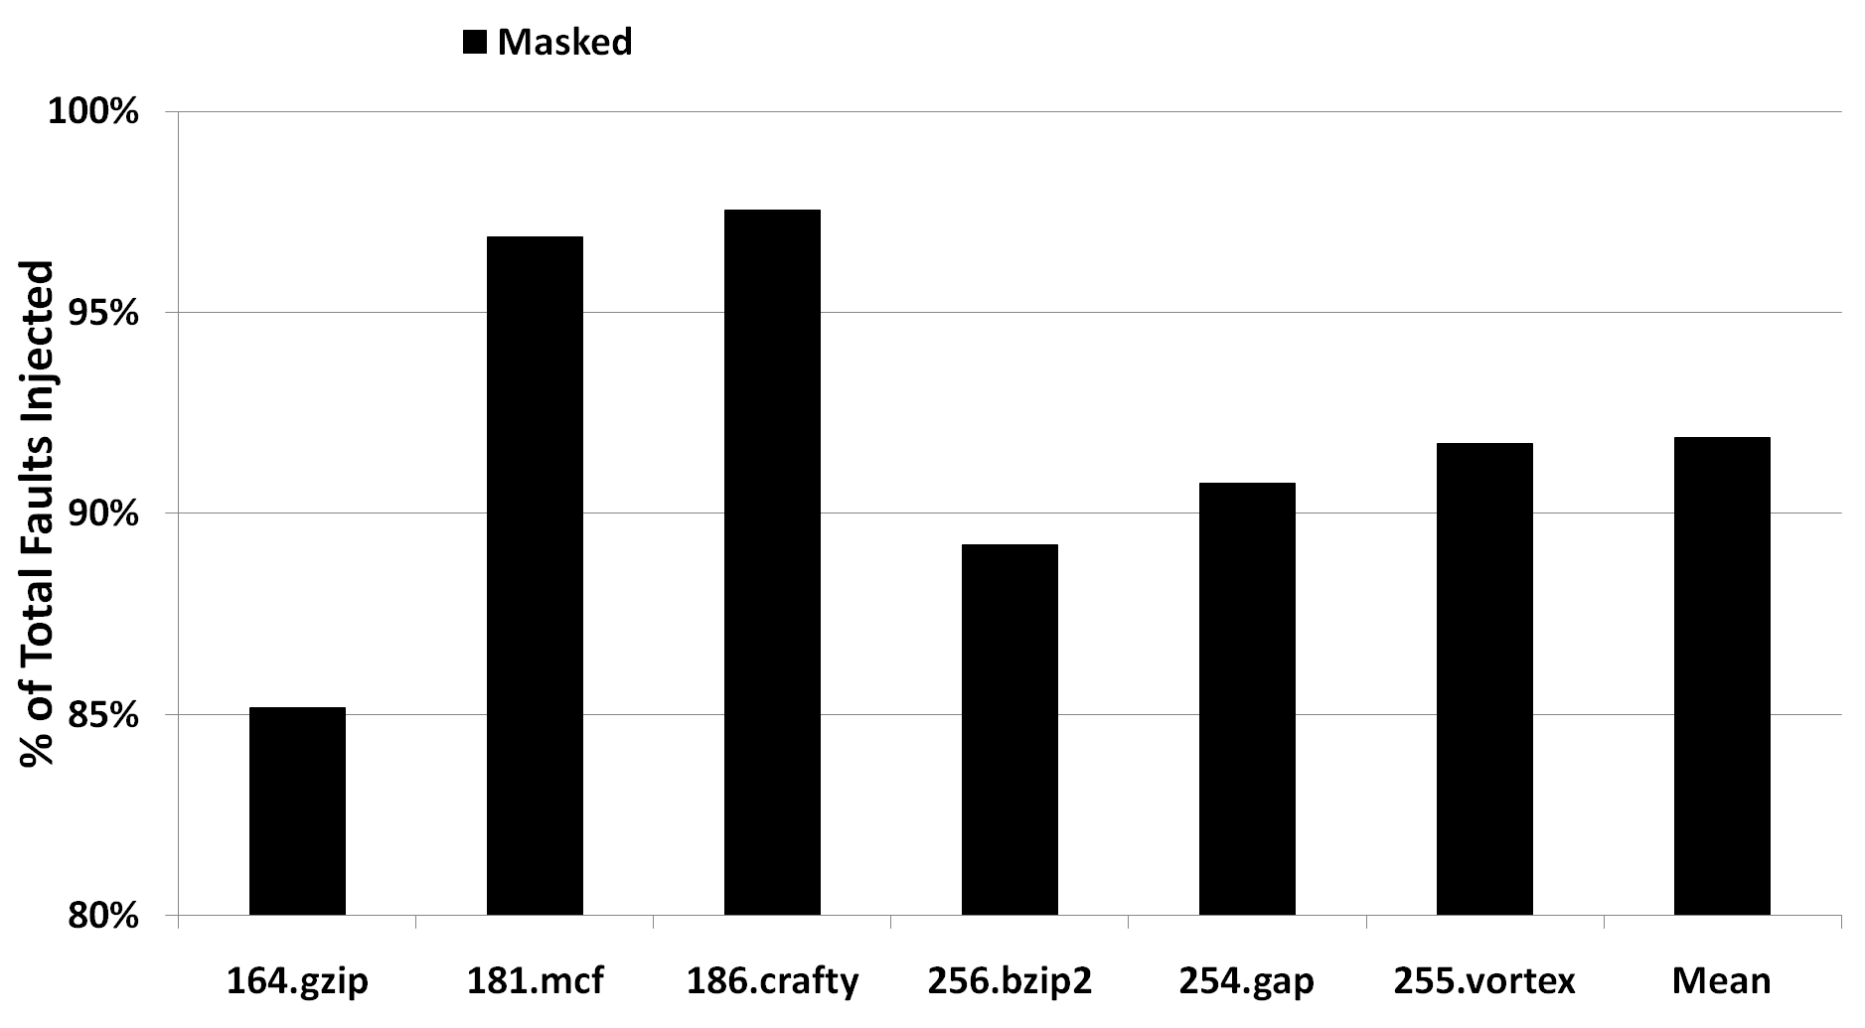
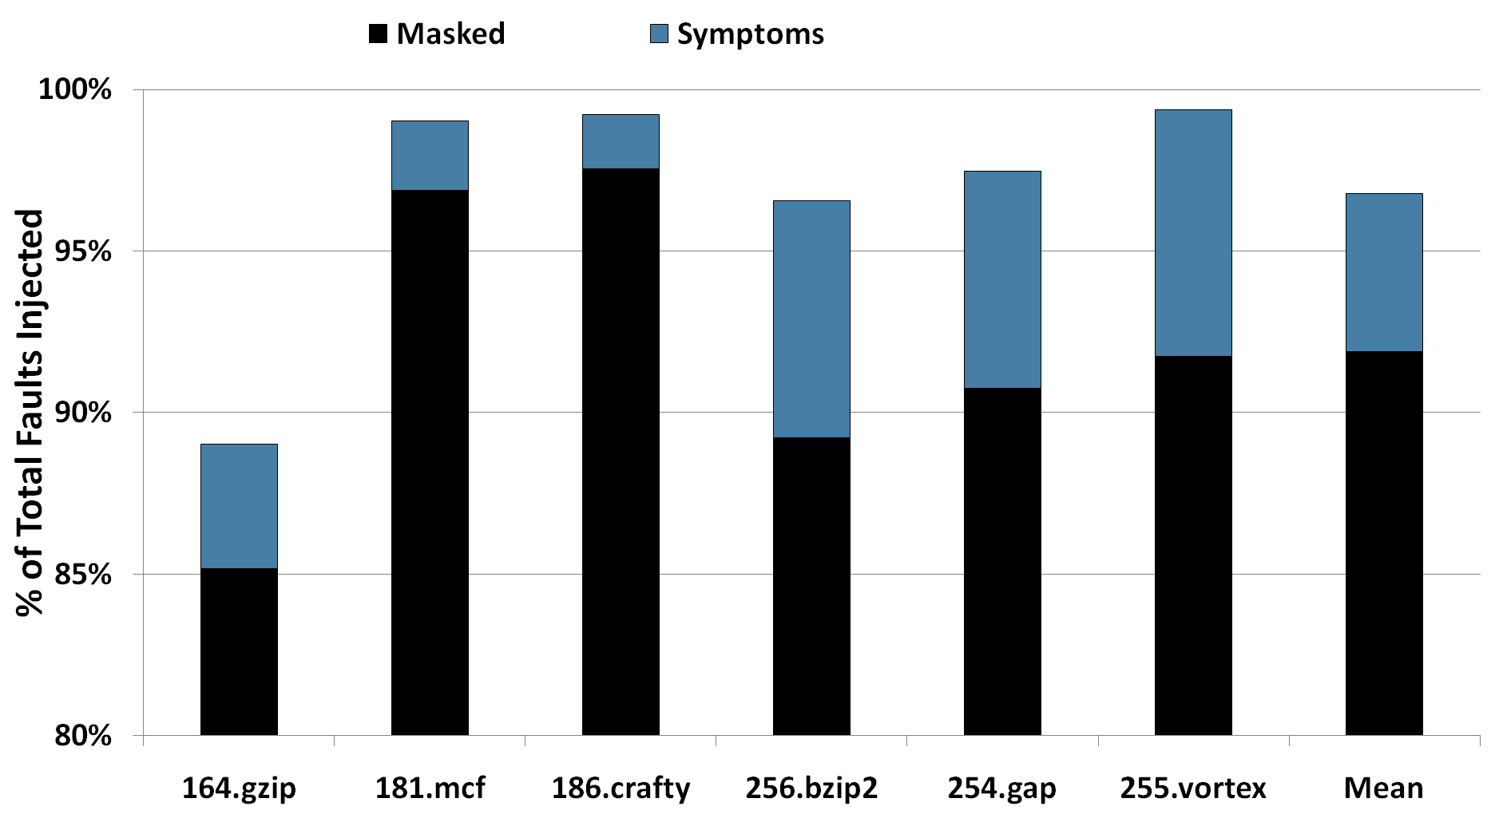
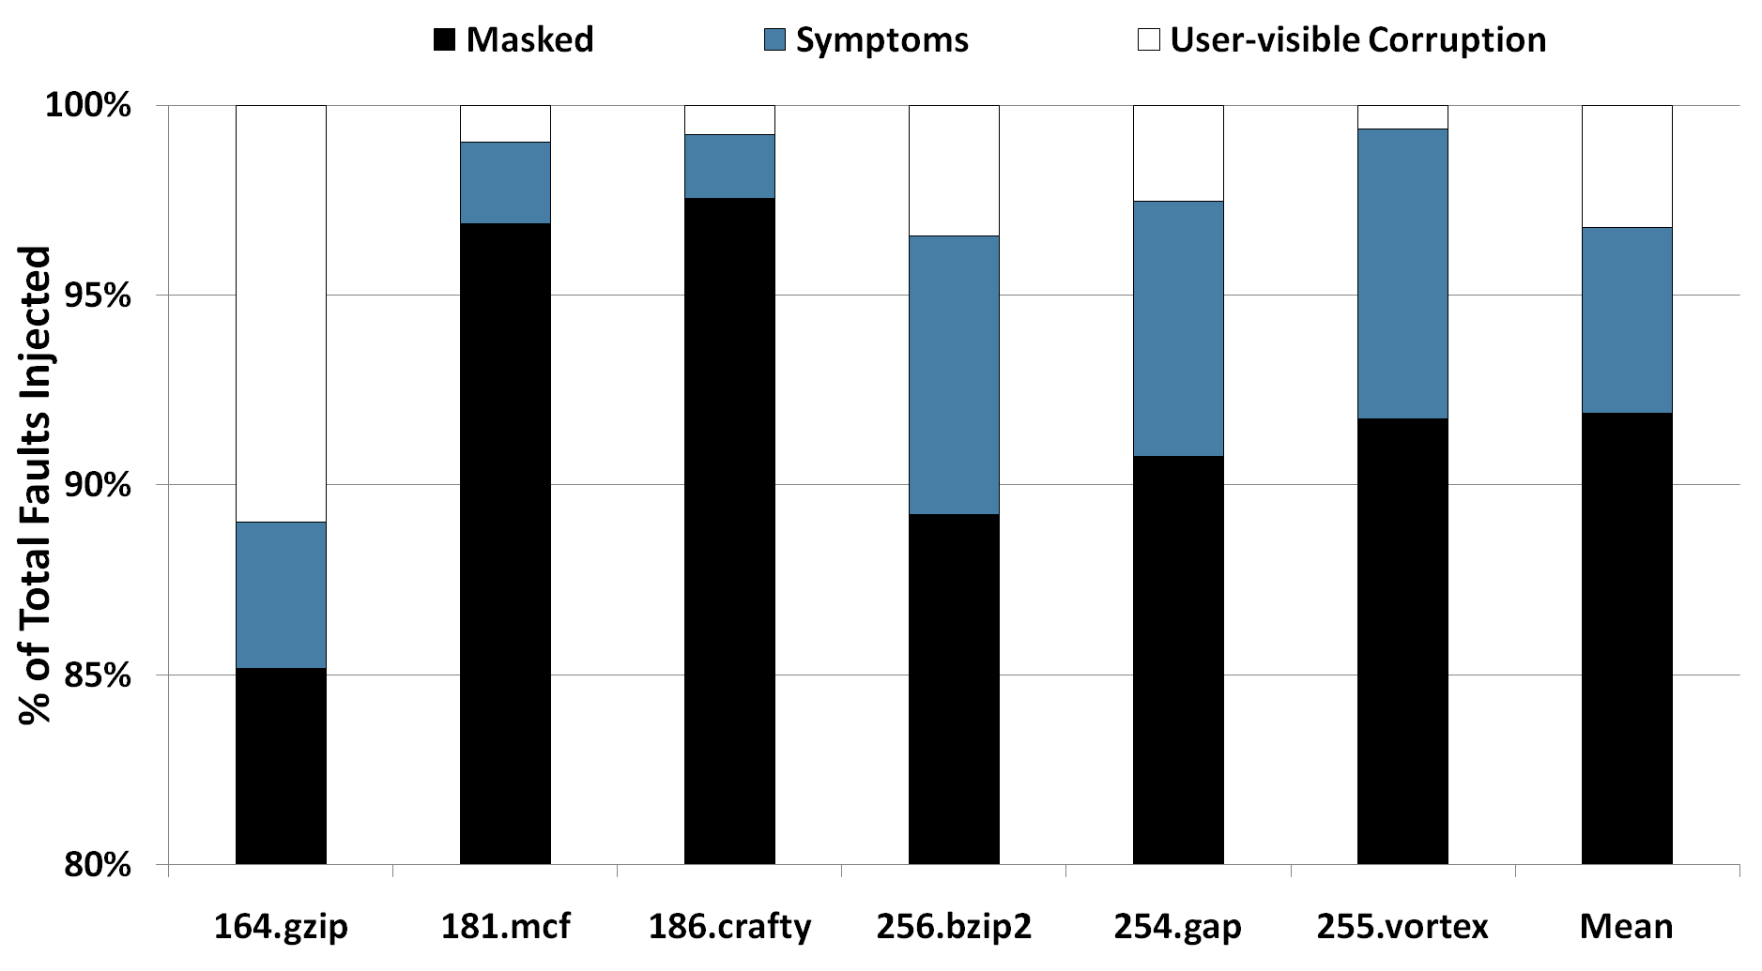
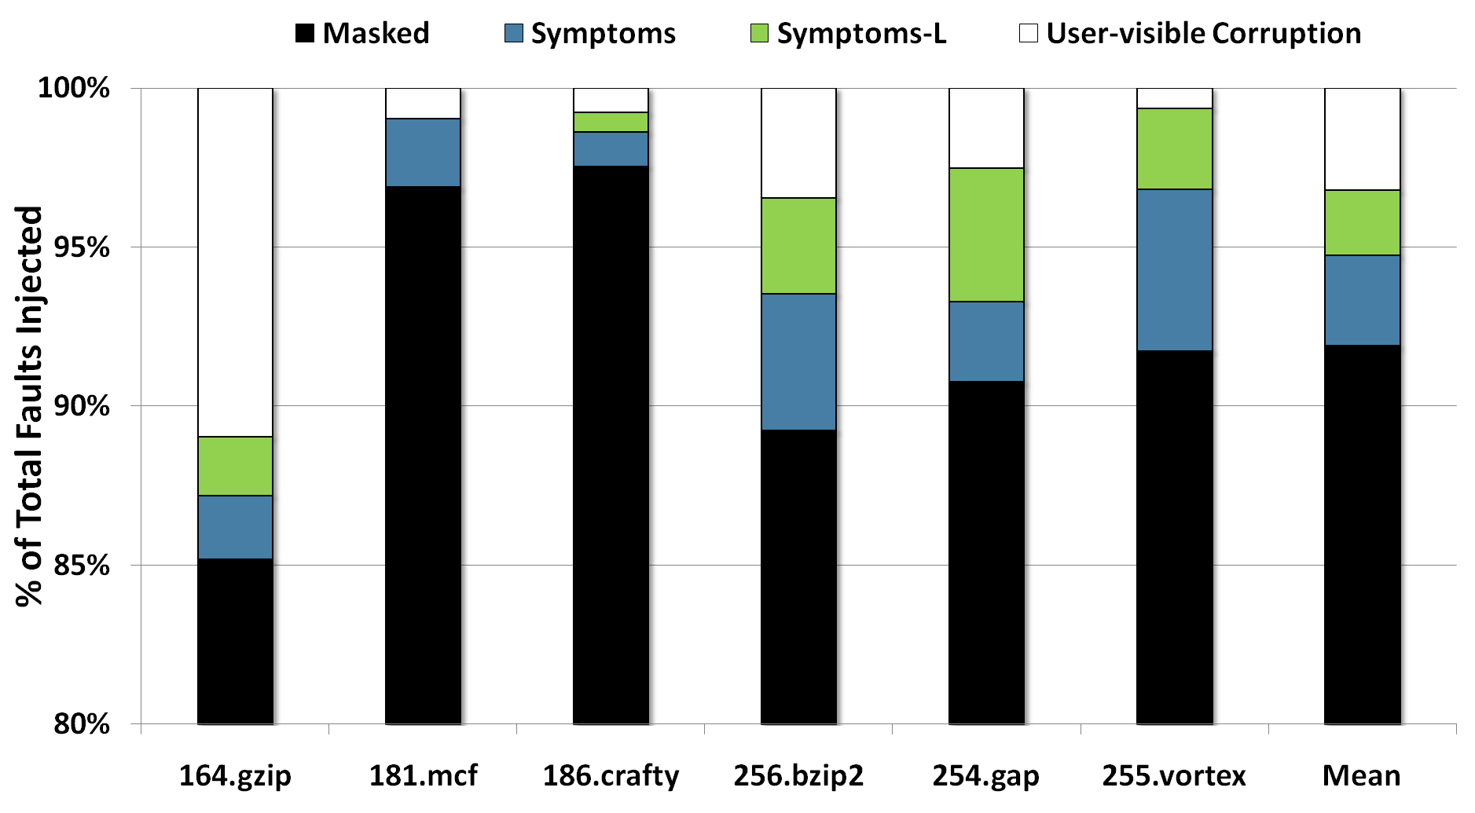
Coverage: w/ Symptoms Only
Could be the difference between one fault per day/week vs. month

Slide 20
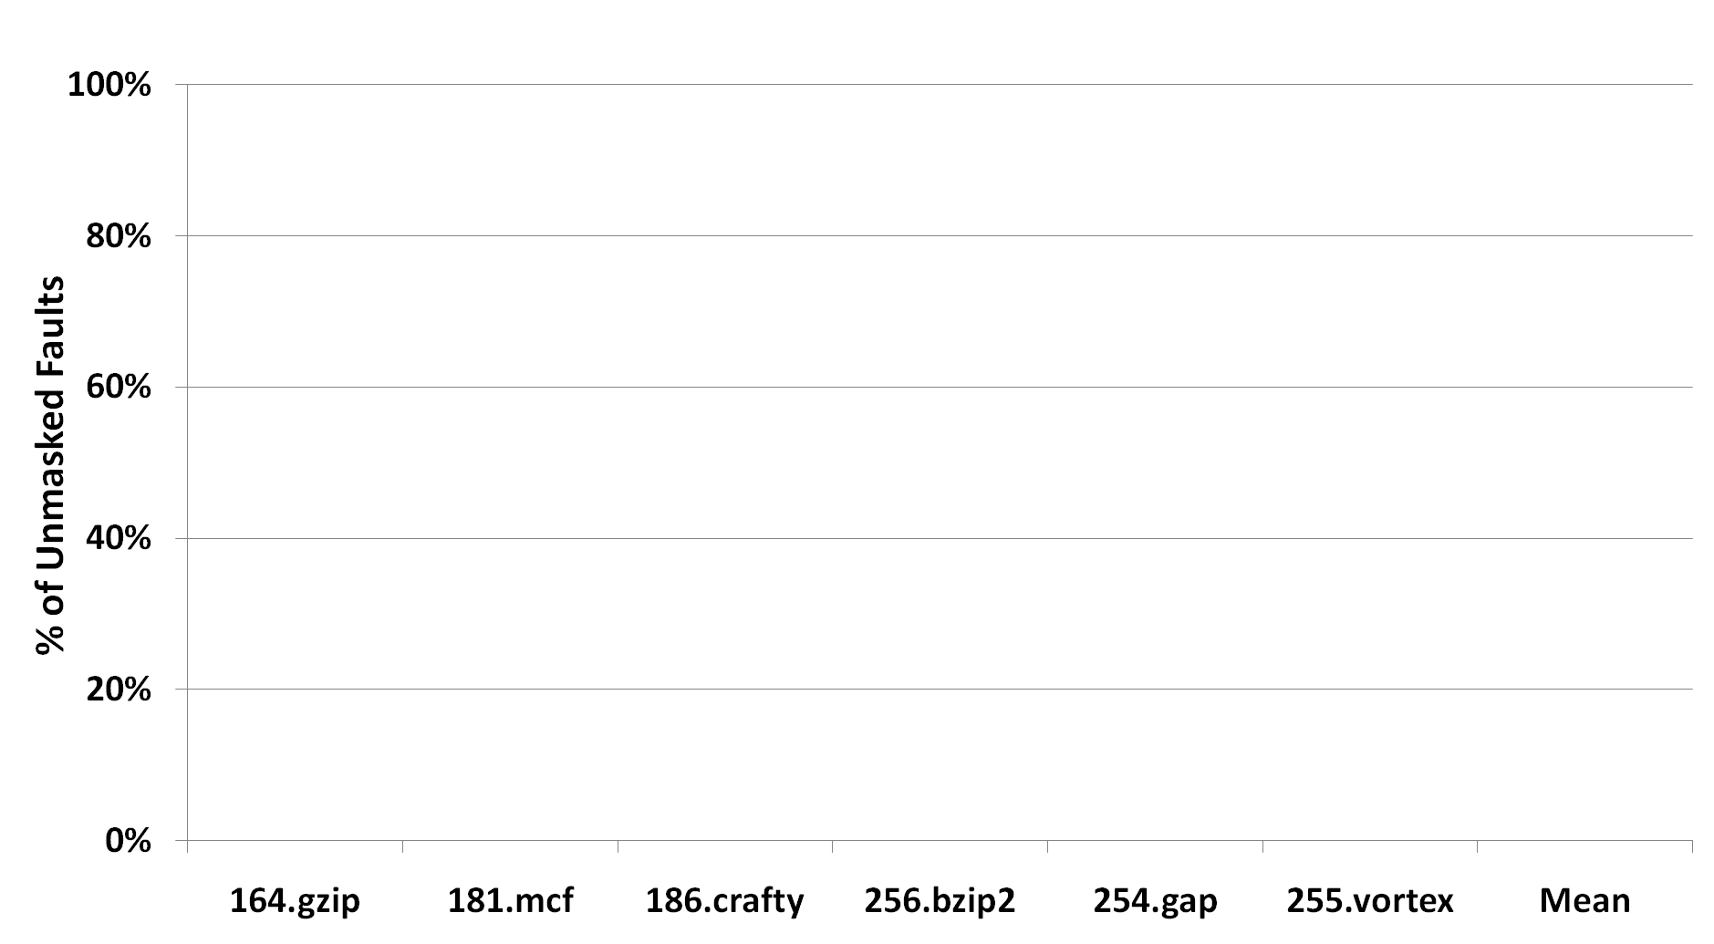
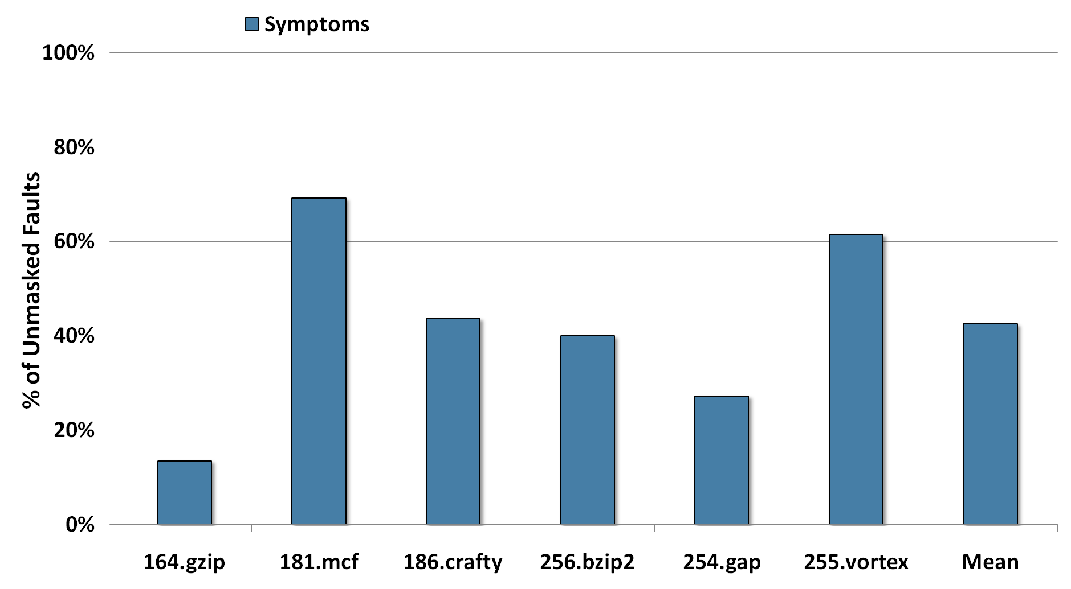
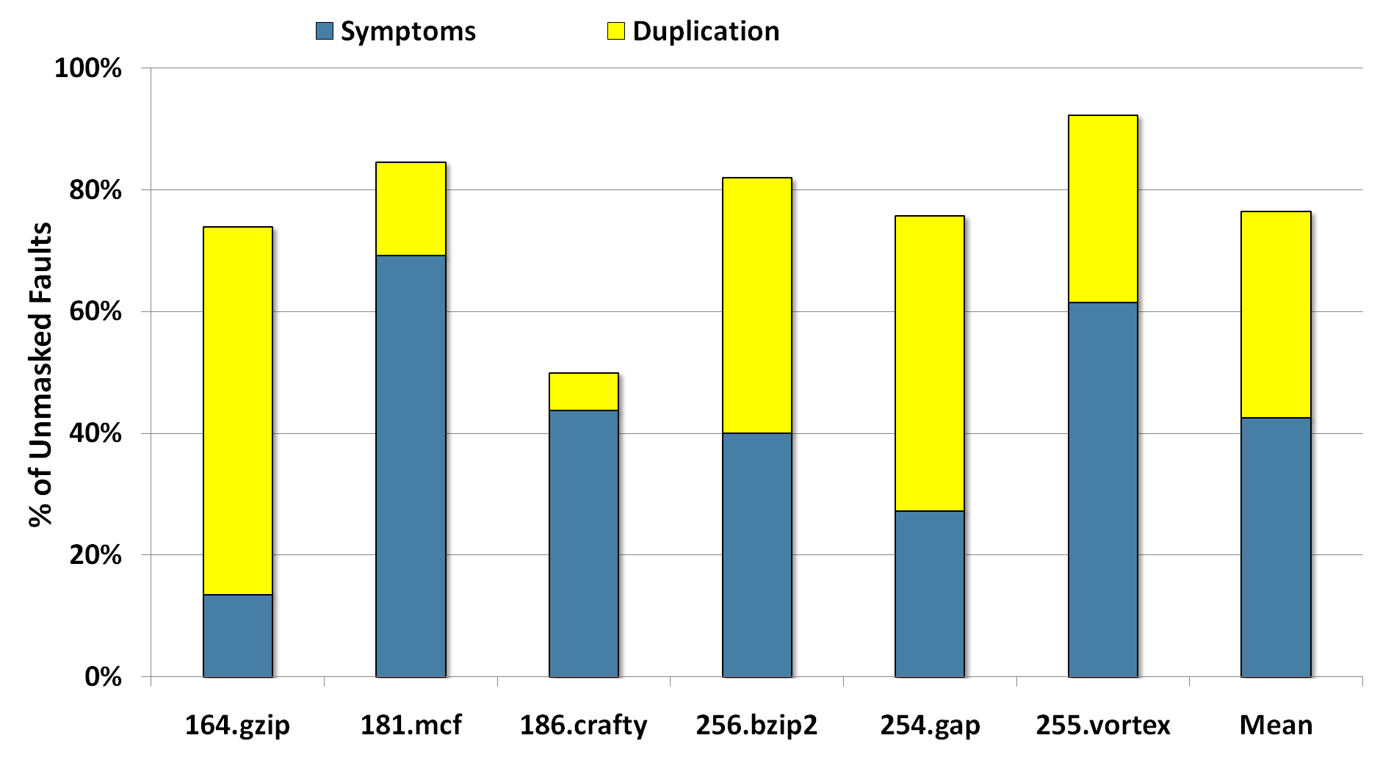
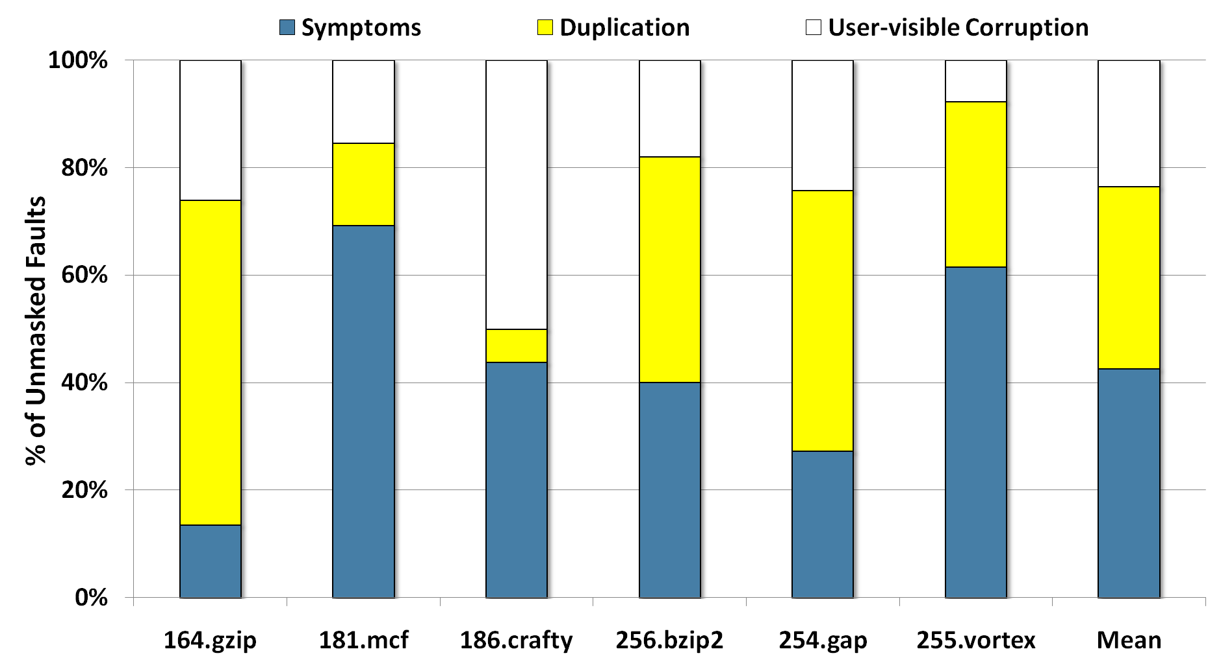
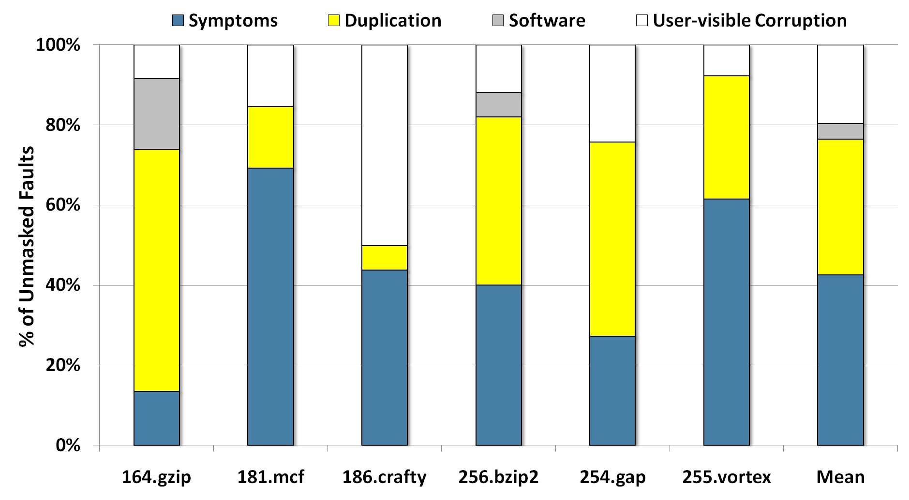
Coverage: w/ Symptoms and Duplication

Slide 21
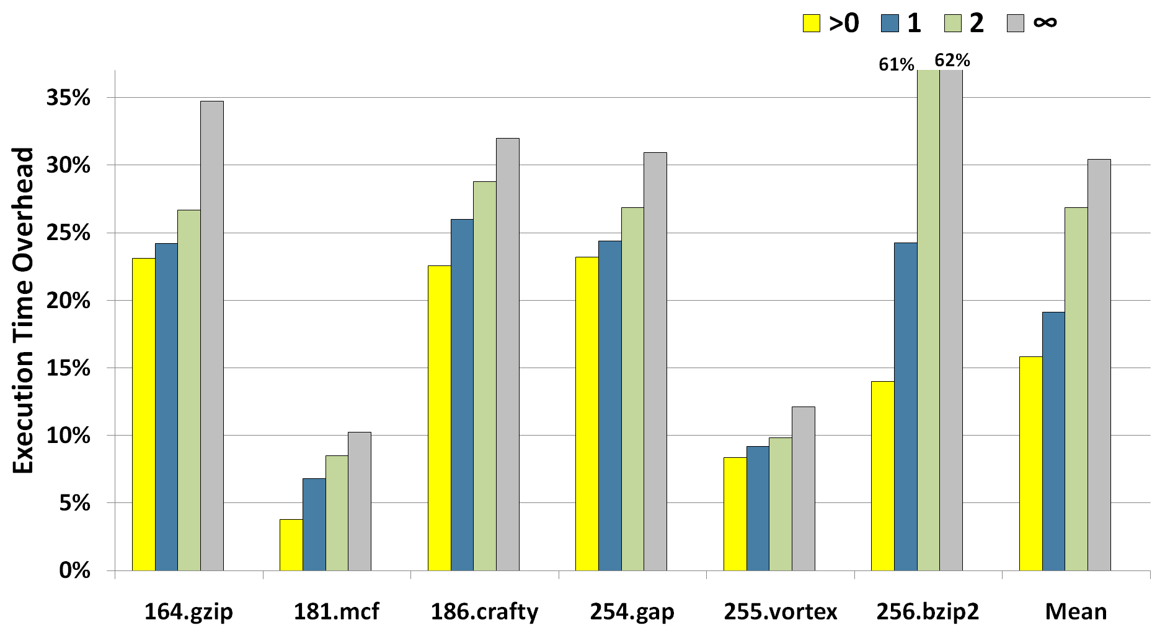
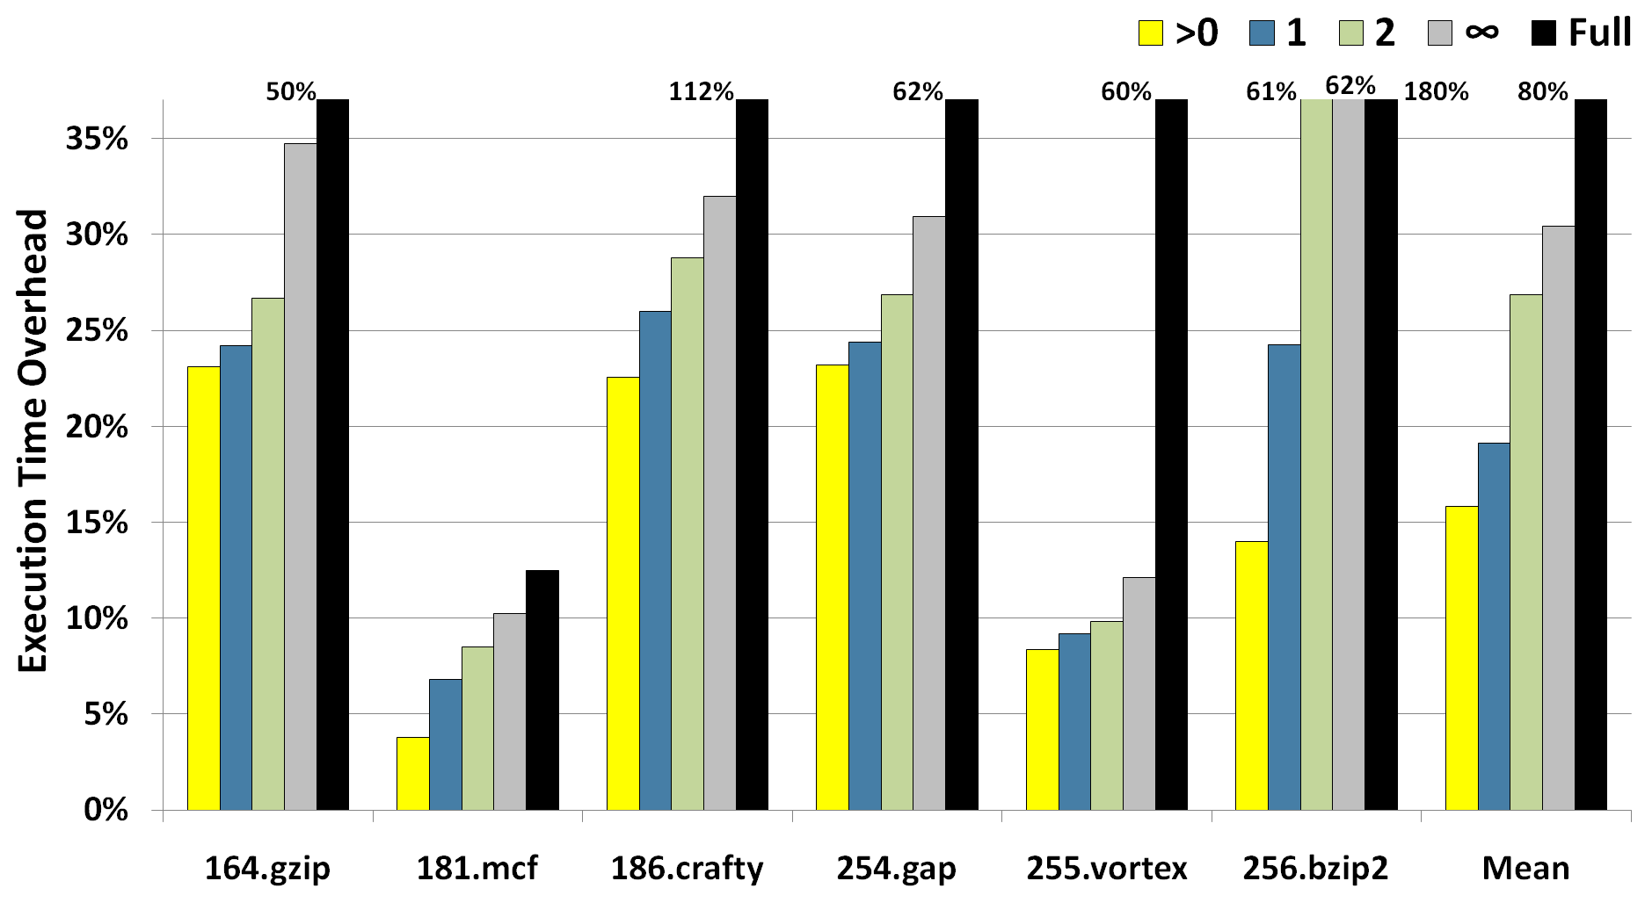
Runtime Overhead
[SWIFT, CGO`05]
Increasing values for S_{t}
(fewer safe instructions)

Slide 22
Conclusions
Unlike traditional schemes, Shoestring provides mainstream, commodity systems with reliability on the cheap.
Shoestring can augment symptom-based schemes with selective duplication to cover an additional 33.9% of unmasked faults.
Overall, Shoestring allows just 1.6% of all faults to manifest as user-visible corruptions (~5x reduction).
@ 15.8% performance penalty (vs. ~80%)
Developing more sophisticated heuristics (vulnerability analysis, high value instructions) presents opportunities for improvement.

Slide 23
Questions?
http://cccp.eecs.umich.edu

