Slide 1
ZerehCache: Armoring Cache
Architectures in High Defect
Density Technologies
Amin Ansari, Shantanu Gupta,
Shuguang Feng, and Scott Mahlke
University of Michigan, Ann Arbor
Micro-42
December 14, 2009

Slide 2
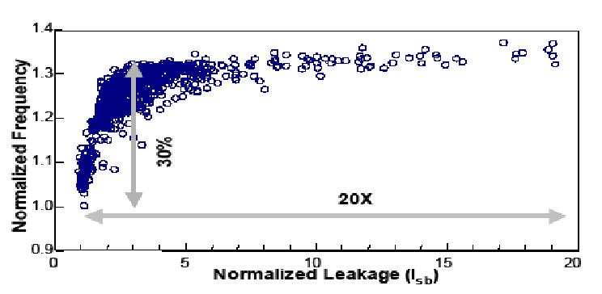
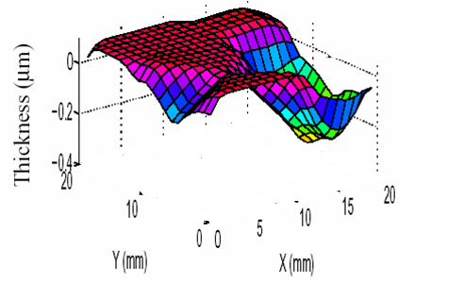
Process Variation
[Borkar’03]
Robustness of silicon chips affected by
Process/manufacturing variation
Operating condition variation (temperature)
too leaky
[Austin’08]
too slow
Process variation
Intra-die and inter-die variations
Intra-die variation became significant from 0.13um
Systematic and random variations
Systematic: equipment, process (sub-wave length lithography)
Random: inherent variation (random dopant fluctuation)
Causes delay variations by affecting transistors and metal wires

Slide 3
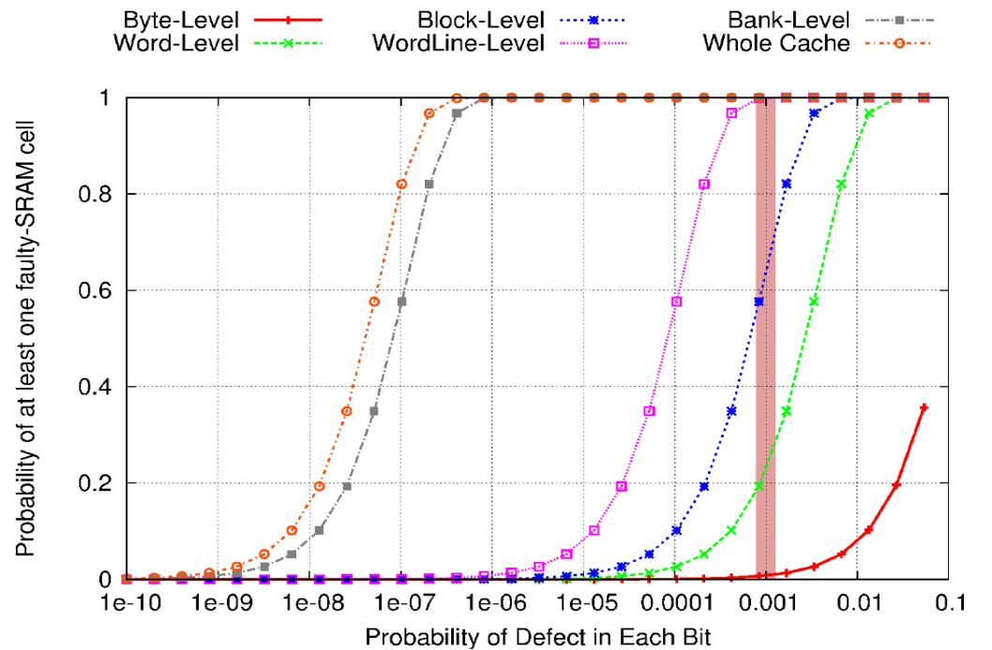
On-Chip Cache Reliability
More than 70% of the chip area in the modern processors can be devoted to the on-chip SRAM arrays
The yield of an unprotected cache in 45nm can be as low as 30% [Agarwal’05]
Lower granularity of redundancy required to provide the robustness guarantee → complexity of the spare substitution
A 2-bank 2MB L2 cache with 128B block size and 256b word

Slide 4
Our Goals
High failure rate tolerant cache protection scheme
A unified architectural approach for both L1 and L2
Providing high degree of freedom in spare substitution
Minimizing the amount of redundancy required while keeping the access delay and power overheads as low as possible
Using our scheme to mitigate the yield loss, caused by process variation induced failures, in high-performance microprocessors

Slide 5
Motivation
We want to use redundancy in multiple ways
Minimizing the amount of required redundancy
Lines with the same color form a “logical group”
Several word-lines along with their corresponding spare line
Changing group of the lines can solve the collisions
Line swapping allows a line to change its group
collision ₁
collision ₂
Cache Lines
Spare Lines
Not functional
Functional
Functional

Slide 6
ZerehCache Architecture
Fault map:
Same number of lines as spare
cache
For each redundancy unit, it stores
the row number in the
corresponding logical group which
utilized that redundancy
Comparison stage:
Determines whether the unit of
redundancy should replace the
main cache data chunk
Interconnection network:
Between decoder and main cache
Benes network is leveraged
Shuffling between the lines to
resolve the collisions
Depth of network determines the
degree of freedom in line
swapping (access delay)
Network
Configuration Storage
Spare cache:
Each line in spare cache
corresponds to a logical group of
lines in the main cache
Each line is broken up to smaller
redundancy units with fixed size
Offset
BIST block
Network configuration storage:
Contains the proper configuration
of the interconnection network
(non-volatile memory)
Group 1
MUXing level:
Does the selection between the
main cache and spare cache data
chunks
Group 2
(2)
Tag
Array
Data Array
Row Decoder
Interconnection Network
Interleaved Spare Cache
(3)
Fault Map
Hit/Miss
=
Column Decoder
Comparator
(1)
Sense Amp & Drivers
(2)
=
…
=
Address Format
Mux Level
Tag (1)
Set (2)
Word (3)
Data
Data array divided to equal sized groups

Slide 7
Benes Network (BN)
Interconnection net consists of
multiple unidirectional local BNs
with small depth
Shuffling the cache lines and
forming the logical groups
Two back-to-back butterfly nets
Non-blocking, full permutation
among the lines in the same
“swapping set”
Logarithmic diameter (scalable)
2n-1 stages for connecting 2^{n} lines
Efficient implementation [Shi’03]
Butterfly
Butterfly
Row Decoder
Data Array
Group 1
Interconnection Network
Row Decoder
Group 2
Group 3
Group 4
Interconnection
Network
Data Array

Slide 8
Configuration Necessity
Configuration: Assignment of the cache word-lines to the spare word-lines [essential for having a functional cache]
collision ₁
collision ₂
Cache Lines
Spare Lines
Not functional

Slide 9
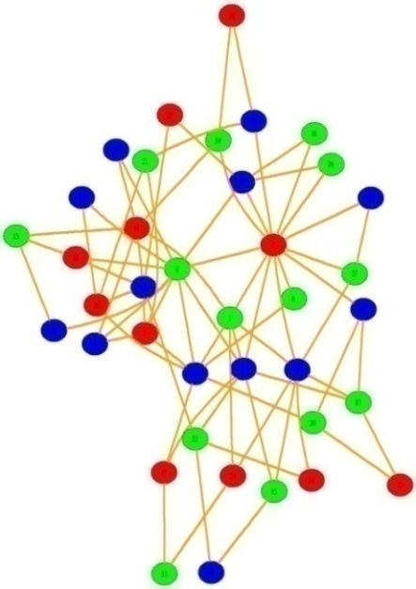
ZC Configuration
Two algorithmic problems:
Effective group formation
Benes network configuration problem
Effective group formation [Graph Coloring]
The base graph is constructed from the
collision pattern in the main/spare caches
A heavily optimized solver (IBSC) [manufacturing test time]
Benes network configuration
It maps a valid coloring assignment to the actual content of the network configuration storage [Recursive Subnet Mapping]

Slide 10
Construction of Collision Graph
Local BN₂
Local BN₁
a
b
a
b
Main Cache
1
2
1
1
2
2
1
3
4
8
4
7
5
3
8
4
7
6
3
7
8
6
5
6
5
Spare Cache
a
d
b
X
d
c
c
X
c
d
X
X
An edge exists between two nodes, if the corresponding lines cannot be in the same logical group
Intrinsic edges: bold lines, limitations of network
Fault edges: dotted lines, collision pattern
• Lines with the same color in the main/spare cache form
a single logical group
• Each logical group contains a single spare line

Slide 11
Usage of Local Benes Networks
Actual cache layout
Local BN₁
Between the odd lines
?
Main Cache
Main Cache
1
1
1
2
1
3
8
4
7
5
2
6
5
7
4
8
3
6
Spare Cache
Local BN₂
Spare Cache
a
a
8
1
8
b
X
b
2
7
7
c
X
c
5
4
d
X
X
d
6
3
6
Between the even lines
Virtual cache layout

Slide 12
Design Space Exploration
A large set of values for the main design parameters:
Number of cache spare lines (from {2^{i} | i ϵ {0, 1, …, 8}})
Depth of BNs (from {1, 3, 5, … , 19})
MUXing granularity (from {2i | i ϵ {0, 1, …, 10}})
1980 initial design points for L1 and L2 ZCs
Practical constraints on design space:
Graph-coloring solver time
Cache access latency
Probability of operation
Area and power overhead

Slide 13
Design Space Exploration (cont)
Graph-coloring solver time
Manufacturing test time is expensive (10s from several mins)
Cache access latency
An additional cycle for caches assuming no slack
P_{op}: Probability that a specific ZC can properly operate for a given P_{F} and also architecture parameters
Calculated using probabilistic analysis of random graphs
MUXing granularity ↓ results in P_{op} ↑
Number of redundant lines ↑ results in P_{op} ↑
Depth of BNs ↑ results in P_{op} ↑

Slide 14
Area Overhead
CACTI along with PowerCompiler and DesignCompiler are used to evaluate overheads of our extra structures
L1/2 - # of spare lines - MUXing granularity - BN depth

Slide 15
Dynamic Energy Overhead
CACTI along with PowerCompiler and DesignCompiler are used to evaluate overheads of our extra structures
L1/2 - # of spare lines - MUXing granularity - BN depth

Slide 16
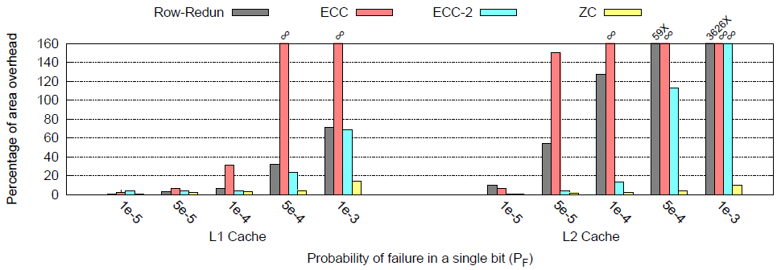
Comparison with Conventional Methods
• Protecting L2 is much harder than L1 because of larger
size and longer lines
• ECC-2 is costly even for the low failure rate situations
( 50% energy consumption overhead )
Comparing ZC with: row-redundancy, 1-bit, and 2-bit error correction coding schemes.
For each protection mechanism and a given P_{F}, area overhead increased from 0% until P_{op} > 90%.

Slide 17
Yield Analysis
Inter-die variation, intra-die variation, and clustering effect (using large area clustering negative binomial model [Koren’00])
VARIUS used to model the inter-die variation and module-level intra-die variation
Population of 1000 chips generated based on the different process variation characteristics for 45nm
An L2
bank
For our selected L1
and L2 ZCs, 99% and 96%
manufacturing yield can be
achieved, respectively.
Yield of a cache without
any protection mechanism
can be as low as 33%
Around 30% is
reported in [Agarwal’05]
Working enabled by ZC

Slide 18
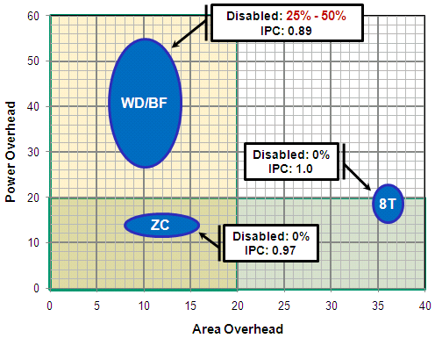
Comparison with Recently Proposed Methods
Comparing with: Wilkerson et. al. [WD/BF] and 8T SRAM bit-cells

Slide 19
Conclusion
ZC minimizes the required redundancy by:
Static row multiplexing
Dynamic line swapping
Effective group formation
Efficient design space exploration methodology for finding the optimal ZCs based on the design objectives
Outperforming the conventional and recently proposed cache protection mechanisms
L1 ZC: 16% area and15% power overheads
L2 ZC: 8% area and 12% power overheads

Slide 20
Thank You
http://cccp.eecs.umich.edu

