Slide 1
Enabling Ultra Low Voltage System Operation by Tolerating On-Chip Cache Failures
Amin Ansari, Shuguang Feng, Shantanu Gupta, and Scott Mahlke
Advanced Computer Architecture Lab.
University of Michigan, Ann Arbor
August 20, 2009

Slide 2
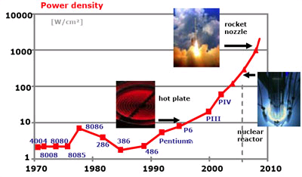
Motivation
Extreme technology integration in sub-micron regime
Heat dissipation ↑ and power density ↑
Cost of thermal packaging, cooling, and electricity ↑
Device lifetime ↓
If high performance is not needed → DVS
Improvement in battery life of medical devices, laptops, and etc
Large SRAM structures limit the min achievable V_{dd}
because SRAM delay increases at a higher rate than CMOS logic delay as V_{dd} is decreased

Slide 3
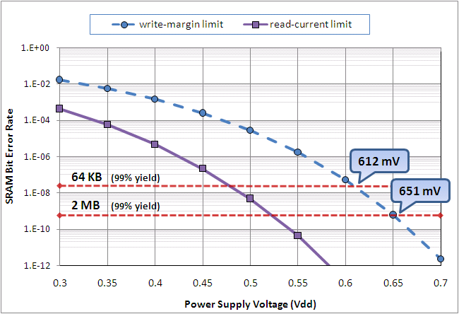
Bit-Error-Rate for an SRAM Cell
Extremely fast growth in failure rate with decreasing V_{dd}
Due to systematic and random process variation
Min sustainable V_{dd} of entire cache is determined by the one SRAM bit-cell with the highest required operational voltage
Min achievable V_{dd} for 64KB and 2MB caches
In 90nm while targeting 99% yield
Write-margin of L2 cache determines the min V_{dd}

Slide 4
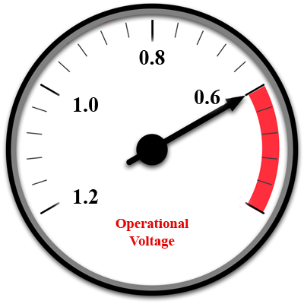
Our Goal
Enabling DVS to push core’s V_{dd} down to
Ultra low voltage region ( < 600mV )
While preserving correct functionality of on-chip caches
Proposing a highly flexible and FT cache architecture that can efficiently tolerate these SRAM failures
No gain in high power mode
Minimizing our overheads in this mode
Single power supply, because dual V_{dd} have
Area and design complexity ↑
Necessity of voltage converters
Large noise from the high voltage island

Slide 5
Our Fault-Tolerant Cache
Interweaving a set of n+1 partially functional cache word-lines to give the appearance of n functional lines
Partitioning the set of all lines into large groups
One line per group serves as redundancy for other lines
Each line is divided to multiple chunks (smaller redundancy units)
Two lines have collision, if they have at least one faulty chunk in the same position (10 and 15 are collision free)
We form groups such that there are no collision between any two lines within a group
Group 3 (G3) contains lines 4, 10, and 15

Slide 6
Architecture
Added modules:
+ Memory map
+ Fault map
+ MUXing layer
Group address of data line
Fault map address
Sacrificial line
Memory Map
Data line
Input Address
15
4
G3
2
First Bank
Second Bank
1
9
G3(1)
2
10
3
G3(S)
11
4
12
5
13
6
14
G3(2)
7
15
8
16
Fault Map
Two type of lines:
+ data line
+ sacrificial line
MUXing layer
G3
1
-
-
2
Functional Block

Slide 7
Group Formation
1
G1(S)
9
G1(1)
2
G2(1)
10
G2(S)
3
G2(2)
11
G1(2)
cache fault
pattern
G3(S)
G4(S)
4
G4(1)
12
G3(1)
5
G4(2)
13
G3(2)
6
G4(3)
14
D
7
G5(S)
15
G5(1)
8
16
Group
1
1
G1(S)
9
G1(1)
11
G1(2)
Group 2
2
G2(1)
10
G2(S)
3
G2(2)
Group
3
4
G3(S)
13
G3(1)
14
G3(2)
12
G4(S)
Group
4
5
G4(1)
6
G4(2)
7
G4(3)
Group
5
8
G5(S)
16
G5(1)

Slide 8
Operation Modes
Low power mode (V_{dd} < 651mV)
First time processor switches to this mode
BIST scans cache for potential faulty cells
Processor switches back to high power mode
Forms groups and fills the memory and fault maps
High power mode (V_{dd} ≥ 651mV)
Our scheme is turned off to minimize overheads
There is no sacrificial lines in this case
Clock gating to reduce dynamic power of SRAM structures
Bypass MUXes still burn dynamic power
No power gating is used for leakage mitigation

Slide 9
Evaluation Methodology
Performance
SimAlpha that is based on SimpleScalar OoO
Processor is modeled after DEC EV-7
Delay, power and area
CACTI for caches and other SRAM structures
Synopsys standard tool-chain for
Miscellaneous logic (e.g. bypass MUXes and comparators)
Given set of cache parameters (e.g. V_{dd})
Monte Carlo (with 1000 iterations) using described algorithm
Determining disabled portion of caches (for 99% yield)

Slide 10
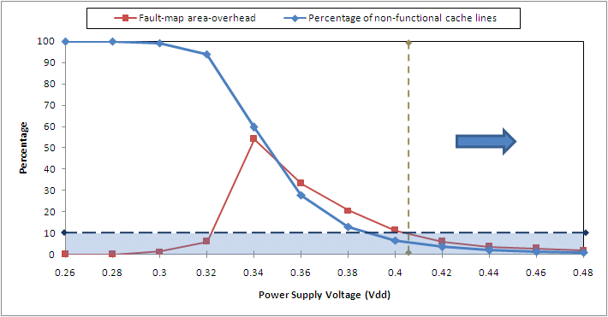
Minimum Achievable V_{dd}
Protecting L2 is harder than L1
Due to longer lines and larger size
Chunk size = 8b for L2 and 4b for L1
Achieving 420mV by enforcing the following 10% limits

Slide 11
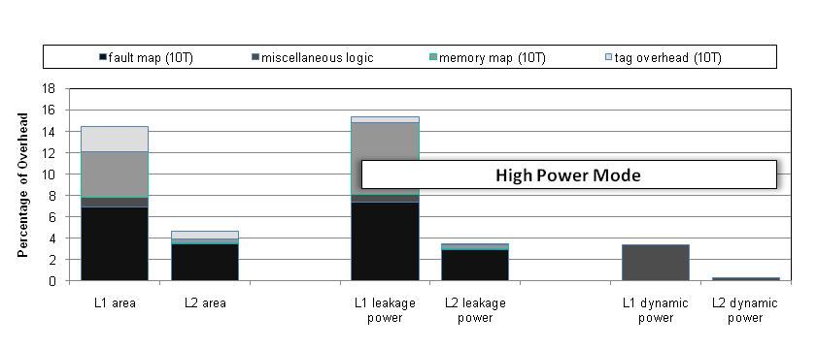
Overheads
Overheads for L1 and L2 caches
10T used to protect fault map, tag array, and memory map
Using SPEC2K benchmark suite
INT: (gzip, vpr, gcc, mcf, crafty, parser, vortex, bzip2, twolf)
FP: (swim, mgrid, applu, art, equake, ammp, sixtrack)
4.7% performance penalty for EV-7 (simAlpha)

Slide 12
Conclusion
DVS is widely used to deal with high power dissipation
Minimum achievable voltage is bounded by SRAM structures
We proposed a flexible FT cache architecture
To tolerate these SRAM failures efficiently when operating in low power mode
Using our approach
Operational voltage of processor can be reduced to 420mV
80% dynamic power saving and 73% leakage power saving
4.7% performance overhead for microprocessor
< 15% overhead for on-chip caches

