Slide 1
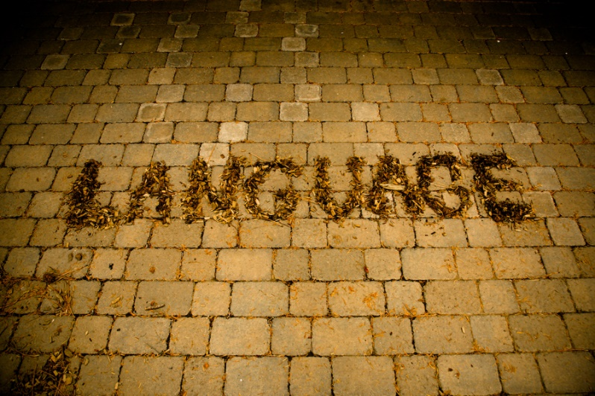
Formal semantics and pragmatics, and their origins in philosophy
Foundations of Semantics
NASSLLI
June 23, 2018
Zoltán Gendler Szabó
Richmond Thomason

Slide 2
0. Two theses
Compositionality:
The meaning of a sentence is a function of the meanings of its parts and its structure.
Truth-conditionality:
The truth-conditions of a sentence are a function of its meaning.
Some sentences arguably lack truth-conditions (e.g. imperatives), some parts of sentences arguably are meaningless (e.g. agreement morphemes). Let’s understand the first thesis as quantifying only over meaningful parts and the second as quantifying only over truth-apt sentences.

Slide 3
1. Compositionality 1. Prior knowledge
Query: We understand sentences we never heard before. How is that possible?
Answer: We know something antecedently that allows us to work out their meanings.

Slide 4
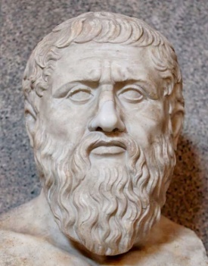
1. Compositionality 1. Prior knowledge
Query: We understand sentences we never heard before. How is that possible?
Answer: We know something antecedently that allows us to work out their meanings.
In the Meno, Plato raises the question how inquiry is possible. Either we know something, or we don’t. If we do there is no need for search; if we don’t then we don’t know what to search for. Plato’s solution is that learning requires tacit knowledge: to be ignorant is to be temporarily unable to recall something already in our mind.

Slide 5
1. Compositionality 2. The minimal assumption
To understand a new expression one must know its structure and the meanings of its constituents. The minimal assumption is that these are enough, and hence, that the meaning of the expression must be a function of these two factors.
Compositionality (more precisely and more generally):
There is a function that maps the complete structure and the meanings
of the ultimate constituents of any complex expression onto its meaning.

Slide 6
1. Compositionality 3. Empirical claim
Suppose we stipulate that whenever it rains at the location of an utterance of the sentence Elephants are gray, the sentence shall mean on that occasion that Julius Caesar was murdered on the ides of March while retaining its usual meaning on all other occasions. Let’s also stipulate that this is the only difference between English and our new language.
Rain English is not compositional: the meaning of Elephants are gray varies with the weather while its structure and the meanings of its constituents stay the same.
Rain English is learnable: you have already learned it!

Slide 7
1. Compositionality 4. Idioms
Since idioms cannot be understood by those who have never heard them before (unless we posit hidden constituents or a special mode of semantic composition for them) they are counterexamples to compositionality.
We may have to opt for the more moderate claim that natural languages are compositional—except for the finite number of non-compositional idioms they contain.

Slide 8
1. Compositionality 5. What the argument fails to show
Semanticists often assume a stronger compositionality claim: that there is a function that maps the immediate structure and the meanings of the immediate constituents of any complex expression onto the meaning of that expression. This is unsupported by considerations of productivity.
Semanticists also often assume that competent speakers in fact understand complex expressions by ascertaining their structure and the meanings of their constituents. But the argument from productivity only maintains that they can, in principle, understand them in this way.

Slide 9
2. Truth-conditionality 1. Non-substantive?
If a sentence is truth-apt its truth-value depends on its meaning and a variety of other factors.
On another fairly standard definition (employed, for example, by David Kaplan), truth-conditions are a function from all those factors minus the ones fixed by context to truth-values. If so, Truth-conditionality is falsified by any truth-apt context sensitive sentence.

Slide 10
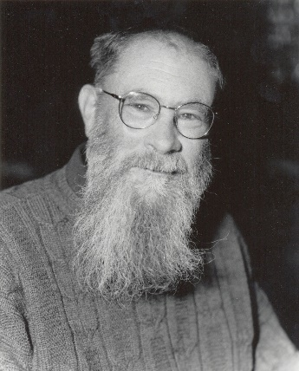
2. Truth-conditionality 1. Non-substantive?
If a sentence is truth-apt its truth-value depends on its meaning and a variety of other factors.
On one a fairly standard definition (employed, for example, by David Lewis), truth-conditions are a function from all those factors to truth-values. If so, Truth-conditionality is true by definition.
On another fairly standard definition (employed, for example, by David Kaplan), truth-conditions are a function from all those factors minus the ones fixed by context to truth-values. If so, Truth-conditionality is falsified by any truth-apt context sensitive sentence.

Slide 11
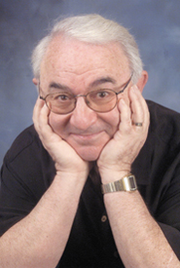
2. Truth-conditionality 1. Non-substantive?
If a sentence is truth-apt its truth-value depends on its meaning and a variety of other factors.
On one a fairly standard definition (employed, for example, by David Lewis), truth-conditions are a function that maps all those factors to truth-values. If so, Truth-conditionality is true by definition.
On another fairly standard definition (employed, for example, by David Kaplan), truth-conditions are a function that maps all those factors minus the ones fixed by context to truth-values. If so, Truth-conditionality is falsified by any truth-apt context sensitive sentence.

Slide 12
2. Truth-conditionality 2. Underdetermination
Many philosophers insist that Truth-conditionality is substantively false – they claim that meaning even together with context underdetermines truth-conditions.
(1) Alice went to the gym [into vs. near]
(2) Bert didn’t have fish for dinner [eat vs. order]
(3) Cecile destroyed her shoes [blemished vs. ruined]
(4) Dan owns a dangerous dog [attacks vs. infects]
(5) Evelyn is a philosopher [employment vs. temperament]
The claim requires the (contentious) assumption that manifested speaker intentions are not aspects of the context.

Slide 13
2. Truth-conditionality 3. Extensional semantics
The simplest model for meaning will (i) identify sentence meanings with truth-conditions and (ii) reduce the factors on which truth-value depends to nil. This means that the semantic values of sentences are truth-values. We can then take the semantic values of proper names (PN) to be their bearers and the semantic values of common nouns (CN) the things of which they can be truly predicated.
$⟦Lea⟧=Lea$
$⟦orthodontist⟧= \left\{x:x is an orthodontist\right\}$
$⟦[_{VP}is a\left(n\right) CN]⟧= ⟦CN⟧$
$⟦PN VP⟧=true if ⟦PN⟧∈⟦CN⟧, false otherwise$

Slide 14
2. Truth-conditionality 4. The substitution argument
Suppose all and only orthodontists are insomniacs. Then, if we use extensional semantics, $⟦orthodontist⟧=⟦insomniac⟧$. But if on some exoplanet in a far-away galaxy, or at some forgotten time in ancient past, or in some bizarre possible world there happens to be an orthodontist who sleeps well then substituting insomniac for one of the occurrences of orthodontist in (1)-(3) changes these false sentences into true ones.
(1) Somewhere, there is a orthodontist who is not a orthodontist
(2) Once, there was a orthodontist who was not a orthodontist
(3) Possibly, there might be a orthodontist who is not a orthodontist
These are violations of compositionality, so we need semantic values richer than extensions.

Slide 15
2. Truth-conditionality 5. Metaphysical presuppositions
Objection: Many would complain that if there is a orthodontist who is not an insomniac, no matter how far away, orthodontist and insomniac cannot have the same extension. Some would also say that the extensions must differ if there was a time when there was a orthodontist who was not an insomniac. And a few—notably, David Lewis—would insist that the mere fact that there could be a orthodontist who is not an insomniac is enough to rule out the extensional equivalence of orthodontist and insomniac.
Reply: This all depends on your metaphysics – what you take to be real. Suppose you belong to the current metaphysical majority: you think spatially or temporally distant orthodontists are real, but modally distant ones are not. Then sentences containing somewhere or once are straightforward for you, but the ones containing possibly still pose a compositionality problem. You will switch to a semantics where semantic values are intensions (functions from possible worlds to extensions).

Slide 16
3. Reference 1. Does semantics need any notion other than truth?
If Compositionality and Truth-functionality hold, one of the things meanings do is help determine truth-conditions for sentences. On the most austere conception they have no other job.
On the austere conception, we should think of sub-sentential meanings purely instrumentally. There are many alternative systems of geographic coordinates we could use to fix a position of a ship at sea and there are many equally good ways to pick semantic values and rules to fix the conditions under which declarative sentences are true.

Slide 17
3. Reference 2. Austere truth-conditional semantics
On the austere conception of truth-conditional semantics, we do not rely on a pre-theoretical notion of reference.

Slide 18
3. Reference 2. Austere truth-conditional semantics
On the austere conception of truth-conditional semantics, we do not rely on a pre-theoretical notion of reference.
Let π be a proxy function that maps Frege to Russell, Russell to Tarski, and Tarski to Frege. On the austere conception, the normal semantics is no better than the warped.
Normal semantics Warped semantics
${⟦Frege⟧}^{w}$= Frege ${⟦Frege⟧}^{w}$= Russell
${⟦Russell⟧}^{w}$ = Russell ${⟦Russell⟧}^{w}$ = Tarski
${⟦Tarski⟧}^{w}$ = Tarski ${⟦Tarski⟧}^{w}$ = Frege
${⟦walks⟧}^{w}$ = {x : x walks in w} ${⟦walks⟧}^{w}$ = {x : $π^{−1}$(x) walks in w}

Slide 19
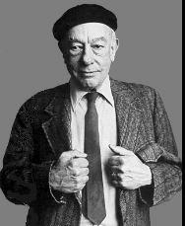
3. Reference 3. Inscrutabiliuty
For Quine, the empirical basis of any theory consists of observation sentences. These are sentences of a language that linguistically competent and perceptually well-functioning speakers can come to agree on simply by witnessing a scenario. If these are all we base our theory choice on, the natural and warped semantics are evidentially on a par.
Davidson rejected the idea that there is a principled distinction between observation sentences and the rest, but he too believed that all evidence for or against a semantic theory comes from observable facts concerning the way speakers use their sentences—and this is enough for inscrutability.

Slide 20
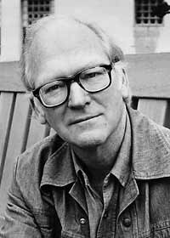
3. Reference 3. Inscrutabiliuty
For Quine, the empirical basis of any theory consists of observation sentences. These are sentences of a language that linguistically competent and perceptually well-functioning speakers can come to agree on simply by witnessing a scenario. If these are all we base our theory choice on, the natural and warped semantics are evidentially on a par.
Davidson rejected the idea that there is a principled distinction between observation sentences and the rest, but he too believed that all evidence for or against a semantic theory comes from observable facts concerning the way speakers use their sentences—and this is enough for inscrutability.

Slide 21
3. Reference 4. Appeal to simplicity?
If we want to reject the thesis we need a more liberal view about what counts as evidence.
A theory according to which, in normal cases, a particular use of a demonstrative pronoun refers to the object o the speaker demonstrates (usually by pointing, but often in some other way) is simpler than the one according to which it refers to some object o′ identified by first identifying o and then applying a proxy function.
Once inscrutability is given up for normal uses of demonstratives, we can leverage this to refute inscrutability for other expressions as well. We might insist, for example, that when someone introduces Frege by pointing at him and uttering Frege then the word uttered must refer to the individual demonstrated.

Slide 22
3. Reference 5. Irrelevance?
Most semanticists believe that Russell is not the referent of Frege but insist that he, or any other artificial proxy of Frege, would serve equally well to model the real referent.
No theory should make assumptions beyond those it actually uses, and the assumption that semantic values are real world referents is idle in semantic theorizing. Reference is not inscrutable, it is just beside the point.
But … if the semantic values of words and phrases are regarded as a more or less arbitrary way to derive the correct truth-conditions for sentences then these values tell us very little about what words and phrases mean. That seems like a problem.

Slide 23
3. Reference 6. Referring expressions
Semantics textbooks usually tell us that referring expressions are pronouns,
proper names, and definite descriptions. But bound or anaphoric pronouns,
complex or descriptive proper names, and plural and mass definite
descriptions are not always counted as referring expressions.
Two desiderata:
(i) Some expressions refer, some don’t. (E.g. Neptune refers, Vulcan does not.)
(ii) Some expressions are for referring, some are not. (E.g. both Neptune and Vulcan are for referring, neither orbits the Sun and Neptune orbits the Sun are for referring.)

Slide 24
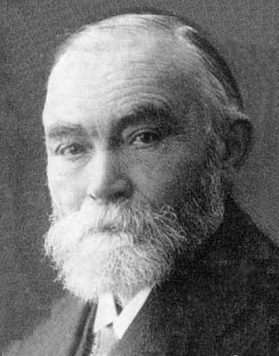
3. Reference 7. Fregean accounts
For Frege, every expression is a referring expression: the referent of orbits the Sun is a function from objects to truth-values and the referent of Neptune orbits the Sun is a truth-value. Vulcan lacks referent but that is because it is not a real name, only appears to be one.
Frege-inspired semanticists might say that referring expressions are those whose referent is an object (as opposed to a function). This helps with distinguishing referring expressions from other expression but does not help with distinguishing referring expressions that refer from referring expressions that don’t.
Saying that Vulcan refers to a null object does not help: if there is a null object it can be named and we want to distinguish its name from Vulcan.

Slide 25
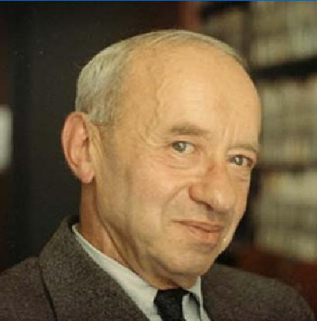
3. Reference 7. Tarskian accounts
For Tarski, no expression is a referring expression: Neptune₁ is satisfied by a variable assignment g just in case g(x₁) is Neptune, Vulcan₂ is satisfied by a variable assignment g just in case g(x₂) is Vulcan, x₃ orbits the Sun is satisfied by a variable assignment g just in case g(x₃) orbits the sun.
A Tarski-inspired semanticist might say that referring expressions are all and only those that bear indices, and among referring expressions, the ones that actually refer are all and only the ones that are satisfied by some variable assignment.
The problem is that the category of referring expressions appears to be syntactically heterogeneous, and so, we have no obvious way to decide which expressions are supposed to bear indices.

Slide 26
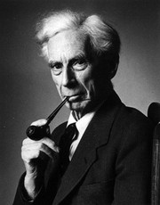
3. Reference 8. A Russellian suggestion
Russell thought logically proper names are mare tags – they designate their bearers without describing them. To understand a logically proper name we must be acquainted with its bearer.
Russellian acquaintance is demanding – we are only acquainted with ourselves and with our sense data. We can liberalize the notion to allow acquaintance with everyday objects, and we can extend it to allow acquaintance with things with which others are acquainted. Referring expressions are those one can understand only if one is acquainted in this loose sense with a particular. (So, orbits the Sun and Neptune orbits the Sun are not referring expression).
Vulcan is not a referring expression but it shares an important function with referring expressions—to designate a particular. It fails to perform this function—the definite description it abbreviates describes nothing at all.

Slide 27
the end

