Slide 1
BLE Security
EECS 582 -- Spring 2015

Slide 2
Overview
BLE Refresher
Attacks
Improvements
Authentication
Privacy
Discussion

Slide 3
BLE: Quick/Simplified Refresh
Application Layer
GATT
ATT
L2CAP
Link Layer
Physical Layer

Slide 4
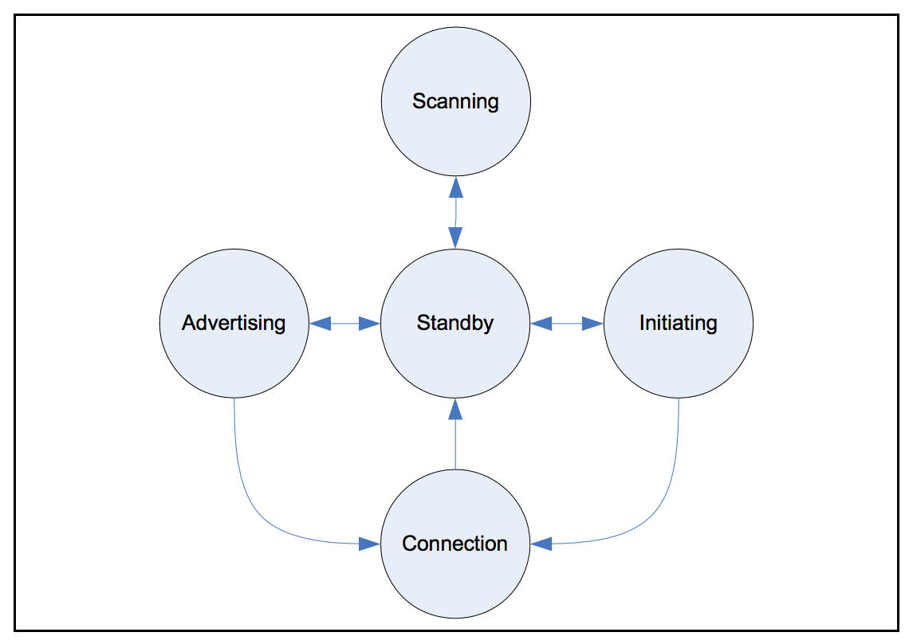
Link Layer State Machine

Slide 5
Link Layer Connections - Steps
Initiate Connection
Exchange keys <- Attack!
Authenticate
Send encrypted messages

Slide 6
BLE CONNECT_REQ Packet
Notes:
The AA field shall contain the Link Layer connection’s Access Address
determined by the Link Layer following the rules specified in Section 2.1.2.
The CRCInit field shall contain the initialization value for the CRC calculation
for the Link Layer connection, as defined in Section 3.1.1. It shall be a ran-
dom value, generated by the Link Layer.
The WinSize field shall be set to indicate the transmitWindowSize value, as
defined in Section 4.5.3 in the following manner: transmitWindowSize = Win-
Size * 1.25 ms.
The WinOffset field shall be set to indicate the transmitWindowOffset value,
as defined in Section 4.5.3 in the following manner: transmitWindowOffset =
WinOffset * 1.25 ms.
The Interval field shall be set to indicate the connInterval as defined in Sec-
tion 4.5.1 in the following manner: connInterval = Interval * 1.25 ms.
The Latency field shall be set to indicate the connSlaveLatency value, as
defined in Section 4.5.1 in the following manner: connSlaveLatency =
Latency.
The Timeout field shall be set to indicate the connSupervisionTimeout value,
as defined in Section 4.5.2, in the following manner: connSupervisionTime-
out = Timeout * 10 ms.
The ChM field shall contain the channel map indicating Used and Unused
data channels. Every channel is represented with a bit positioned as per the
data channel index as defined in Section 1.4.1 . The LSB represents data
channel index 0 and the bit in position 36 represents data channel index 36.
A bit value of ‘0’ indicates that the channel is Unused . A bit value of ‘1’ indi-
cates that the channel is Used . The bits in positions 37, 38 and 39 are
Reserved for Future Use . Note: When mapping from RF Channels to data
channel index, care should be taken to remember that there is a gap where
the second advertising channel is placed.
The Hop field shall be set to indicate the hopIncrement used in the data
channel selection algorithm as defined in Section 4.5.8.2. It shall have a ran-
dom value in the range of 5 to 16.
The SCA field shall be set to indicate the masterSCA used to determine the
worst case Master’s sleep clock accuracy as defined in Section 4.2.2. The
value of the SCA field shall be set as defined in Table 2.2 .

Slide 7
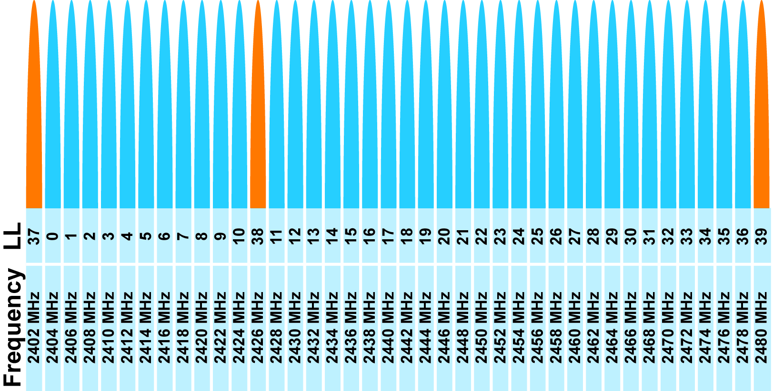
Initiating a BLE Connection
Peripheral advertises
Initiator starts connection
hopInterval
hopIncrement
accessAddress
crcInit
Initiator and peripheral move to next channel

Slide 8
Sniffing an on going connection
Eliminate false positives (how do you know what is a packet)
Look for 16-bit header for empty packet, take prior 32-bits as AA
crcInit can be reversed, by running the packet through the LFSR in reverse (magic, magic, math, math...)
Access Address is set in each packet.
Wait on a channel and observe subsequent packets, record time between
Wait for a packet on two separate data channels

Slide 9
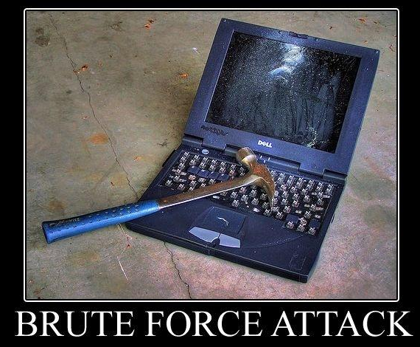
Encryption - BLE 4.0 & 4.1
Custom key exchange
Select TK (128 bit AES key)
Use TK to agree upon LTK
What’s TK?
Just WorksTM: key == 0
6-digit passkey: key in 0-999,999
Out of Band: You’re on your own.

Slide 10
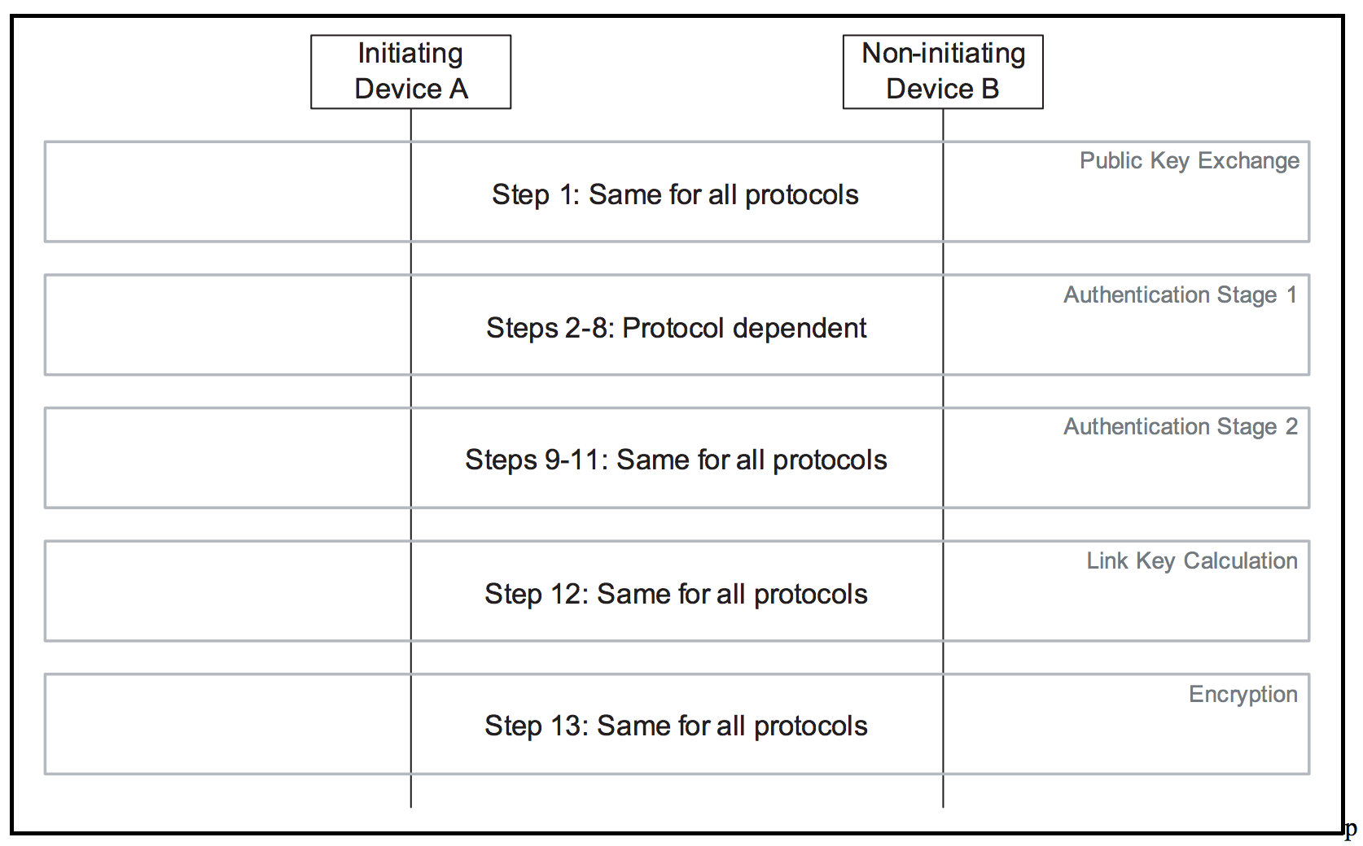
BLE 4.2 - Secure Simple Pairing
Elliptic Curve Diffie Hellman
96 bits of entropy with P-192 or 128 bits with P-256
Protects against passive eavesdropping
Does not protect against MITM
Association models (anti-MITM)
Numeric comparison
Out of Band
Passkey
Secure Connections Only Mode
Notes:
PHASE 1: PUBLIC KEY EXCHANGE Initially, each device generates its own Elliptic Curve Diffie-Hellman (ECDH) public-private key pair (step 1). This key pair needs to be generated only once per device and may be computed in advance of pairing. A device may, at any time, choose to discard its public-private key pair and generate a new one, although there is not a requirement to do so.
Authentication Stage 1 has three different protocols: Numeric Comparison, Out-of-Band, and Passkey Entry. Note that there is not a separate protocol for the Just Works association model. This association model shares the Numeric Comparison protocol.
PHASE 3: AUTHENTICATION STAGE 2 The second stage of authentication then confirms that both devices have successfully completed the exchange. This stage is identical in all three protocols. Each device computes a new confirmation value that includes the previously exchanged values and the newly derived shared key (step 9). The initiating device then transmits its confirmation value which is checked by the responding device (step 10). If this check fails, it indicates that the initiating device has not confirmed the pairing, and the protocol must be aborted. The responding device then transmits its confirmation value which is checked by the initiating device (step 11). A failure indicates that the responding device has not confirmed the pairing and the protocol should abort.
PHASE 4: LINK KEY CALCULATION Once both sides have confirmed the pairing, a link key is computed from the derived shared key and the publicly exchanged data (step 12). The nonces ensure the freshness of the key even if long-term ECDH values are used by both sides. This link key is used to maintain the pairing.
PHASE 5: LMP AUTHENTICATION AND ENCRYPTION The final phase in Simple Pairing consists of authentication and generation of the encryption key. This is the same as the final steps in legacy pairing.

Slide 11
Link Layer Encryption
TCP/IP
No encryption
No authentication
Relies on application layer
Vulnerable to passive listener
BLE
Node-to-node encryption
Impractical authentication (for many IoT)
Simply Secure is safe from passive listener

Slide 12
Could I be tracked?
Device Address Randomization
Access Address generated by identity key (IRK)
IRK exchanged during bonding
Do people use it?
“We do not currently employ Bluetooth Smart in this capability.”
“...we do not use randomize device address.”
“As far as we are aware, our two products that use BLE do not utilize this feature.”

Slide 13
Summary
Proven link-layer encryption scheme node to node (in 4.2)
No protection against MITM without traditional I/O
Option for randomizing device address

Slide 14
Wishlist
Better way to do authentication
Many IoT class devices don’t have classical I/O
How to I control what devices are connected to my gateway?
How can I control what gateways I connect to?
Multihop communication
Do I trust the nodes in between the gateway and destination?
What happens if one of my devices is compromised?
Do I trust my gateway?

Slide 15
References
https://lacklustre.net/bluetooth/Ryan_Bluetooth_Low_Energy_USENIX_WOOT.pdf
https://eprint.iacr.org/2013/309.pdf
https://www.bluetooth.org/DocMan/handlers/DownloadDoc.ashx?doc_id=286439

Slide 16
What does IoT need?
Confidentiality
I don’t want people monitoring my habits at home
...but people can already see if my lights are on…
Communication between nodes should be kept secret
Authentication
We want to know what nodes are on our network and that they’re legit.
Preventing pivots
If a node is compromised, it should be hard for that node to pop other devices.
Do I want people to know what devices I have in my house?
Prevent neighbors from turning off lights
General framework that different classes of devices can “inherit” from: medical IoT can specify something that fitness IoT needn’t have.
Notes:
Goal is to brainstorm what security properties IoT actually needs so that we can have a discussion about whether BLE is appropriate or not.

