Slide 1
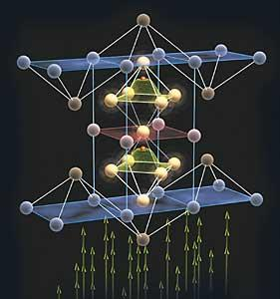
Ferroelectric Random Access Memory
(FeRAM)
George Allen
Carl Stanfield
Guanye Zheng
EECS 373 Presentation
University of Michigan
11/27/2012
http://www.symetrixcorp.com/lib/images/Devices/SuperLatice_01.jpg

Slide 2
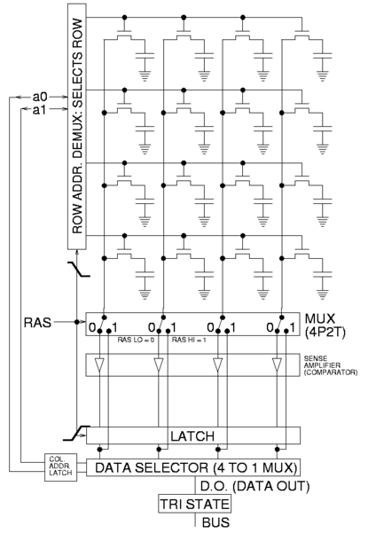
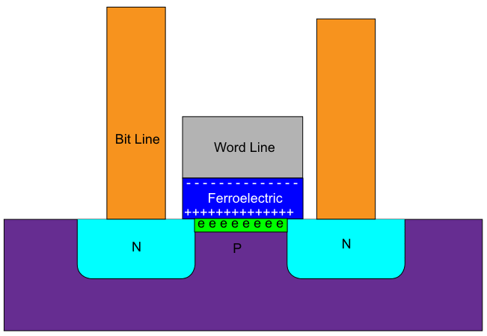
History
Dudley Allen Buck, graduate thesis, MIT 1952
"Ferroelectrics for Digital Information Storage and Switching" - http://hdl.handle.net/1721.3/40244

Slide 3
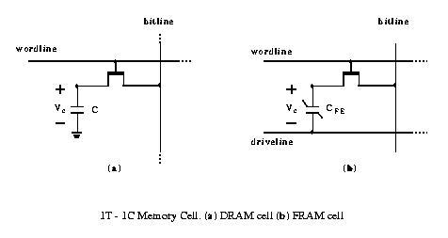
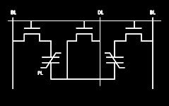
Is FeRAM just a fancy version of DDR?
DDR
1T-1C cell
dielectric layer
read requires cap refresh
volatile
<50nm
refresh ~65ms
FeRAM
1T-1C cell
ferroelectric layer (PZT)
read requires cap refresh
non-volatile (sorta)
130nm
refresh not needed

Slide 4
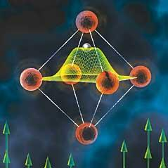
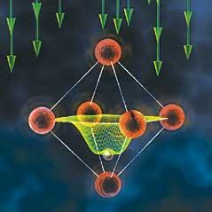
Read/Write process
Read
force cell to '0' state
reorientation of atoms causes a pulse sent to driveline
prior state was '1' - pulse is detected
prior state was '0' - pulse not detected
refresh state
Write
charge forces a polarity change
 | write '0' | write '1' | read
wordline | assert | assert | assert
bitline | gnd | vdd | float
driveline | vdd | gnd | vdd

Slide 5
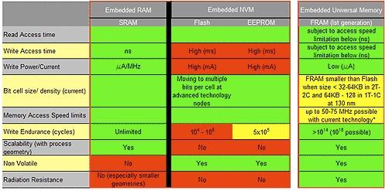
Why FRAM?
Rough Comparison (1st generation)
source: TI's presentation on FRAM

Slide 6
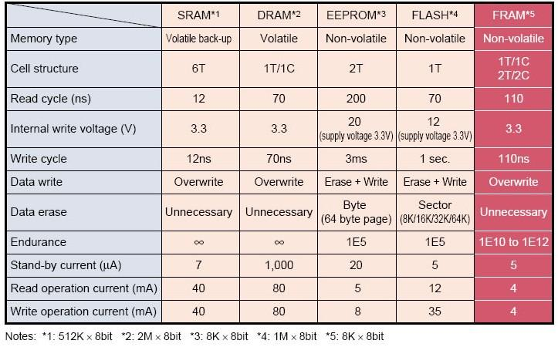
More Detailed / Overall
Memory Products Comparison
source:http://www.fujitsu.com/emea/services/microelectronics/fram/technology/

Slide 7
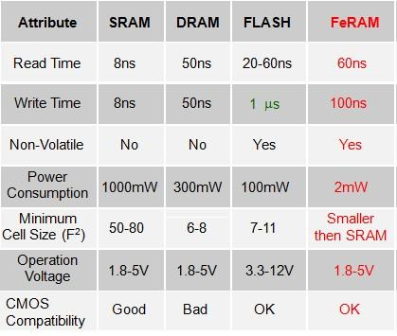
Memory Product Comparison
On Power and Size
source: presentation (titled Novel Memory Architectures)
by Insoo Kim / Feng Wang, The Penn State Universitym on Mar. 23th, 2005

Slide 8
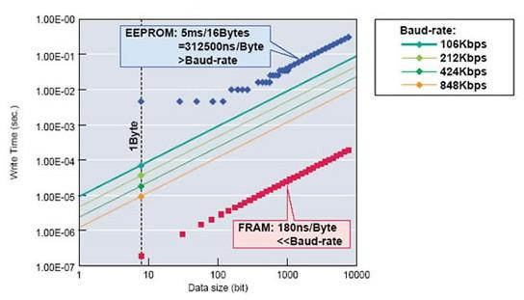
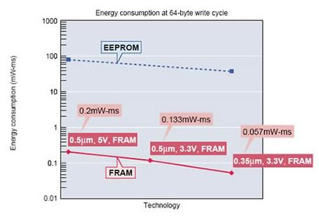
FRAM vs EEPROM
1/30,000 Write Time
1/20 Energy -- 1/400 Power
source: http://www.fujitsu.com/emea/services/microelectronics/fram/technology/

Slide 9
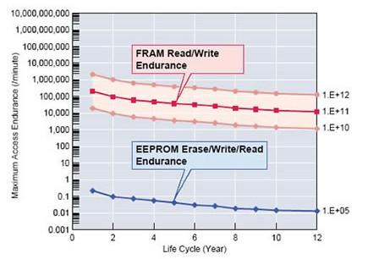
FRAM vs EEPROM
100,000 Times Better ENDURANCE
source: http://www.fujitsu.com/emea/services/microelectronics/fram/technology/

Slide 10
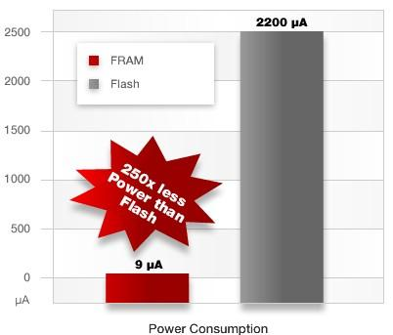
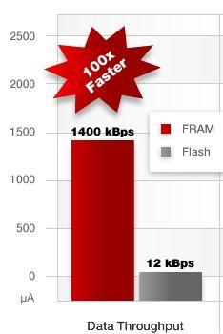
FRAM vs FLASH
Less Power and Faster Speed
source: http://www.ti.com.cn/mcu/cn/docs/mcuproductcontentnp.tsp?familyId=1751&sectionId=95&tabId=2840&family=mcu

Slide 11
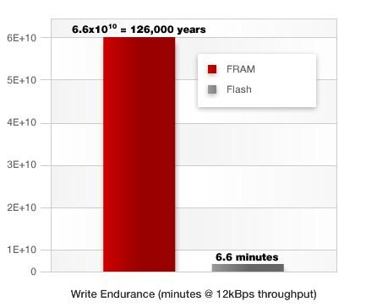
FRAM vs FLASH
Much Better Endurance
source: http://www.ti.com.cn/mcu/cn/docs/mcuproductcontentnp.tsp?familyId=1751&sectionId=95&tabId=2840&family=mcu

Slide 12
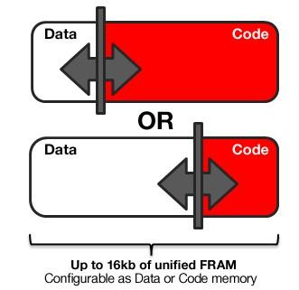
FRAM vs SRAM
SRAM is better at:
Price & Speed(not that much)
FRAM is more
Flexible
(all-in-one memories)
source: http://www.ti.com.cn/mcu/cn/docs/mcuproductcontentnp.tsp?familyId=1751&sectionId=95&tabId=2840&family=mcu

Slide 13
FRAM vs DRAM
When density and price are most important
(for example, memories for pixels)
DRAM is best choice
FRAM cannot replace DRAM yet

Slide 14
FRAM getting better at density!
Currently:
up to 4Mbits (according to TI's data)
Not as good as DRAM and SRAM
Better than EEPROM and FLASH
Expected:
As good as DRAM

Slide 15
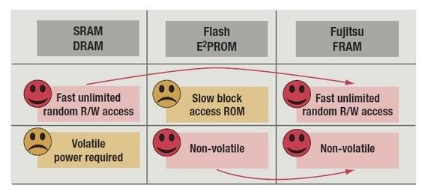
Take-away Point:
FRAM combines Advantages!
source: http://www.ti.com.cn/mcu/cn/docs/mcuproductcontentnp.tsp?familyId=1751&sectionId=95&tabId=2840&family=mcu

Slide 16
Application Benefits
Low Power Consumption
  Good For: Low energy access systems
  Reason: Write cycles require less power (RFID)
Fast Write Speed
  Good For: High noise environment
  Reason: Short write time limits window of vulnerability
High Endurance
  Good For: Diagnostic and maintenance systems
  Reason: No restriction of system state writes
Misc
  Resistant to Gamma Radiation (70kGray) unlike EEPROM
  AEC-Grade 1 adder cheaper than other nonvolatile memory

Slide 17
Application Drawbacks
Low Storage Density
  Bad For: Storing large amounts of data
  Reason: Poor density compared to DRAM & SRAM
Higher Cost

Slide 18
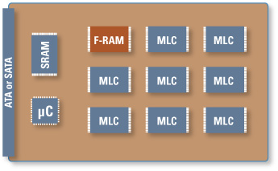
Current Applications
Automotive
  Shift-by-Wire/Navigation/Anti-Pinch Control
Computing
  Solid State Drive/LAN Bypass/Network Router
http://www.ramtron.com/applications/computing.aspx

Slide 19
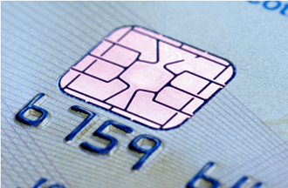
Current Applications
Metering
  Advanced Metering/Gaming/POS Systems
Industrial
  Motion Control/Process Controls
RFID/Wireless Memory
  Wireless Datalogging/Gamma Radiation
http://www.ramtron.com/applications/metering.aspx

Slide 20
The Future of FRAM
Improved Storage Density
  Stacking
  3D integration
Improved Manufacturing Process
  Conventional process degrades ferroelectric layer
Reduction in Size
  Unknown charge density detection limit
  Theoretical performance unclear

Slide 21
Q & A

