Slide 1
EECS 373
Energy Harvesting
David Cesiel
Jakob Hoellerbauer
Shane DeMeulenaere
University of Michigan
*

Slide 2
Outline
Why are Energy Harvesting Devices Important?
Energy Sources
Available Energy Harvesting Devices
Comparison of Devices
Power Storage
*

Slide 3
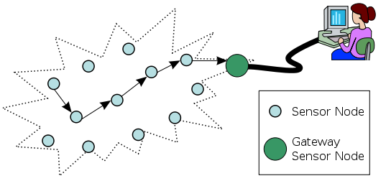
Why are Energy Harvesting Devices Important?
Wireless Sensor Networks
Autonomous sensors monitoring physical or environmental conditions
Pass data through network back to a main location
*

Slide 4
Uses for Wireless Sensor Networks
Air Quality Monitoring
Forest Fire Detection
Landslide Detection
Machine Health Monitoring
Sense when machines need to be serviced
Water Quality Monitoring
Monitoring Soil for Agriculture
Structural Monitoring
Checking loads and vibration on bridges
Home Monitoring
*

Slide 5
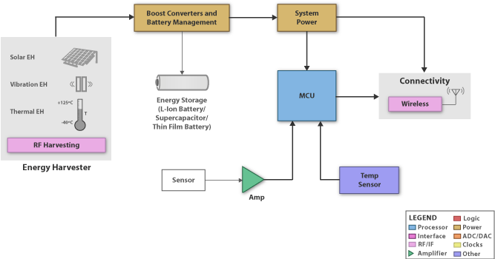
Energy harvesting as part of a system

Slide 6
Energy harvesting as part of a system

Slide 7
Energy harvesting as part of a system

Slide 8
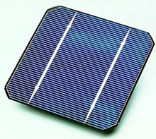
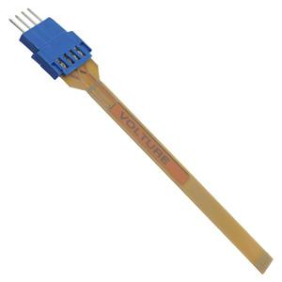
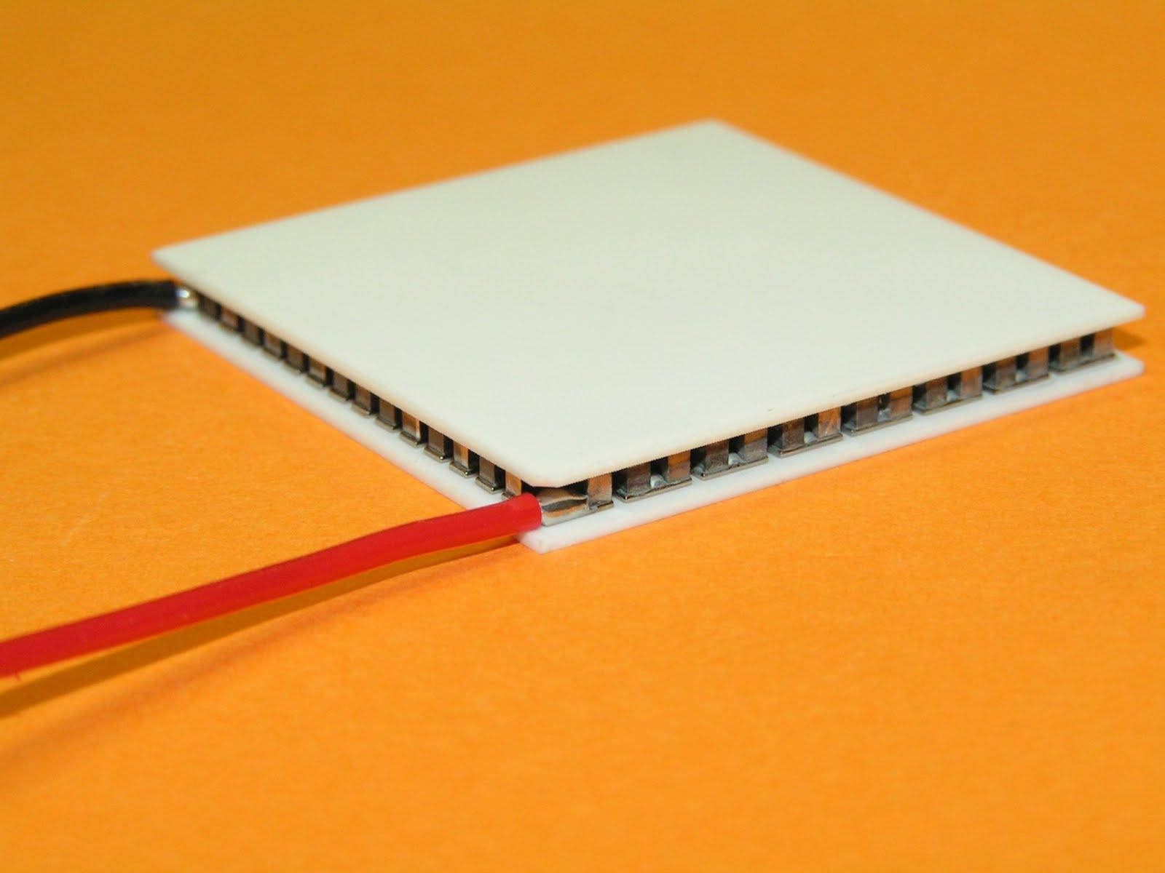
Energy Sources
Piezoelectric
Thermoelectric
Solar
*

Slide 9
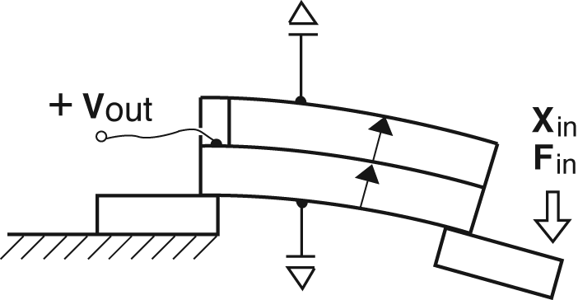
Piezoelectric Energy Harvesting
Uses materials, usually crystals, that accumulate charge under stress
This can be used to convert movement into power
Can achieve power conversion efficiency of nearly 90%

Slide 10
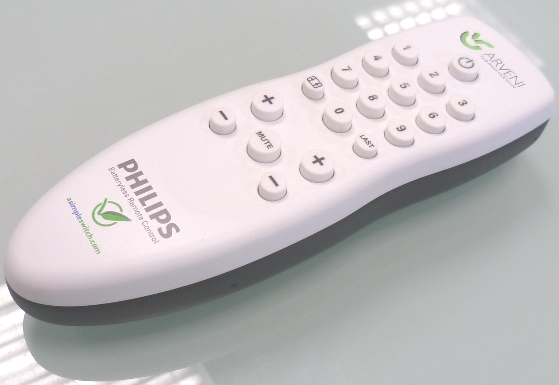
Piezoelectric Energy Harvesting
Could be used:
To generate power from human motion
Shoes
Clothing
Wrist Watches
TV Remote Controls
Seismic Vibration
Train station walk ways
To harvest power from acoustic noise
To power sensors
Sensors that detect wear on industrial robots

Slide 11
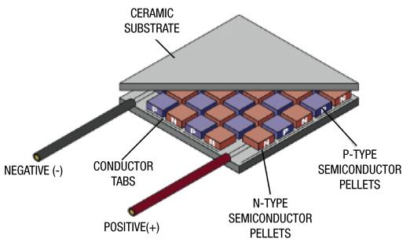
Thermoelectric Energy Harvesting
Converts temperature differences to electric voltage using the thermoelectric effect.
This effect occurs when one end of the device is at a different temperature then the other.
Temperature change causes charge carriers in the thermoelectric material to diffuse from one end of the conductor to the other
Maximum efficiency of ~10%
Notes:
Hot charge carriers diffuse from the hot end to the cold end, since there is a lower density of hot carriers at the cold end of the conductor, and vice versa.

Slide 12
Thermoelectric Energy Harvesting
Could be used:
For heat recovery on vehicles
To power consumer electronics through body heat
Sensors
Notes:
Condition codes are simply a way of testing the ALU status flags.

Slide 13
Photovoltaic (Solar)
Converts solar radiation into power using semiconductors that exhibit the photovoltaic effect
Materials such as Monocrystalline Silicon, Polycrystalline Silicon and Amorphous Silicon
Maximum efficiency of current solar energy harvesters is ~40%
Notes:
Electrons inside the metallic atom asorb solar energy and become excited and begin moving current.

Slide 14
Power Management

Slide 15
Energy Harvesting Power Managers
Step up/Rectify input voltage source
Store Energy in Battery/Capacitor/SuperCap
Output Regulated power to MCU/Radios/etc
Signal MCU when power is available
Many ICs available from companies like TI, Maxim Integrated and Linear Technology

Slide 16
Trade-offs
Minimum Startup Voltage
Idle (quienscent) current
Minimum charging voltage
Storage types (Battery/Capacitors)
Energy Source Types
Output voltage(s)

Slide 17
Texas Instruments - BQ25504
Cold Start Startup Voltage: 330mV
Charging Voltage: 80 mV
Quiescent current: <330nA (typical)
Storage Types: Batteries, Caps, Supercaps
Output Voltages: 2.5V - 5.25V
Energy Sources: Broad(Solar, TEG, Piezoelectric, etc..)

Slide 18
LTC3108
Startup Voltage: 20mV
Idle (quiescent) Current: 0.2μA
Charging Voltage: 20 - 500 mV
Storage Types: Capacitor
Energy Source Types: Thermoelectric and Solar
Output voltage(s): 2.35V, 3.3V, 4.1V or 5V

Slide 19
LTC3109
Startup Voltage: +-30mV
Idle (quiescent) Current: 0.2μA
Charging Voltage: +- 30 +- 500 mV
Storage Types: Capacitor or Battery
Energy Source Types: Thermoelectric or Solar
Output voltage(s): 2.35V, 3.3V, 4.1V, 5V

Slide 20
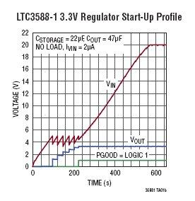
LTC3588-1
Startup Voltage: 2.7V
Idle (quiescent) Current: 950nA
Charging Voltage: 2.7-20V
Storage Types: Capacitor
Energy Source Types: Piezoelectric, any AC
Output voltage(s): 2.35V, 3.3V, 4.1V or 5V

Slide 21
MAX17710
Startup Voltage: 0.75 V
Idle (quiescent) Current: 625nA
Charging Voltage: 0.75 - 5.3 V
Storage Types: Micropower-storage cells
Energy Source Types: Anything
Output voltage(s): 1.8V, 2.3V, 3.3V

Slide 22
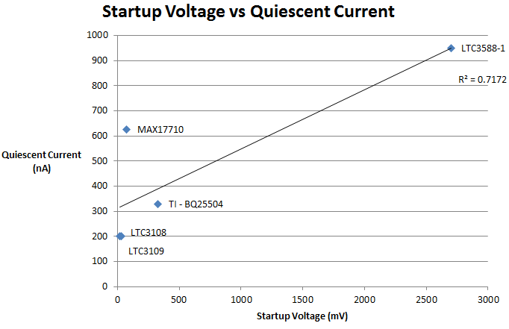

Slide 23
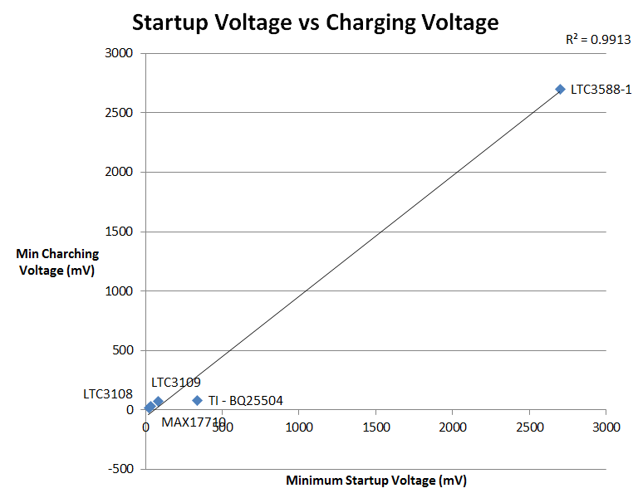

Slide 24
Best Components
Low Power: BQ25504 or LTC3108
AC sources: LTC3588-1 or LTC3109

Slide 25
Power Storage

Slide 26
Why is Power Storage Necessary?
Energy Harvest sources will not always be able to generate current
Solar cells: at night, there is no light
Piezoelectric: there will not always be motion
thermoelectric devices: there will not always be a suitable temperature gradient

Slide 27
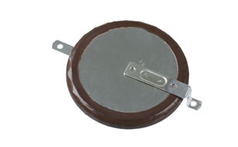
Li-Ion/Li-polymer Batteries
Can be made extremely small
Li-Po batteries are more often used for energy harvesting systems because they have a very high discharge to charge efficiency (greater than 99 % compared to less than 90 % for standard Li-ion)
One drawback is that Li-ion/Li-polymer batteries have to be charged very carefully. Overcharging could cause the battery to become unstable
Notes:
The P088-ND from Panasonic can delivier 200 microA for 500 hours

Slide 28
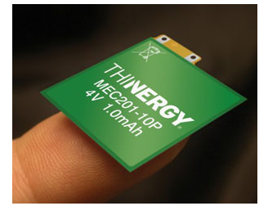
Solid State Thin Film Batteries
Are also Li-Ion batteries but the electrolyte is a solid
Therefore, thin film batteries can be used at very low temperatures, down to -40°C
Example: Infinite Power Solutions' (IPS) THINERGY Micro-Energy Cells
Near zero self-discharge current
about 100,000 recharge cycles
low internal resistance, so it can be charged by a very low-current source

Slide 29
Supercapacitors
Another name for an electric double-layer capacitor (EDLC)
Usually used for energy storage rather than in a circuit
Much higher energy density than regular capacitors
An EDLC has several orders of magnitude larger capacitance than a similar sized regular capacitor
Can only withstand low voltages
Energy density is only around 1/10 that of a conventional battery
Power density is generally 10 to 100 times greater

Slide 30
References
http://www.ti.com/ww/en/apps/energy-harvesting/index.shtml?DCMP=MSP430_Energy&HQS=Other+OT+430energy
http://www.infinitepowersolutions.com/images/stories/downloads/controlled_documents/DS1012.pdf
http://www.digikey.com/us/en/techzone/energy-harvesting/resources/articles/storage-battery-solutions.html
http://cds.linear.com/docs/Datasheet/3108fb.pdf
http://cds.linear.com/docs/Datasheet/35881fa.pdf

Slide 31
References
http://www.ti.com/product/bq25504
http://www.linear.com/product/LTC3108
http://www.linear.com/product/LTC3109
http://www.linear.com/product/LTC3588-1
http://www.maximintegrated.com/datasheet/index.mvp/id/7183

