Slide 1
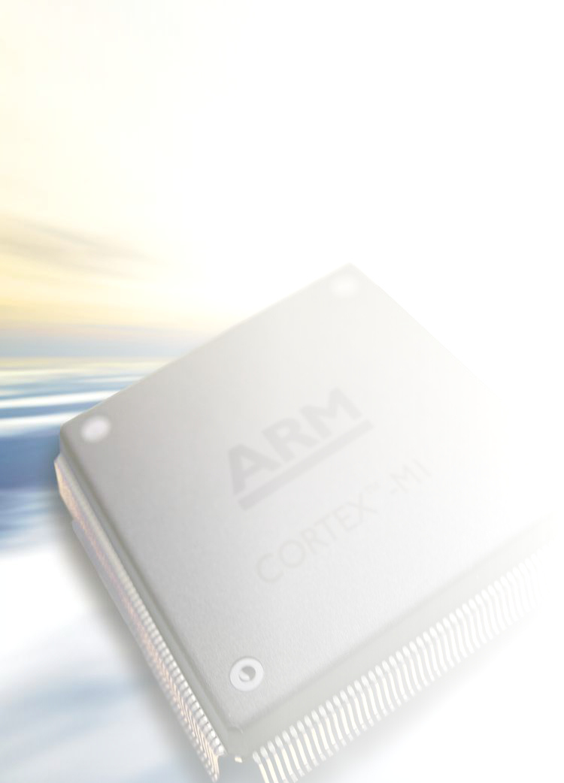


Systems Research with ARM:
The Architecture for the Digital World
Peter Aldworth
Systems Research
R&D Division

Slide 2
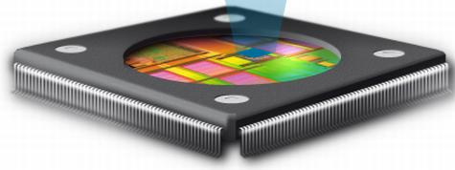
Who are we?
ARM as a company
  Founded in 1990 (as Advanced RISC Machines Ltd)
  Leader in microprocessor Intellectual Property (IP)
    Over 75% of all 32-bit embedded CPUs
    Over 99% of all mobile phones and tablets
  Products ranging from MCUs to high-end CPUs and GPUs
  ~2200 employees world wide
R&D group based in Cambridge (UK) and Austin (US)
  Systems group of ~17 people
    Focus on system-level aspects
      Workloads, application drivers
      Interconnect, caches, memories
      Power, energy, thermals
      Simulation, infrastructure, modelling, analysis

Slide 3

ARM Cortex Advanced Processors
ARM Cortex-A family:
  Applications processors
  Targeted for OS’s, graphics, demanding tasks
ARM Cortex-R family:
  Embedded processors
  Real-time signal processing, control applications
ARM Cortex-M family:
  Microcontroller-oriented processors
  MCU, ASSP, and SoC applications
...2.5GHz
x1-4
Cortex-A15
x1-4
Cortex-A9
Cortex-A8
x1-4
Cortex-A5
1-2
Cortex-R7
1-2
Cortex-R5
Cortex-R4
Cortex-M4
SC300
Cortex-M3
Cortex-M1
SC000
12k gates...
Cortex-M0
Notes:
Version 7 of the instruction set architecture coincided with the introduction of the Cortex product naming convention.
Cortex processors are named based on how they are used (letter), along with a qualitative numeric indicator of performance and functionality.
This slide shows the 3 families along with the processor designs we have in hand today and can deliver tomorrow.

Slide 4

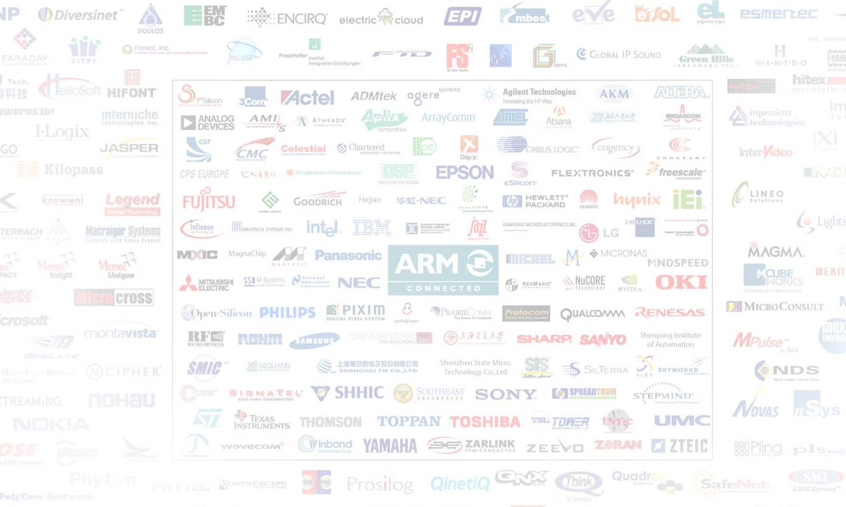
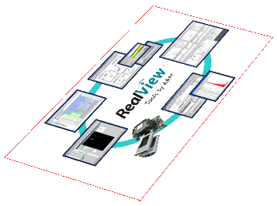
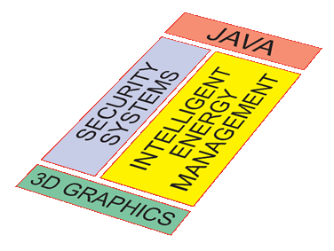
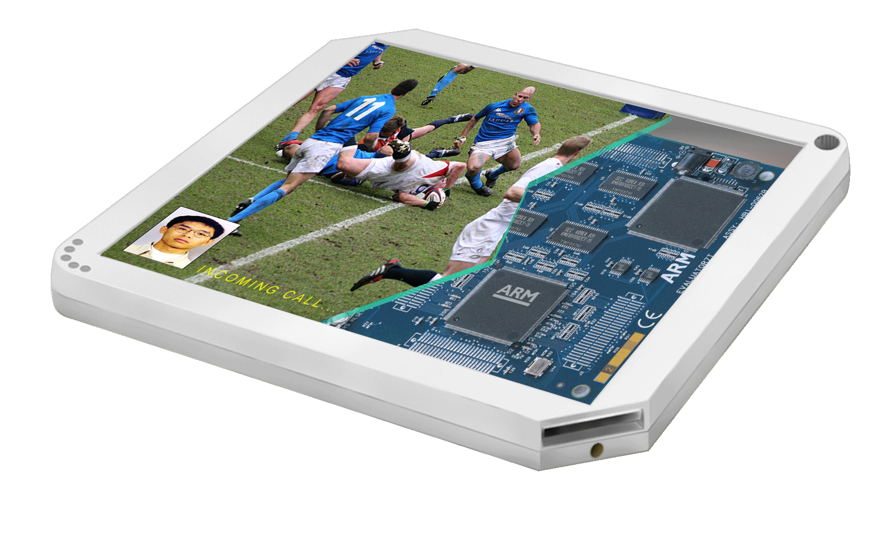


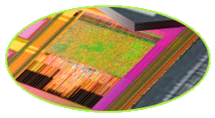
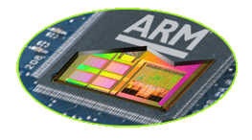
ARM’s Activities
Connected Community
Development Tools
Software IP
Processors
System Level IP:
Data Engines
Fabric
3D Graphics
memory
SoC
Physical IP
Notes:
The slide helps explain where ARM products play. A generic Digital product; ARM supplies system level IP into the SoC along with Physical IP to ensure its manufacturable;
Software IP into the system; Development tools to help design and build the system architecture and software.
Finally, we work with an extensive 3rd party community to make the whole device creation possible.
Remember this helps frame what we do not cover also, e.g. industrial design of the device.

Slide 5
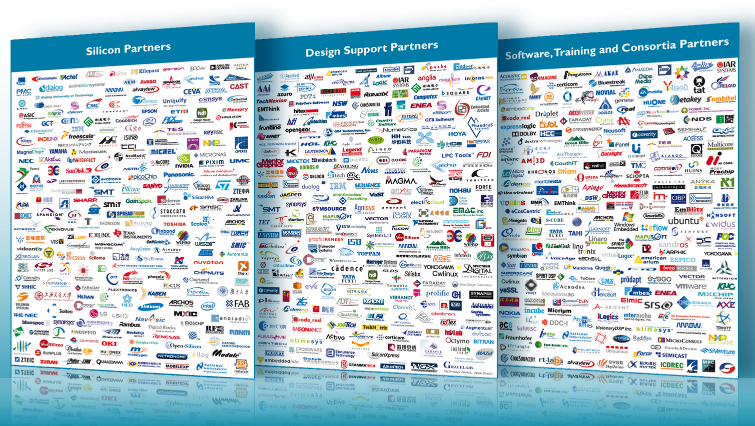
ARM Connected Community – 800+

Slide 6
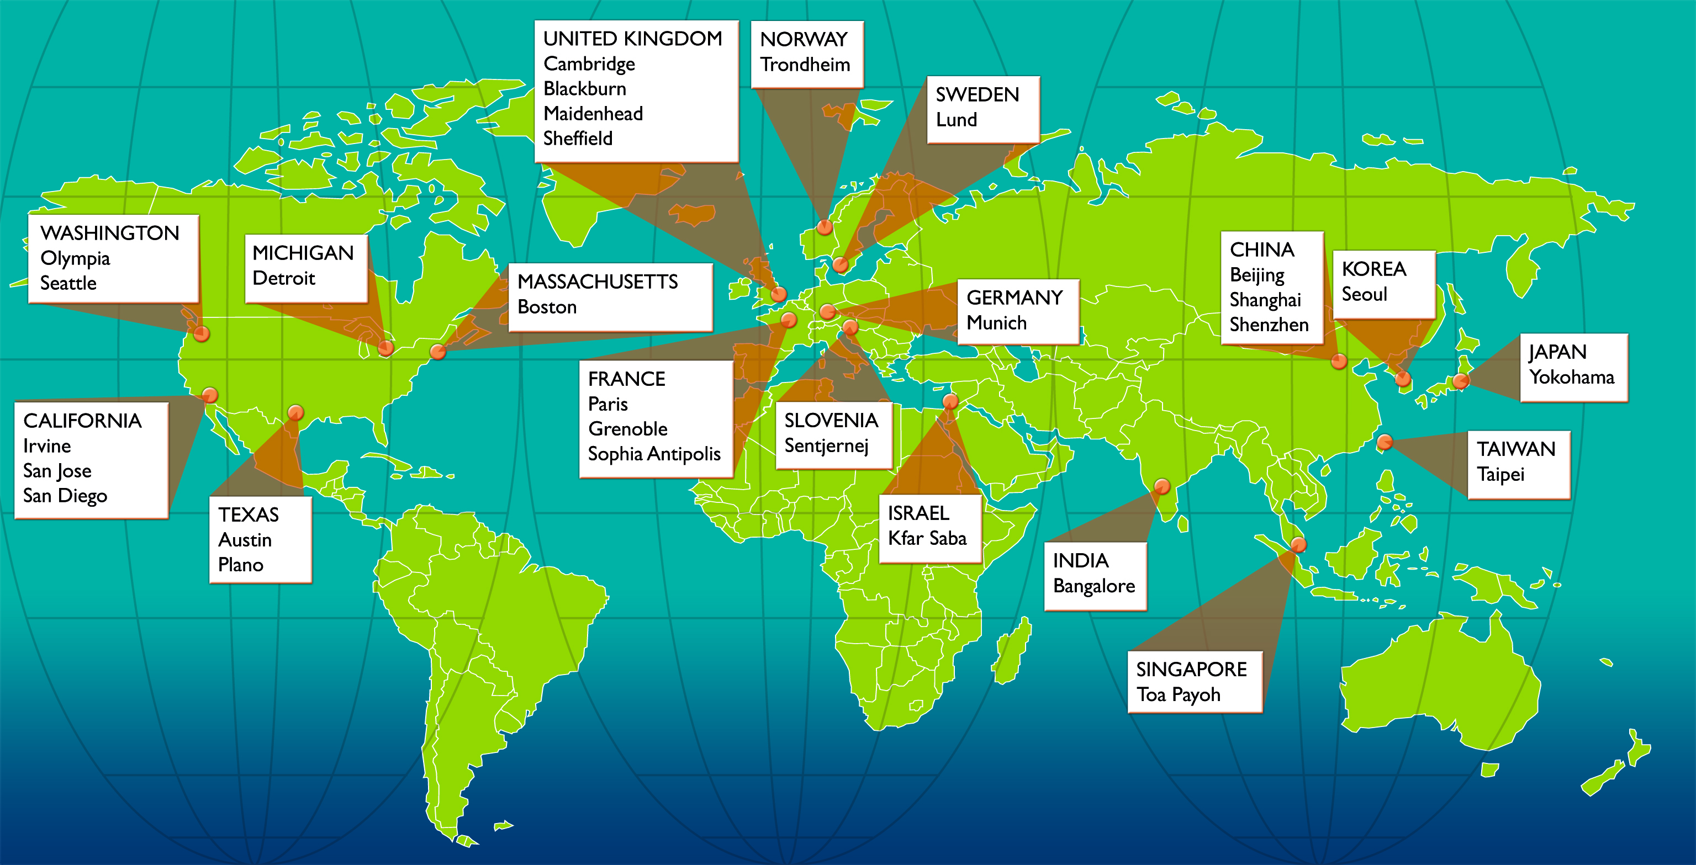
ARM Offices Worldwide
Notes:
6

Slide 7


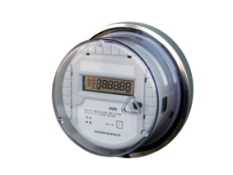
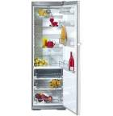


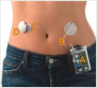



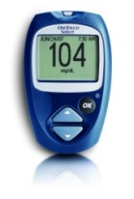




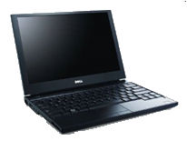
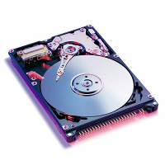
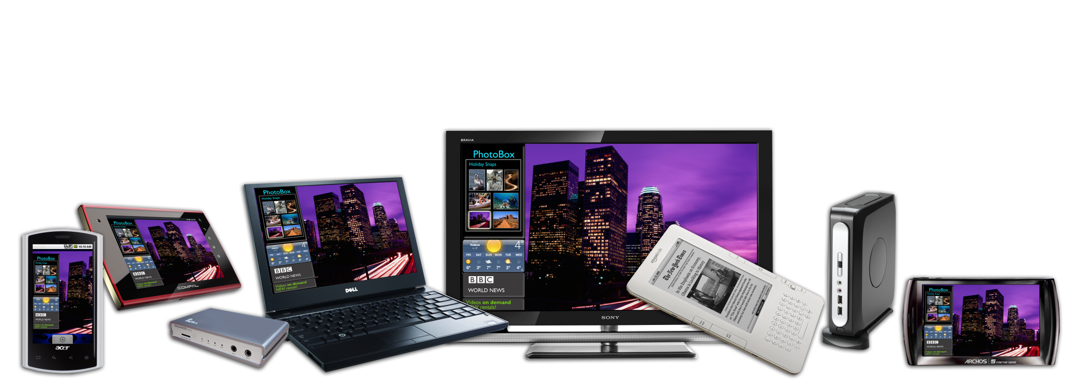




Huge Range of Applications
IR Fire Detector
Utility Meters
Exercise Machines
Intelligent Vending
Intelligent toys
Energy Efficient Appliances
Tele-parking
Equipment Adopting 32-bit ARM Microcontrollers
Notes:
7
7

Slide 8
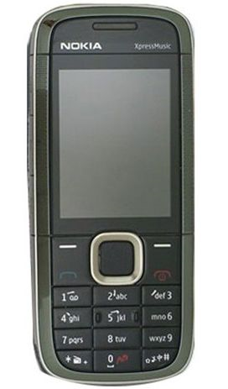
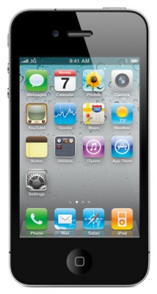
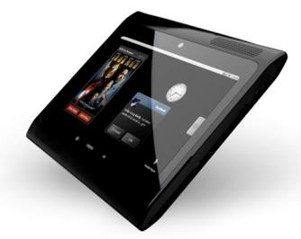










How many ARM’s Do You Have?
Mobile phones
Smartphones
Mobile Computers
Digital TVs
Ultra Low Cost
Ultra Low Cost
Ultra Low Cost
~100%
market share
3x 100%
market share
5x 100%
market share
35%
market share
Disk Drives
PC Peripherals
Cars
Microcontrollers
Ultra Low Cost
Ultra Low Cost
Ultra Low Cost
Ultra Low Cost
~75%
market share
40%
market share
5x 50%
market share
35%
market share

Slide 9

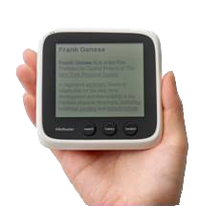
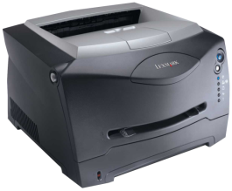

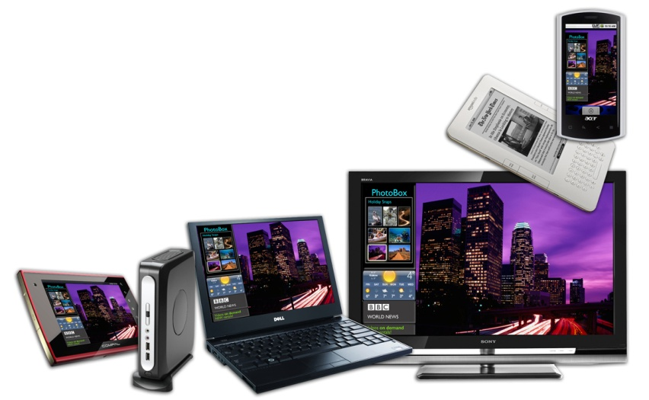

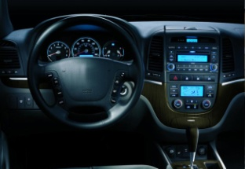

Huge Opportunity For ARM Technology
25+
100+
billion
billion
cores accumulated
after next 9 yrs
cores to date
1998
2011
2020
Notes:
In 2001, after cumulatively shipping >400k units, we projected cumulative shipments exceeding 1 billion by mid Q4 of that year COO – we did over 3.4bn
2002 CEO
ARM7TDMIr4 @ 11,000 MIPS/Watt
2004 1 billion per year
In 2005, we predicted you’d ship 4.5 billion chips in 2010
In our first half, we reported over 2.8 billion chips
In 2007 we predicted over 5 billion cores in 2010
Mobile has been what has established the ARM architecture as the World leading architecture that it has become and as the devices diversify coming from this position is more conducive to building on the mobile heritage. However many of the growth areas are related to what we have already achieved in the mobile space – performance energy efficient solutions that are extending battery life beyond what could have been dreamed of a few years ago, compelling interfaces that create the emotional attachment to devices
Currently, the ARM Partnership has shipped 20 billion units
The growth areas that we are seeing means that we are just scratching the surface of the opportunity before us - 100 billion units are in sight
Starting to see the new generate of ARM industry leading products coming to market – the Cortex , R and M class products are already on the market. At the APM, you’ll learn how we’re extending these roadmaps to ensure your success in the years to come.
20 billion units under the belt
We’re just scratching the surface
100 billion units in sight
Cortex now ramping rapidly

Slide 10
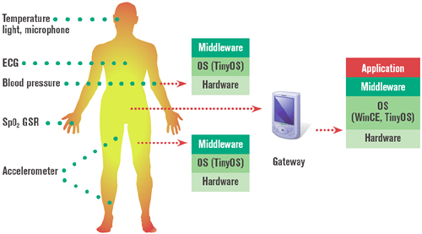
Systems Research and Development

Slide 11
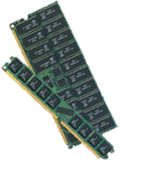

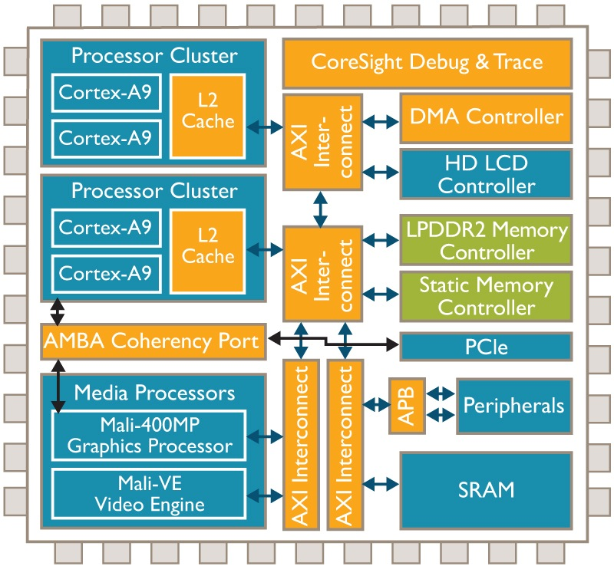






gem5
A simulation tool set for rapidly exploring new system architectures
  Highly configurable model
  Using real workloads
Simulating systems
  Memory and I/O devices
  Full OS, Web browsers
  Clients and servers
gem5 supports:
  Two ARM CPU models
  System Platforms – Versatile Express
  OS – Android, Ubuntu
  Applications – Smartphone, Server

Slide 12
Public Gem5 Component Availability
ARM IP
Currently available on
gem5 website
OS support
ARM ISA Support
Ubuntu
Android
ARMv7a
NEON
THUMB
VFPv3
INT
EXCP
Simulation support
Traffic
Gen
Traffic
Monitor
Stream
Line
Interconnect
Bridges
CPU Models
Atomic
Timing
IO components
Out of
Order
LCD
DMA
UART
USB
Memory
GIC, RTC
Timer
L1-L3 $
SCU
Flash
DRAM
PCIe
Ethernet
Done
Planned

Slide 13
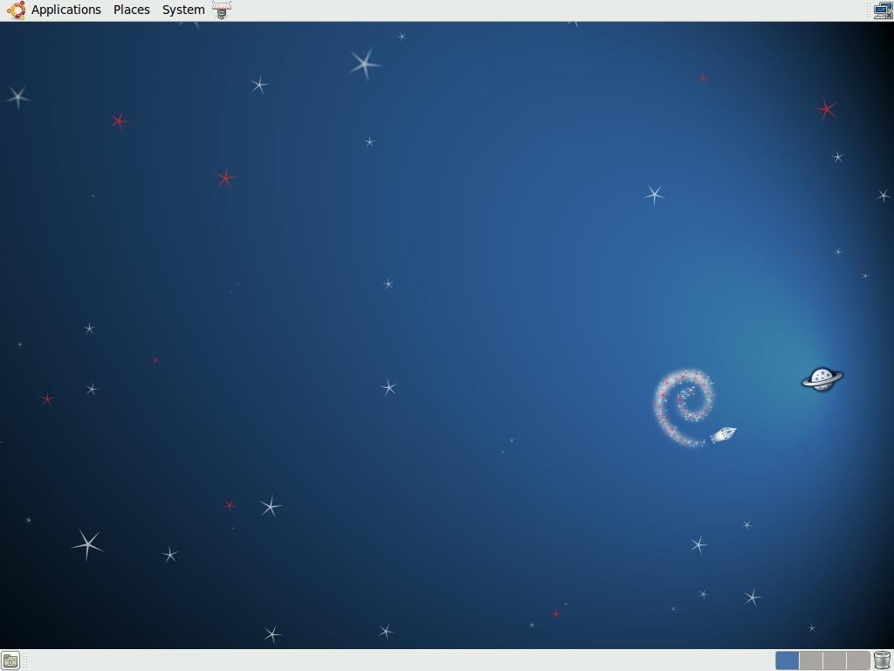

OS Support on Gem5
Ubuntu 12.04
Android Jellybean
Full software stacks
  Latest Ubuntu and Android distributions running
  Kernel v3.5-rc7 is the latest available
        Based off of the Linaro tree
        Includes some Device Tree support

Slide 14
Smartphone

Slide 15




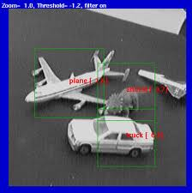



























Mobile System Requirements
Physical
Interaction
Social
Networks
Recognizing the
Environment
Secure
Transactions
Multimedia
Information Retrieval
Location and Proximity
Connectivity
Smartphone features are evolving rapidly
Many independent sources of information
Complex interactions and transformations of data streams
Does power, BW, compute work for these usage cases?
How does new IP solve the real issues?
Notes:
Key message: Mobile devices are becoming more aware of the environment that they operate, more incoming data streams in many formats that need processing and may new and interesting ways of combining and presenting mixtures of data into an context aware output – Cognisant computing because the devices are become more congnisant of their surroundings.

Slide 16
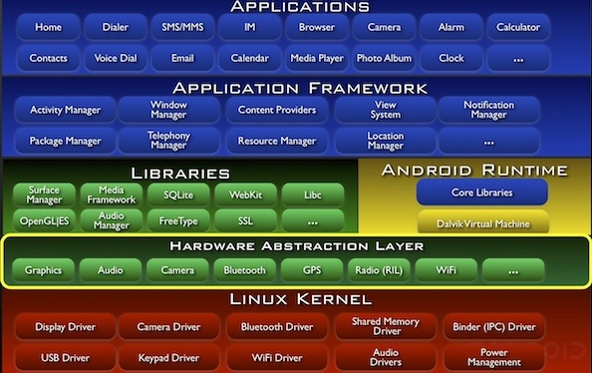


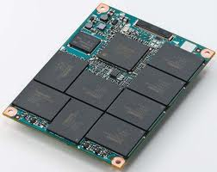
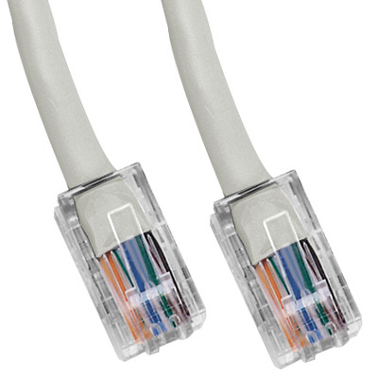
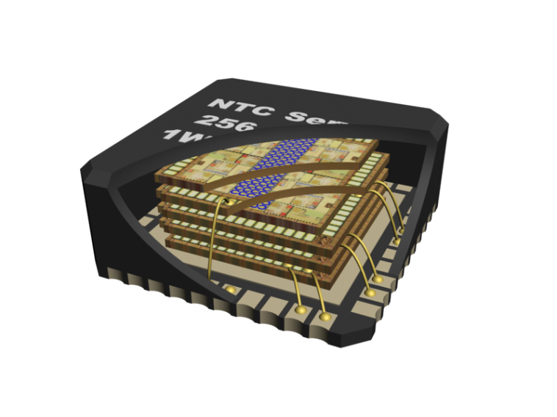
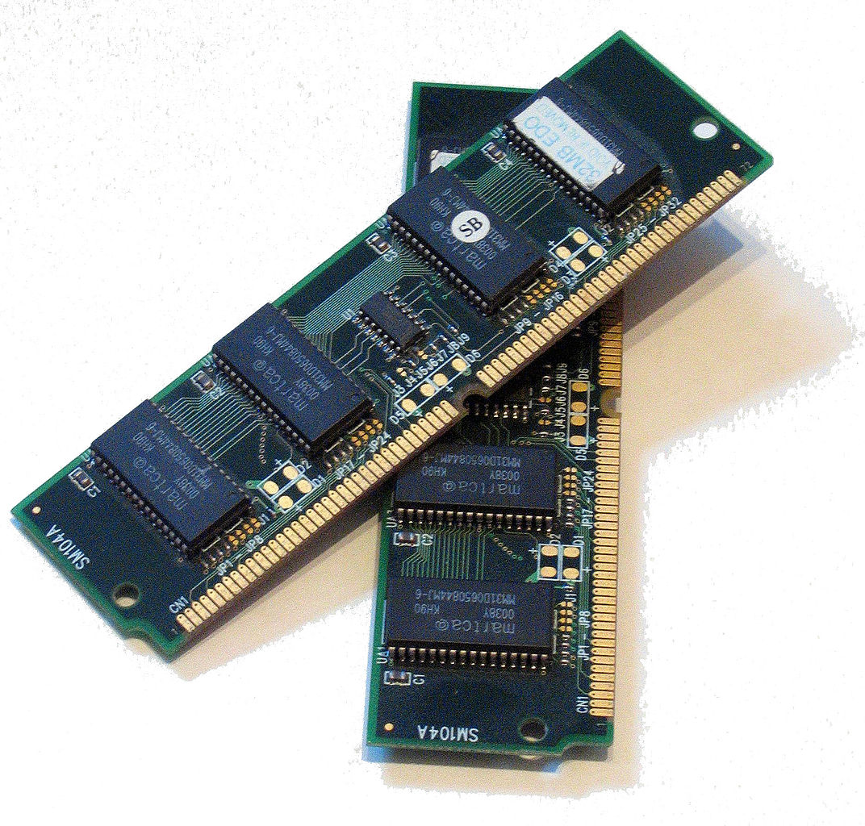
Partitioning a System
  Drive to increase system efficiency
        Map tasks onto most efficient resources
        Divide whole application and SW stack
Partition system on heterogeneous compute
  Multiple compute subsystems
  Task optimized subsystems
What are the interesting system
partitions?
  What are the characteristics
  of each partition?
  How many distinct partitions
  are there?
  How can each partition be
  mapped onto the most
  power efficient HW?
Partition
OS Optimized
Subsystem
Video
Subsystem
Video HW
CPU
GIC
&
Events
CPU
Audio
Subsystem
GP APPS
Subsystem
Camera
Subsystem
CPU
HS I/O
Subsystem
IO OPT
CPU
Security
L2 Cache
GPU/Throughput
Processing
SOC L3
Memory
Subsystem
HW
Accelerators
Notes:
Diverse requirements – need to partition. Stress potential room for multi-performance ARMs like M3 alongside A-class cores

Slide 17
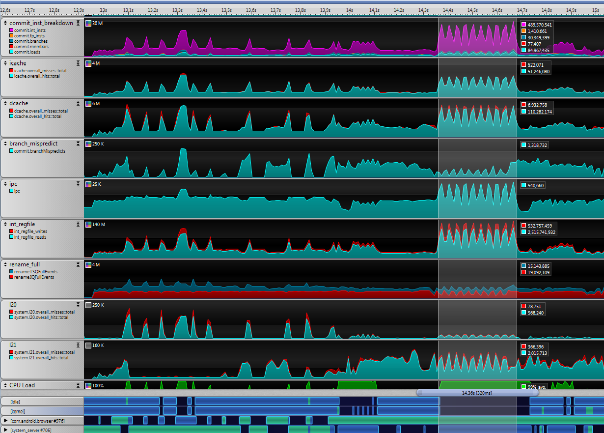
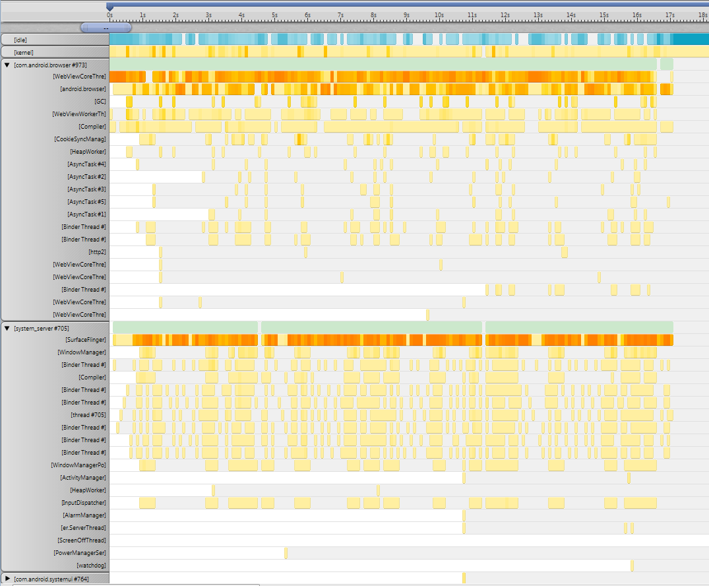
Partitioning a System
We can expose opportunities for optimization by identifying partitions between unique behaviors in the system
  Phase partitioning: Real use-cases have phases of behavior that stress the system in different ways over time
  Thread partitioning: Threads of activity may have unique characteristics associated with them
Phase partitioning of BBench use case
Thread partitioning of BBench use case

Slide 18
Thread Partitioning
Individual threads and functions can run more efficiently on specialized compute subsystems
  Exploit programmers’ partitioning of the workload
  Favor optimal compute resources per thread, per function, etc.
Example study
  Three primary threads in Android-BBench consume 93% of the CPU cycles

Slide 19
Thread Analysis
Android.Browser thread is relatively memory-intensive
Read / Write Bandwidth (MB/s)
D$ / DTLB Miss Rates
SurfaceFlinger
android.browser
WebViewCoreThread
20-pt moving averages shown as BOLD
Threads may vary in many ways – just a few examples shown
Can we build cores or subsystems more tailored to needs of different threads?
Performance or power efficiency gains both wins

Slide 20
Thread Partitioning
Can we increase Browser efficiency by running Android.Browser on a more power-efficient core?
  Android.Browser is memory intensive and is not limited by core frequency. Browser performance can be maintained while lowering energy requirements of the system.
  Create two systems with one fast core and one slower core with same memory subsystem performance
  Pin all threads to the fast CPU0 except for Android.Browser
    Pin Android.Browser to CPU1 using taskset utility
    Observed identical performance with significant power savings
All other
threads
All other
threads
1 GHz
ARM
(V=1.0)
1 GHz
ARM
(V=1.0)
1 GHz
ARM
(V=1.0)
500 MHz
ARM
(V=0.73)
android.browser
android.browser
1 GHz L2
1 GHz L2
1 GHz L2
500 MHz L2
Coherent Interconnect
Coherent Interconnect
System 1: Control
System 2: Experimental

Slide 21
Phase Partitioning
Identify unique phases of the workload
  Each phase has different system sensitivities
Map to most efficient resources
  Determine metrics of interest
  Phase-optimized HW
  Dynamic scheduling
For BBench, 97.6% of the estimated performance can be determined by three phases
Opportunity to create custom heterogeneous architecture to improve system energy efficiency
SystemBench Firefox 3.5

Slide 22
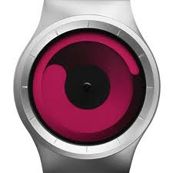

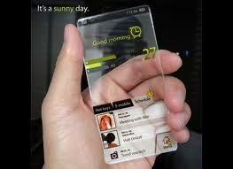
Future Platforms: Systems of Systems
Smarter watches, glasses, phones, jewelry will work together as a personal area system
Plug-and-play new forms of compute, storage, capability
Notes:
Again, diverse systems possible using array of ARM technology including M3-type things they work on

Slide 23
Research Themes
  Workload Characterization
    Classify program behaviors across workloads of interest using thread-level profiling and program-phase analysis
  Hardware Partitioning – Designing Optimal Heterogeneous Architectures
    Design and model cores that run key program behaviors efficiently (e.g. memcpy-optimized core, I/O-optimized core, etc)
    Determine how to connect heterogeneous cores together with a heterogeneous set of system memories
  Software Partitioning – Running Software on the Optimal Subsystem
    Dynamically map and schedule software to run on the most optimal compute subsystem
  Device Partitioning – Intelligently Partitioning Compute, Storage, and Communication
    Determine how to optimally and dynamically distribute compute, storage, and communication across different physical devices
  Future Platforms
    Create vision of on-person computing of the future
    Reason about future platforms by researching roadmaps for the relevant technology building blocks

Slide 24
Memory & Interconnect
Notes:
Raid Rene’s tech meeting slides
Slide on HMC
Slide on Samsung meetings

Slide 25
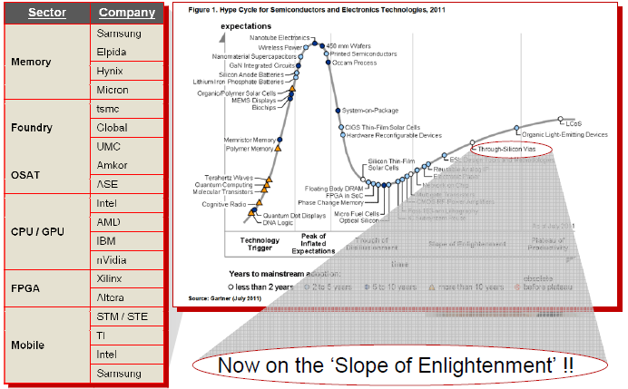
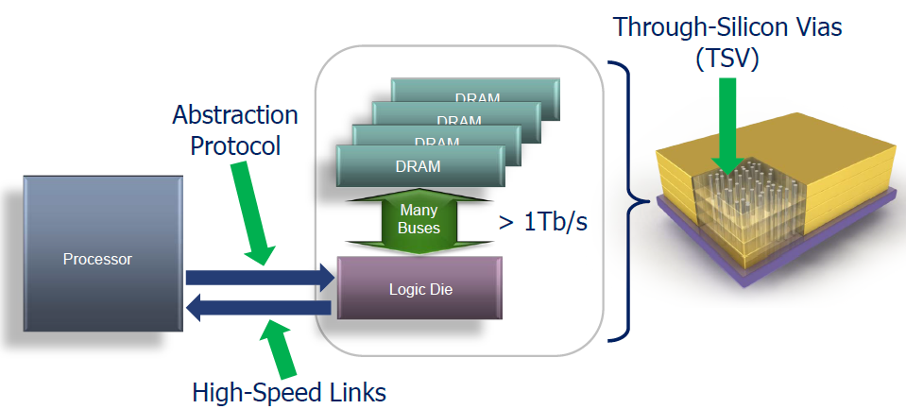
Emerging Memory Technologies
2.5D/3D...everyone is doing it, and it’s mostly about energy
Communication energy outweighs computation energy
  Must minimise communication
  energy / op
Memory technology landscape is fundamentally changing
  Heterogeneous memory/storage technologies with complex trade-offs,
  but huge potential to be harnessed
Influence and steer emerging memory technologies and interfaces to improve performance and efficiency
Notes:
Maybe merge this with next slide

Slide 26
What are we doing?
Evaluating and tuning ARM IP and strategy to emerging memory technologies and architectures
  Providing evaluation framework and realistic benchmarks, evaluating IP proposals, guiding APD with output and transfer
Proposing future interfaces and memory architectures and providing feedback and guidance to partners and standardisation bodies
Stacked DRAM architected to serve as an efficient L3 cache
New controllers to extract most value from emerging disruptive memory technologies
C
…
C
C
…
C
L3
3D-DRAM
Cache
PCM
MRAM
Resource
manager
L2
Cache
Intent-based interface that abstracts from memory details and allow efficient partitioning
L2
Cache
(NV) Memory controller
Bus
C
Bus
Bridge(s)
Hybrid Memory
Cube
Bridge(s)
DRAM
System-level framework for Quality-of-Experience for maximum energy efficiency
C
C
C
NIC
UART
NIC
UART
NV

Slide 27
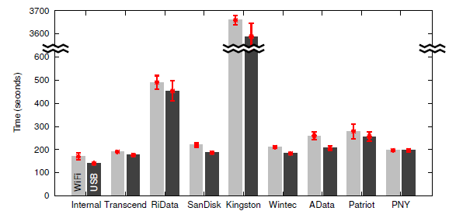
UFS is next-big-thing in Mobile Flash
UFS is a fact in the mobile world, both x86 and ARM
  Match increasing I/O
  rates and use-cases
    USB3, 802.11ac
    High res. video
But does it really
matter in actual apps?
Choice of eMMC flash causes
3x performance difference
on Android browser bench
  Can UFS solve the problem?
  Where in the stack are the
  bottlenecks?
Linaro: “Next Gen. Mobile Storage: UFS, Yejin Moon, 2011
Revisiting Storage for Smartphones; Hyojun Kim et al. FAST’12 - Best paper award
Notes:
Need a gener

Slide 28
UFS in a System Context
UFS has a complex stack (Linux shown)
  Bottleneck can be at different levels
  Maintenance, e.g. GC, is an extra burden
  Address abstractions make it impossible
  for OS to predict were data will end up
To evaluate UFS we need a full-system
model with real workloads
  Full system up and running in gem5
  Android setup with Linux kernel 3.4 rc3
  Highly-configurable (behavioural) model
  Measures activity of all the levels in the stack
  Workloads
    Synthetic stress test and
    verification using Iozone
    Real life tests using bbench,
    RLBench, AppLaunch, AppInstall

Slide 29
BBench – UFS Impact
Reading the disk; peak 80 MB/s
Write transactions; peak 3.3 MB/s
Browser bench shows strong connection between instruction throughput and disk accesses, especially for cold run
  Many small accesses (SQLite) which is detrimental for performance
  Related to SQLite used for web cache
        All synchronous accesses
Notes:
Maybe something like this – need clear message from slide

Slide 30
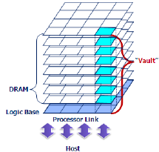

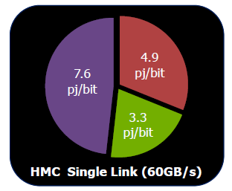
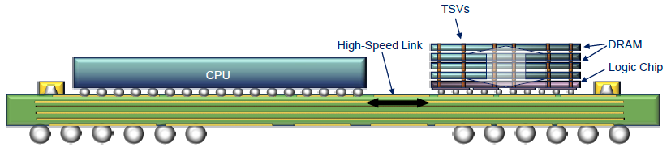
Hybrid Memory Cube
ARM is now a “Developer” in HMC consortium
Massively parallel TSV stacked DRAM architecture
  8 dies x16 “vaults” (channels) x 2 banks
    More responders -> lower average and worst-case latency
  DRAM peak bandwidth 160GByte/s
  15 pJ/bit compared to DDR4 45 pJ/bit (DDR3 70pJ/bit)
  Influence abstract interfaces with ARM-system
  requirements in mind
    AMBA-like/Skyros protocol stack, power-efficiency/proportionality,
    ordering rules, quality of service, non-blocking flow control
Path to increased bandwidth and power efficiency
beyond JEDEC
    Gap with DDR widens with gen3
    Solving “dark bandwidth”?
Notes:
Are The pictures non confidential

Slide 31
High Performance Computing
Architecture Exploration
Compilers and Libraries
Operating Systems & Runtime
Interconnect
And
Storage
Notes:
Raid Rene’s tech meeting slides
Slide on HMC
Slide on Samsung meetings

Slide 32

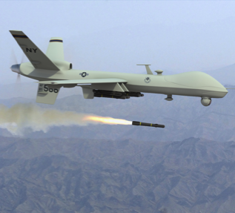
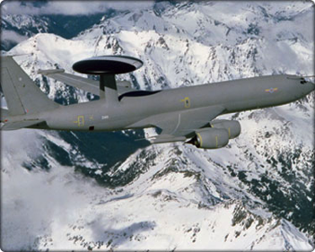
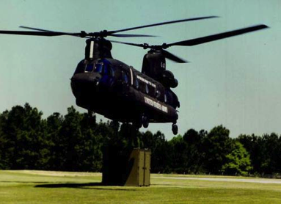
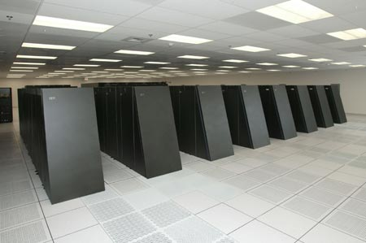

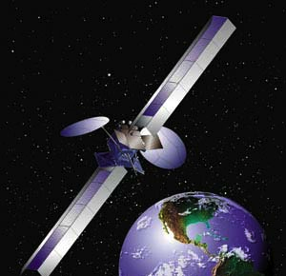
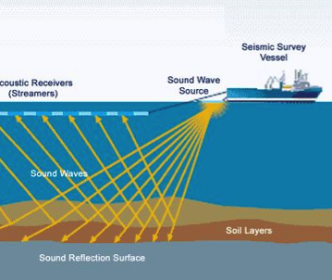




High Performance Computing
High performance computing (HPC) is becoming much more pervasive.
ARM has had pull from partners to explore how we can apply our technology to HPC.
Already involved in European Exascale Mont-Blanc project, but want to get involved in US HPC and Exascale programs.
2018-2022 DARPA/DOD/DOE Visions for HPC:
50 GFLOPS/W (20 pJ/FLOP)
20W Chip
Teraflop
5KW Chassis
Terascale
20KW Rack
Petascale
20MW Data Center
Exaflop
Medical/Pharma
Notes:
HPC is the new microscope, being used to make discoveries and enable innovation at both very small and very large scales – is is becoming THE critical tool to drive progress across scientific, industrial, medical, and financial domains.
Mont-Blanc has started building out a foundation for ARM within the HPC domain, I want to build on their work and expand its impact using US based funding opportunities from the Department of Energy, the Department of Defense, and DARPA based fudning opportunities.
These agencies are currently driving progress on HPC computing with a target of achieving Exascale computers in the 2018-2022 timeframe (budget permitting). For the exascale system, this translates to a data-center sized computer which operates at around 20MW. But the various funding agencies aren’t only interested in data-center scale computers – they are interested in seeing the same power and performance density necessary to achieve data center exascale in rack, chassis, and even chip embodiments.
While these funding agencies are primarily focused on military applications there are technology transfer opportunities for all of these different form-factors into commerical domains.
Pushing from the bottom on Servers, entering HPC lets us push down from the top and eat Intel’s lunch from both ends.

Slide 33
Research Areas
Interconnect & Storage
OS/Runtime
Compiler/Libraries
Architecture Exploration
Massive multi-core optimizations for synchronization, communications, and transactions
big.LITTLE & Heterogeneity
Gem5 extensions for HPC interconnects & fault injection
Power/Reliability/Precision tradeoffs
64-bit Optimizations
Dynamic optimization on heterogeneous systems (both big.LITTLE and GPUs)
Focused architecture-driven optimization of key HPC math libraries.
Partitioned systems for I/O and Compute acceleration enablement
Role-based core assignment
Alternative allocation and scheduling models for HPC
Low-latency node-to-node communication and synchronization.
Enablement of novel hybrid memory cube models incorporating acceleration and computation offload.
Architected communication offload models incorporated into OS/Runtime
Compiler & Library driven energy and reliability optimizations/instrumentation
Co-Design
Co-Design
Co-Design

Slide 34
Activities and Opportunities
European Mont-Blanc Project
  Current phase building prototypes at Barcelona Supercomputing Center with existing available hardware and components
  Next generation will involve more custom designed hardware.
Outstanding proposals for involvement in DOD funded big-data oriented HPC
Upcoming expected DOE funding opportunities
  Operating Systems/Runtime (4Q12)
  Analytical Modeling and Simulation of Applications (4Q12)
  Resiliency (4Q12/1Q13)
Accelerating research in this space

Slide 35

Server Research in Brief
Understanding server workload and performance on ARM
  Cores, fabric, network, memory
Create representative workloads for IP design and evaluation
      Specweb, memcached, Hadoop, SSJ
    Taking server performance to the next level
    Enabling and evangelism for past couple of years...
Notes:
----- Meeting Notes (4/25/12 14:37) -----
PCIe why and when

Slide 36

Server Research in Brief
Understanding server workload and performance on ARM
  Cores, fabric, network, memory
Create representative workloads for IP design and evaluation
      Specweb, memcached, Hadoop, SSJ
    Taking server performance to the next level
    Enabling and evangelism for past couple of years...
Monday, October 29, 2012
http://www.zdnet.com/amd-unveils-plans-for-64-bit-arm-processors-for-servers-7000006549/

Slide 37




Your Future at ARM…
Graduate and Internship/Co-op Opportunities
  Engineering: Memory, Validation, Performance, DFT, R&D, GPU and more!
  Sales and Marketing: Corporate and Technical
  Corporate: IT, Patents, Services (Training and Support), and Human Resources
Incredible Culture and Comprehensive Benefit Package
  Competitive Reward
  Work/Life Balance
  Personal Development
  Brilliant Minds and Innovative Solutions
Keep in Touch!
  www.arm.com/about/careers

Slide 38

What can you expect?
All projects involve
  Problem definition and refinement...you will own the problem and be the expert
  Team work and co-ordination with other R&D and product divisions
  Development of models and modelling infrastructure to fit in a high-level full-system simulation framework
  Evaluation of new architectures and methodologies using realistic models and workloads
Currently our work is focused on
  Evaluating emerging workloads and future heterogeneous system architectures
    e.g. cloud servers, high-end portable computing
  Capturing and evaluating a wider range of performance metrics
    e.g. temporal performance, power, thermals

Slide 39
Project examples
Evaluate system implications of new memory technologies and improve performance/power
  emerging memory types, organisations and combinations
  complete software stack and hardware system design, from smartphones to servers
Extend system-simulation with power and thermal modelling
  scalable and parametrisable power models for system components
  monitor activity and use e.g. HotSpot for analysis
Propose power/energy regulation mechanisms
  e.g. bandwidth throttling, clock gating, frequency scaling
  combination with performance Quality of Service (QoS)
Dynamic system-adaptation and performance/power tuning
  use on-line performance/power metrics and tune system for the workloads, exploit heterogeneity

Slide 40
How to apply?
Send a mail with a cover letter and resume
  andreas.hansson@arm.com
Let us know
  why you want to do your MSc project at ARM
  why your experience is a good fit with the work we do
  when you would like to come (we expect a six month duration)
We look forward to hearing from you!

Slide 41
University Resources
www.arm.com/university/
University@arm.com

Slide 42

Fin
Notes:
FIN means “end” in French. It’s a mock of French Indie films who seem to think it’s kind of a “posh” way to end films.

