Slide 1
Delegated Persist Ordering
Aasheesh Kolli
Jeff Rosen
Stephan Diestelhorst
Ali Saidi
Steven Pelley
Sihang Liu
Peter M. Chen
Thomas F. Wenisch
MICRO 2016 - Taipei

Slide 2
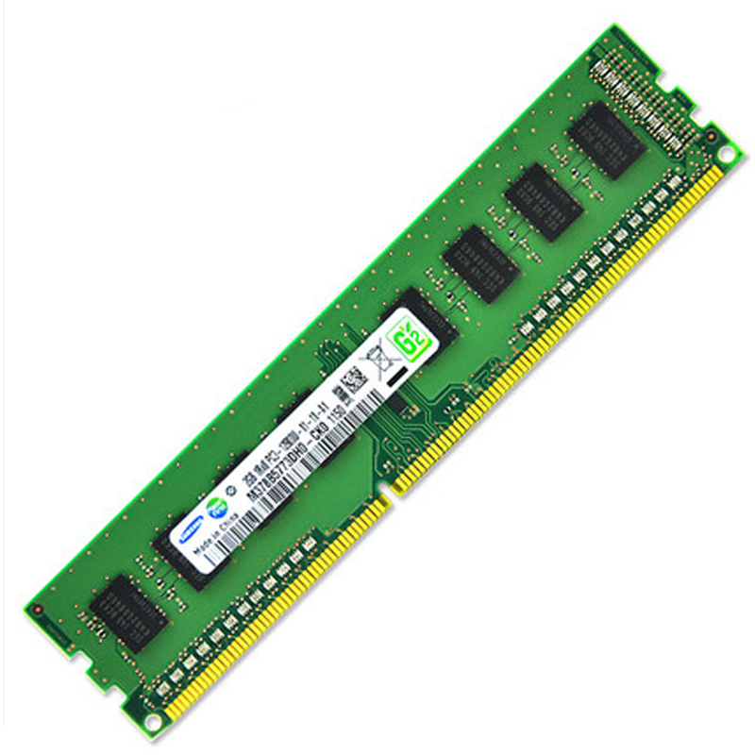
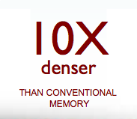
Promise of Persistent Memory (PM)
Performance*
Density
Non-volatility
Byte-addressable, load-store interface to storage

Slide 3
Recoverable data structures in PM
Correct recovery relies on ordering writes to PM
prepareUndoLog (P)
mutateData (M)
Recoverable
commitTx (C)
Need primitives to express desired write order to PM

Slide 4
Memory persistency models
Programmers can express write order to PM
Hardware enforces write order
Similar to memory consistency models
[Condit ‘09] [Pelley ‘14] [Intel ‘14] [Joshi ‘15] …

Slide 5
Contributions
Implications of Synchronous Ordering [Intel ‘14]
Semantics and performance
7.2x slowdown over volatile execution
Delegated Persist Ordering
Implementation strategy for persistency models
3.5x speedup over Synchronous Ordering

Slide 6
Outline
Background
Synchronous Ordering (SO)
SO drawbacks
Delegated Persist Ordering (DPO)
Evaluation

Slide 7
Persistent memory system
Core-1
Core-2
Core-3
Core-4
L1 $
L1 $
L1 $
L1 $
LLC
Recovery
DRAM
Persistent Memory (PM)
Notes:
A future persistent system would be multi-core, with a fairly traditional cache hierarchy, and with both DRAM and Persistent memory ion the memory bus.
We expect the address space to be partitioned into a volatile region, mapped to DRAM, and a persistent region, mapped to persistent memory.
In the event of failure, all the contents of the cores, caches and DRAM are lost, however the contents of the persistent memory are retained.
Upon restart, Recovery may inspect the contents of the persistent memory, to restore the system to a consistent state.

Slide 8
Terminology
Persist
Act of making a store durable in PM
Persist memory order (PMO)
Memory events ordered by persistency model
Governs the order in which stores persist
Notes:
Memory events.
We define a persist to be the act of making a store durable in Persistent memory
Volatile Memory Order or VMO, order of memory events as desribed by the consistency model of the system.
I.E VMO governs the order in which loads and stores become visible to the other cores in the system.
In this study, we use TSO as the underlying consistency model.
The persist memory order of PMO, is the order of memory events as required by the perisstency model of the system.
This governs the order in which stores becomes durable in NVM.
While ordering stores is required for recovery correctness, reducing the ordering dependencies is essential for performance.
In this talk, I present results for only one persistency model,called epoch persistency, more detailed analysis with different persistency models can be found in the main paper.
----- Meeting Notes (3/29/16 17:24) -----
no as per
----- Meeting Notes (3/31/16 14:57) -----
constraints, why is fewer better

Slide 9
Persistency model
Consistency
/* Init: a = 0, b=0
a,b are persistent */
Core-1 Core-2
St a = x
while (a==0){}
St b = y
Constraint: St a < St b
Writeback caching
Mem Ctrl reordering
Core-1
Core-2
L1 $
L1 $
Persistency models must minimize
additional performance overheads
LLC
Persistency
b
PM
a
Notes:
In this slide, I want to differentiate consistency and persistency models.
On the left we have a simple piece of code, we initially have variables a and b set to zero. Both are backed to persistent memory..
Core -1 sets a to one, core-2 spins until a is set to one, followed by setting b to one.
So, we require that the stoer to a happens before store to b.
The responsibility of ensuring that the stores to a and B becomes visible to all the cores in the desired order is the responsibility of the consistency model.
However, if this ordering is required for recovery coorectness, we must ensure that a nd b also persist in order.
The responsibility of the persistency model is ensureing that a and b navigate the cache hierarchy and persist in order.
This impliest that typical perf enhancing techniques such as writeback caching and mem ctrl reordering, are not effective. So, ordering constrains, result in poor performance. The rest of this talk is about trying to gain the lost performance, without giving up on ordering guarantees.
----- Meeting Notes (3/29/16 17:24) -----
a and b are in pm, use notation, sta and stb, optimizations may not be correct also

Slide 10
Epoch persistency [Condit ‘09, Pelley ‘14, Joshi ‘15]
FENCEs break thread execution into epochs
Persists across epochs are ordered
No ordering within epoch
PMO
…
Epoch-1
prepareUndoLog (P)
P₁
P₂
P_{n}
FENCE
mutateData (M)
…
Epoch-2
M₁
M₂
M_{n}
However, many ways to skin a cat …

Slide 11
Synchronous Ordering (SO)
Based on x86 ISA changes for PM
CLWB <Addr>
Writes back cache block to Memory Controller (MC)
PCOMMIT
Persists all accepted stores at MC
1. CLWB
Cores
2. PCOMMIT
Caches
Mem Ctrl
PM

Slide 12
Ordering via stalling
Objective: persist A and B in order
St A = x
CLWB <A>
fence
PCOMMIT
fence
St B = y
Core
Caches
b
a
1
a
2
Stalled
a
3 – completion ACK
b
4
Ordering via stalling → frequent processor stalls

Slide 13
Further drawbacks
Places the PCOMMIT on critical path
Negates scheduling optimizations at the MC
Has to respect all accepted stores at the MC
Explicit CLWB annotations from user
Challenge for multi-party software dev
Affects cache coherence permissions
7.2x slowdown for PCM main memories

Slide 14
Ideal ordering
Objective: persist A and B in order
Core
Caches
St A = x
fence
St B = y
b
a
1
a
b
2
b
>
a
3
Buffered persistency [Condit ‘09] [Pelley ‘14] [Joshi ‘15]
Ordering without stalling

Slide 15
Delegated Persist Ordering (DPO)
Goals
Reduce processor stalls
More scheduling freedom for MC
Key ideas
Buffer persists & ordering info alongside cache hierarchy
Decouple persistence from core execution
Challenge
Accurately track persist order across cores

Slide 16
Proposed architecture
Core-1
Core-2
Core-3
Core-4
Persist buffer at L1-D $
Houses persist for each store to PM
Retired fences
Dependency tracking
Via coherence traffic
Persists drain to MC
Decoupled from WBs
L1 $
L1 $
L1 $
L1 $
LLC
MC
PM

Slide 17
DPO in action
/* Init: a = b = 0; a,b are persistent */
Core-1 Core-2
St a = x
while (a==0){}
fence
St b = y
Constraint: St a <p St b

Slide 18
DPO in action
St a = x
Ld a
1
St b = y
Core-1
fence
Core-2
/* Init: a = b = 0; a,b are persistent */
Core-1 Core-2
St a = x
while (a==0){}
fence
St b = y
Constraint: St a <p St b
ID
Deps
Blk
ID
Deps
Blk
b
-
a
3
b
1
-
a
a
2
fence
a | 1
a |
a | 1
a |
LLC
MC
PM

Slide 19
DPO highlights
Decouples persistence from core execution
Better scheduling at the MC
Fewer stalls at the core

Slide 20
Experimental setup
gem5 simulator – details in paper
Workloads: write intensive micro-benchmarks
Concurrent queue: insert/delete entries
Array swaps: random swaps of array elements
TATP: update location transaction from TATP
RB-Tree: insert/delete entries
TPCC: new order transaction from TPCC
PM configs
PCM
DRAM
PWQ → assuming a persistent write queue at the MC

Slide 21
Performance
* Execution times normalized to volatile execution
35
16
Better
Normalized execution times
Execution times down with lower memory latencies

Slide 22
Performance
* Execution times normalized to volatile execution
35
16
Better
3.5x
Normalized execution times
2.5x
1.3x
DPO consistently out performs SO for all mem configs

Slide 23
Recent developments
4 weeks ago →
Require persistent write queue (at MC)
Cores
Caches
Mem Ctrl
Persistent
domain
PM

Slide 24
Performance
* Execution times normalized to volatile execution
35
16
Better
Normalized execution times
1.3x

Slide 25
Conclusions
Persistency model semantics affect performance
SO couples ordering with completion of persists
Often unnecessary
DPO decouples persistence from core execution
DPO significantly outperforms SO

Slide 26
Questions?

Slide 27
Thank you!

Slide 28
Backup

Slide 29
DPO in action
Core-1 Core-2
St a = x
while (a==x){}
fence
St b = y
PBE:
ID | Deps | Addr & Data

Slide 30
DPO in action
St a = x
Core-1
Ld a
Core-2
St b = y
fence
1
Core-1 Core-2
St a = x
while (a==x){}
fence
St b = y
b
ID: 3
-
b
a
ID: 1
-
a
a
ID: 2
fence
a | 1
a | 1
a |
a |
LLC
PBE:
ID | Deps | Addr & Data
MC
PM

Slide 31
Root cause – barrier semantics
SO
Buffered persistency [Pelley ’14]
Ordering + Completion
High latency
Completion not always necessary [Chidambaram ‘13]
Ordering only
Low latency
Pipeline persists

Slide 32
SO example
Objective: persist A and B in order
St A = x
CLWB A
fence
PCOMMIT
fence
St B = y
(1) Ensures `A’ is accepted to MC before PCOMMIT
Barrier
(2) Ensures `B’ cannot reach cache before `A’ persists
(1) + (2) => A and B persist in order

Slide 33
The dark side of PCOMMIT
St A = x
CLWB A
fence
PCOMMIT
fence
St B = y
(1) Ensures `A’ is accepted to MC before PCOMMIT
Barrier
(2) Ensures `B’ cannot reach cache before `A’ persists
Exposes PM latency to the core on every PCOMMIT
Frequent processor stalls

Slide 34
Recent developments
Intel deprecated PCOMMIT 4 weeks ago
Requires a persistent write queue at MC
Cores
Caches
Mem Ctrl
Persistent
domain
PM

Slide 35
SO example revisited
Objective: persist A and B in order
St A = x
CLWB A
Sfence
St B = y
Ensures `A’ is accepted to MC before `B’ reaches cache
MC access latency still exposed to core (vs PM latency)
1.5x slowdown vs 7.3x

Slide 36
RCBSP
Relaxed Consistency Buffered Strict Persistency
Relaxed consistency
We use ARM v7a
Strict persistency
Persist order = Store order
Buffering
/* Init: a = 0, b=0
a,b are persistent */
Core-1 Core-2
St a = x
while (a==0){}
dmb
St b = y
St a <_{m} St b → St a <_{p} St b

Slide 37
Delegated Persist Ordering
Aasheesh Kolli Jeff Rosen Stephan Diestelhorst Ali Saidi
Steven Pelley Sihang Liu Peter M. Chen Thomas F. Wenisch
MICRO 2016 - Taipei
Notes:
Good morning everyone, I am Aasheesh Kolli from the university of michigan, and today I am going to talk about how to design transactions for future persistent memory enable systems.

Slide 38
Delegated Persist Ordering
Aasheesh Kolli Jeff Rosen Stephan Diestelhorst Ali Saidi
Steven Pelley Sihang Liu Peter M. Chen Thomas F. Wenisch
MICRO 2016 - Taipei
Notes:
Good morning everyone, I am Aasheesh Kolli from the university of michigan, and today I am going to talk about how to design transactions for future persistent memory enable systems.

Slide 39
Performance
* Execution times normalized to volatile execution
35
16
3.5x
2.5x
1.3x
?
Array swaps, most write intensive, suffers the most, except …
RCBSP, consistently out performs SO for all mem configs
RB tree, least write intensive, dominated by volatile execution
Execution times down with lower memory latencies
Concurrent queue, thread contention exposes CLWBs

Slide 40
Memory persistency models
Allow programmers to express write order to PM
Hardware responsible for enforcing write order
Similar to memory consistency models
Synchronous Ordering (SO) – based on [Intel ‘15]

Slide 41
SO barrier v. RCBSP barrier
SO (based on [Intel ‘15])
RCBSP [Pelley ‘14]
Ordering + Completion
Stronger guarantee
Easier to reason
Potentially fewer barriers
Conservative stalling
Completion not always req.
Synchronous barrier
Ordering only (mostly)
Weaker guarantee
Harder to reason
Potentially more barriers
Stall when no buffer space
Ordering mostly sufficient
Delegation barrier

Slide 42
Barriers in action
Synchronous: Epoch-1 persists before Epoch-2 begins
Delegation: Epoch-1 ordered to persist before Epoch-2
E1
E2
Finish
Core
$
Time
E1
E2
>
Finish
Core
$
Time

