Slide 1
Eidetic Systems
David Devecsery, Michael Chow, Xianzheng Dou, Jason Flinn, Peter Chen
University of Michigan

Slide 2
What is an Eidetic System?
Eidetic – Having “Perfect memory” or “Total Recall”
Eidetic System – A system which can recall and trace through the lineage of any past computation
Notes:
An eidetic system is one that remembers all computation, and can query the history of it. That means it can look through temporary variables, named pipes, process address space, and track the history and evolution of the computer system.
If you were to work at an eidetic workstation you would never have to worry about accidently deleting files, etc.

Slide 3
Motivation - Heartbleed
Was Heartbleed exploited?
What data was leaked?
Notes:
Consider “Heartbleed”
People didn’t know if they were exploited. What leaked? Whose data leaked? How important was that data? What data was even available in the web server to leak?

Slide 4
Motivation - Heartbleed
Heartbleed
Message
Leaked Data
Was Heartbleed exploited? - Yes
What data was leaked?

Slide 5
Motivation - Heartbleed
Leaked Database
Rows
Heartbleed
Message
Leaked Data
Was Heartbleed exploited? - Yes
What data was leaked?

Slide 6
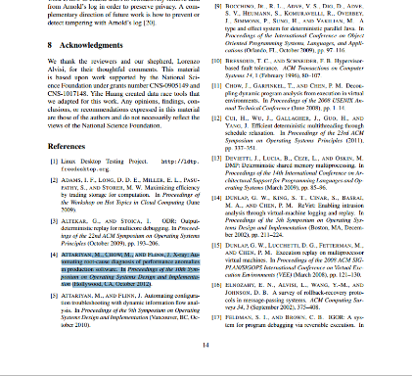
Motivation – Wrong Reference
Bad Citation
How did I get the wrong citation?

Slide 7
Motivation – Wrong Reference
How did I get the wrong citation?

Slide 8
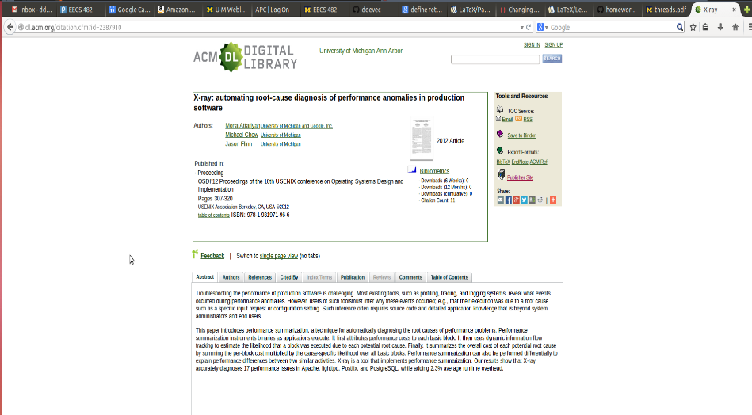
Motivation – Wrong Reference
How did I get the wrong citation?

Slide 9
Motivation – Wrong Reference
How did I get the wrong citation?
What else did this affect?

Slide 10
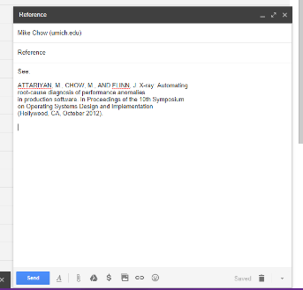
Motivation
How did I get the wrong citation?
What else did this affect?

Slide 11
Arnold
First practical eidetic computer system
Efficiently records & recalls all user-space computation
Process register/memory state
Inter-process communication
Handles lineage queries
What data was affected?
What states and outputs were affected?
Targeted towards desktop/workstation use
Reasonable overheads
Record 4 years of data on $150 commodity HD
Under 8% performance overhead on most benchmarks

Slide 12
Overview
Introduction
Motivation
How Arnold remembers all state
How Arnold supports lineage queries
Conclusion
Notes:
From here I will divide my talk into two parts:
First I’ll explain how Arnold goes about efficiently recording all states, and I’ll even evaluate our recording mechanisms
Then, I’ll tell you about how Arnold goes about supporting the powerful lineage queries which make an Eidetic System so useful

Slide 13
Remembering State
Requirements:
Store years of state on a single disk
Memory/register space within a process
Inter process communication
File state
Recall any state in reasonable time
Solution:
Deterministic record & replay
“Process group” based replay
“Process graph” to track inter-process lineage
Log compression

Slide 14
Recording Granularity
External
Inputs
What granularity is best to record our system?

Slide 15
Recording Granularity
External
Inputs
Whole system recording
Low space overhead
Costly to replay

Slide 16
Recording Granularity
External
Inputs
Process level recording
Efficient to replay
Uses extra disk space
No Inter-process tracking

Slide 17
Recording Granularity
External
Inputs
Process group recording
Efficient to replay
Reasonable disk space
No Inter-process tracking

Slide 18
Implementation – Process Graph
Record Log
IPC
Read
1
2

Slide 19
Implementation – Process Graph
Record Log
IPC
Read
1
2

Slide 20
Recording
External
Inputs
Process group recording + process graph
Efficient to replay
Reasonable disk space
Inter-process tracking

Slide 21
Space Optimizations

Slide 22
Space Optimizations

Slide 23
Space Optimizations

Slide 24
Space Optimizations
4 years of data on a $150 4TB commodity HD

Slide 25
Model-Based Compression
Formulate a model of a typical execution
Only record deviations from that model
ret_val = sys_read (fd, buffer, count);
Idea: Partial determinism
Encourage the program to conform to the model
usually equal
Notes:
e.g. delta encoding, move-to-front transform for X server messages
After sys_read
We only need to record when.. , otherwise, we need to record nothing
The better the model, the less we need in our log. The log size is proportional to the deviations

Slide 26
Semi-Deterministic Time
Frequent time queries are non-deterministic
Use partially deterministic clock
Real time clock & deterministic clock
Bound deviation
if (deterministic_clock – real_time_clock < threshold) {
adjust deterministic_clock
record deviation
}
return deterministic_clock

Slide 27
Performance Evaluation

Slide 28
Overview
Introduction
Motivation
How Arnold remembers all state
How Arnold supports lineage queries
Conclusion
Notes:
From here I will divide my talk into two parts:
First I’ll explain how Arnold goes about efficiently recording all states, and I’ll even evaluate our recording mechanisms
Then, I’ll tell you about how Arnold goes about supporting the powerful lineage queries which make an Eidetic System so useful

Slide 29
Querying Lineage
Two types of queries:
Reverse: Where did this data come from?
Forward: What did this data affect?
How does Arnold support these queries?
User specifies initial state
Trace the lineage of the computation
Intra-process tracking
Inter-process tracking

Slide 30
Intra-Process Lineage
Use taint tracking for intra-process causality
Run retroactively, on recorded execution
Parallelizable
Arnold supports several notions of causality:
Copy Only
Data Flow
Data+Index Flow
Control Flow
Strong input/output
relation
Precision
Weak input/output
Relation
Recall
May miss relations
Misses few relations

Slide 31
Intra-Process Lineage
Inputs
Program
Which linkage tool should Arnold use?

Slide 32
Intra-Process Lineage
Strong input/output
relation
Precision
Weak input/output
Relation
Recall
May miss relations
Misses few relations
Copy
Data Flow
Data+Index
Flow

Slide 33
Intra-Process Lineage
Strong input/output
relation
Precision
Weak input/output
Relation
Recall
May miss relations
Misses few relations
Copy
Data Flow
Data+Index
Flow

Slide 34
Intra-Process Lineage
Strong input/output
relation
Precision
Weak input/output
Relation
Recall
May miss relations
Misses few relations
Copy
Data Flow
Data+Index
Flow

Slide 35
Intra-Process Lineage
Strong input/output
relation
Precision
Weak input/output
Relation
Recall
May miss relations
Misses few relations
Copy
Data Flow
Data+Index
Flow

Slide 36
Intra-Process Lineage
Strong input/output
relation
Precision
Weak input/output
Relation
Recall
May miss relations
Misses few relations
Copy
Data Flow
Data+Index
Flow

Slide 37
Intra-Process Lineage
Strong input/output
relation
Precision
Weak input/output
Relation
Recall
May miss relations
Misses few relations
Data Flow
Arnold selects the
most precise tool with
at least one result

Slide 38
Inter-Process Lineage
Two notions of inter-process linkage
Process graph
Tracks lineage through inter-process communication
Precise
Captures group to group communication
Human linkage
Handles relations between user inputs and outputs
Infers linkages based on data content and time
Imprecise – may have false negatives and false positives
Can capture linkages the process graph can miss

Slide 39
Evaluation – Wrong Reference
Data
Copy
Copy
Data
Data + Index
Human
Linkage
Few false positives (font files, latex sty files, libc.so, libXt.so)
No false negatives
Record Time | Replay Time | Replay + Pin Time | Query Time
96.1s | 2.2s | 70.0s | 209.5s

Slide 40
Evaluation – Heartbleed
Data + Index
Data + Index
Data + Index
No false positives or negatives
Record Time | Replay Time | Replay + Pin Time | Query Time
230.3s | 0.4s | 139.5s | 235.1s

Slide 41
Conclusion
Eidetic Systems are powerful tools
Complete vision into past computation
Answer powerful queries about state’s lineage
Arnold – First practical Eidetic System
Low runtime overhead
4 years of computation on a commodity HD
Supports powerful lineage queries
Code is released https://github.com/endplay/omniplay

