Slide 1
R2C2: A Network Stack for Rack-scale Computers
Paolo Costa, Hitesh Ballani, Kaveh Razavi, Ian Kash
Microsoft Research Cambridge

Slide 2
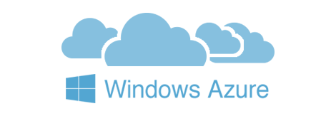
Authors
MSR Cambridge Systems and Networking
Towards predictable datacenter networks: Oktopus [SIGCOMM’11]
Datacenter for Multi-tenant services
Rack-scale computers for multi-tenant

Slide 3
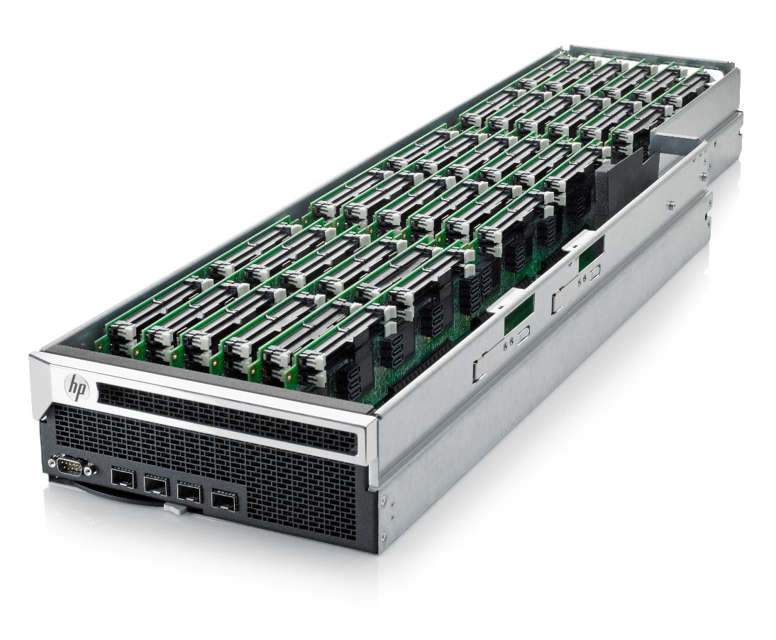
Rack-scale computing
“Building block” of future datacenters
High BW low latency network
Direct-connected topology
HP moonshot ≈ 10K $
SoC based micro-servers
100s cores, 1TB RAM, SSDs
Not a single giant but array of dummies

Slide 4
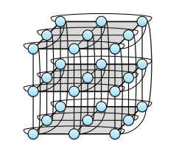
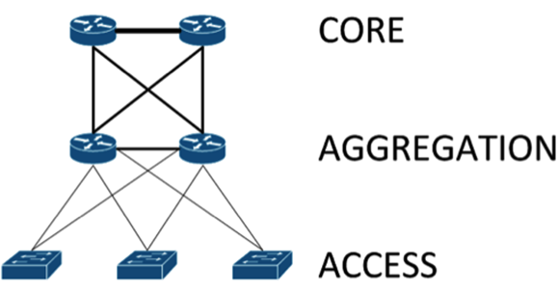
Rack-scale network topology
Distributed switch (each node works as switch)
Path diversity↑ load-balancing, congestion control?
3D torous
Rack-scale topology
HPCs
Fat-tree
Datacenter topology

Slide 5
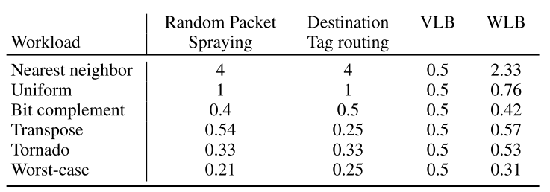
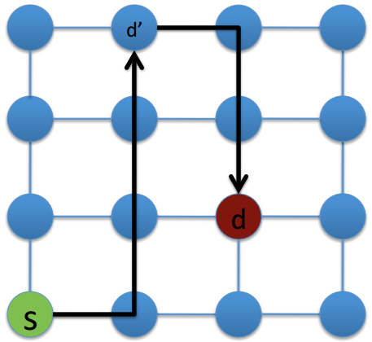
Motivation
Direct-connect topology in multi-tenant clusters
Unpredictable workloads and network flows
One routing-fits-all
Thoroughput of different routing algorithms
Valiant Load Balancing

Slide 6
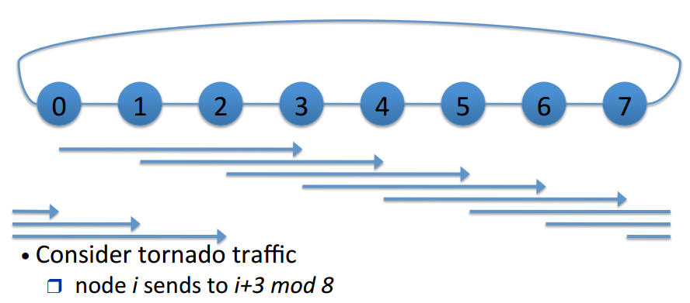
Tornado traffic
Require adaptive load balancing

Slide 7
Problem statement
Given direct-connected network and unpredictable network pattern
Adaptive routing and Congestion control
Decouple Routing /Control plane
Rack Routing Congestion Control

Slide 8
Big idea
Broadcast is cheap
With global traffic knowledge of active flows (allocation, topology, and routing protocol) fair sending rate calculated locally for congestion control

Slide 9
R2C2
Broadcast when flow starts
Sender Node1
Node4
Node2
Node3
Global traffic matrix
Flows | Routing | Rate alloc
Flow1 | 2-4 | 10
Flow2 | 1-3-4 | 10
New flow | 1-2-4 | …
Broadcasting

Slide 10
R2C2
Broadcast when flow starts
Sender Node1
Node4
Node2
Node3
Global traffic matrix
Flows | Routing | Rate alloc
Flow1 | 2-4 | 10 5
Flow2 | 1-3-4 | 10
Flow3 | 1-2-4 | 5
Broadcasting

Slide 11
R2C2
Broadcast when flow starts and finishes
Sender Node1
Node4
Node2
Node3
Global traffic matrix
Flows | Routing | Rate alloc
Flow1 | 2-4 | 10 5
Flow2 | 1-3-4 | 5
Flow3 | 1-2-4 | 5 10
Broadcasting

Slide 12
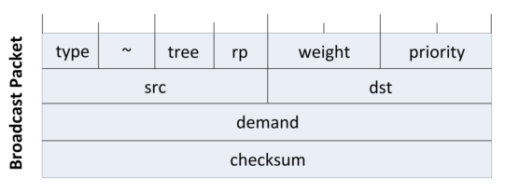
Broadcast
Broadcast route?: shortest-path tree for node
95% of traffic comes from < 4% flows
$⇒ \frac{broadcast traffic}{total traffic}$ = 1.3%
16 byte

Slide 13
Rate Computation
Routing protocol dictates relative rate across paths
Max-min fair allocation lead to network under-utilization
f1
f2
optimal
Max-min fair

Slide 14
Rate Computation
Routing protocol dictates relative rate across paths
Max-min fair allocation lead to network under-utilization
f1
f2
optimal
Max-min fair

Slide 15
Routing selection
Genetic algorithm with aggregate throughput fitness
Adaptation period of few seconds/minutes
Adaptive routing with statistical heuristic

Slide 16
Evaluation
Method: Simulation validated by emulated Rack server
Throughput / latency
Broadcast overhead
Rate computation period
Centralized vs de-centralized
TCP (ECMP single-path routing) as baseline
PFQ(random packet spraying) as ideal case

Slide 17
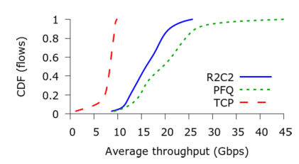
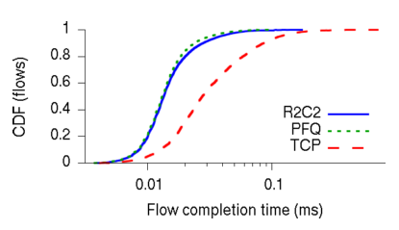
Throughput/ latency
R2C2 congestion control improves network load-balancing
better
better
Long flows
Short flows

Slide 18
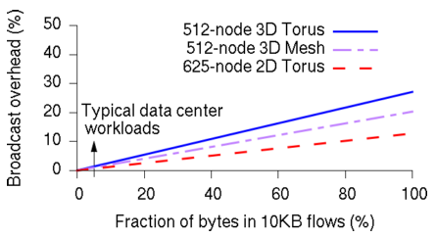
Broadcast overhead
More hops (average traffic↑) = lower relative overhead

Slide 19
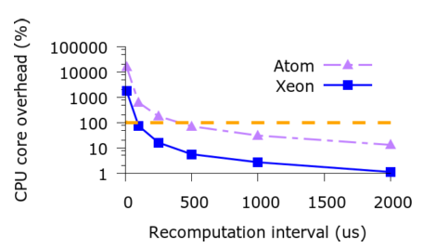
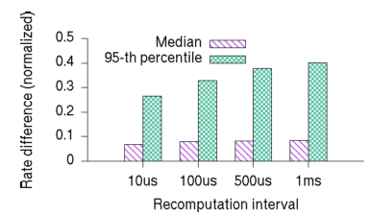
Rate computation interval
Overhead =$\frac{compute time}{interval}$ compute time $≅25 μs$
Rate update (median) is < 10%
CPU overhead for 512-node with 1 us flow inter-arrival time
Deviation from ideal rate

Slide 20
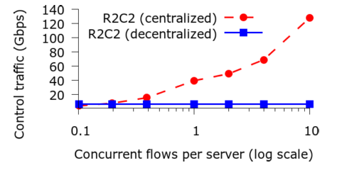
Decentralized design
Centralized control increases network traffic
How about short flows?
Concurrent “long” flow

Slide 21
Discussion
Decouple control / routing plane? But control is dictated by routing protocol
Broadcast would not scale. assuming rack will not scale?
Single-path TCP is unfair baseline?

Slide 22
Conclusion
Maintaining global traffic matrix, optimize decision by separating routing and congestion control
Simulation allows extensive parameterization of experiment

