Slide 1
PACMan: Coordinated Memory Caching for Parallel Jobs
Ganesh Ananthanarayanan, Ali Ghodsi, Andrew Wang, Dhruba Borthakur, Srikanth Kandula, Scott Shenker, Ion Stoica
NSDI 2012

Slide 2
Motivation
JOBS
Scheduler

Slide 3
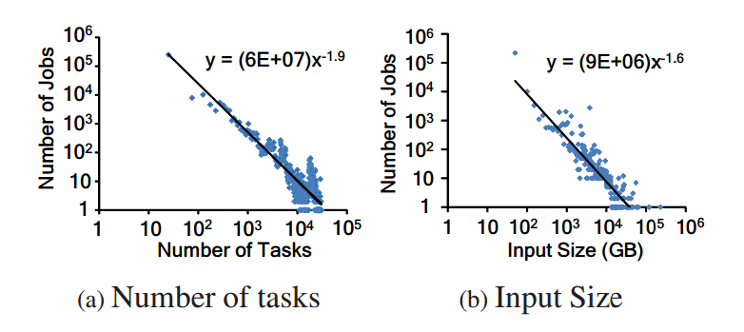
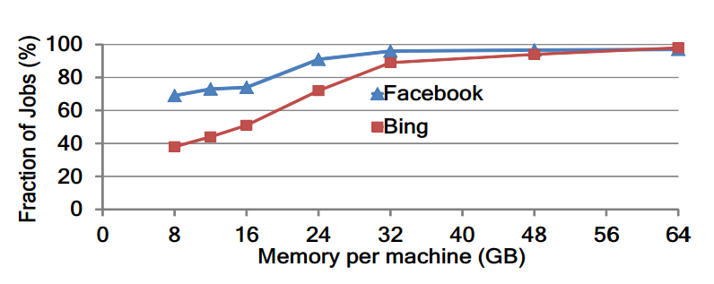
In-Memory Caching
Majority of jobs are small in size
Input data of most jobs can be cached in 32GB of memory
92% of jobs in Facebook’s Hadoop cluster fit in memory
IO-intensive phase constitute significant portion of datacenter execution
79% of runtime, 69% of resource

Slide 4
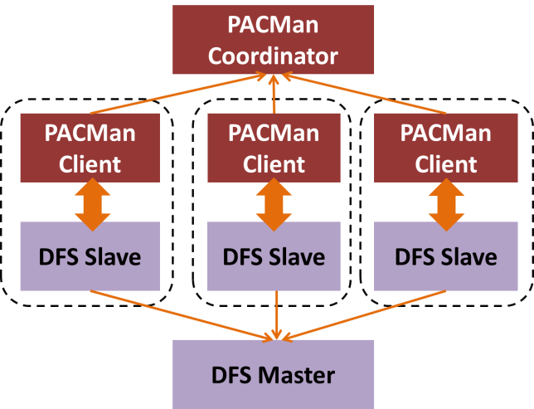
PA Man: Parallel All-or-nothing Cache MANager
Globally coordinates access to its distributed memory caches across various machines
Two main tasks:
Support queries for the set of machines where block is cached
Mediate cache replacement globally across machines

Slide 5
PA Man Coordinator
Keep track of the changes that are made by clients.
Maintain a mapping between every cached block and the machines that cache it.
Implements the cache eviction policies such as LIFE and LFU-F
Secondary coordinator on cold standby as a backup.

Slide 6
PA Man Clients
Service requests to existing cache blocks and manage new blocks.
Data is cached at the destination, rather than the source
What Is the Optimal Eviction Policy?

Slide 7
Key Insight: All-or-Nothing Property
Tasks of small jobs run simultaneously in a wave
Task duration
(uncached input)
Task duration
(cached input)
slot₁
slot₁
slot₁
slot₂
slot₂
slot₂
time
time
time
completion
time
completion
time
completion
time
All-or-nothing: Unless all inputs are cached, there is no benefit

Slide 8
Problem of Traditional Policies
Simply maximizing the hit-rate may not improve performance
Ex) If we have Job 1 and Job 2 where Job 2 depends on result of Job 1
Task duration
(uncached input)
Task duration
(cached input)
Job 1
Job 2
Job 1
Job 2
Sticky Policy: Evict the Incomplete Caches first.
slot₁
slot₂
slot₃
slot₄
slot₁
slot₂
slot₃
slot₄
Job 1
completion
Job 2
completion
Job 1
completion
Job 2
completion

Slide 9
Eviction Policy - LIFE
Goal: Minimize the average completion time of jobs
Are there any Incomplete Files?
“largest” – file with largest wave-width
Wave-width: Number of parallel tasks of a job
YES
NO
Evict largest Incomplete File
Evict largest Complete File

Slide 10
Eviction Policy – LFU-F
Goal: Maximize the resource efficiency of the cluster (Utilization)
Are there any Incomplete Files?
YES
NO
Evict least accessed Incomplete File
Evict least accessed Complete File

Slide 11
Eviction Policy – LIFE vs LFU-F
Job 1 – Wave-width: 3 Capacity: 3 Frequency: 2
Job 2 – Wave-width: 2 Capacity: 4 Frequency: 1
LIFE: Evict the highest wave-width
LFU-F : Evict the lowest frequency
slot₁
slot₂
slot₃
slot₄
slot₅
slot₁
slot₂
slot₃
slot₄
slot₅
Job 1
Job 1
Job 2
Job 2
Capacity Required: 4
Capacity Required: 3

Slide 12
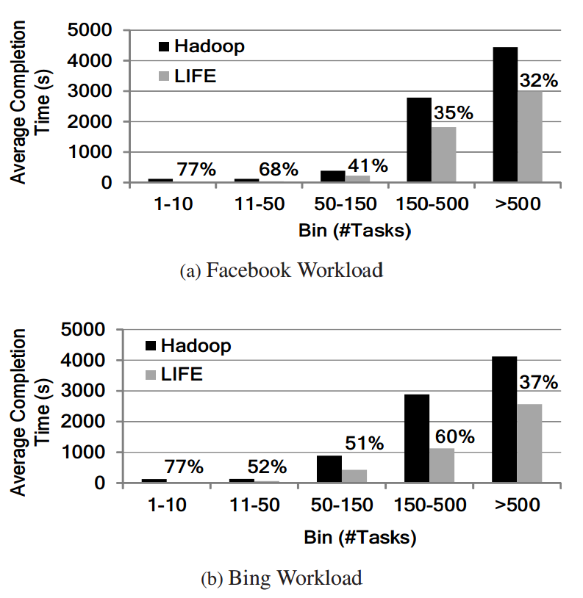
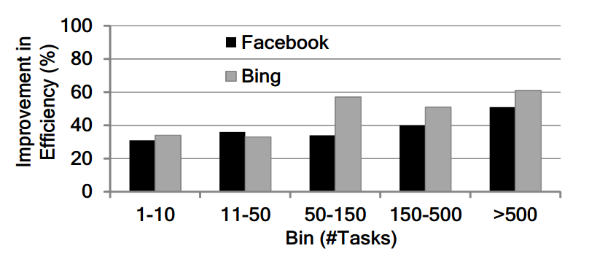
Results: PACMan vs Hadoop
Significant reduction in completion time for small jobs.
Better efficiency at larger jobs.

Slide 13
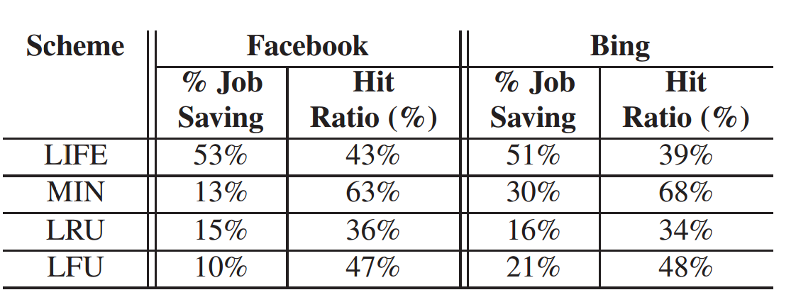
Results: PACMan vs Traditional Policies
LIFE performs significantly better than MIN, despite having lower hit ratio for most applications.
Sticky-policy help LFU-F have better cluster efficiency.

Slide 14
Summary
Most datacenter workloads are small in size, and can fit in memory.
PACMan – Coordinated Cache Management System
Take into account All-or-nothing nature of parallel jobs to improve:
Completion Time (LIFE)
Resource Utilization (LFU-F)
53% improvement in runtime, 54% improvement in resource utilization over Hadoop.

Slide 15
Discussion & Questions
How “fair” is PACMan? Will it favor or prioritize certain types of jobs over another? Is it okay?
Are there workloads where “all-or-nothing” property does not hold true?

Slide 16
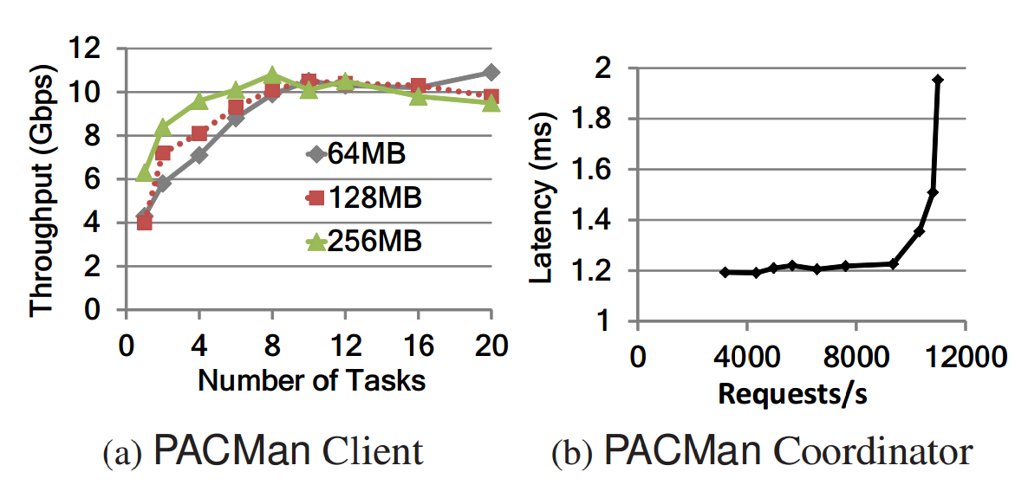
Scalability of PACMan
PACMan client saturate at 10-12 tasks per machine, for block sizes of 64/128/256MB, which is comparable to Hadoop
Coordinator maintains a constant ~1.2ms latency till 10,300 requests per second, significantly better than Hadoop’s 3,200 requests per second bottleneck.

Slide 17
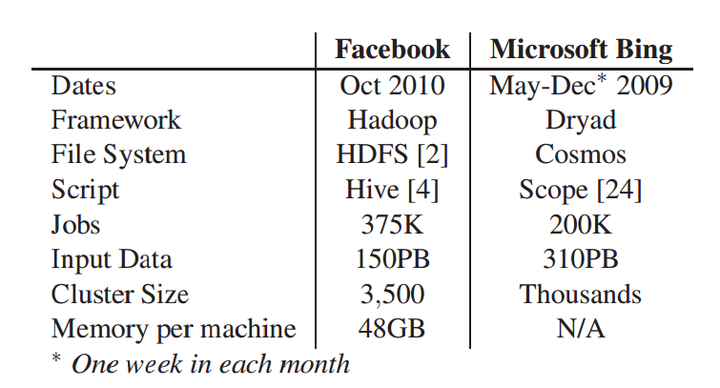
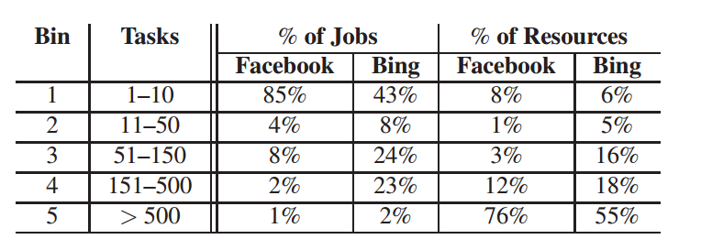
Evaluation
Experimental Platform: 100-node cluster in Amazon EC2
34.2GB of memory, 20GB of cache allocation for PACMan per machine
13 cores and 850 GB storage
Traces from Facebook and Bing

