Slide 1
Scaling Distributed Machine Learning with the Parameter Server
By M. Li, D. Anderson, J. Park, A. Smola, A. Ahmed, V. Josifovski, J. Long E. Shekita, B. Su.
Notes:
Collaboration by: CMU, Baidu and Google

Slide 2
Outline
Motivation
Parameter Server architecture
Why is it special?
Evaluation

Slide 3
Motivation
Notes:
Many distributing computation systems exist to improve distributed ML:
spark was partially conceived from this environment
Graphlab, petuum, REEF, aiad, Mlbase

Slide 4
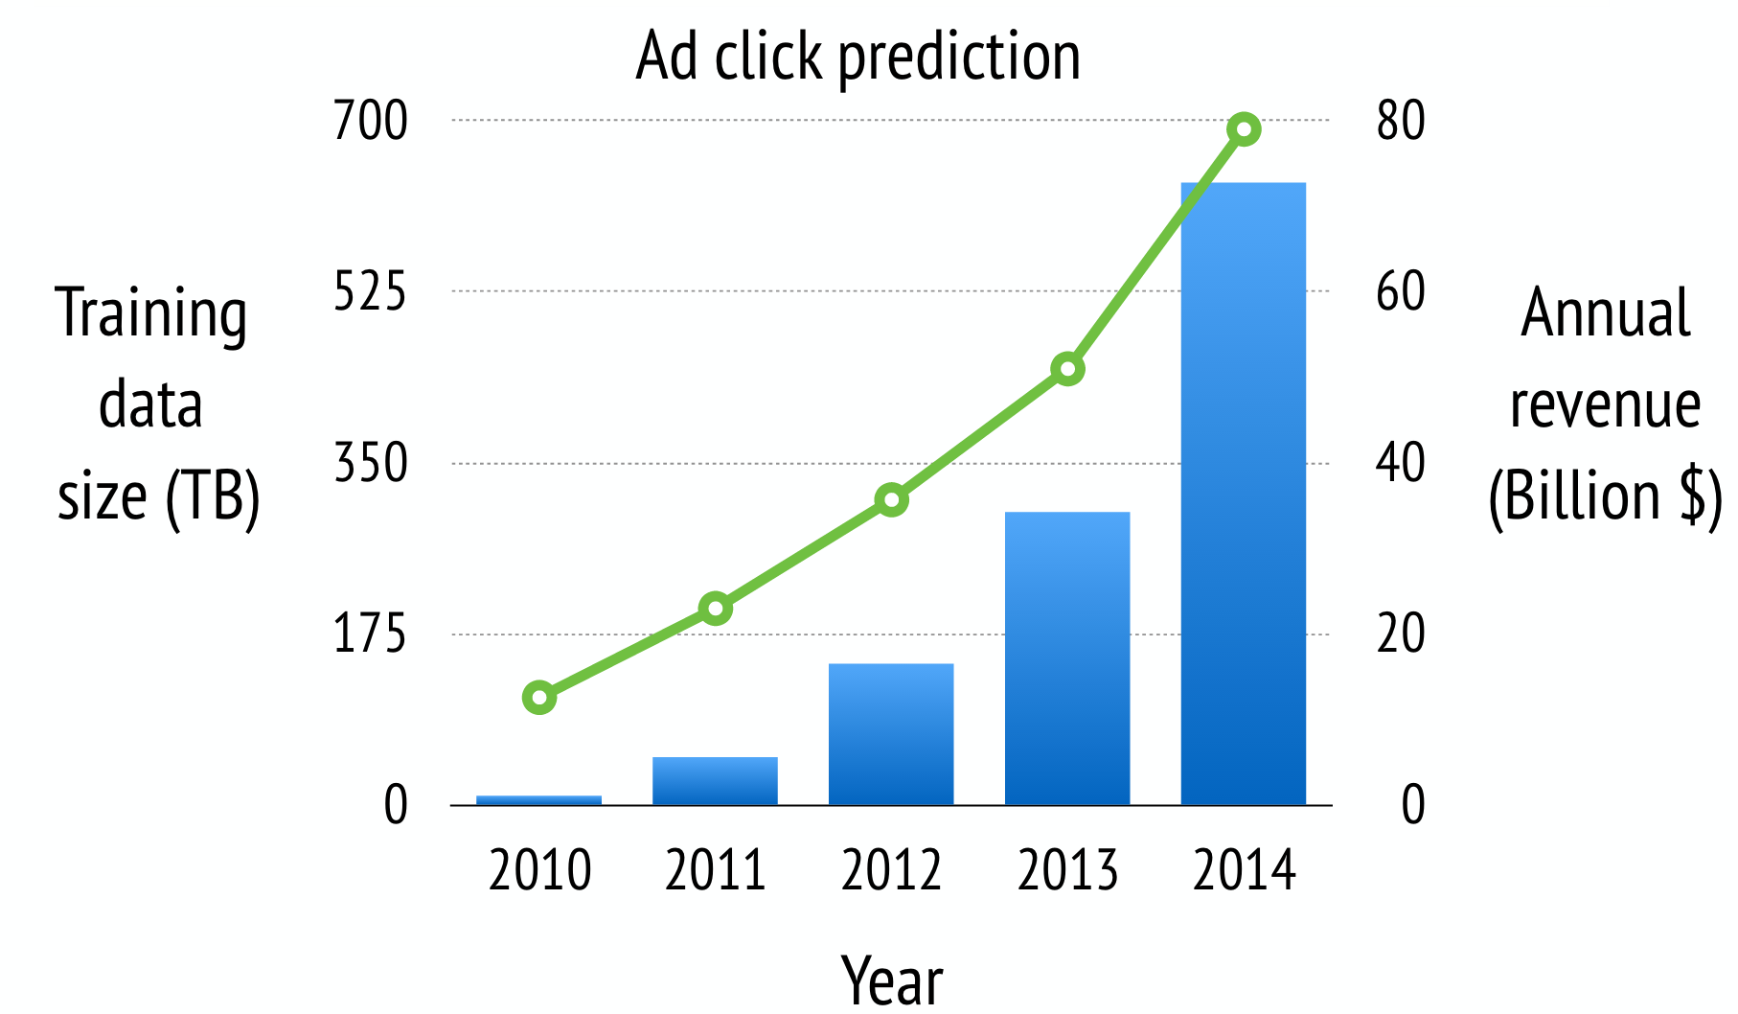
Motivation
Notes:
Unabashadely stolen from the author

Slide 5
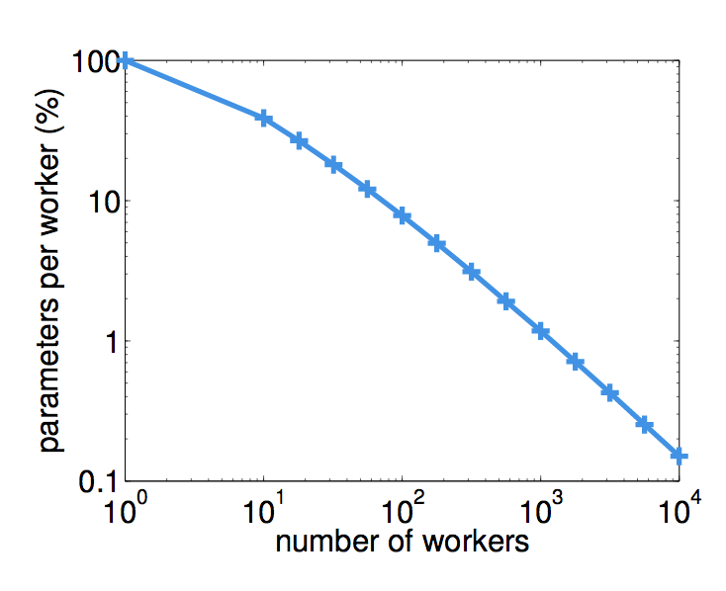
Motivation
Notes:
A single machine can’t handle a model of this size!
Distribute the training set across all your workers
Each worker updates smaller set of parameters that are changed!

Slide 6
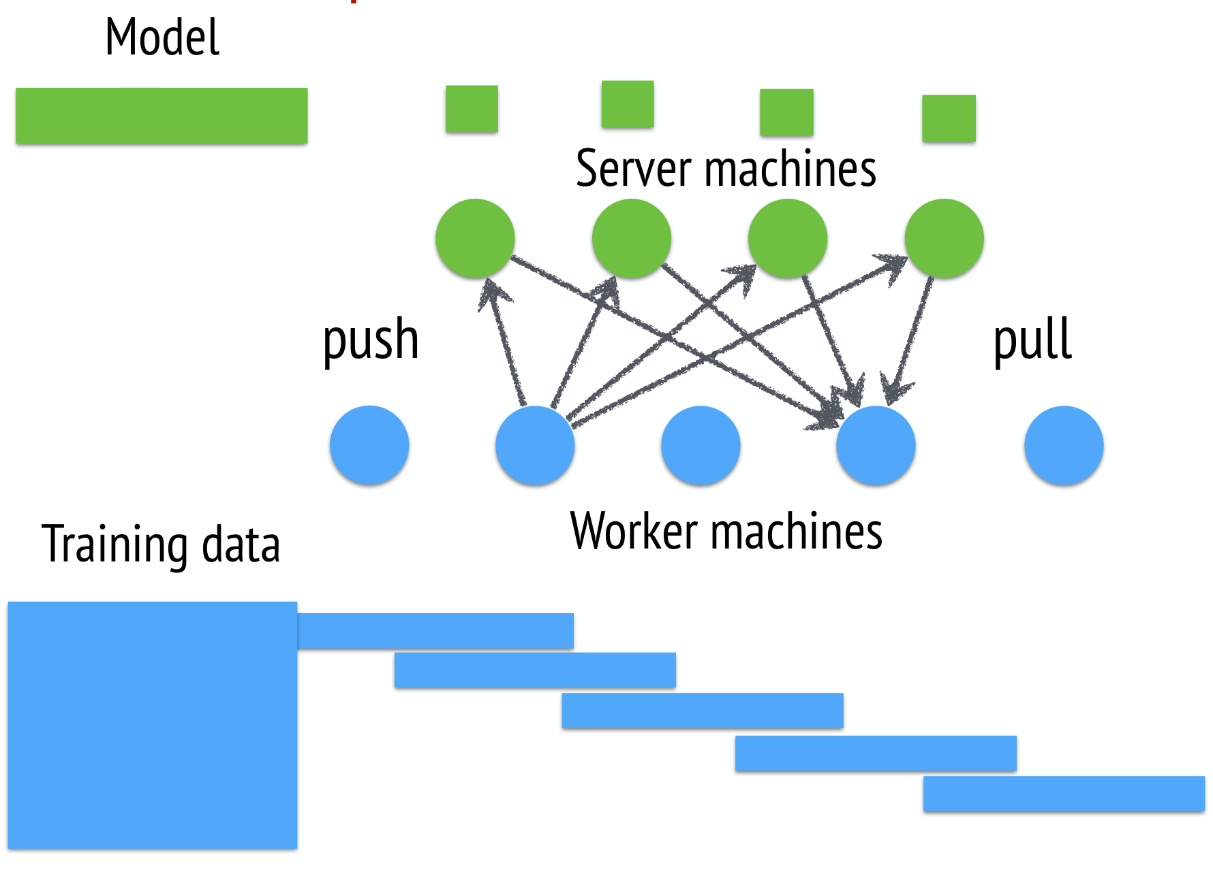
Parameter Server
Notes:
Model (parameters) live in the ‘server group’
Training data lives on the worker machines
Workers communicate w/ server by pushing and pulling down the model

Slide 7
Parameter Server
How is this different from a traditional KV store?
Notes:
Model (parameters) live in the ’server group’
Training data lives on the worker machines
Workers communicate w/ server by pushing and pulling down the model

Slide 8
Key Value Stores
Key-Value Store
Clients
Notes:
Clients send requests to the KV store w/out information about the distribution
API is update / get (key)
Highly available by sacrificing (potentially) consistency guarantees

Slide 9
Diff from KV (leverage domain knowledge)
Treat KVs as sparse matrices
Computation occurs on PSs
Flexible consistency
Intelligent replication
Message Compression
Notes:
I’m going to skip (read dynamo / this paper / Distributed Hash Table papers)
consistent hashing
Server Management
Vector Clocks

Slide 10
KVs as Sparse Matrices
Notes:
We do ML with matrices!
Gradient, data, label and model are all matrices
This includes matrix multiply, matrix add, transpose, scalar multiply

Slide 11
KVs as Sparse Matrices
Notes:
Stored as a sparse vector:
Allows them to expose linear algorithm ops such as vector addition, multiplication etc.
Very practically lets them leverage the scientific community's optimized programs

Slide 12
User-defined Functions
PSs aggregate data from the workers:
In distributed gradient descent workers push gradients that PSs use to calculate how to update the parameters
Users can also supply user defined functions to run on the server

Slide 13
Flexible Consistency
Notes:
Traditional ML algorithms are sequential
Most KV stores offer Eventual consistency

Slide 14
Flexible Consistency
Notes:
Traditional ML algorithms are sequential
Most KV stores offer Eventual consistency
K-bounded delay: have model from at most k behind

Slide 15
Intelligent Replication
Notes:
Default: use chain replication – synchronous updates –
Optimization: only replicate after PS server has aggregated data

Slide 16
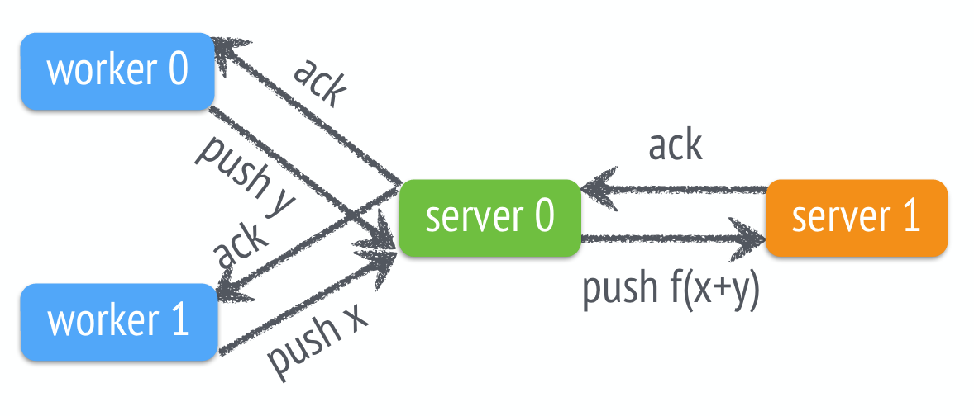
Intelligent Replication
Notes:
Default: use chain replication – synchronous updates –
Optimization: only replicate after PS server has aggregated data
Reduces used traffic from k to k / n (where k is number of replicas, n is number of workers)

Slide 17
Message Compression
Notes:
Vc(R) – vector clock (just ignore)
R – range of keys in this update
(K,V) key value pairs

Slide 18
Message Compression
Training data does not change:
Only send hash of training data on subsequent iterations
Values are often 0
Only send non-zero values

Slide 19
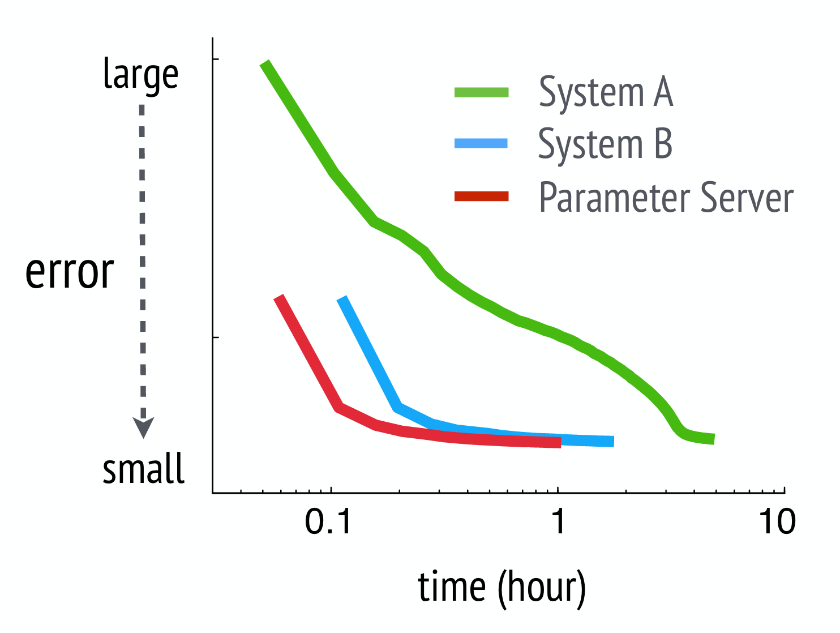
Evaluation (logistic regression)
Notes:
Logistic Regression of ad data (error numbers are application specific!)

Slide 20
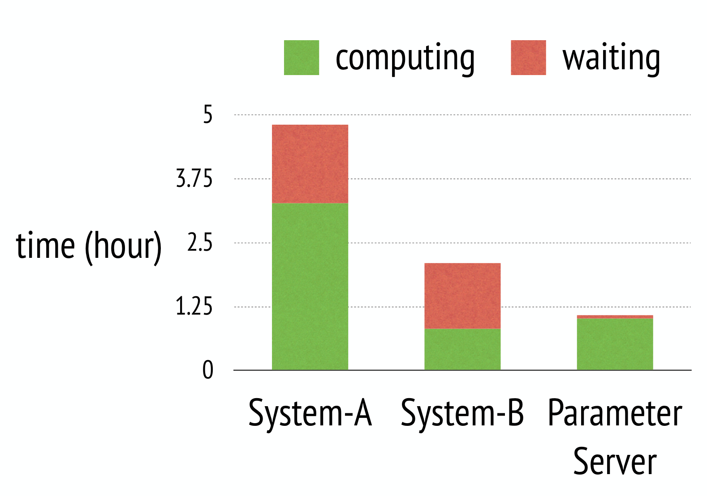
Evaluation (logistic regression)
Notes:
How often do the workers… work?

Slide 21
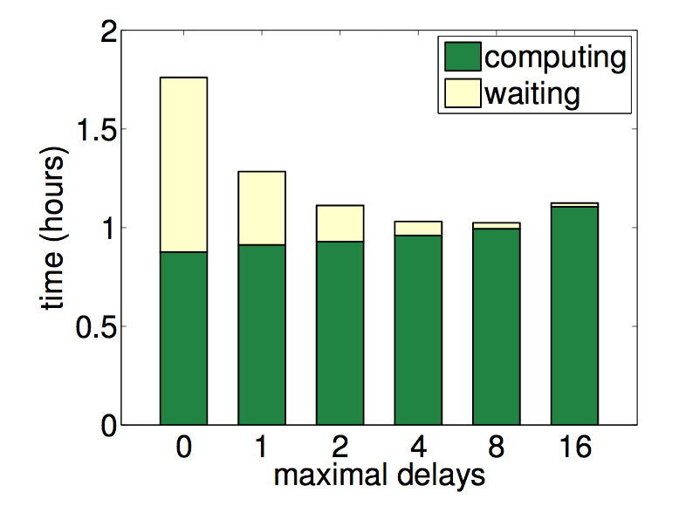
Evaluation (logistic regression)
Notes:
How does the time to converge depend on delay (bounded consistency)
It depends on the workload / algorithm!

Slide 22
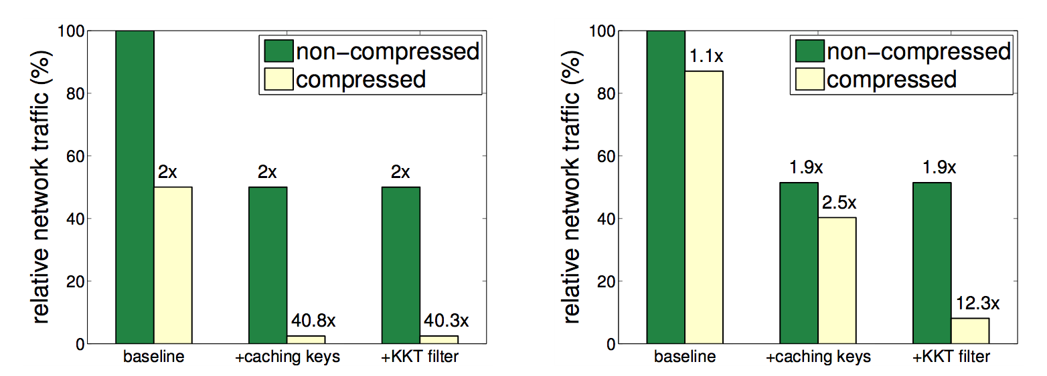
Evaluation (logistic regression)
Notes:
How does the compression work?

Slide 23
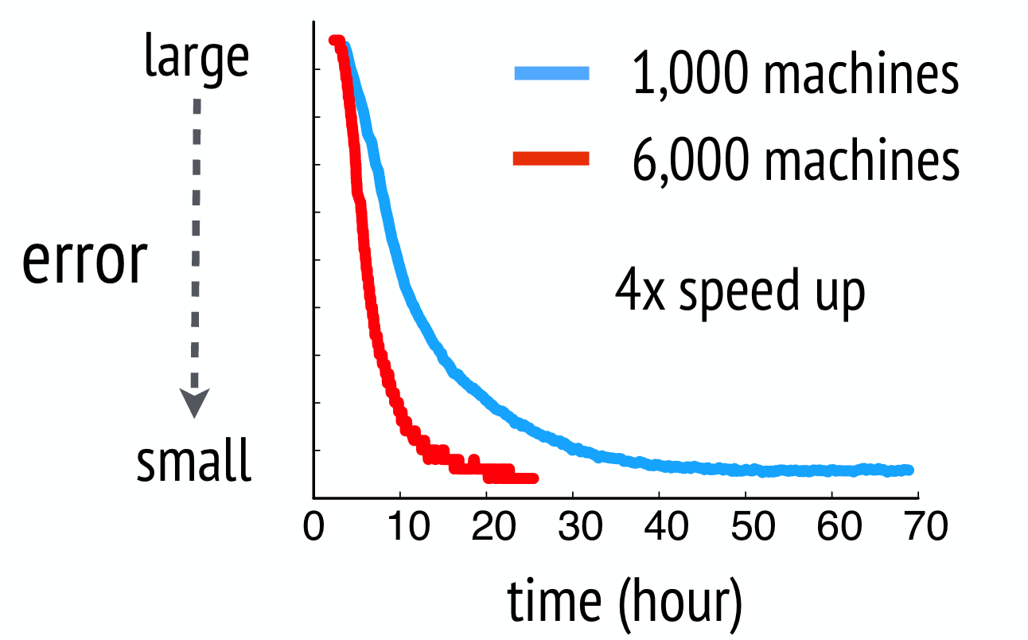
Evaluation (Topic Modeling)
Notes:
Their system scales!

Slide 24
Conclusion
The Parameter Server model is a much better model for machine learning computation than comparing models

Slide 25
Conclusion
The Parameter Server model is a much better model for machine learning computation than comparing models
Designing a system around a particular problem exposes optimizations which dramatically improve performance

