Slide 1
Dominant Resource Fairness: Fair Allocation of Multiple Resource Types
Ali Ghodsi, Matei Zaharia, Benjamin Hindman, Andy Konwinski, Scott Shenker, Ion Stoica
University of California, Berkley

Slide 2
Outlines
Introduction
Motivation
Dominant Resource Fairness (DRF)
Experiment result
Conclusion

Slide 3
What is fair sharing?
n users want to share a resource (e.g. CPU)
- Solution:
Allocate each 1/n of the shared resource
Generalized by max-min fairness
- Handles if a user wants less than its fair share
- E.g. user 1 wants no more than 20%
Generalized by weighted max-min fairness
- Give weights to users according to importance
- User 1 gets weight 1, user 2 weight 2
Notes:
First I will introduce the background of fair sharing
Max-min fairness maximizes the minimum allocation received by a user in the system

Slide 4
Properties of max-min fairness
• Share incentive
– Each user can get at least 1/n of the resource
– But will get less if her demand is less
• Strategy‐proof
– Users are not better off by asking for more than they need
– Users have no reason to lie

Slide 5
Why use max-min fairness?
Desirable properties of max‐min fairness
– Isolation policy:
A user gets her fair share irrespective of the demands of other users
– Flexibility separates mechanism from policy:
Proportional sharing, priority, reservation,...
• Many schedulers use max‐min fairness
– Datacenters: Hadoop’s fair sched, capacity, Quincy
– OS: rr, prop sharing, lottery, linux cfs, ...
– Networking: wfq, wf2q, sfq, drr, csfq, ...
Notes:
The max-min fairness policy defines itself the isolation policy that the system has, in other words, a user gets her fair share irrespective of the demands of the other users. If two users share the same resource, each of them will get 50 percent.
The second great property is that it provides very flexible mechanism, many different policies can be implemented by this mechanism. For example, for the proportional sharing, which you can give different users different weights, we can implement priority by setting the weights very far apart, to guarantee the user has highest weight will also get the resource when it wants. We can also implement reservation through this. For example, if we want to guarantee one user hold at least 10% of the resource, we can set its weight to be 10, and the total weight cannot be greater than 100.

Slide 6
Outlines
Introduction
Motivation
Dominant Resource Fairness (DRF)
Experiment result
Conclusion

Slide 7
Why is max-min fairness not enough?
• Job scheduling in datacenters is not only about CPUs
– Jobs consume CPU, memory, disk, and I/O

Slide 8
Heterogeneous Resource Demands
Some tasks are
CPU‐intensive
Most task need ~
<2 CPU, 2 GB RAM>
Some tasks are
memory‐intensive
2000‐node Hadoop Cluster at Facebook (Oct 2010)
Notes:
If we look at this bubble graph, it shows the task demands of 2000-node Hadoop Cluster at Facebook in 2010. The x-axis shows the memory demand of the task and the y-axis shows the cpu demands of every task.
The resource demands are heterogeneous.

Slide 9
Heterogeneous Resource Demands
Notes:
CDF is the cumulative distribution function
This graph shows the CDFs of the ratio between the task CPU demand and the slot CPU share, and of the ratio between the task memory demand and the slot memory share. A ratio of 1 corresponds to a perfect match between the task demands and slot resources, a ratio below 1 corresponds to tasks underutilizing their slot resources, and a ratio above 1 corresponds to tasks over-utilizing their slot resources, which may lead to thrashing.

Slide 10
Motivation
Figure 1 shows that though the majority of tasks are CPU-heavy, there exist tasks that are memory heavy as well, especially for reduce operations.
Figure 2 shows that most of the tasks either underutilize or overutilize some of their slot resources.
Notes:
Thus it is important to come up with a scheduler which can be used to multiple resource types.

Slide 11
Important Allocation Properties
1. Sharing incentive:
Each user should be better off sharing the cluster, than exclusively using her own partition of the cluster.
Every user should get 1/n of at least one resource.
2. Strategy-proofness:
Users should not be able to benefit by lying about their resource demands. This provides incentive compatibility, as a user cannot improve her allocation by lying.

Slide 12
Important Allocation Properties
3. Envy-freeness:
A user should not prefer the allocation of another user.
4. Pareto efficiency:
It should not be possible to increase the allocation of a user without decreasing the allocation of at least another user.

Slide 13
Some other nice-to-have properties
Single resource fairness:
For a single resource, the solution should reduce to max-min fairness.
Bottleneck fairness:
If there is one resource that is percent-wise demanded most of by every user, then the solution should reduce to max-min fairness for that resource.

Slide 14
Some other nice-to-have properties
Population monotonicity:
When a user leaves the system and relinquishes her resources, none of the allocations of the remaining users should decrease.
Resource monotonicity:
If more resources are added to the system, none of the allocations of the existing users should decrease.

Slide 15
Problem Definition
How to fairly share multiple resources when users have heterogeneous demand on them?

Slide 16
An Example of Multiple Resource Sharing
---Example
Total Resource: <9CPU, 18GB>
User A wants <1CPU, 4GB> per tasks
User B wants <3CPU, 1GB> per tasks

Slide 17
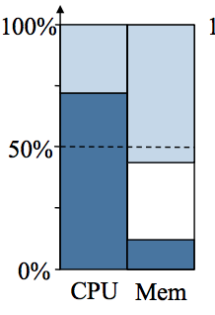
A Natural Approach – Asset Fairness
Asset Fairness
Aims to equalize the aggregate resources allocated to each user
Total resources <9CPU, 18GB>
CPU ~ 2$
1GB ~ 1$
User 1 wants <1CPU, 4GB> ~ 6$/tasks
User 2 wants <3CPU, 1GB> ~ 7$/tasks
Solution
Find max(x,y) such that 6x = 7y
x=2.52, y=2.16
1 gets <2.5CPU, 10.1GB> 2 gets <6.5CPU, 2.2GB>

Slide 18
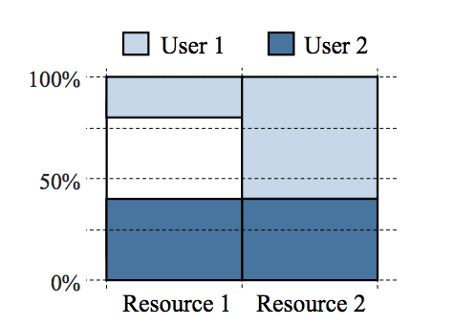
A Natural Approach – Asset Fairness
Drawback of Asset Fairness
Violates the sharing incentive property
Counter Example
Total resources <30CPU, 30GB>
User 1 wants <1,3>
User 2 wants <1,1>
Solution: User 1 gets <6, 18> ~24/60
User 2 gets <12,12> ~24/60
User A gets less than half of both resources!

Slide 19
Dominant Resource Fairness - DRF
Allocation policy for multiple resource
Meets all four of the required policy:
Sharing incentive
Strategy-proofness
Envy-freeness
Pareto efficiency

Slide 20
Dominant Resource Fairness - DRF
Dominant Resource:
The resource that a user has the biggest share of
Example: Total resources: <9CPU, 18GB>
User 1’s allocation: <3CPU, 4GB>
Dominant resource is memory for 3/9>4/18
Dominant Share:
The fraction of the dominant share a user is allocated
User 1’s dominant share is 33% (1/3)

Slide 21
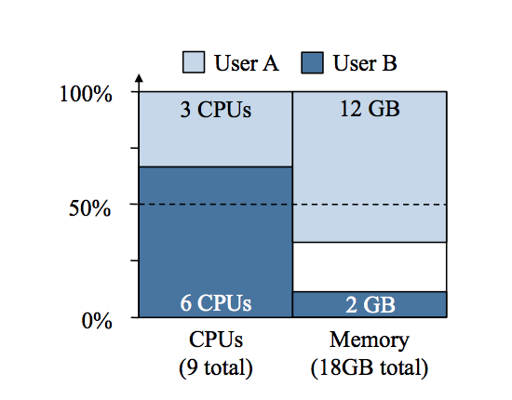
Dominant Resource Fairness - DRF
Apply max-min fairness to dominant shares
Equalize the dominant share of the users
Solution to the example
Total <9CPU, 18GB>
User 1 <1CPU,4GB> User 2<3CPU,1GB>
max(x,y) (Maximize allocations)
such that 2/9x = 3/9y (equalize dominant shares)
Solution: User 1<3CPU, 12GB>, User 2<6CPU, 3GB>

Slide 22
Online DRF Scheduler
Whenever there are available resources and tasks to run:
Schedule a task to the user with smallest dominant share

Slide 23
DRF pseudo-code

Slide 24
Alternative Fair Allocation Policy: CEEI
Economist’s way to fairly divide resources
Competitive Equilibrium from Equal Incomes:
Give each user 1/n of every resource initially
let them trades their resources with other users in a perfectly competitive market
Solution given by Nash barging solution

Slide 25
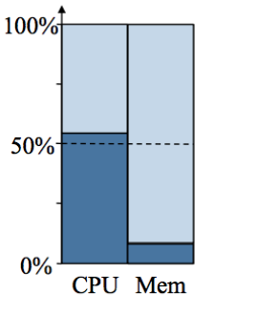
Alternative Fair Allocation Policy: CEEI
Market Clearance
Drawback : Violate strategy proofness
User can cheat by claiming more than he needs
to have more tasks allocated

Slide 26
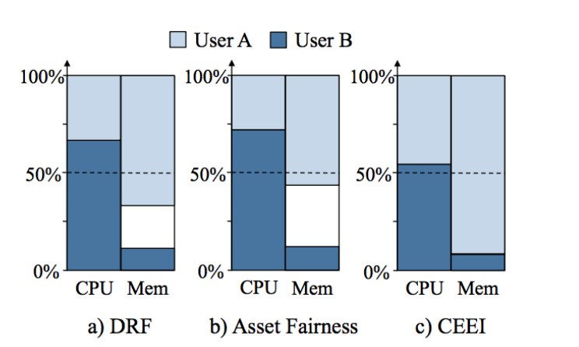
Comparison Between Three Allocation

Slide 27
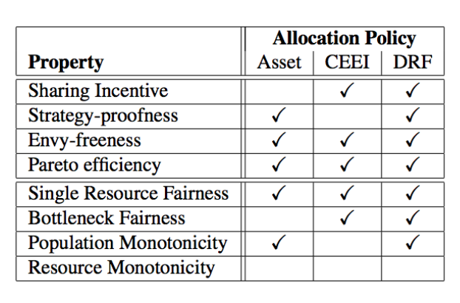
Comparison Between Three Allocation
DRF is the only one satisfying
four required properties
Resource monotonicity is not
possible to achieve when
other properties are achieved

Slide 28
Experiment Result
Experiment: DRF vs. Alternative Allocation Policies
48 node Mesos cluster on EC2 instances with 8CPU cores and 7GB RAM each (1GB for OS).
Two users:
User 1 <1CPU, 0.5GB>
User 2 <2CPU, 2GB>
Compared with:
Slot-based fair scheduling (a common policy in current system, e.g. Hadoop Fair Scheduler)
Max-min fair sharing for CPU resource only

Slide 29
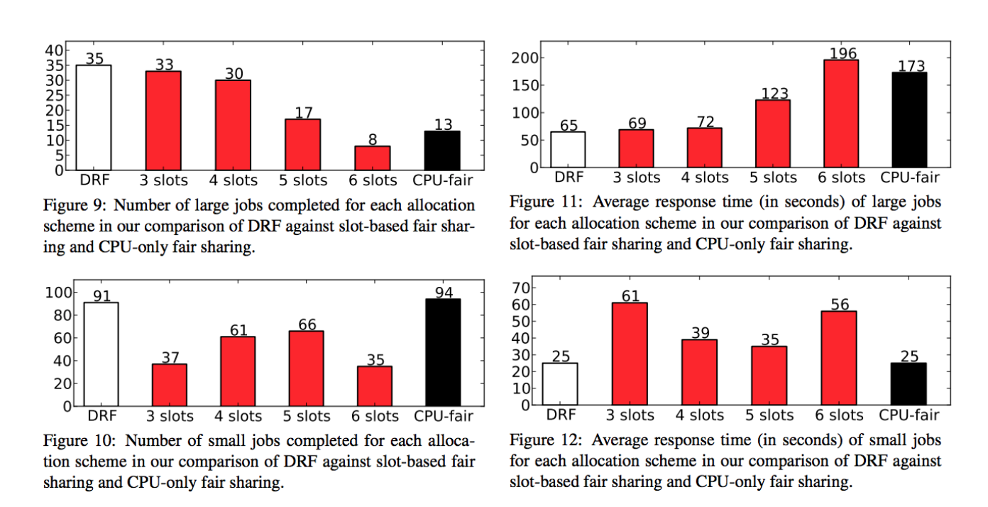
Experiment Result

Slide 30
Experiment Result
Experiment: Simulations using Facebook Traces
Log traces from a 2000 node cluster at facebook (one week periord)
Simulate the traces with 400 nodes
Each node consists of 12 slots, 16 cores, 32 GB memory
Compared with Hadoop’s fair scheduler(slot)

Slide 31
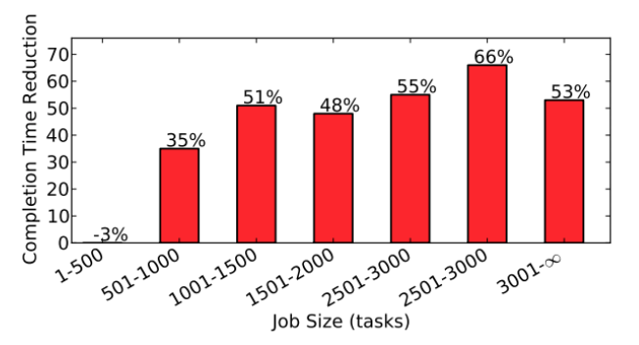
Experiment Result

Slide 32
Conclusion
DRF provides provides multiple multiple‐resource resource fairness fairness in the presence of heterogeneous demand
First generalization generalization of max‐min fairness fairness to multiple‐resources
DRF satisfies all of the desired properties of fair allocation except for resource monotonicity
DRF performs better than current approaches.

Slide 33
Acknowledgement
Some of our slides are borrowed from their presentation in NSDI in 2011

