Slide 1
Omega: flexible, scalable schedulers for large compute clusters
Malte Schwarzkopf (University of Cambridge Computer Lab)
Andy Konwinski (UC Berkeley) Michael Abd-El-Malek (Google) John Wilkes (Google)
Presented by: Yikai Lin, Chao Kong
Slides adapted from the EuroSys ‘13 presentation

Slide 2
Outline
1. Problem statement
2. Related work
3. Proposed solution
4. Comparison of approaches
5. Case study
6. Conclusion
7. Discussion
Notes:
What problem this paper is trying to address
What are the existing solutions there
What does Omega look like and how does it work
How is Omega claimed to be better than the other solutions
A case study simply showing its flexibility
Conclusion

Slide 3
A scheduling problem

Slide 4
In the context of…

Slide 5
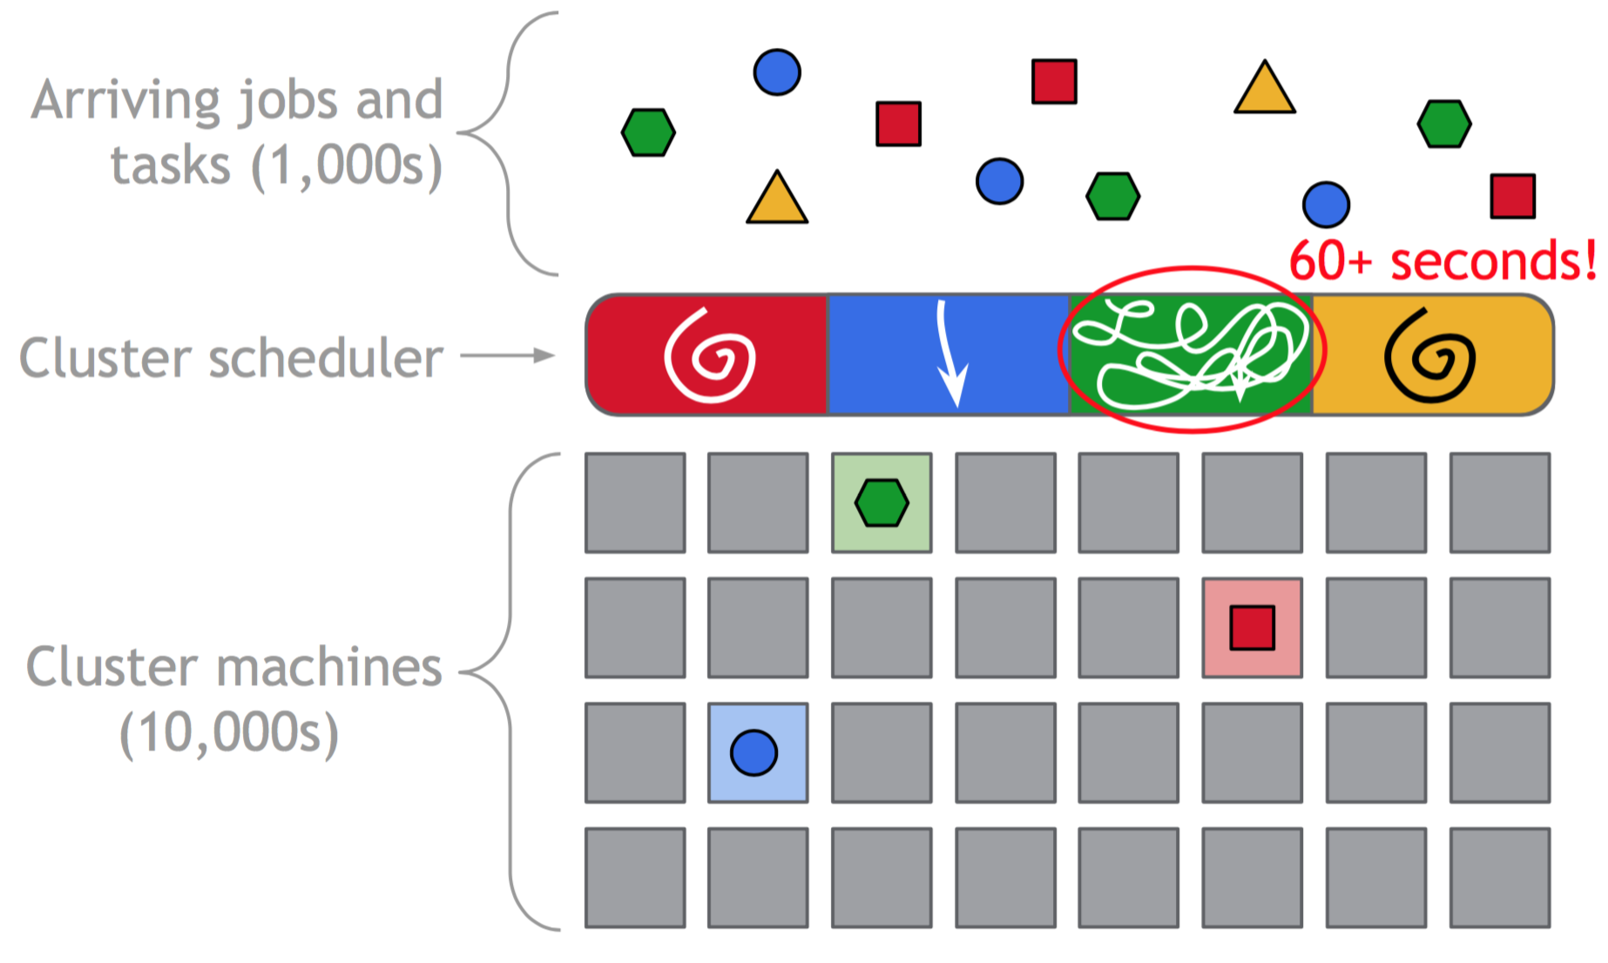
Why is it important to solve?

Slide 6
The actual problem
Increasing complexity!

Slide 7
Problem statement
1. Break up the cluster scheduler into independent schedulers
2. Arbitrate resources between schedulers

Slide 8
Existing solutions

Slide 9
Proposed solution: Omega

Slide 10
Example

Slide 11
Example

Slide 12
Example

Slide 13
Example
Conflict!

Slide 14
Example

Slide 15
Workload characterization
Most jobs are batch, but most resources are consumed by service jobs.

Slide 16
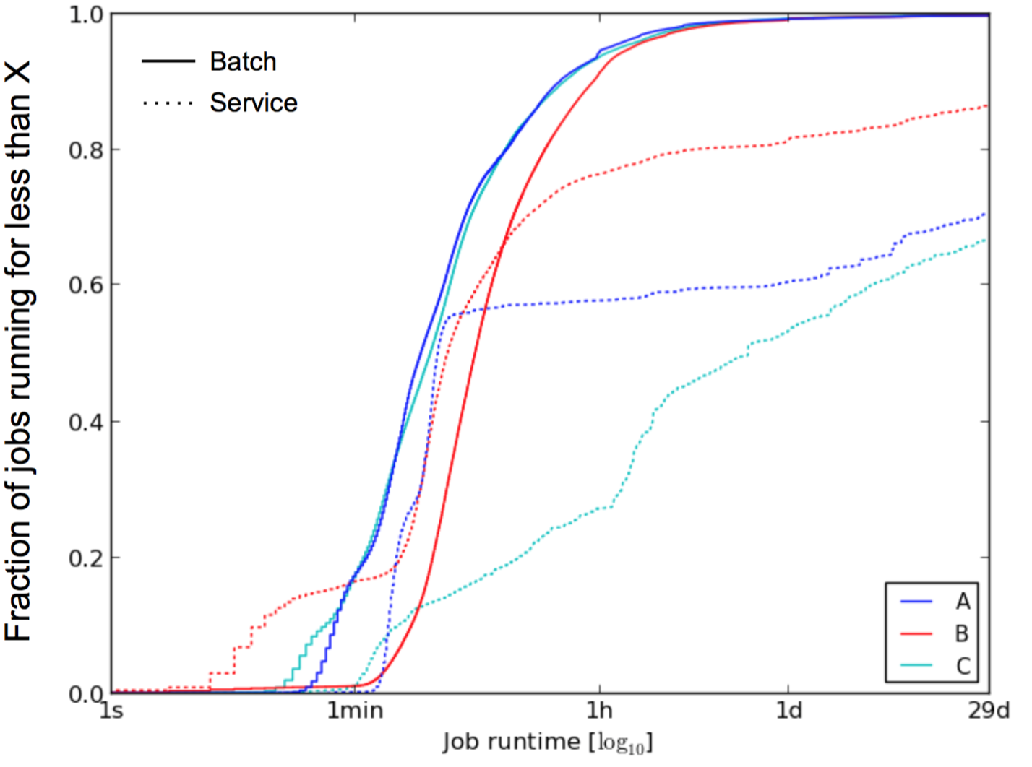
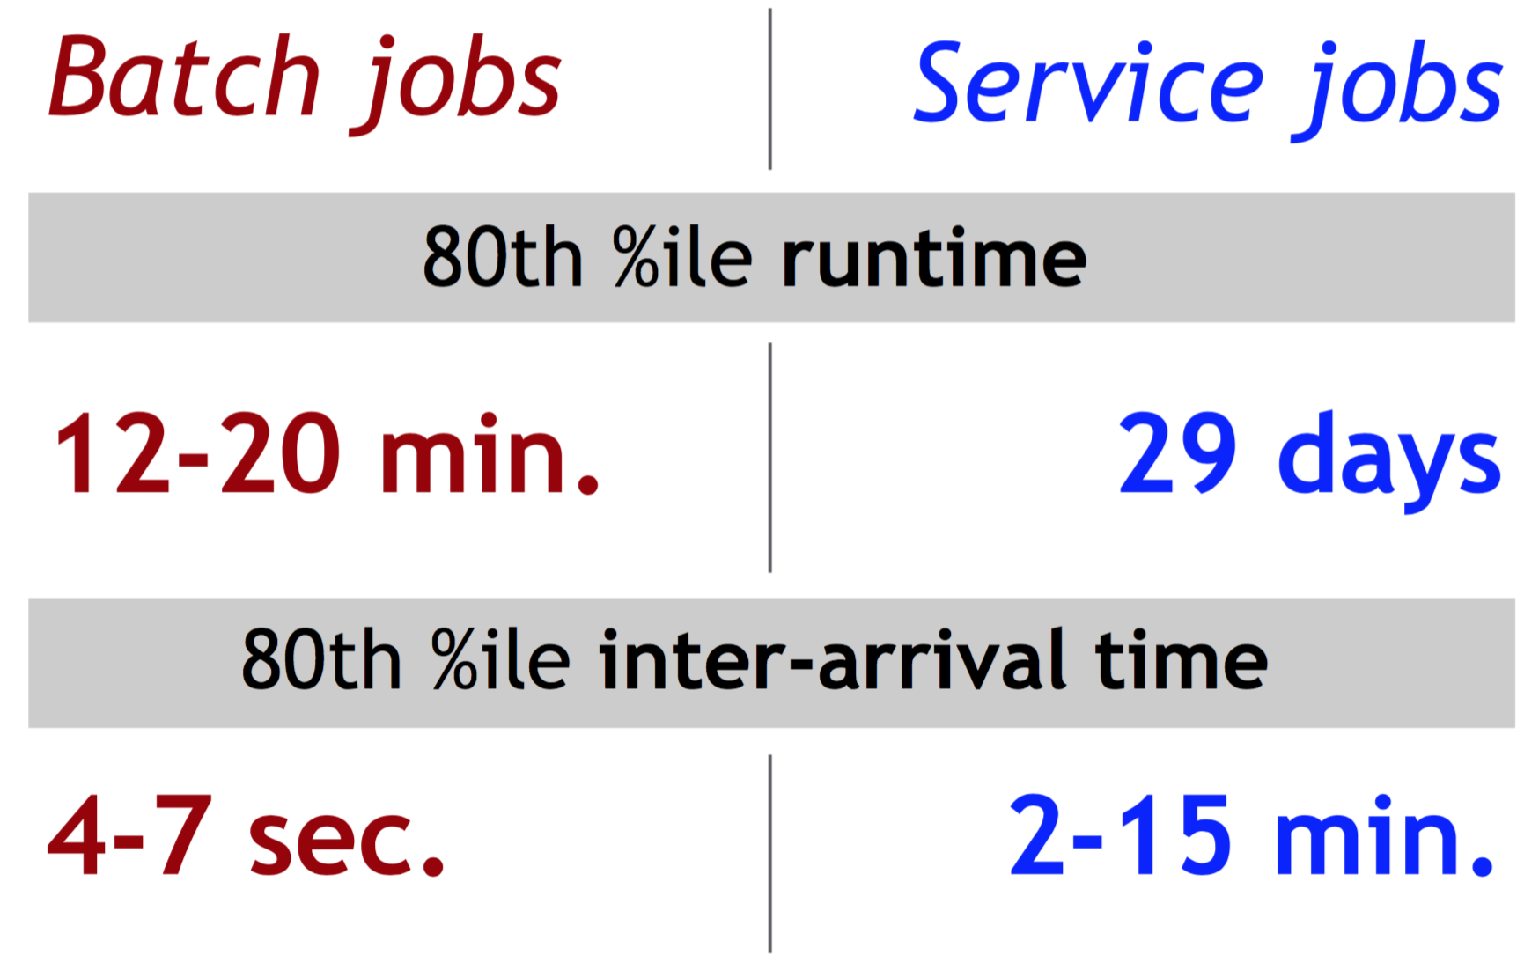
Workload characterization

Slide 17
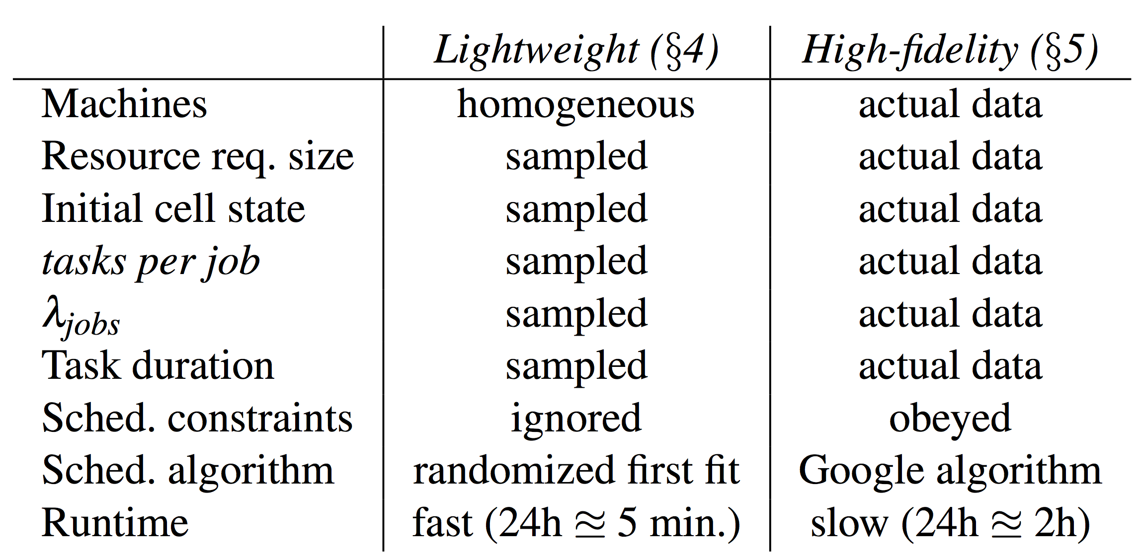
Comparison of approaches
Two Simulators
A lightweight simulator: Monolithic scheduler, Mesos, Omega
A high-fidelity simulator: Omega
Notes:
A high-fidelity simulator that replays historic workload traces from Google production clusters, and reuses much of the Google production scheduler’s code. This gives us behavior closer to the real system, at the price of only supporting the Omega architecture and running a lot more slowly than the lightweight simulator: a single run can take days.
While the high-fidelity simulator is driven by the actual workload traces, for the lightweight simulator we analyze the workloads to obtain distributions of parameter values such as the number of tasks per job, the task duration, the per-task resources and job inter-arrival times, and then synthesize jobs and tasks that conform to these distributions.

Slide 18
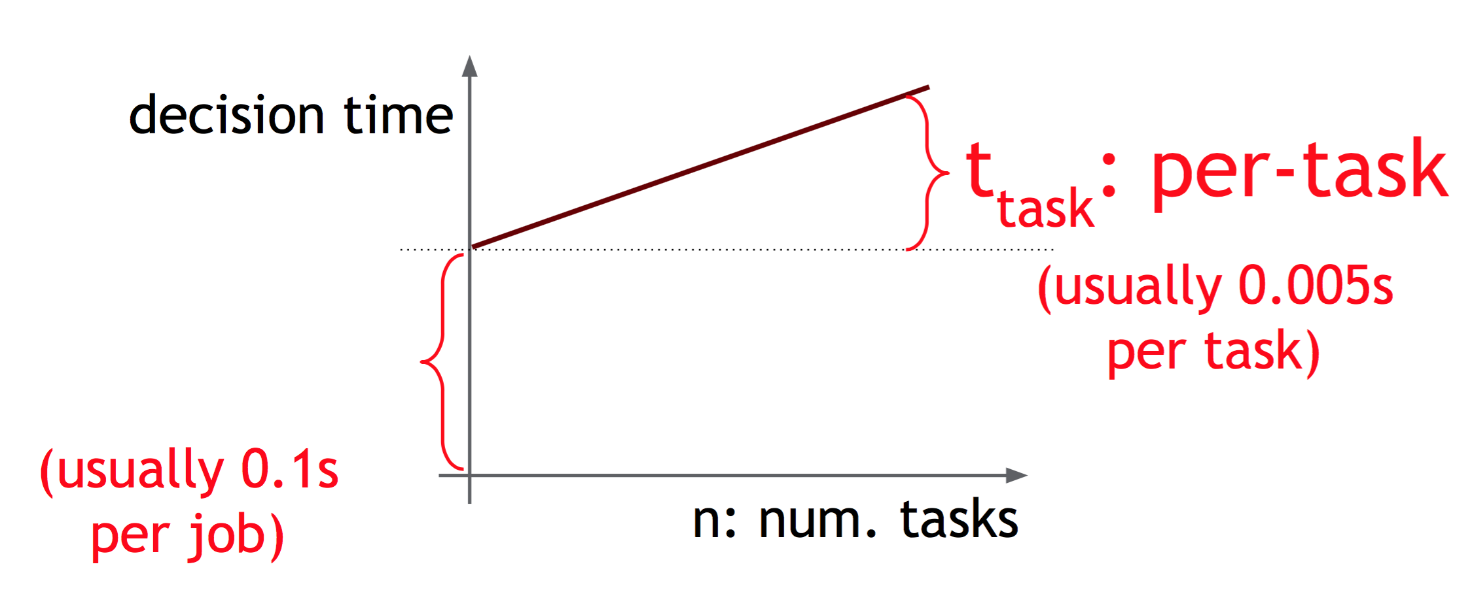
Parameters and Metrics
Schedule decision time
Metrics
Job wait time
Scheduler busyness
Conflict fraction
Notes:
Values for tjob and ttask are based on somewhat conservative estimates from measurements of our current production system’s behavior.
For the metrics:
job wait time: the difference between the job submission time and the beginning of the job’s first scheduling attempt
Scheduler busyness: the fraction of time in which the scheduler is busy making scheduling decisions
Conflict fraction: average number of conflicts per successful transaction
A value of 0 means no conflicts took place; a value of 3 indicates that the average job experiences three conflicts, and thus requires four scheduling attempts.

Slide 19
Experiment 1
Comparison in the lightweight simulator
Systems:
Monolithic, Mesos, Omega
Dataset: All clusters, 7 simulated days
Approach: varying service scheduler

Slide 20
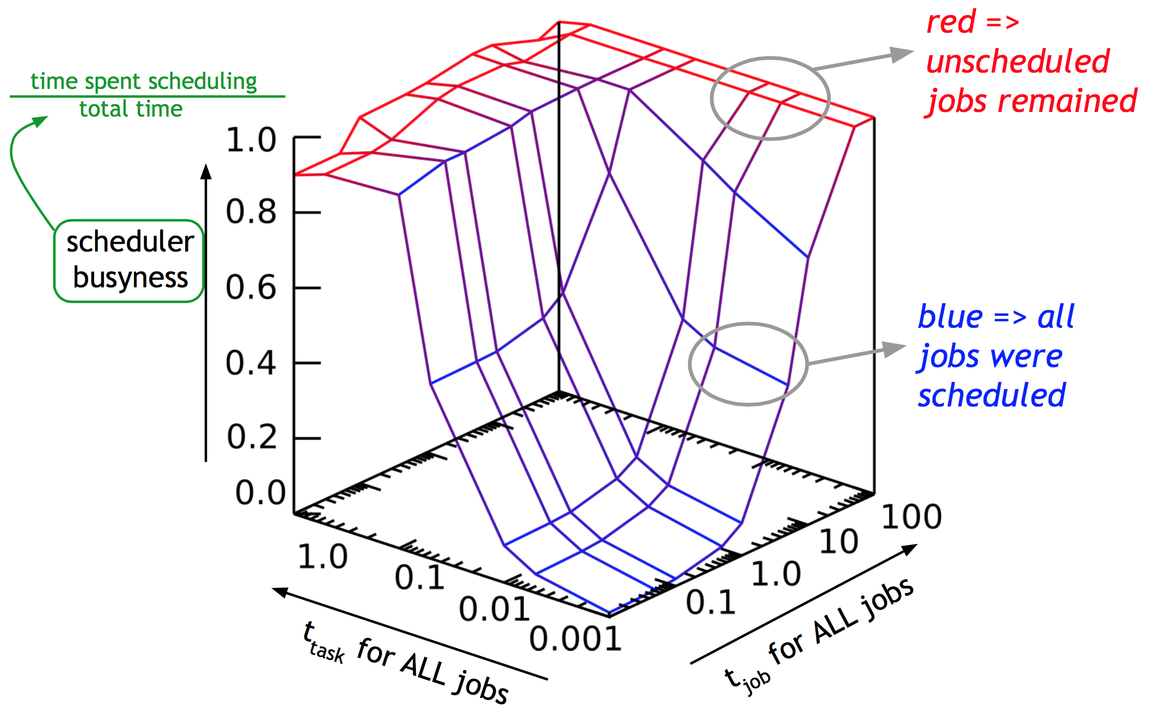
Monolithic - I
Uniform decision time (single logic)
Notes:
For monolithic scheduler, there are two mechanisms:
A single-path implementation: run same code for every job type
a multi-path monolithic scheduler: it still schedules only one job at a time, with a fast code path for batch jobs
The scheduler busyness is low as long as scheduling is quick, but scales linearly with increased tjob.
As a consequence, job wait time increases at a similar rate until the scheduler is saturated.

Slide 21
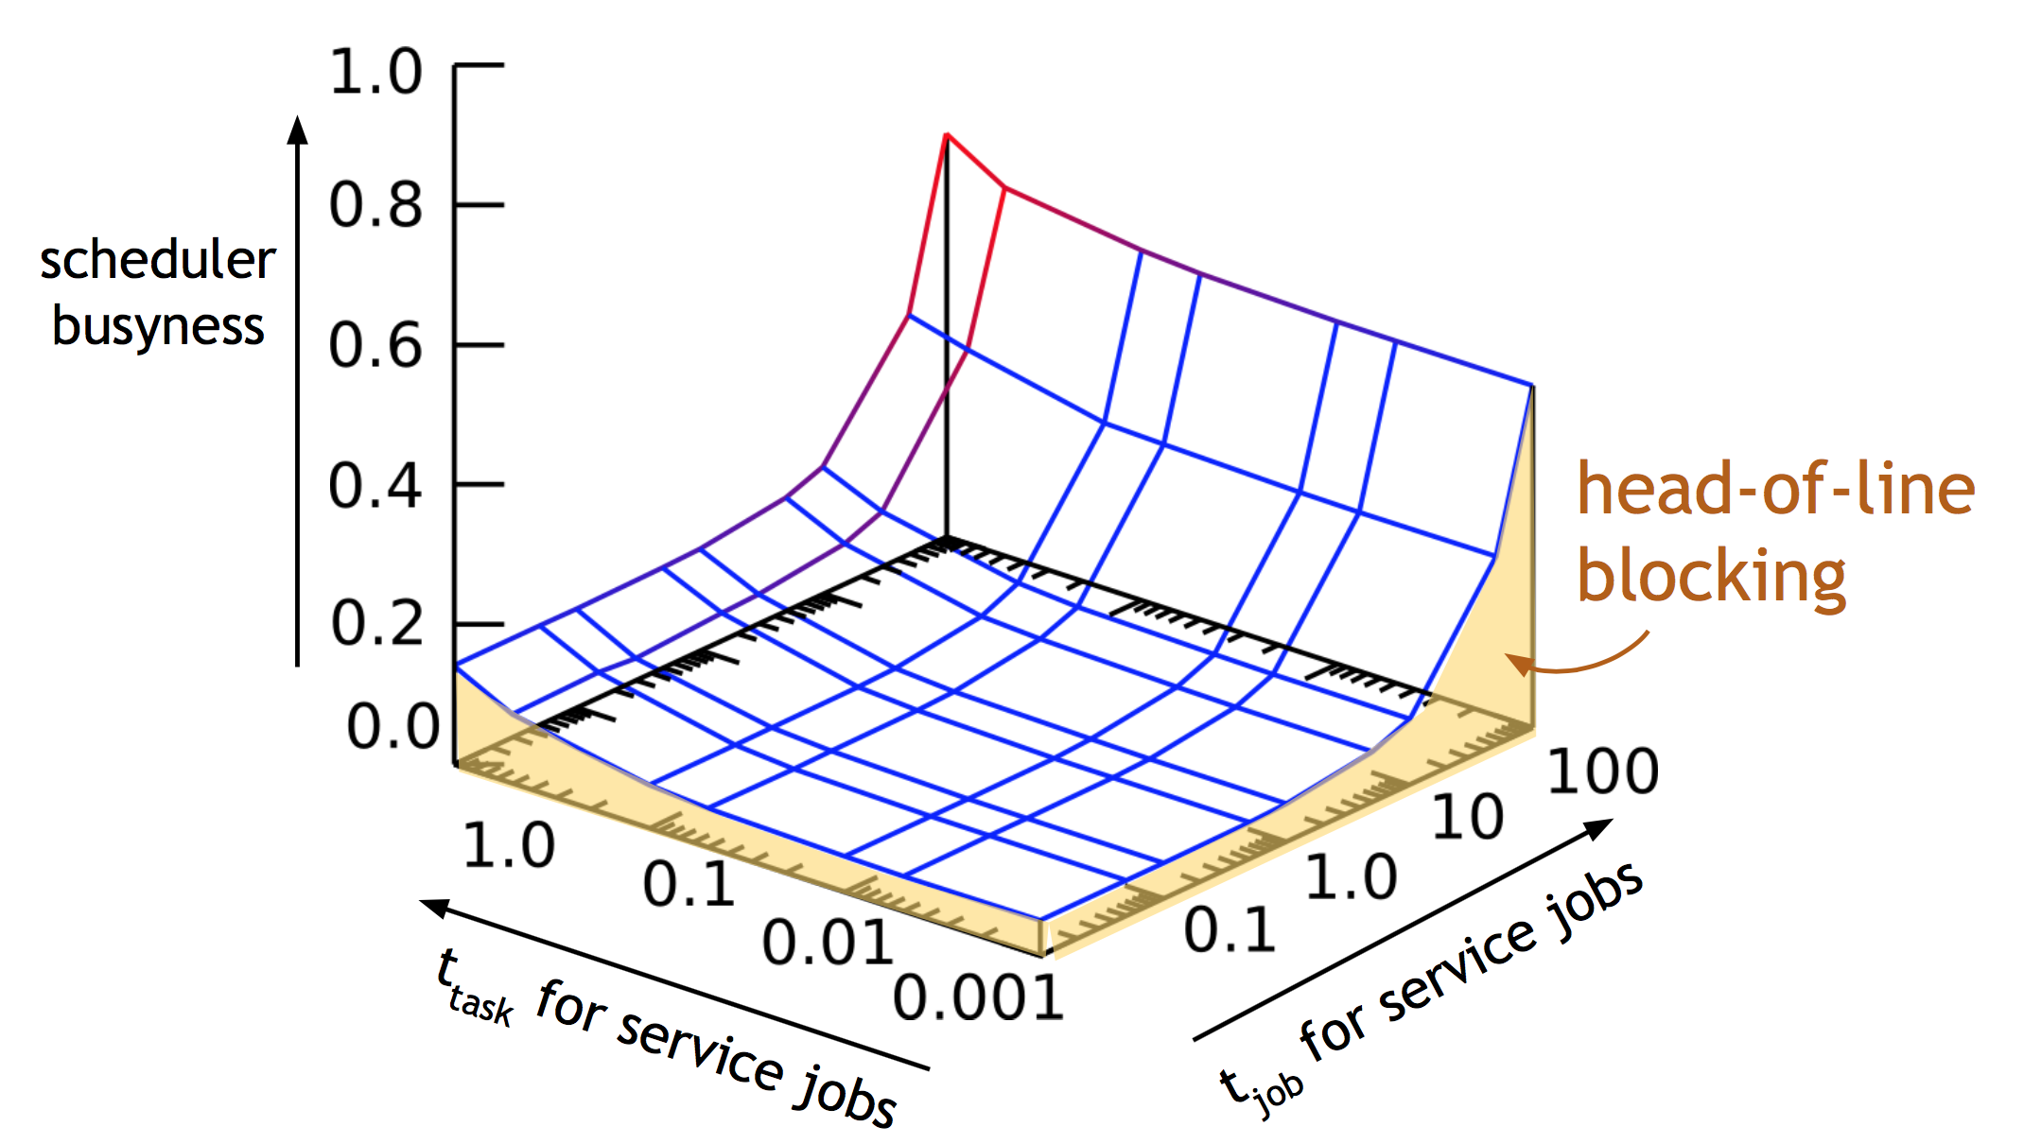
Monolithic - II
Fast-path batch decision time
Notes:
In the multi-path case, they split the workload into batch and service workloads and use the defaults for the batch scheduler decision time while they vary tjob (service).
a multi-path monolithic scheduler: it still schedules only one job at a time, with a fast code path for batch jobs
Both average job wait time and scheduler busyness decrease significantly even at long decision times for service jobs, since the majority of jobs are batch ones.
But batch jobs can still get stuck in a queue behind the slow-to-schedule service jobs, and head-of-line blocking occurs: scalability is still limited by the processing capacity of a single scheduler
Head-of-line blocking (HOL blocking) in computer networking is a performance-limiting phenomenon that occurs when a line of packets is held up by the first packet,

Slide 22
Mesos
Notes:
a single resource manager and two scheduler frameworks, one handling batch jobs and one handling service jobs.
They assume that a scheduler only looks at the set of resources available to it when it begins a scheduling attempt for a job. (i.e., any offers that arrive during the attempt are ignored).
Resources not used at the end of scheduling a job are returned to the allocator; they may be re-offered again if the framework is the one furthest below its fair share.
They keep the decision time for the batch scheduler constant, and vary the decision time for the service scheduler by adjusting t (service). Job.

Slide 23
Mesos
Notes:
Mesos achieves fairness by alternately offering all available cluster resources to different schedulers, predicated on assumptions that resources become available frequently and scheduler decisions are quick. As a result, a long scheduler decision time means that nearly all cluster resources are locked down for a long time, inaccessible to other schedulers.
The only resources available for other schedulers in this situation are the few becoming available while the slow scheduler is busy. These are often insufficient to schedule an above-average size batch job, meaning that the batch scheduler cannot make progress while the service scheduler holds an offer.
Reason: Mesos’s assumption of quick scheduling decisions, small jobs and high resource churn, which do not hold for our service jobs.

Slide 24
Omega - I
Notes:
In the lightweight simulator:
one handling the batch workload, one handling the service workload.

Slide 25
Omega - II
Notes:
In high-fidelity simulator. It does not model machine failures (as these only generate a small load on the scheduler); it does not model the disparity between resource requests and the actual usage of those resources in the traces.
Dealing with conflicts:
coarse-grained conflict detection, a scheduler’s placement choice would be rejected if any changes had been made to the target machine since the local copy of cell state was synchronized at the beginning of the transaction.
all-or-nothing scheduling, an entire cell state transaction would be rejected if it would cause any machine to be over-committed.
gang scheduling is a scheduling algorithm for parallel systems that schedules related threads or processes to run simultaneously on different processors.

Slide 26
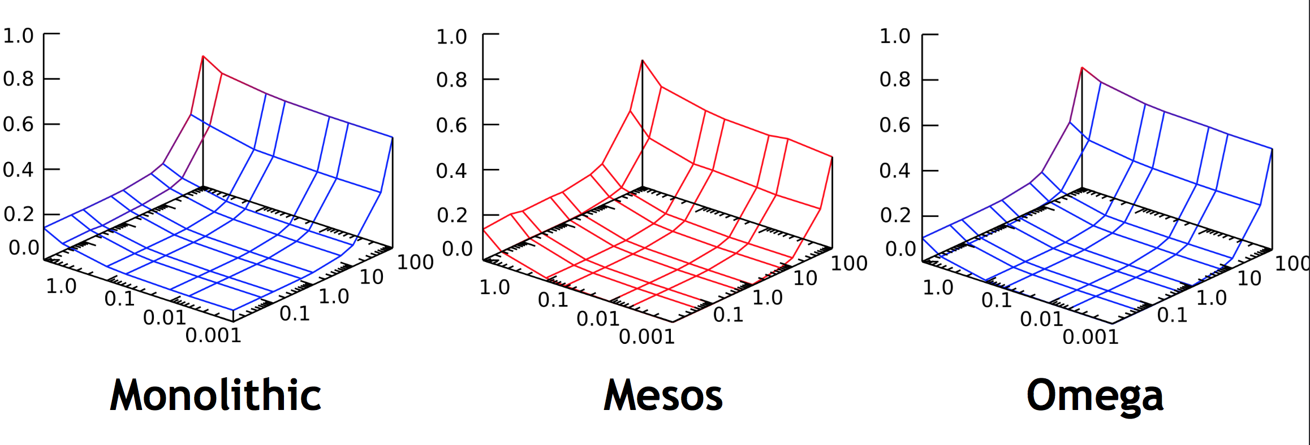
Experiment 1 - summary
The Omega shared-state model performs as well as a (complex) monolithic multi-path scheduler.
Notes:
In short, the monolithic scheduler is not scalable. Although adding the multi-path feature reduces the average scheduling decision time, head-of-line blocking is still a problem for batch jobs, and means that this model may not be able to scale to the workloads we project for large clusters. The two-level model of Mesos can support independent scheduler implementations, but it is hampered by pessimistic locking, does not handle long decision times well, and could not schedule much of the heterogeneous load we offered it.
The shared-state Omega approach seems to offer competitive, scalable performance with little interference at realistic operating points, supports independent scheduler implementations, and exposes the entire allocation state to the schedulers.

Slide 27
Experiment 2
Scalability of Shared - state design
Dataset: cluster B, 7 simulated days
System: Omega
Approaches: varying job arrival rate and number of schedulers

Slide 28
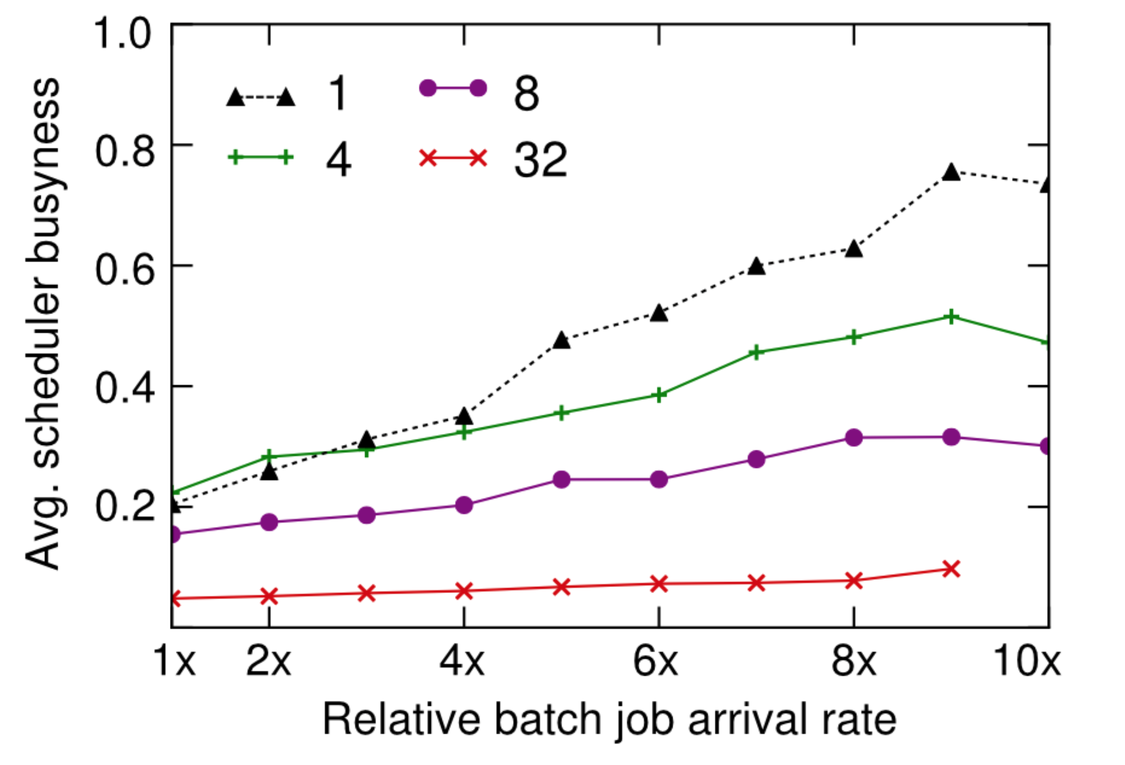
Experiment 2 - summary
Omega is scalable to many schedulers

Slide 29
Case study
11
200
“data from a month’s worth of MapReduce jobs run at Google showed that frequently observed values were 5, 11, 200 and 1,000 workers.”

Slide 30
Case study
“…number of workers could be chosen automatically if additional resources were available, so that jobs could complete sooner"

Slide 31
Conclusion
1. Optimistic concurrency over shared state is a viable, attractive approach to cluster scheduling (as shown with Google’s workloads)
2. More work to be re-done to resolve the conflicts, but it’s a price worth paying for the parallelism and scalability
3. Visibility in global state allows specialized scheduler design

Slide 32
Discussions
1. Jobs are divided into roughly two categories: batch and service
2. Compatibility with non-Google workloads (i.e. short-lived) is unclear
3. Fairness and starvation barely studied
4. Scalability in terms of many different types of schedulers is unclear
5. The frequency of cell state update: overhead vs. # of conflicts
5. Global optimality

Slide 33
Backup slides

Slide 34
Experiment 3
Scheduler interference in real Google workloads
Dataset: cluster C, 29 days, high-fidelity simulator
System:
Omega: two schedulers, non-uniform decision time
Approach: varying service scheduler

Slide 35
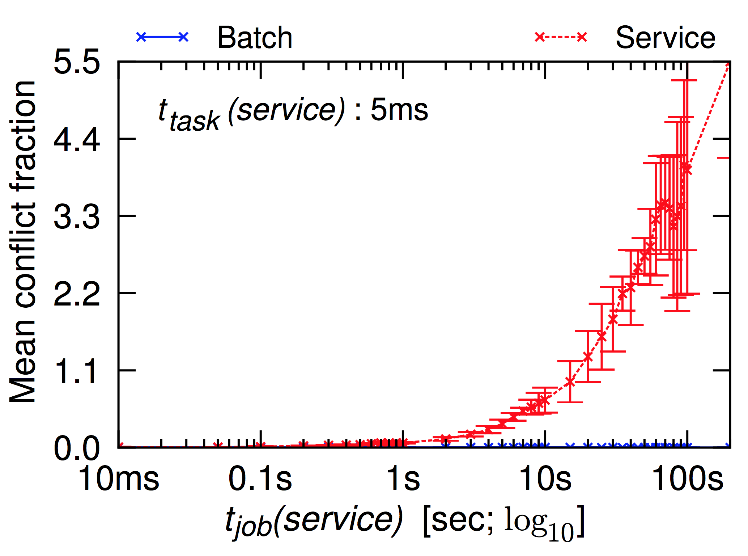
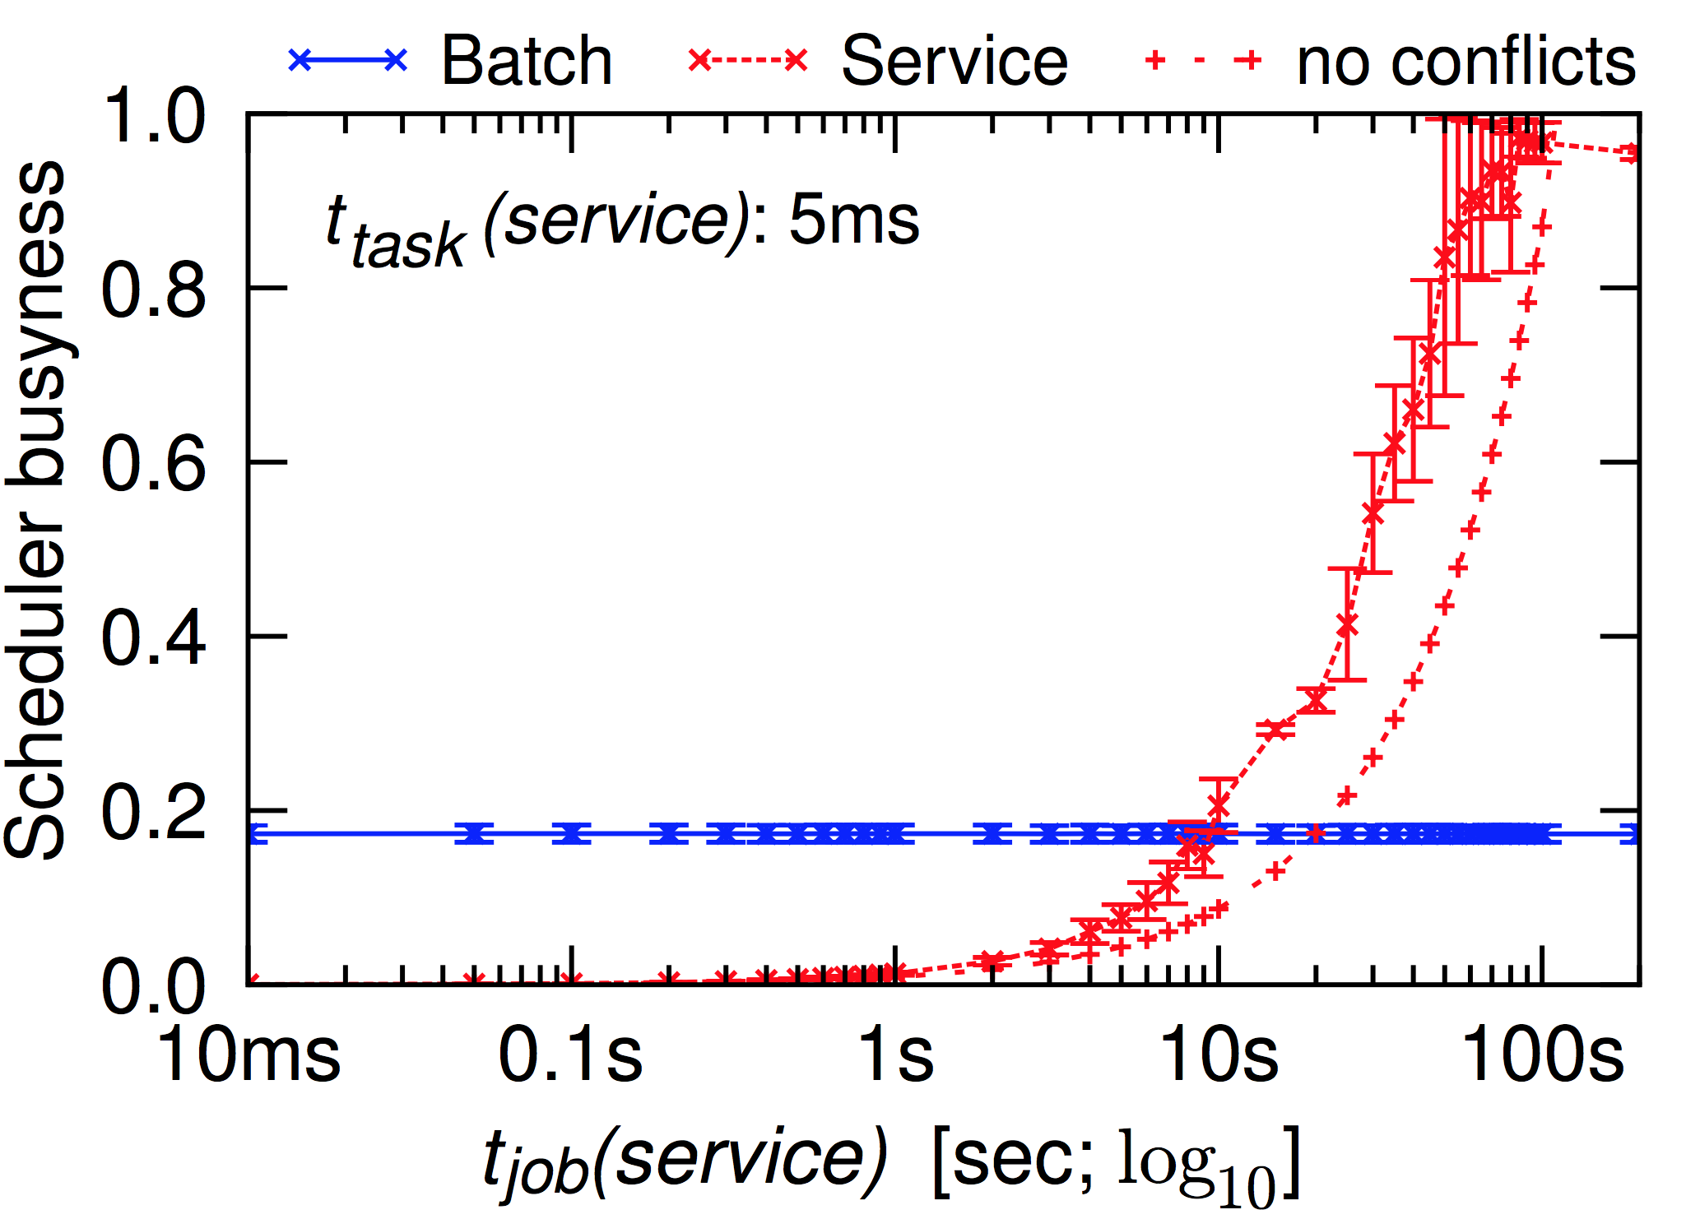
Experiment 3 - summary
Interference is higher for real-world settings.
Conflict fraction
Scheduler busyness

Slide 36
Experiment 4
Deal with conflicts
Dataset: cluster C, 29 days, high-fidelity simulator
System:
Omega
Approach: varying scheduling methods

Slide 37
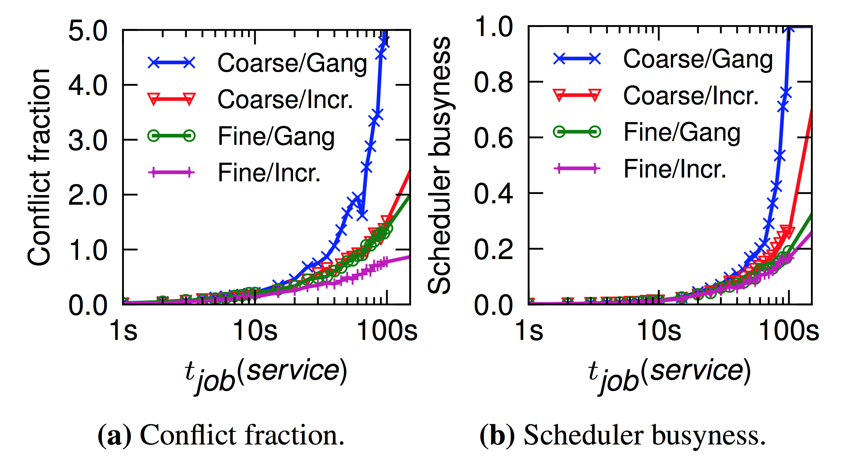
Experiment 4 - summary
Default: Incremental transactions with fine grain conflicted detection

