Slide 1
Mesos: A Platform for Fine-Grained Resource Sharing in the Data Center
NSDI 11’
Benjamin Hindman, Andy Konwinski, Matei Zaharia,
Ali Ghodsi, Anthony D. Joseph, Randy Katz, Scott Shenker, Ion Stoica
Presented by Youngmoon Lee

Slide 2
Agenda
Introduction
Problem statement
Design
Results
Discussion
Real world Mesos

Slide 3
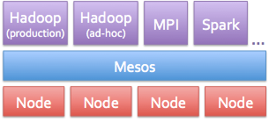
A cluster manager that provides resource sharing and isolation across cluster frameworks, Hadoop, Spark, MPI.
Datacenter OS, even shorter

Slide 4
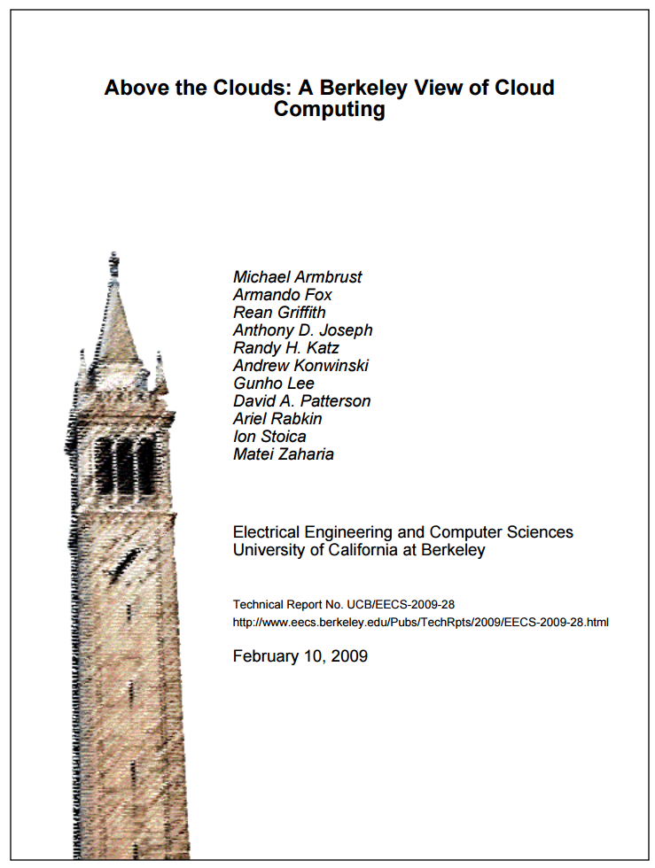
Background
[2009] A Berkeley view of Cloud Computing
[2009] Nexus: Common substrate for Cloud
[2011] Mesos: Fine-grained resource sharing
[2011] DRF: Dominant Resource Fairness
[2013] YARN
[2013] Omega
[2015] Borg

Slide 5
Introduction
Want to run different frameworks in a single cluster
Static partitioning: No sharing

Slide 6
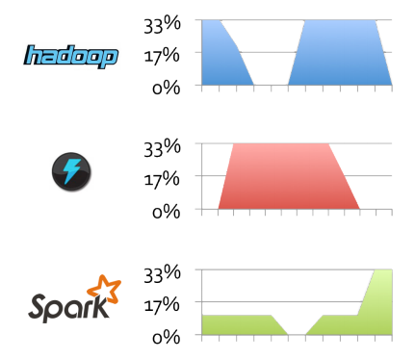
Problem
Required resource is different for frameworks: under-utilization
time
Static assignment
time
time

Slide 7
Problem
Required resource is different for frameworks: under-utilization
time
time
time

Slide 8
Solution

Slide 9
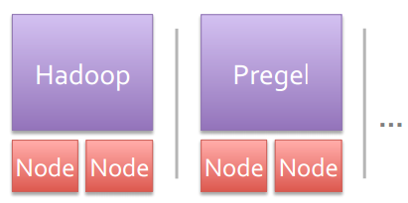
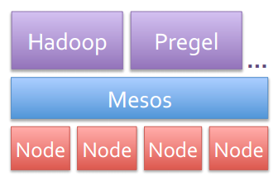
Solution

Slide 10
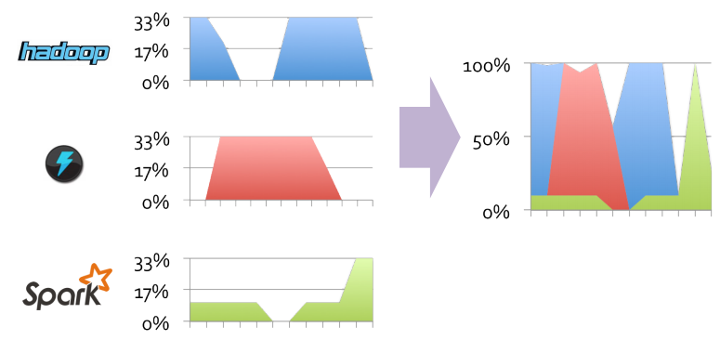
Objective
Dynamic sharing and management of resources
Utilization( and scalability

Slide 11
Design
Objectives
Design
Concern
Implementation
Micro-kernel pushes scheduling logic to frameworks “Minimal resource multiplexer (two-level)”
Utilization!
Task-level
Fine-grained sharing
Performance
Isolation?
Containers
Scalability!
Resource offers
“Let framework pick”
Fairness?
Max-min fairness[DRF}
Revoke resource

Slide 12
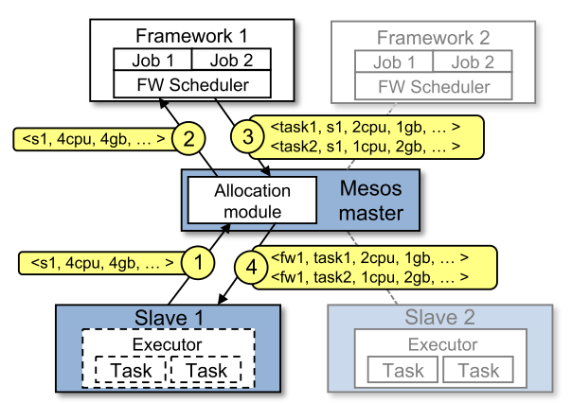
Resource offer
Free!
Notes:
master-slave Two level mechanism

Slide 13
Resource offer
Suit yourself

Slide 14
Resource offer

Slide 15
Resource offer

Slide 16
Resource offer
Suit yourself
<s1, 1cpu, 1gb, … >
5
So harmonious, yet…
Notes:
Looks very harmonious

Slide 17
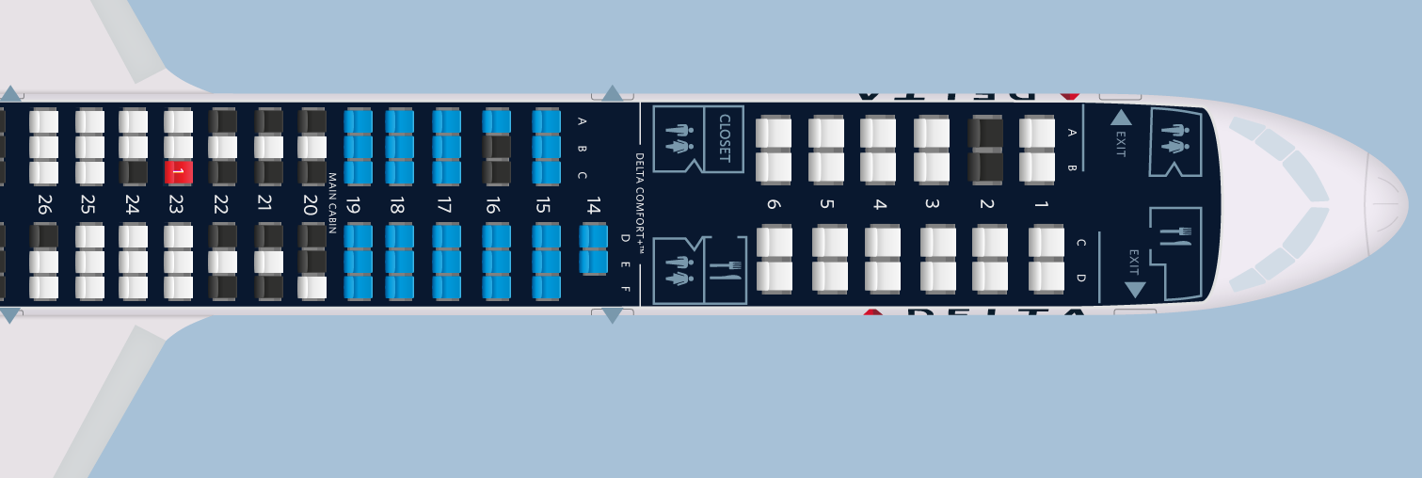
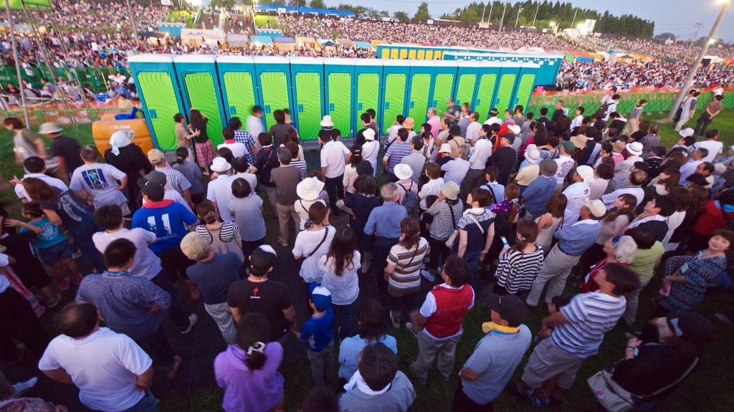
Hypothesis
Tasks are short-lived returning resources frequently
All long running, no resource return, No sharing?
Job sizes are small compared to the size of cluster
Most of time
0 CPU remains
Notes:
Relatively harmonious check-in process
Hectic toilet suage
If toilet attendance checks your ticket and allocate the toilet, you would get mad
Become queueing theory

Slide 18
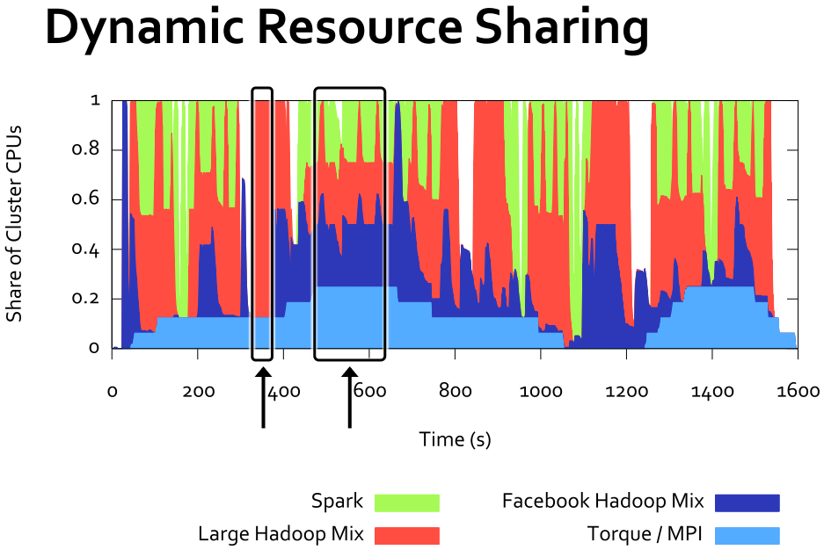
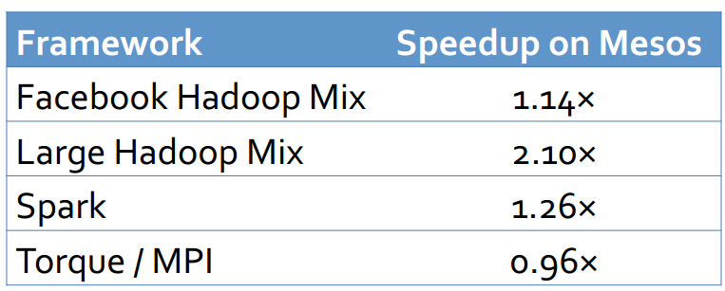
Results
Static resource sharing
vs

Slide 19
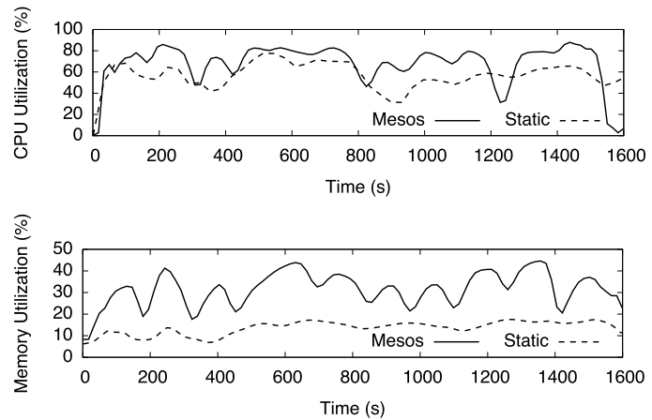
CPU/Memory Utilization
CPU 10%, Memory 17% Improves

Slide 20
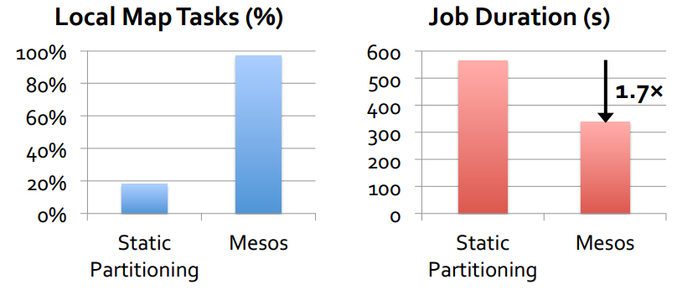
Resource offer
Hadoop finds better data-locality with resource offers

Slide 21
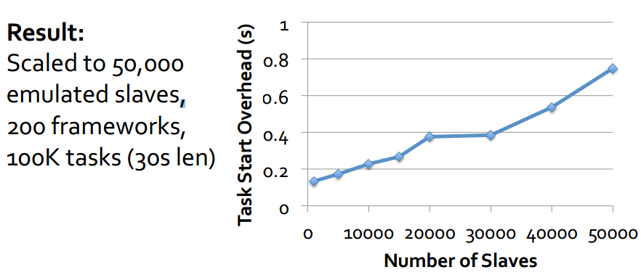
Scalability
Simple inter-framework scheduling micro-kernel
10%
Note: 10 s task
8%
6%
4%
2%
0%
Number of Nodes

Slide 22
Discussion
Max-min fairness allocation? Framework Starvation? Malicious Framework? Lottery/stride scheduling? Omega?
0 CPU
50000 CPU

Slide 23
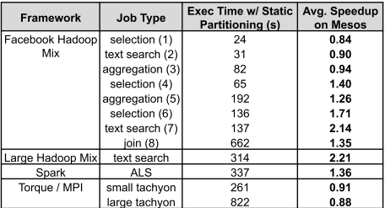
Discussion
MPI becomes slower, how to handle resource contention? MPI interdependency affects performance?
934 s ∆=112 s

Slide 24
Discussion
Overhead of 8% for 50K nodes? For 10% utilization gain?
10 s tasks takes 11 s start time increases with resource requirements?
10%
Note: 10 s task
8%
6%
4%
2%
0%

Slide 25
enterprise
Long running service
Fault tolerant Cron-like system
PaaS

Slide 26
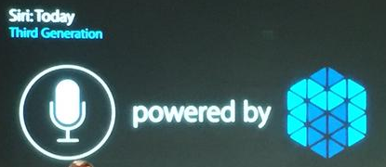
Enterprise Consulting
Long running service
Fault tolerant Cron-like system
PaaS

Slide 27
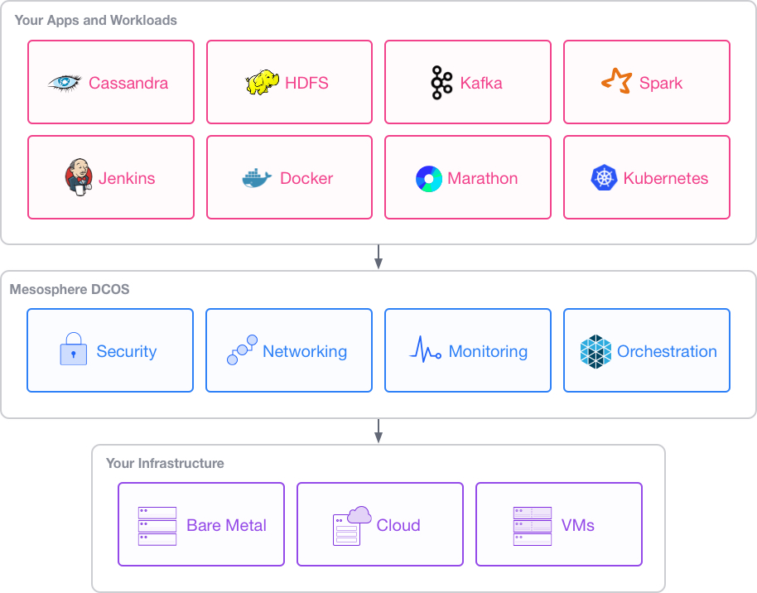
“Datacentre OS”

Slide 28
Original motivation
Originally, Mesos built to run different version of Hadoop
If it’s useful, also can be useful for many things
v1
v2
v3

Slide 29
Thank you

Slide 30
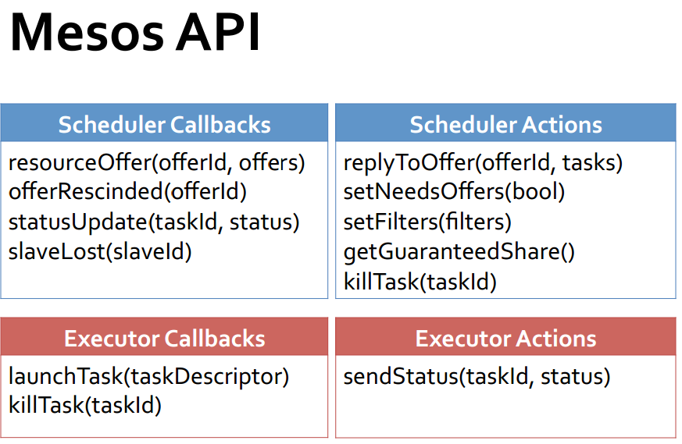

Slide 31
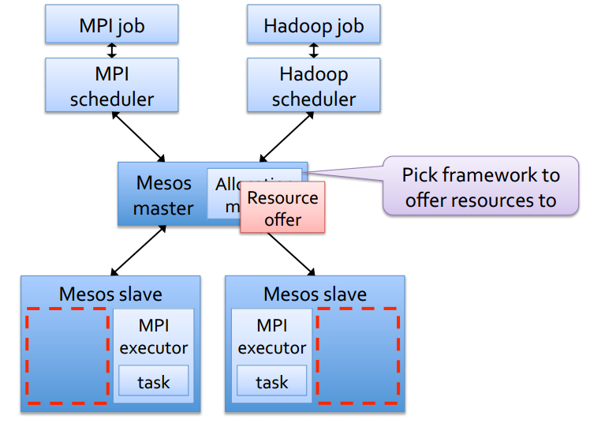
Resource offers

Slide 32
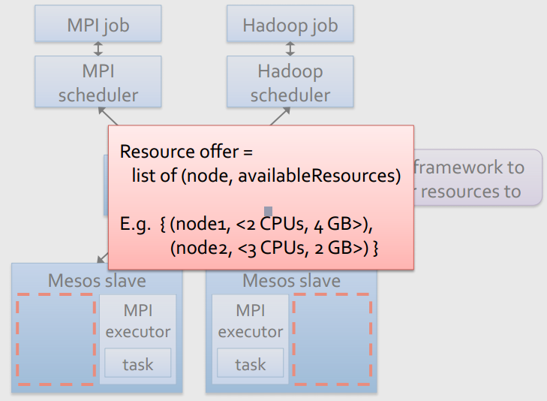
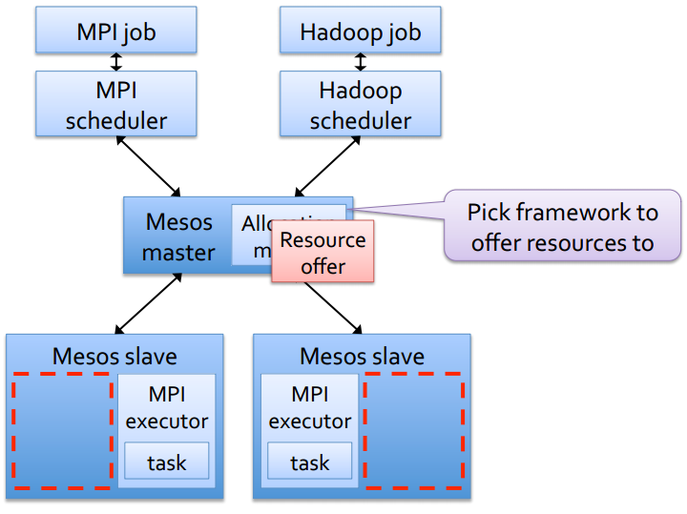
Resource offers

Slide 33
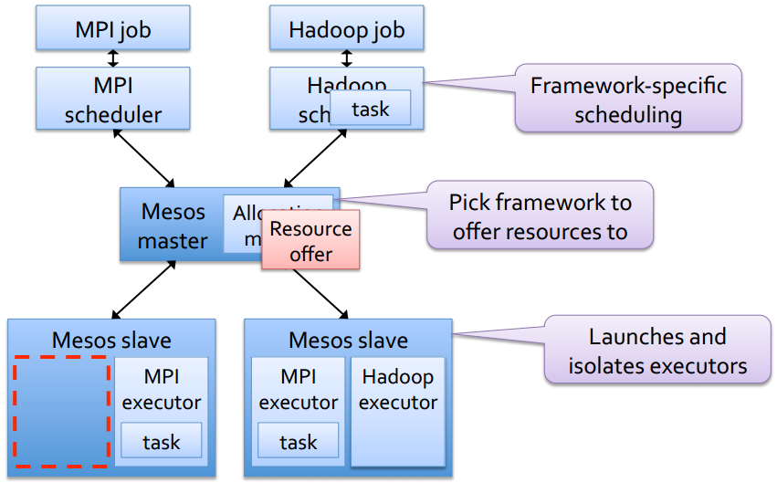
Resource offers

