Slide 1
Resilient Distributed Datasets
A Fault-Tolerant Abstraction for In-Memory Cluster Computing
Matei Zaharia, Mosharaf Chowdhury, Tathagata Das, Ankur Dave, Justin Ma, Murphy McCauley, Michael J. Franklin, Scott Shenker, Ion Stoica
University of California, Berkeley
Presented by Qi Gao, adapted from Matei’s NSDI’12 presentation

Slide 2
Overview
A new programming model (RDD)
parallel/distributed computing
in-memory sharing
fault-tolerance
An implementation of RDD: Spark

Slide 3
Motivation
MapReduce greatly simplifies “big data” analysis on large, unreliable clusters
Simple interface: map and reduce
Hides the details of parallelism, data partition, fault-tolerance, load-balancing...
Problems
cannot support complex applications efficiently
cannot support interactive applications efficiently
Root cause
Inefficient data sharing
In MapReduce, the only way to share data across jobs is stable storage -> slow!

Slide 4
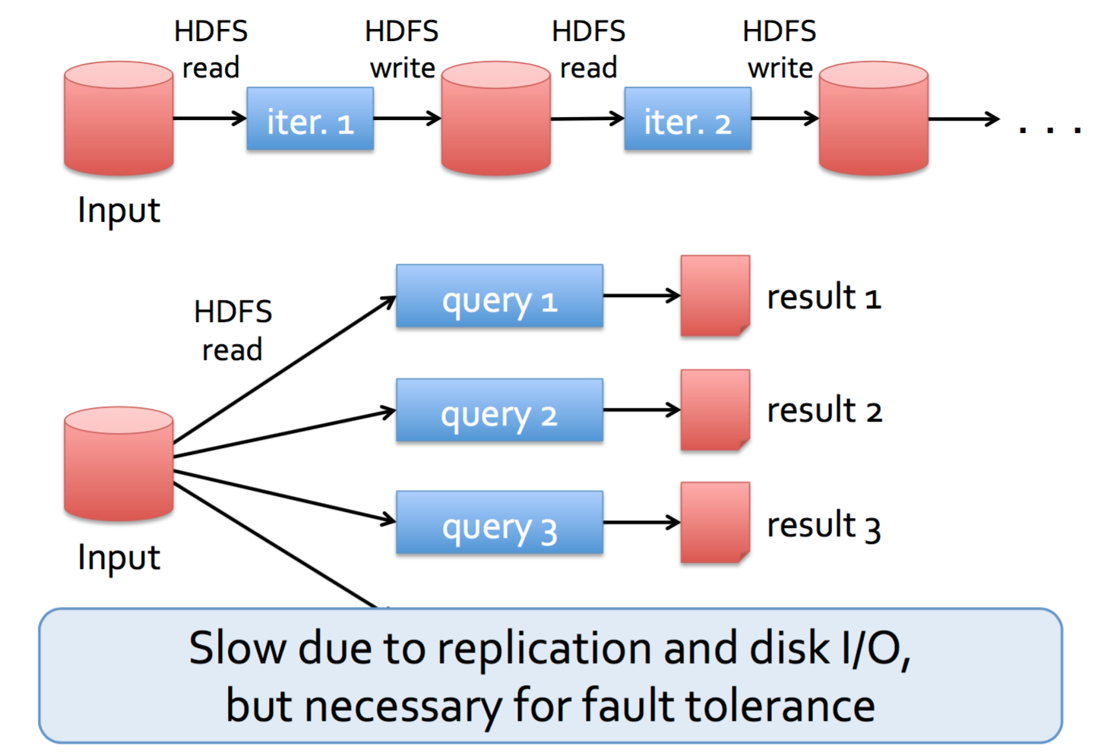
Motivation

Slide 5
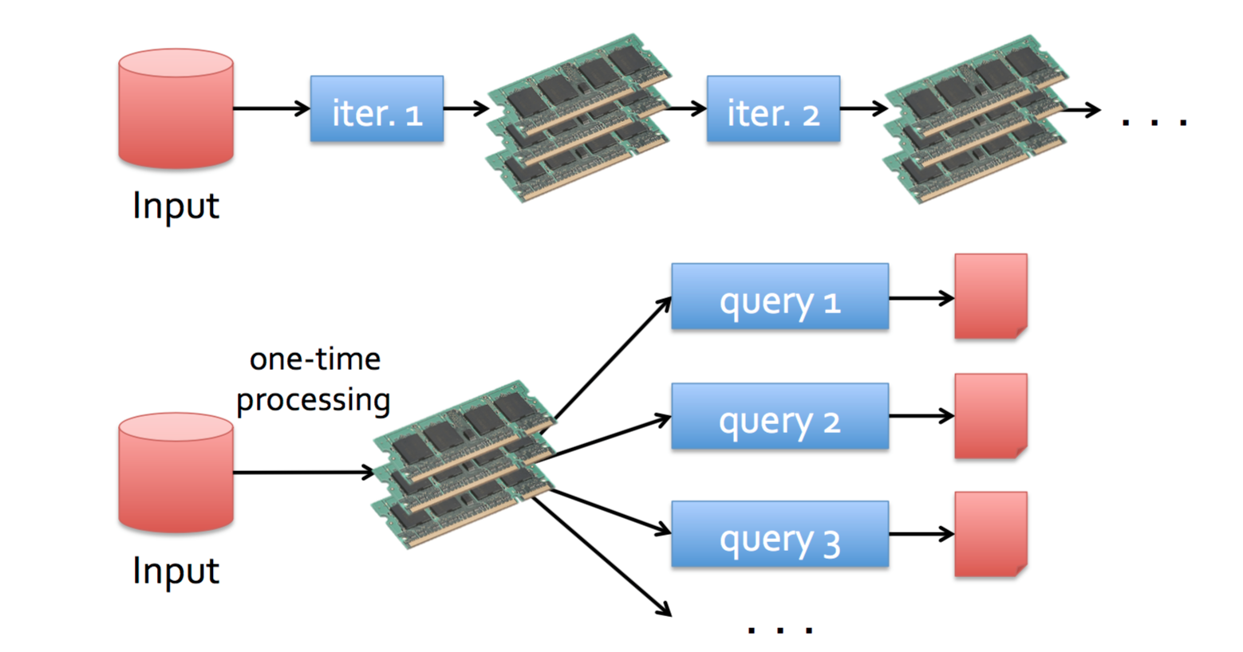
Goal: In-Memory Data Sharing

Slide 6
Challenges
10-100x faster than network/disk, but how to achieve fault-tolerance efficiently?
Data replication?
Log fine-grained updates to mutable states?
Network bandwidth is scarce resource
Disk I/O is slow
Costly for data-intensive apps

Slide 7
Observation
Coarse-grained operation:
In many distributed computing, same operation is applied to multiple data items in parallel

Slide 8
RDD Abstraction
Restricted form of distributed shared memory
immutable, partitioned collection of records
can only be built through coarse-grained deterministic transformations (map, filter, join...)
Efficient fault-tolerance using lineage
Log coarse-grained operations instead of fine-grained data updates
An RDD has enough information about how it’s derived from other dataset
Recompute lost partitions on failure
Notes:
Immutable: guarantees consistency, and makes backup jobs easy to mitigate stragglers

Slide 9
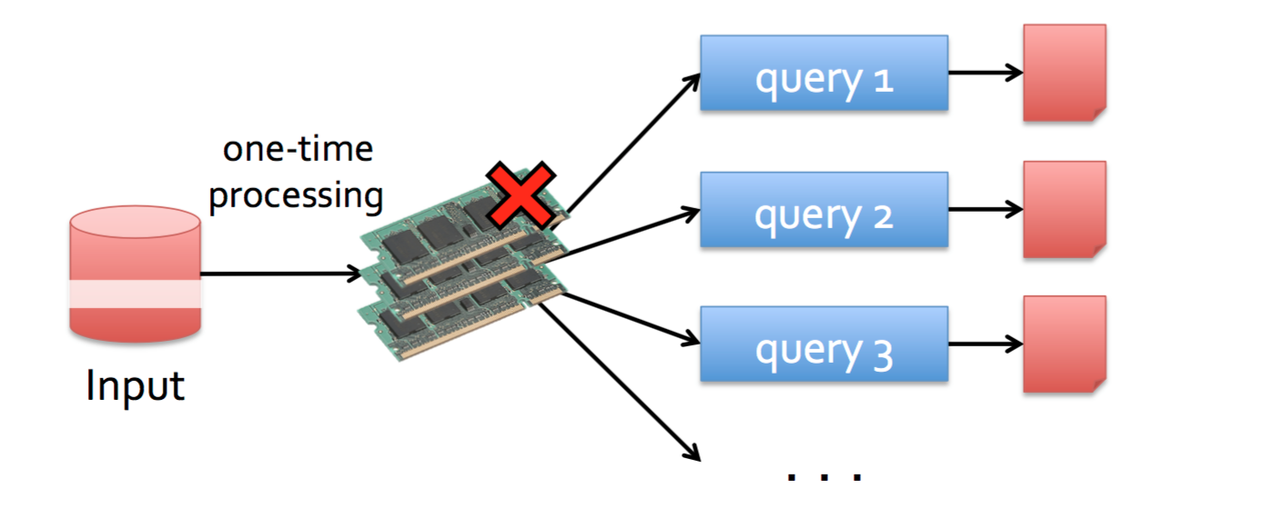
Fault-tolerance

Slide 10
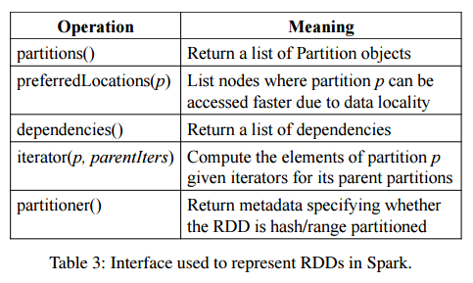
Spark
Implements Resilient Distributed Datasets (RDDs)
Operations on RDDs
Transformations: defines new dataset based on previous ones
Actions: starts a job to execute on cluster
Well-designed interface to represent RDDs
Makes it very easy to implement transformations
Most Spark transformation implementation < 20 LoC

Slide 11
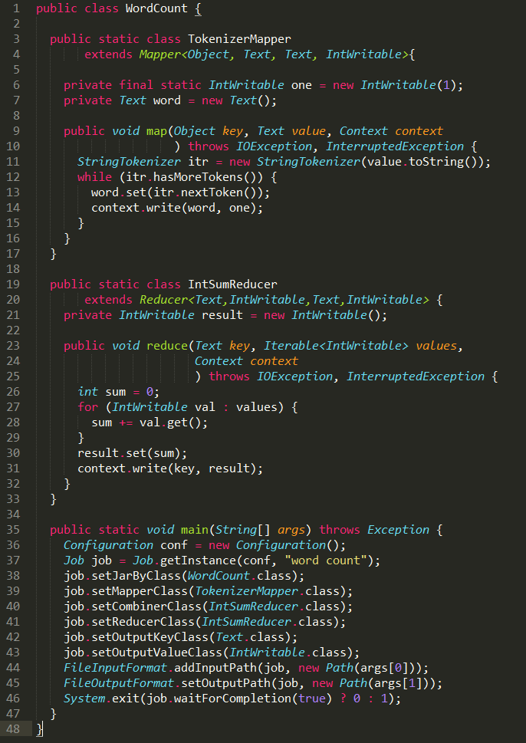
Simple Yet Powerful
WordCount Implementation: Hadoop vs. Spark
Pregel: iterative graph processing, 200 LoC using Spark
HaLoop: iterative MapReduce, 200 LoC using Spark

Slide 12
Spark Example: Log Mining
Load error messages from a log into memory and run interactive queries
base RDD
lines = spark.textFile("hdfs://...")
errors = lines.filter(_.startsWith("ERROR"))
transformation
errors.persist()
action!
errors.filter(_.contains("Foo")).count()
errors.filter(_.contains("Bar")).count()
Master
Worker
Result: full-text search on 1TB data in 5-7sec vs. 170sec with on-disk data!
Worker

Slide 13
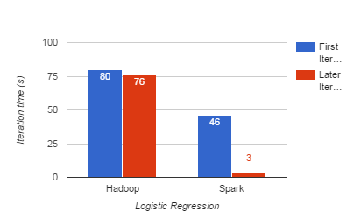
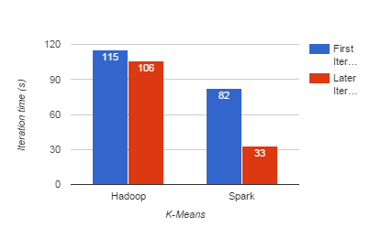
Evaluation
10 iterations on 100GB data using 25-100 machines
Notes:
Gain on first iteration: Hadoop heartbeat protocol between master and workers

Slide 14
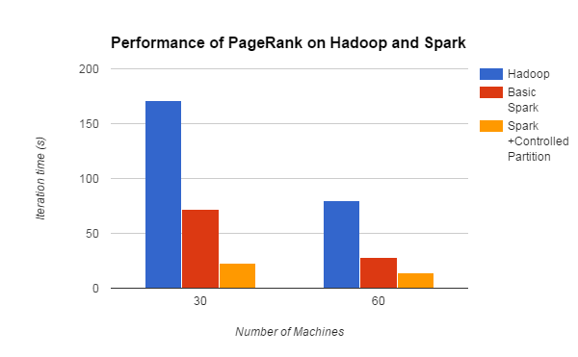
Evaluation
10 iterations on 54GB data with approximately 4M articles
7.4x
2.4x
Notes:
54GB wikipedia webpages, ~ 4M articles; 10 iterations;

Slide 15
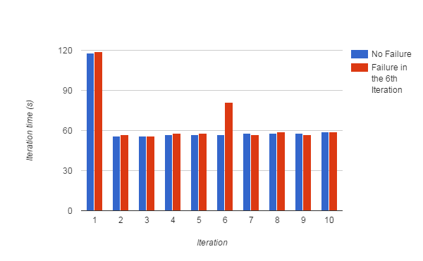
Evaluation
running time for 10 iterations of k-means on 75 nodes, each iteration contains 400 tasks on 100GB data
Notes:
running times for 10 iterations of k-means application on 75-node
each iteration consists of 400 tasks working on 100GB data

Slide 16
Conclusion
RDDs offer a simple yet efficient programming model for a broad range of distributed applications
RDDs provides outstanding performance and efficient fault-tolerance

Slide 17
Thank you!

Slide 18
Backup

Slide 19
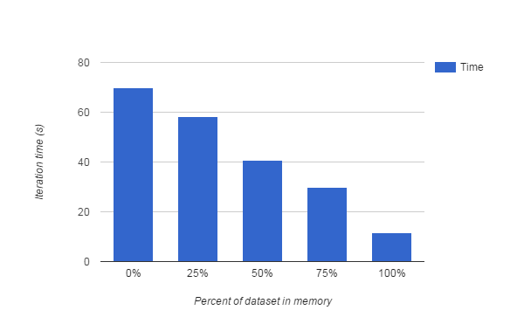
Evaluation
Performance of logistic regression using 100GB data on 25 machines

Slide 20
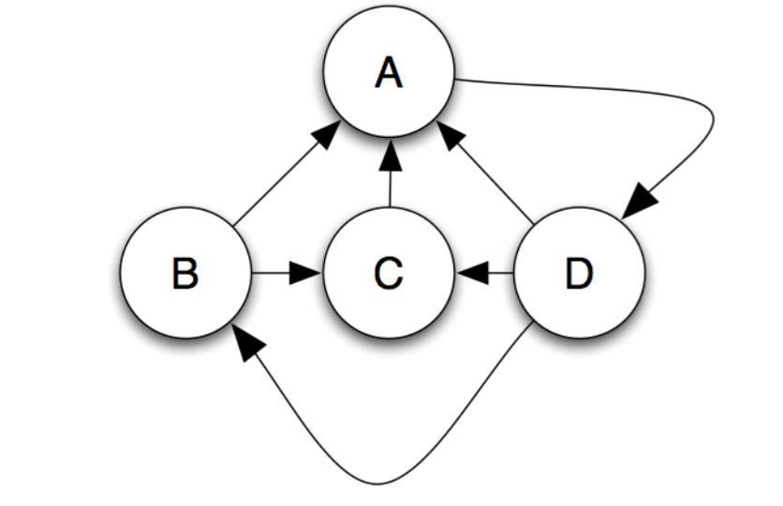
Example: PageRank

Slide 21
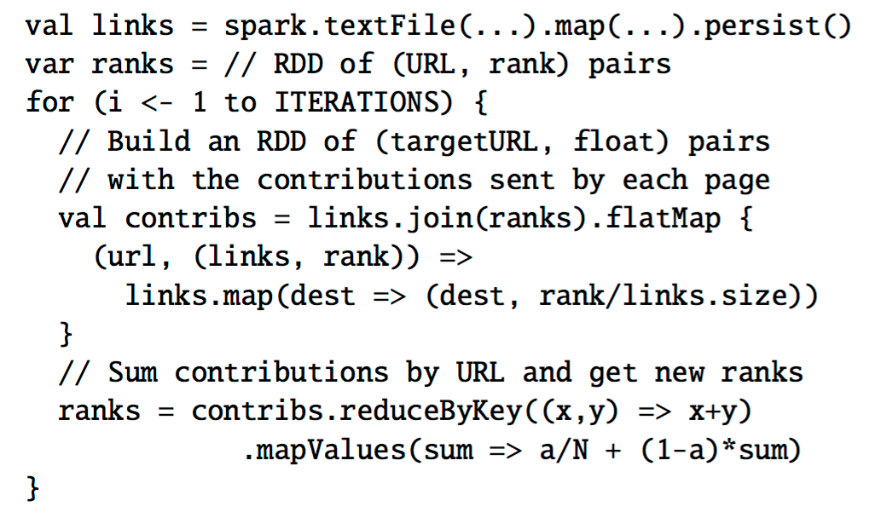
Example: PageRank
A good example to show the advantage of in-memory sharing vs. MapReduce’s stable storage sharing

Slide 22
Data Layout Optimization

Slide 23
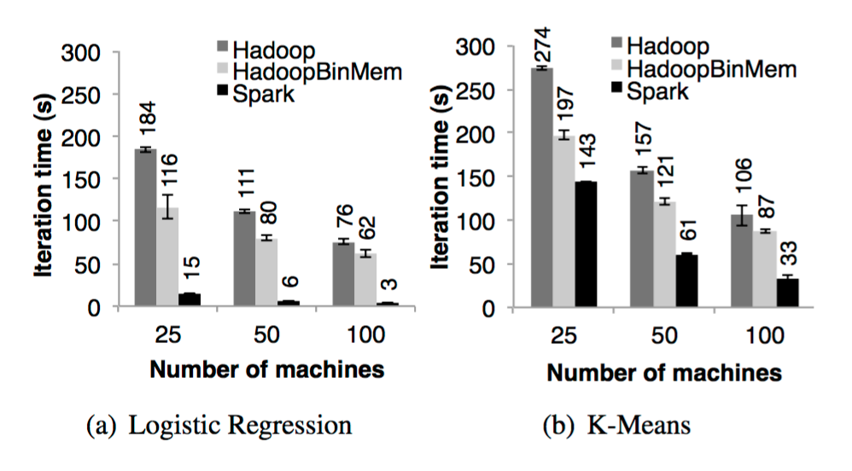
Another interesting evaluation
Notes:
k-means: compute intensive

