Slide 1
Live Migration of Virtual Machines
Authors: Christopher Clark, Keir Fraser, Steven Hand, Jacob Gorm Hansen, Eric Jul, Christian Limpach, Ian Pratt, Andrew Warfield
University of Cambridge Computer Laboratory
University of Copenhagen, Denmark
Presenter: Juncheng Gu

Slide 2
Outline
Motivation
Design
Implementation
Evaluation
Conclusion
Future Work

Slide 3
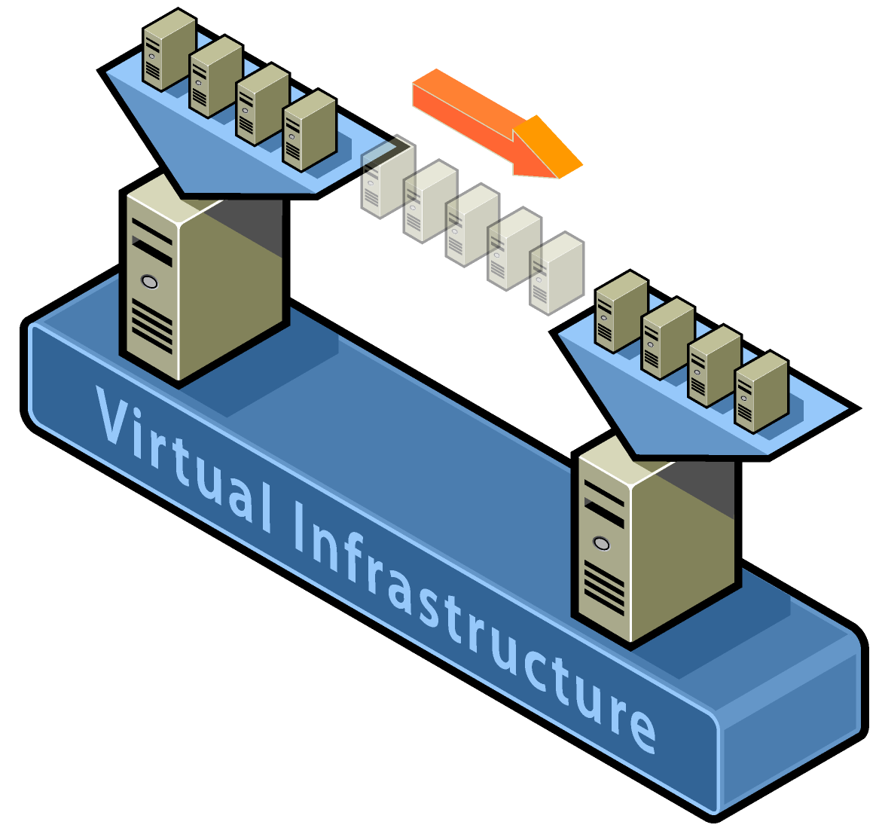
Motivation
What’s VM live migration?
Move VM instances across distinct physical hosts with little or no downtime for running services.
Services are unaware of the migration.
Maintain network connections of the guest OS.
VM is treaded as a black box.

Slide 4
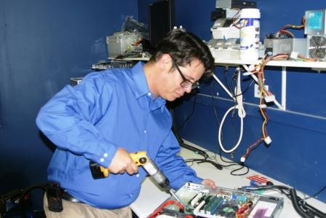
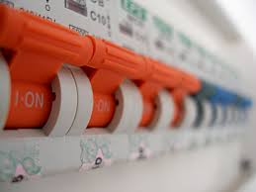
Motivation
VM live migration can be a extremely powerful tool for cluster administrators.
Hardware / Software maintenance / upgrades
Load balancing / resource management
Distributed power management

Slide 5
Motivation
Why OS-level migration, instead of process-level?
Avoid ‘residual dependencies’
Original host can be power-off / sleep once migration completed.
Can transfer in-memory state in a consistent and efficient fashion
E.g. No reconnection for media streaming application
Allow a separation of concerns between the users and operator of a cluster
Users can fully control of the software and services within their VM.
Operators don’t care about what’s occurring within the VM.

Slide 6
Motivation
Related Work
Approach | Feature
Collective project | stop-and-copy
Zap | stop-and-copy
VMotion | similar with live migration
Process migration | residual dependencies

Slide 7
Design-challenges
Minimize service downtime
Minimize migration duration
Avoid disrupting running service
Source Host
Destination Host
.BIN
.VSV
.XML
Storage
.VHD

Slide 8
Design-memory migration
Options
Phase | service downtime | migration duration
push | - | -
stop-and-copy | longest | shortest
pull (demand) | shortest | longest
Pre-copy
a bounded iterative push phase + a very short stop-and-copy phase
Careful to avoid service degradation

Slide 9
Design-local resources
Open network connections
Migrating VM can keep IP and MAC address.
Broadcasts ARP new routing information
Some routers might ignore to prevent spoofing
A guest OS aware of migration can avoid this problem
Local storage
Network Attached Storage

Slide 10
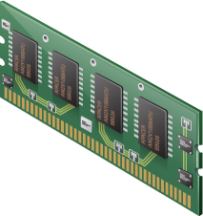
Design-local resources
Virtual Machine
Virtual Machine
Source
Destination

Slide 11
Design-overview

Slide 12
Implementation-writable working sets
Significant overhead: transferring memory pages that are subsequently modified.
Good candidates for push phase
Pages are seldom or never modified.
Writeable working set (WWS)
Pages are written often, and should best be transferred via stop-and-copy
WWS behavior
WWS varies significantly between the different sub-benchmarks
Migration results depend on the workload and the precise moment when migration begins

Slide 13
Implementation-managed & self migration
Managed migration
Performed by a migration daemon running in the management VM
Self migration
Within the migratee OS, and a small stub required on the destination host
Difference | Managed | Self
Track WWS | shadow page table + bitmap | bitmap + a spare bit in PTE
Stop-and-copy | suspend OS to obtain a consistent checkpoint | two-stage stop-and-copy, ignore page updates in last transfer

Slide 14
Implementation-track WWS (managed)
Using shadow page table to track dirty pages in each push round
Xen inserts shadow pages under the guest OS, populated using guest OS's page tables.
The shadow pages are marked read-only.
If OS tries to write to a page, the resulting page fault is trapped by Xen.
Xen checks the OS's original page table and forwards the appropriate write permission.
At the same time, Xen marks the page as dirty in bitmap.
At the beginning of next push round
Last round’s bitmap is copied to the control software, Xen’s bitmap is cleared.
Shadow page tables are destroyed and recreated, all write permissions are lost

Slide 15
Implementation-dynamic rate limiting
downtime
performance
More network bandwidth, less service downtime !
Less network bandwidth, less impact on running service !
Dynamically adapt the bandwidth limit during each round
Set a minimum and a maximum bandwidth limit, begin with the minimum limit
${bandwidth}_{next}={dirty rate}_{current}+constant increment$
${dirty rate}_{current}={dirty pages}/{duration}$
When terminate push, and switch to stop-and-copy ?
${dirty rate}_{current}>{bandwidth}_{max}$
$dirty pages<threshold$

Slide 16
Implementation-paravirtualized optimizations
Stunning rouge processes
Rouge process: generate dirty page at a very high rate (write one word in every page)
Forking a monitor process: monitor the WWS of individual processes
If a process exceeds write fault limitation, then move it to wait queue
Freeing page cache pages
Typically, OS have a number of free pages
Using ballooning mechanism to return free pages to VMM

Slide 17
Evaluation-simple web server
Migration starts
A highly loaded server with relative small WWS
Controlled impact on live services
Short downtime

Slide 18
Evaluation-rapid page dirtying
Stop-and-copy
In the third round, the transfer rate is scaled up to 500Mbit/s (max)
Switch to stop-and-copy, resulting in 3.5s downtime
Diabolical workload may suffer considerable service downtime

Slide 19
Conclusion
OS-level live migration
Pre-copy: iterative push and short stop-and-copy
Dynamically adapting network-bandwidth
Balance service downtime and service performance degradation
Paravirtualized optimizations
Minimize service downtime and impact on running service

Slide 20
Future Work
Cluster management
Make decisions for the placement and movement of virtual machines
Wide Area Network Redirection
OS will have to obtain a new IP address, or some kind of indirection layer
Storage Migration
Local disks are considerably larger than volatile memory

Slide 21
Q&A
Thank You!

