Slide 1
Lottery Scheduling: Flexible Proportional-Share Resource Management
By Carl A. Waldspurger and William E. Weihl
Presented by Nathan Immerman

Slide 2
Outline
Standard Scheduling
Lottery Scheduling
Other Applications
Conclusion

Slide 3
Standard Scheduling
First In First Out (FIFO)
Round Robin
Earliest Deadline First (EDF)
Others...
Priority Schemes usually ad hoc

Slide 4
Lottery Scheduling
Randomized Proportional-Share Scheduling
Tickets
Lotteries
Ready “Queue”
Ticket Transfers
Ticket Currencies

Slide 5
Tickets
Abstract: independent of machine details
Relative: ticket importance depends on total number of tickets
Uniform: easily represent heterogeneous resources

Slide 6
Lotteries
Priority is determined based on number of tickets each thread has
Scheduler picks a winning ticket randomly
Probabilistically Fair
Throughput is proportional to number of tickets
Latency is inversely proportional to number of tickets

Slide 7
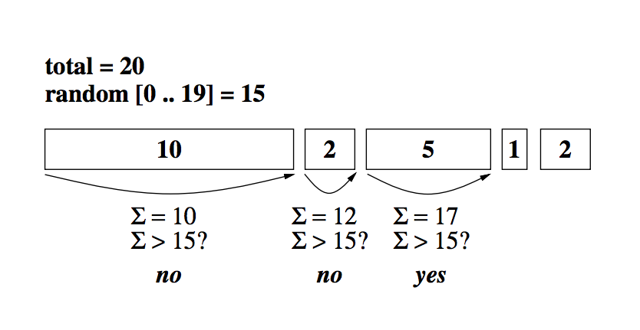
Ready “Queue”
Pick random ticket - find thread holding the winning ticket. O(n)
Analogous to having an ordering of tickets, and finding the nth ticket
Improvements
Sort threads by number of tickets - improves average search time
Create tree of partial ticket sums where threads are the leaves. O(logn)

Slide 8
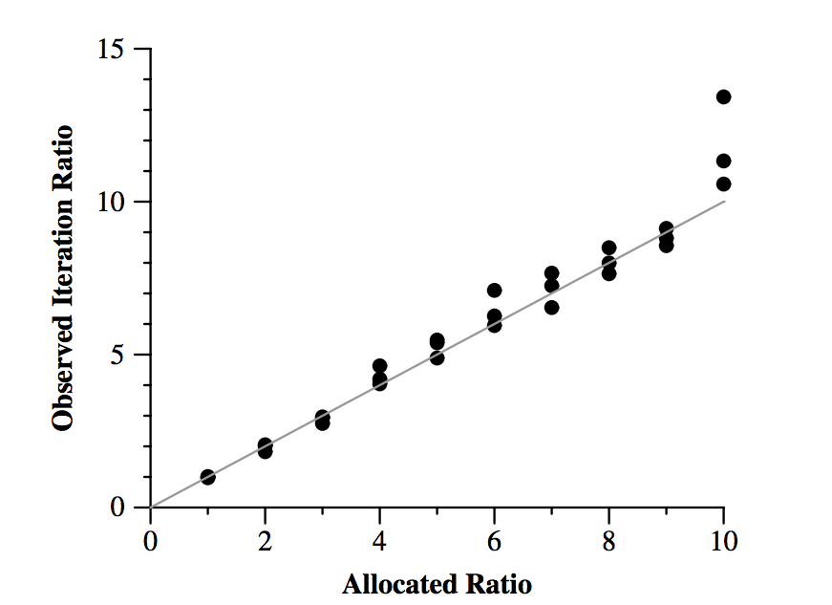
How fair is lottery scheduling?
Relative Rate Accuracy: Lottery scheduling can successfully control the distribution of allocated resources.
Two tasks were run with various allocated ratios. The x-axis plots the ticket allocated ratio (ex. 5:1 or 8:1) and the y-axis plots the observed allocation ratio.

Slide 9
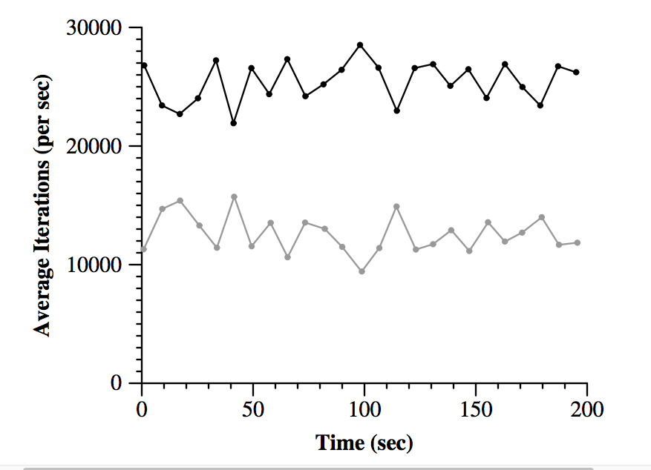
How fair is lottery scheduling?
Fairness Over Time
Two threads were run with a ticket ratio of 2:1.
Over the entire run their average iterations/sec were 25378 and 12619 respectively, for an average 2.01:1 ratio.

Slide 10
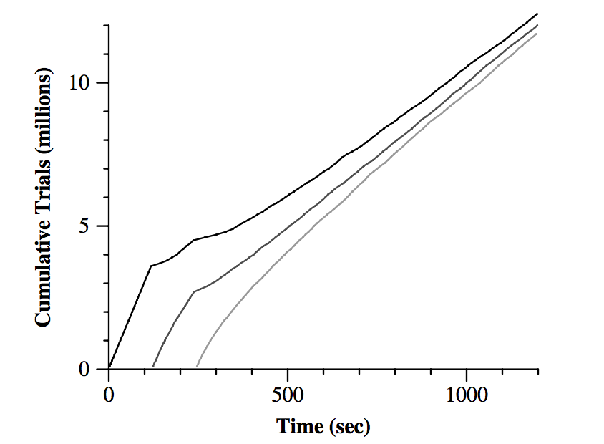
Flexible Control
Dynamic Execution Rates
Three tasks are running a Monte-Carlo simulation
Tasks periodically changes their ticket allocation to be proportional to their error

Slide 11
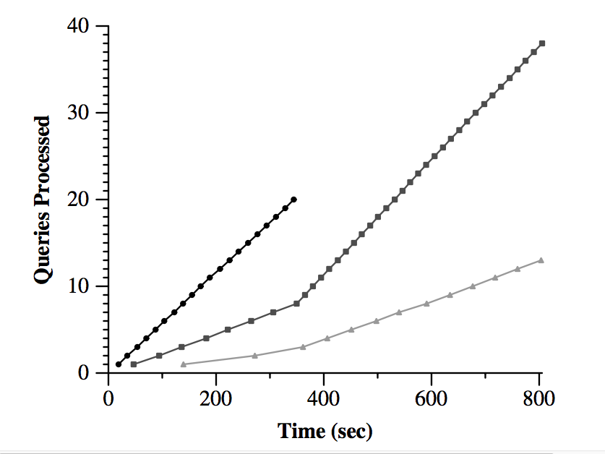
Ticket Transfers
Explicitly transfer tickets to another task
Useful when a task blocks for any reason
RPC: A task can transfer tickets to the task running on the server on its behalf
Solves priority inversion

Slide 12
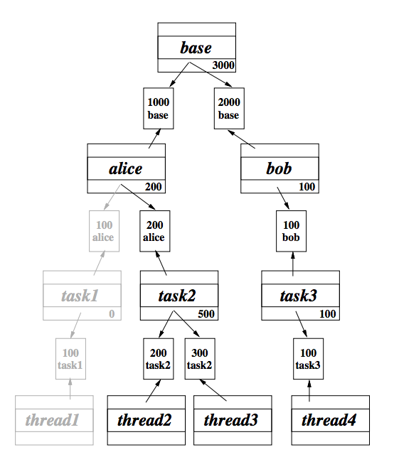
Ticket Currencies
Currencies create logical tasks groups
Funded by tickets in base currency
Lotteries still evaluated on base currency

Slide 13
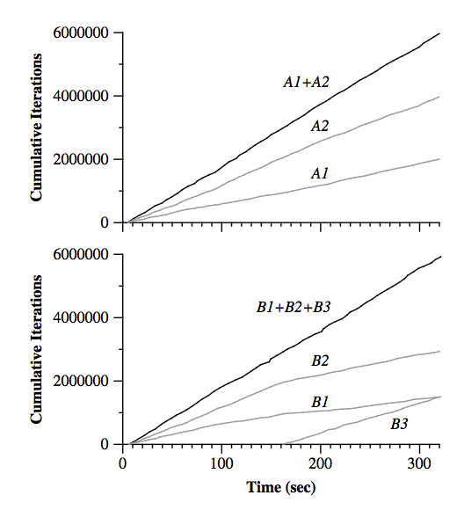
Ticket Currencies
Introducing more tickets in currency B has no effect on distribution of currency A
Currencies A and B have equal funding
The ratio of A1:A2 and B1:B2 is 1:2
B3 is introduced with a ratio of B1:B2:B3, 1:2:3

Slide 14
Other Applications
Mutex Acquisition
When a task is waiting for a mutex it transfers all of its tickets to the mutex currency. The mutex holds a lottery on the mutex currency to give lock.
Page Faults
Hold a inverse lottery to determine which page is swapped out of memory

Slide 15
Conclusion
Randomized Proportional-Share Scheduling
Fair, Flexible, Simple to Implement, Dynamic Priorities
Overhead comparable to standard Mach timesharing policy

