Slide 1
The Multikernel: A New OS Architecture for Scalable Multicore Systems
By (last names): Baumann, Barham, Dagand, Harris, Isaacs, Peter, Roscoe, Schupbach, Singhania
Presented by: Clyde Byrd III

Slide 2
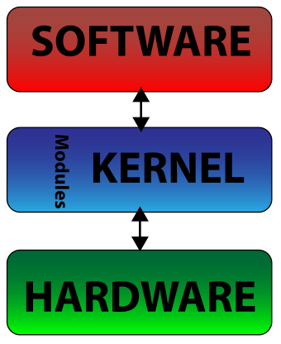
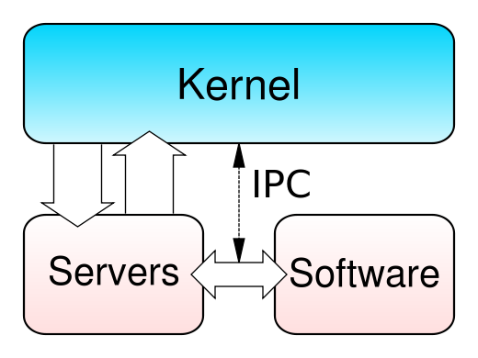
The Modern Kernel(s)
Monolithic
Microkernel

Slide 3
The Problem with Modern Kernels
Modern Operating systems can no longer take serious advantage of the hardware they are running on
There exists a scalability issue in the shared memory model that many modern kernels abide by
Cache coherence overhead restricts the ability to scale to many-cores

Slide 4
Solution: MultiKernel
Treat the machine as a network of independent cores
Make all inter-core communication explicit; use message passing
Make OS structure hardware-neutral
View state as replicated instead of shared

Slide 5
But wait! Isn’t message passing slower than Shared Memory?
Not at scale

Slide 6
But wait! Isn’t message passing slower than Shared Memory?
At scale it has been show that message passing has surpassed shared memory efficiency
Shared memory at scale seems to be plagued by cache misses which cause core stalls
Hardware is starting to resemble a message-passing network

Slide 7
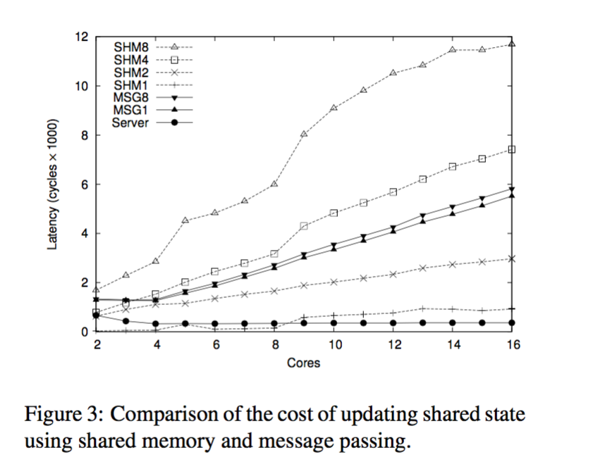
But wait! Isn’t message passing slower than Shared Memory? (cont.)

Slide 8
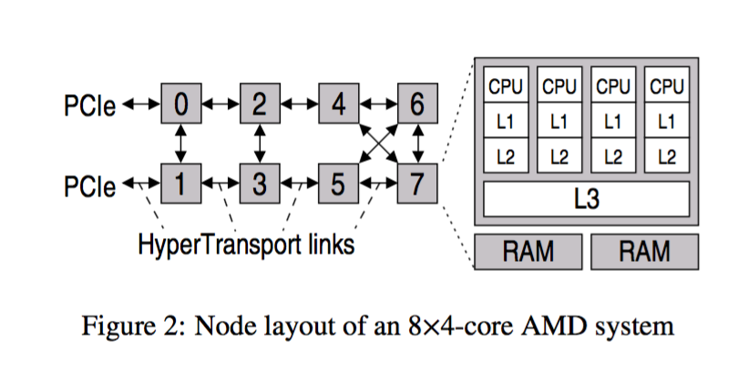
But wait! Isn’t message passing slower than Shared Memory? (cont.)

Slide 9
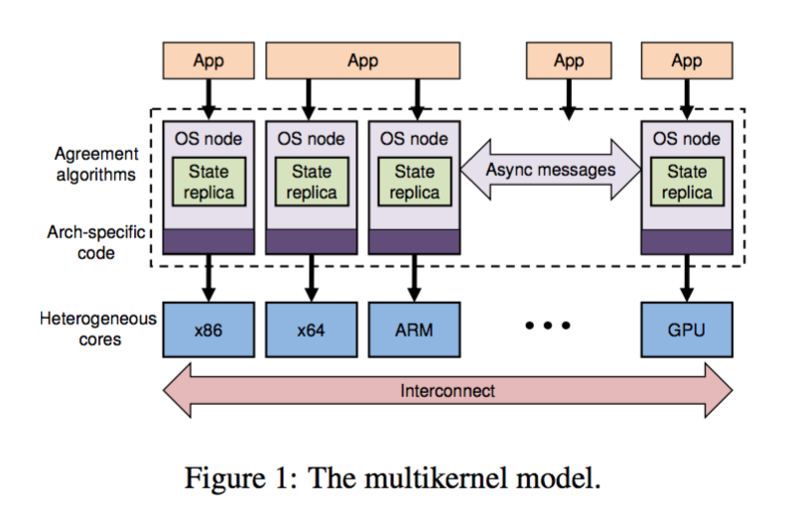
The MultiKernel Model

Slide 10
Make inter-core communication explicit
All inter-core communication is performed using explicit messages
No shared memory between cores aside from the memory used for messaging channels
Explicit communication allows the OS to deploy well-known networking optimizations to make more efficient use of the interconnect

Slide 11
Make OS structure hardware-neutral
A multikernel separates the OS structure as much as possible from the hardware
Hardware-independence in a multikernel means that we can isolate the distributed communication algorithms from hardware details
Enable late binding of both the protocol implementation and message transport

Slide 12
View state as replicated
Shared OS state across cores is replicated and consistency maintained by exchanging messages
Updates are exposed in API as non-blocking and split-phase as they can be long operations
Reduces load on system interconnect, contention for memory, overhead for synchronization; improves scalability
Preserve OS structure as hardware evolves
Notes:
Split phase = operating sends a request and immediately continues with the expectation that a reply will arrive at some time in the future.

Slide 13
In practice
Model represents an ideal which may not be fully realizable
Certain platform-specific performance optimizations may be sacrificed – shared L2 cache
Cost and penalty of ensuring replica consistency varies on workload, data volumes and consistency model

Slide 14
Barrelfish

Slide 15
Barrelfish Goals
Comparable performance to existing commodity OS on multicore hardware
Scalability to large number of cores under considerable workload
Ability to be re-targeted to different hardware without refactoring
Exploit message-passing abstraction to achieve good performance by pipelining and batching messages
Exploit modularity of OS and place OS functionality according to hardware topology or load

Slide 16
System Structure
• Multiple independent OS instances communicating via explicit messages
• OS instance on each core factored into
privileged-mode CPU driver which is hardware dependent
user-mode Monitor process: responsible for intercore communication, hardware independent
System of monitors and CPU drivers provide scheduling, communication and low-level resource allocation
Device drivers and system services run in user-level processes

Slide 17
CPU Drivers
Enforces protection, performs authorization, time-slices processes and mediates access to core and hardware
Completely event-driven, single-threaded and nonpremptable
Serially processes events in the form of traps from user processes or interrupts from devices or other cores
Performs dispatch and fast local messaging between processes on core
Implements lightweight, asynchronous (split-phase) same-core IPC facility

Slide 18
Monitors
Schedulable, single-core user-space processes
Collectively coordinate consistency of replicated data structures through agreement protocols
Responsible for IPC setup
Idle the core when no other processes on the core are runnable, waiting for IPI
Notes:
Suited for split-phase, message oriented inter-core communication of messages
Wakes up blocked processes in response to messages from other cores

Slide 19
Process Structure
Process is represented by collection of dispatcher objects, one on each core which might execute it
Communication is between dispatchers
Dispatchers are scheduled by local CPU driver through upcall interface
Dispatcher runs a core local user-level thread scheduler
Notes:
Thread library provides support for model of threads sharing single process address space across multiple cores

Slide 20
Inter-core communication
Variant of URPC for cache coherent memory – region of shared memory used as channel for cache-line-sized messages
Implementation tailored to cache-coherence protocol to minimize number of interconnect messages
Dispatchers poll incoming channels for predetermined time before blocking with request to notify local monitor when message arrives

Slide 21
Memory Management
Manage set of global resources: physical memory shared by applications and system services across multiple cores
OS code and data stored in same memory - allocation of physical memory must be consistent
Capability system – memory managed through system calls that manipulate capabilities
All virtual memory management performed entirely by user-level code
Notes:
Capabilities are user-level references to kernel objects or regions of physical memory

Slide 22
System Knowledge Base
System knowledge base (SKB) maintains knowledge of underlying hardware in subset of first-order logic
Populated with information gathered through hardware discovery, online measurement, pre-asserted facts
SKB allows concise expression of optimization queries
Allocation of device drivers to cores, NUMA-aware memory allocation in topology aware manner
Selection of appropriate message transports for inter- core communication

Slide 23
Experiences from Barrelfish implementation
• Separation of CPU driver and monitor adds constant overhead of local RPC rather than system calls
Moving monitor into kernel space is at the cost of complex kernel-mode code base
Differs from current OS designs on reliance on shared data as default communication mechanism
Engineering effort to partition data is prohibitive
Requires more effort to convert to replication model
Shared-memory single-kernel model cannot deal with heterogeneous cores at ISA level

Slide 24
Evaluation of Barrelfish
The testing setup was not accurate
making any quantitative conclusions from their benchmarks would be bad
Barrelfish performs reasonably on contemporary hardware
Barrelfish can scale well with core count
Gives authors confidence that multikernel can be a feasible alternative

Slide 25
Related Work
MicroKernels
Reduction of shared memory/data structures
Distributed Systems

Slide 26
Q &A?

