Slide 1
A History and Evaluation of System R
Mosharaf Chowdhury

Slide 2
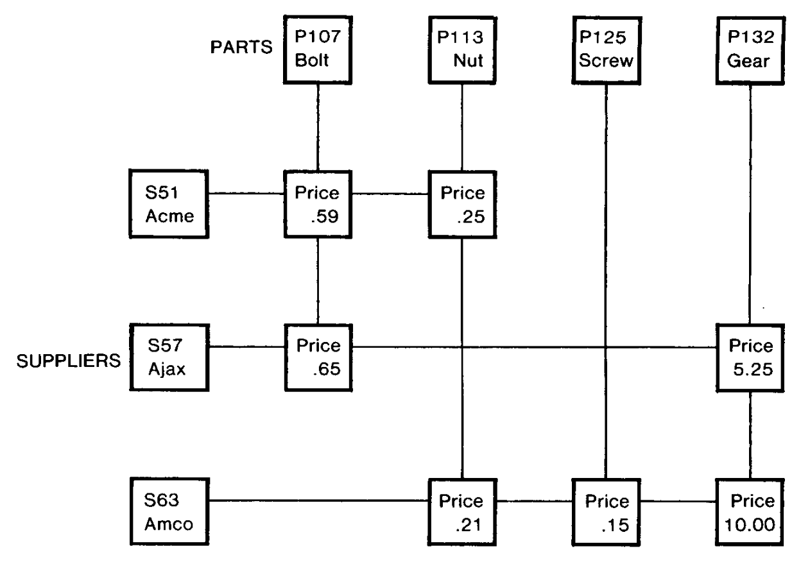
Navigational Database Model
Records and objects are found by following links or references from other objects
Imperative: users tell how to get the results
Dependent on data structure
Charles Bachman
Integrated Data Store (IDS) around 1963 while at GE

Slide 3
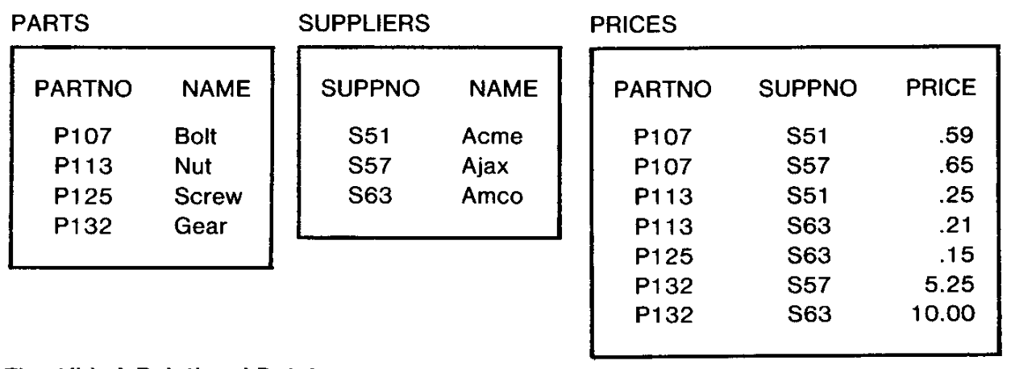
Relational Database Model
Data independence
Not tied to underlying data representation
Users specify what to do not how
Declarative
Edgar F. Codd
PhD from University of Michigan!
Invented relational model while at IBM in 1970

Slide 4
System R is an Experimental Prototype
For SQL (SEQUEL)
For relational model
For demonstrating performance similar to that of navigational model
With the added benefit of data independence

Slide 5
Goals
RDBMS
Multiple users
General system
Evolvable and dynamic
View maintenance
Fault tolerance
High performance

Slide 6
Phase Zero
Throwaway prototype tied to XRM
XRM: Extended (N-ary) Relational Memory
Single user
No fault-tolerance
No joins but sub-queries are supported
Query optimizer minimized the number of tuples fetched
Without considering the actual cost

Slide 7
Takeaway from Phase Zero (Among Others)
“strongly felt conclusion was that it is a very good idea, in a project the size of System R, to plan to throw away the initial implementation.”
- “A History and Evaluation of System R”

Slide 8
Phase One
Separation of access and query representation methods
RSS (Research Storage System) and RDS (Relational Data System)
Led to modularity
RSS replaced XRM and opened to the path toward multi-user
Locking subsystem was introduced with different levels of locking
Views were introduced (to some extent) to limit/control access
Recovery subsystem for fault-tolerance

Slide 9
Phase One Optimizations
Compilation of (sub-)queries into machine language
Reusing them by mixing and matching across many queries
Indexes using B-Trees
Easier scans
Query optimizer
Based on actual cost
Can use different ways to join based on the context
Shadow pages and checkpoints
As opposed to Write-Ahead Logs (WAL)

Slide 10
Convoy Effect
When a process loses its time quanta, it can go to sleep/wait while holding the lock
Everyone waiting for the lock gets blocked!
When a process releases a lock, the first in the queue gets it
Even when this process has the time quanta, it must wait!
Waste of CPU time
Allow other processes to get the lock but don’t give it right away
The original process can now get it within the same quanta if needed
If it goes to sleep, someone already has permissions to use it

Slide 11
What Happened After IBM System R?
They basically abandoned it
Oracle was born

