Slide 1
EECS 582 Introduction
Mosharaf Chowdhury

Slide 2
Today’s Agenda
Administrivia
Topics we will and won’t cover

Slide 3
About the Instructor
Mosharaf Chowdhury
Assistant Professor
Ph.D. from UC Berkeley in 2015
http://www.mosharaf.com/
Research interests span
Networked systems and networking in the context of big data applications and cloud computing infrastructure
The core tenet being “application-infrastructure symbiosis”
A quick overview of my recent work follows; email/talk to me to know more!

Slide 4
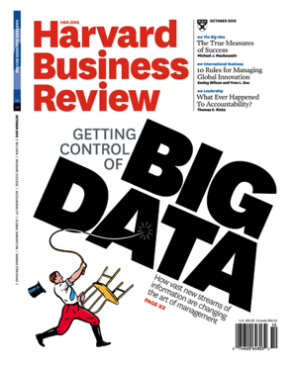
Big Data
The volume of data businesses want to make sense of is increasing
Increasing variety of sources
Web, mobile, wearables, vehicles, scientific, …
Cheaper disks, SSDs, and memory
Stalling processor speeds

Slide 5
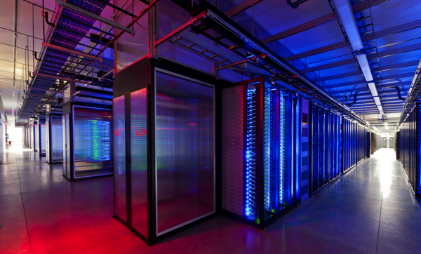
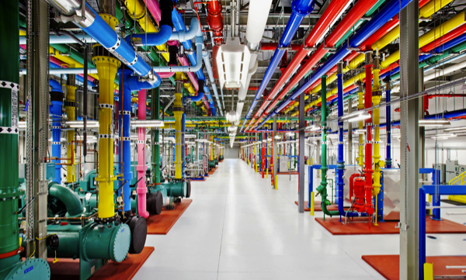
Big Datacenters for Massive Parallelism
BlinkDB
Storm
Spark-Streaming
Pregel
GraphLab
GraphX
DryadLINQ
Spark
Dremel
MapReduce
Hadoop
Dryad
Hive
2005
2010
2015

Slide 6
1. Application-Aware Networking
Big data applications transfer large volumes of data with a unique communication characteristic
Communication stage cannot complete until all the individual communication have completed
Coflow is a new networking abstraction to exploit this characteristic
Efficient Coflow Scheduling Without Prior Knowledge, SIGCOMM’15
Efficient Coflow Scheduling with Varys, SIGCOMM’14
Managing Data Transfers in Computer Clusters with Orchestra, SIGCOMM’11

Slide 7
2. Multi-Resource Allocation
Big data applications run on shared datacenters
How do we fairly allocate resources between tenants and increase datacenter efficiency?
HUG: Multi-Resource Fairness for Correlated and Elastic Demands, NSDI’16
FairCloud: Sharing the Network in Cloud Computing, SIGCOMM’12
How do we increase fault-tolerance of applications while meeting bandwidth demands?
Surviving Failures in Bandwidth-Constrained Datacenters, SIGCOMM’12

Slide 8
3. Big Data Systems
Big data applications read/write a lot of data to cluster file systems
We can place data anywhere to load balance the network, as long as certain constraints are met
Leveraging Endpoint Flexibility in Data-Intensive Clusters, SIGCOMM’13
Big data applications can be made faster if they are in-memory, but how do we make in-memory computations fault-tolerant?
Resilient Distributed Datasets: A Fault-Tolerant Abstraction for In-Memory Cluster Computing, NSDI’12 (Best Paper)
Apache Spark!

Slide 9
What About You?
Let’s a do quick round with your
Name
Level of study
Research area
Advisor
Please fill out the form at http://goo.gl/forms/45pLp2QFSD by this weekend

Slide 10
Today’s Agenda
Administrivia
Topics we will and won’t cover

Slide 11
Waitlist Status
As of today: 25 registered, 15 on waitlist
Course limit: 25
Everyone must participate!
Waitlist priority: CS PhD, CS Master’s, Other PhD, the rest
Others should check with the instructor
Typically, not advisable for undergrads
If you are not planning to take the class, please drop ASAP

Slide 12
Course Schedule
Webpage: http://www.mosharaf.com/eecs582/
Meetings
3PM – 4:30 PM (Mon/Wed for lectures and discussions)
2:30PM – 3:30PM (Fri for makeups and projects)
Pay attention to the online announcements and schedule
On average, two meetings per week
Friday makeups will be added on a need-to-add basis

Slide 13
Prerequisites
EECS 482 (Introduction to Operating Systems)
Basics of OS organization, threads, memory management, file systems, scheduling, networking, etc.
Equivalent course of EECS 482 is acceptable as well
Good programming skills
Build substantial systems for course project
Questions
Have you taken a grad-level systems (e.g., OS, networking) course before?
Have you worked on large systems-building project?

Slide 14
Course Requirements
Paper Reviews | 20%
Paper Presentation | 15%
Participation | 10%
Midterm Exam | 15%
Final Project | 40%

Slide 15
Readings
44 papers across
Operating Systems venues like SOSP and OSDI
(Networked) Systems venues like NSDI and EuroSys
Networking venues like SIGCOMM
Many of these papers are classics, test-of-time award winners, and best-paper award winners

Slide 16
Paper Reviews
This is a paper-reading course
Paper reviews account for 20% of the total grade
36 summaries to write
What goes in a good summary?
What is the problem? Why is the problem important?
What is the hypothesis?
What is the intuition behind the proposed solution?
What is (at least) one limitation? How would you fix it?

Slide 17
Paper Reviews
Reviews must be submitted electronically 24 hours before the class
Submission site: http://eecs582.eecs.umich.edu/papers/
You can miss at most four without any penalty
Each missing one beyond that will result in 25% decrease in grade for this segment
Meaning, missing eight or more will result in 0% for the “Paper Reviews” segment of your grade
Read (if you haven’t already!)
How to Read a Paper by S. Keshav
Writing Reviews for Systems Conferences by Timothy Roscoe

Slide 18
Paper Presentation
This is a seminar-style course
Each student must present at least one paper; some might be presented by two
Paper presentation account for 15% of the total grade
Two papers per class and 20-minutes presentation for each
Followed by discussion anchored by the presenters
What should go in a useful presentation?
Motivate and provide background
Discuss the high-level idea and insights; ignore details
Differentiate from related work

Slide 19
Paper Presentation
Email your slides to the instructor 24 hours before the class
Use the template on the course website
Prepare early
Practice a lot
Also, read
How to Give a Bad Talk, by David A. Patterson

Slide 20
Participation
Attend all lectures
Can miss at most two with legitimate reasons
Read all the papers and participate

Slide 21
Midterm
One midterm exam
During class hours
Includes everything we’d read up to the exam
There will be a review before the midterm
Questions about important parts of papers, such as
“How does System X provide fault-tolerance?”
Questions about important concepts, such as
“How would you design a starvation-free scheduler?”

Slide 22
Project
The biggest component of this course
Pick an interesting problem. Why is it important?
What has already been done? Why are they not enough?
Develop a hypothesis about how you’d improve it.
Intuitively, why will your approach work?
Build a substantial prototype.
Experiment, measure, and compare against the state-of-the-art
We’ll discuss project requirements and some project suggestions in details on Friday (1/8/16)

Slide 23
Before We Move On…
No extensions
Slides will be posted after the class
Everyone must come after reading all the assigned papers
Lecture starts at Michigan time
Presentation of typically two papers
Followed by a short break
Presenters lead discussions on the papers we’ve read and related topics

Slide 24
Today’s Agenda
Administrivia
Topics we will and won’t cover

Slide 25
What is a Computer?
A collection of resources
Processing, memory, storage, and network
Enables people to get things done
Can take many forms
Raspberry Pi, mobile phones, tablets, laptops, workstations
Large clusters, entire datacenters
We’ll primarily consider
Individual, self-sufficient computers [First half]
Collection of such machines as a computer [Second half]
Resource-disaggregated computers [Last class]

Slide 26
Topics We Will Cover
Traditional Computer
Datacenter as a Computer
Classics
OS, Kernels, VMs
Concurrency, Scheduling
File Systems, Storage
Memory Management
Networking
Programming models
Datacenter OS
Resource allocation/scheduling
File system
Memory management
Network Scheduling

Slide 27
Topics We Won’t Cover
Details of many topics we cover
Most of them can have its own course
Networking details
Traditional high-performance Computing (HPC)
Distributed systems issues
Consistency, quorums etc.
Compilers and languages
Security

Slide 28
How to Make a Computer…
Easy to use?
High performance?
Fault-tolerant/reliable?
Scalable?
Extendable?
Useful?

Slide 29
Abstractions, Interfaces, and Programming Models
Allows clients/users/programmers to use/access some resource or component through an implementation
Most overlooked, yet (arguably) the most important
Dictates how things are done
Should be simple and narrow, yet complete and easy/intuitive to use
Often conflicting
Shouldn’t restrict implementations for specific goals

Slide 30
Performance
When is it enough? At what cost?
Driven primarily by bottlenecks
Latency numbers every programmer should know (by Colin Scott) http://www.eecs.berkeley.edu/~rcs/research/interactive_latency.html
Parallelism at every layer
Multiple CPUs, memory banks, disks, NICs
Multiple computers!

Slide 31
Concurrency and Scheduling
Who can run in parallel? Who should run when?
Within one machine and across many
How to handle failures and races?
Complexity increases with concurrency
How to provide consistency? What type of consistency anyway?
We won’t cover
What is the correct behavior?

Slide 32
Reliability and Fault Tolerance
Failure is the norm
How do we keep things running when failure inevitably happens?
How much failure can we tolerate?
What are the fault domains?
Where to handle failure?
Expose to the user and avoid redundancy
Hide from the user and avoid complexity
No right answer; it depends

Slide 33
Scalability
Especially relevant for datacenter-scale computers
Distributed vs. centralized design
Traditional view: centralized designs cannot scale
GFS @ 2003: Single master file system for thousands of machines in Google
Again, it depends
How do we decide?
Look at the tradeoff

Slide 34
Virtualization
Virtual machines
Isolation and security
Heterogeneity of OSes and applications
Fast deployment and migration
Heavyweight solution
Containers
Lightweight VMs (logically)
Networks are being virtualized as well
Software-defined networking (SDN) and network function virtualization (NFV)

Slide 35
Persistent and Volatile Storage
Managing data on a single disk
Handling corruptions and failure
RAID: Redundant Array of Inexpensive Disks on individual machines
Replication on cluster file systems
Memory Management
Virtual memory, paging, and caching

Slide 36
The Role of the Network
Relevant for distributed setups like clusters, datacenters, or resource-disaggregated machines
Faster doesn’t always translate to better if we are not judiciously using it
Hence, application-infrastructure symbiosis

Slide 37
Next Class…
Read the assigned papers
Including today’s short reads if you haven’t already; no reviews for this week
Everything related to your projects for this course
Please fill out http://goo.gl/forms/45pLp2QFSD by this weekend
This includes your presentation preference
Decide if you’ll drop, before you fill it
Create account at http://eecs582.eecs.umich.edu/papers/ ASAP

