Slide 1
A Scalable, Commodity Data Center Network Architecture
Mohammad Al-Fares, Alexander Loukissas, Amin Vahdat
University of California, San Diego
Thanks Hakim Weatherspoon
Presented by Linh Nguyen

Slide 2
Overview
Background of current Data Center Network (DNC) architectures
Desired properties in a DNC
Fat-tree based solutions
Evaluations

Slide 3
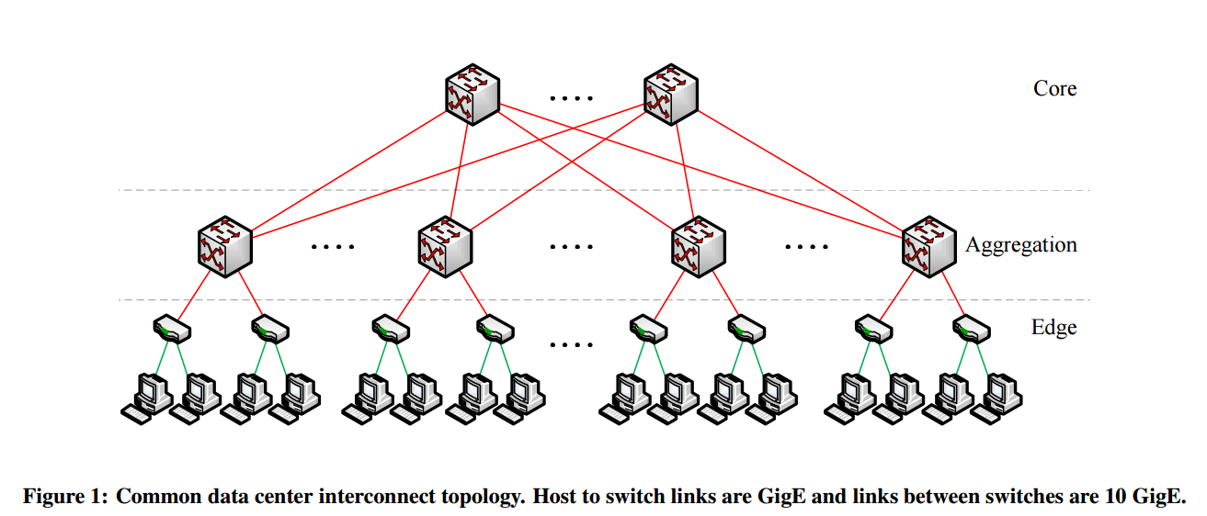
Background
Topologies typically consist of 2-3 level trees of switches and routers
2 levels: 5K-8K hosts
3 levels: >25K hosts (focus of this paper)

Slide 4
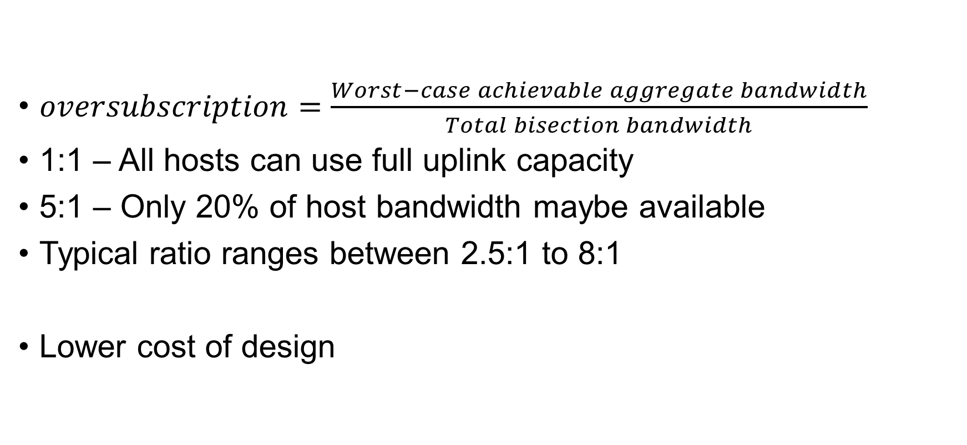
Oversubscription
$oversubscription=\frac{Worst−case achievable aggregate bandwidth}{Total bisection bandwidth}$
1:1 – All hosts can use full uplink capacity
5:1 – Only 20% of host bandwidth maybe available
Typical ratio ranges between 2.5:1 to 8:1
Lower cost of design

Slide 5
Multi-path Routing
“Multi-rooted” tree required to communicate at full-bandwidth
Equal-Cost Multi-path Algorithm (ECMP)
Performs static load splitting, cannot account for flow sizes
Routing tables become very large with multiple paths

Slide 6
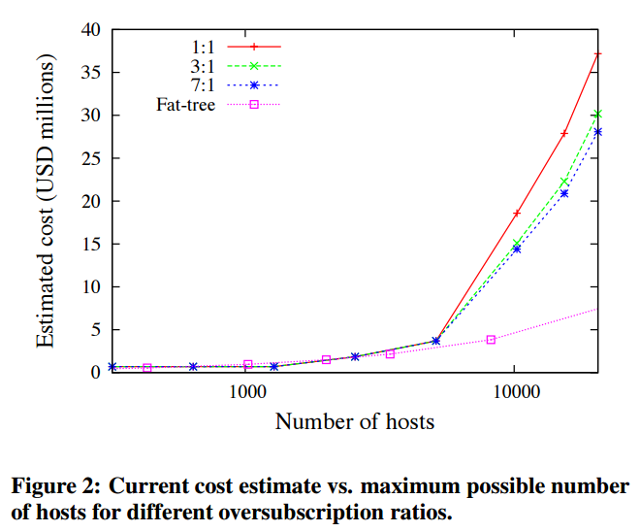
Cost Analysis

Slide 7
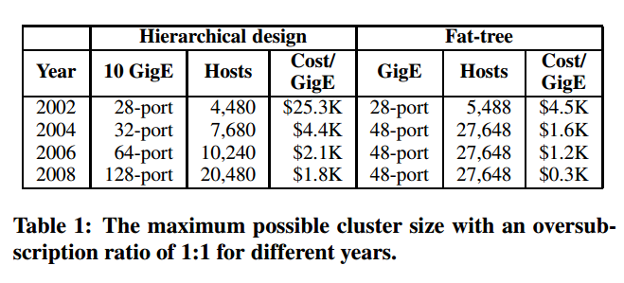
Cost Analysis (cont.)

Slide 8
Problems?
Single point of failure
Core routers are bottleneck
Require high-end routers (expensive)
High cost:
Edge: $7,000 for each 48-port GigE switch
Aggregation and Core: $700,000 for 128-port 10GigE switches
Approximately $37M
Prohibitive!

Slide 9
Properties of Solutions
Backwards compatible with existing infrastructure
No change in application
Support of Ethernet and IP
Cost Effective
Low power consumption and heat emission
Inexpensive hardware
Scalable
An arbitrary host can communicate with any other host at full bandwidth of its local network interface

Slide 10
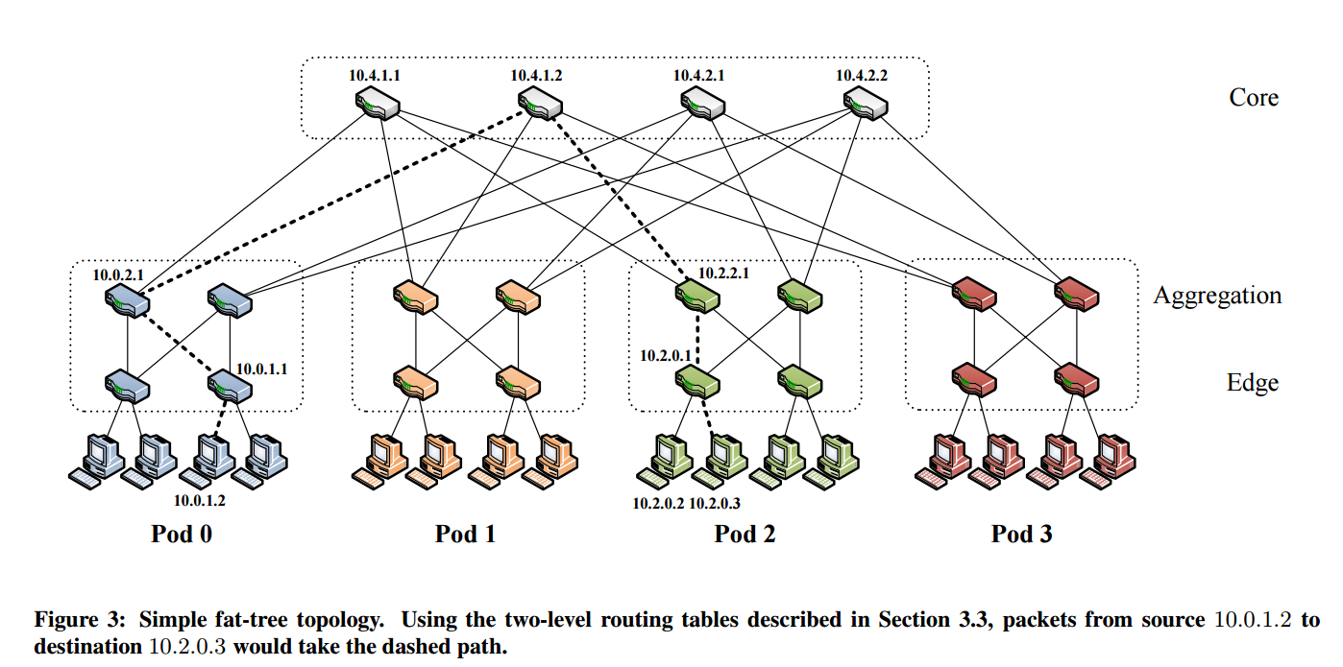
Fat-tree Architecture
3-layer topology
K pods
Two layers of k/2 switches
${(k/2)}^{2}$ core switches
Supports $k^{3}/4$ servers

Slide 11
Why fat-tree?
Can be built using cheap devices with uniform capacity
Each port supports same speed as end host
All devices can transmit at line speed if packets are distributed uniformly along available paths
Scalability
History: similar trends happened in telephone area. Charles Clos designed a network topology that delivers high levels of bandwidth for many end devices by interconnecting commodity switches

Slide 12
Routing options
Flow classification: a flow is a sequence of packets
Pod switches forward subsequent packets of the same flow to same outgoing port; periodically reassign a minimal number of output ports
Eliminate local congestion
Assign traffic to ports on per-flow basis instead of per-host basis
Ensure fair distribution on flows
Flow scheduling: routing large flows
Edge switches detect outgoing flow whose size is above a predefined threshold, then notify a central scheduler, which tries to assign non-conflicting paths for these large flows
Eliminate global congestion
Prevent long lived flows from sharing the same links
Assign long lived flows to different links

Slide 13
Experiment Setup
4-port fat-tree (20 switches, 16 end hosts)
Each host generates a constant 96Mbit/s of outgoing traffic
Benchmark suite of communication mappings with 3.6:1 oversubscription

Slide 14
Results (Network Utilization)

Slide 15
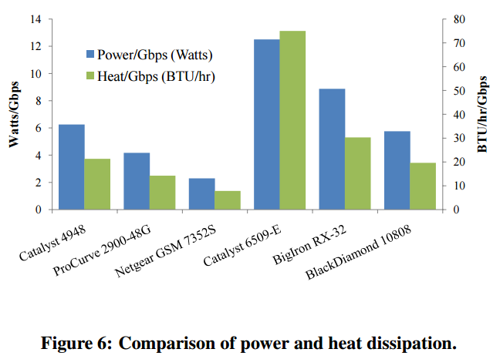
Results (Cost of maintaining switches)

Slide 16
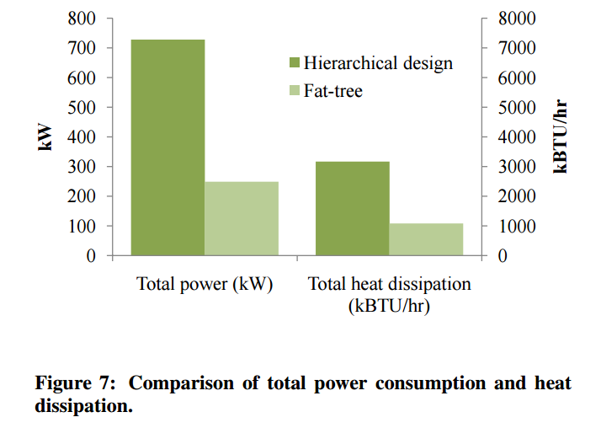
Results (Heat and Power Consumption)

Slide 17
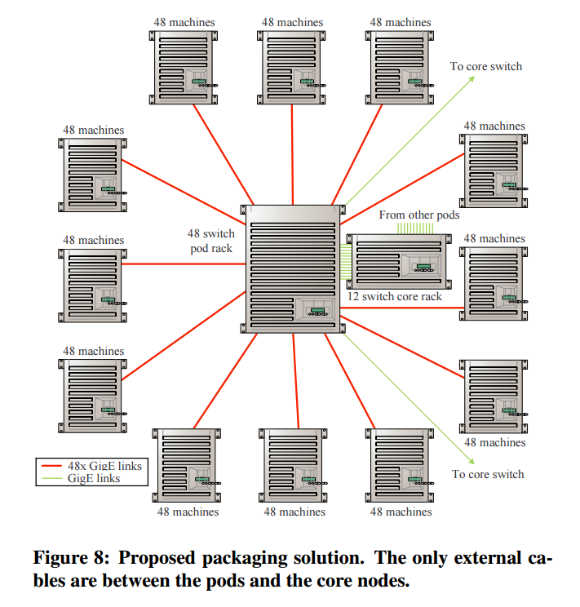
Packaging
Increased wiring overhead is inherent
One pod: 12 racks (48 machines each)
Place 48 switches in centralized rack
Minimize total cable length by placing racks around the pod switch

Slide 18
Discussion
Scalability? How do we mitigate the problems of complex cabling, central scheduler and scale to larger scale, geo-distributed system?
Evaluation? How do we set up an experiment for larger scale?
Other approaches (Portland, BCube, VL2)?

