Slide 1
PA an Coordinated Memory Caching for Parallel Jobs
Ganesh Ananthanarayanan, Ali Ghodsi, Andrew Wang, Dhruba Borthakur, Srikanth Kandula, Scott Shenker, Ion Stoica
Presented by- Subarno Banerjee

Slide 2
Motivation
Jobs
Scheduler

Slide 3
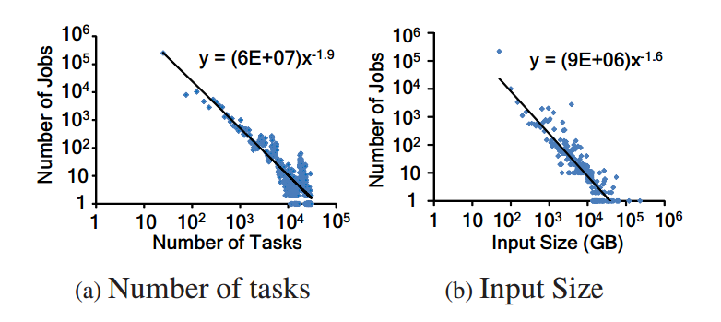
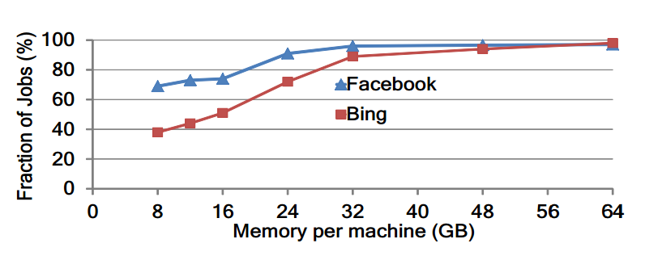
Motivation
Heavy-tailed Input Sizes of Jobs
96% of Facebook’s smallest jobs account for 10% overall data
Input data of most jobs can be cached in 32GB of memory
96% of jobs in Facebook’s Hadoop cluster fit in memory
Popularity Skew

Slide 4
Motivation
IO-intensive phase constitute significant portion of datacenter execution
79% of runtime, 69% of resource
+
Majority of jobs are small in size
+
Popularity skew
||
In-Memory Caching

Slide 5
PACMan: Parallel All-or-nothing Cache Manager
PACMan Coordinator
Globally coordinates access to its distributed memory caches across various machines
Two main tasks:
Support queries for the set of machines where block is cached
Mediate cache replacement globally across machines
PACMan Client
PACMan Client
PACMan Client
DFS Slave
DFS Slave
DFS Slave
DFS Master

Slide 6
PACMan Coordinator
PACMan Coordinator
Keep track of the changes that are made by clients.
Maintain a mapping between every cached block and the machines that cache it.
Implements the cache eviction policies such as LIFE and LFU-F
Secondary coordinator on cold standby as a backup.
PACMan Client
PACMan Client
PACMan Client
DFS Slave
DFS Slave
DFS Slave
DFS Master

Slide 7
PACMan Client
PACMan Coordinator
Service requests to existing cache blocks and manage new blocks.
Data is cached at the destination, rather than the source
PACMan Client
PACMan Client
PACMan Client
DFS Slave
DFS Slave
DFS Slave
DFS Master

Slide 8
Insight: All-or-Nothing Property
Tasks of small jobs run simultaneously in a wave
Task duration
(uncached input)
Task duration
(cached input)
slot₁
slot₁
slot₁
slot₂
slot₂
slot₂
time
time
time
completion
time
completion
time
completion
time
All-or-nothing: Unless all inputs are cached, there is no benefit

Slide 9
Insight: All-or-Nothing Property
All-or-nothing property matters for efficiency as well
Task duration
(uncached input)
Task duration
(cached input)
Map
Read
Idle
Read
Compute
Read
Compute
Reduce
Read
Idle
Read
Compute
Read
Compute
time
time

Slide 10
Problems with Traditional Policies
Simply maximizing the hit-rate may not improve performance
E.g. If we have Job 1 and Job 2 where Job 2 depends on result of Job 1
Task duration
(uncached input)
Task duration
(cached input)
Job 1
Job 2
Job 1
Job 2
Sticky Policy: Evict the Incomplete Files first.
slot₁
slot₂
slot₃
slot₄
slot₁
slot₂
slot₃
slot₄
Job 1
completion
Job 2
completion
Job 1
completion
Job 2
completion

Slide 11
Eviction Policy - LIFE
Goal: Minimize the average completion time of jobs
Are there any Incomplete Files?
“largest” – file with largest wave-width
Wave-width: Number of parallel tasks of a job
YES
NO
Evict largest Incomplete File
Evict largest Complete File

Slide 12
Eviction Policy – LFU-F
Goal: Maximize the resource efficiency of the cluster (Utilization)
Are there any Incomplete Files?
YES
NO
Evict least accessed Incomplete File
Evict least accessed Complete File

Slide 13
Eviction Policy – LIFE vs LFU-F
Job 1 – Wave-width: 3 Capacity: 3 Frequency: 2
Job 2 – Wave-width: 2 Capacity: 4 Frequency: 1
LIFE: Evict the highest wave-width
LFU-F : Evict the lowest frequency
slot₁
slot₂
slot₃
slot₄
slot₅
slot₁
slot₂
slot₃
slot₄
slot₅
Job 1
Job 1
Job 2
Job 2
Capacity Required: 4
Capacity Required: 3

Slide 14
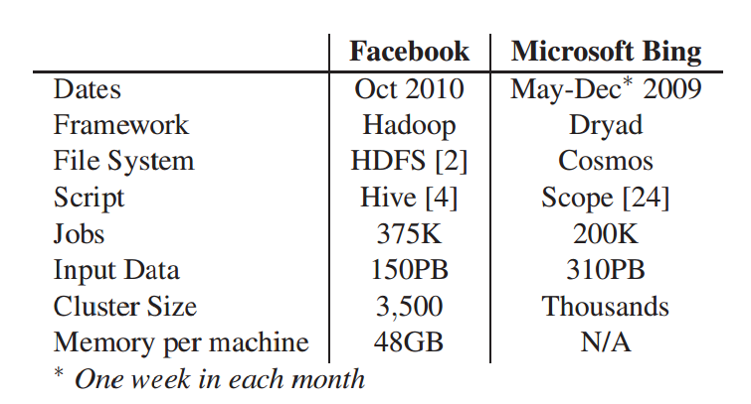
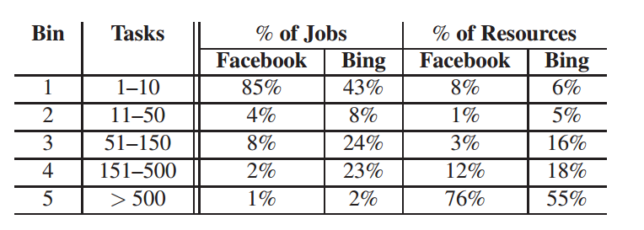
Evaluation
Experimental Setup: 100-node cluster in Amazon EC2
34.2GB of memory, 20GB of cache allocation for PACMan per machine
13 cores and 850 GB storage
Traces from Facebook and Bing

Slide 15
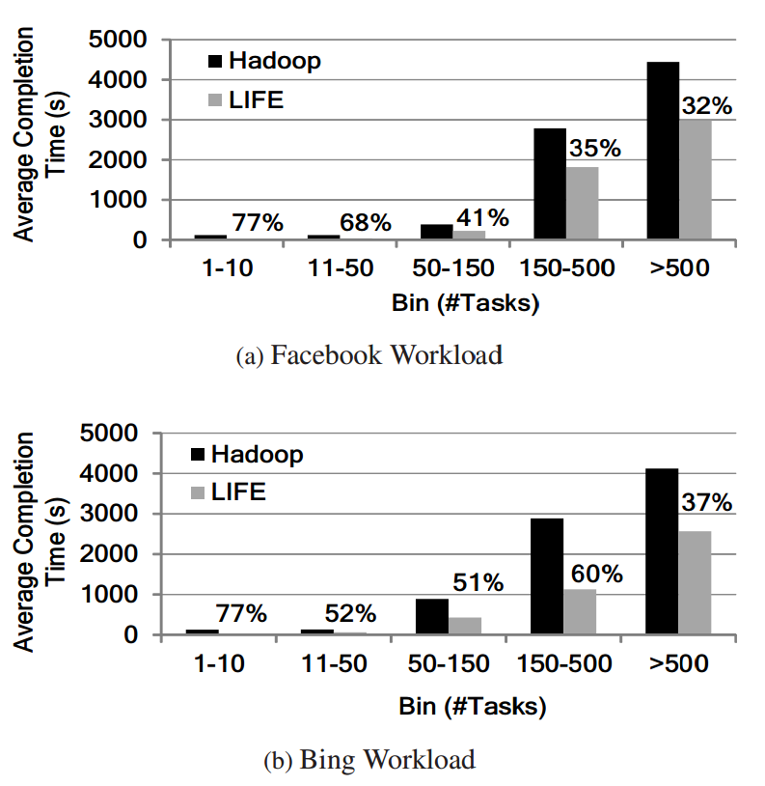
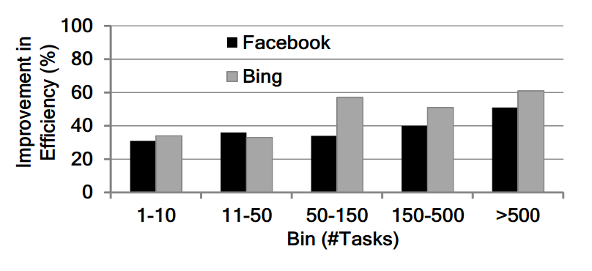
Results: PACMan on Hadoop
Significant reduction in completion time for small jobs.
Better efficiency at larger jobs.

Slide 16
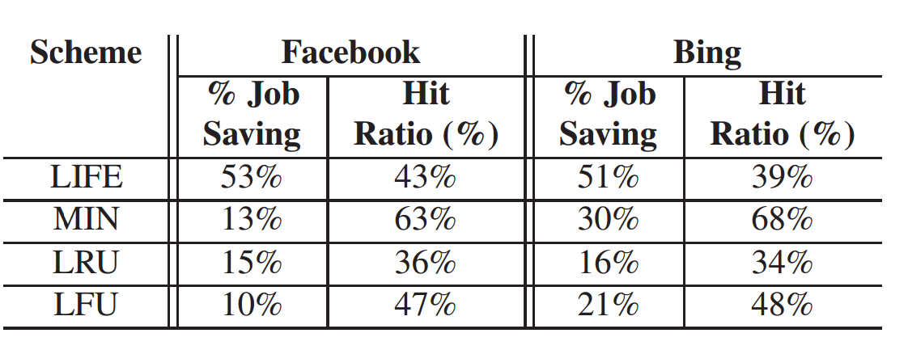
Results: PACMan vs Traditional Policies
LIFE performs significantly better than MIN, despite having lower hit ratio for most applications.
Sticky-policy help LFU-F have better cluster efficiency.

Slide 17
Takeaways
Most datacenter workloads are small in size, and can fit in memory.
PACMan – Coordinated Cache Management System
Take into account All-or-nothing nature of parallel jobs to improve:
Completion Time (LIFE policy)
Resource Utilization (LFU-F policy)
53% improvement in runtime, 54% improvement in resource utilization over Hadoop.

Slide 18
Reviews
All-or-nothing
Wave-based execution
Reduces completion time
Increases cluster efficiency
Significant performance gain
Theoretical analysis
Coordination architecture independent of replacement policy
Overheads
Fairness?
No Prefetching
Wave-width approximation
Communication overhead with scheduler for prefetching
Generalize to other parallel workloads?
More policies ?
Scalability? >10 tasks per machine? Single coordinator bottleneck?
Reliability? Clients become uncooperative
Fault tolerance? Coordinator failure recovery is slow
Priority inversion? Long running jobs suffer due to many small jobs

Slide 19
Discussion
Should PACMan be scaled down to coordinate shared cache management for multicore processors ?
Are there distributed workloads where the “all-or-nothing” property does not hold ?
PACMan assumes remote memory access is constrained by the network. How does RDMA affect PACMan’s design ?

Slide 20
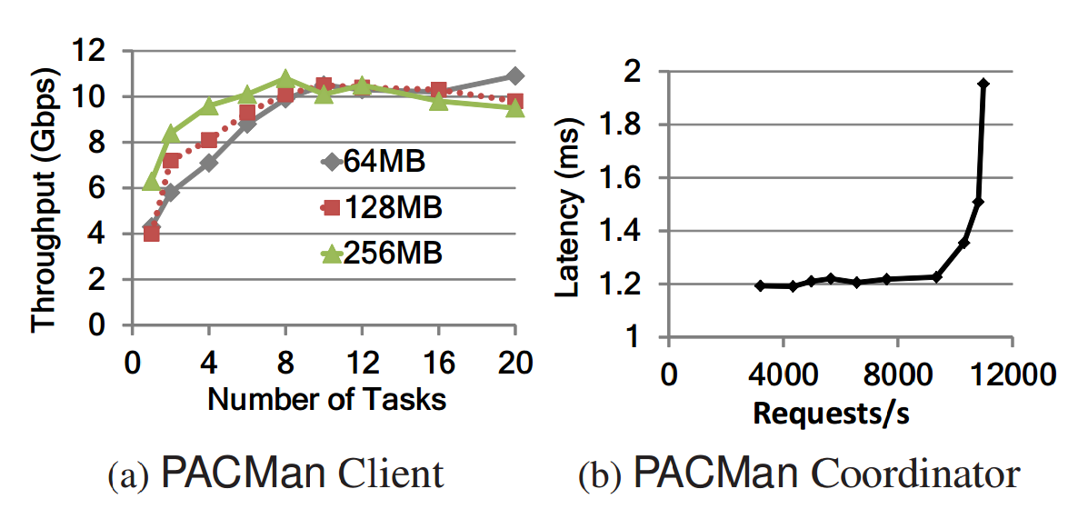
Results: PACMan’s Scalability
PACMan client saturate at 10-12 tasks per machine, for block sizes of 64/128/256MB, which is typical of Hadoop
Coordinator maintains a constant ~1.2ms latency till 10,300 requests per second; Hadoop handles 3,200 requests/s

Slide 21
Results: PACMan’s sensitivity to Cache Size
Both LIFE and LFU-F react gracefully to reduction in cache size.
At 12GB cache-
LIFE yields 35% reduction in completion time,
LFU-F yields 29% improvement in cluster efficiency

