Slide 1
EC-Cache: Load-balanced, Low-latency Cluster Caching with Online Erasure Coding
K. V. Rashmi, Mosharaf Chowdhury, Jack Kosaian, Ion Stoica, Kannan Ramchandran
Presented by Haoran Wang

Slide 2
Background
The trend of in-memory caching for object store
Reduced a lot of disk I/O
e.g. Alluxio(Tachyon)
Load imbalance
Skew of popularity
Background network traffic congestion

Slide 3
Erasure coding in a nutshell
Fault-tolerance in a space-efficient fashion
Trade data availability for space efficiency

Slide 4
Replication
X
Y
Z

Slide 5
Replication
X
Y
Z
Replica factor = 2
X
Y
Z

Slide 6
Erasure Coding
X
Y
Z

Slide 7
Erasure Coding
a₁₁
X
a₁₂
Y
+
a₁₃
Z
=
W
+
Linear parity
a₂₁
X
+
a₂₂
Y
+
a₂₃
Z
=
T

Slide 8
Erasure Coding
a₁₁
X
a₁₂
Y
+
a₁₃
Z
=
W
+
Linear parity
k = 3, r = 2
a₂₁
X
+
a₂₂
Y
+
a₂₃
Z
=
T

Slide 9
Erasure Coding
a₁₁
X
a₁₂
Y
+
a₁₃
Z
=
W
+
Linear parity
k = 3, r = 2
a₂₁
X
+
a₂₂
Y
+
a₂₃
Z
=
T
A well-known co-efficient matrix:
$$\begin{matrix}a_{11} & a_{12} & a_{13} \\ a_{21} & a_{22} & a_{23}\end{matrix}$$

Slide 10
Fault tolerance - Replication
X
Y
Z
Survived 1 failure
X
Y
Z

Slide 11
Fault tolerance - Replication
X
Y
Z
Survived 2 failures
X
Y
Z

Slide 12
Fault tolerance - Replication
X
Y
Z
Cannot survive
X
Y
Z

Slide 13
Fault tolerance - Replication
Total storage is 6 units
Only guaranteed to survive one failure

Slide 14
Fault tolerance - EC
a₁₁
X
a₁₂
Y
+
a₁₃
Z
=
W
+
Linear parity
k = 3, r = 2
a₂₁
X
+
a₂₂
Y
+
a₂₃
Z
=
T
A well-known co-efficient matrix:
$$\begin{matrix}a_{11} & a_{12} & a_{13} \\ a_{21} & a_{22} & a_{23}\end{matrix}$$

Slide 15
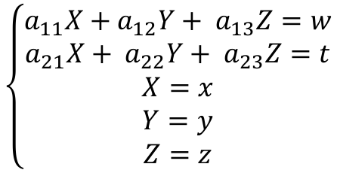
Fault tolerance - EC
Translated into linear equations:
$$\left\{\begin{aligned}a_{11}X+a_{12}Y+ a_{13}Z=w \\ a_{21}X+ a_{22}Y+ a_{23}Z=t \\ X=x \\ Y=y \\ Z=z\end{aligned}\right.$$
$X$ : the symbol that represents data $X$
$x$: the actual value of $X$

Slide 16
Fault tolerance - EC
Translated into linear equations:
$$\left\{\begin{aligned}a_{11}X+a_{12}Y+ a_{13}Z=w \\ a_{21}X+ a_{22}Y+ a_{23}Z=t \\ X=x \\ Y=y \\ Z=z\end{aligned}\right.$$
Still solvable, with unique solution (set)

Slide 17
Fault tolerance - EC
Translated into linear equations:
$$\left\{\begin{aligned}a_{11}X+a_{12}Y+ a_{13}Z=w \\ a_{21}X+ a_{22}Y+ a_{23}Z=t \\ X=x \\ Y=y \\ Z=z\end{aligned}\right.$$
5 equations and 3 variables
Can survive ANY 2 failures
Because N variables can be solved from N (linearly independent) equations

Slide 18
Fault tolerance – EC
Need only 5 storage units to survive 2 failures
Compared to replication: (6,1)

Slide 19
What’s the tradeoff?
Saving space V.S. Time needed to reconstruct (solving linear equations)

Slide 20
Switch of context
EC for fault-tolerance → EC for load balancing and low latency
Granularity: single data object → splits of object
How about the tradeoff?
Deal with primarily in-memory cache, so reconstruction time won’t be a problem

Slide 21
Load balancing
4 pieces of data: Hot Hot Cold Cold

Slide 22
Load balancing
Seemingly balanced
Hot
Cold
Hot
Cold

Slide 23
Load balancing
What if some data is super hot ? Super hot >> hot + cold + cold
Super Hot
Hot
Cold
Cold

Slide 24
Load balancing
Introducing splits
“Distribute” the hotness of single object
Also good for read latency – read splits in parallel

Slide 25
But what’s wrong with split-level replication?
Server 1
Server 2
Server 3
Server 4
Server 5
Server 6
…
…
…
…
…
…
X
Y
Z
X
Y
Z
…
…
…
…
…
…

Slide 26
But what’s wrong with split-level replication?
Server 1
Server 2
Server 3
Server 4
Server 5
Server 6
…
…
…
…
…
…
X
Y
Z
X
Y
Z
…
…
…
…
…
…
Need at least one copy of (X,Y,Z) to retrieve the whole object
Notes:
This is replication with static factor = 2, but the problem still remains for selective replication

Slide 27
The flexibility of EC
Server 1
Server 2
Server 3
Server 4
Server 5
…
…
…
…
…
X
Y
Z
W
T
…
…
…
…
…
Any k (= 3) of k + r (=5) units would suffice to reconstruct the original object

Slide 28
EC-Cache: Dealing with straggler/failures
Server 1
Server 2
Server 3
Server 4
Server 5
…
…
…
…
…
X
Y
Z
W
T
…
…
…
…
…
Failed/Slow, but it’s OK
Read $k+ ∆ (∆$ < r) out of k + r units, finish as long as first k reads are complete

Slide 29
Writes
Create splits
Encode to parity units
Uniformly randomly distribute to distinct servers

Slide 30
Implementation
Built on top of Alluxio (Tachyon)
Transparent to backend storage/caching server
Reed-Solomon codes instead of linear parities
Intel ISA-L for faster encoding/decoding
Zookeeper to manage metadata
Location of splits
Mapping of object to splits
Which splits to write
Backend storage server takes care of “ultimate” fault-tolerance
EC-Cache deals with only in-memory caches

Slide 31
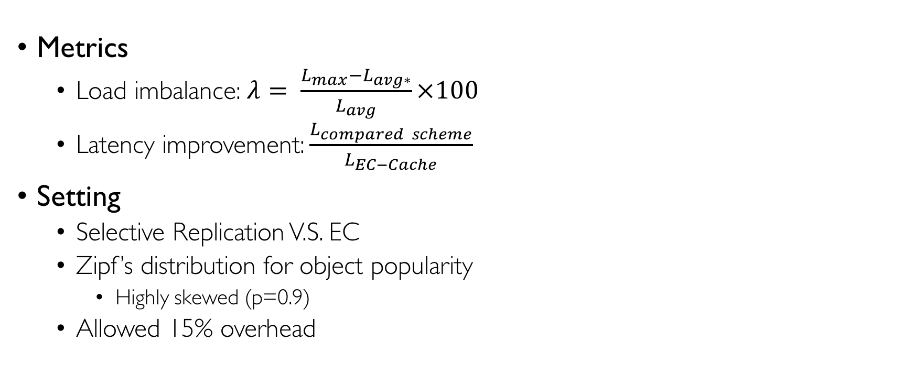
Evaluation
Metrics
Load imbalance: $λ= \frac{L_{max}−L_{avg∗}}{L_{avg}}×100$
Latency improvement: $\frac{L_{compared scheme}}{L_{EC−Cache}}$
Setting
Selective Replication V.S. EC
Zipf’s distribution for object popularity
Highly skewed (p=0.9)
Allowed 15% overhead

Slide 32
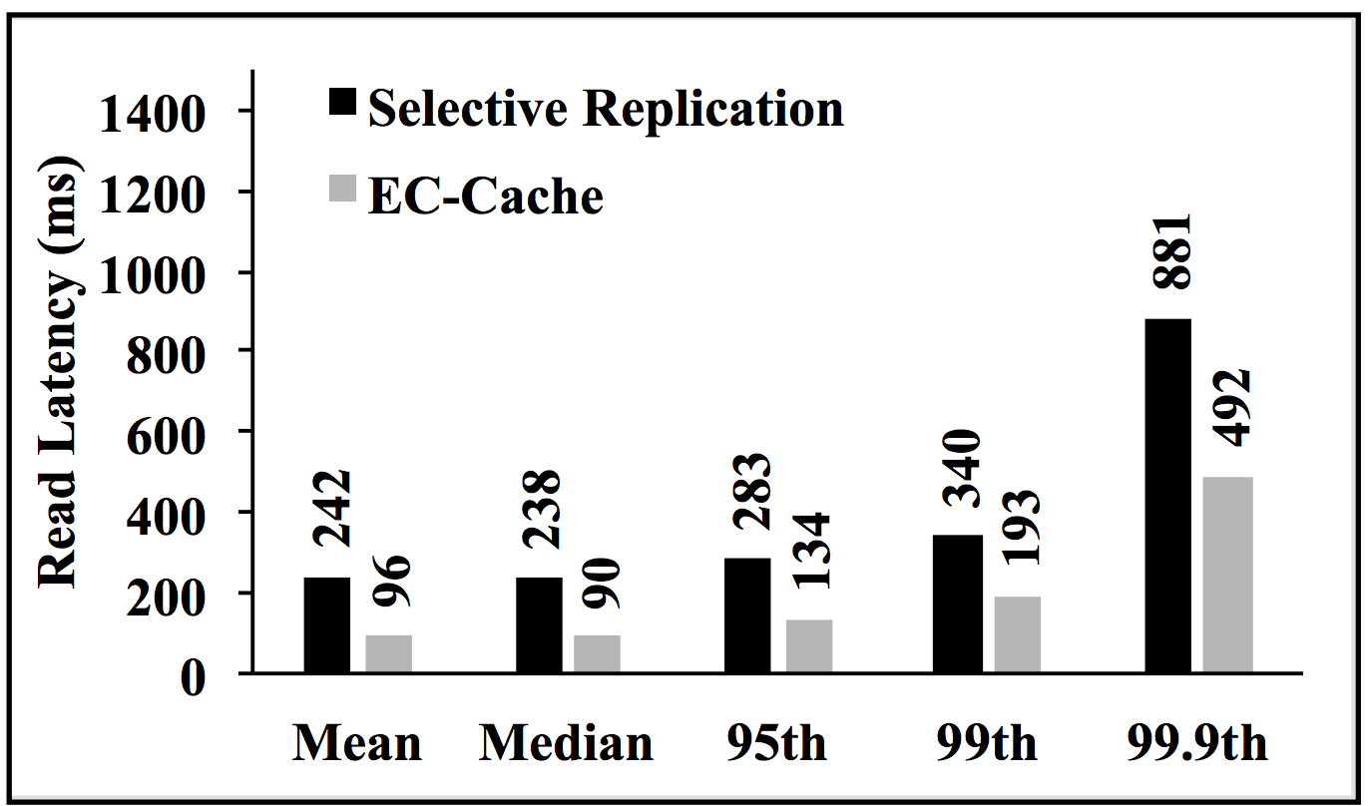
Evaluation – Read latency

Slide 33
Evaluation – Load Balancing

Slide 34
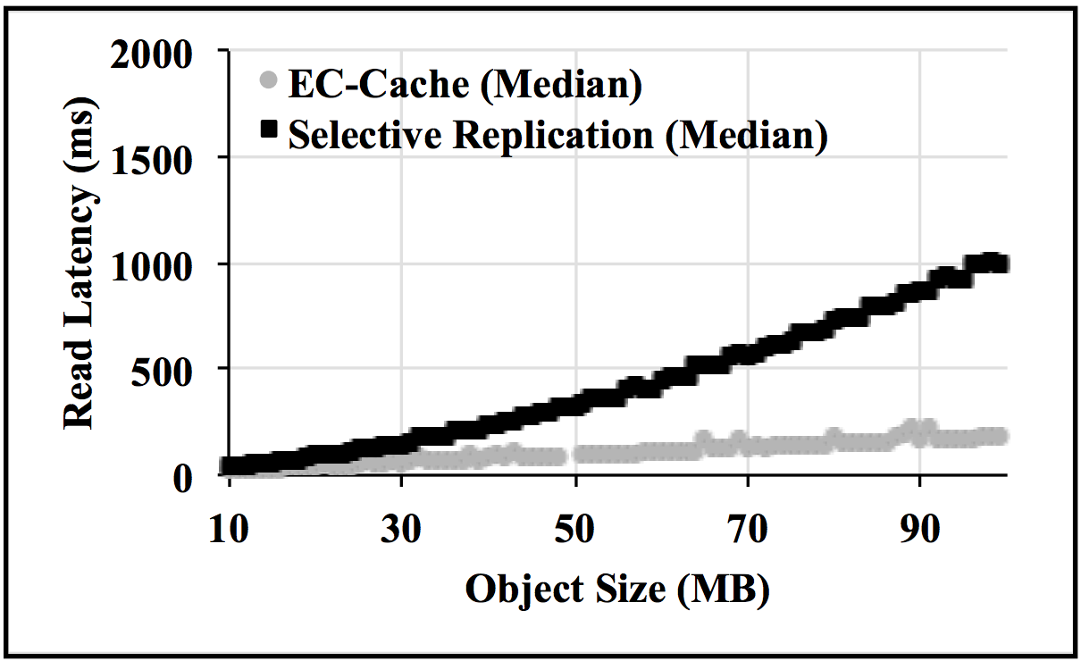
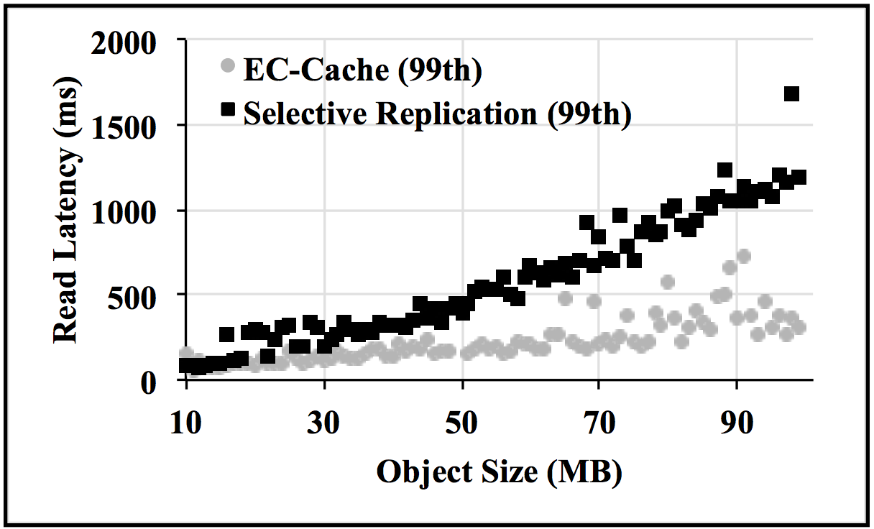
Evaluation – Varying object sizes
Median latency
Tail latency

Slide 35
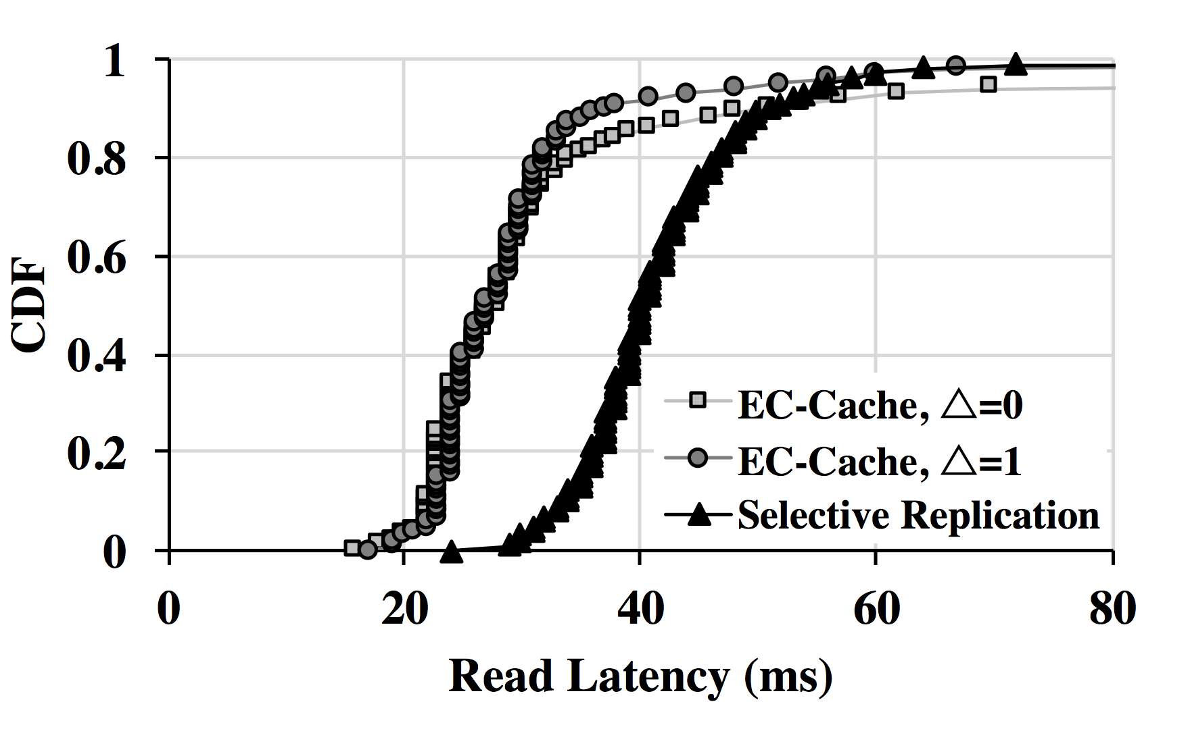
Evaluation – Tail latency improvement from additional reads

Slide 36
Summary
EC used for in-memory object caching
Effective for load balancing and reducing read latency
Suitable workloads
Immutable objects
Because updates to any data units would require re-encoding a new set of parities
Cut-off for small objects
Overhead cannot be amortized – still use SR for small objects

Slide 37
Discussions
In EC-cache, there are extra overheads for encoding/decoding/metadata/networking, in what contexts can they be tolerated/amortized?
What design would be good for frequent in-place updates? Any existing solutions?
What policy could minimize the eviction of splits needed for current read requests?
Notes:
In paper review, a lot talked about overhead of decoding/encoding and networking (TCT connection overhead for small splits)
In my understanding, encoding/decoding can be justified because in-memory computation is fast
Networking/metadata overhead can be amortized if we only use EC-Cache for big object, and we choose proper k and r so that splits are big enough too
In-place updates is another popular concern, are there any existing solutions for that?

