Slide 1
Omega: flexible, scalable schedulers for large compute clusters
Malte Schwarzkopf, Andy Konwinski, Michael Abd-El-Malek, John Wilkes
Presented by Muhammed Uluyol
*Some graphics from John Wilkes’ CMU presentation

Slide 2
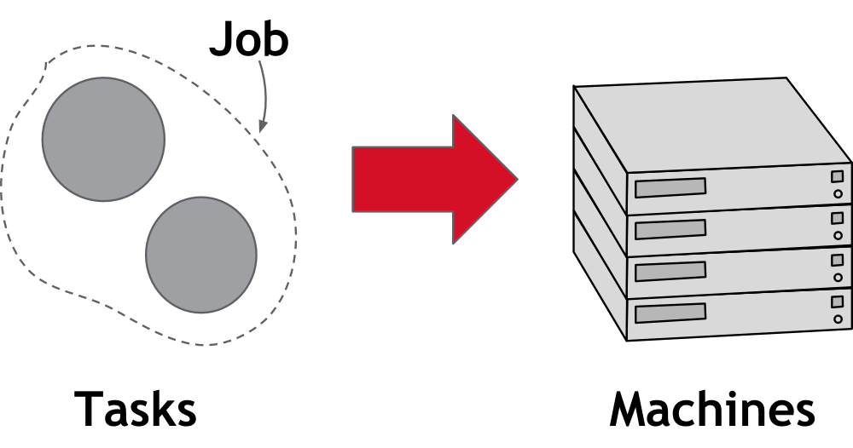
Problem

Slide 3
Problem
Heterogeneous Workloads
Both long-running services and batch jobs
Growing Clusters
Can avoid resource fragmentation
More Jobs
Many Constraints

Slide 4
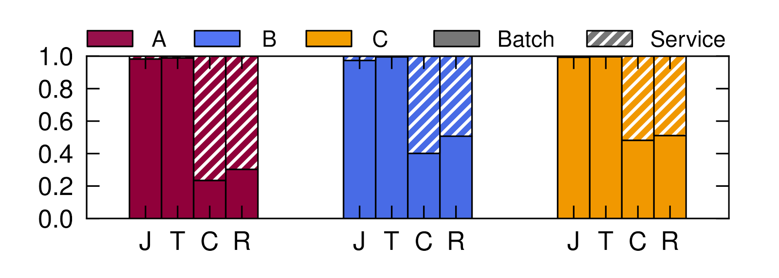
Workload Heterogeneity
Job Count
Task Count
CPU Requested
Memory Requested

Slide 5
Workload Heterogeneity

Slide 6
Workload Heterogeneity

Slide 7
Scheduling Complexity
60+ seconds

Slide 8
Scheduling Requirements
Heterogeneous workloads
High-utilization
Scalability
Fault-tolerant
User Constraints
Availability

Slide 9
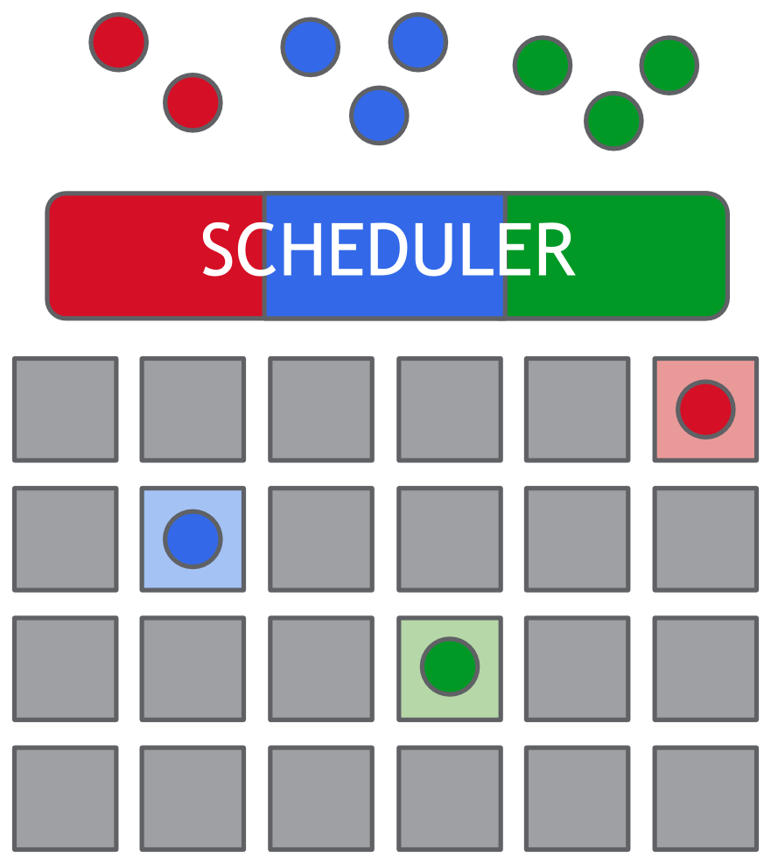
Approach: Monolithic
Complex
Head-of-line blocking
Scalability issues

Slide 10
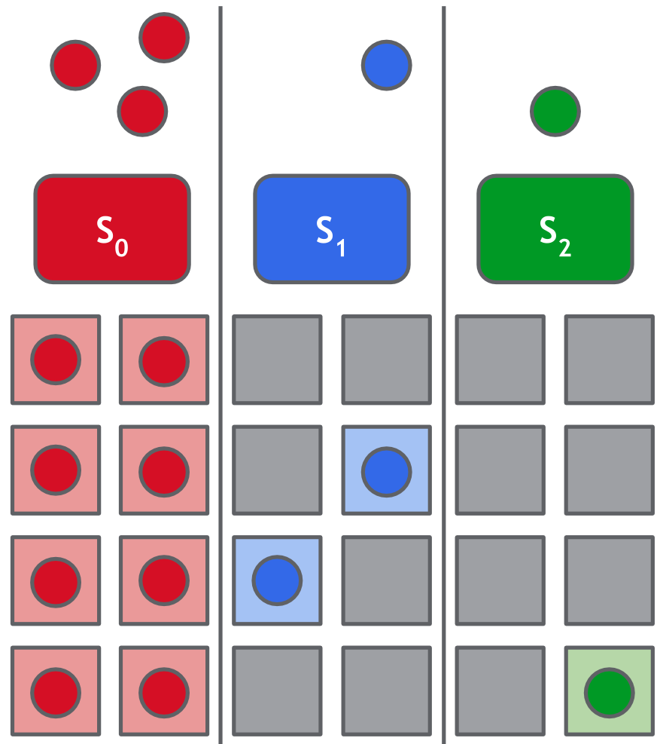
Approach: Static Partitioning
Simple
Bad utilization
Restricted placement

Slide 11
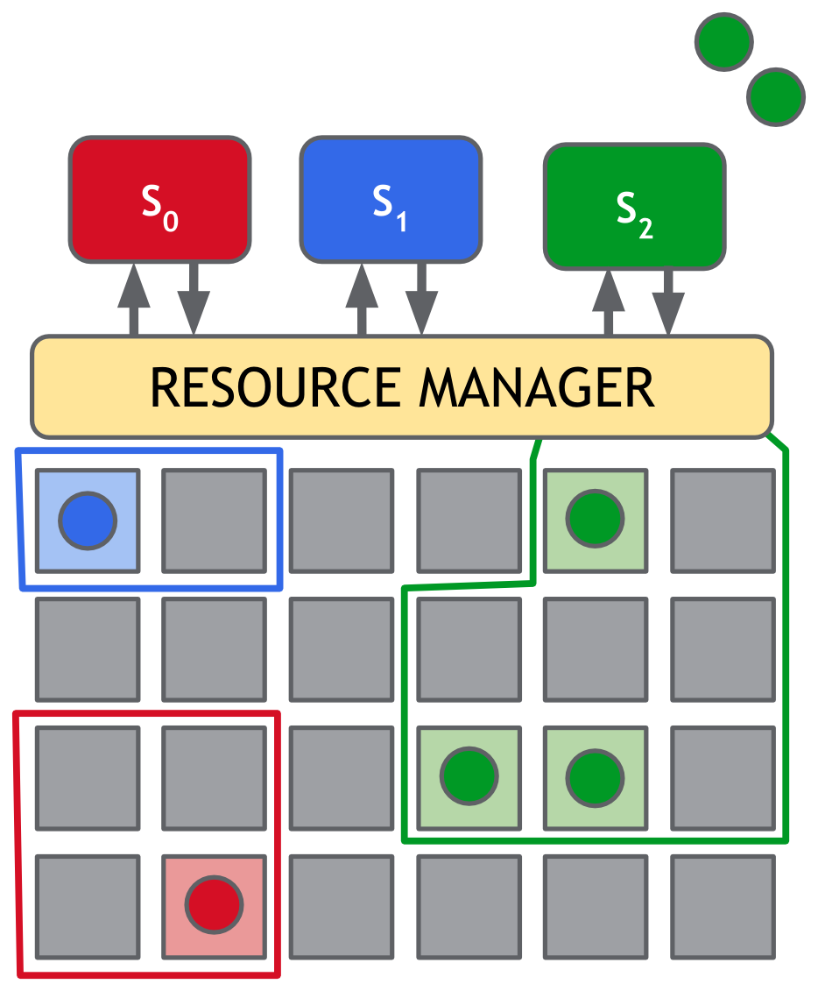
Approach: Two-Level
Flexibility: multiple schedulers
Pessimistic
Resources are “locked”
No conflicts
Limited placement

Slide 12
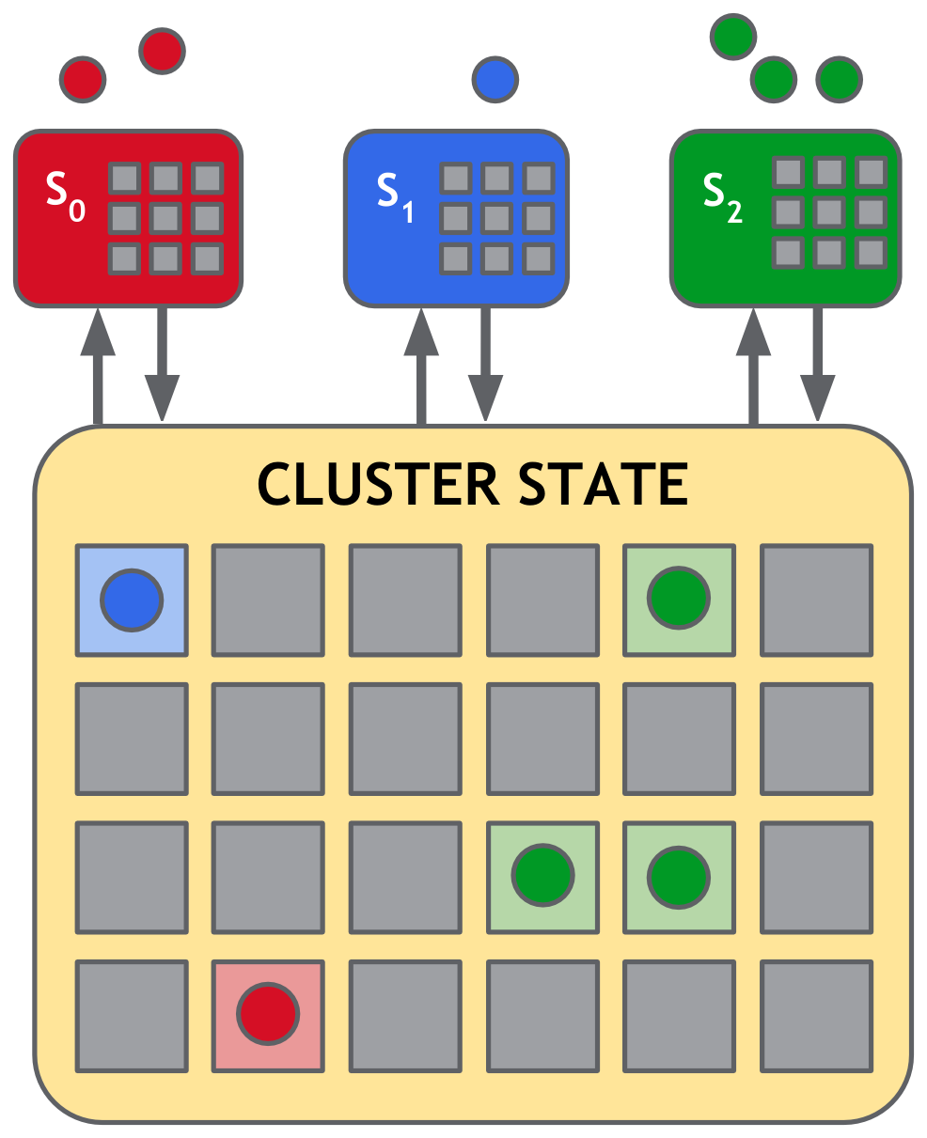
Approach: Shared-State
Flexibility: multiple schedulers
Optimistic
No locking
Can have conflicts
Free placement

Slide 13
Omega
Schedulers download copies of cell-state
Atomic commits (incremental or full)
No central resource manager*

Slide 14
Evaluation (Simulation)
 | Lightweight | High-Fidelity
Machines | Homogeneous | Actual
Resource request size | Sampled | Actual
Initial Cell state | Sampled | Actual
Tasks/Job | Sampled | Actual
Job inter-arrival time | Sampled | Actual
Task duration | Sampled | Actual
Scheduling Constraints | Ignored | Obeyed
Scheduling Algorithm | Randomized First-Fit | Google
Runtime | 24 h = 5 min | 24 h = 2 h
No preemption
No failures
Resource requests = actual usage
Allocations = initially requested size

Slide 15
Lightweight simulator: Monolithic
Notes:
Red = SLO exceeded

Slide 16
Lightweight simulator: Multi-Path Monolithic

Slide 17
Lightweight Simulator: Mesos

Slide 18
Why are there so many failures?
“Mesos achieves fairness by alternately offering all available
cluster resources to different schedulers”
Since service jobs take time to schedule, batch jobs are blocked
Scheduling is assumed to be quick
Resource churn is expected to be high

Slide 19
Lightweight Simulator: Omega

Slide 20
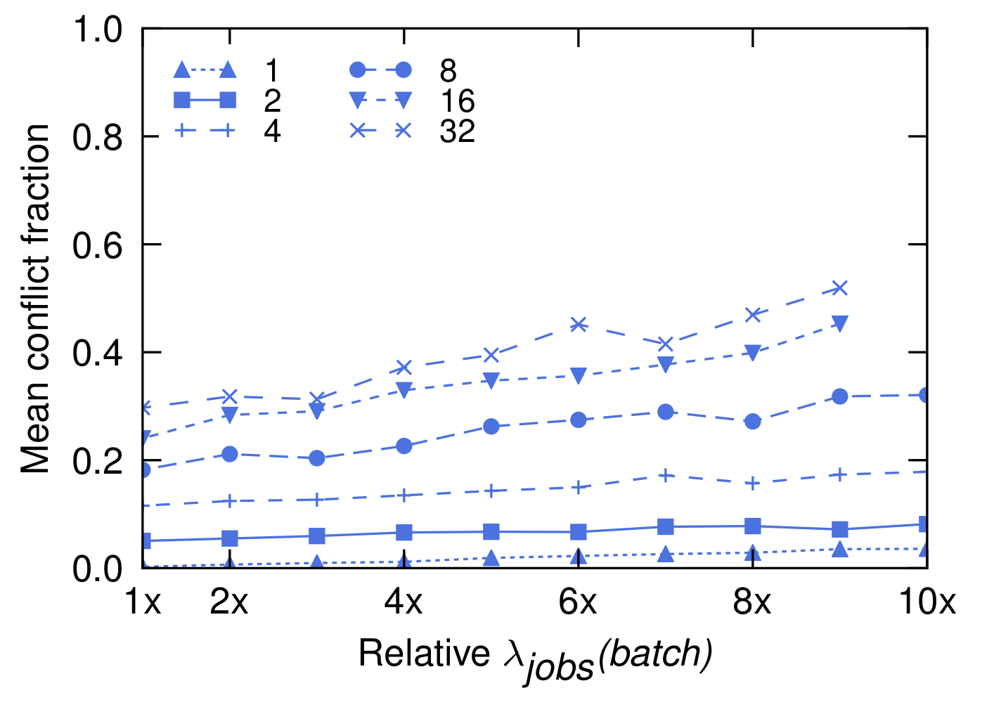
Scalability

Slide 21
Lightweight Simulator: Summary
Similar to monolithic multi-path without head-of-line blocking
Does not suffer from heterogeneity issues
Scales, but non-linear

Slide 22
High-Fidelity Simulator

Slide 23
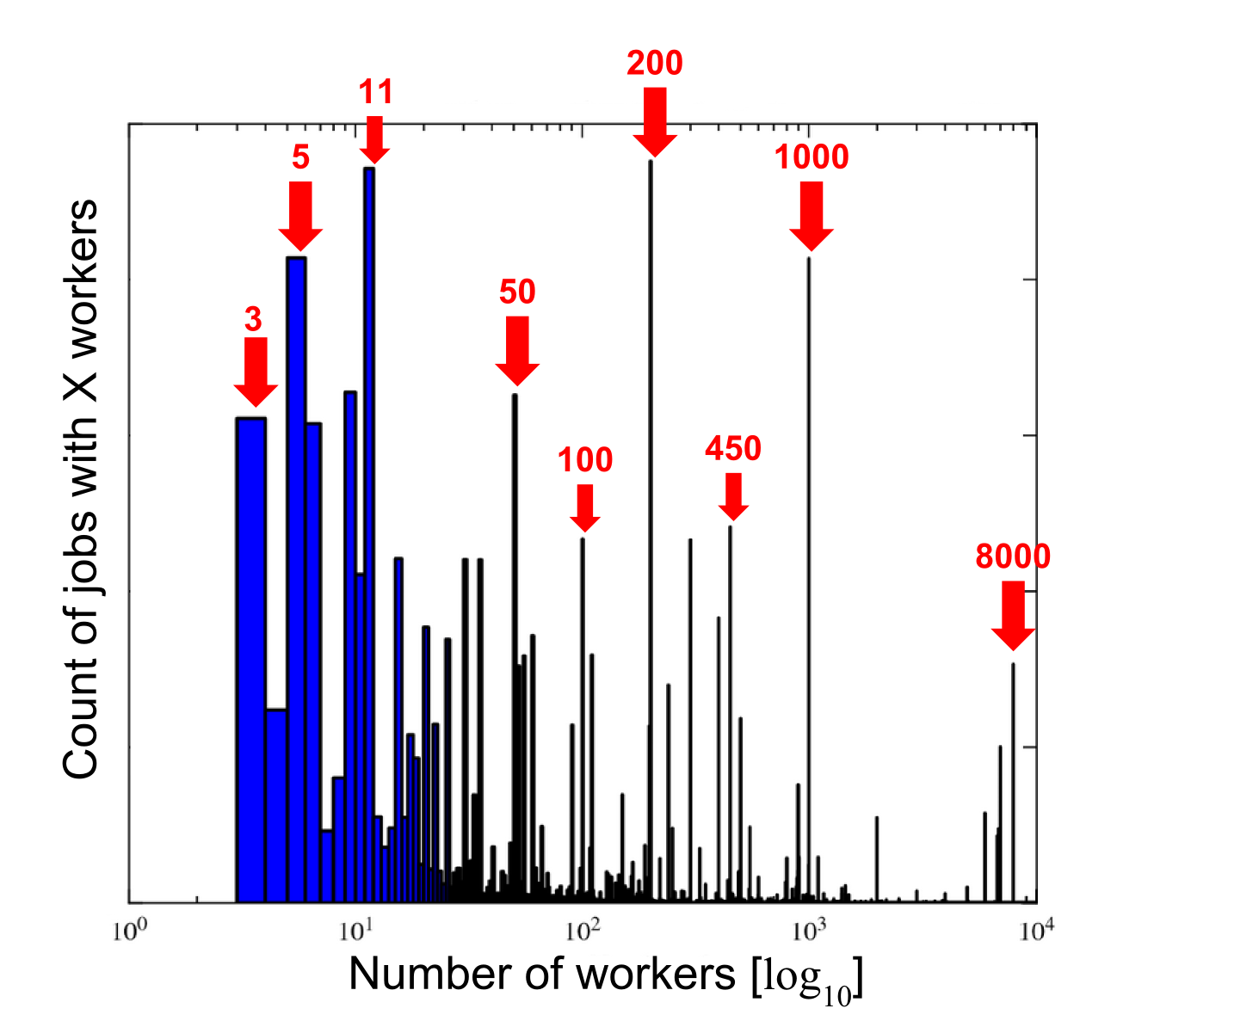
Application-Specific Scheduler: MapReduce
Engineers are not good at picking worker counts
Add MR-specific scheduler
Assume linear speedup
Add more workers if possible

Slide 24
Application-Specific Scheduler: MapReduce

Slide 25
Wrap-Up
Optimistic concurrency
Overhead outweighed by benefits
Scalability
No head-of-line blocking
Simplicity
Facilitates specialized schedulers

Slide 26
Discussion
When do users care about fairness?
How well does Omega scale down?
Can Mesos be fixed to handle long scheduling times?

