Slide 1
Mesos: A Platform for Fine-Grained Resource Sharing in the Data Center
Benjamin Hindman, Andy Konwinski, Matei Zaharia, Ali Ghodsi, Anthony D. Joseph, Randy Katz, Scott Shenker, Ion Stoica
Presented by Muhammed Uluyol

Slide 2
Problem
Many frameworks
How to share resources?
  Better utilization
  Low operational cost

Slide 3
Status Quo
Hadoop 1.x
Hadoop 2.x
Spark

Slide 4
Status Quo
Underutilized (resource fragmentation)
Suboptimal placement
  Locality
  Failure tolerance
Hadoop 1.x
Hadoop 2.x
Spark

Slide 5
Goal
Hadoop 1.x
Hadoop 2.x
Spark

Slide 6
Goal
Mesos
Hadoop 1.x
Hadoop 2.x
Spark

Slide 7
Design Goals
High Utilization
Framework agnostic
Scalability (10,000s of nodes)
Fault-tolerant

Slide 8
Scheduling
Potential Solution: Global Scheduler
  Frameworks specify requirements
  Pros:
    Obvious solution
    Can make good placement decisions across all tasks
  Cons:
    Complex
    How to scale?
    How to address future needs?

Slide 9
Resource Offers
Present available resources to framework schedulers
Scheduler picks which resources to use for a job
Pros:
  Minimal work done in Mesos
Cons:
  Schedulers unaware of each other’s jobs leads to suboptimal decisions

Slide 10
Architecture
Mesos Slave
Hadoop Executor
MPI Executor
Hadoop Scheduler
Task
Task
Mesos Master
MPI Scheduler
Jobs
Allocation Module
Mesos Slave
Hadoop Executor
Spark Executor
Spark Scheduler
Task
Task

Slide 11
Allocation Modules
Pluggable
Wrote two:
  Fair Sharing
  Priority
Expects tasks to be short
Long tasks can be killed

Slide 12
Isolation
Use OS-provided mechanisms
E.g. containers on Linux

Slide 13
Resource Offers
Count towards usage until a selection is made
Offer are taken back after timeouts

Slide 14
Fault-Tolerance
Only need
  Active Slaves
  Active Frameworks
  Running Tasks
Store in ZooKeeper
Framework schedulers need to provide fault-tolerance

Slide 15
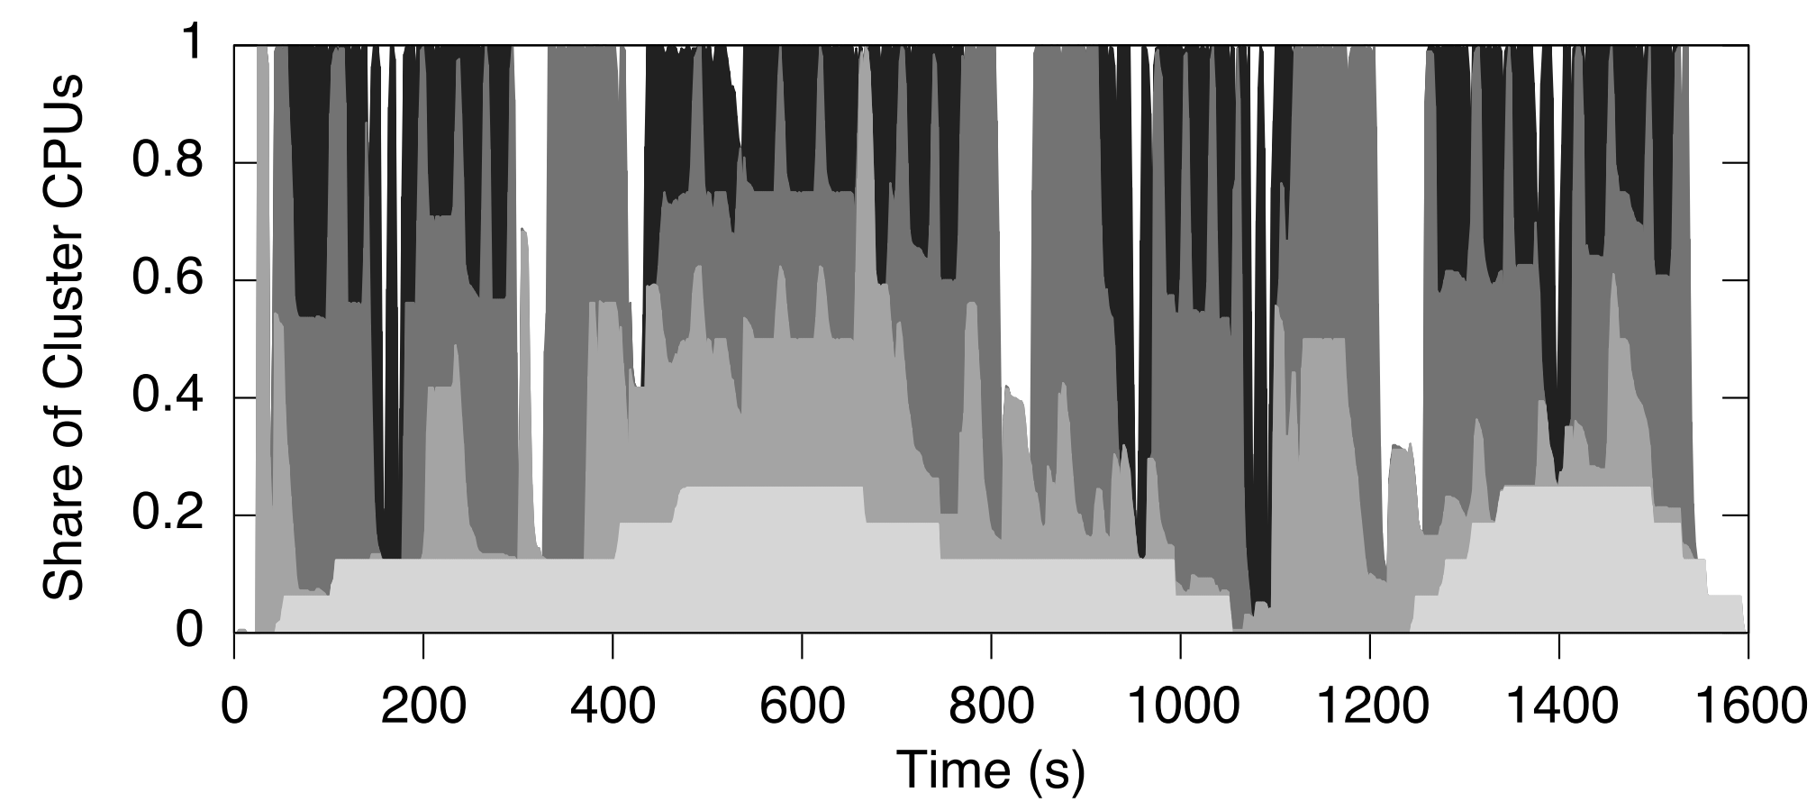
Evaluation: Sharing

Slide 16
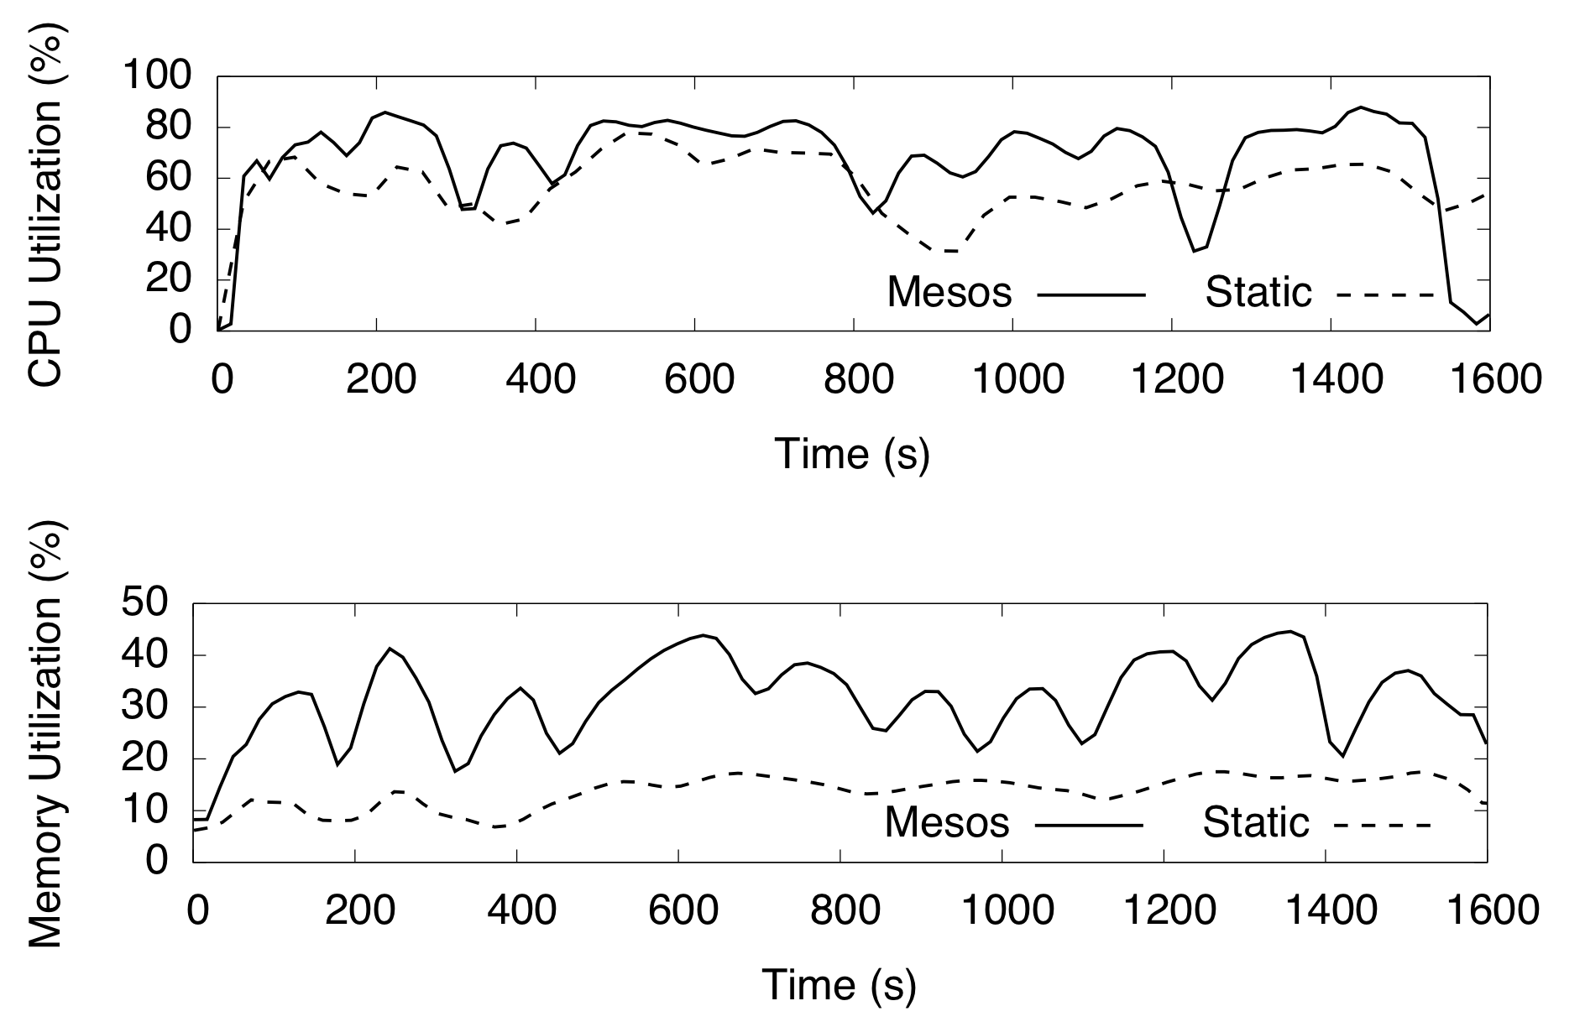
Evaluation: Utilization

Slide 17
Evaluation: Mesos vs Static Partitioning
Framework | Speedup on Mesos
Facebook Hadoop Mix | 1.14
Large Hadoop Mix | 2.10
Spark | 1.26
Torque/MPI | 0.96

Slide 18
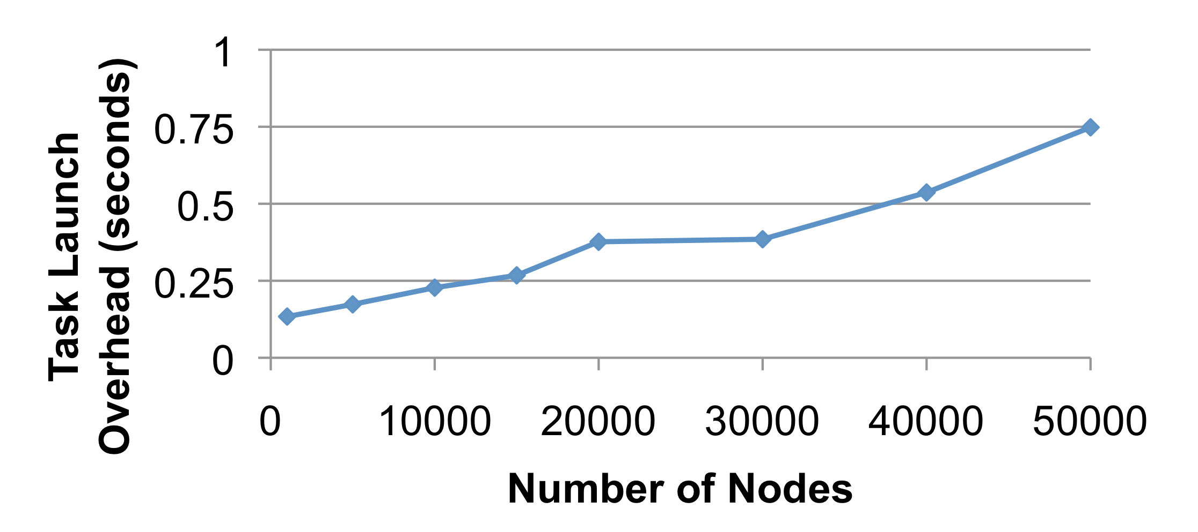
Evaluation: Scalability

Slide 19
Wrap Up
Mesos shares machines across different cluster compute frameworks
Fine-grained sharing enables better locality and utilization
Resource offers are a scalable, decentralized approach for application-controlled schedling

Slide 20
Discussion
What happens if tasks take a long time to execute?
How can application schedulers be made fault-tolerant?
Can Mesos be used for long-running (web) services?

