Slide 1
Large-scale Cluster Manager at Google with Borg
Abhishek Verma, Luis Pedrosa, Madhukar Korupolu,
David Oppenheimer, Eric Tune, John Wilkes
Presented By: Arjun Khurana
Notes:
EuroSys 2015

Slide 2
Agenda
Motivation / Design Goals
User Level Perspective
Borg Architecture
Evaluation
Future Work
Conclusion
Discussion Questions

Slide 3
Motivation / Design Goals
Cost Effective Resource Sharing
3 Main Benefits
Hides details of resource management & failure handling
Operates with very high reliability and availability
Run Workloads across tens of thousands of machines effectively

Slide 4
User Level Perspective
Job hello_world = {
runtime = { cell = ‘ic’ } // What cluster should we run in?
binary = ‘…/hello_world_webserver // What program are we to run?
args = { port = ‘%port%’ } // Command line parameters
requirements = { // Resource requirements
ram = 100M
disk = 100M
cpu = 0.1
}
replicas = 10000 // Number of Tasks
}
Notes:
2.5 minutes for 45 MB a piece

Slide 5
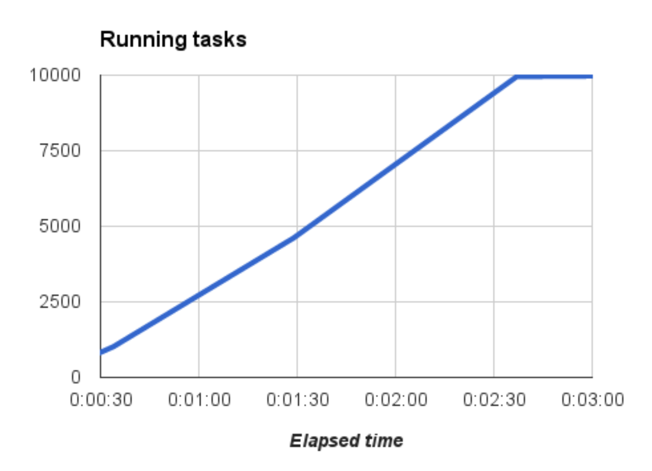
Running Tasks

Slide 6
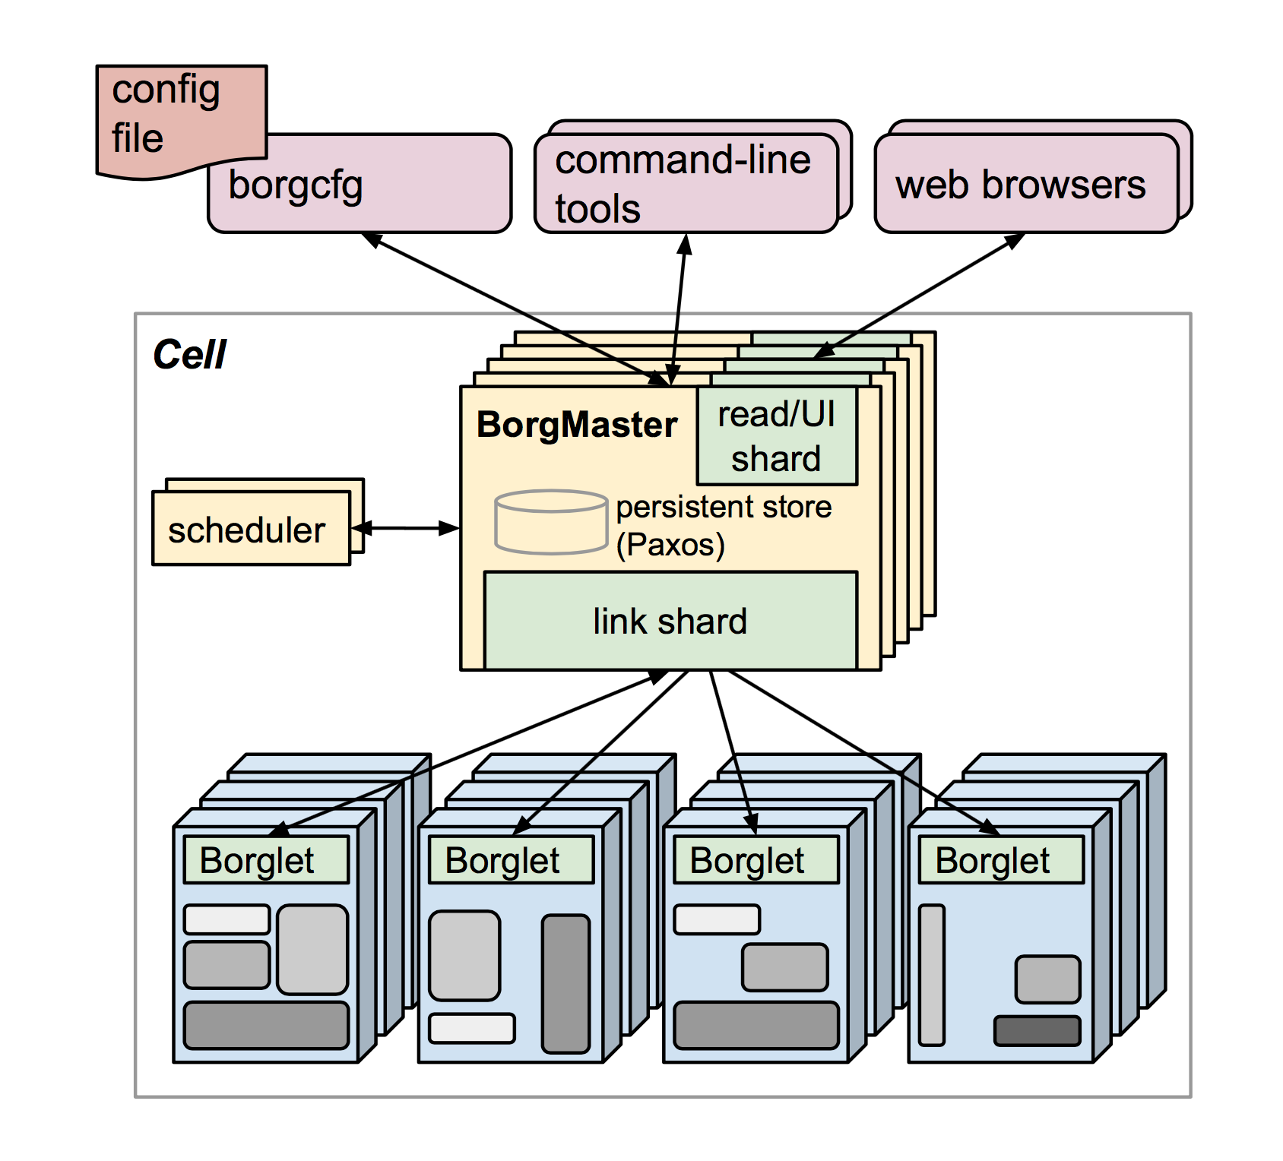
Borg Architecture – High Level
Compile the program and stick it in the cloud
Pass configuration to command line (Borg Config)
Send an RPC to the Borg Master
Borg Master writes to persistent store & tasks added to pending queue
Scheduler asynchronous scan
Link Shards check Borglets

Slide 7
Borg Architecture
Borg Master
Central “brain” of system
Holds Cluster State
Replicated for Reliability (PAXOS)
Scheduling
Where to place tasks???
Feasibility Checking
Scoring
Borglet
Machine Agent
Supervises local tasks
Interacts with BorgMaster
Notes:
When Job submitted, BorgMaster writes to persistent store & adds to pending queue. Scanned Asynchronously by scheduler.

Slide 8
Borg Architecture
Scalability
Simple synchronous loop
Split scheduler into separate processes
Separate threads to Borglets
Score Caching
Don’t recompute scores if same state
Equivalence classes
Only do feasibility checking & scoring once per similar task
Relaxed randomization
Calculate feasibility and scores wasteful

Slide 9
Running Tasks

Slide 10
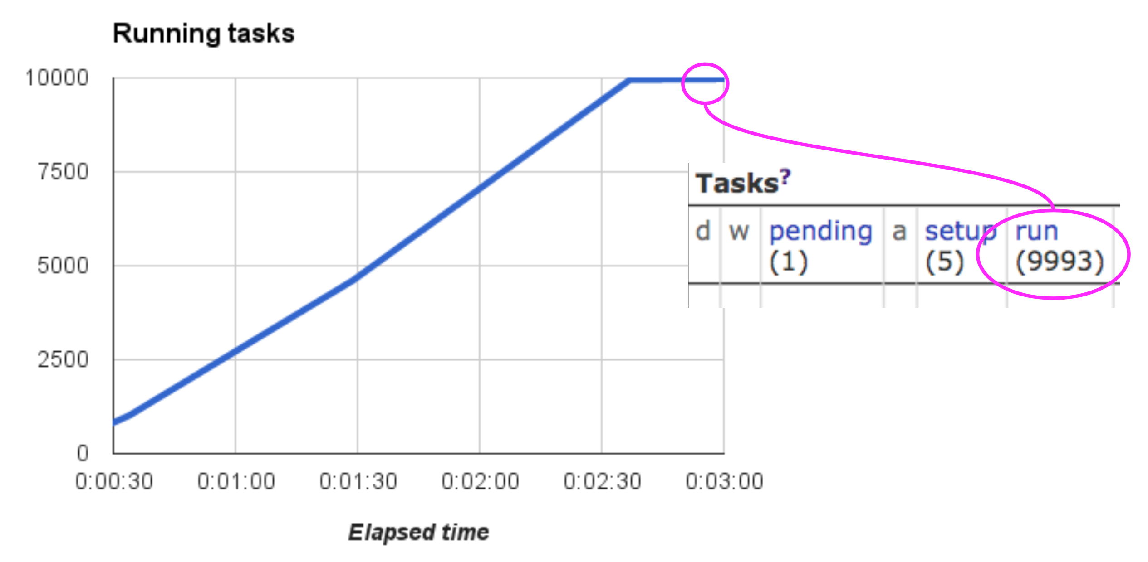
Running Tasks
Notes:
Best Case.
Pending / Setup. Waiting to go into scheduler

Slide 11
Failures
Notes:
Production Jobs v. Non-Production Jobs
Failure Cases First, Performance Second -> if it’s not up, performance doesn’t matter
Discuss Availability (Section 4)

Slide 12
Utilization
Notes:
Why?
Heterogenous machines, Batch Jobs, etc.
Machine heterogeneity (random remove). Maintain sophisticated constraints
Cell Compaction: Take a cell. Randomly remove machines from it. See if you can continue to pack the workload. Run a few times.

Slide 13
Utilization
Evaluation Metric: Cell Compaction
Smallest cell that workload will work
Randomly selected machines to remove
Notes:
Why?
Heterogenous machines, Batch Jobs, etc.
Machine heterogeneity (random remove). Maintain sophisticated constraints
Cell Compaction: Take a cell. Randomly remove machines from it. See if you can continue to pack the workload. Run a few times.

Slide 14
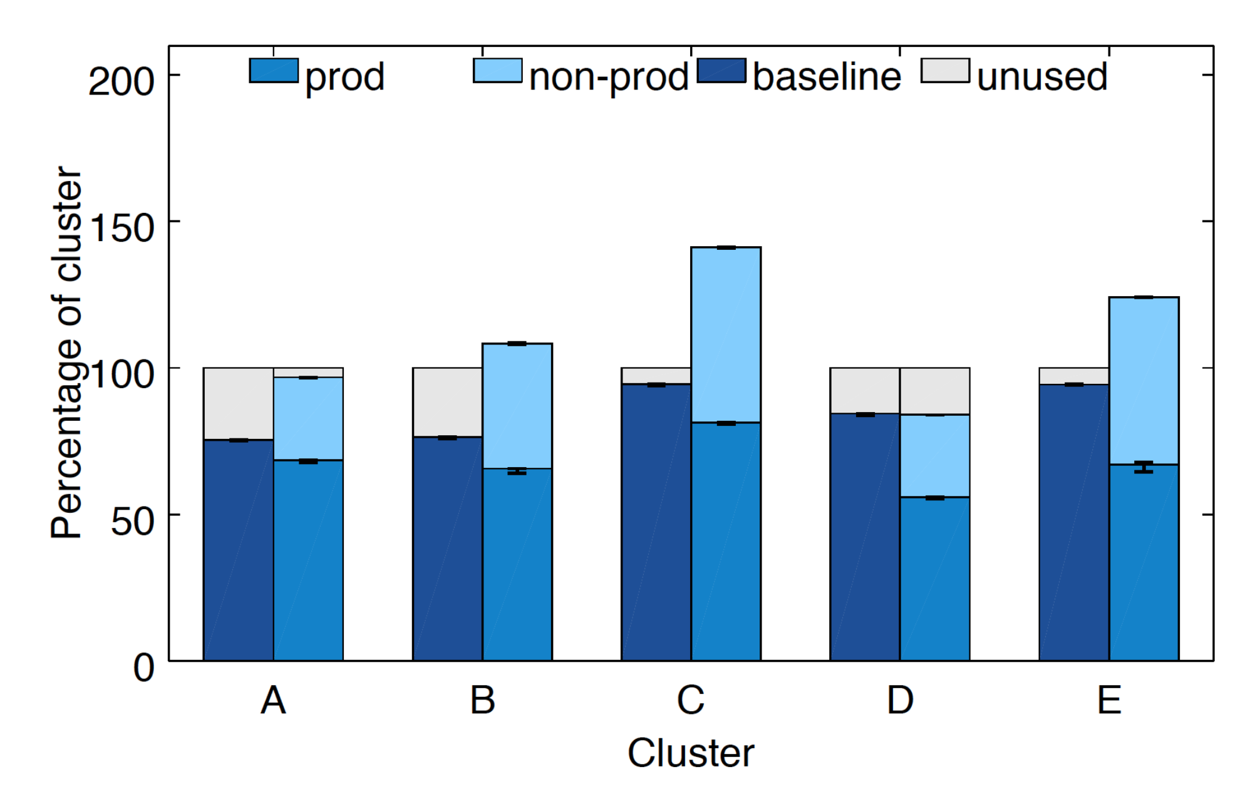
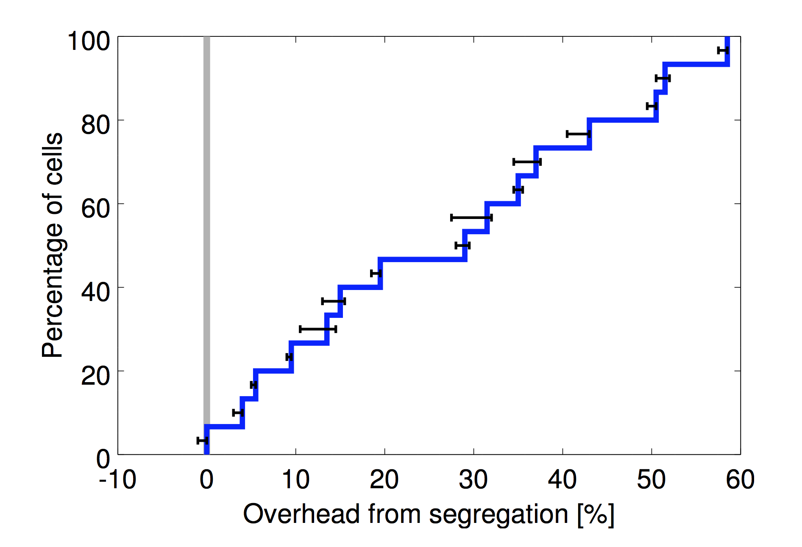
Utilization
Cell Sharing
Notes:
Sharing between Prod/ Non-Prod. => Segregation needs more machines

Slide 15
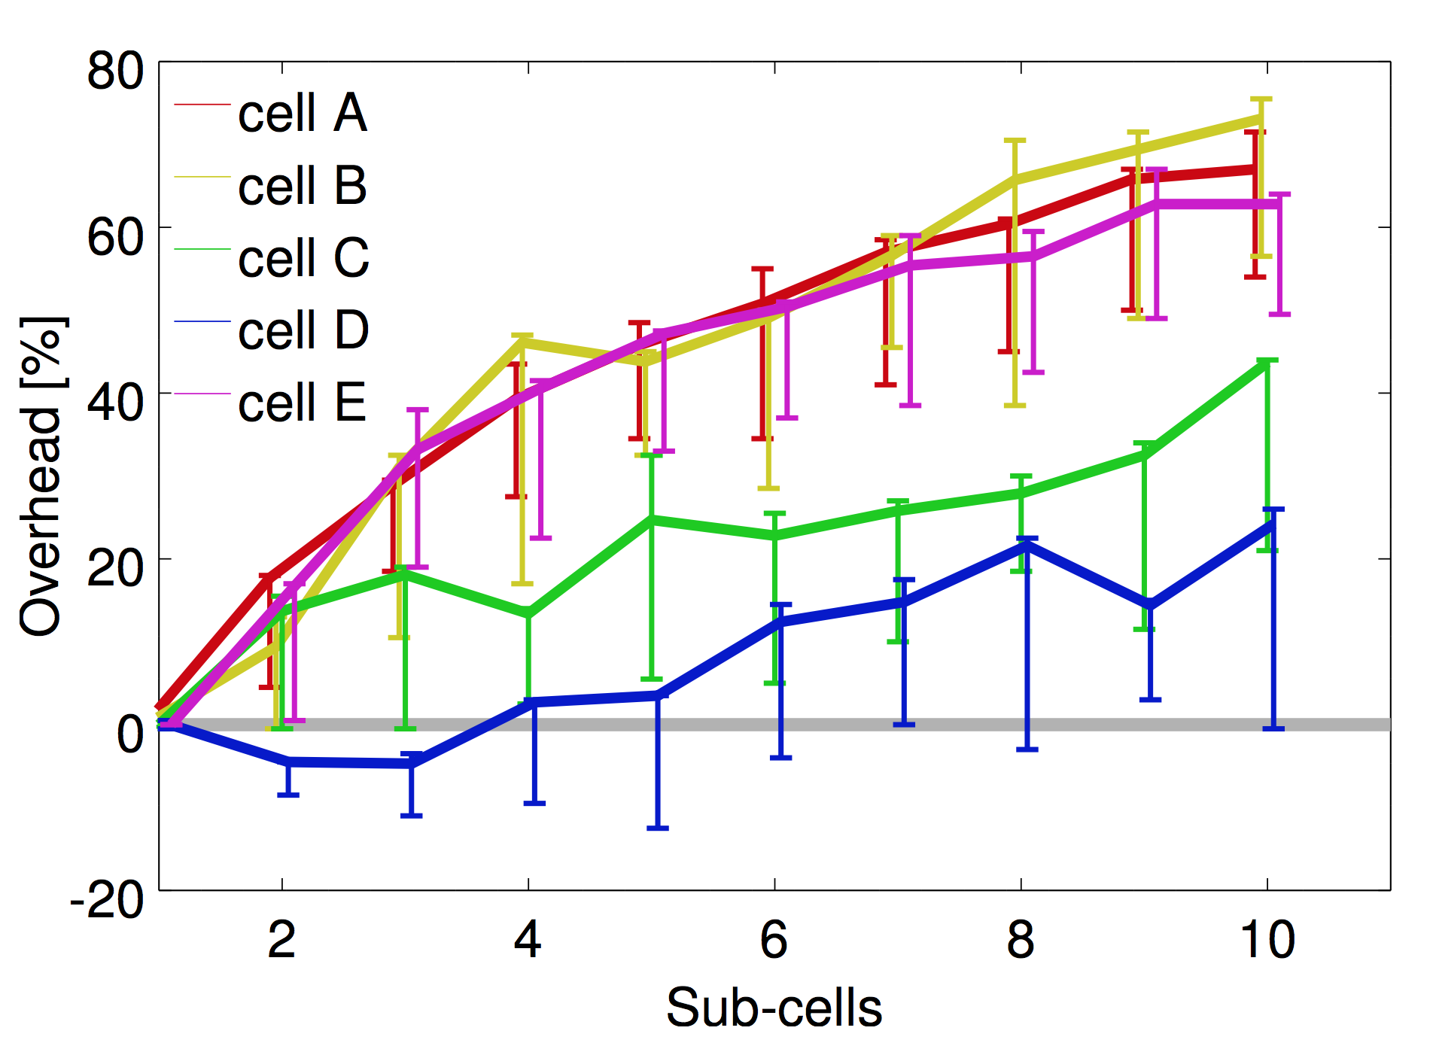
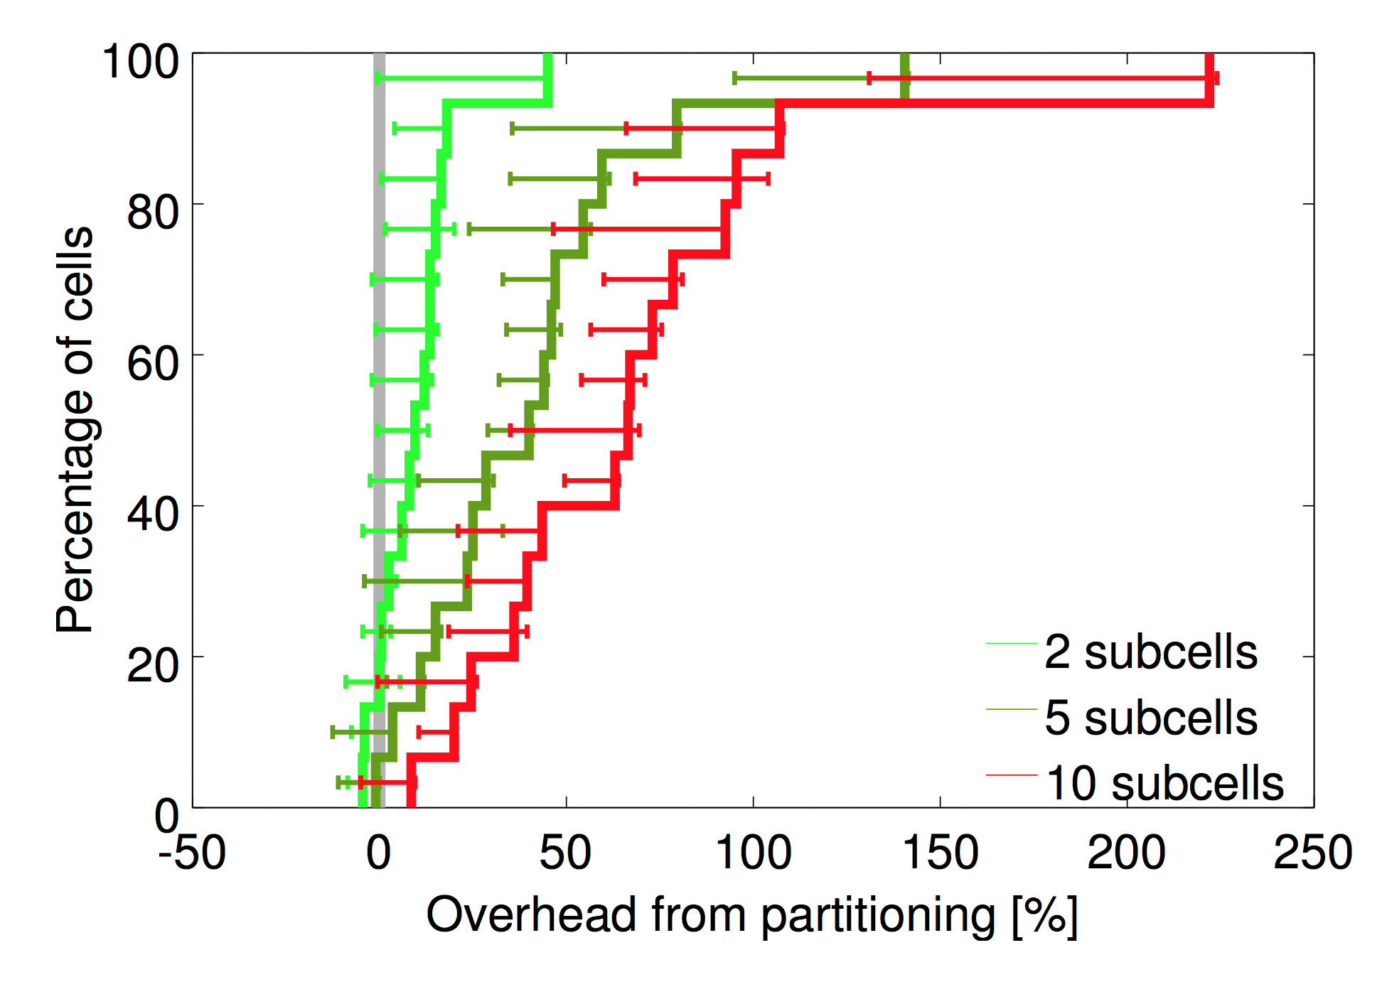
Utilization
Large Cells

Slide 16
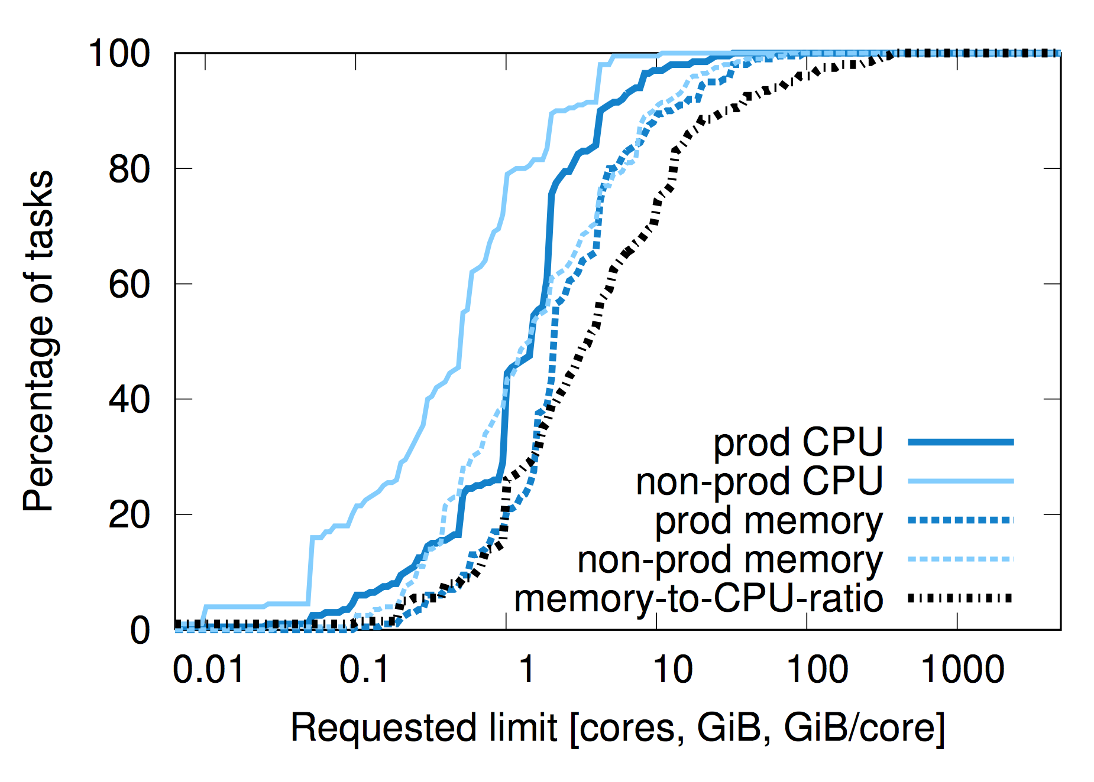
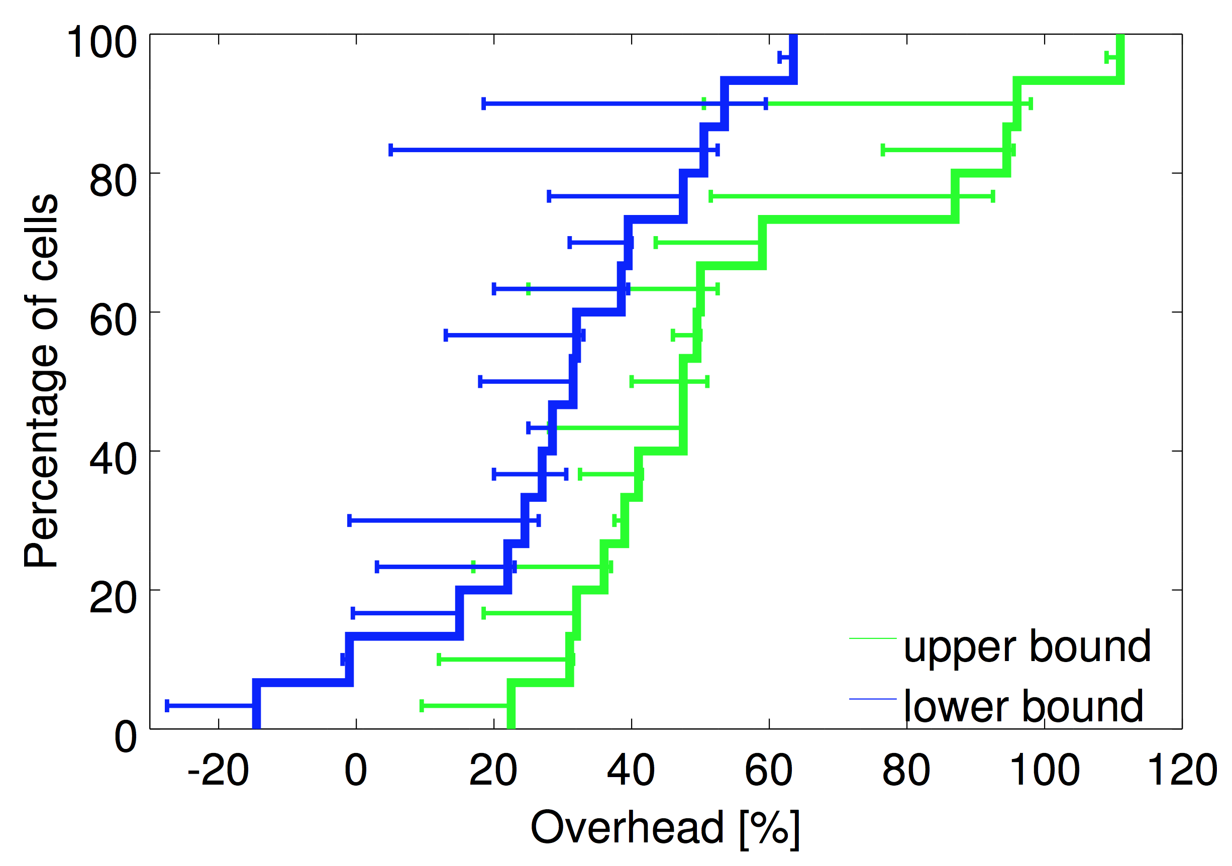
Utilization
Fine-grained Resource Requests

Slide 17
Utilization
Reclamation

Slide 18
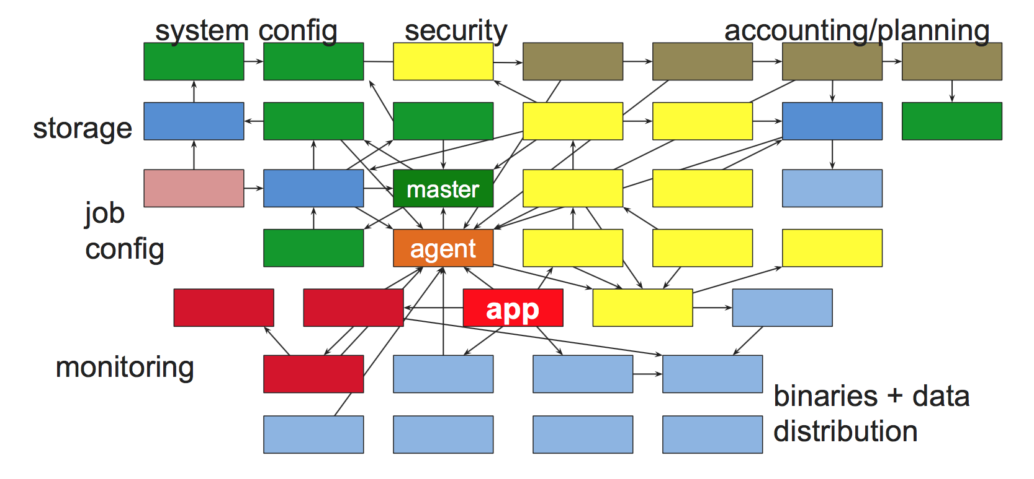
Big Picture

Slide 19
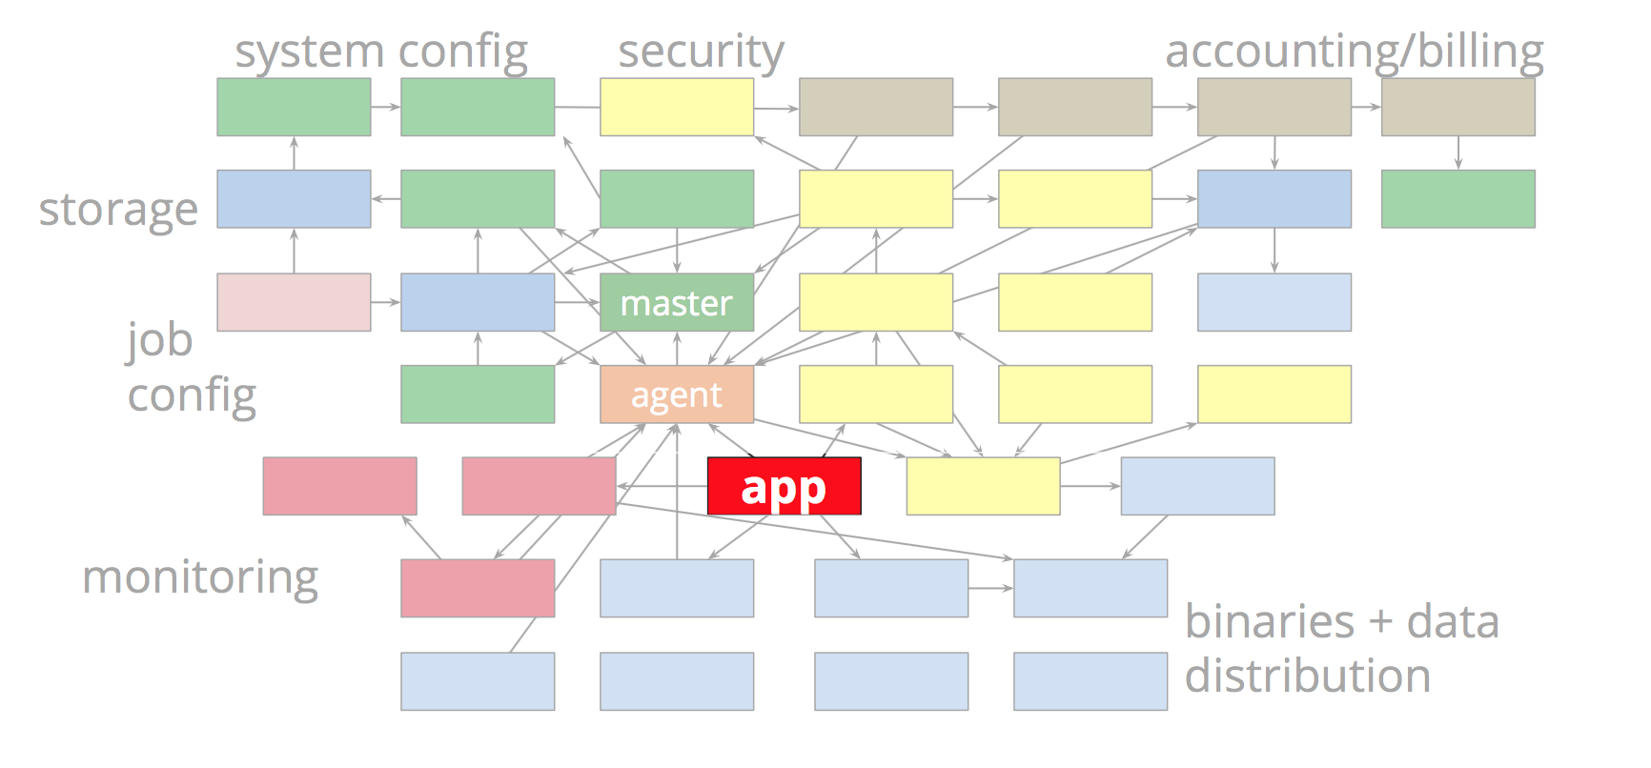
Big Picture

Slide 20
Isolation
Security Isolation
Chroot
Cgroup
Performance Isolation
Linux cgroup-based resource container
Borglet manipulates container settings
Production Tasks get best treatment

Slide 21
Future Work - Kubernetes
Directly From Borg
Borglet => Kubelet
Alloc => pod
Borg Containers => docker
New & Improved
Job => labels + label query
Managed ports => IP per pod
Master => Microservices

Slide 22
Conclusion
Google’s Cluster Manager
Automate application deployment
Hide details of resource allocation and failure handling
Support ALL workloads
Resiliency – Focuses on Fault Tolerance
Efficiency – Resource sharing for workloads

Slide 23
Discussion Questions
Borg gives programmers the opportunity to reserve resources for their applications, but end up with a large amount of overprovisioning. Are there any alternatives to the reclamation technique discussed?
There are several different kinds of schedulers developed. Can we look at use cases for monolithic (Borg), two level (Mesos), and shared state schedulers (Omega).
Our favorite question: Now that we’ve seen Google using containers, are containers more advantageous than VMs?

Slide 24
Resources
John Wilkes’ EuroSys Slides

