Slide 1
Arrakis: The Operating System is the Control Plane
Simon Peter, Jialin Li, Irene Zhang, Dan R. K. Ports, et al.
presented by Jimmy You

Slide 2
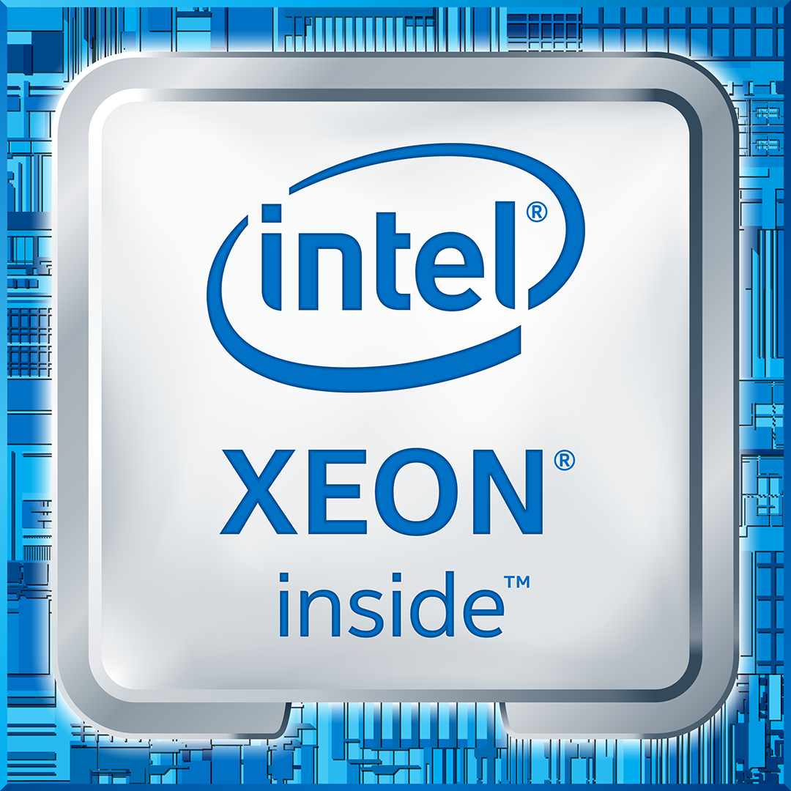
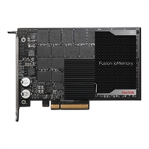
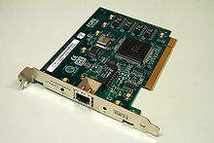
Background
Today’s hardware is fast!
Typical commodity desktop (Dell PowerEdge R520 ~$1000):
10G NIC
~2us / 1KB pkt
6-core CPU
RAID w/ 1G cache
~25 us / 1KB write

Slide 3
Background
But Data Center is not as fast as hardware.
8.7 us
163 us

Slide 4
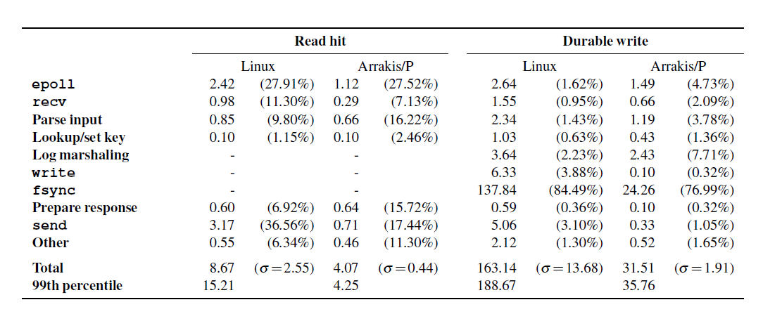
Background
Who is dragging?

Slide 5
Background
Who is dragging?
System Calls are slow:
epoll : 27% time of read
recv : 11% time of read
send : 37% time of read
fsync : 84% time of write

Slide 6
Motivation
Design Goals:
Skip kernel for data-plane operations (low overhead)
Retain classical server OS features (transparency)
Appropriate OS/hardware abstractions (virtualization)

Slide 7
Hardware I/O virtualization
Already de facto on NICs
Multiplexing:
SR-IOV: split into virtual NICs, each w/ own queues, registers, etc.
Protection:
IOMMU (e.g. intel VT-d): devices use virtual memory of apps
Packet Filter: control the I/O
I/O Scheduling:
Rate limiting, packet scheduling

Slide 8
Traditional OS
Apps
Kernel
Hardware
API
Multiplexing
Naming
Resource limit
Access Ctrl
I/O Scheduling
Protection
I/O Processing
Libs

Slide 9
Skipping the kernel
Apps
Kernel
Hardware
API
Multiplexing
Naming
Resource limit
Access Ctrl
I/O Scheduling
Protection
I/O Processing
Libs

Slide 10
Skipping the kernel
Apps
Libs
Kernel
Hardware
API
Multiplexing
Naming
Resource limit
Access Ctrl
I/O Scheduling
Protection
I/O Processing

Slide 11
Skipping the kernel
Control Plane
Data Plane
Apps
Control
libos
User Space
HW Space
Data
“Kernel”
Virtual Interface
Control
Data
Hardware

Slide 12
Hardware Model
NICs (Multiplexing, Protection, Scheduling)
Storage
VSIC (Virtual Storage Interface Controller)
each w/ queues etc.
VSA (Virtual Storage Areas)
mapped to physical devices
associated with VSICs
VSA & VSIC : many-to-many mapping
Notes:
Assumes NICs can filter/demux flows at a level (e.g. packet headers).
May not be currently available features.

Slide 13
Control Plane Interface
VIC (Virtual Interface Card)
Apps can create/delete VICs, associate them to doorbells
doorbells (like interrupt?)
associated with events on VICs
filter creation
e.g. create_filter(rx,*,tcp.port == 80)
Notes:
In terms of main components

Slide 14
Control Plane Features
Access control
enforced by filters
infrequently invoked (during set-up etc.)
Resource limiting
send commands to hardware I/O schedulers
Naming
VFS in kernel
actual storage implemented in apps

Slide 15
Network Data Interface
Apps send/receive directly through sets of queues
filters applied for multiplexing
doorbell used for asynchronous notification (e.g. packet arrival)
both native (w/ zero-copy) and POSIX are implemented

Slide 16
Storage Data Interface
VSA supports read, write, flush
persistent data structure (log, queue)
modified Redis by 109 LOC
operations immediately persistent on disk
eliminate marshaling (layout in memory = in disk)
data structure specific caching & early allocation

Slide 17
Evaluation
UDP echo server
Memcached key-value store
Redis NoSQL store
HTTP load balancer (haproxy)
IP-layer middle box
Performance isolation (rate limiting)

Slide 18
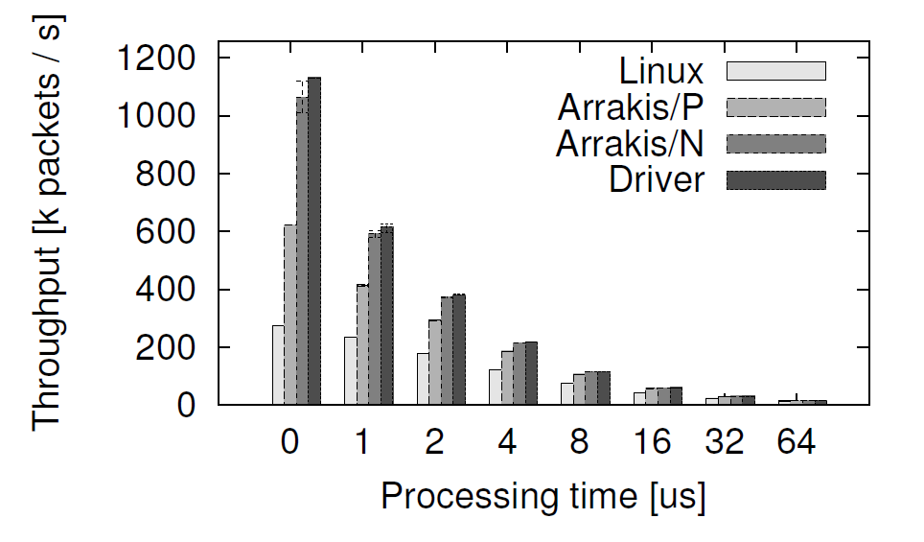
Case 1: UDP echo

Slide 19
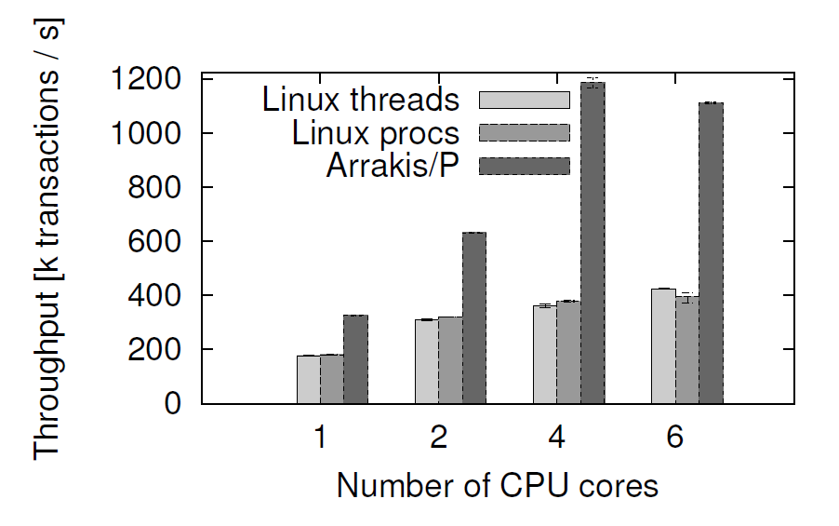
Case 2: Memcached
Notes:
Note the drop of 6 core.
Due to barrelfish

Slide 20
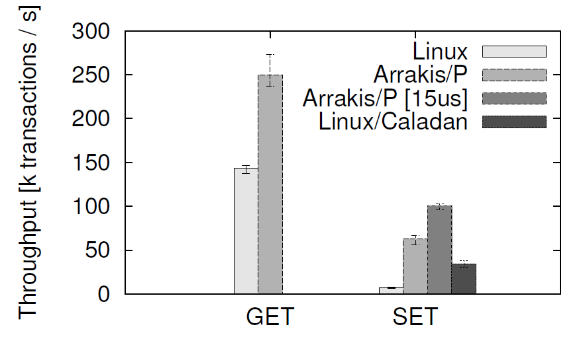
Case 3: Redis NoSQL

Slide 21
Case 3: Redis NoSQL cont’d
9 us
4 us
163 us
31 us
Adapted from the original presentation at OSDI’14

Slide 22
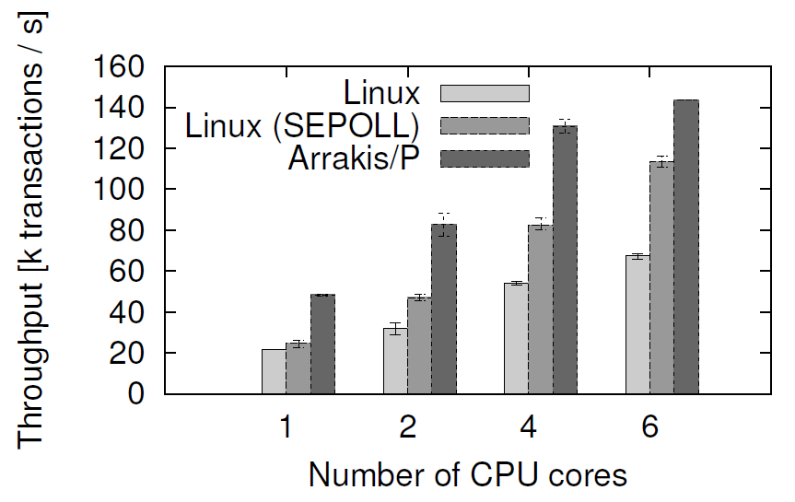
Case 4: HTTP load balancer (haproxy)
Notes:
Background activity of Barrelfish

Slide 23
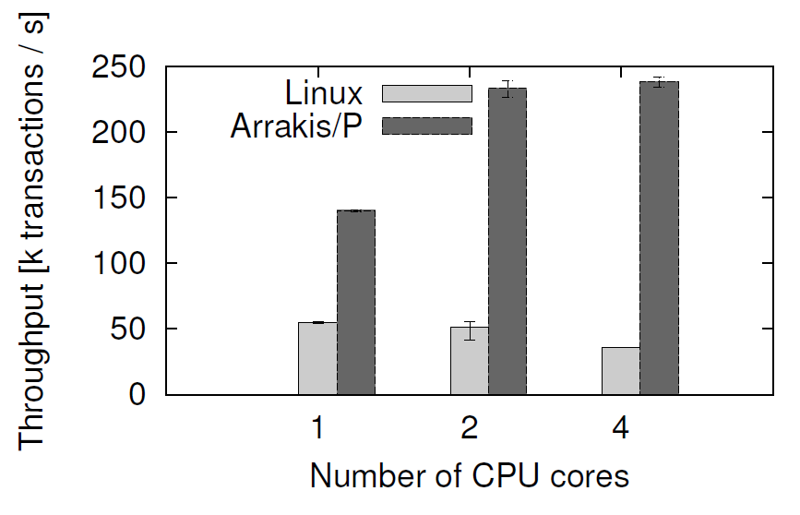
Case 5: IP-layer middlebox
Notes:
Linux stack does not scale at all. Raw IP sockets carry no connection information.
Not mentioning why Arrakis doesn’t scale

Slide 24
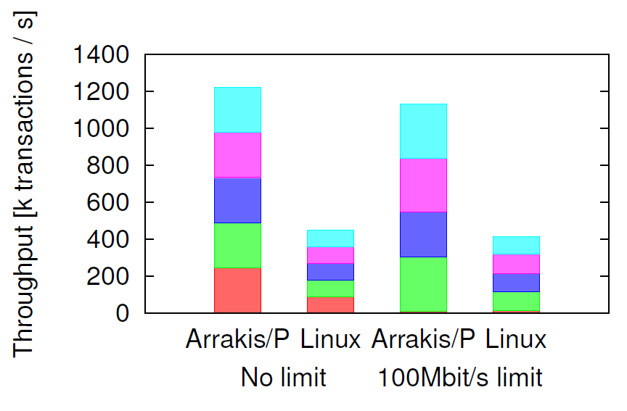
Case 6: Performance Isolation

Slide 25
Conclusion
Pros:
much better raw performance (for I/O intensive Data Center apps)
Redis: up to 9x throughput and 81% speedup
Memcached: scales to 3x throughput
Cons:
some features require hardware functionality that is no yet available
require modification of applications
not clear about storage abstractions
not easy to track behaviors inside the hardware
Notes:
By “raw” performance I mean Lantency/Throughput. Which may or may not translate into other metrics.

Slide 26
Discussion
Related work (IX, Exokernel, Multikernel, etc.)
Is Arrakis trading “OS features” for raw performance? How will new techniques change this trade-off? (SDN, NetFPGA)
And of course, how much does raw performance matter?
Security concerns

Slide 27
Related Work
90’s library Oses
Exokernel, SPIN, Nemesis
Kernel-bypass
U-Net, Infiniband, Netmap, Moneta-D
High-performance I/O stacks
mTCP, OpenOnLoad, Sandstorm, Aerie
IX, Dune; Barrelfish (Multikernel)
Adapted from the original presentation at OSDI’14

Slide 28
IX, Arrakis, Exokernel, Multikernel
Arrakis is like Exokernel built on Barrelfish (multikernel)
 | IX | Arrakis
Reduce SysCall overhead | Adaptive batching Run to completion | No SysCall in data-plane
Hardware virtualization | No IOMMU No SR-IOV | Expect more than what we have
Enforcement of network I/O policy | Under software control | Rely on hardware
Notes:
IX: run to completion, adaptive batching

Slide 29
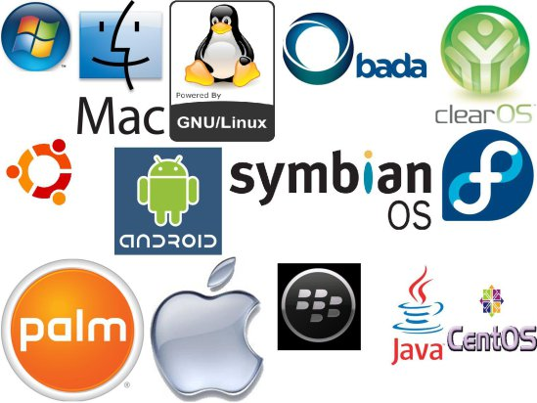
raw performance vs. (everything else)
Two potential (and maybe diverging) direction:
Be hardware-dependent (NetFPGA etc.)
Be software-controllable (SDN etc.)
60’s switchboard operator
Modern Operating Systems

Slide 30
Security concerns
Will bypassing the kernel be safe?
…

