Slide 1
The Scalable Commutativity Rule: Designing Scalable Software for Multicore Processors
Presented by Remzi Can Aksoy
*Some slides are borrowed from a ‘Papers We Love’ Presentation

Slide 2
Outline
The Scalable Commutativity Rule: Whenever interface operations commute, they can be implemented in a way that scales.
Problem
More about the Rule
Formalization and Proof
Applying the Rule

Slide 3
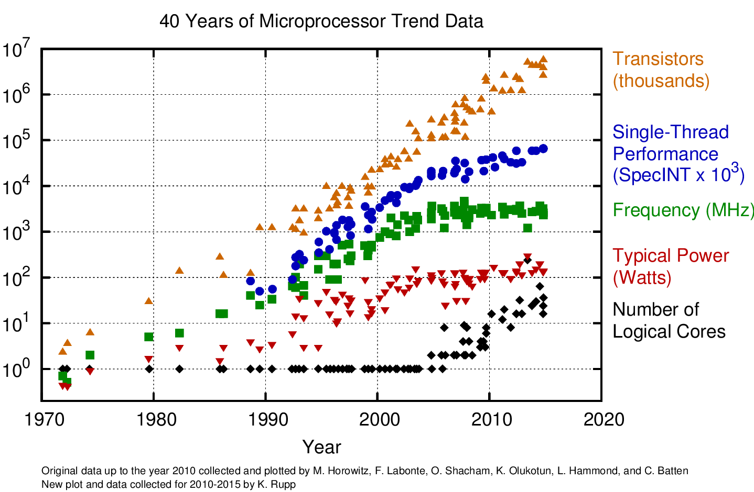
CPU Trends

Slide 4
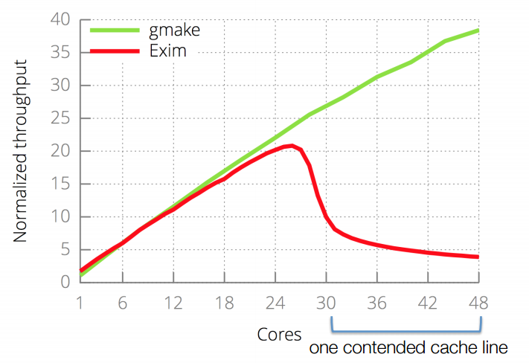
A Scalability Bottleneck

Slide 5
Current Techniques
Try a Workload, Plot Scalability, Fix top Bottleneck
Disadvantages:
New workloads expose new bottlenecks
More cores expose new bottlenecks
The real bottlenecks may be in the interface design

Slide 6
Outline
The Scalable Commutativity Rule: Whenever interface operations commute, they can be implemented in a way that scales.
Problem
More about the Rule
Formalization and Proof
Applying the Rule

Slide 7
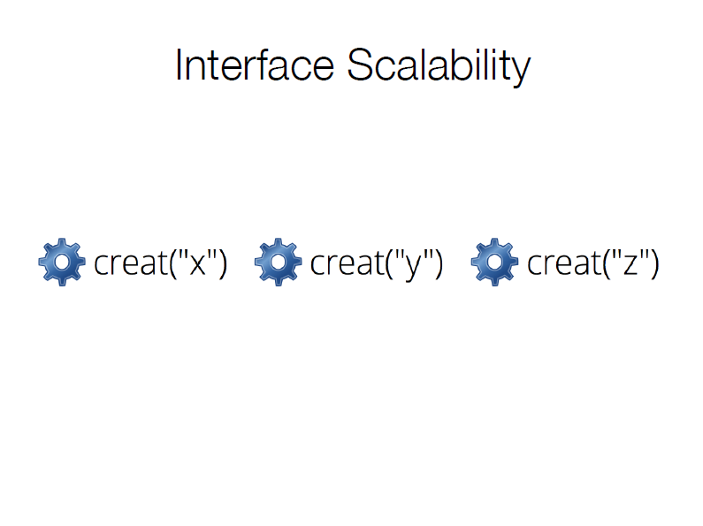

Slide 8
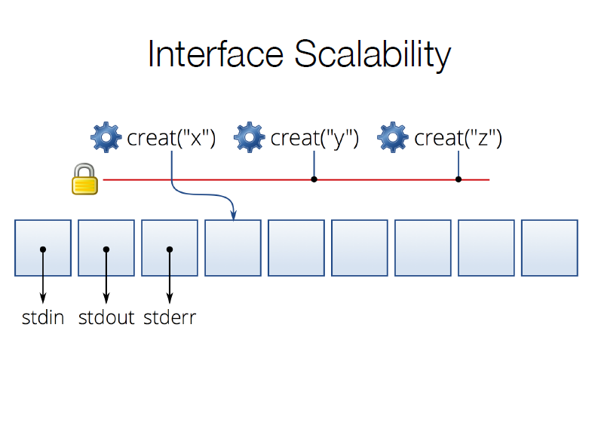

Slide 9
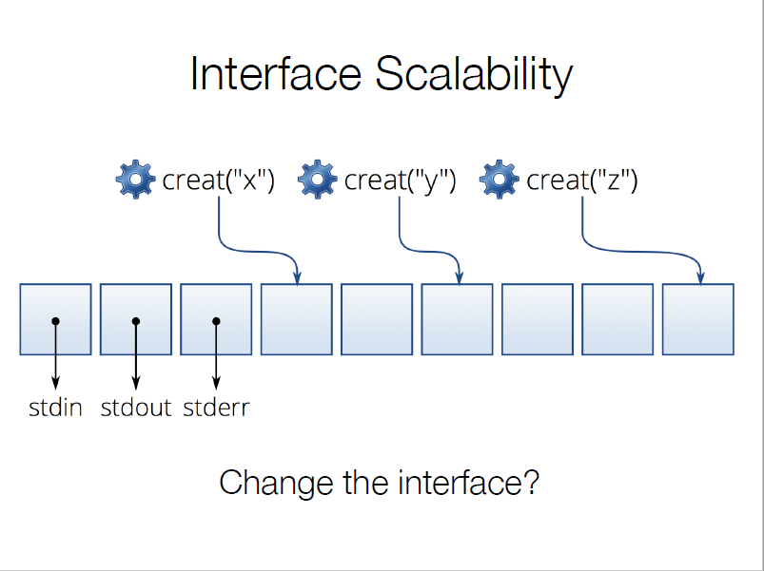
Change the Interface?

Slide 11
Intuition
Whenever interface operations commute, they can be implemented in a way that scales.
Operations commute
results are independent of order
communication is unnecessary
without communication, no conflicts

Slide 12
Outline
The Scalable Commutativity Rule: Whenever interface operations commute, they can be implemented in a way that scales.
Problem
More about the Rule
Formalization and Proof
Applying the Rule

Slide 13
Formalization
A history H is sequence of invocations and responses on threads.
A specification ζ defines an interface. ζ is the set of legal histories given the allowed behavior of the interface.
A reordering H’ is a permutation of H that maintains operations order for each individual thread (H|t = H’|t for all t).

Slide 14
Commutativity
Different Commutativity Definition: State-dependent, Interface-based, Monotonic
A region Y of a legal history XY SIM-commutes if every reordering Y’ of Y also yields a legal history and every legal extension Z of XY is also a legal extension of XY’.
(And this must be true for every prefix of every reordering of Y.)

Slide 15
The Formal Rule
Let ζ be a specification with a reference implementation M. Consider a history where XY where Y commutes in XY and M can generate XY.
There exists a correct implementation M’ of ζ whose execution of XY is conflict-free in the commutative region Y.

Slide 16
Outline
The Scalable Commutativity Rule: Whenever interface operations commute, they can be implemented in a way that scales.
Problem
More about the Rule
Formalization and Proof
Applying the Rule

Slide 17
Refining POSIX with the Rule
Lowest FD versus any FD
stat versus xstat
What we can learn:
Embrace non-determinism
Decompose compound operations

Slide 18
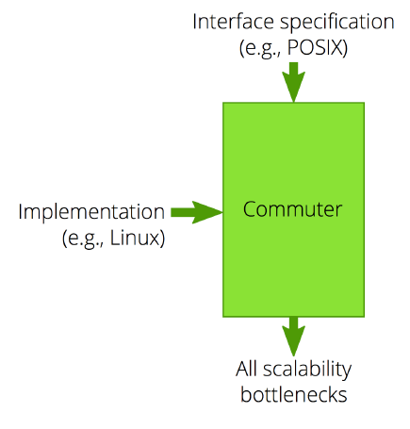
Commuter

Slide 20
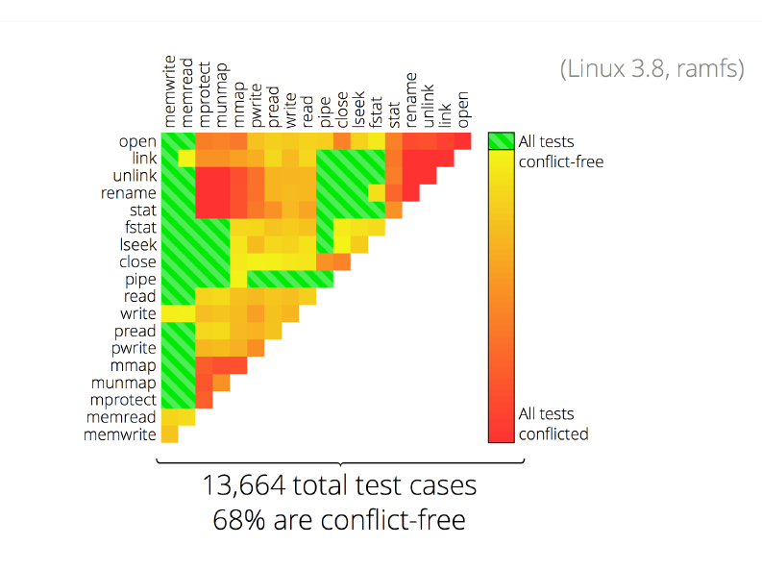

Slide 21
sv6: A Scalable OS
• POSIX-like operating system
• File system and virtual memory system follow commutativity rule
• Implementation using standard parallel programming techniques, but guided by Commuter

Slide 22
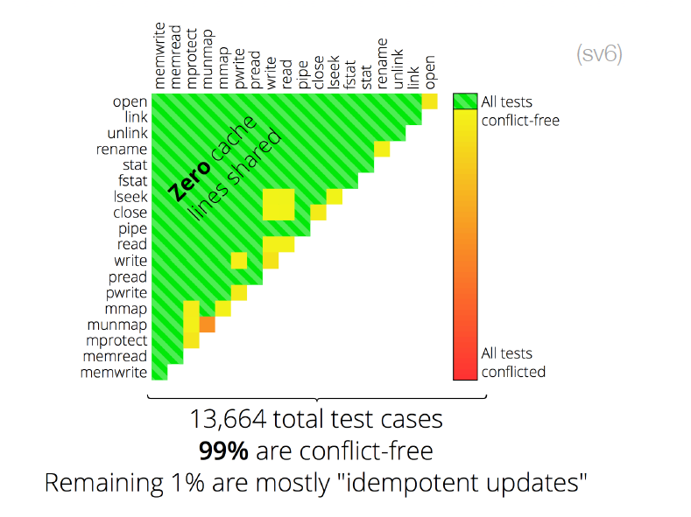

Slide 23
Discussion Topics:
Can we apply a similar principles to network, database systems?
Do you think this new technique improve development speed?

