Slide 1
IX: A Protected Dataplane Operating System for High Throughput and Low Latency
OSDI ‘14 Best Paper Award
Adam Belay George Prekas Ana Klimovic
Samuel Grossman Christos Kozyrakis Edouard Bugnion
Presented by Jeremy Erickson

Slide 2
What do we want?
When do we want it?
We want our networks fast!
(Specifically, packet processing on commodity servers)
Now
(Or back in 2014)
https://memegenerator.net/instance/64946097

Slide 3
Challenges
Tail Latency
Some SLAs require µs tail latency
High Packet Rates
Key-value stores - tons of small packets
Protection
Multiple services share a single server
Resource Efficiency
Load varies significantly over time
https://memegenerator.net/instance/57260030

Slide 4
What else is out there?
Basic Linux Networking Stack
Potentially tuned for parallel incoming connections
User-space Networking Stacks
mTCP (NSDI ‘14 - April compared to IX’s OSDI ‘14 in October)
Not secure
Infiniband (RDMA)
Requires special hardware -- datacenter only
Some others...

Slide 5
Why don’t we just use those?
Basic Linux Networking Stack
Too slow
User-space Networking Stacks
mTCP (NSDI ‘14 - April compared to IX’s OSDI ‘14 in October)
Not secure
Infiniband (RDMA)
Requires special hardware -- datacenter only
Some others...

Slide 6
Lessons learned from Middleboxes
Integrate the networking stack and application into dataplane
Application gets (almost) direct access to hardware
Run each packet to completion
No context-switching to introduce latency (tail-latency, yuck)
Adaptive batching when congested for higher throughput
Also prevents Head-of-Line blocking

Slide 7
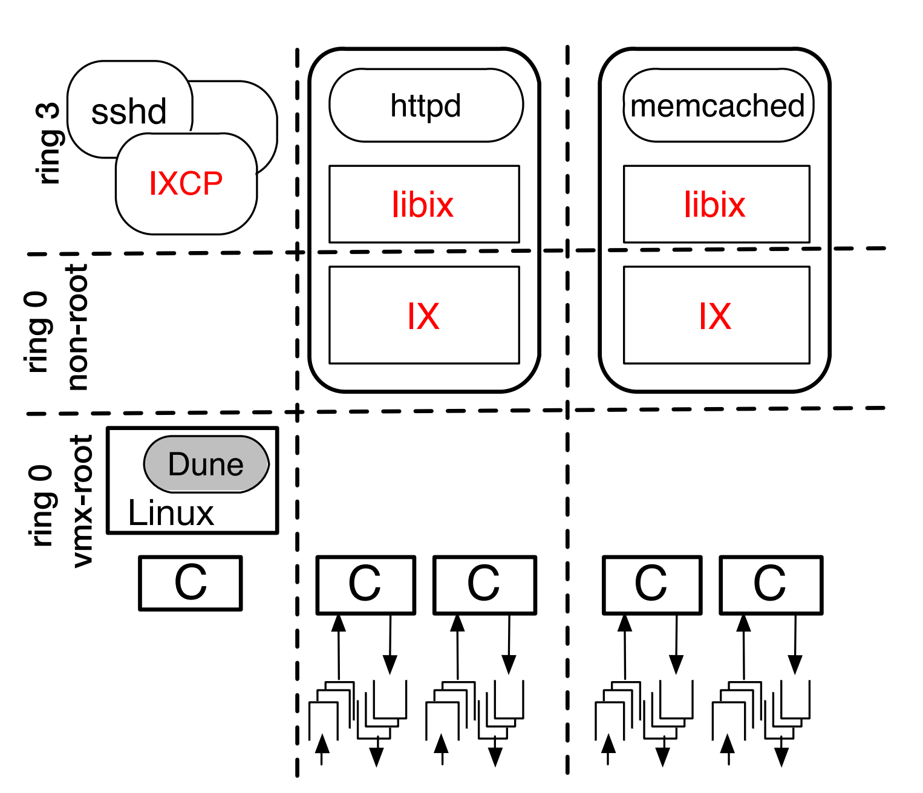
Design
The paper provides this diagram:
I thought it was a little hard to see what’s going on.

Slide 8
Design (maybe this is easier to visualize?)
Similar to Exokernel, but with system protection and backwards compatibility
Ring 3
httpd
(libix)
memcached
(libix)
Ring 0
(Dataplane)
IX
IX
IXCP
App1
...
AppN
Ring 3
VMX Ring 0
Linux kernel
Dune
Hardware
40Gbps NIC
40Gbps NIC
1Gbps NIC
Core 0
Core 1
Core 2
Core 3

Slide 9
Important details
Zero-Copy API
Packets are grabbed from NIC by IX and put in memory buffer
Memory buffer is exposed to dataplane application
Read-only through virtual memory protection
Incoming traffic is randomly distributed among threads
Uses NIC hardware Receive Side Scaling (RSS)
For outgoing traffic, they probe ports to find same thread for return traffic
The non-IX portion of the machine can still run legacy code!
Backwards compatible!

Slide 10
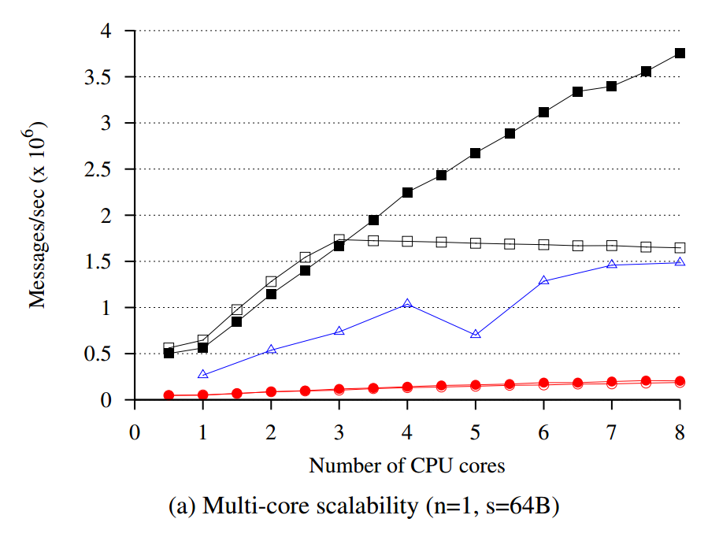
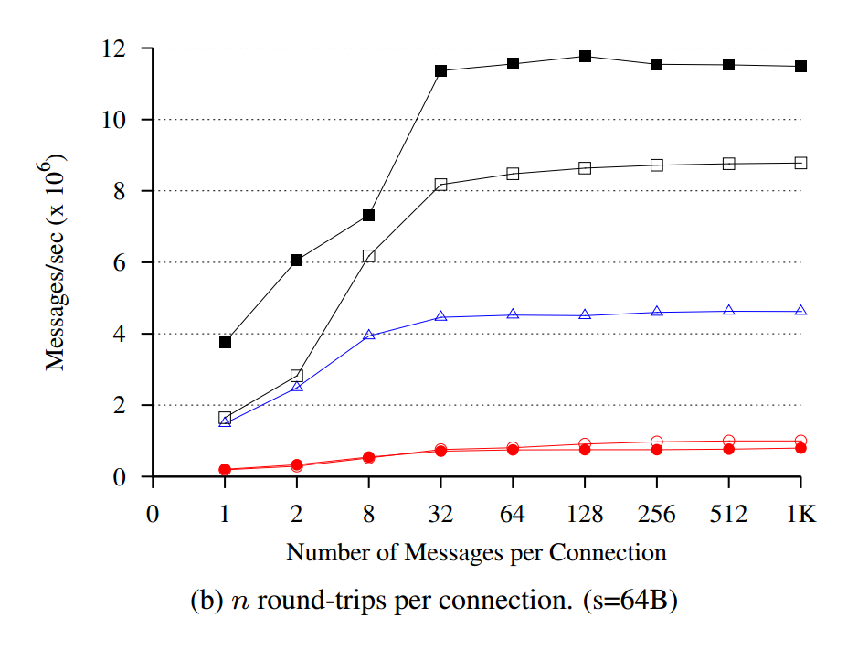
Performance

Slide 11
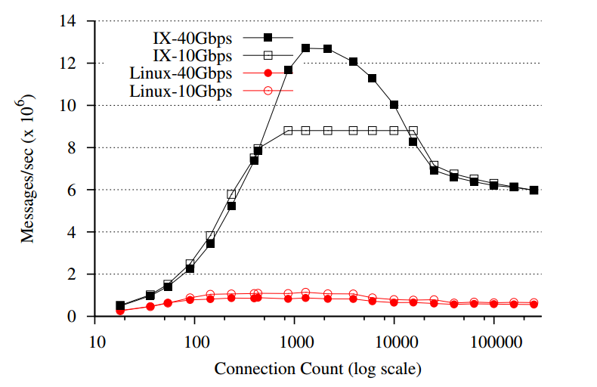
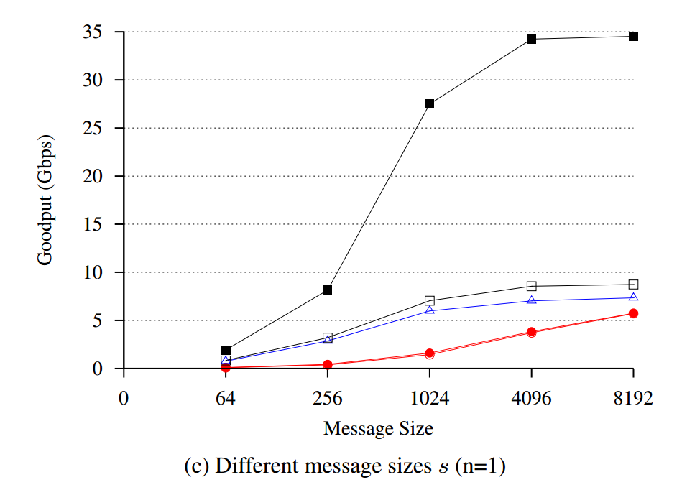
Performance

Slide 12
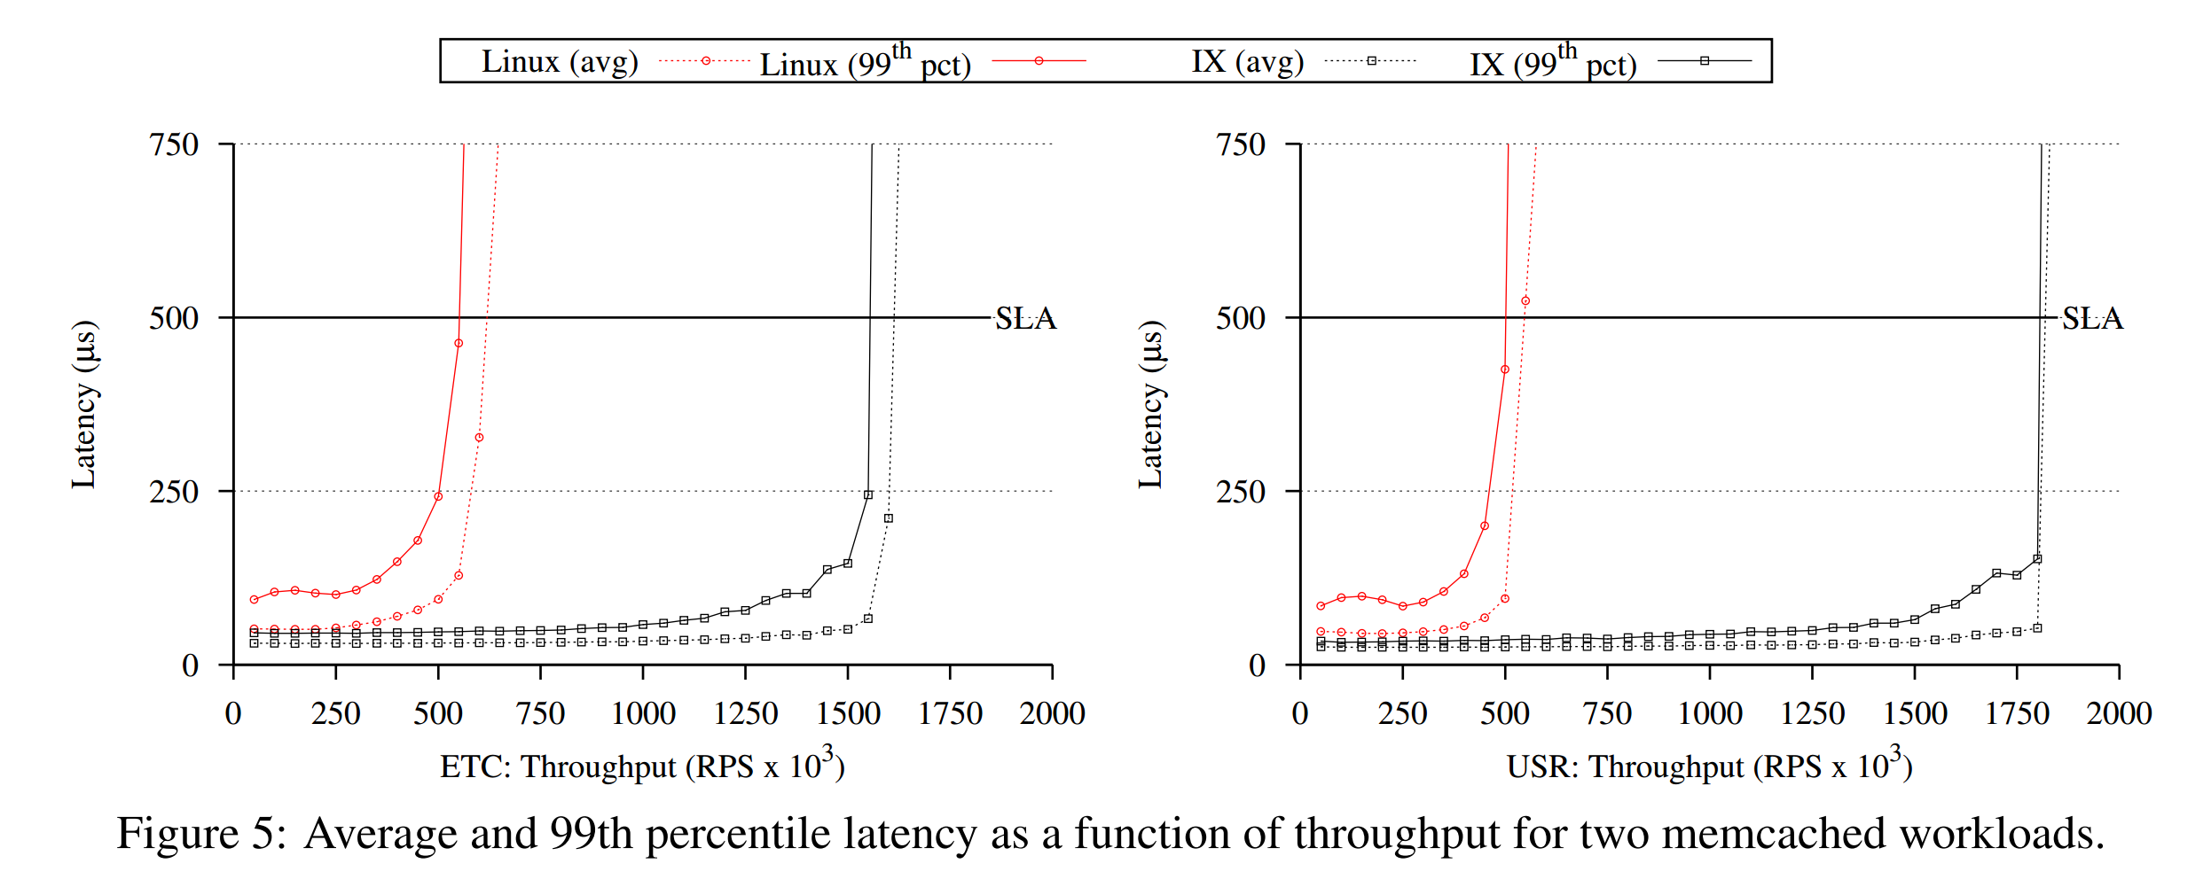
Performance

Slide 13
Questions
What potential performance downsides are there to this approach?
What potential usability downsides are there to this approach?
How could they make it even faster?
They mention at the end of the paper that they could take advantage of Single-root input/output virtualization (SR-IOV) to share the NICs between multiple dataplanes and scale even harder

Slide 14
Questions
What potential performance downsides are there to this approach?
Large packets + Run-to-Completion + Slow Application ?= Delay
What potential usability downsides are there to this approach?
Applications must be specifically developed (or ported) to a new API
How could they make it even faster?
They mention at the end of the paper that they could take advantage of Single-root input/output virtualization (SR-IOV) to share the NICs between multiple dataplanes and scale even harder

