Slide 1
Exokernel: An Operating System Architecture for Application-Level Resource Management
Dawson R. Engler, M. Frans Kaashoek, and James O’Toole Jr
[SOSP’97]
Presented by HyunJong (Joseph) Lee
Notes:
Hello everyone, my name is HyunJong, often called Joseph and I’m going to present Exokernel today.
The paper was appeared in SOSP 1997 and had a major impact on OS design. Cited more than 1400 times!

Slide 2
Background
Tanenbaum-Torvalds debate in 1992
Andrew S. Tanenbaum:
“Linux is obsolete”
Linus G. Torvalds:
“look at who makes money off minix,
and who gives linux out for free”
Notes:
Before delving into details, I would like to share a background about the war between micro and monolithic kernel forks.
The famous example is Tanenbaum Torvalds debate in 1992, held at Usenet discussion group comp.os.minix
Andrew Tanenbaum is an initial contributor to micro kernel named Minix.
In January 1992, he posted the first criticism toward Linux kernel with a title “Linux is obsolete” and saying that “a giant step back into the 1970s”.
A day later, Linus Torvalds, the founder of Linux kernel, responded, pointing out the inherent flaw in microkernel design such as lack of multithreading.
Even after a quarter century, the war is still going on as micro kernel design such as Xen, Mac OS X versus monolithic kernel design such as Unix-like, KVM, and Android forks are still competing one another.
We will visit this quarter century-long war later at discussion.

Slide 3
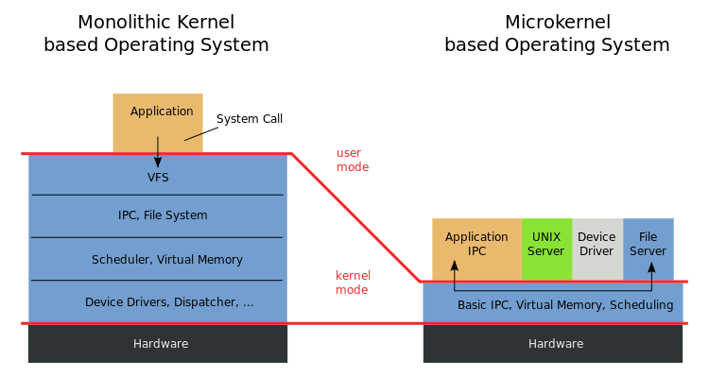
Traditional Approach
Central resource-management
Kernel exposes minimal H/W abstractions
Fixed high-level abstractions
Notes:
Let’s get back to Exokernel.
The motivation behind traditional approach to build a system in monolithic kernel includes central resource management, minimal exposition of hardware abstractions and fixed high-level abstractions like File.
What the authors trying to claim is these kernel design comes at high overhead.

Slide 4
Problem w/ high-level abst.
Hurts app. performance
no single fixed abstraction is good for all apps.
Hides information from OS
lack of app. specific resource-management
Limits functionality of apps.
use only fixed high-level abstraction
Notes:
The authors of paper argues that problem with high-level abstraction from traditional approach is that
It hurts application performance because no single fixed abstraction is suitable for all kinds of apps
It hides information from OS.
Examples are low-level exception like page fault, timer interrupt, access to row I/O devices.
This makes hard to implement application’s own resource management scheme.
For instance, thread user library lack of system integration, doesn't know, if there is a page fault
Finally, It limits functionality of applications.
In other words, fixed abstractions are only interface apps can use, and thus, change to these abstractions cannot be done.

Slide 5
Motivation
Central resource management
Move to untrusted app level
Kernel exposes minimal abstractions of H/Ws
Securely multiplex H/W to upper layer
Fixed high-level abstractions
Flexible low-level interfaces
Apps know better about their goal!
Notes:
The paper argues for moving resource management to untrusted application level,
securely multiplexing hardware to above kernel level,
providing flexible low-level interfaces.
All these argument comes from the assumption that applications know better about their goal than underlying system!

Slide 6
Goal
OS gives as much control as possible to apps.
separate protection from management
low-level interfaces
multiplex H/Ws
Notes:
The goal of Exokernel is to give as much control as possible to applications in order to
separate protection from resource management
expose low-level interfaces and
multiplex hardwares.

Slide 7
libOS
no need to multiplex a resource
simpler & specialized implementation out-of-kernel
multiple concurrent libOSes
protection provided by Aegis [discussed later]
less number of kernel crossings
b/c OS runs in application’s address space
Notes:
before delving into exokernel design, it is important to know the benefit of moving many things out of kernel
That is, the beauty of exokernel design is library operating system
that does not have to multiplex a resource among competing applications
that supports multiple OSes simultaneously like today’s virtual machines
and because libOS itself runs in application’s address space, there is less number of kernel crossings which considered to be high overhead in OS design

Slide 8
Exokernel Design
Securely expose H/Ws
Expose allocation, names, and revocation
Secure bindings
h/w multiplexing, s/w caching, downloading app. code
Visible revocation
allows libOSes to participate in resource revocation
Abort protocol
break bindings of uncooperative libOSes
Notes:
Exokernel’s design is centered around four bullet points
1. securely expose hardwares by exposing allocation, names and revocation of hardwares
2. use secure bindings to multiplex hardware, software caching and downloading application code
3. by visible revocation, allow libOSes to participate in resource revocation
4. break bindings of uncooperative libOSes using abort protocol.
We will revisit abort protocol in discussion later.

Slide 9
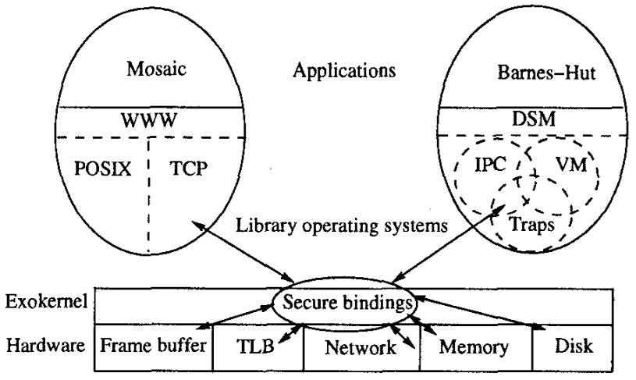
Exokernel Design
Notes:
As you can see from the diagram, hardwares are exposed via secure bindings to protect them.
All functionality other than protection is moved to application level.
This allows flexible application-specific implementation.

Slide 10
Evaluation
Aegis: exokernel
System calls & Exceptions
Protected control transfers
Address translations & DPF
ExOSs: library operating system
IPC abstractions
App-level virtual memory
App-specific Safe Handlers (ASH)
Extensibility in RPC, Page-Table structures, Schedulers
Notes:
Let’s move the gear to evaluation. In the paper, Aegis and ExOS are evaluated.
- Aegis is an exokernel that exports the processor, physical memory, TLB, exceptions, interrupts and network interfaces.
* We are going to cover a overhead in system calls and exceptions.
* Details in protected control transfers, address translations and DPF are detailed in the paper.
- ExOS is a library operating system that implements processes, virtual memory, user-level exceptions, various interprocess abstractions (IPC) and a few network protocols.
* We are going to cover IPC abstractions, application-level virtual memory and stride scheduling.
* Details in application specific safe handlers (ASH) and other extensibility examples can be found in the paper.
Spoiler: there is only few papers that say their system is bad in evaluation!

Slide 11
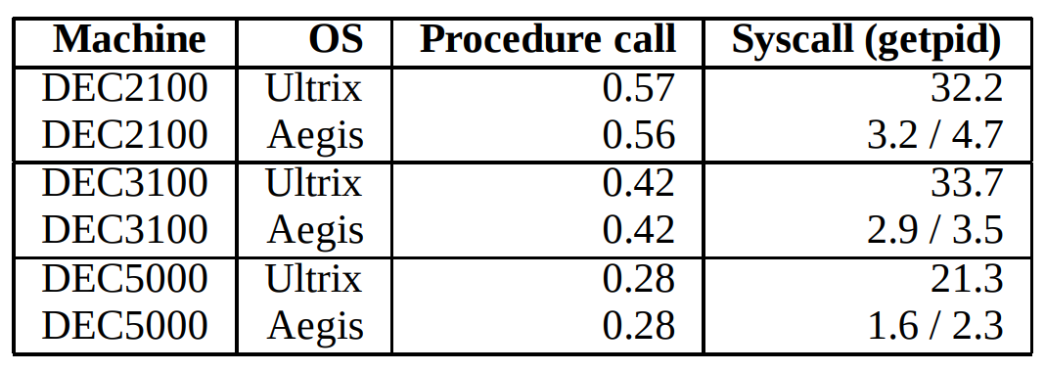
Aegis
Base costs
using stack vs.
not [getpid()]
Exception costs
no kernel intervention
Null procedure and system call costs in micorseconds
Aegis vs. Ultrix exception handling times in microseconds
Notes:
* Aegis compares with the state of art monolithic kernel, Ultrix.
- Base cost with null procedure is shown to prove that Aegis’s scheduling flexibility does not add overhead to base operations (first columns)
- The system calls that require a stack is an order of magnitude faster in Aegis, because Aegis does not map its data structure and does not have page tables, no TLB misses due to kernel TLB faults.
* Also, Aegis dispatches all hardware exceptions to application by
- saving scratch registers into save area using physical addresses
- loading exception program counter, last virtual address where translation failed that is root of the exception
- jumping to application specified PC where execution resumes.
Results in two orders of magnitude faster than Ultrix and evenly distributed cost.

Slide 12
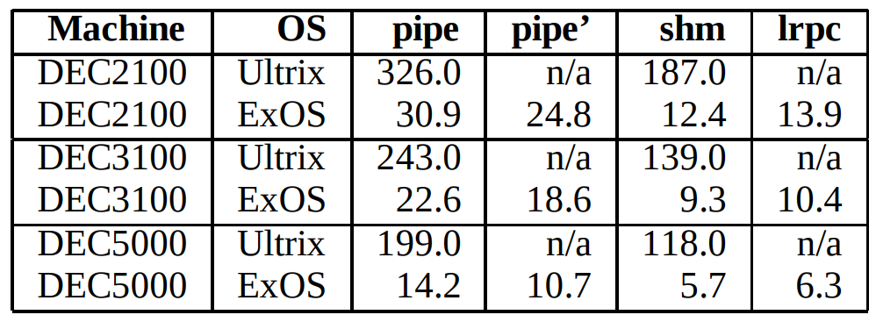
ExOS
ExOS manages fundamental OS abstractions at application-level
Notes:
ExOS manages fundamental operating system abstractions such as virtual memory and process at application level.
The measured latency in the table is from the latency of pingponging between two processes using different methods.
- pipe uses sending a word-sized message.
- shm uses a shared counter (Aegis’s Yield syscall vs. Ultrix’s signal)
- Light RPC is built on top of Aegis’s protected control transfer.
The main reason in performance improvement is “using flexible low-level abstractions”.
In other words, existing systems such as Ultrix must emulate new primitives on top of existing ones due to fixed high-level abstractions.

Slide 13
ExOS contd.
Even with two limitations,
ExOS offers richer interface to apps to
implement app-specific functionality
Notes:
There are two main limitations: no swapping and page-tables as a linear vector
The overall performance of ExOS in each of virtual memory operation is better, of course.
One thing to point out is that prot100 and unprot100 (read and remove read-protected 100 pages).
The authors note that because ExOS requires access to two data structures, one from Aegis’s STLB and ExOS’s page table, it shows poor performance.

Slide 14
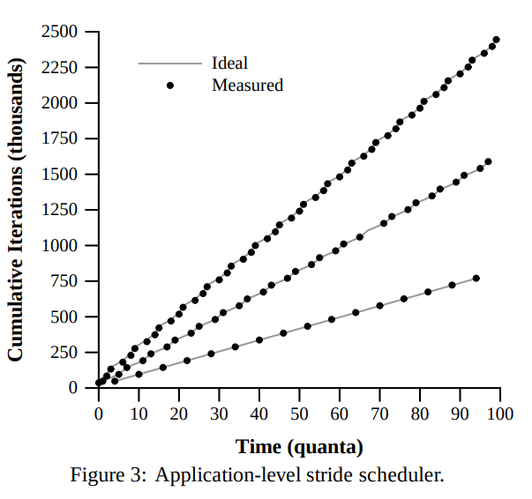
Extensibility
Stride scheduler
example of Aegis’s use of fine-grained control to enhance modularity of app. design
Notes:
Stride scheduler is implemented on ExOS.
Just creates three processes that increment counters in shared memory.
The result shows that it’s close to ideal case.
Aegis includes yield primitives to donate the remainder of a process’ current quanta to another process.
This highlights extensibility in exokernel even with a process scheduler, that is considered as hard to be application specific!

Slide 15
Conclusion
Exokernel decouples protection from central resource management in kernel.
Exokernel exposes primitives to apps.
Exokernel achieves higher performance.
Notes:
READ…!

Slide 16
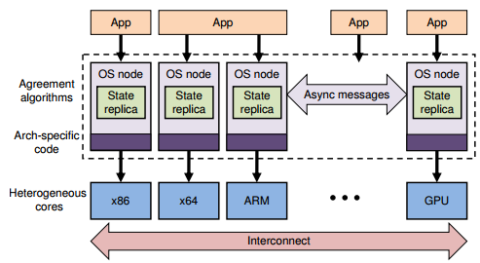
Types of kernel
Notes:
I would like to close this presentation by going over types of kernel.
There are broadly three types of kernel:
1. Traditional monolithic kernel
2. “new” micro kernel that moves as much out of kernel space
3. Hybrid kernel that is mostly used today

Slide 17
Discussion Topics
Is Exokernel considered as a microkernel?
Performance improvement in exchange of security & burden of implementation?
Hybrid-kernels w/ loadable module support?
Implementation cost | 12 | Too low-level interface | 5 | Portability | 4
Security concern | 12 | CPU/resource scheduling | 5
Notes:
The table is a summary of what you guys wrote about weakness.
Bring up Xen & Android example
Bring up Node.js (just import whatever you want) crash incidence
Bring up that only memory management and process creation cannot be done at module level.

Slide 18
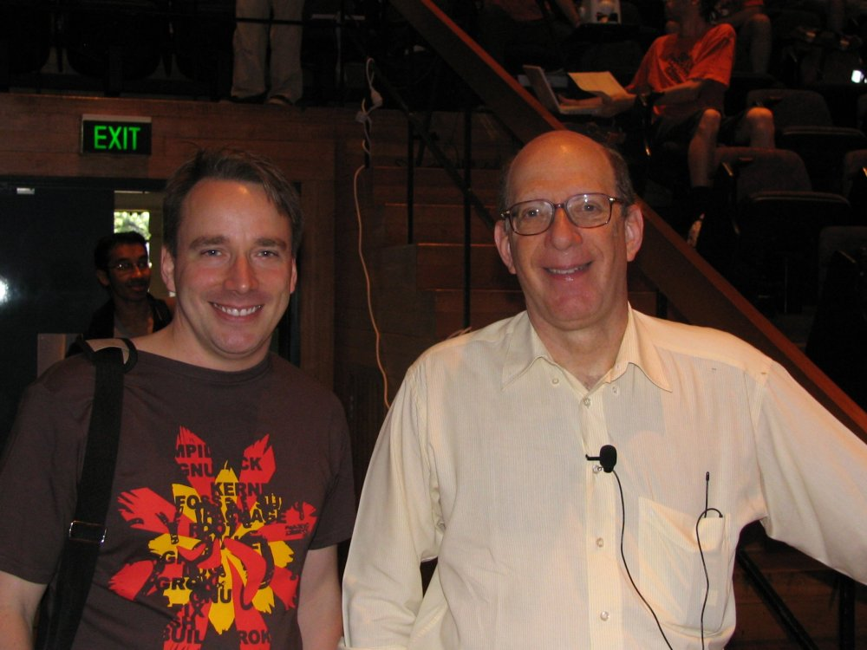
Happy Ending
Notes:
Coming back to background, Linus and Tanenbaum got a happy ending.

Slide 19
Except Prof. Engler
Notes:
Except Prof. Engler, who developed exokernel

