Slide 1
A Case for Redundant Arrays of Inexpensive Disks (RAID)
David A Patterson, Garth Gibson, and Randy H Katz
Presented by Connor Bolton

Slide 2
Background
1974 to 1984 – Single chip speed increased 40% a year
Magnetic disk doubled capacity and halved in price every 3 years
I/O speed did not increase at this rate
1971 to 1981 – IBM disk seek time 2x
Caches and SRAM helped to compensate
Need faster read and write speed

Slide 3
Motivation for RAID
Characteristics | IBM 3380 | Fujitsu M2361A | Conners CP3100 | Conners CP3100 (75x)
Formatted Data Capacity (MB) | 7500 | 600 | 100 | 7500
Price/MB | $18-$10 | $20-$17 | $10-$7 | $10-$7
I/O Bandwidth | 120 | 24 | 20 | 1500
MTTF Rated (hours) | 30000 | 20000 | 30000 | 400
Power/box (W) | 6600 | 640 | 10 | 1000

Slide 4
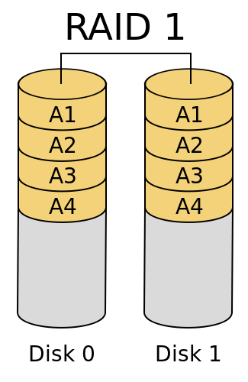
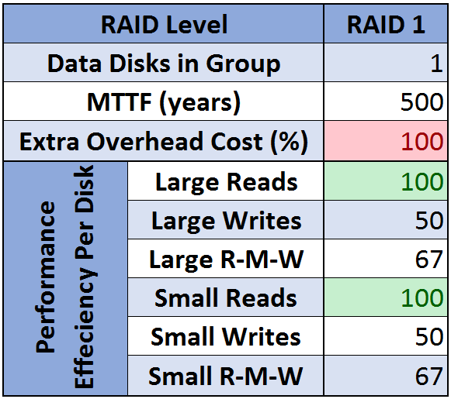
RAID 1 – Mirrored Disks
G = 1
C = 1
G = data disks in group
C = check disks per group

Slide 5
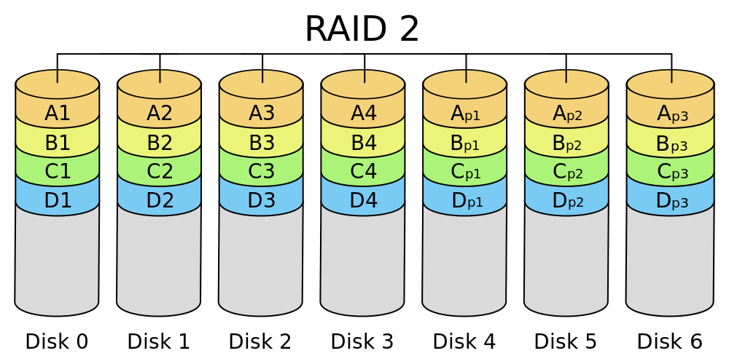
RAID 2 – Hamming Code for ECC
Bit level striping
Requires discs to be in sync
Hamming Code parity to correct single error
Variable number of check disks per group
Reads of less than group size require reading the whole group
G = 4
C = 3
G = data disks in group
C = check disks per group

Slide 6
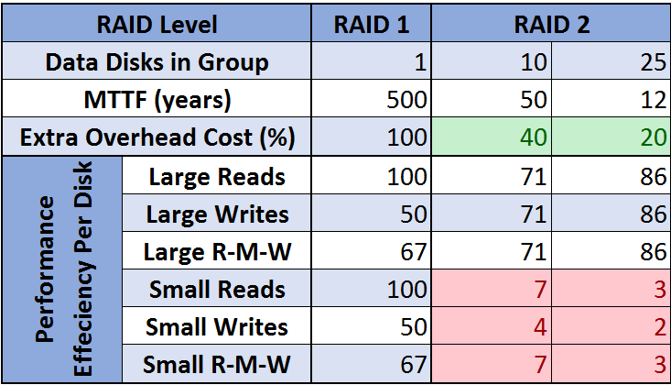
RAID 2 – Hamming Code for ECC

Slide 7
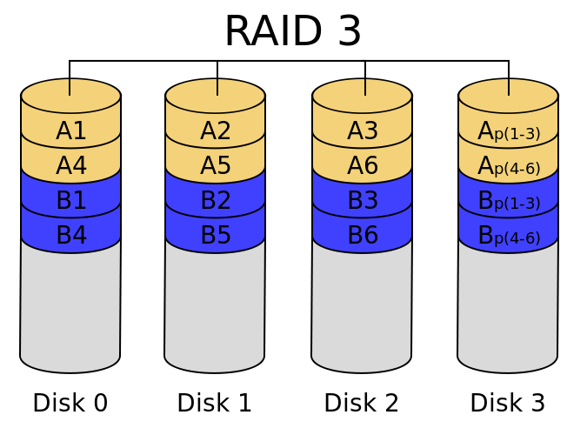
RAID 3 – Single Check Disk Per Group
Byte level striping
Requires discs to be in sync
Parity to detect single error
Use disk controllers to detect which disk failed
Single check disk per group
G = 3
C = 1
G = data disks in group C = check disks per group

Slide 8
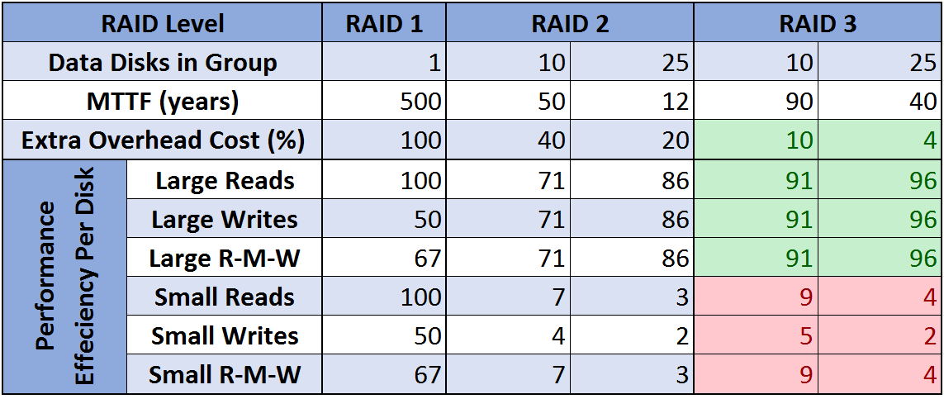
RAID 3 – Single Check Disk Per Group

Slide 9
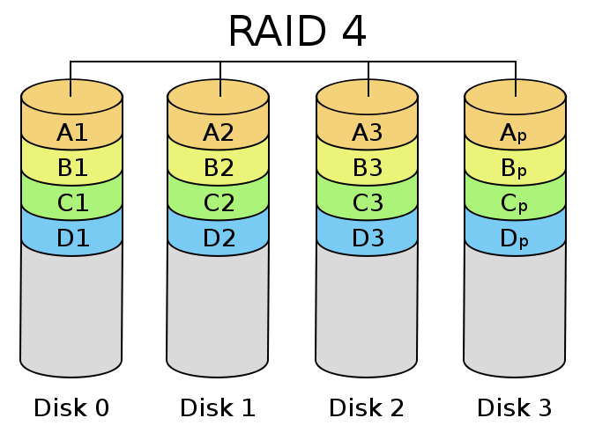
RAID 4 – Independent Read/Writes
Block level striping
Can read in parallel
Cannot write in parallel
In write parity can be calculated with just 2 disks
Single check disk per group
G = 3
C = 1

Slide 10
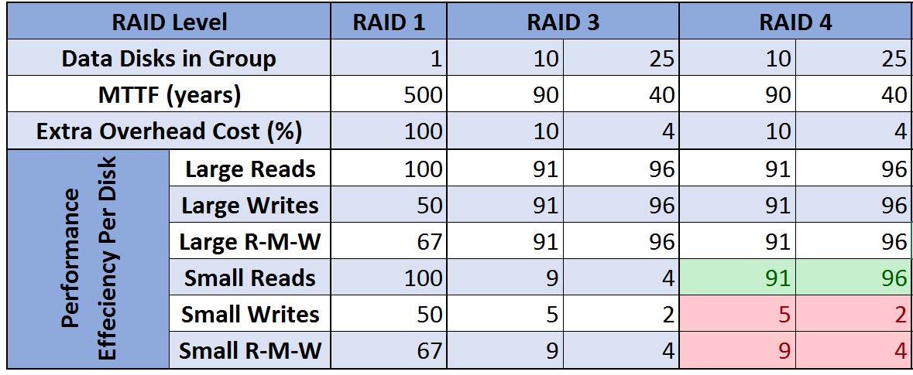
RAID 4 – Independent Read/Writes

Slide 11
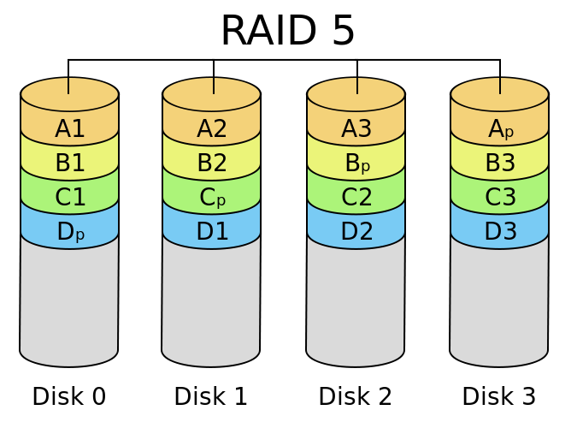
RAID 5 – No Single Check Disk
Block level striping
Distribute data and check info across all disks
Can read and write in parallel
Single “check disk” per group
G = 3
C = 1

Slide 12
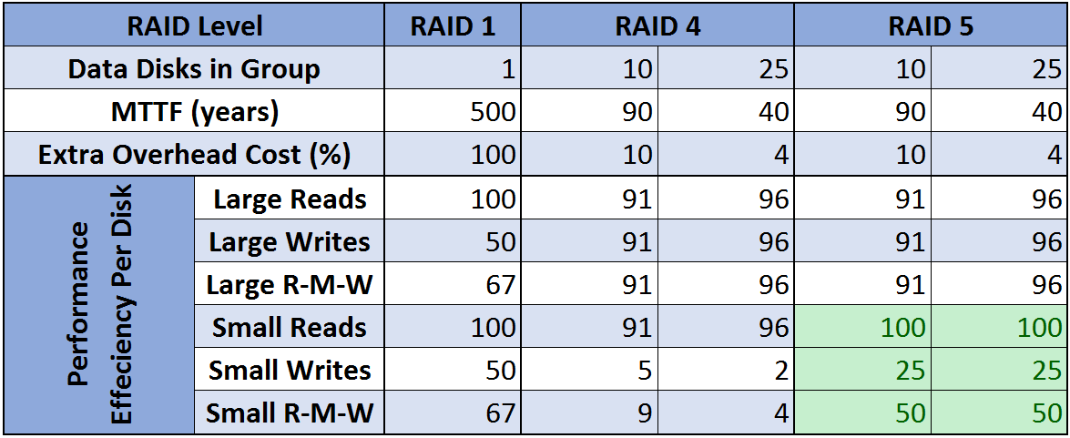
RAID 5 – No Single Check Disk

Slide 13
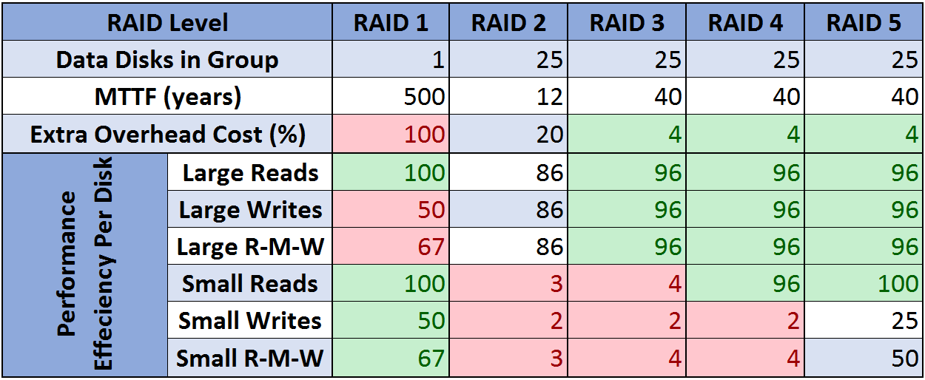
RAID Level Comparison

Slide 14
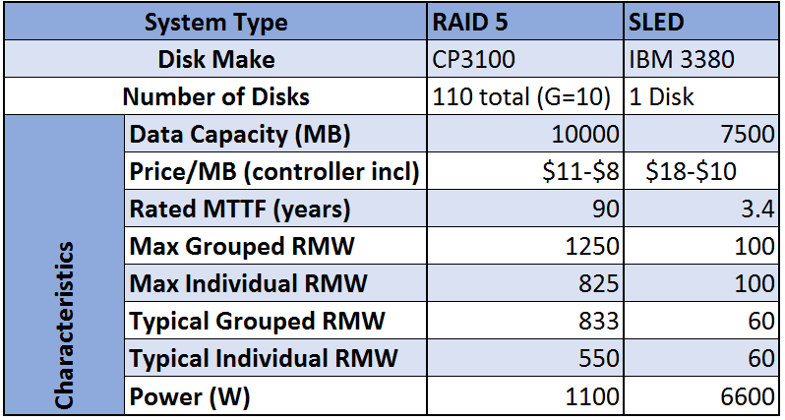
RAID 5 vs SLED

Slide 15
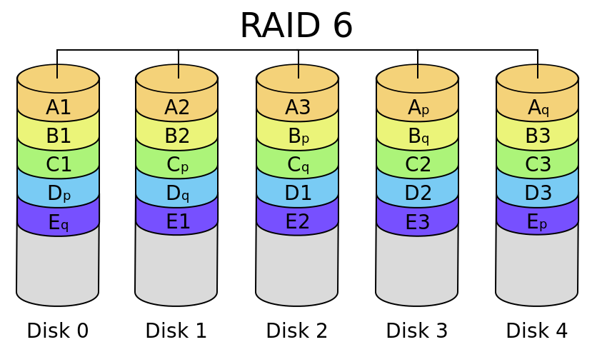
The Addition of RAID 6
RAID 5 with 2 check disks
Can detect 2 errors
Can reconstruct data from 2 broken disks at once

Slide 16
Current Day Issues:
Excessive bit errors due to bad sectors on large discs
RAID 6 with 2TB drives in 1000 disk system there is a 5% chance of annual data loss
8TB drives with 40% loss
Rebuild times are being elongated as drive sizes increase

Slide 17
Discussion Topics:
How do you modify RAID to mitigate large bit error and long rebuild times?
What are the advantages and disadvantages of using RAID with SSDs?

