Slide 1
Image Processing in CS1
Brad Miller
David Ranum
Luther College

Slide 2
Image Processing with cImage
Classes
Methods
Window
Image
File Image
Empty Image
List Image
Pixel
Does not require PIL
Images
getWidth, getHeight
getPixel,setPixel
Pixels
getRed, setRed
getGreen, setGreen
getBlue, setBlue
http://knuth.luther.edu/~pythonworks

Slide 3
def blackWhite(pic):
bwpic = EmptyImage(pic.getWidth(), pic.getHeight())
for row in range(pic.getHeight()):
for col in range(pic.getWidth()):
thepixel = pic.getPixel(col,row)
r = thepixel.getRed()
g = thepixel.getGreen()
b = thepixel.getBlue()
gray = (r + g + b)//3
if gray <= 127:
p = Pixel(0,0,0)
else:
p = Pixel(255,255,255)
bwpic.setPixel(col,row,p)
return bwpic

Slide 4
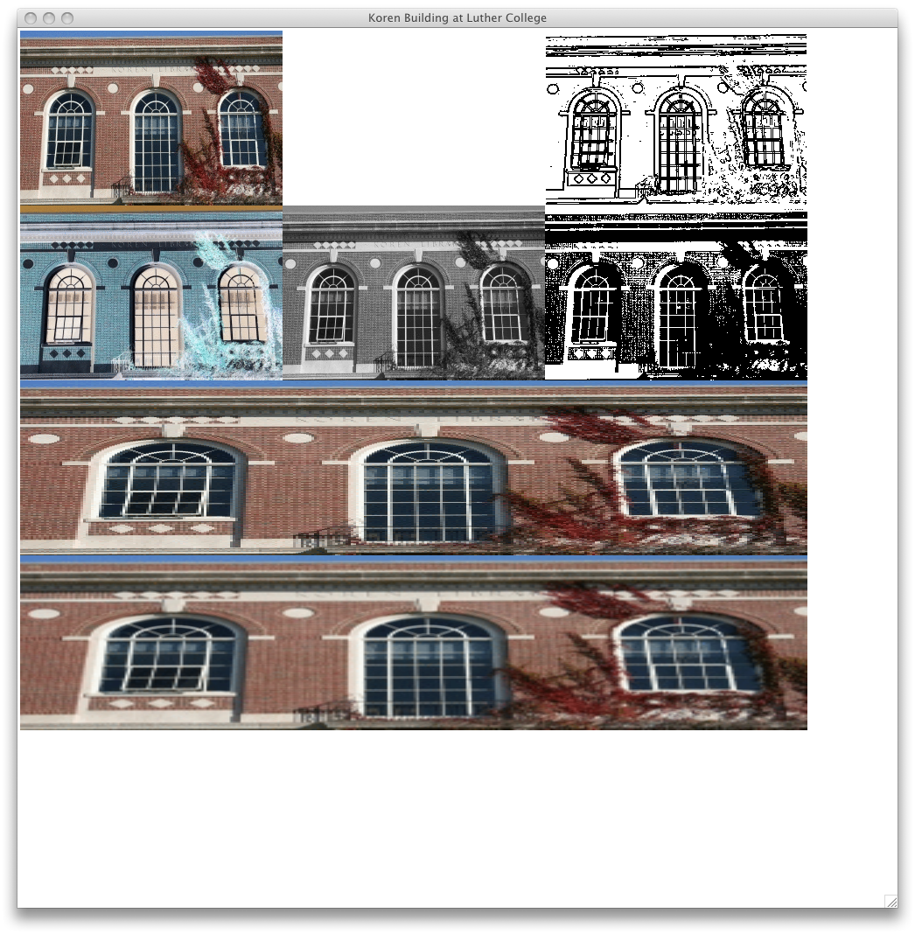

Slide 6
Edge Detection
Iteration Patterns
Four levels of nesting
Setting boundaries
Edge Cases
Sum of Products

Slide 7
