Slide 1
Contexts in Computer Science Education
Mark Guzdial
School of Interactive Computing

Slide 2
Story
Beyond teaching computing to more,
teaching computing to everyone.
Computing for All at Georgia Tech
  1999-2003: One course for all
  2003-2008: Contextualized Computing Education
Evaluation Results: Different contexts, at different schools
  Media Computation, Engineering, Robotics
  Pre CS1: Contexts for Girl Scouts
  Beyond CS1: Media Computation CS2, Gameboy for Computer Organization

Slide 3
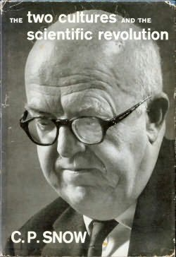
The Two Cultures
Notes:
We want everyone – different camps. How do we draw them in? Why would they want to join us?

Slide 4
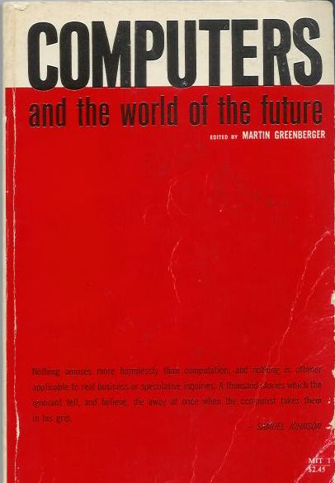
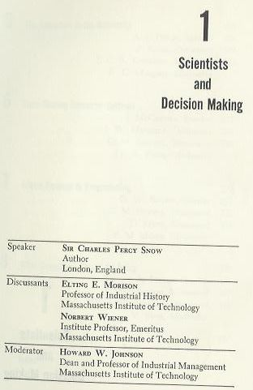
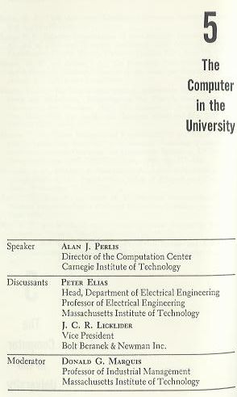
1961 MIT Sloan School Symposium
Notes:
Why might they want to join us?
In “Dream Machines,” biography of J.C.R. Licklider.
Other speakers include Vannevar Bush, Herbert A. Simon, Marvin L. Minsky, J. C. R. Licklider, Jay W. Forrester, Grace M. Hopper, Claude E. Shannon, John G. Kemeny, Gene M. Amdahl.

Slide 5
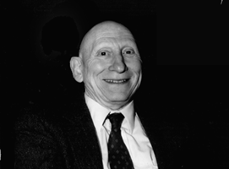
Learn Programming to Re-Think Process Everywhere
Alan Perlis argued that computer science should be part of a liberal education.
  Explicitly, he argued that all students should learn to program.
Why?
  Because Computer Science is the study of process.
  Automated execution of process changes everything
    Including how we think about things
Notes:
Talked about the economics department at Carnegie Tech (at that time). Talk about rethinking Calculus.

Slide 6
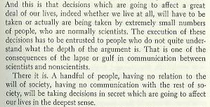
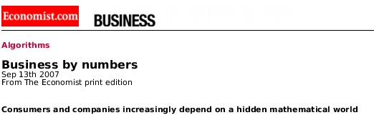
The Power and Fear of Algorithms
The Economist (Sept., 2007) spoke to the algorithms that control us, yet we don’t understand.
  Credit Ratings, Adjustable Rate Mortgages, Search Rankings
C.P. Snow foresaw this in 1961.
  Those who don’t understand algorithms, can’t understand how the decisions are made.
“A handful of people, having no relation to the will of society, having no communication with the rest of society, will be taking decisions in secret which are going to affect our lives in the deepest sense.”

Slide 7
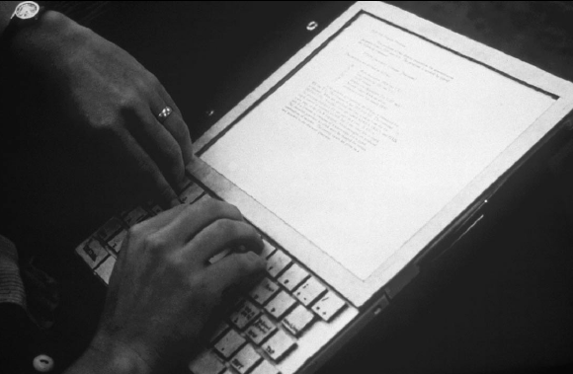
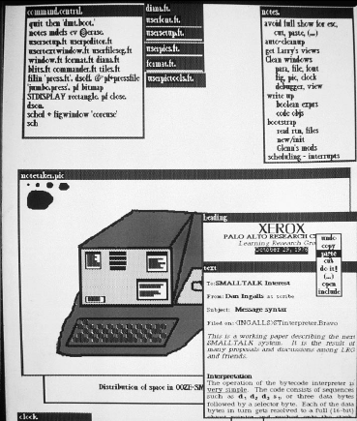
1970- : Alan Kay’s Dynabook
Alan Kay (2004 ACM Turing Awardee) sees the Computer as humanity’s first metamedium
  A medium that can represent all other media.
  Programming as an important new medium
The computer-as-Dynabook is for creative metamedia exploration and reading

Slide 8
Fall 1999: Georgia Tech
Fall 1999:
All students at Georgia Tech must take a course in computer science.
  Considered part of General Education, like mathematics, social science, humanities…
Why did Georgia Tech make that decision?
  Computing was a College.
    Solved a problem for Engineering
  Making a competitive distinction for Liberal Arts

Slide 9
Computing for Everyone is
Already Happening
Computing is already cross-campus
  Bio2010 (NRC) calls for programming for mathematical and computational models.
  Physics teaches VPython for labs where they solve three-body problems.
Computer science provides the tools and metaphors for understanding our world
  Jeanette Wing’s “Computational Thinking”
Scientists and engineers use computing to model, simulate, and understand.
  Why shouldn’t students?
Notes:
Bio2010 in NRC.
New approach by Ruth Chabay and Bruce Sherwood, being adopted now at Georgia Tech, Purdue, and North Carolina State.
It’s a problem for them and us.

Slide 10
Richard Dawkins on Fresh Aire
GROSS: You close your book saying, "I am thrilled to be alive at a time when humanity is pushing against the limits of understanding." How do you think that's happening in your field of evolutionary biology?
Mr. DAWKINS: Well, it's the most exciting time to be a biologist… Since Watson and Crick in 1953, biology has become a sort of branch of computer science. I mean, genes are just long computer tapes, and they use a code which is just another kind of computer code. It's quaternary rather than binary, but it's read in a sequential way just like a computer tape. It's transcribed. It's copied and pasted. All the familiar metaphors from computer science fit.
Notes:
This perspective is being taught to biology undergraduates today. Yet we are playing very little role.

Slide 11
Computer Science = = Computer Science
Key Point: Only one course met the requirement:
CS1321 Introduction to Computing
  Shackelford’s pseudocode approach in 1999
  Later Scheme: How to Design Programs (MIT Press)
Why only one?
  It’s all the same computer science.
  Resource issues
  “Service Ghetto”

Slide 12
One-class CS1: Pass (A, B, or C) vs.
WDF (Withdrawal, D or F)
Success Rates in CS1 from Fall 1999 to Spring 2002
Architecture | 46.7%
Biology | 64.4%
Economics | 53.5%
History | 46.5%
Management | 48.5%
Public Policy | 47.9%
Notes:
Actually, quite good pass rates, compared to many others in CS.
Across campus, these are the pits.
And the women are failing or withdrawing. in greater numbers than the men.
This looks like C.P. Snow’s “Two Cultures”

Slide 13
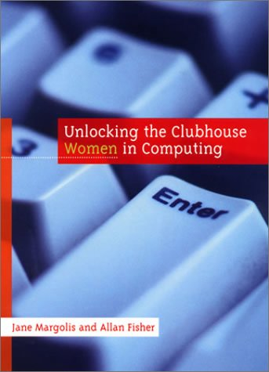
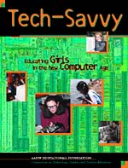
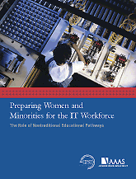
Contextualized Computing Education
What’s going on?
  Research results: Computing is “tedious, boring, irrelevant”
Since Spring 2003, Georgia Tech teaches three introductory CS courses.
  Based on Margolis and Fisher’s “alternative paths”
Each course introduces computing using a context (examples, homework assignments, lecture discussion) relevant to majors.
  Make computing relevant by teaching it in terms of what computers are good for (from the students’ perspective).
Notes:
Talk about iPods and Blackberries.

Slide 14
Contexts, Results, and Themes
Media Computation
Computing for Engineers (MATLAB)
Robotics for CS1
  Institute for Personal Robotics in Education
Pre CS1
  Contexts with Girl Scouts
Beyond CS1
  Impact on CS2
  Gameboy programming for Computer Organization

Slide 15

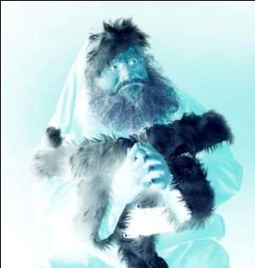
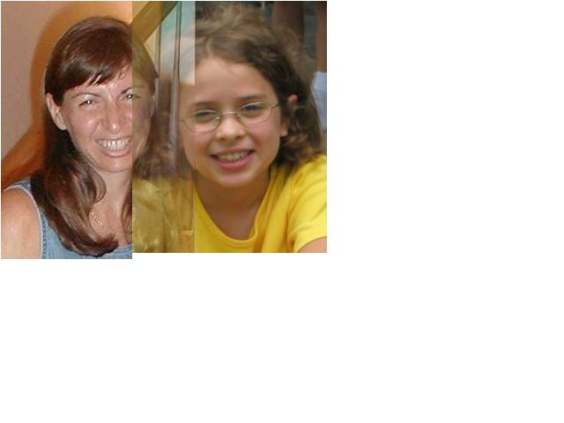

Media Computation:Teaching in a Relevant Context
Presenting CS topics with media projects and examples
  Iteration as creating negative and grayscale images
  Indexing in a range as removing redeye
  Algorithms for blending both images and sounds
  Linked lists as song fragments woven to make music
  Information encodings as sound visualizations

Slide 16
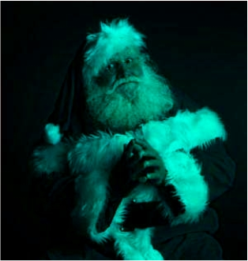
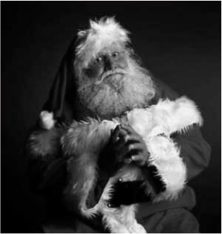
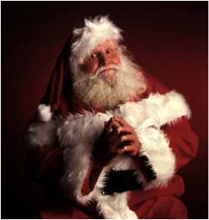
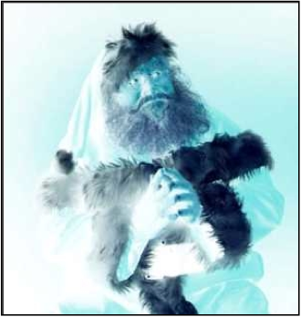
def clearRed(picture):
for pixel in getPixels(picture):
setRed(pixel,0)
def greyscale(picture):
for p in getPixels(picture):
redness=getRed(p)
greenness=getGreen(p)
blueness=getBlue(p)
luminance=(redness+blueness+greenness)/3
setColor(p, makeColor(luminance,luminance,luminance))
def negative(picture):
for px in getPixels(picture):
red=getRed(px)
green=getGreen(px)
blue=getBlue(px)
negColor=makeColor(255-red,255-green,255-blue)
setColor(px,negColor)

Slide 17
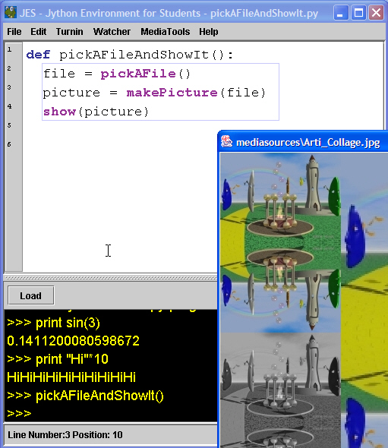
Selecting Python as the programming language
Significant issue: Non-CS faculty, who don’t program, speak for their students.
How do they choose?
  Check Google: General opinion counts.
  Looks like other programming languages
    Potential for transfer
  Use in commercial contexts authenticates the choice
    IL&M, Google, Nextel, etc.
Our experience: Easy transition to Java
Notes:
Does this deal with the tediousness issues?

Slide 18
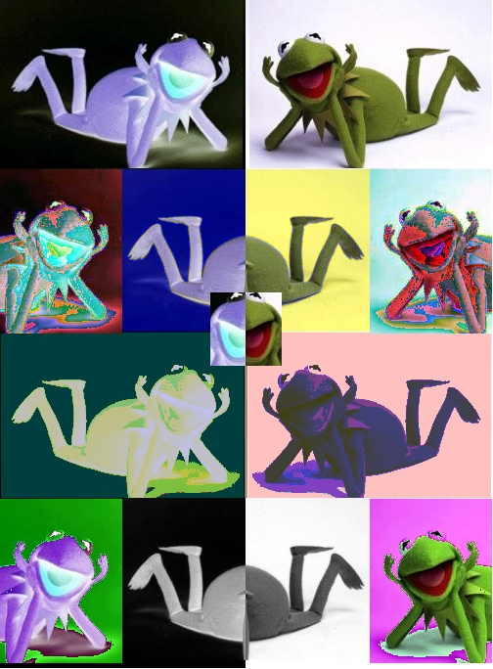
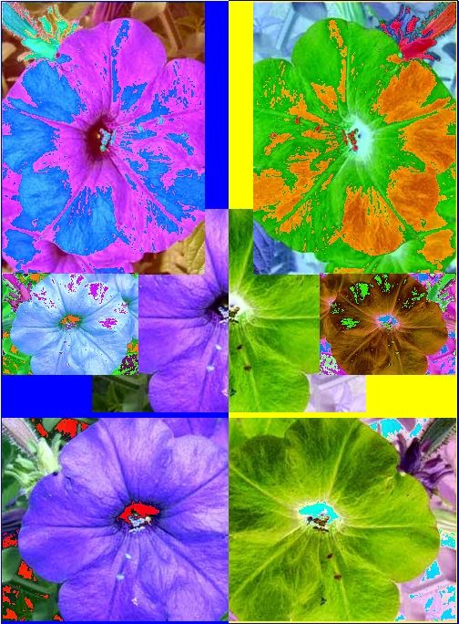
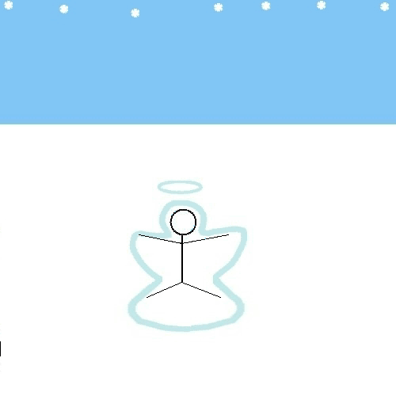
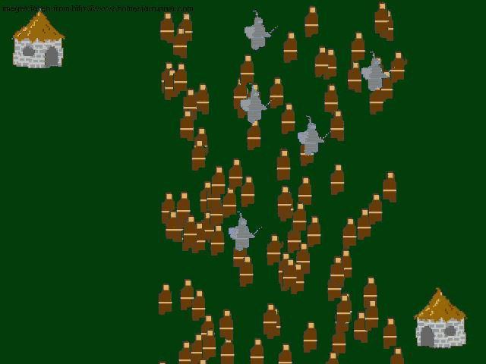
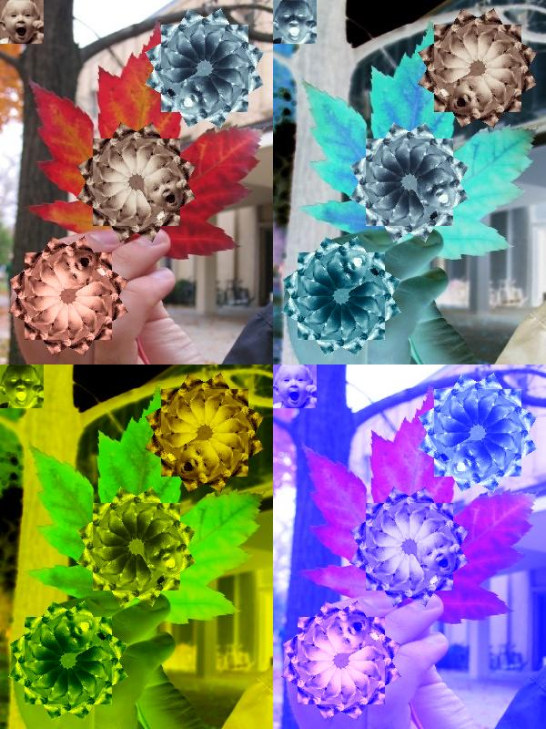
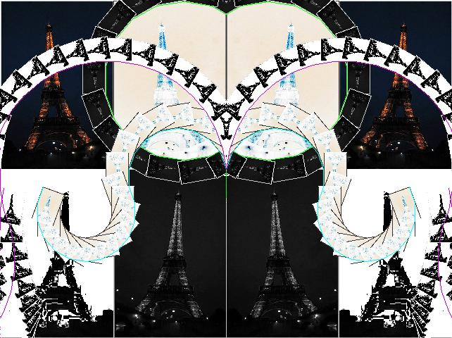

Open-ended, contextualized homework
Sound collage
Music

Slide 19
Results:CS1“Media Computation”
Change in Success rates in CS1 “Media Computation” from Spring 2003 to Fall 2005
Architecture | 46.7% | 85.7%
Biology | 64.4% | 90.4%
Economics | 54.5% | 92.0%
History | 46.5% | 67.6%
Management | 48.5% | 87.8%
Public Policy | 47.9% | 85.4%

Slide 20
Voices fromMedia Computation Students
Intl Affairs student (female): “I just wish I had more time to play around with that and make neat effects. But JES [IDE for class] will be on my computer forever, so… that’s the nice thing about this class is that you could go as deep into the homework as you wanted. So, I’d turn it in and then me and my roommate would do more after to see what we could do with it.”
Results from a survey a year later.
  19% of respondents had programmed since class ended
  “Did the class change how you interact with computers?”
  80% say “Yes”
    “Definitely makes me think of what is going on behind the scenes of such programs like Photoshop and Illustrator.”
Notes:
FIX HAVE->HAD

Slide 21
“Did the class change how you interact with computers?”
Results from a survey a year later:
  “Definitely makes me think of what is going on behind the scenes of such programs like Photoshop and Illustrator.”
  'I understand technological concepts more easily now; I am more willing and able to experience new things with computers now’
  'I have learned more about the big picture behind computer science and programming. This has helped me to figure out how to use programs that I've never used before, troubleshoot problems on my own computer, use programs that I was already familiar with in a more sophisticated way, and given me more confidence to try to problem solve, explore, and fix my computer.’

Slide 22
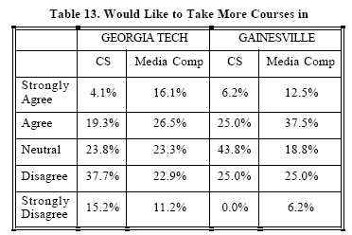
Results at Gainesville College
(Tew, Fowler, Guzdial, SIGCSE 2005)

Slide 23
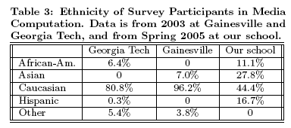
Results at U. Illinois-Chicago
(Sloan and Troy, SIGCSE 2008)

Slide 24
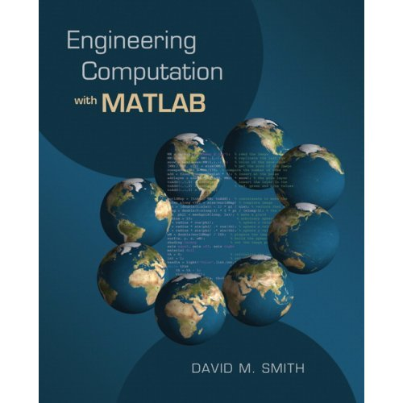
Introducing Computing in an Engineering Context
Developed in collaboration with Civil, Mechanical, and Aerospace Engineering.
Uses Engineering problems and MATLAB
Covers traditional CS1 topics
Among our 3 CS1’s, these are the first students to program outside of class.

Slide 25
Results:CS1 for Engineering

Slide 26
Side Trip: How about CS?
Notes:
How can our lessons about contextualized computing education improve computing education for CS majors, too?

Slide 27
Comparing Spring 2004

Slide 28
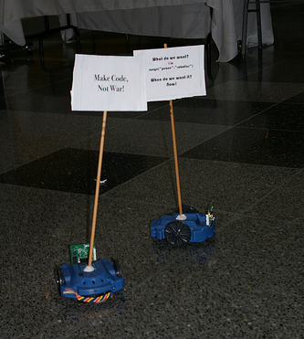
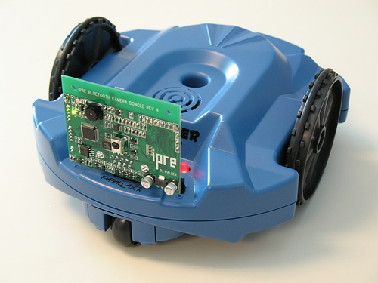
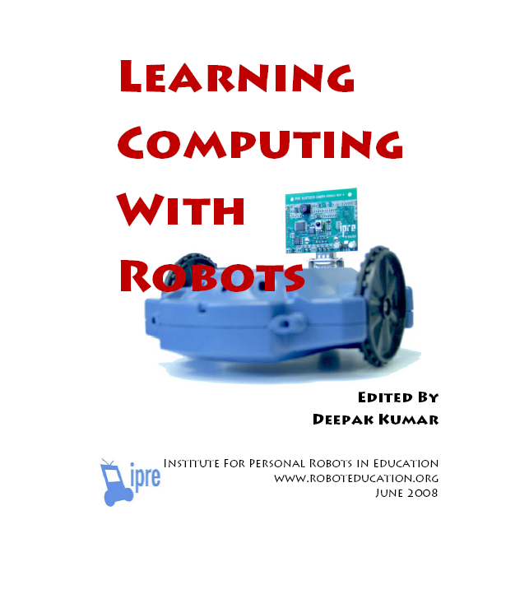
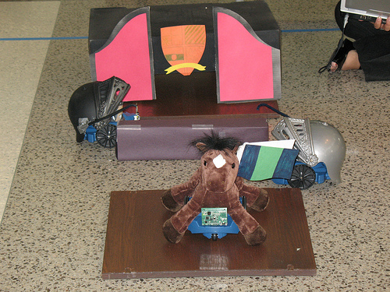
A Context for CS1 forCS majors: Robotics
Microsoft Research has funded the Institute for Personal Robotics in Education
  Tucker Balch, Deepak Kumar, Doug Blank
  Joint between Bryn Mawr and Georgia Tech
  http://www.roboteducation.org
Goal is to develop a CS1 with robotics as the context.
  Includes a camera and media computation functions

Slide 29
Robot Movies
Wonderful project by Jay Summet:
Creative and Collaborative – and Distributed/Parallel!
  Robots are characters.
  Multiple characters mean multiple students with multiple robots.
  One robot is camera
    How do you zoom?
    Aim and go forward!
  Challenges:
  How do you know when your actors are in their places?
  How do you “cue” the others?
  Post-processing media computation for eerie disappearing effects.

Slide 30

Example Movie

Slide 31
Attitudes in Spring 2007
All students enjoyed the robot, were comfortable with it, and found it easy to get working.
  Personalizing the robot improved the course, in students’ opinion.
Reported that the class was about computer science
Found homework challenging
BMC students did more on homework “because it was cool.”
Notes:
31
© 2007 Microsoft Corporation. All rights reserved. Microsoft, Windows, Windows Vista and other product names are or may be registered trademarks and/or trademarks in the U.S. and/or other countries. The information herein is for informational purposes only and represents the current view of Microsoft Corporation as of the date of this presentation. Because Microsoft must respond to changing market conditions, it should not be interpreted to be a commitment on the part of Microsoft, and Microsoft cannot guarantee the accuracy of any information provided after the date of this presentation. MICROSOFT MAKES NO WARRANTIES, EXPRESS, IMPLIED OR STATUTORY, AS TO THE INFORMATION IN THIS PRESENTATION.
01/09/08 16:37

Slide 32
Fall 2007:
Final Exam Comparison at GT

Slide 33
Statistically Significant p <= 0.015
Ignore the Tracing Question

Slide 34
Confound: Differences in Class Demographics
Due to the laptop requirement, advisors steered students who were declared as
CS majors into the robots class,
and other students into the non-robots class.
4% CS/Computation Majors in the Non-Robots class
81% CS/Computation majors in Instructor B's Robots class.

Slide 35
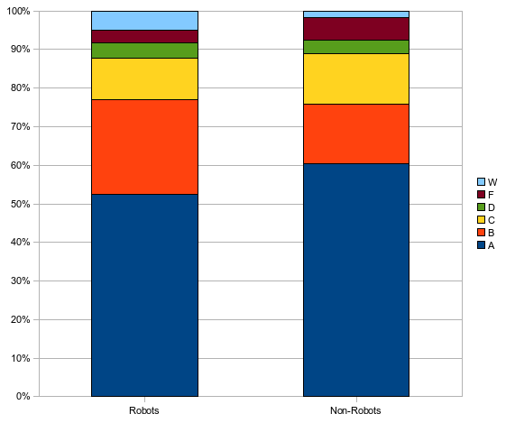
W’s vs. F’s, statistically significant
Notes:
35
© 2007 Microsoft Corporation. All rights reserved. Microsoft, Windows, Windows Vista and other product names are or may be registered trademarks and/or trademarks in the U.S. and/or other countries. The information herein is for informational purposes only and represents the current view of Microsoft Corporation as of the date of this presentation. Because Microsoft must respond to changing market conditions, it should not be interpreted to be a commitment on the part of Microsoft, and Microsoft cannot guarantee the accuracy of any information provided after the date of this presentation. MICROSOFT MAKES NO WARRANTIES, EXPRESS, IMPLIED OR STATUTORY, AS TO THE INFORMATION IN THIS PRESENTATION.
01/09/08 16:37

Slide 36
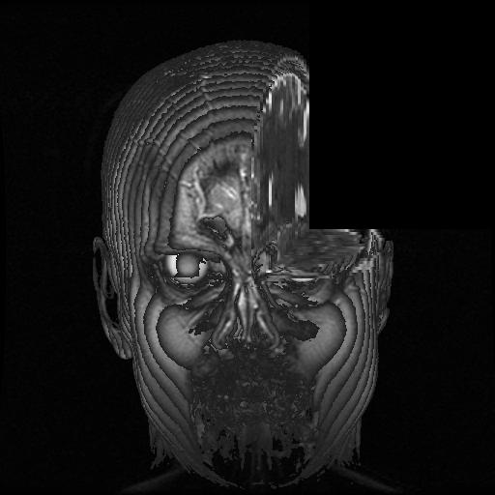
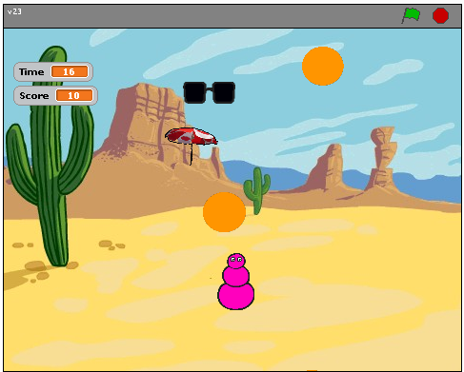
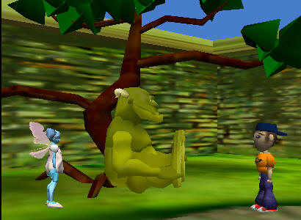
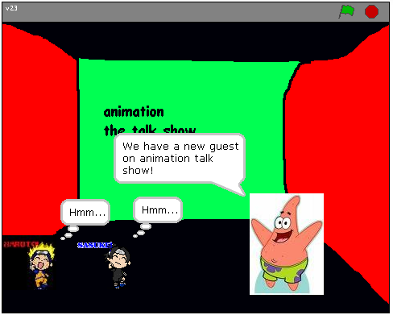
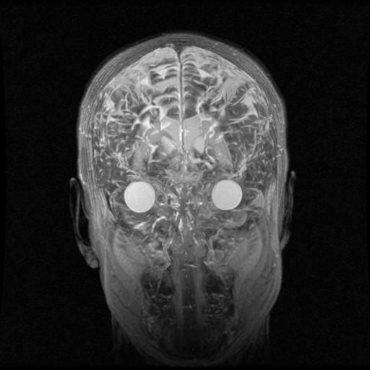
Others: Storytelling, Music Video,
Analysis

Slide 37
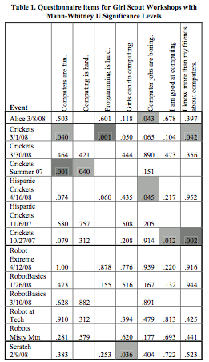
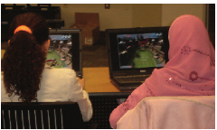
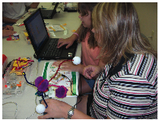
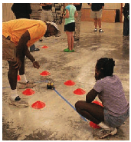
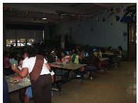
Pre-CS1: “Georgia Computes!”
Use in Girl Scouts Workshops

Slide 38
What about beyond CS1?
If students get context in CS1, how do they do in a context-free CS2?
Are students as well-prepared in CS2 after a contextualized CS1?
Is context useful in CS2 and beyond?

Slide 39
The Impact of Contextualized CS1 on CS2
Bryn Mawr College Data for 12 years of CS2
CS2 Data Structures Enrollment
Notes:
39
© 2007 Microsoft Corporation. All rights reserved. Microsoft, Windows, Windows Vista and other product names are or may be registered trademarks and/or trademarks in the U.S. and/or other countries. The information herein is for informational purposes only and represents the current view of Microsoft Corporation as of the date of this presentation. Because Microsoft must respond to changing market conditions, it should not be interpreted to be a commitment on the part of Microsoft, and Microsoft cannot guarantee the accuracy of any information provided after the date of this presentation. MICROSOFT MAKES NO WARRANTIES, EXPRESS, IMPLIED OR STATUTORY, AS TO THE INFORMATION IN THIS PRESENTATION.
01/09/08 16:37

Slide 40
Including last two years (since robots)
CS2 Data Structures Enrollment
Notes:
40
© 2007 Microsoft Corporation. All rights reserved. Microsoft, Windows, Windows Vista and other product names are or may be registered trademarks and/or trademarks in the U.S. and/or other countries. The information herein is for informational purposes only and represents the current view of Microsoft Corporation as of the date of this presentation. Because Microsoft must respond to changing market conditions, it should not be interpreted to be a commitment on the part of Microsoft, and Microsoft cannot guarantee the accuracy of any information provided after the date of this presentation. MICROSOFT MAKES NO WARRANTIES, EXPRESS, IMPLIED OR STATUTORY, AS TO THE INFORMATION IN THIS PRESENTATION.
01/09/08 16:37

Slide 41
Media Computation impact on CS2
Trial at Columbus State University
Fall 2007, 3 sections of CS1 for Majors:
Media Computation Java vs. traditional
  From Wayne Summers (Dept Chair):
  We also taught two other CS1 sections without the Media Computation focus (using the Lewis/Loftus book) and are assessing the difference. The Media Computation class had a significantly higher completion and pass rate and appears to have a higher student satisfaction rate. We will be able to better compare the two methods after this semester. Students from both groups are taking the same CS2 class.
Spring 2008: Same CS2 for all 3 sections.
Results:
  No difference on retention rates, midterm exam grades, final exam grades.

Slide 42
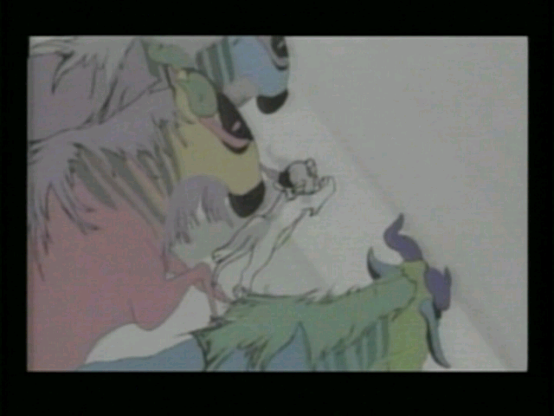
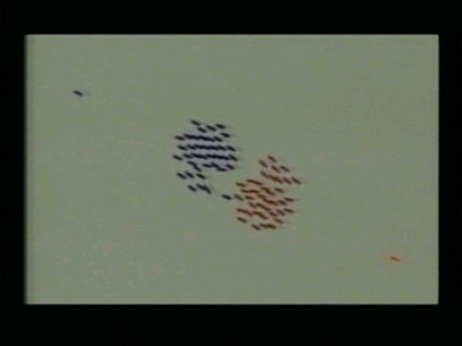
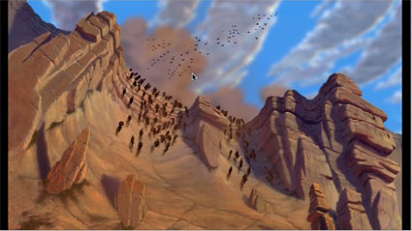
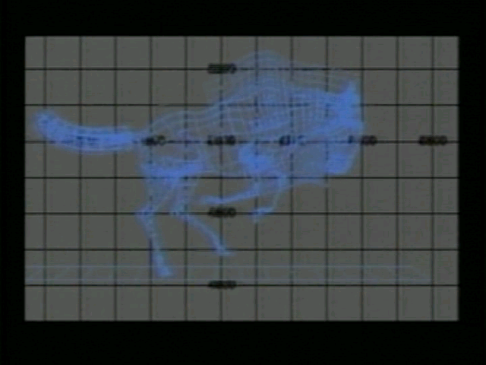
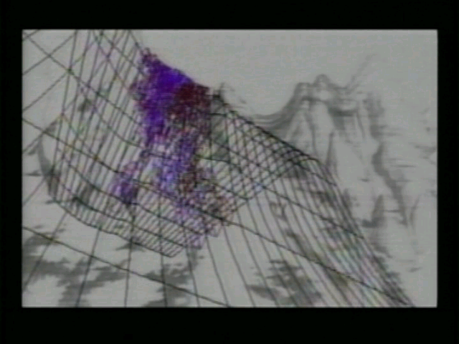
AContextualized CS2: MediaComp Data Structures
How did the Wildebeests charge over the ridge in Disney's "The Lion King"?
Notes:
How is it different? The first “tree” that students use is an n-ary tree, a scene graph. Why not start with a binary tree? Because binary trees are irrelevant to media developers.
Java course, all non-majors, 90% success rate

Slide 43
Research Question: Is context still useful in a second course?
11% agreed with “Working with media is a waste of time that could be used to learn the material in greater depth.”
  “I didn’t take this class to learn how to make pretty pictures.”
A majority of the class (70%) agreed or strongly agreed that working with media makes the class more interesting.
67% of the students agreed or strongly agreed that they were really excited by at least one class project
66% reported doing extra work on projects to make the outcome look “cool.”
(Yarosh and Guzdial, JERIC, Jan 2008)

Slide 44
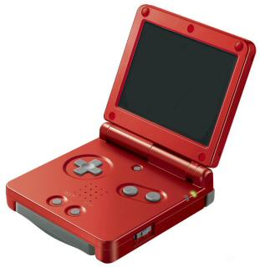
Context: Programming a Gameboy
Traditional Computer Organization using an imaginary processor, vs.
Computer Organization using a Gameboy
  Not all the same topics (e.g., Gameboy graphics modes)
  Common focus on C programming, bit manipulations, model of the computer (including memory and I/O)
Post-class survey comparison: No significant performance difference. Big motivation difference.
  100% of students in Gameboy class did extra on at least one homework, because it was fun.
  30% of traditional students never put any extra effort in (p=0.046).
(Tew, Dorn, Leahy, Guzdial, JERIC, to appear)

Slide 45
Summary: What do we know about contexts for CS Ed?
Including context has led to evaluation reports of:
  Increased retention (in CS1, across multiple schools, with both majors and non-CS majors, across genders and ethnicities),
  Some evidence of increased enrollment in CS2, and
  Student reports of increased time-on-task, even beyond CS1.
Not all contexts work for all students.
  Context is about personal engagement
  Some students do just fine with computing Fibonacci numbers
  Therefore, we need to offer multiple contexts, for all Snow’s “cultures”

Slide 46
Summary: What don't we know about context?
What is a context?
What do students perceive as a relevant context?
When do contexts work? For how long? For whom?
Do contexts help with learning? Over time?
When the context is fixed (e.g., professional graphics designers), how do you teach within that context?
What is needed for teachers to succeed with a context?
Notes:
XXX

Slide 47
Conclusions
Computing is important for everyone,
We should aim to be able to teach computing to everyone.
Contextualized Computing Education has great promise for achieving the goal of teaching everyone about computing.
  At multiple levels
We need more data and better instruments on contexts.

Slide 48
With thanks to our funding supporters
National Science Foundation
  Statewide BPC Alliance: Project “Georgia Computes!” http://www.gacomputes.org
  CCLI Grant
Microsoft Research
Georgia Tech's College of Computing
Georgia’s Department of Education
GVU Center,
Al West Fund,
President's Undergraduate Research Award,
Toyota Foundation

Slide 49
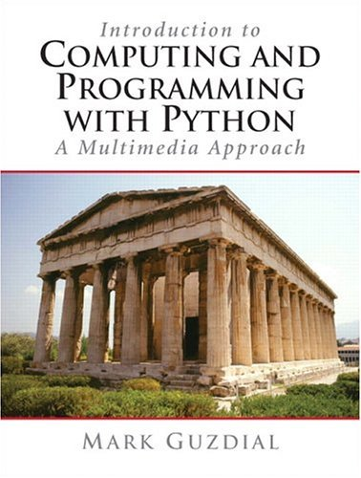

Thank you!
http://www.cc.gatech.edu/~mark.guzdial
http://home.cc.gatech.edu/csl
For more on MediaComp approach (including papers, software, and slides, and workshops):
http://coweb.cc.gatech.edu/mediaComp-plan
Media Computation Teachers’ Site:
http://coweb.cc.gatech.edu/mediaComp-teach

