Slide 1
New Features of HTML 5.0
Barbara Ericson
ericson@cc.gatech.edu

Slide 2
What is new in HTML 5.0?
Canvas – draw on a canvas with JavaScript
Audio and Video – new tags instead of plug-ins
Geolocation – get your location
Local Storage – store data in the user’s browser
Forms – built-in types for verification
CSS3 – Animate elements, add rounded corners, and drop shadows
New Markup – new tags for headers, footers, and more
Web Workers – allow scripts to run at the same time and in the background
Offline Web Apps – work without the internet
Notes:
Try the exercise on page 16 after you cover this section. Also see page 23 in the book.

Slide 3
Should I use HTML 5.0?
It isn’t the standard yet but browsers are adding the features now
Stable by 2014
Can’t I just use Flash?
Flash doesn’t work on all devices like IPads
HTML 5.0 and JavaScript will let you create web applications
Should work on many devices like cell phones

Slide 4
Using the Canvas
Add a canvas to your html page with a unique id
<canvas id="myCanvas" width=400 height=200>
Your browser does not support the canvas tag.
</canvas>
Add JavaScript to get the canvas object
<script type="text/javascript">
var canvas=document.getElementById('myCanvas');
Get the drawing context from the canvas object
var ctx =canvas.getContext('2d');
Set the fill and/or stroke color
ctx.fillStyle="blue”;
Draw something
ctx.fillRect(50,20, 200, 100);

Slide 5
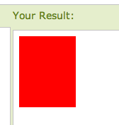
Rectangle Challenge
Go to http://www.w3schools.com/html5/tryit.asp?filename=tryhtml5_canvas
Click the “Edit and Click Me” button
You will see a red rectangle
Now change the example to draw a green rectangle with a width of 200, a height of 100 at x=50 and y=20
Click the “Edit and Click Me” button
Try creating several filled rectangles
What are the values of x and y at the top left corner?
Try to add a black border to the canvas element using CSS
Notes:
See http://www.webmonkey.com/2010/02/color_charts/ for hexadecimal color codes

Slide 6
Adding a border and size
Use CSS to add a black border to the canvas
Specify the width and height of the canvas
Using width= and height=
Default is 300 by 150
<DOCTYPE html>
<html>
<head>
<title>Canvas Test</title>
<meta charset="utf-8" />
<style>
canvas {border: 1px solid black;}
</style>
</head>
<body>
<canvas id="myCanvas" width=400 height=200>Your browser does not support the canvas tag.</canvas>

Slide 7
Drawing a Triangle
Create a path
Use moveTo to get to the starting location
Without drawing
Use lineTo to draw a line from the current position to the given x and y
closePath will add a line from the last point to the first point
ctx.beginPath();
ctx.moveTo(100,130);
ctx.lineTo(250,75);
ctx.lineTo(125,30);
ctx.closePath();
ctx.lineWidth=3;
ctx.stroke();
ctx.fillStyle="red";
ctx.fill();
Notes:
Copy the JavaScript and add it to the window with the filled rectangles.

Slide 8
Pentagon Challenge
Draw a 5 sided figure (a pentagon)
You will need to create a path
Use moveTo(100,150) to get to the starting point
Use lineTo to add 4 lines
125,30
200,10
300,80
250,160
Use closePath to add the 5th line from the last point to the starting point
Fill it with blue

Slide 9
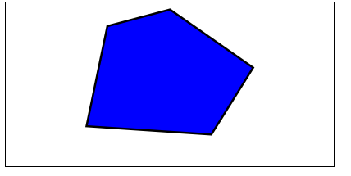
Pentagon Example
<canvas id="myCanvas" width=400 height=200>Your browser does not support the canvas tag.</canvas>
<script type="text/javascript">
var canvas=document.getElementById('myCanvas');
var ctx=canvas.getContext('2d');
ctx.beginPath();
ctx.moveTo(100,150);
ctx.lineTo(125,30);
ctx.lineTo(200,10);
ctx.lineTo(300,80);
ctx.lineTo(250,160);
ctx.closePath();
ctx.lineWidth=5;
ctx.stroke();
ctx.fillStyle="blue";
ctx.fill();

Slide 10
Drawing Arcs and Circles
Begin a path
Create an arc
x and y of center of the circle
radius
startAngle
Angle between x axis and starting point in radians
endAngle in radians
2 * PI radians in a circle
<canvas id="myCanvas" width="300" height="150" style="border:1px solid #d3d3d3;">
your browser does not support the canvas tag </canvas>
<script type="text/javascript">
var c=document.getElementById("myCanvas");
var ctx=c.getContext("2d");
ctx.beginPath();
ctx.arc(100,75,50,0,2*Math.PI);
ctx.strokeStyle="green";
ctx.stroke();
Notes:
See pages 314 and 315 of the book and http://www.w3schools.com/html5/html5_ref_canvas.asp for the Canvas API. Also try it at http://www.w3schools.com/html5/tryit.asp?filename=tryhtml5_canvas_arc. There are 2 * PI radians in a circle. You can get the number of radians from the degrees by (degrees * Math.PI)/180.

Slide 11
Circle Challenge
Create at least 3 circles of different sizes
Fill at least one circle with a color
Create a few arcs
One from 0 to 180
Create a smiling face
See page 321of the book

Slide 12
Drawing Text
Set the font
Style, weight, size, and family
Fill text with fillText
Pass string, x, y
Outline text with strokeText
Pass string, x, y
You can also set the alignment or baseline
Page 328-329
<!DOCTYPE html>
<html>
<body>
<canvas id="myCanvas" width="300" height="150" style="border:1px solid #d3d3d3;">
your browser does not support the canvas tag </canvas>
<script type="text/javascript">
var c=document.getElementById("myCanvas");
var ctx=c.getContext("2d");
ctx.font="30px Arial";
ctx.fillText("Hello World",10,50);
</script>
</body>
</html>
Notes:
Try this out at http://www.w3schools.com/html5/tryit.asp?filename=tryhtml5_canvas_font

Slide 13
Drawing an Image
Create the image variable and name it
var name = new Image();
Set the source for the image
name.src = "twitterBird.png";
Draw the image after it loads
ctx.drawImage(name,x,y,
width, height);
var twitterBird = new Image();
twitterBird.src = "twitterBird.png";
twitterBird.onload = function() {
context.drawImage(twitterBird, 20, 120, 70, 70);
}
Notes:
Try opening hfhtml5/chapter7/index.html to try this out

Slide 14
Image Challenge
Draw a picture of a beach in a canvas
Draw a border around the picture
Draw your name on the picture
In a color that stands out

Slide 15
What is the canvas good for?
Composite images
Using an image as a background
Adding text to images dynamically
See https://developer.mozilla.org/en/Canvas_tutorial for a tutorial and ideas
Graphs, clock, etc
Doing Media Computation on Pictures
See http://codeinthebrowser.org/
Teaching JavaScript

Slide 16
Adding Interactivity
http://www.blobsallad.se/
http://andrewwooldridge.com/canvas/canvasgame001/canvasgame002.html
http://arapehlivanian.com/wp-content/uploads/2007/02/canvas.html
http://igrapher.com/# stock market grapher

Slide 17
Scalable Vector Graphics
Also used to draw in web pages
But using vector graphics not bitmap
Specify elements with xml
So SVG can be searched , indexed, scripted, and compressed
SVG will scale better than a canvas drawing without pixelation
Notes:
See page 537 in the book.

Slide 18
Video
New tag for <video>
Try hfhtml5/chapter8/webvilletv.html
Can set the width and height of the video
Can set the image to display when the video isn’t playing
Poster – otherwise uses first frame
Can create custom video controls
Can process all frames in a video
Not all browsers support all types of video
Best to provide multiple videos with different formats: mp4, webm, ogv, etc
Notes:
See page 358 for how to specify several videos as the source. Try running webvilletv.html then webvilletv_playlist.html and then videobooth.html.

Slide 19
More on Video
Video tag has properties
videoWidth, videoHeight, currentTime, loop, muted, paused, duration, ended, readyState, …
Can call these methods on videos
play, pause, load, canPlayType
Catch these events
play, pause, progress, ended, abort, …
Notes:
See page 408 for a summary of the video tag.

Slide 20
Audio
New <audio> tag
Can specify the source
Wav, mp3, and Ogg Vorbis are popular formats
Can specify if you want controls to show
Has properties, methods, and events
<audio src="cowbell.wav" id="cowbellSound" controls>
Sorry but your browser doesn't support the audio tag
</audio>
Notes:
Try running labs/cowbell/Cowbell.html. Also see page 533 in the book.

Slide 21
Geolocation
Try hfhtml5/chapter5/myLoc.html
Create a div to write the location to
<div id="location”>Your location will go here.</div>
Use JavaScript to get the location if supported
if (navigator.geolocation) {
navigator.geolocation.getCurrentPosition(displayLocation);
} else {
alert(“Oops, no geolocation support”);
}
JavaScript function
Notes:
The argument displayLocation is the name of the method to call when the current position has been found.

Slide 22
Displaying the Location
function displayLocation(position) {
var latitude = position.coords.latitude;
var longitude = position.coords.longitude;
var div = document.getElementById("location");
div.innerHTML = "You are at Latitude: " +
latitude + ", Longitude: " + longitude;
}

Slide 23
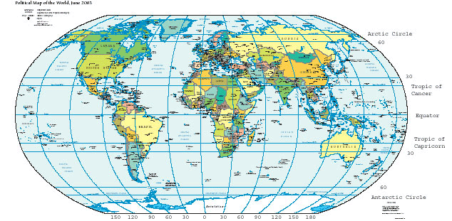
What does the location mean?
The latitude is the distance north (positive) or south (negative) from the equator
The longitude is the distance east (positive) or west (negative) from Greenwich, England.

Slide 24
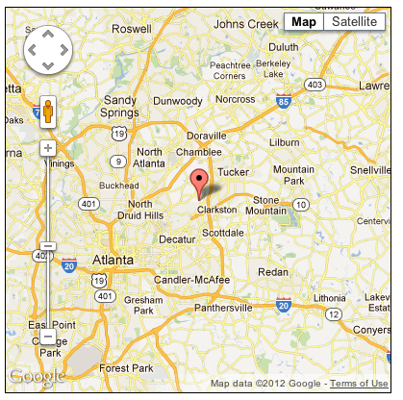
Showing a location on a map
Add a link to the script for Google maps
Add a div for the map
Use the latitude and longitude to get the map
From Google maps
Show the map
Add a pin (marker) to show the current location

Slide 25
Other Possibilities
Control zoom, pan, and view with JavaScript
Get directions from current location
Add a custom overlay to a map
Like current traffic or a route
Record the current location
For pictures, to check in, or to find your car

Slide 26
How Does it Work?
On a phone with GPS
If the GPS is working
On a desktop
IP Address – maybe ISP office location
On a laptop using WiFi
WiFi access points
Non-GPS Cell phone
Distance from cell phone towers
Notes:
You won’t realy know what process was used to get the location.

Slide 27
Local Storage
Store data on the local user device
Instead of using a cookie
Key and value pairs
A cookie is limited to 4k of data
Cookies are transmitted to the server and stored in the browser
Local storage (also called web storage)
5 Megabytes of storage per domain
Store key and value pairs (unique keys)
Keys and values are strings

Slide 28
Try it out
Try hfhtml5/chapter9/notetoself.html
And view the source to see the JavaScript
Items are added to the local storage using
localStorage.setItem("sticky_0", "Pick up dry cleaning");
A value is retrieved using getItem and the key
localStorage.getItem(“sticky_0”);

Slide 29
More on Local Storage
Can use localStorage like an associative array
localStorage[“sticky_0”] = “Pick up milk”;
var sticky = localStorage[“sticky_0”];
Get the number of items using length
localStorage.length
You can iterate through the items
var key = localStorage.key(i);
var value = localStorage[key];
Notes:
Try out hfhtml5/chapter9/notetoself2.html

Slide 30
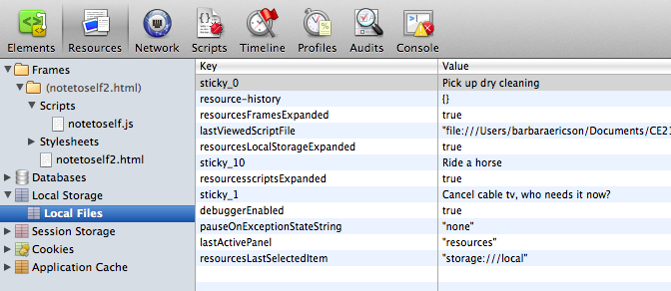
Seeing the localStorage
Browsers have ways to show localStorage
Notes:
How you do this is different for different browsers. This pictures shows the Resources tab of the Developer tools in Safari.

Slide 31
Clearing the localStorage
Empty the local storage using clear()
localStorage.clear();
Remove a key and value pair
localStorage.removeItem(key);
Can use JSON.stringify to store more complex data like arrays or objects
You can use sessionStorage if you only want to store data for a browser session

Slide 32
Form Validation
New attributes
required, placeholder, min, max, maxlength, step and pattern
New types
Color, date, datetime, datetime-local, email, month, number, search, tel, time, url, week
Can specify a pattern for validation
<input type="url" pattern="https?://.+” />
<input type="tel" id="tel" name="tel" pattern="\d{10}" placeholder=
"Please enter a ten digit phone number" required />
Notes:
See http://www.alistapart.com/articles/inline-validation-in-web-forms/ for why client-side validation is a good thing. See http://www.alistapart.com/articles/forward-thinking-form-validation/ for more information and examples.

Slide 33
Form Challenge
Try adding validation to a form with
a phone number,
a url,
a date,
an email address,
and a number from 1 to 10.
Try the form in different browsers
See http://www.w3schools.com/html5/att_input_pattern.asp for information on patterns

Slide 34
New Markup
New Structural Types: Article, Nav, Aside
http://www.w3schools.com/html5/html5_new_elements.asp
Headers
http://www.w3schools.com/html5/tag_header.asp
Footers
http://www.w3schools.com/html5/tag_footer.asp
Notes:
Structural information is very useful for understanding a web page and for screen readers. See http://www.w3schools.com/html5/html5_reference.asp for a list of all the html 5 tags with new tags marked.

Slide 35
CSS3
Animations
http://www.w3schools.com/css3/css3_animations.asp
Rounded borders and image borders
http://www.w3schools.com/css3/css3_borders.asp
Text drop shadows
http://www.w3schools.com/css3/css3_text_effects.asp
Notes:
See http://www.w3schools.com/css3/default.asp for a tutorial on the new features

Slide 36
Web Workers
JavaScript does sequential execution (one thing at a time)
Sometimes you might see a “slow script” dialog box – especially when processing lots of data
Like image processing on a canvas
With web workers you can do parallel execution
Write the JavaScript for the worker in a separate file
Workers don’t have access to the DOM
Create the worker in your web page
Use a JavaScript message to start the worker
The worker sends a message back to the web page when it is finished with an event object
Specify a function to handle that message
Notes:
See chapter 10 in the book for an example.

Slide 37
Web Worker Challenge
Why do you think a worker doesn’t have access to the DOM?
Try running hfhtml5/chapter10/pingpong.html
Change worker.js
Add another message to respond to like “marco”
Add a new thing to return in response like “pollo”
Run hfhtml5/chapter10/Mandel/fractal.html
Click on the image to zoom in

Slide 38
Offline Web Apps
Create a cache manifest file with a list of the files your app needs to work
The browser will download all the files and switch to these local files if your device goes offline
Add the manifest file name to your html
<html manifest=“fileName.manifest”>
Create the manifest file
CACHE MANIFEST
CACHE:
Name.html
Name.css
Name.js
Set up your server to support cache-manifest
Notes:
See page 538 for more information.

Slide 39
Summary
HTML 5 has changed to better support how people create and use web pages
It also allows you to create a web application
That can run on many devices
That can even run off-line
It isn’t fully supported by all browsers
So add error handling to any web pages you create with HTML 5
And test with many browsers
HTML 5 isn’t the standard yet!
But browsers have started supporting it

